Slide 1






Living Computing Project May 12th 2017 Update Meeting NSF Site Visit Year 1 Boston University
Chris J. Myers
University Of Utah
Data Management Workflow

Slide 2





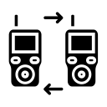


Digital
Transcriptional/Translational Combinatorial and Sequential Logic
Metrics/Data
Recombinase Based Computing
Analog
Retroactivity
Resource Sharing
SynBioHub
ICE
Memory
BT Sync
Metafluidics
Chromatin
Communication
Outreach
STEM Pathways
synNotch
VLP/Exosomes
Phloretin
Build
Spotter Based
Robot Based
Notes:
Doug will provide a big image that you can “circle” to highlight your area.

Slide 3
Motivation
Synthetic biology field has had significant challenges with data reproducibility and exchange.
Data captured is often incomplete and unreliable.
Recent advances in data standards and support software provide an opportunity to address this.

Slide 4
Synthetic Biology Open Language (SBOL)

Slide 5
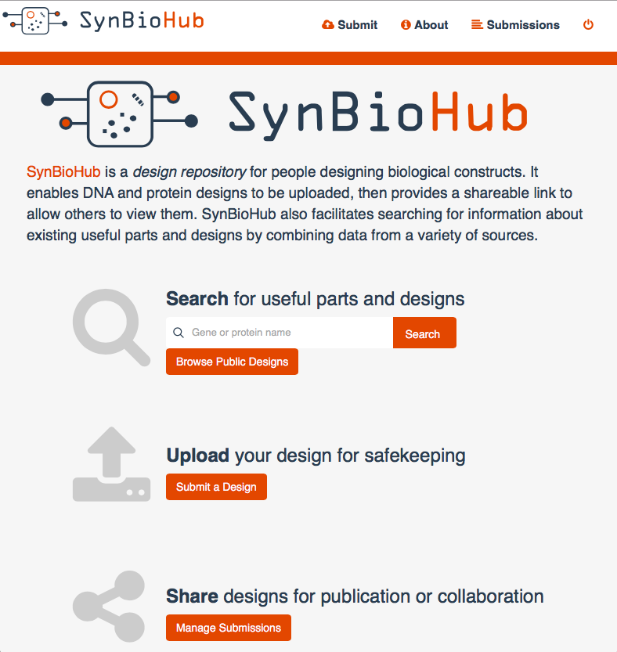


Anil Wipat
James McLaughlin
Chris Myers
Zach Zundel

Slide 6
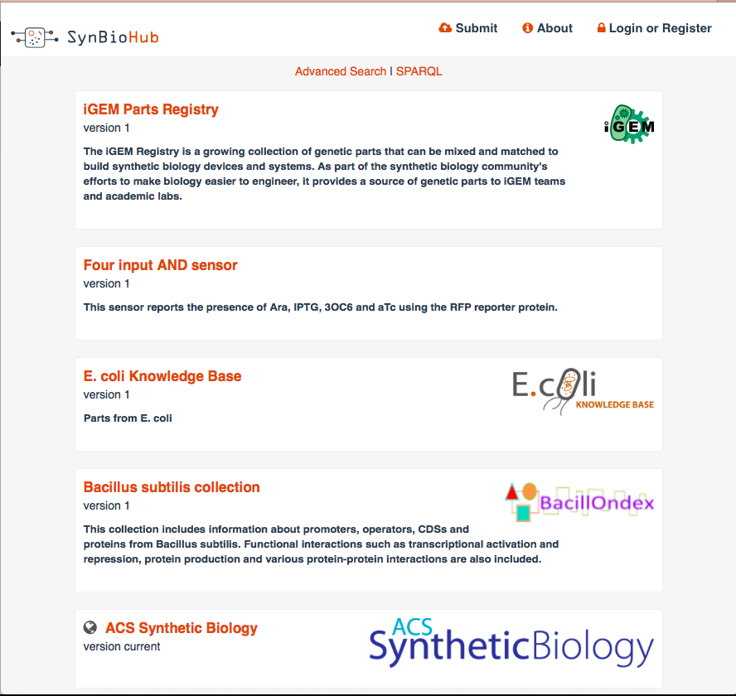
Anil Wipat
James McLaughlin
Chris Myers
Zach Zundel

Slide 7
Wish List from the Lab
Provide real time DNA editing
Capture metadata (identifier, creator, created, modified, description, type, antibiotic resistant gene, etc.)
Visualize plasmid maps
Attach sequencing results
Record status and localization information
Provide a good search mechanism
Export to formats, such as GenBank and SBOL
Include space for experimental data files, attachments, links, and other text.
Communicate with their design tool (Benchling)
Easy to exchange data with "customers"

Slide 8




Information Flow (Before)
ICE
GenBank
GenBank
Fasta

Slide 9



Information Flow (Now)
ICE

Slide 10
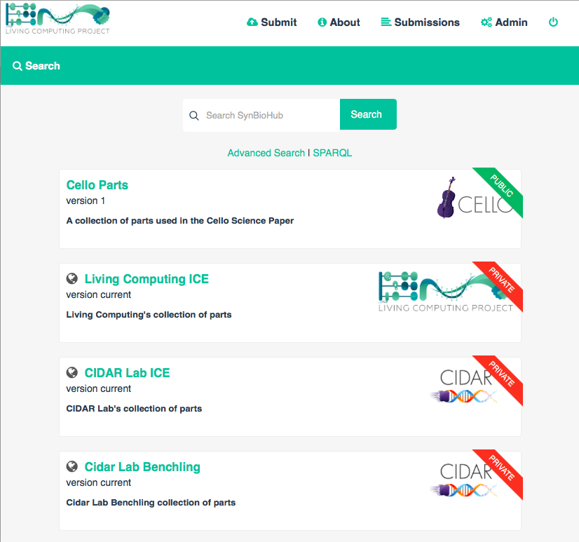
WORKFLOW
DEMO
https://youtu.be/crZg20BNPsE

Slide 11
Wish List from the Lab
Provide real time DNA editing
Capture metadata (identifier, creator, created, modified, description, type, antibiotic resistant gene, etc.)
Visualize plasmid maps
Attach sequencing results
Record status and localization information
Provide a good search mechanism
Export to formats, such as GenBank and SBOL
Include space for experimental data files, attachments, links, and other text.
Communicate with their design tool (Benchling)
Easy to exchange data with "customers"
ICE

Slide 12
LCP Workflow Setup
Each LCP lab will run Benchling/Geneious/etc. for sequence-level design.
Each lab will have their own instance of ICE to track their fabricated constructs.
LCP will run a single SynBioHub instance to manage the workflow and share designs.
Training for lab managers on May 15th at 5pm.
Training for BU iGEM team on May 24th.

Slide 13
Best Practices
Guidelines need to be put into place to ensure data captured is “FAIR” ¹
Findable, Accessible, Interoperable, Reusable
Care needs to be taken to minimize data loss during conversions.
For example, GenBank oriented software inherently not hierarchical.
A trustworthy data repository will require careful data curation (who makes public?).
¹ Courtesy Carole Goble

Slide 14
LCP & SBOL Community
Living Computing Project can:
Provide live test-bed for SBOL-enabled workflows.
Provide a rich data set of genetic design data.
New software tools that support SBOL.
SBOL Community can:
Provide enhancements to the SBOL standard.
Software infrastructure support for developers.
Training workshops for developers and users.

