Slide 1


TASBE Flow Analytics
Jacob Beal
SEED 2018
Arizona
June, 2018

Slide 2
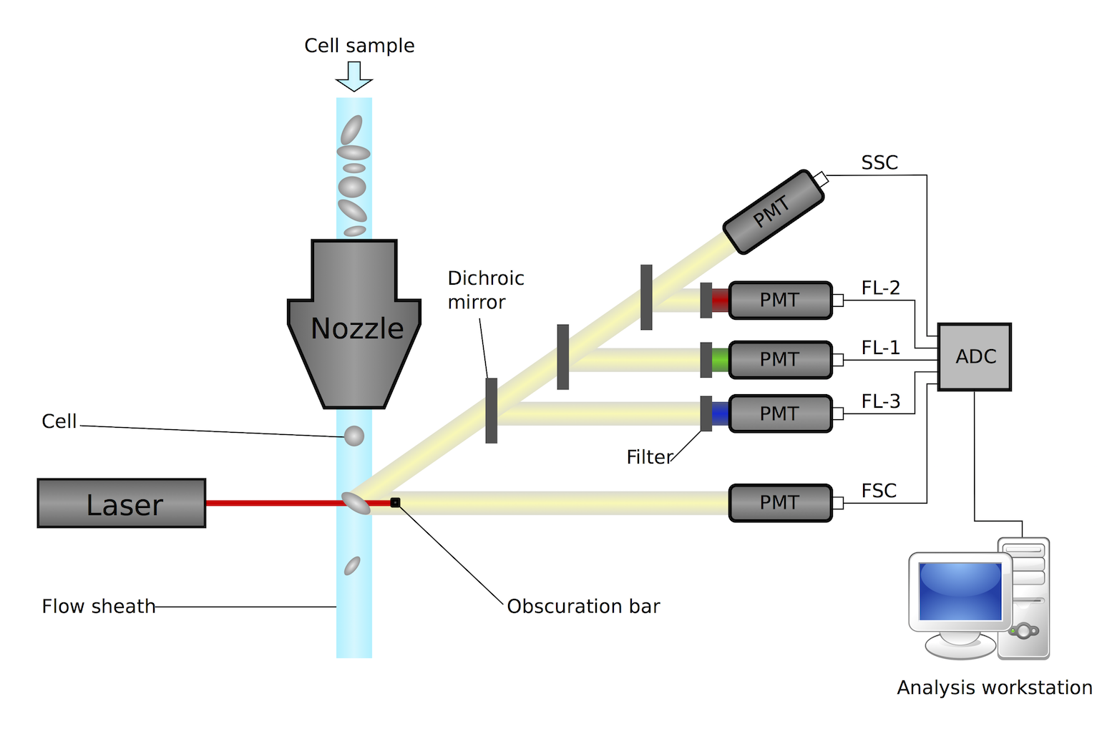
How Flow Cytometry Works
Challenges:
Autofluorescence
Variation in measurements
Spectral overlap
Time Contamination
Lots of data points!
Different protein fluorescence
Individual cells behave (very) differently

Slide 3
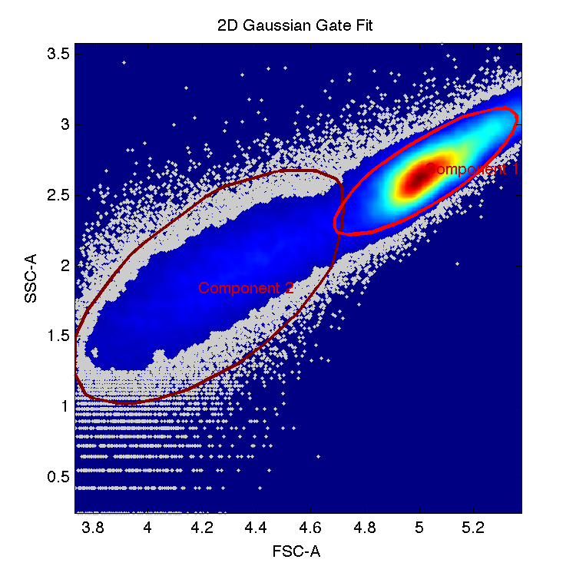
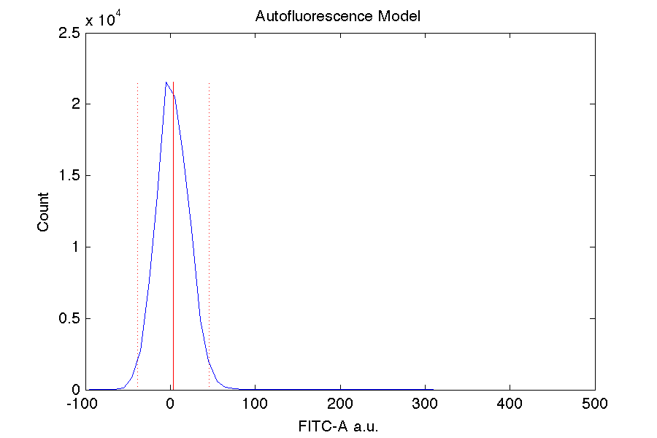
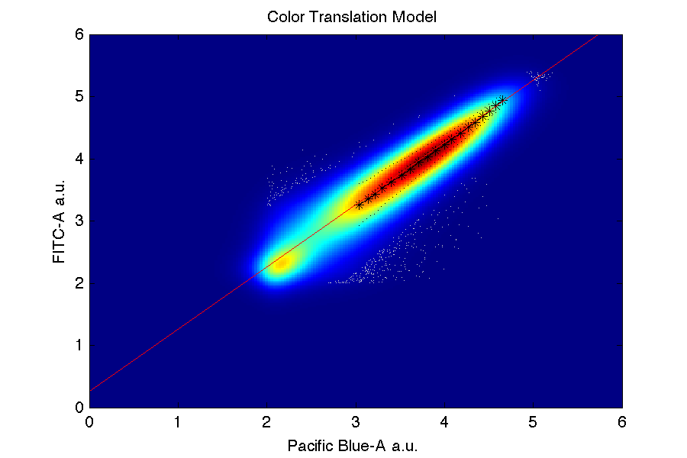
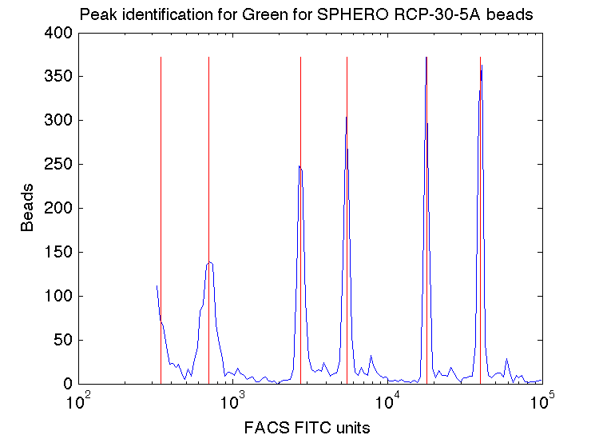
Calibrated Flow Cytometry
Arbitrary Units (a.u.)
keep only events
passing gates
Filtered a.u.
minus mean
autofluorescence
Negative control:
find healthy cell size/granularity
Net a.u.
Negative Control:
autofluorescence
divide by spectral
overlap matrix
Compensated a.u.
Single positive controls:
compensate for spectral overlap
times mean ratio
of FITC / color
FITC a.u.
Multi-color control:
conversion of non-FITC channels
times mean bead peak
calibrated / observed
Calibrated MEFL
Calibration beads:
Convert FITC a.u. to MEFL
[Roederer, 2002; Wang et al., 2008; NIST/ISAC, 2012; Beal et al., 2012; Kiani et al., 2014; Beal et al., 2014; Davidsohn et al, 2014; Beal 2015]

Slide 4
Calibration → Precision & Comparison
1.22x geo. std.dev.
across 3 labs!

Slide 5
Example Applications
High-Performance Devices
gRNA
Cas9m
Transcription initiation complex
RNA Pol-II
Gal4VP16
x
Mini-CMV
x
EYFP
Poly(A)
Stage 1
5xUAS
gRNA
Stage 2
V1
V1
V2
V2
V3
V3
Precision Prediction from Device Models
Dox
nsP1-4
SGP
mVenus
rtTA3
T2A
VP16Gal4
EBFP2
nsP1-4
SGP
mKate
pCAG
pTRE
pCAG
R1
R2
EYFP
nsP1-4
SGP
EBFP2
pCAG
mkate
pTRE
pUAS-Rep1
pUAS-Rep2
T14-T21 T21-T14 T21-LmrA LmrA-T21 LmrA-T14 T14-LmrA

Slide 6
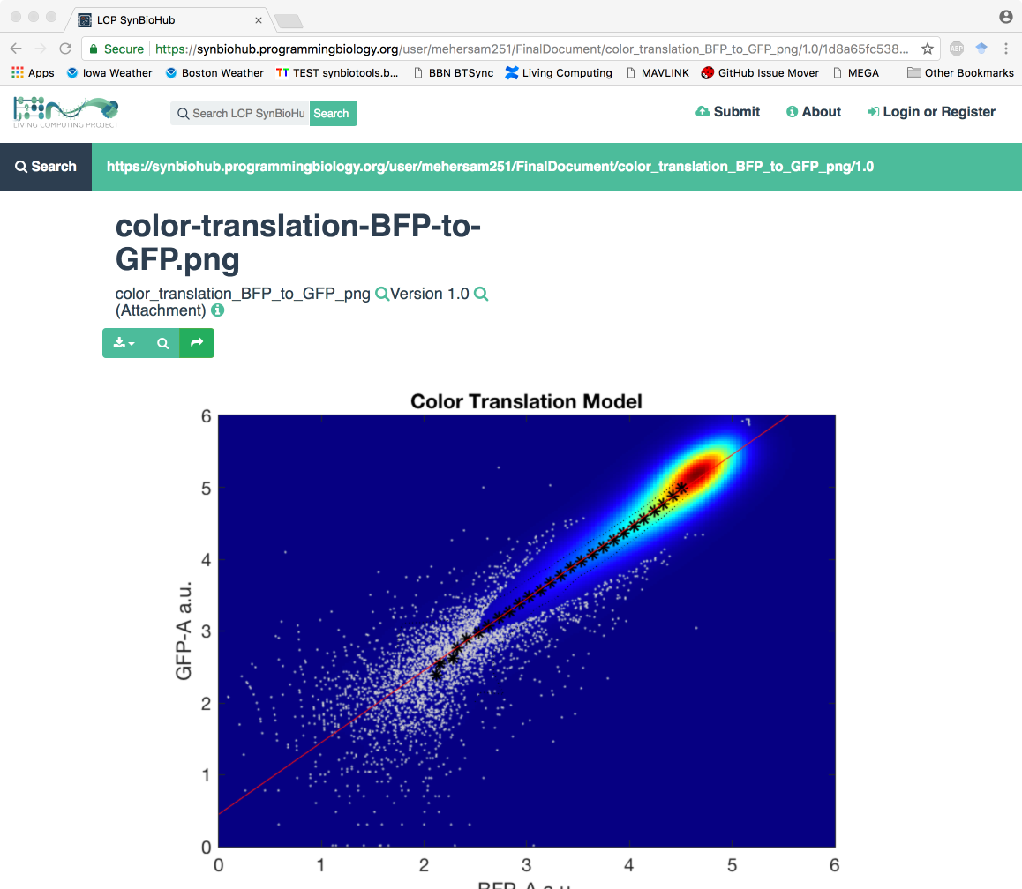
In Development: SynBioHub Integration

Slide 7


Using Calibrated Flow Yourself
Cytoflow
FlowCal
https://github.com/TASBE
https://taborlab.github.io/FlowCal
http://bpteague.github.io/cytoflow
Provide feedback / report problems via GitHub issue trackers

