Slide 1
Software for Synthetic Biology Workflows
Jacob Beal, Kevin Clancy, Ernst Oberortner
SEED 2018
Arizona, June 2018

Slide 2
Tools → Workflows → Productivity
LEARN

Slide 3
Workshop Schedule
Introduction: workflows and enabling technology
(Jacob Beal, Raytheon BBN Technologies)
Tool Introductions:
JBEI ICE
(Nathan Hillson, JBEI/Berkeley)
SynBioHub, iBioSim, and SBOLDesigner
(Tramy Nguyen, University of Utah)
Cello
(Shuyi Zhang, MIT)
Operon Calculator and RBS Library Calculator
(Howard Salis, Penn State)
BOOST
(Ernst Oberortner, Joint Genome Institute)
TASBE Analytics
(Jacob Beal, Raytheon BBN Technologies)
Coffee Break
Hands-on Workflows Session
(Kevin Clancy, Synthetic Genomics)

Slide 4
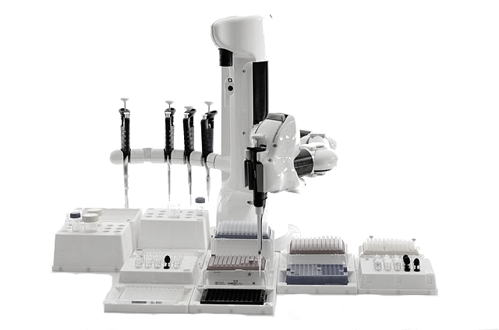




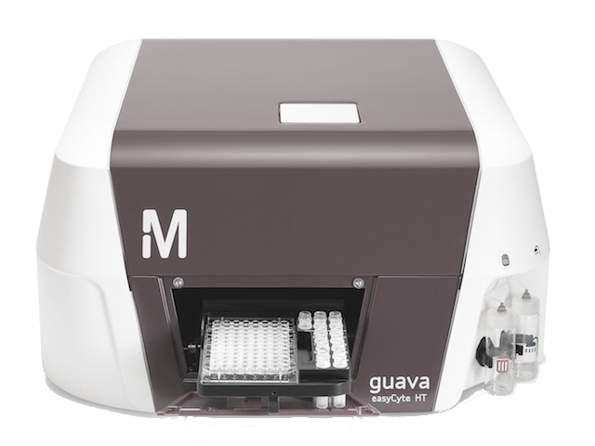









Enabling Technology: SBOL
Lots of different synthetic biology resources…
Repositories & Databases
Automation & Integration
Lab Automation
LIMS
GenBank
HT Assays
Modeling
Emerging Approaches
Sequencing & Synthesis
SO
Strain Data
BioPAX
ChEBI
BioModels.Net
Measurement Data
… SBOL is a "hub" for linking them together
Notes:
SBOL 2.0 describes sequence, plus just enough information about function to provide hooks for integrating a broad range of resources together.

Slide 5
Representing Structure & Function
FASTA
GenBank
SBOL 1.x
SBOL 2.x
ACTGTGCCGTTAAACGTGATTAAATCCGTACTGATAT…
TetR
pTet
GFP
aTc detector
GFP reporter
TetR
pTet
GFP
aTc detector
aTc
GFP reporter
TetR
GFP
TetR
pTet
GFP

Slide 6
SBOL Visual
Sequence Feature Glyphs
Molecular Species Glyph
Nucleic Acid Backbone
GFP
pTet
gfp
tetR
Labels
Interactions
Reverse Complement Nucleic
Acid Component Glyphs
Grey text and lines (including this) are annotations

Slide 7
What SBOL 2.2 Represents
aTc detector
aTc
GFP reporter
TetR
GFP
TetR
GFP
pTet
Measurement Data
GenBank
Protocol Information
Sequence structure
Incomplete designs
Qualitative function
Heterarchical composition
Links to other information

Slide 8
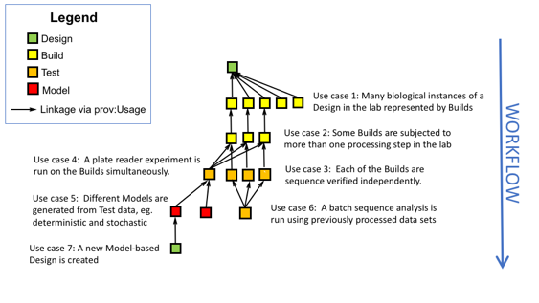
Tracking Information Provenance

Slide 9
Integration with non-SBOL Data
aTc detector
aTc
GFP reporter
TetR
GFP
TetR
pTet
GFP
Protocol Information
Embed SBOL in data
Embed data in SBOL
Link SBOL to data
Links data to SBOL
Whatever model works best for the tools…

Slide 10



SBOL supports many workflows
Repositories
User
User
Automation
Vendors

Slide 11
SBOL supports many workflows
Repositories
User
User
Reuse/Share
Automation
Vendors

Slide 12
SBOL supports many workflows
Repositories
User
User
Reuse/Share
Visualize
Automation
Vendors

Slide 13
SBOL supports many workflows
Repositories
User
User
Reuse/Share
Visualize
Design/Model
Automation
Vendors

Slide 14
SBOL supports many workflows
Repositories
User
User
Reuse/Share
Visualize
Design/Model
Synthesize/Build
Automation
Vendors

Slide 15
SBOL supports many workflows
Repositories
User
User
Reuse/Share
Visualize
Design/Model
Synthesize/Build
Automate
Automation
Vendors

Slide 16
Now, on to the tools…
JBEI ICE SHARE
(Nathan Hillson, JBEI/Berkeley)
SynBioHub, iBioSim, and SBOLDesigner SHARE, DESIGN
(Tramy Nguyen, University of Utah)
Cello DESIGN
(Shuyi Zhang, MIT)
Operon Calculator and RBS Library Calculator DESIGN
(Howard Salis, Penn State)
BOOST BUILD
(Ernst Oberortner, Joint Genome Institute)
TASBE Analytics TEST
(Jacob Beal, Raytheon BBN Technologies)

