Slide 1


Vector NTI® Express Designer SBOL Workshop Berkeley Kevin Clancy January 8th, 2014

Slide 2
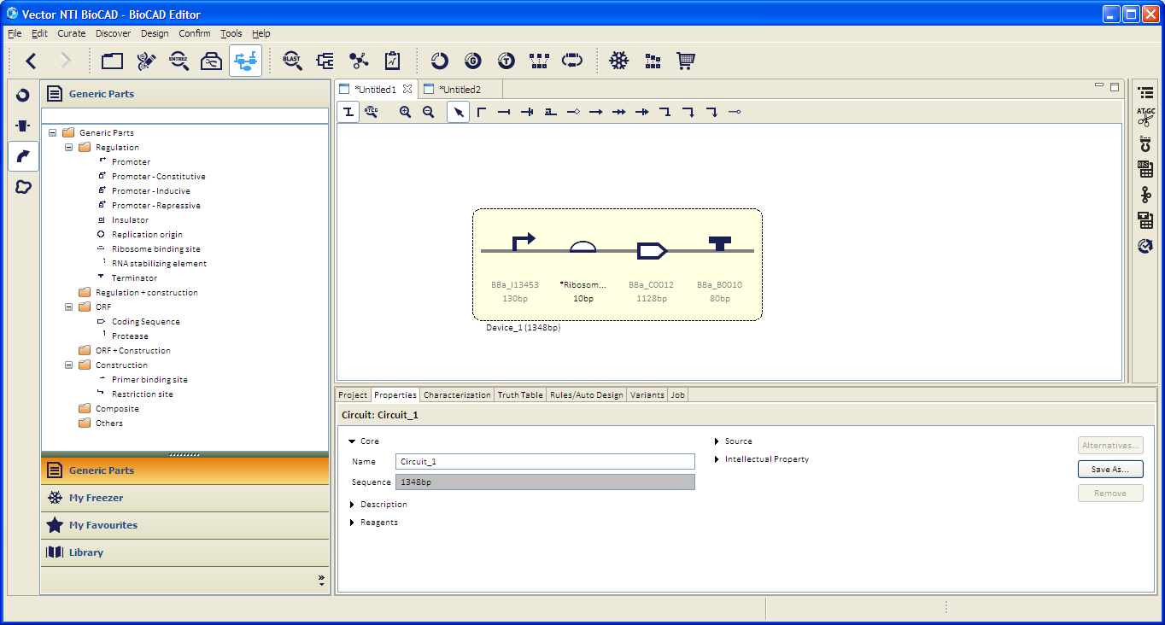
MVD – Minimal Viable Device Example
Promoter, RBS, CDS, Terminator
Notes:
Promoter, RBS, CDS, Terminator

Slide 3
Table of Contents 1 of 2
D
DESIGNER – WORKFLOWS SET I
Launching Vector NTI® Designer
Data Management with DB Explorer
Adding a Component to my Freezer
Importing a Public Sequence / Component Record (SBOL)
Exporting a Sequence / Component Record (SBOL)
Adding a New Part Category
Starting a New Designer Project
Creating a Part
Designing a Device – Manual & EUGENE based
Using a Newly Created Part
Creating a Device with Parts
1
2
3
4
5
DESIGNER – WORKFLOWS SET II
1
2
3
4
5
6

Slide 4
Table of Contents 2 of 2
E
DESIGNER – WORKFLOWS SET III
Automating Design
Adding Rules
Automatic Design of Devices
Forming a Circuit with Devices
Device and Circuit Truth Tables
RNA Secondary Structure Analysis
RBS Calculator
Assembly Compatibility Checking & Assembly
Gene Synthesis Integration
Other Workflows & Tools
1
2
3
4
5
DESIGNER – WORKFLOWS SET IV
1
2
3
4
5

Slide 5
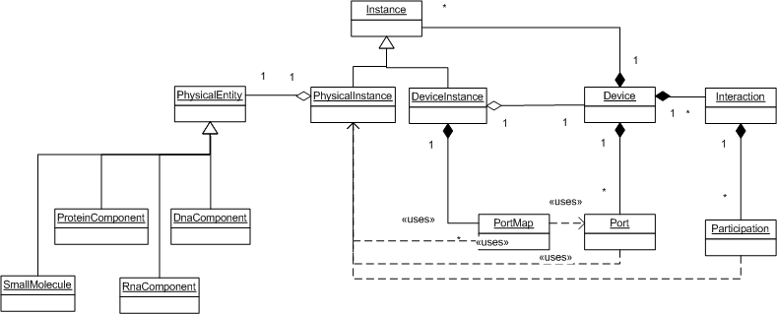
UML for New SBOL

Slide 6
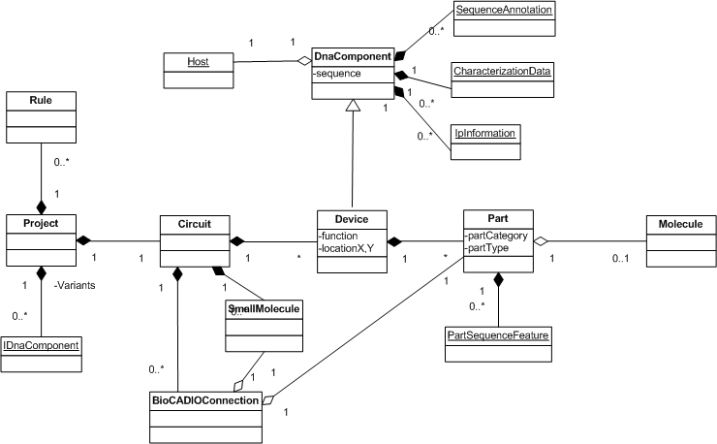
UML for Vector NTI Designer
1
5
3
2
4

Slide 7
Design in Vector NTI Designer
DnaComponent
Base class for Part, Device and Circuit. Follows original SBOL design where DnaComponent can be built hierarchically, i.e. parts make up device, devices make up circuit
Always contain a Sequence
Additionally we have CharacterizationData for storing the experimental data, and IpInformation for storing any IP-related info
It maintains a reference to Host, which in future will be further developed to contain Host Genome
Part
Examples: promoter, RBS, gene, terminator
We allow mining parts from existing DNA in Vector NTI. Parts created here shall maintain a reference to original molecules.

Slide 8
Design in Vector NTI Designer – cont’d
Device
Device is made up of parts, and has a function (e.g. Reporter)
When a part is added to a device, it is copied by value
Circuit
Circuit is made up of devices, small molecules and BioCADIOConnections (e.g. Repression, Activation)
Each connection links up a Part and a Small Molecule in the circuit
In a Circuit, each device will have a location (X,Y) to allow reconstructing the circuit in the canvas
Project
A project is not a domain object, rather it is a workspace in Designer for performing jobs e.g. Device Characterization, Circuit Design etc
Each project will contain only 1 circuit

Slide 9
Discussion of Vector NTI Designer Design
We have a clear representation of domain models in hierarchical manner: a part represent the smallest work unit e.g. promoter, a device represent a functional unit, and a circuit is a collection of devices and their interaction, roughly equivalent to the Device in new SBOL
We do not differentiate between ‘Entity’ and ‘PhysicalInstance’ – everything is physical instance. We have a rich library of Parts and Devices in the database, all are concrete instances complete with sequence. This makes data storage & software implementation slightly easier. E.g. when dragging a component onto the Designer canvas, a copy of the component is created and ready for use without having to create the PhysicalInstance from the Entity

Slide 10
Next Desired Steps
SBOL support finalized
API to support search, read, write
ICE connectivity – ability to submit, retrieve, search
Tool based data exchange

