Slide 1

SBOL 2.0: Vision and Structure
Nicholas Roehner, Chris J. Myers
University of Utah
SBOL Workshop 10: UC Berkeley
N. Roehner, C. J. Myers (U. of Utah) SBOL 2.0: Vision and Structure SBOL Workshop 10: UC Berkeley

Slide 2
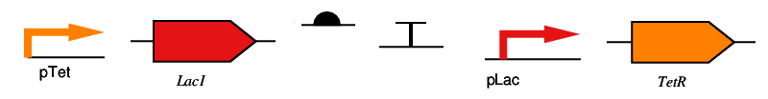
Current Capabilities of SBOL 1.0
Specification of DNA components
N. Roehner, C. J. Myers (U. of Utah) SBOL 2.0: Vision and Structure SBOL Workshop 10: UC Berkeley

Slide 3
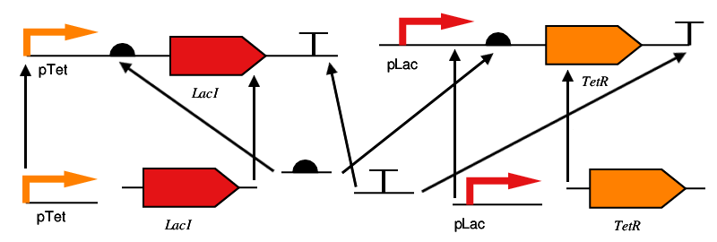
Current Capabilities of SBOL 1.0
Specification of DNA components
Hierarchical composition of DNA components
N. Roehner, C. J. Myers (U. of Utah) SBOL 2.0: Vision and Structure SBOL Workshop 10: UC Berkeley

Slide 4
Goals for SBOL 2.0
Increase the range of biological structure and function that we may specify.
Provide an extensible basis for composition of functional modules with structural components and other functional modules.
N. Roehner, C. J. Myers (U. of Utah) SBOL 2.0: Vision and Structure SBOL Workshop 10: UC Berkeley

Slide 5
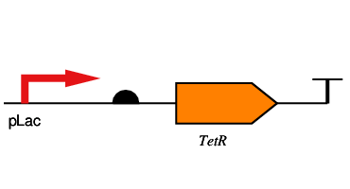
Increasing Structural Range
N. Roehner, C. J. Myers (U. of Utah) SBOL 2.0: Vision and Structure SBOL Workshop 10: UC Berkeley

Slide 6
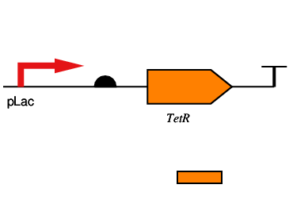
Increasing Structural Range
RNA components (mRNA, tRNA, siRNA)
N. Roehner, C. J. Myers (U. of Utah) SBOL 2.0: Vision and Structure SBOL Workshop 10: UC Berkeley

Slide 7
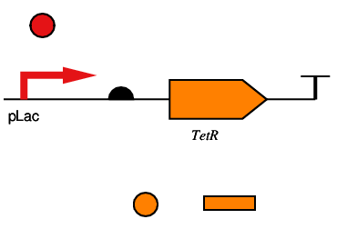
Increasing Structural Range
RNA components
Protein components (TFs, enzymes)
N. Roehner, C. J. Myers (U. of Utah) SBOL 2.0: Vision and Structure SBOL Workshop 10: UC Berkeley

Slide 8
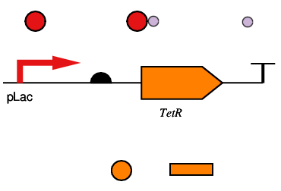
Increasing Structural Range
RNA components
Protein components
Other Components (small molecules, complexes, light, pressure, pH, temp)
N. Roehner, C. J. Myers (U. of Utah) SBOL 2.0: Vision and Structure SBOL Workshop 10: UC Berkeley

Slide 9
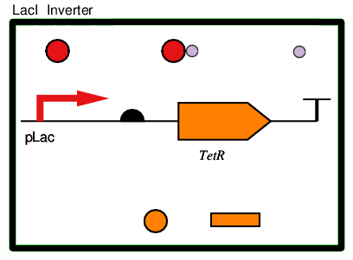
Increasing Functional Range
Modules (logic gates, latches, oscillators, sensors, transducers, pathways, cascades)
N. Roehner, C. J. Myers (U. of Utah) SBOL 2.0: Vision and Structure SBOL Workshop 10: UC Berkeley

Slide 10
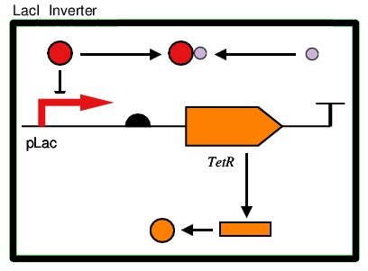
Increasing Functional Range
Modules
Interactions (activation, repression, complexation, transcription, translation, phosphorylation)
N. Roehner, C. J. Myers (U. of Utah) SBOL 2.0: Vision and Structure SBOL Workshop 10: UC Berkeley

Slide 11
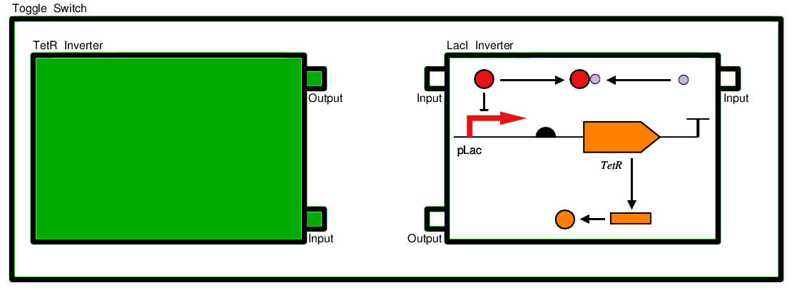
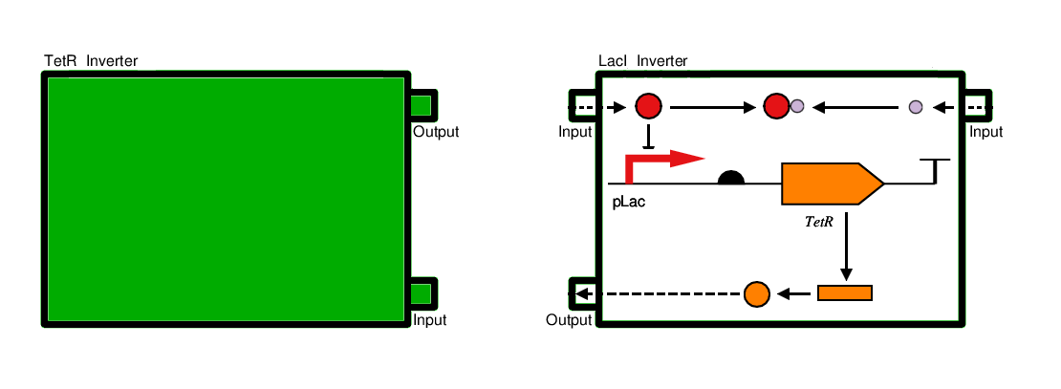
Basis for Composition
Ports
N. Roehner, C. J. Myers (U. of Utah) SBOL 2.0: Vision and Structure SBOL Workshop 10: UC Berkeley

Slide 12
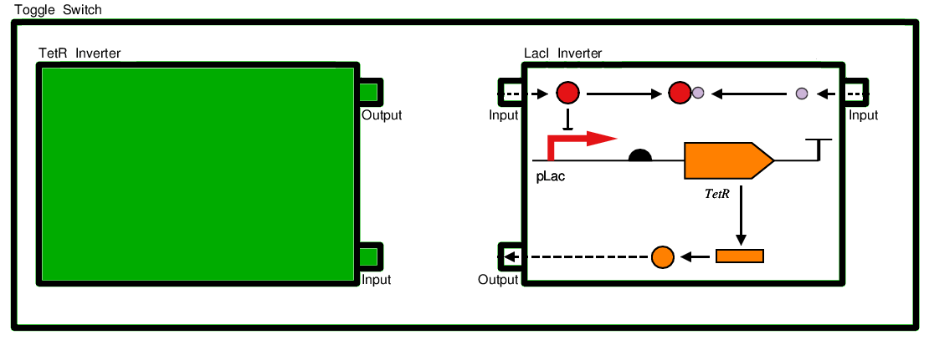
Basis for Composition
Ports
Instantiation
N. Roehner, C. J. Myers (U. of Utah) SBOL 2.0: Vision and Structure SBOL Workshop 10: UC Berkeley

Slide 13
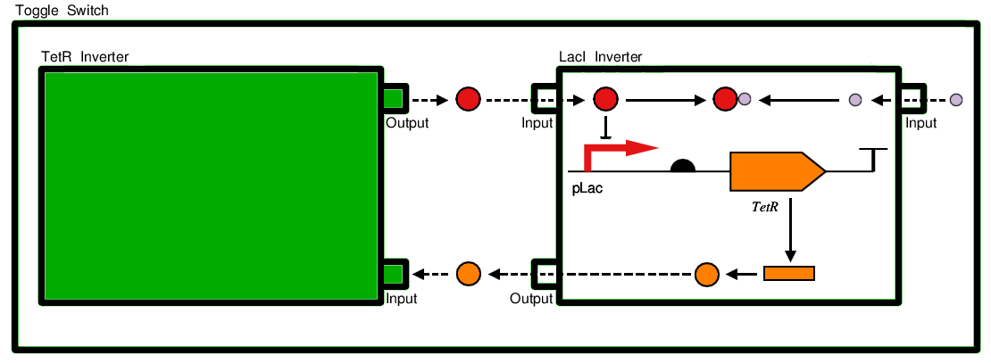
Basis for Functional Composition
Ports
Instantiation
Port Mapping and Mixed Hierarchy
N. Roehner, C. J. Myers (U. of Utah) SBOL 2.0: Vision and Structure SBOL Workshop 10: UC Berkeley

Slide 14
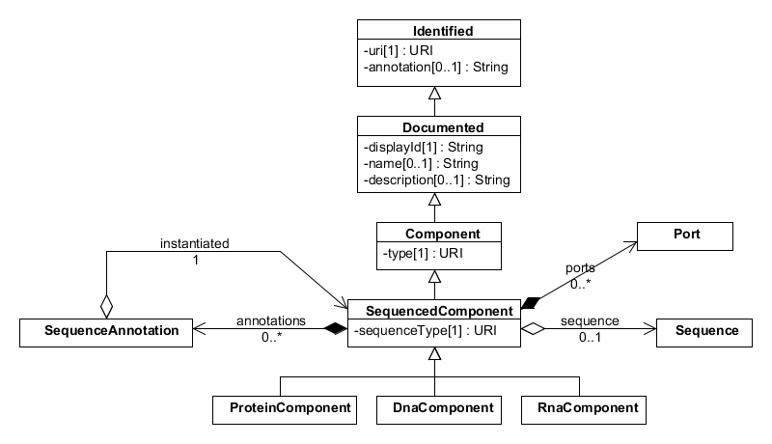

Data Model: Sequenced Component
N. Roehner, C. J. Myers (U. of Utah) SBOL 2.0: Vision and Structure SBOL Workshop 10: UC Berkeley

Slide 15
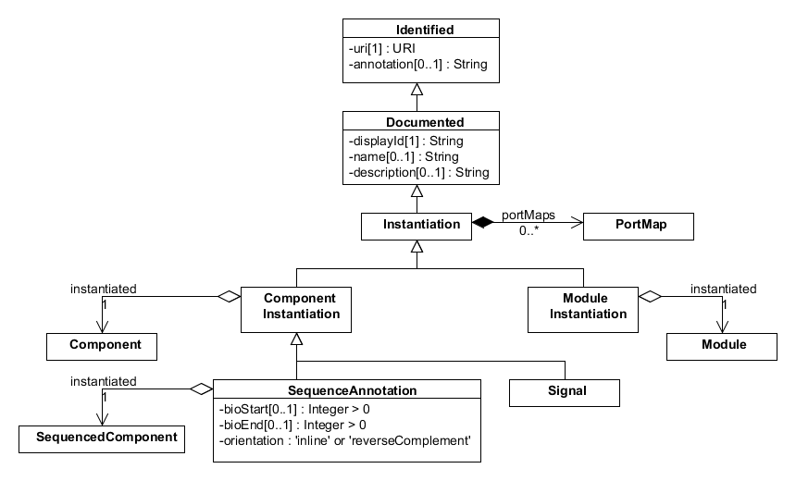

Data Model: Instantiation
N. Roehner, C. J. Myers (U. of Utah) SBOL 2.0: Vision and Structure SBOL Workshop 10: UC Berkeley

Slide 16
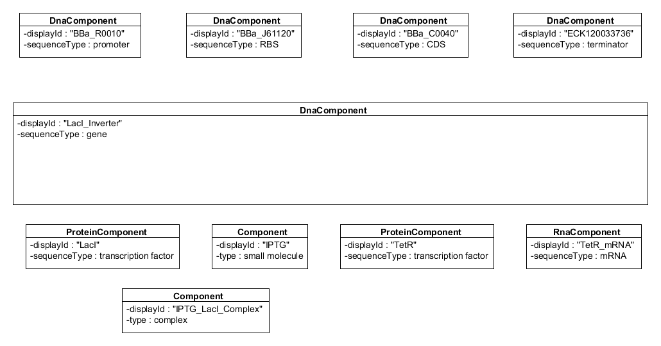
Example: Components
N. Roehner, C. J. Myers (U. of Utah) SBOL 2.0: Vision and Structure SBOL Workshop 10: UC Berkeley

Slide 17
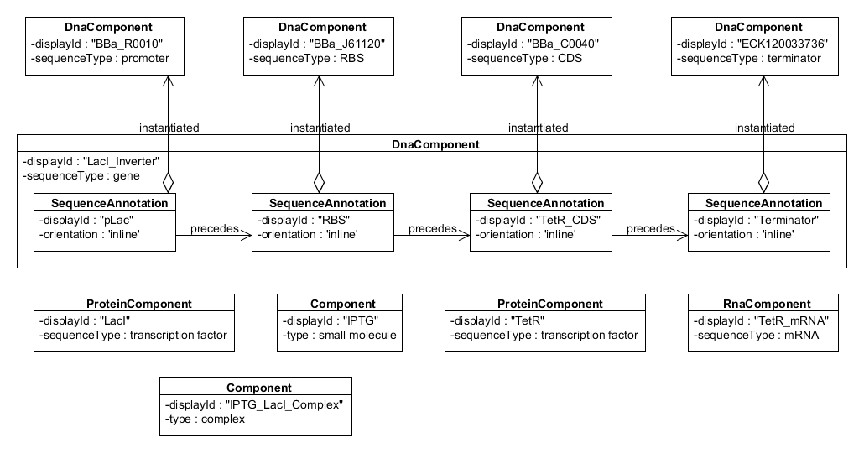
Example: Sequence Instantiation
N. Roehner, C. J. Myers (U. of Utah) SBOL 2.0: Vision and Structure SBOL Workshop 10: UC Berkeley

Slide 18
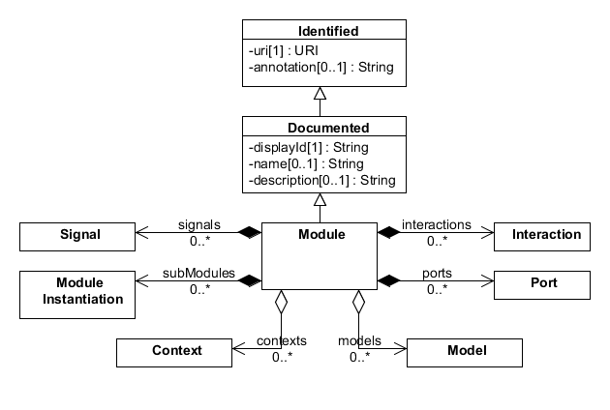
Data Model: Module
N. Roehner, C. J. Myers (U. of Utah) SBOL 2.0: Vision and Structure SBOL Workshop 10: UC Berkeley

Slide 19
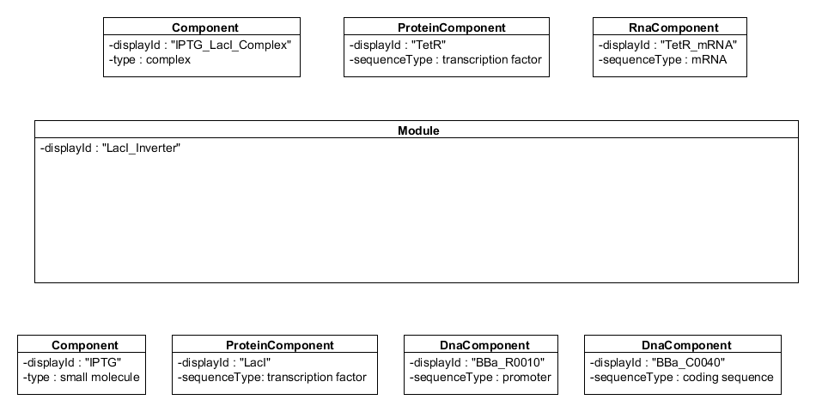
Example: Module
N. Roehner, C. J. Myers (U. of Utah) SBOL 2.0: Vision and Structure SBOL Workshop 10: UC Berkeley

Slide 20
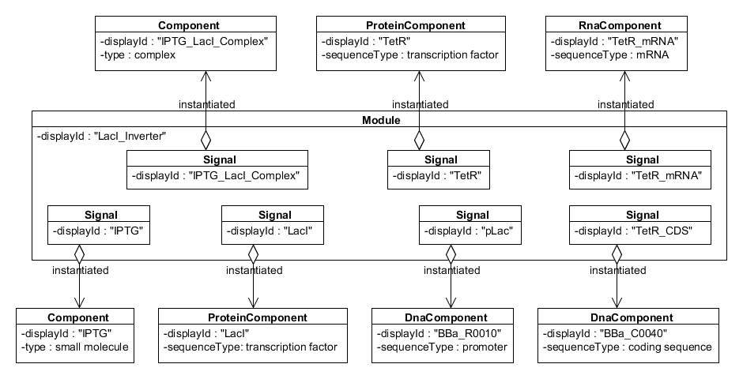
Example: Signal Instantiation
N. Roehner, C. J. Myers (U. of Utah) SBOL 2.0: Vision and Structure SBOL Workshop 10: UC Berkeley

Slide 21
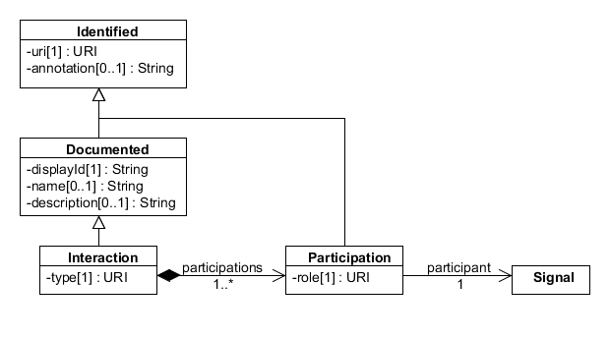
Data Model: Interactions
N. Roehner, C. J. Myers (U. of Utah) SBOL 2.0: Vision and Structure SBOL Workshop 10: UC Berkeley

Slide 22
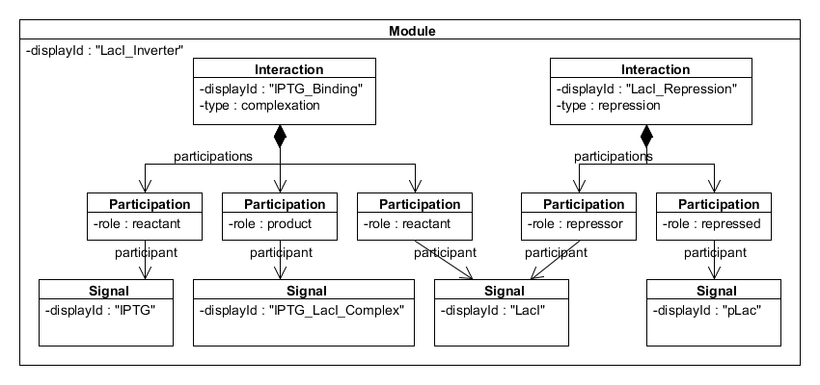
Example: Interactions
N. Roehner, C. J. Myers (U. of Utah) SBOL 2.0: Vision and Structure SBOL Workshop 10: UC Berkeley

Slide 23
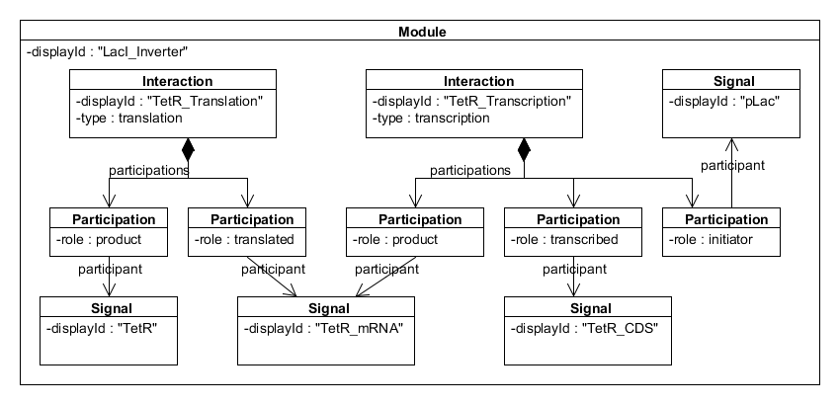
Example: Interactions
N. Roehner, C. J. Myers (U. of Utah) SBOL 2.0: Vision and Structure SBOL Workshop 10: UC Berkeley

Slide 24
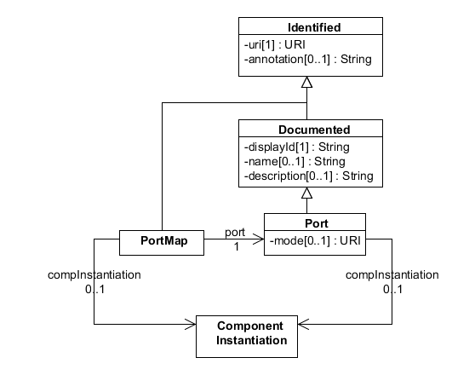
Data Model: Ports and PortMaps
N. Roehner, C. J. Myers (U. of Utah) SBOL 2.0: Vision and Structure SBOL Workshop 10: UC Berkeley

Slide 25
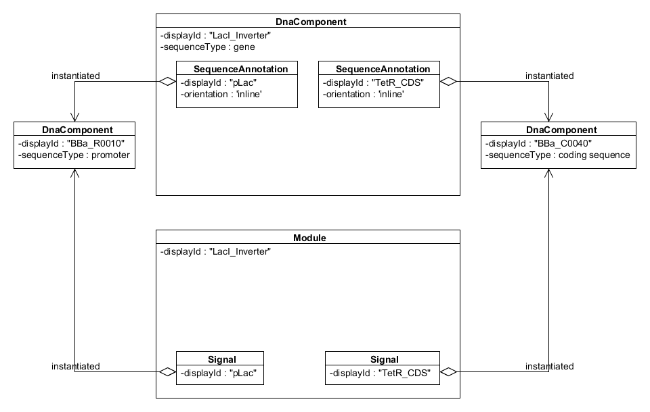
Composing Inverter Component with Module
N. Roehner, C. J. Myers (U. of Utah) SBOL 2.0: Vision and Structure SBOL Workshop 10: UC Berkeley

Slide 26
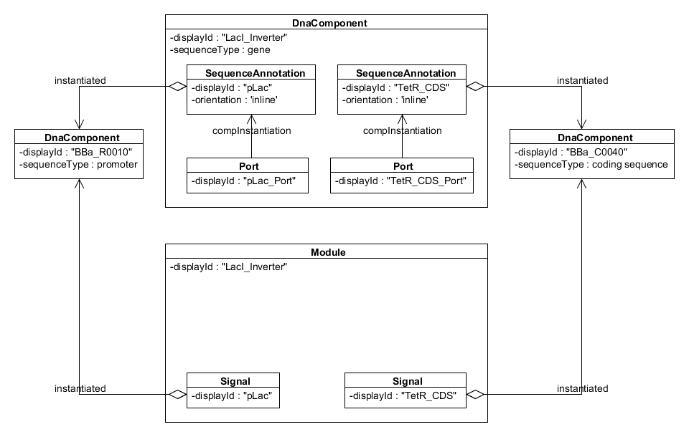
Example: Component Ports
N. Roehner, C. J. Myers (U. of Utah) SBOL 2.0: Vision and Structure SBOL Workshop 10: UC Berkeley

Slide 27
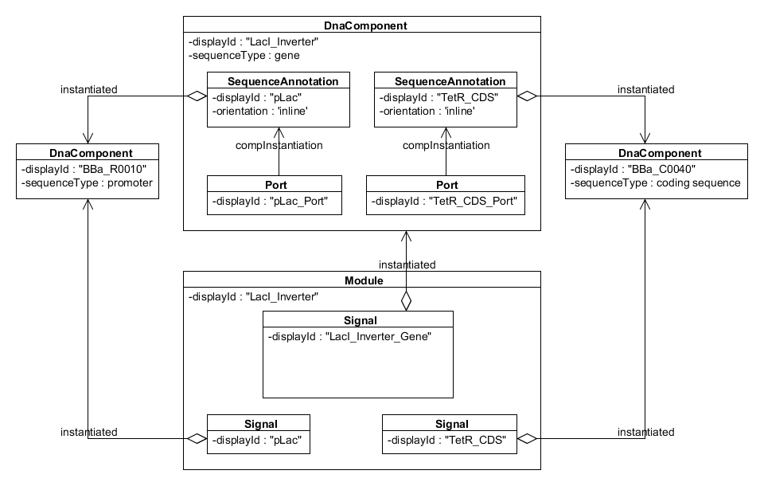
Example: Signal Instantiation
N. Roehner, C. J. Myers (U. of Utah) SBOL 2.0: Vision and Structure SBOL Workshop 10: UC Berkeley

Slide 28
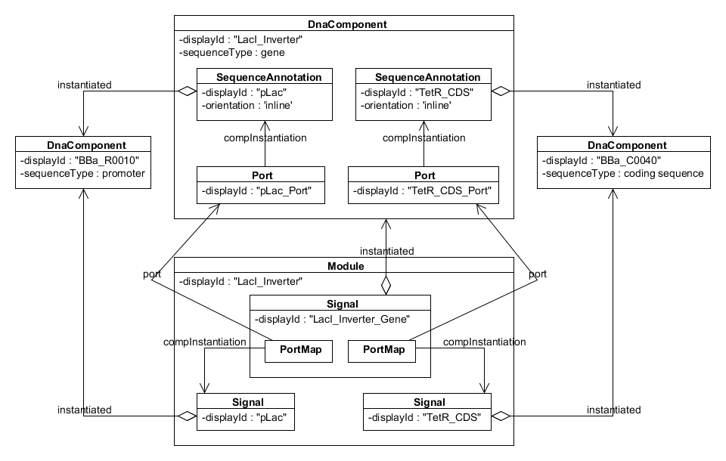
Example: Port Mapping
N. Roehner, C. J. Myers (U. of Utah) SBOL 2.0: Vision and Structure SBOL Workshop 10: UC Berkeley

Slide 29
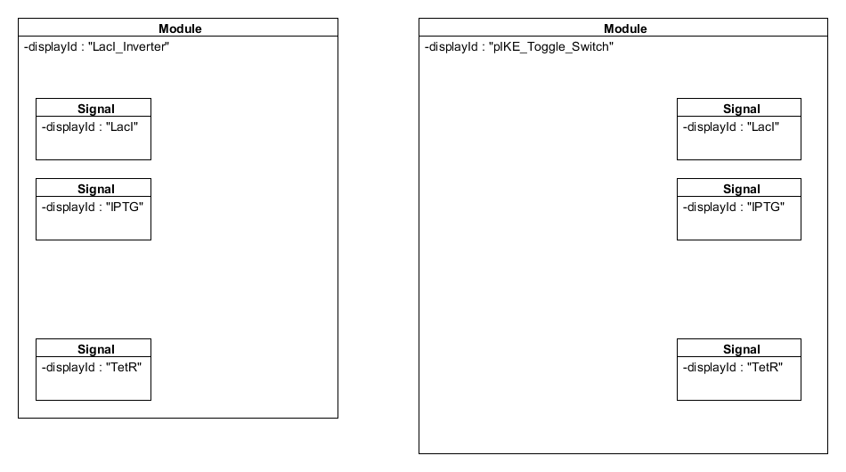
Composing Inverter Module with Toggle Module
N. Roehner, C. J. Myers (U. of Utah) SBOL 2.0: Vision and Structure SBOL Workshop 10: UC Berkeley

Slide 30
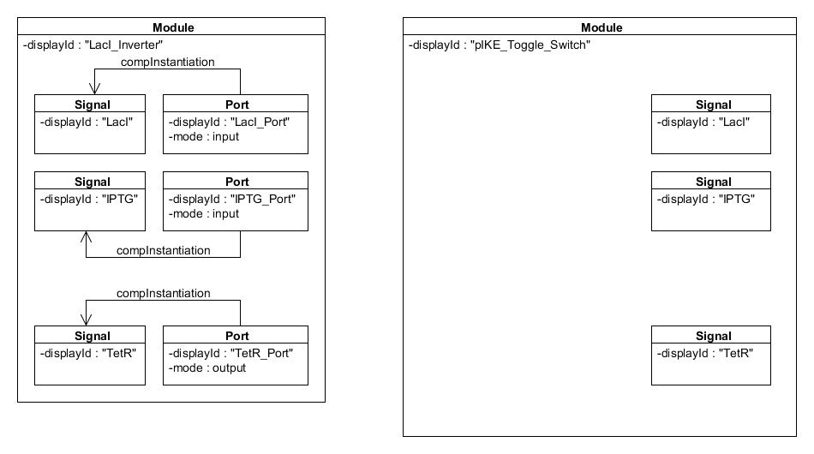
Example: Module Ports
N. Roehner, C. J. Myers (U. of Utah) SBOL 2.0: Vision and Structure SBOL Workshop 10: UC Berkeley

Slide 31
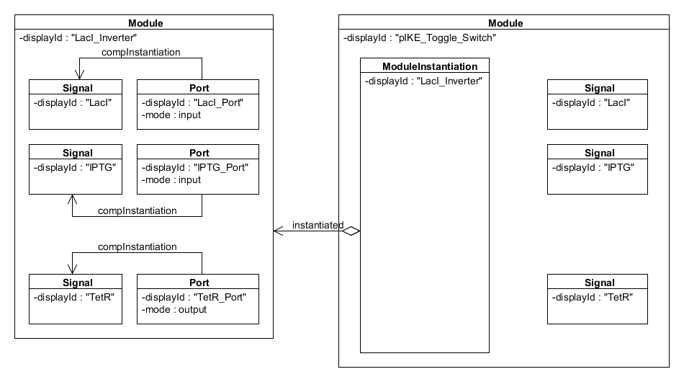
Example: Module Instantiation
N. Roehner, C. J. Myers (U. of Utah) SBOL 2.0: Vision and Structure SBOL Workshop 10: UC Berkeley

Slide 32
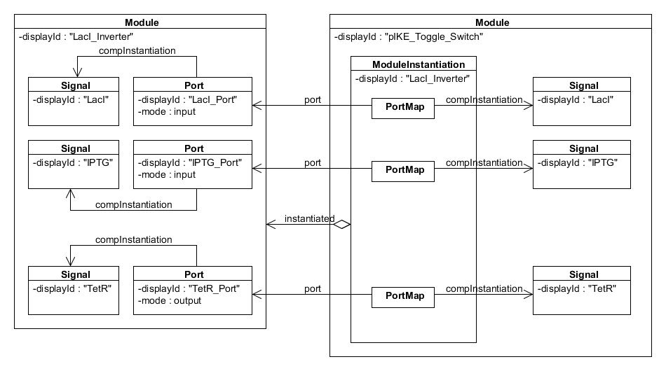
Example: Port Mapping
N. Roehner, C. J. Myers (U. of Utah) SBOL 2.0: Vision and Structure SBOL Workshop 10: UC Berkeley

Slide 33
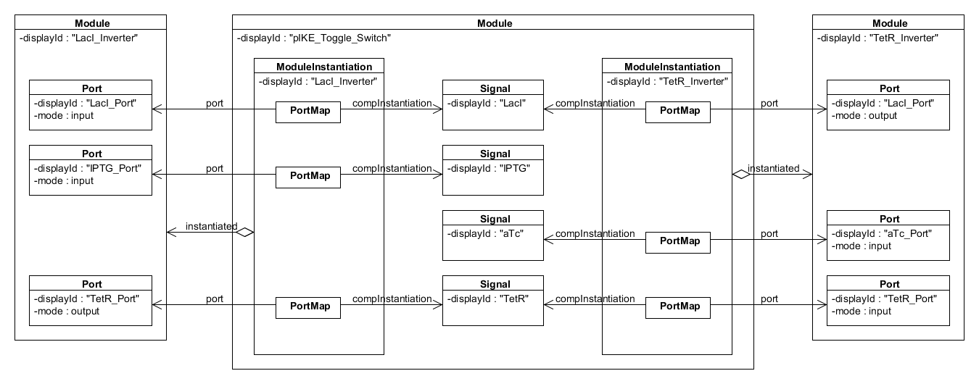
Toggle Module Composed
N. Roehner, C. J. Myers (U. of Utah) SBOL 2.0: Vision and Structure SBOL Workshop 10: UC Berkeley

Slide 34
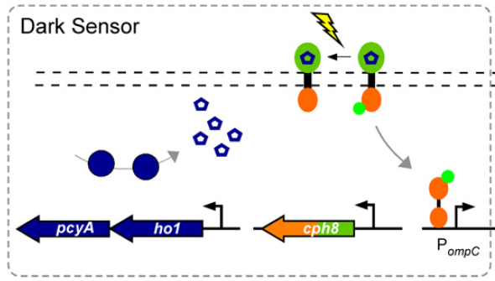
Dark Sensor (Tabor et al. 2009)
N. Roehner, C. J. Myers (U. of Utah) SBOL 2.0: Vision and Structure SBOL Workshop 10: UC Berkeley

Slide 35
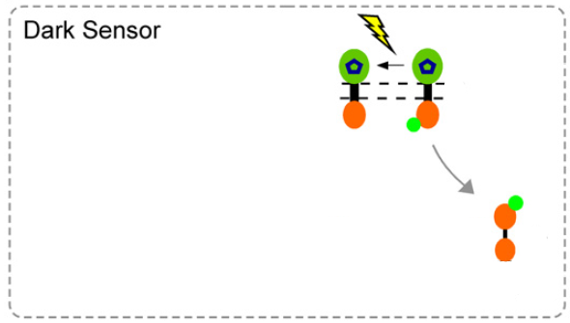
Dark Sensor (Tabor et al. 2009)
N. Roehner, C. J. Myers (U. of Utah) SBOL 2.0: Vision and Structure SBOL Workshop 10: UC Berkeley

Slide 36
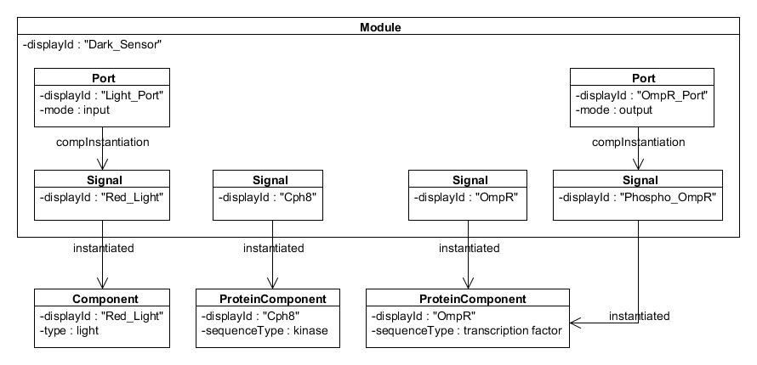
Dark Sensor: Instantiation
N. Roehner, C. J. Myers (U. of Utah) SBOL 2.0: Vision and Structure SBOL Workshop 10: UC Berkeley

Slide 37
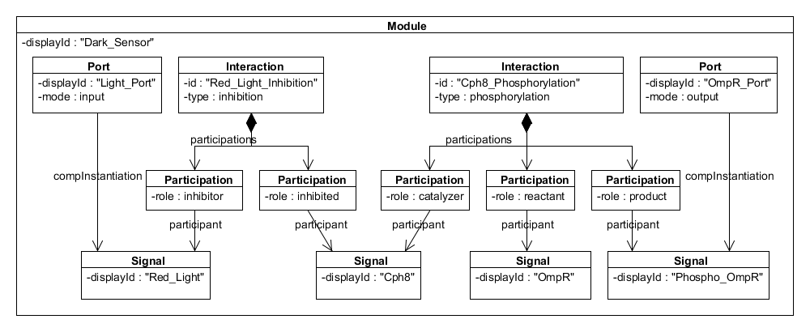
Dark Sensor: Interactions
N. Roehner, C. J. Myers (U. of Utah) SBOL 2.0: Vision and Structure SBOL Workshop 10: UC Berkeley

Slide 38
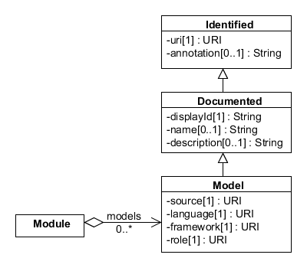
Extension Status: Modeling
N. Roehner, C. J. Myers (U. of Utah) SBOL 2.0: Vision and Structure SBOL Workshop 10: UC Berkeley

Slide 39
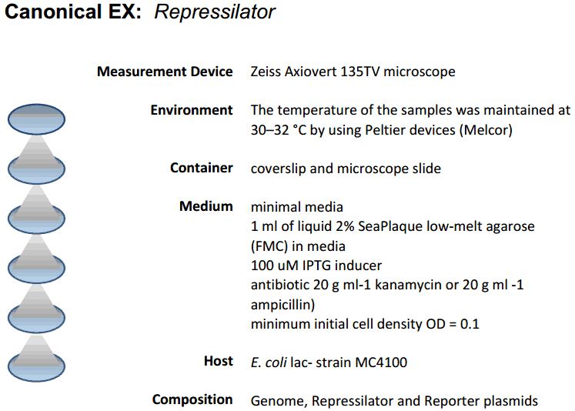
Extension Status: Context
N. Roehner, C. J. Myers (U. of Utah) SBOL 2.0: Vision and Structure SBOL Workshop 10: UC Berkeley

Slide 40
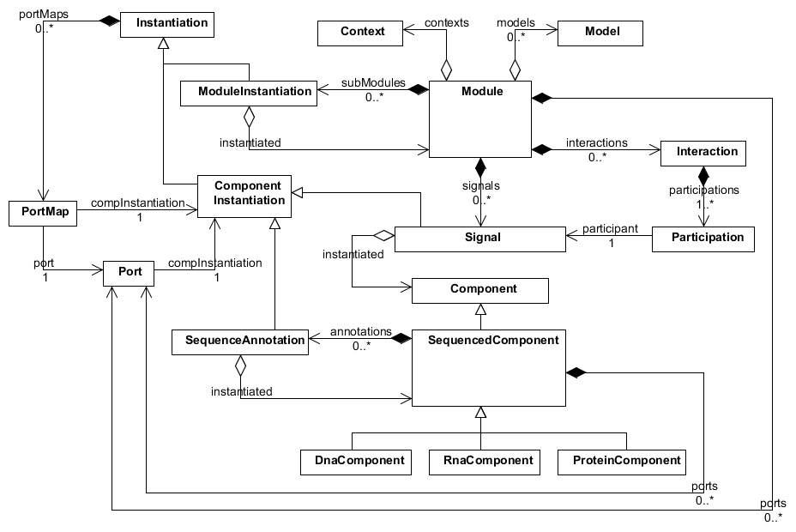
Summary UML
N. Roehner, C. J. Myers (U. of Utah) SBOL 2.0: Vision and Structure SBOL Workshop 10: UC Berkeley

