Slide 1

Using SBOL as a Genetic Data Model
Nicholas Roehner
University of Utah
SBOL Workshop 10: UC Berkeley
N. Roehner, C. J. Myers (U. of Utah) SBOL 2.0: Vision and Structure SBOL Workshop 10: UC Berkeley

Slide 2
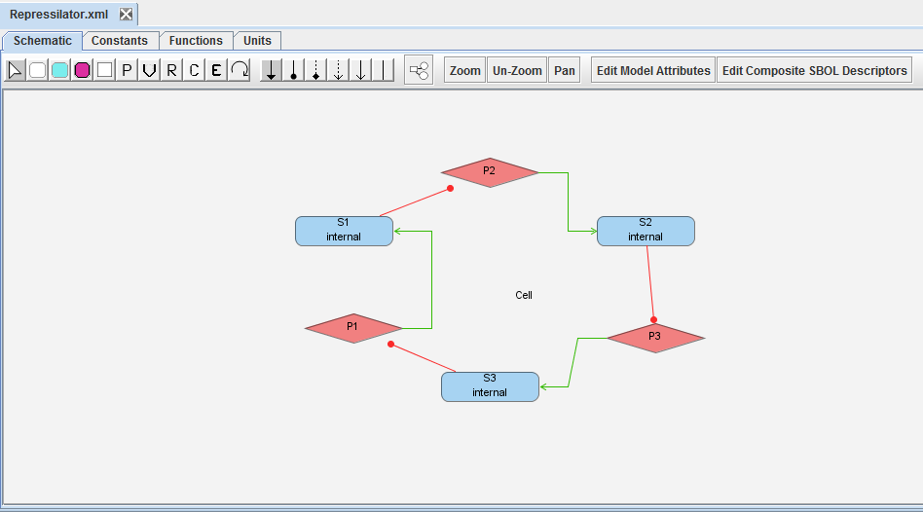
Functional Genetic Model of iBioSim
Functional description of genetic regulation
Written in SBML annotated with SBO
N. Roehner, C. J. Myers (U. of Utah) SBOL 2.0: Vision and Structure SBOL Workshop 10: UC Berkeley

Slide 3
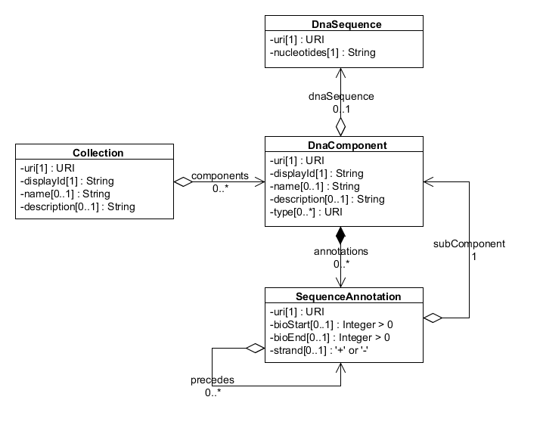
SBOL Version 1.0
N. Roehner, C. J. Myers (U. of Utah) SBOL 2.0: Vision and Structure SBOL Workshop 10: UC Berkeley

Slide 4
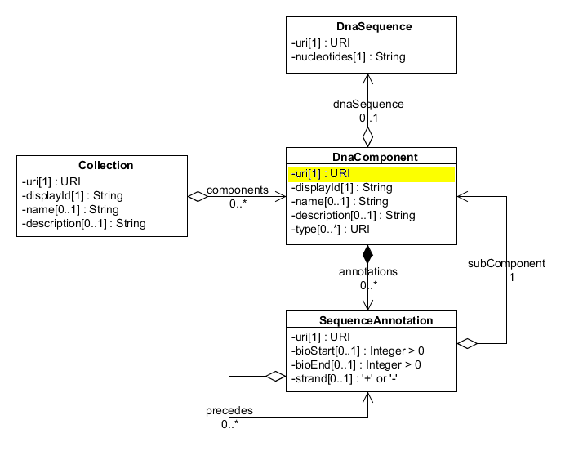
SBOL Version 1.0
N. Roehner, C. J. Myers (U. of Utah) SBOL 2.0: Vision and Structure SBOL Workshop 10: UC Berkeley

Slide 5
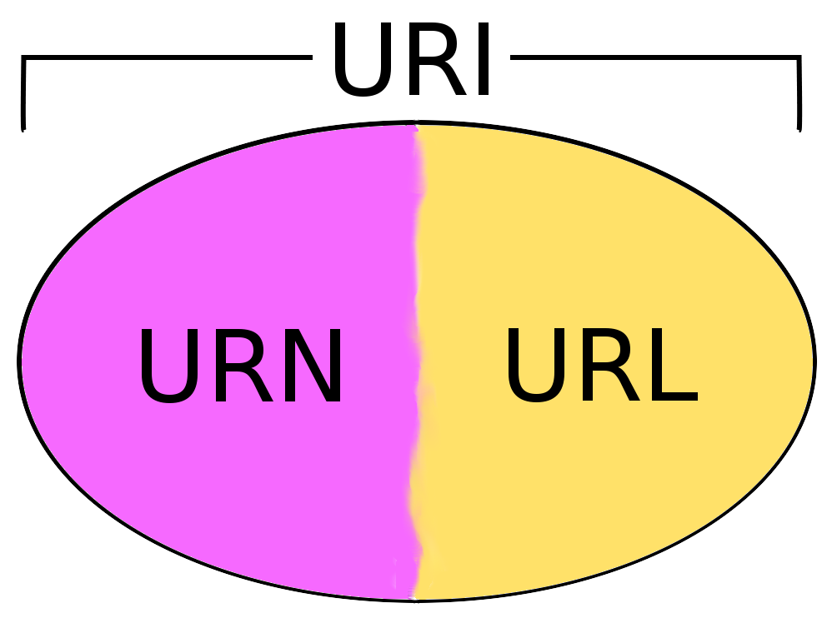
Uniform Resource Identifier (URI)
Typical URI form is authority plus unique ID.
iBioSim uses lab homepage plus auto-generated ID.
N. Roehner, C. J. Myers (U. of Utah) SBOL 2.0: Vision and Structure SBOL Workshop 10: UC Berkeley

Slide 6
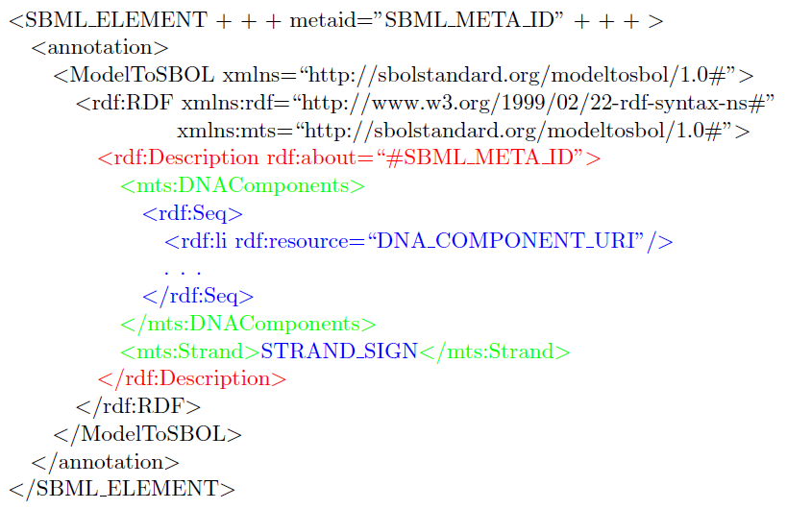
Annotation via URI
iBioSim annotates SBML with SBOL via URIs.
N. Roehner, C. J. Myers (U. of Utah) SBOL 2.0: Vision and Structure SBOL Workshop 10: UC Berkeley

Slide 7
Best Practices for URIs
If you change an object that exists somewhere else in another file, then you should also change that object’s URI.
Many other best practices found at http://www.sbolstandard.org/initiatives/best-practices
N. Roehner, C. J. Myers (U. of Utah) SBOL 2.0: Vision and Structure SBOL Workshop 10: UC Berkeley

Slide 8
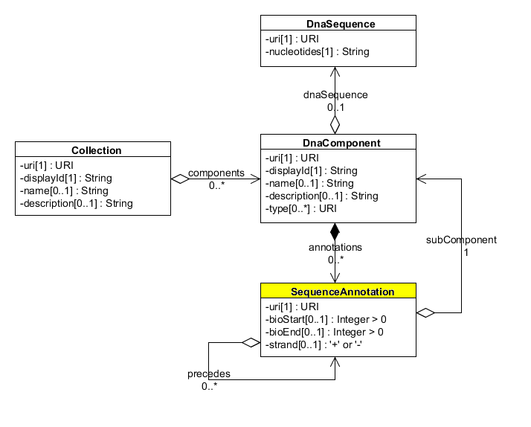
SBOL 1.0: Sequence Annotations
N. Roehner, C. J. Myers (U. of Utah) SBOL 2.0: Vision and Structure SBOL Workshop 10: UC Berkeley

Slide 9
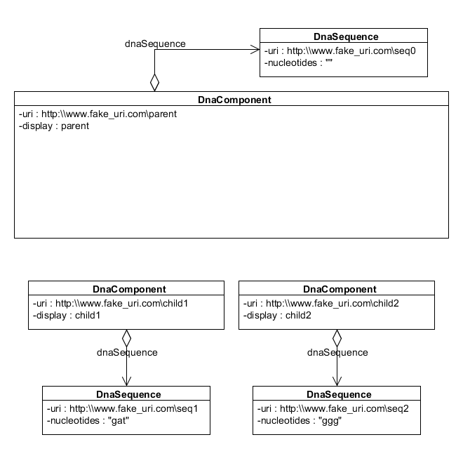
Composing DNA Components
N. Roehner, C. J. Myers (U. of Utah) SBOL 2.0: Vision and Structure SBOL Workshop 10: UC Berkeley

Slide 10
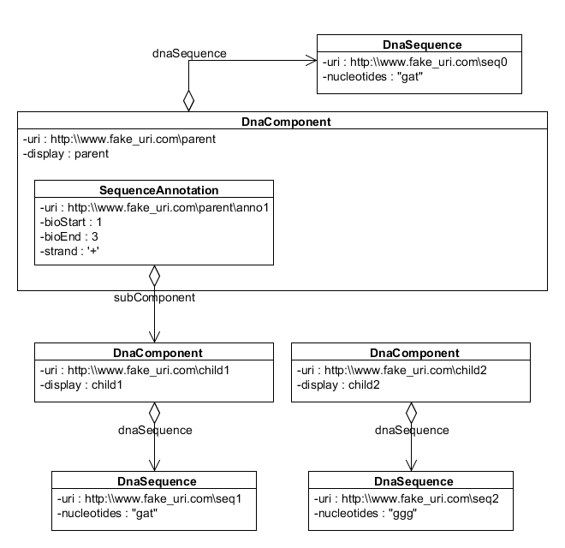
Composing DNA Components
N. Roehner, C. J. Myers (U. of Utah) SBOL 2.0: Vision and Structure SBOL Workshop 10: UC Berkeley

Slide 11
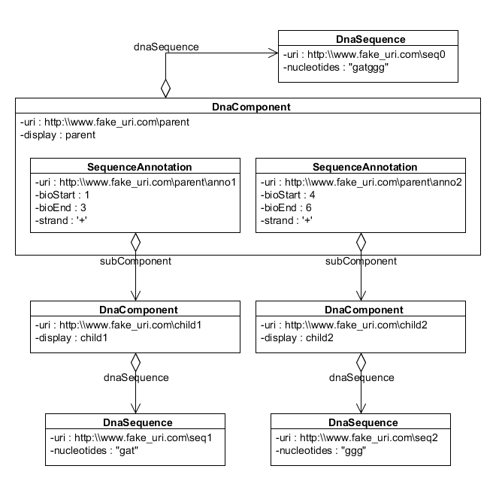
Composing DNA Components
N. Roehner, C. J. Myers (U. of Utah) SBOL 2.0: Vision and Structure SBOL Workshop 10: UC Berkeley

Slide 12
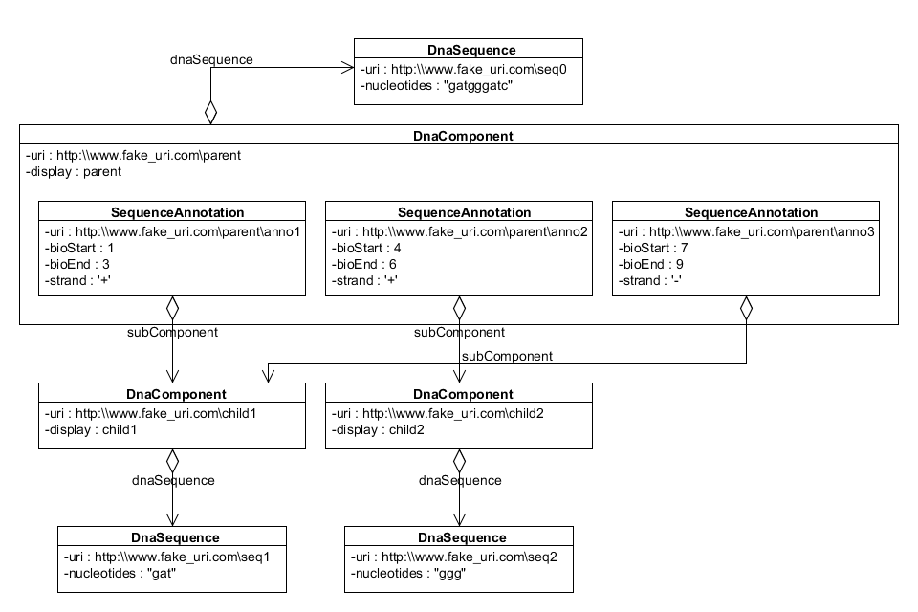
Minus Strand Annotation
N. Roehner, C. J. Myers (U. of Utah) SBOL 2.0: Vision and Structure SBOL Workshop 10: UC Berkeley

Slide 13
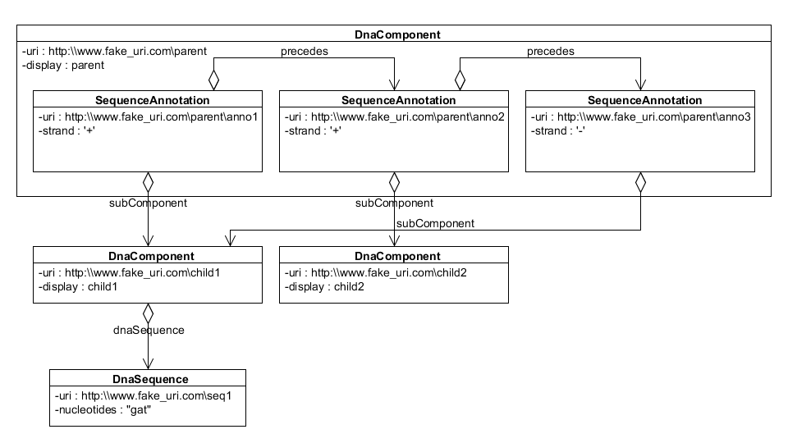
Precedes Relationship
N. Roehner, C. J. Myers (U. of Utah) SBOL 2.0: Vision and Structure SBOL Workshop 10: UC Berkeley

Slide 14
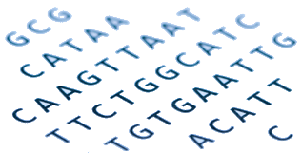
Questions
N. Roehner, C. J. Myers (U. of Utah) SBOL 2.0: Vision and Structure SBOL Workshop 10: UC Berkeley

