Slide 1

libSBOLj in Virtual Parts
8th January 2014
10th SBOL Workshop, Berkeley, USA
Dr. Goksel Misirli
School of Computing Science and Centre for Bacterial Cell Biology

Slide 2
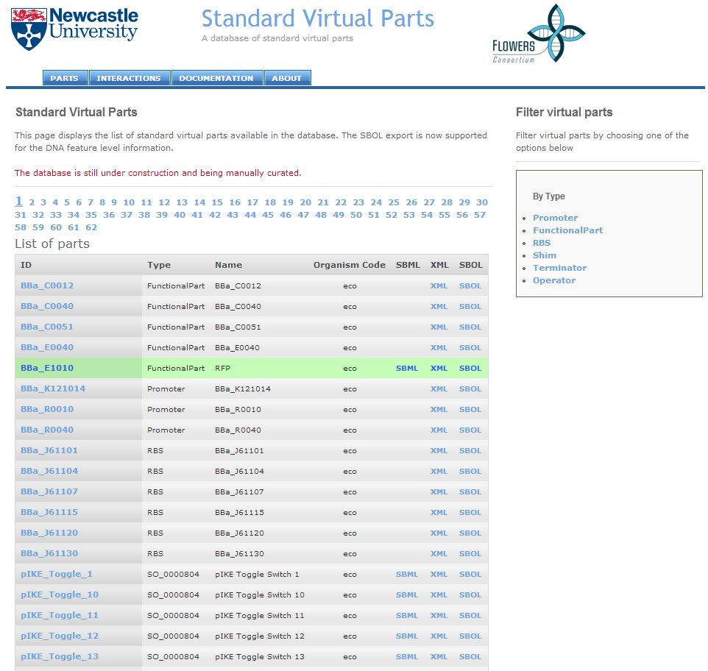
A repository of SVPs
http://www.virtualparts.org

Slide 3

The VirtualParts repository is REST based
All the resources are accessed using REST-based URLs
http://sbol.ncl.ac.uk:8081/part/pIKE_Toggle_1/sbol
SBOL also identifies resources via URLs
The repository uses URLs to access more information rather than including all the details
Only the two sub devices are included for the below design

Slide 4
Creating an SBOL document
public SBOLDocument GetSBOL(List<Part> parts,String baseURL, String collectionURL, String collectionDisplayId)
{
SBOLDocument document=SBOLFactory.createDocument();
Collection collection=SBOLFactory.createCollection();
collection.setURI(new URI(collectionURL));
collection.setDisplayId(collectionDisplayId);
for (Part part : parts)
{
DnaComponent dnaComponent = GetSBOLDnaComponent(part,baseURL); collection.addComponent(dnaComponent);
}
document.addContent(collection);
return document;
}

Slide 5
Creating a DnaComponent
private DnaComponent GetDnaComponent(String uri, String displayId, String name, String description, String type, String sequenceData) throws Exception
{
//Create the component
DnaComponent dnaComponent = SBOLFactory.createDnaComponent(); dnaComponent.setName(name);
dnaComponent.setDescription(description); dnaComponent.setDisplayId(displayId);
dnaComponent.setURI(new URI(uri));
dnaComponent.addType(new URI(GetTypeURI(type)));
//Add the DNA sequence information
DnaSequence sequence=SBOLFactory.createDnaSequence(); sequence.setNucleotides(sequenceData));
sequence.setURI(new URI(dnaComponent.getURI().toString() + "/" + "NA")); dnaComponent.setDnaSequence(sequence);
return dnaComponent;
}

Slide 6
Creating a SequenceAnnotation
private SequenceAnnotation GetSequenceAnnotation(String uri,int start,int end, StrandType strandType,DnaComponent dnaComponent) throws Exception
{
SequenceAnnotation annotation=SBOLFactory.createSequenceAnnotation(); annotation.setURI(new URI(uri));
annotation.setBioStart(start);
annotation.setBioEnd(end);
annotation.setStrand(strandType);
annotation.setSubComponent(dnaComponent);
return annotation;
}
//Adding the sequence annotations
dnaComponent.addAnnotation(annotation);

Slide 7
Serialising/Deserialising
Serialising:
ByteArrayOutputStream buffer=new ByteArrayOutputStream();
SBOLFactory.write(document, buffer);
String xml=buffer.toString();
Deserialising:
sbolDocument=SBOLFactory.read(new ByteArrayInputStream(sbolData.getBytes()));

Slide 8
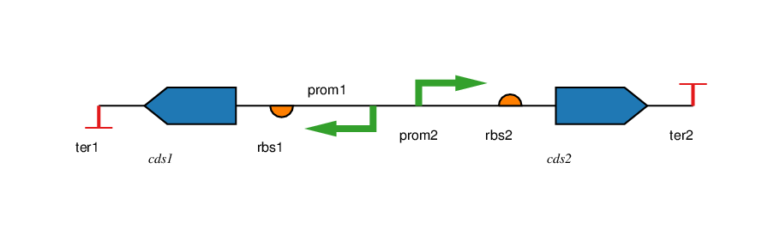
Visualising using PigeonCAD
http://pigeoncad.org/
Format:
<Strand> <part type> <part name> <colour code>
#Arcs
Example:
<t ter1 6
<c cds1 2
<r rbs1 8
<p prom1 4
p prom2 4
r rbs2 8
c cds2 2
t ter2 6
# Arcs

Slide 9
Visualising using PigeonCAD
private List<String> GetPigeonDataDetailed(List<SequenceAnnotation> annotations, List<String> data,StrandType parentCalculatedStrandType){
if (annotations!=null && annotations.size()>0){
for (SequenceAnnotation annotation:annotations){
StrandType innerComponentStrand=GetStrandType(annotation, parentCalculatedStrandType);
DnaComponent component=annotation.getSubComponent();
if (component.getAnnotations()!=null && component.getAnnotations().size()>0){
List<String> annotationsData=new ArrayList<String>();
annotationsData=GetPigeonDataDetailed(component.getAnnotations(), annotationsData,innerComponentStrand);
String text=FormatAnnotationData(annotationsData,text,innerComponentStrand);
data.add(text);
}
else {
String code=GetPigeonCode(component.getTypes());
code=FormatPigeonCode(annotation,parentCalculatedStrandType,component)
data.add(code + System.getProperty("line.separator"));
}
}
}
return data;
}

Slide 10
Downloading the image
HttpHandler handler=new HttpHandler();
String result=handler.Post(pigeonServer + "/pigeon.php", text, "desc"); imagePath=GetImagePath(result,pigeonServer);
if (imagePath!=null) {
handler.saveImage(imagePath, Configuration.IMAGE_DIRECTORY + "/" + partName + ".png");
}
We need a web service that would receive a design and return an image!

Slide 11
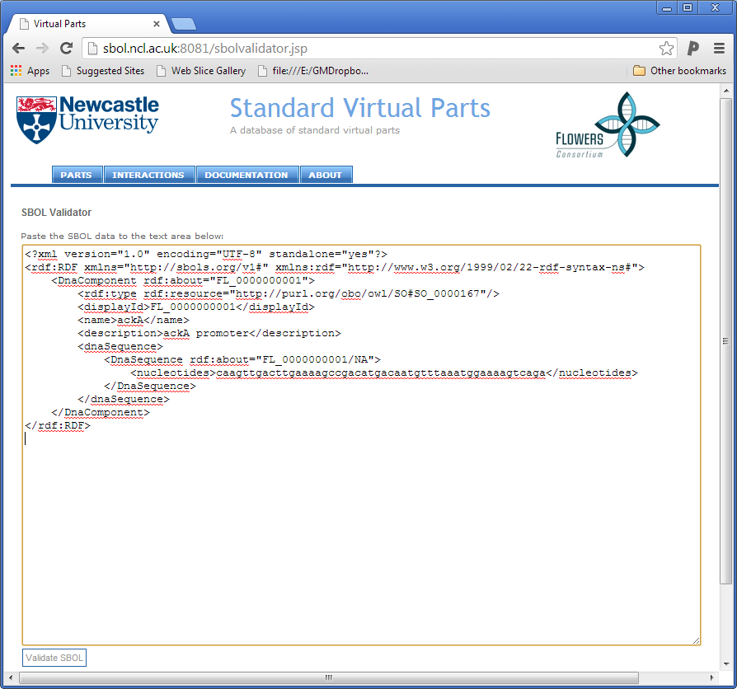
SBOL compliance
An online SBOL validator
It was very helpful during the SBOL exchange for the NBT paper
http://virtualparts.org/sbolvalidator.jsp
Validation is through libSBOLj
Not everything works according to the spec!
Display id: “part A”
NOT VALID according to the spec
VALID according to libSBOLj
Unit tests are needed for rules from the spec

Slide 12
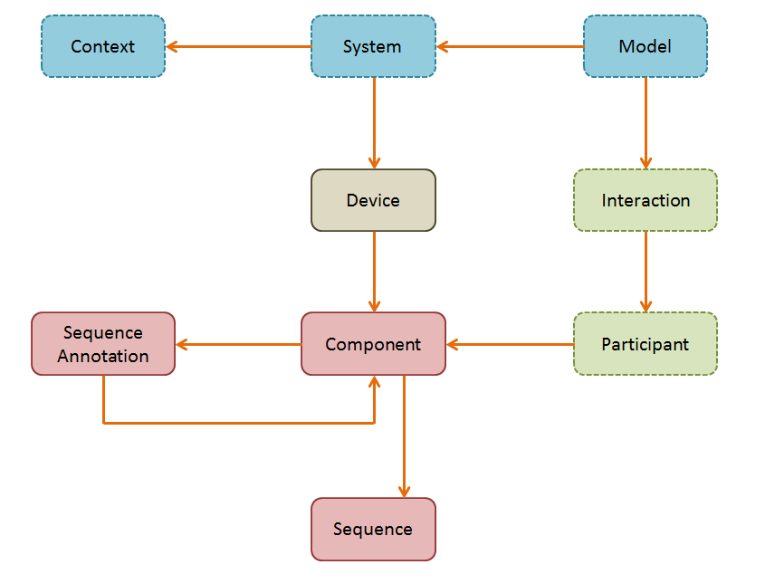
SBOL extensions

Slide 13
SBOL System extension
Described
uri
displayId
name
description
0..*
0..*
Context
System
Model
contexts
models
0..*
0..*
devices
subsystems
Device

Slide 14
Writing the extension
public class SystemRdfPickler extends CoreRdfPicklers implements RdfEntityPickler<SBOLDocument> {
public void pickle(final Model model, SBOLDocument document)
{
for(SBOLObject o : document.getContents()) {
o.accept(new SBOLSystemVisitor<RuntimeException>() {
@Override
public void visit(SBOLSystem system) throws RuntimeException {
systemObjectPickler.pickle(model, system);
} });
}
}
}

Slide 15
Writing the extension
private RdfEntityPickler<SBOLSystem> mkSystemObjectPickler(Properties props) throws IntrospectionException {
RdfPropertyPickler<SBOLSystem, org.sbolstandard.system.Model> model = object(identity, property("http://sbols.org/v1#model"), identity);
RdfPropertyPickler<SBOLSystem, Context> context =object(identity, property("http://sbols.org/v1#context"), identity);
RdfPropertyPickler<SBOLSystem, Device> device=object(identity, property("http://sbols.org/v1#device"), identity);
return all(
byProperty(SBOLSystem.class, "models", notNull(collection(all(model, walkTo(modelPickler))))),
byProperty(SBOLSystem.class, "contexts", notNull(collection(all(context, walkTo(contextPickler))))),
byProperty(SBOLSystem.class, "devices", notNull(collection(all(device, walkTo(devicePickler))))),
sbolNamedObjectPickler,
type(baseURI + "System", identity)
);
}
private RdfEntityPickler<Context> mkContextPickler(Properties props) throws IntrospectionException {
RdfPropertyPickler<Context, String> name=value(identity, property("http://sbols.org/v1#name"));
return all(
type(baseURI + "Context", identity),
sbolNamedObjectPickler
);
}
https://github.com/SynBioDex/libSBOLj/blob/feature/system/system/src/main/java/org/sbolstandard/system/impl/SystemRdfPickler.java

Slide 16
Creating an SBOL System object
SBOLSystem system=new SBOLSystemImpl();
system.setURI(new URI(String.format("%s/part/%s/system", baseURL,part.getName()))); system.setName(String.format("%s system", part.getName()));
system.setDescription(String.format("System representation for the %s part",part.getName())); system.setDisplayId(String.format("%s_system",part.getName()));
//Add the contexts
system.addContext(GetBioenvironmentContext(baseURL,part));
system.addContext(GetCellContext(baseURL, part, organismCode)); }
//Add the device
Device device=new DeviceImpl();
device.setURI(new URI(String.format("%s/part/%s/device", baseURL,part.getName())));
device.setName(String.format("%s device", part.getName()));
device.setDescription(String.format("Device representation for the %s part",part.getName())); device.setDisplayId(String.format("%s_device",part.getName()));
device.addDnaComponent(dnaComponent);
system.addDevice(device);
//Add the models
system.AddModel(GetModel(baseURL, part, "sbml", "ode"));
system.AddModel(GetModel(baseURL, part, "kappa", "rulebased"));
document.addContent(system);
SystemRdfPickler.instance().getIO().write(document, writer);

Slide 17
With the new serialisation
Adding extensions is easier
Implementation of extensions is straightforward
The output is fully RDF
Any RDF tool can read SBOL data
RDF-turtle format can be suitable for human-display

Slide 18



Thanks
Acknowledgements:
Prof. Anil Wipat
Dr. Jennifer Hallinan
Dr. Mathew Pocock
The Flowers consortium
SBOL developers

Slide 19
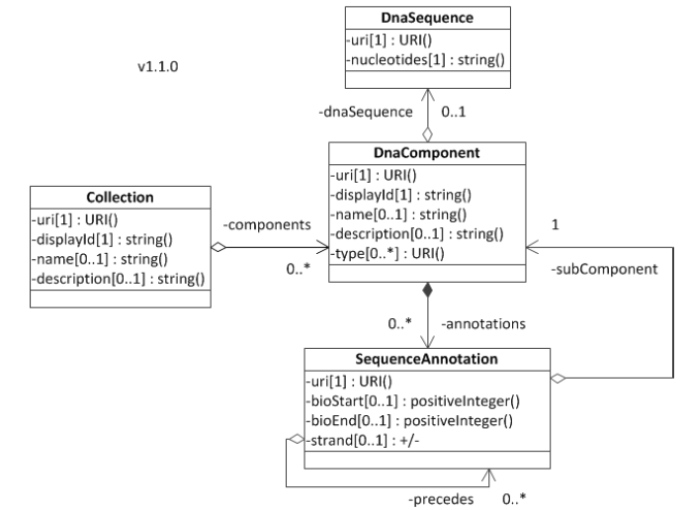
Creating an SBOL document

Slide 20
SBOL to exchange data
<?xml version="1.0" encoding="UTF-8" standalone="yes"?>
<ns2:RDF xmlns="http://sbols.org/v1#" xmlns:ns2="http://www.w3.org/1999/02/22-rdf-syntax-ns#">
<Collection ns2:about="http://sbol.ncl.ac.uk:8081/collection/pIKE_Toggle_1">
<displayId>pIKE_Toggle_1 collection</displayId>
<component>
<DnaComponent ns2:about="http://sbol.ncl.ac.uk:8081/part/pIKE_Toggle_1">
<ns2:type ns2:resource="http://purl.org/obo/owl/SO#SO_0000804"/>
<displayId>pIKE_Toggle_1</displayId>
<name>pIKE Toggle Switch 1</name>
<description>This is a pIKE class toggle switch similar to those constructed by Gardner et al.</description>
<dnaSequence>
<DnaSequence ns2:about="http://sbol.ncl.ac.uk:8081/part/pIKE_Toggle_1/NA">
<nucleotides>ttg…cgc</nucleotides>
</DnaSequence>
</dnaSequence>
<annotation>
<SequenceAnnotation ns2:about="http://sbol.ncl.ac.uk:8081/part/pIKE_Toggle_1/annotation/1_1284_pIKELeftCassette_1">
.............................

