Slide 1
SBOL Visual Examples of Use
created by Michal Galdzicki using software written by Evren Sirin
12/20/2012

Slide 2
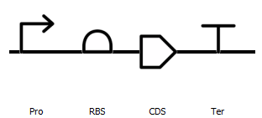
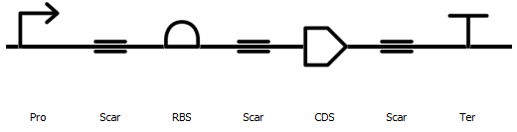
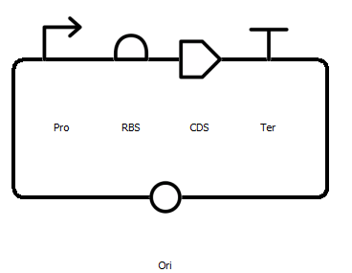
Expression Cassette Templates
labeled with 3 letter abbreviations for DnaComponenttype

Slide 3
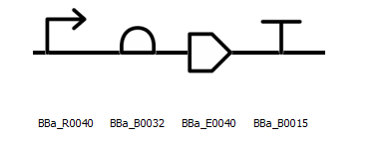
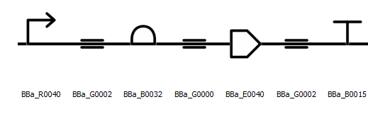
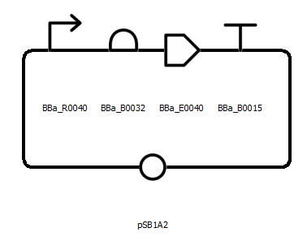
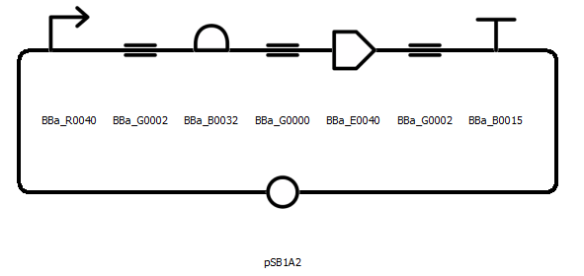
I7101:R0040.B0032.E0040.B0015

Slide 4
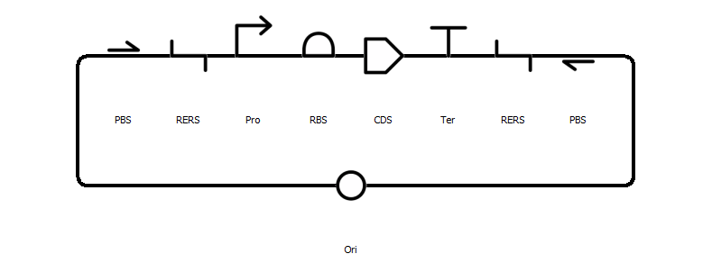

Using other symbols…

