Slide 1
Introduction to SBOL Visual
SBOL Visual Community
Last revised: January 2016

Slide 2

Elements of SBOL Visual:
Construct Icons
Backbone
pTet
GFP
TetR
Direction shown
by orientation
Regulatory Interactions
(in progress)
Synthetic Biology Open Language - Visual
Community standards in development since 2008
SBOL Visual 1.0: BBF RFC #93 doi: 1721.1/78249

Slide 3
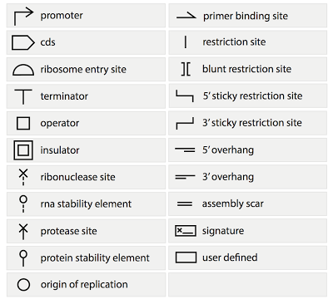
Current SBOLv Symbols:
New symbols added by community consensus

Slide 4
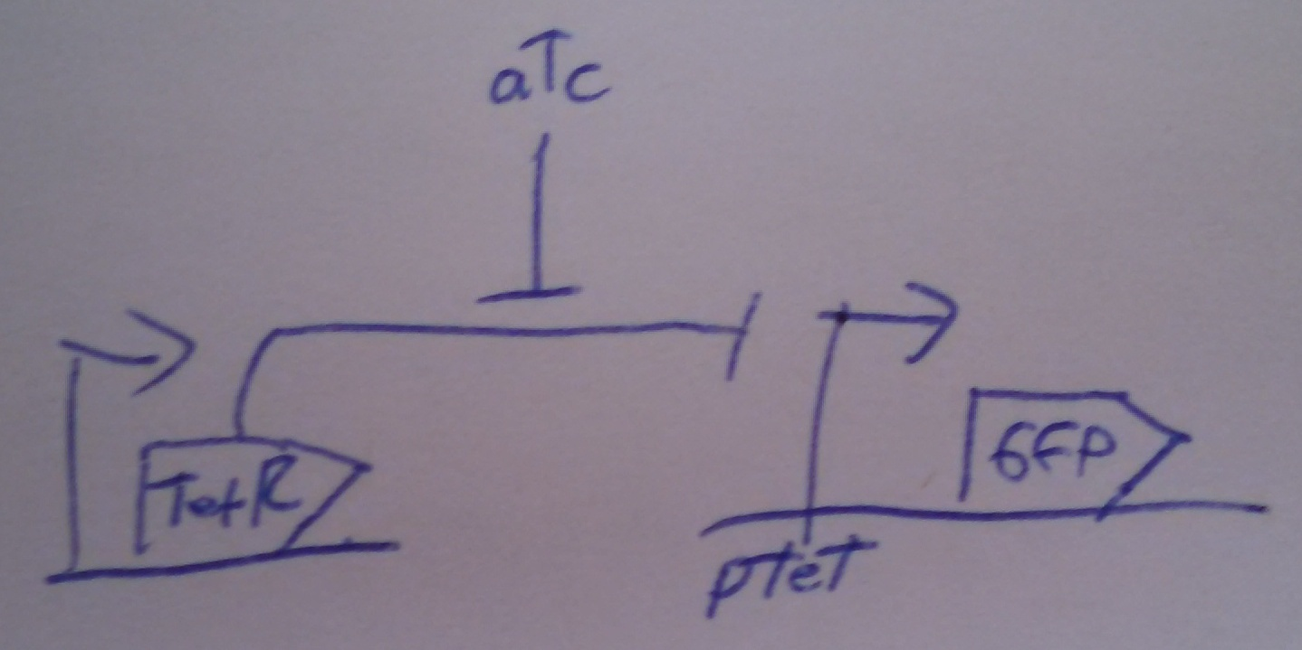
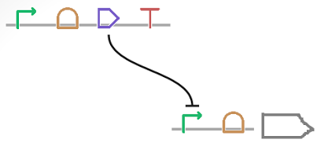
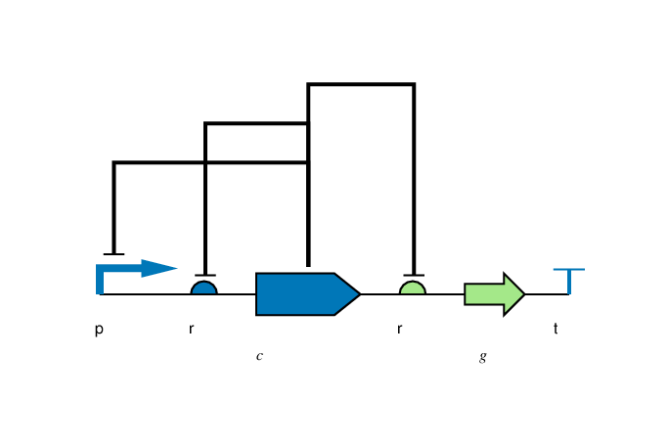
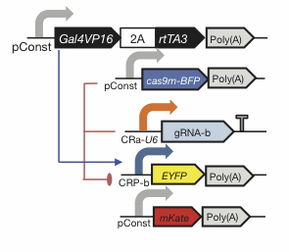
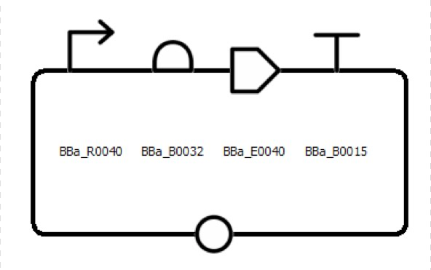
Flexibility of Style
Color, Text, Scaling, Strands: all your choice

Slide 5

Is anything prohibited?
Yes.

Slide 6
Making SBOL Visual Diagrams
Using your favorite graphics editor:
Many icons can be drawn directly
Icons available from: http://sbolstandard.org/visual/
Specialized visualization tools:
Pigeon: http://pigeoncad.org/
VisBOL: http://visbol.org/design/
GraphViz: http://www.graphviz.org/
DNAPlotLib: https://github.com/VoigtLab/dnaplotlib

Slide 7
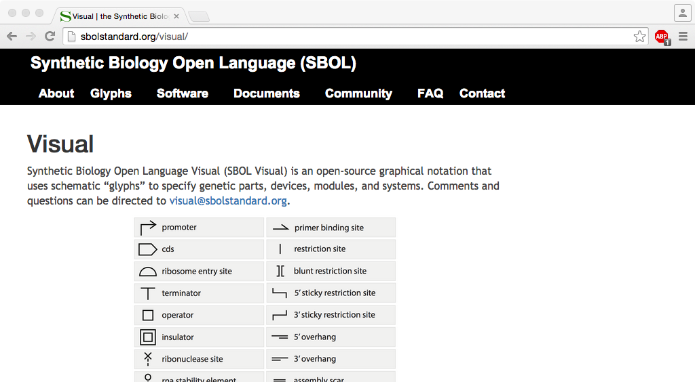
http://sbolstandard.org
Use the symbols in your papers & talks
Contribute opinions, use cases, new symbols
Community is open for anyone to join

