Slide 1
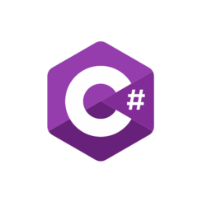
C# OOP
Manrique Gonzalo

Slide 2
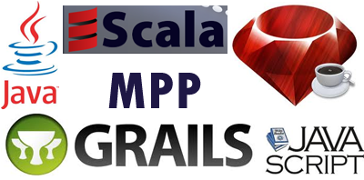
Paradigms:
It’s a multiparadigm language:
*Structured
*Imperative
*Object oriented
*Event driven
*Functional
*Generic
*Reflective

Slide 3

OOP C# Introduction.
Everything in OOP is placed together as self-sustainable “objects.”
An object is a combination of variables, functions, and data that performs a set of related activities.
When the object performs those activities, it defines the object’s behaviour. In addition, an object is an instance of a class. Furthermore, C# offers full support for OOP including inheritance, encapsulation, abstraction, and polymorphism.

Slide 4
Definitions:
Encapsulation is when a group of related methods, properties, and other members are treated as a single object.
Inheritance is the ability to receive (“inherit”) methods and properties from an existing class.
Polymorphism is when each class implements the same methods in varying ways, but you can still have several classes that can be utilized interchangeably.
Abstraction is the process by which a developer hides everything other than the relevant data about an object in order to simplify and increase efficiency.

Slide 5
What is an Object?
Objects are instances of classes. In other words, an instance of a class is an object defined by that particular class. Creating a new instance, or an object, is called instantiation. This is how you define a class:
class SampleClass
{
}

Slide 6
Classes
A light version of classes in C# is called structures. These are beneficial when we want to create a large array of objects but don’t want to overwhelm our available memory. A class is made up of three things:
*A name
*Operations
*Attributes

Slide 7
Objects
Objects are created from a class blueprint, which defines the data and behaviour of all instances of that type.
public class Student
{
}

Slide 8
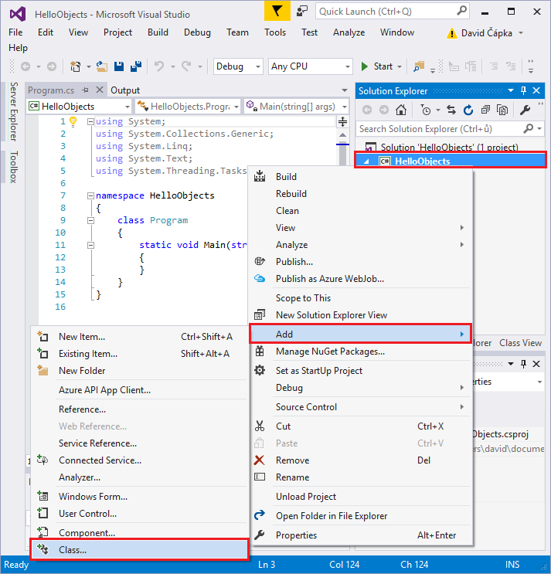
Method
A method is an action an object can execute.
In most instances, we can declare a method within a class definition. Yet, C# supports extension methods that let you add methods to an existing class outside the definition of a class.
Here’s an example of a simple C# program called “Hello World” from C# Corner that illustrates many of OOP fundamentals:

Slide 9
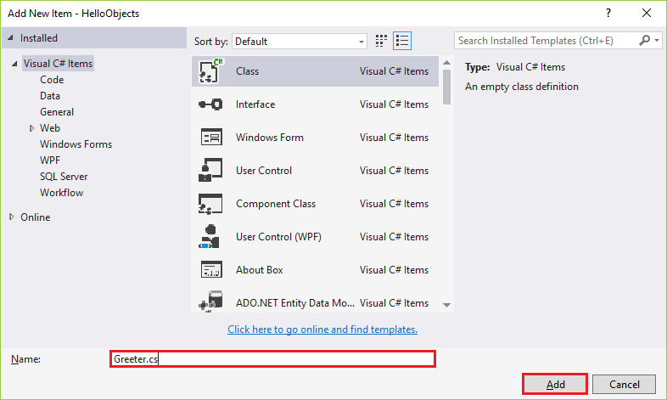
We'll name our class Greeter.cs and confirm. We name classes using CamelCase, meaning that the first letter in every word in the class name is capitalized and we don't write spaces.
The name, of course, shouldn't contain any accent characters, if your native language uses any, you can use them in strings, but never in identifiers.

Slide 10
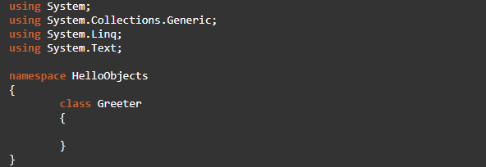
We're going to create a "greeter" object using this class later, which will be able to greet the user. For every action, there is some object responsible. One should not simply start by writing stuff into the Main() method. In our case, it may seem useless, but in more complex applications it'll prove to be more than worthwhile. Another .cs file will be added to our Solution Explorer and VS will open it for us. We can later return to the original Program.cs with the Main() method using tabs or via the Solution Explorer.

Slide 11
Next, we'll add a Greet() method to the Greeter class, which will be publicly visible and won't return a value or take any parameters. In C# .NET, we declare methods as follows: [Access modifier][return type][MethodName]([parameters])

Slide 12
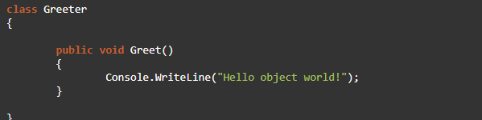
We'll write an access modifier before the method, which in our case is public. If we omit the modifier, C# will assume it is a private, non-public, method. To make the method not return a value we must declare the method using the void keyword. Followed by the method's name, which we will write in CamelCase as well. Parentheses with parameters are required, we'll leave them empty since the method won't have any parameters. In the method body, we'll write code that prints a message to the console.
Our class will now look like this:

Slide 13
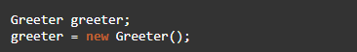
We'll create an instance of the Greeter class in the Main() method body. Which will be a greeter object that we'll be able to work with. We store objects in variables and use the class name as the data type. Instances usually have the same name as classes, but with the first character in lowercase. Let's declare the variable and then store a new Greeter class instance within it:

Slide 14
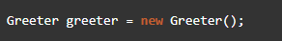
The first line says: "I want a variable named "greeter" that will later contain a Greeter instance".
The second line contains the new keyword which will create a new Greeter class instance. We assign this instance to our variable.
When a new instance is created, the constructor is called. The constructor is a special class method, that's why we write the empty parentheses when creating an instance, we're calling this "creation" method. The constructor usually contains some initialization of the object's internal state, e.g. it initializes the fields with default values. We haven't declared a constructor in our class, that's why C# created the implicit parameterless constructor. So creating an instance of an object is similar to calling a method. Of course, the entire code can be shortened to:

Slide 15
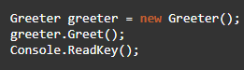
Since now we have a Greeter class instance in a variable, we can let it greet the user. We'll call the Greet() method as greeter.Greet(). We will also add Console.ReadKey() into the application. The Main() method code will now look like this:

Slide 16
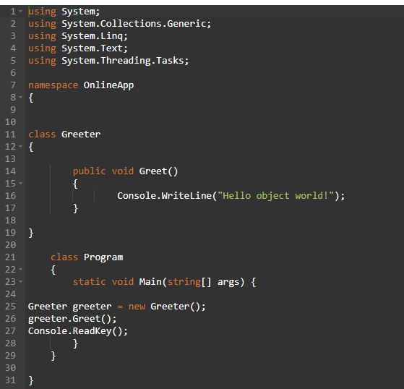
Final Code

Slide 17
