Slide 1
The plan for this week was:Have a complete pipeline from the raspberry pis, through a PC and onto the VR display. In other words, a complete prototype minus the Perimetry reading GUI.
This was not achieved. I am debigging the SSH connections. And the transformation of the images has not been done yet.
What I have produced:
(not working properly)
Software in the pi’s that streams frames into the PC.
Software in the PC that receives said frames and puts them together.
(no bugs known)
Software in the PC that displays the stream of images.
(missing)
The transformer fucntion.

Slide 2
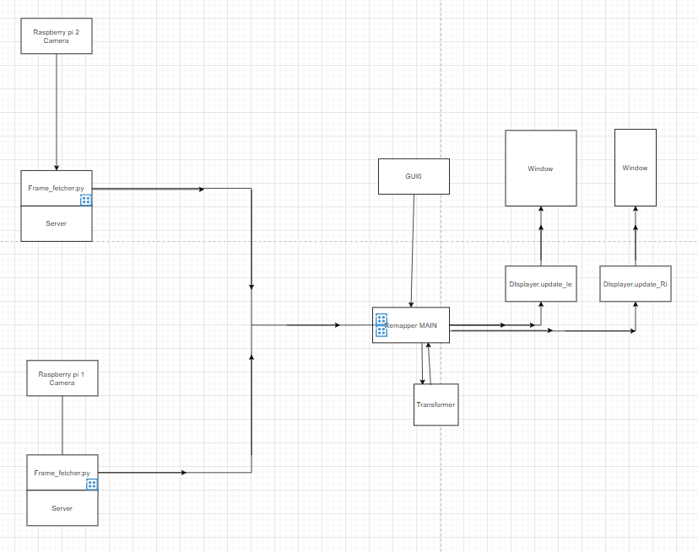



Slide 3
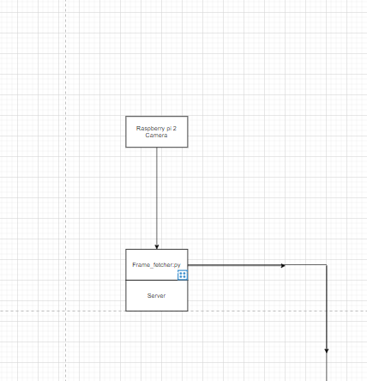
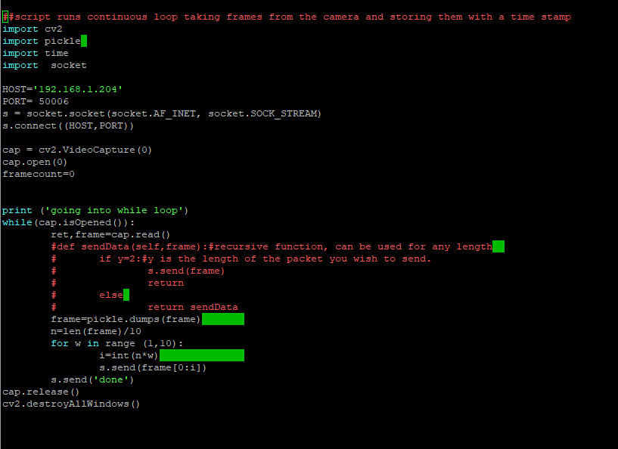
Frame fetcher: loops throug collecting a frame, truning it into bytes
breaking it into 10 parts and sending those parts in order.
It is connected to the PC via SSH.
Using a socket onject.

Slide 5
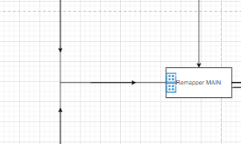
In the pc we have a single script.
The main method in it, reconstructs the frames one at a time.

Slide 6
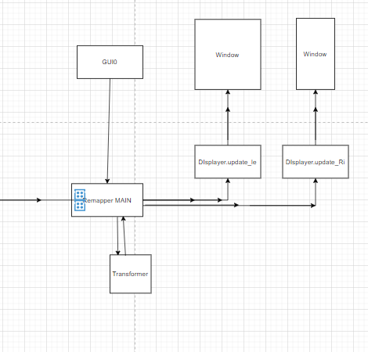
The main method:
1.Gets a dictionary from GUIO
2.Uses the dictionary to instantiate a Displayer object.
THEN
In an infinite loop:
1.Transforms the left image.
2.Updates the left window.
3.Transforms the right image.
4.Updates the right window.
uses a transformer method to modify the images.

Slide 7
Next Steps
Weekend extension of release (done by Monday):
Fix the SSH connection.
Objectives for Next Week:
Code the perimetry Reading GUI.(GUI0)
Code the transformation function.
Review and produce final experiment description.

