Slide 1
.NET
Rob Garner

Slide 2
Overview
Intro and Syllabus
What is .NET?
Assemblies
Parallel Programming
NET Framework Classes
Namespaces
Creating .NET Applications using C#
Role of C# in .NET Enterprise Architecture

Slide 3
Review syllabus
Given the syllabus, explain what is expected of the student and the instructor during the course.

Slide 4
What is .NET
Explain what .NET is.

Slide 5
Relationship of C# to .NET
Explain the relationship of C# to .NET

Slide 6
Relationship of C# to .NET
C# is a modern object-oriented language
C# is specifically designed and targeted for .NET Framework
All code written in C# always runs using the .NET Framework
To understand C# you must understand .NET

Slide 7
Common Language Runtime (CLR)
Define what the Common Language Runtime is and Describe key elements of the Common Language Runtime

Slide 8
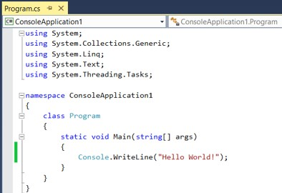
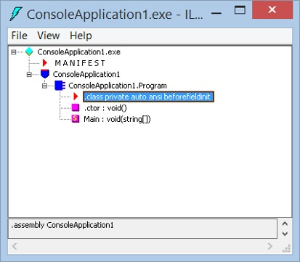
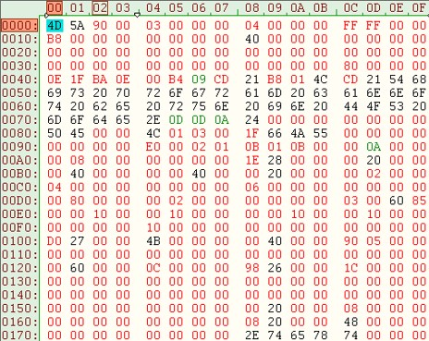
Common Language Runtime (CLR)
Source Code
Intermediate Language
Compiler compiles source code to Microsoft Intermediate Language (IL)
Native Code
CLR compiles IL to platform-specific code
Managed Code
Runtime Execution Environment

Slide 9
Microsoft Intermediate Language
Explain what Microsoft Intermediate Language is and how it relates to .NET

Slide 10
Intermediate Language (IL)
Similar to JAVA Byte Code
Low-level language with simple syntax
Uses numeric codes rather than text.
Can be quickly translated into native machine code.

Slide 11
Platform Independence
.NET programs are compiled to IL
IL is compiled later to machine code specific to that platform
Languages that implement the CLR can theoretically run on any platform that has a .NET runtime
Only implemented for windows so far but effort under way to implement for Linux, Mac OS and others…

Slide 12
Performance Improvement
IL is Just-in-Time (JIT) compiled to native code
JIT compilers will only compile a piece of code one time and store the compiled version of code.
In addition: The JIT compiler optimizes the code for the machine’s processor that the code is running on!
This cannot be done by code that is fully compiled before deployment

Slide 13
C# compiles to:
Native code
C++ code
IL code
Java

Slide 14
IL code compiles to:
Native code
C++ code
IL code
Java

Slide 15
IL code compiles:
Every time it executes.
The first time it executes.

Slide 16
Language Interoperability
IL facilitates language interoperability
IL
C#
Visual Basic
C++
F#
Notes:
Because all .NET languages compile to IL it facilitates interoperability.

Slide 17
Intermediate Language Features
Object orientation and the use of interfaces
Strong distinction between value and reference types
Strong data typing
Error handling using exceptions
Use of attributes
Notes:
Let students know this will be covered in detail in Chapter 2

Slide 18
Support for Object Orientation and Interfaces
IL is based on classic Object Oriented programming patterns and principles
You will need to learn:
  Defining classes
  Inheritance
  Interfaces
  Polymorphism
Notes:
Let students know Object Oriented programming will be covered in changers 3 and 4

Slide 19
“True” Language Interoperability
A class written in one language can inherit from a class written in another language.
The class can contain an instance of another class, no matter what the languages of the two classes are.
An object can directly call methods against another object written in another language.
Objects (or references to objects) can be passed around between methods.
When calling methods between languages, you can step between the method calls in the debugger, even when this means stepping between source code written in different languages.
.NET and IL Achieve this!
Notes:
Emphasize that these terms will be better understood later. For now realize that a key motivator to why .NET is built the way it is to improve interoperability.

Slide 20
Distinct Value and Reference Types
myValueVar
IL makes a strong distinction between value and reference types.
Value type:
  Variable directly stores it’s data
Reference type:
  Variable stores an address where the data can be found.
?
myRefVar
00AD6CFF
Address in memory
?
Notes:
Generally value types will be stored in a place in memory called the stack and reference types will be stored in a place in memory called the heap. We will learn more about this in Chapter 2.

Slide 21
Strong Data Typing
IL is strongly typed
All variables are clearly marked as being of a particular type.
IL does not permit operations that result in ambiguous data types.
Notes:
Strong Data Typing means programmers have to be more rigorous about declaring variables and classes. While on the surface this may seem less convenient it leads to code that has fewer run-time errors because the compiler will detect problems earlier.

Slide 22
Advantages of Type Safety
Language Interoperability
Garbage Collection
Security
Application Domains
Notes:
The advantage of a strongly typed language is type safety which has the advantages presented on this slide.

Slide 23
Strong Data Typing and Interoperability
For a program in one language to access an object/variable in another language it must know what that type is.
.NET implements a Common Type System (CTS) that has all the predefined types IL implements.
IL Int 32
C++ Integer
C# int
CTS Type
Notes:
If both languages force programmers to declare variable types and if those types are defined in the CTS both languages can reference each other’s variables.

Slide 24
Common Type System
Type
Value Type
Built-In
Enumerations
Reference Type
Pointer
User-Defined
Self-describing
Interface
Class Types
Delegates
User-Defined
Boxed-Value
Arrays
Notes:
All types in .NET relate through an Inheritance tree. There are actually more types in this tree than depicted here. Chapter 3 covers all the various types.

Slide 25
Common Language Specification (CLS)
The CLS works with CTS to ensure language interoperability.
CLS is a minimum set of standards .NET languages must support.
Most languages only support a subset of CTS.
OK as long as compiler supports all of CLS.
Notes:
CLS is the set of standards a compiler must implement to be a .NET language.
Side Note: You can mart your assemblies or types as CLS-compliant by applying the [CLSCompliant] attribute.
Compiler will then display error if it is not so.

Slide 26
Garbage Collection
Some languages such as C++ do not have automatic garbage collection
  Programmer is responsible for de-allocation of unused memory
  Can lead to “memory leaks”
C# implements garbage collection
  All unreferenced memory is automatically de-allocated and made available for re-use
Garbage collection is not deterministic! It runs intermittently when needed.
Notes:
Languages without garbage collection force the developer to write code to do it manually or make objects maintain reference counts.
If not done properly this can lead to memory leaks.
IL has been designed to support garbage collection.
C# implements automatic garbage collection.
Although manual garbage collection may present potential performance advantages, in practice, the potential bugs are worse than the potential marginal gain in performance.
Garbage collection is not deterministic means you don’t know when it will run.
C# has commands that you can use to force garbage collection execution but in general this will normally be less performant than letting it figure our when to run on it’s own.
Chapter 14 “Memory Management and Pointers” will cover this in more detal.

Slide 27
Which of the following Object Oriented Principles will you need to learn to use .NET?
Inheritance
Interfaces
Polymorphism
All of the above

Slide 28
The Common Type System (CTS):
is a minimum set of standards .NET languages must support
Is a low-level language with simple syntax similar to JAVA Byte Code
has all the predefined types IL implements

Slide 29
Intermediate Language (IL)
is a minimum set of standards .NET languages must support
is a low-level language with simple syntax similar to JAVA Byte Code
has all the predefined types IL implements

Slide 30
Common Language Specification (CLS):
is a minimum set of standards .NET languages must support
is a low-level language with simple syntax similar to JAVA Byte Code
has all the predefined types IL implements

Slide 31
Assemblies
Explain what an assembly is and list common assemblies used in .NET

Slide 32
Assemblies
An assembly is a compiled C# project.
Two types of assemblies:
  Executable code has a main program entry point. (Your code is compiled into an executable assembly!)
  Library code
    Does not have a main program entry point.
    In C++ you bring them in using #include statements
    In C# you access them by add a using directive
    Most of the functionality you will use in C# will come from assemblies that have libraries of classes you will use in your program.
Notes:
Assemblies will be covered in Chapter 19 “Assemblies”

Slide 33
In .NET an assembly is
A low level language similar to machine code.
A compiled C# project.
Code that has been verified to not be able to access data outside its application domain (other than through an explicit remoting mechanism).

Slide 34
Namespaces
Explain what a namespace is and why it is needed.

Slide 35
Namespaces
Namespaces help prevent name clashes between classes.
Accomplished by prefixing a name to a class name:
namespace MyNameSpace
{
class MyClassName
{
static void Main(string[] args)
{
}
}
}
namespace MyNameSpace.MyOtherNamespace
{
class MyClassName
{
static void Main(string[] args)
{
}
}
}
namespace MyNameSpace.MyOtherNamespace.AndYetAnotherNamespace
{
class MyClassName
{
static void Main(string[] args)
{
}
}
}
Can nest them as far as you want.
Microsoft recommends at least two: CompanyName.SoftwarePackageName

Slide 36
Summary
Intro and Syllabus
What is .NET?
Assemblies
Parallel Programming
NET Framework Classes
Namespaces
Creating .NET Applications using C#
Role of C# in .NET Enterprise Architecture

