Slide 1
Library Projects

Slide 2
Overview

Slide 3
Dynamic link libraries
Explain how to make a library Class or DLL.

Slide 4
Making Stand-Alone Components
Compile class and create an assembly
Assemblies are units configured and deployed in .NET
Classes can be compiled and stored as a dynamic link library (DLL) instead of into the EXE file type
Adds a reference to the DLL
That referenced file with the .dll extension becomes part of the application’s private assembly

Slide 5
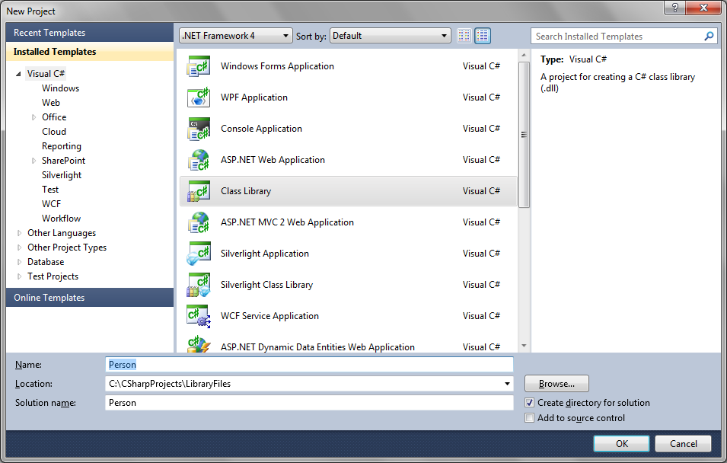
Using Visual Studio to Create DLL Files

Slide 6
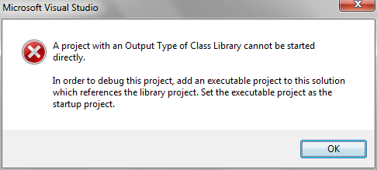
Build Instead of Run to Create DLL
Create the parent class first in order to use IntelliSense
Create the subclass class in the same way as usual, except Build instead of Run the project to create the DLL

Slide 7
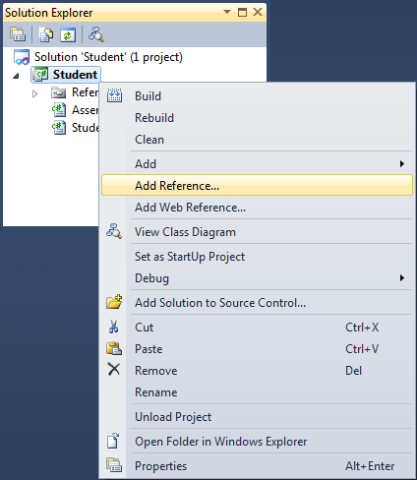
Add Reference to Base Class
One of the first things to do is Add a Reference to the Parent DLL

Slide 8
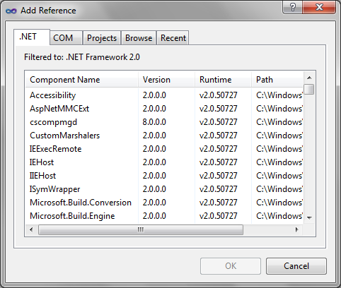
Add Reference to Base Class (continued)
Use Browse button to locate DLL

Slide 9
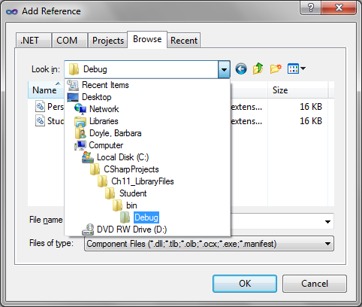
Add Reference to Base Class (continued)

Slide 10
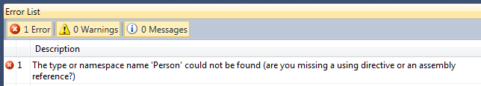
Adding a New Using Statement
In the subclass class, if you simply type the following, you receive an error message
public class Student : Person

Slide 11
Adding a New Using Statement (continued)
Notice fully qualified name
To avoid error, could type:
public class Student : PersonNamespace.Person
Better option is to add a using directive
using PersonNamespace; // Use whatever name you
// typed for the namespace for Person
After typing program statements, build the DLL from the Build option under the Build menu bar

Slide 12
Using ILDASM to View the Assembly
(ILDASM): Intermediate Language Disassembler tool
Assembly shows the signatures of all methods, data fields, and properties
One option – display the source code as a comment in the assembly
Can be run from the command line or from within the Visual Studio IDE
See http://msdn.microsoft.com/en-us/library/f7dy01k1(v=vs.110).aspx

Slide 13
Using a DLL
Explain how to use a DLL

Slide 14
Using a DLL
DLL components can be reused with many different applications
Two steps
Add a reference to the DLL components
Include a using statement with the namespace
Then declare an object of the component type(s)
Use members of the derived, base, or referenced classes

Slide 15
Demonstration/Walkthrough
Demonstrate how to create a Dynamic Link Library.
Demonstrate how to use a Dynamic Link Library.

Slide 16
Summary

