Slide 1
The Object Class

Slide 2
Overview
The Object Class
Object Class Members
Overiding ToString Method

Slide 3
The Object Class
Explain the purpose of and how to use the Object Class.

Slide 4
Object Class
All C# classes implicitly inherit from object.
The three definitions here are the same!
object is a C# keyword that is an alias for Object
Normally we use the top form.
class MyClass //Derives from System.Object
{
// etc.
}
class MyClass: Object //Derives from System.Object
{
// etc.
}
class MyClass: object //Derives from System.Object
{
// etc.
}

Slide 5
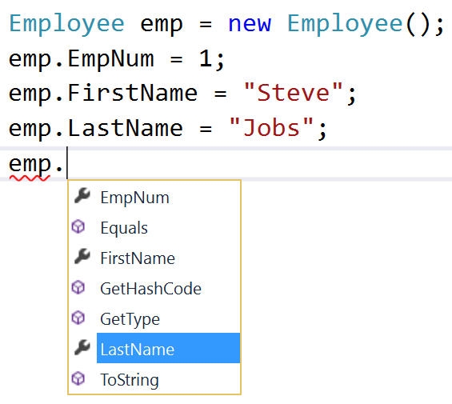
Object Class
All classes automatically inherit from Object
Object provides all classes four members:
  Equals
  GetHashCode
  GetType
  ToString

Slide 6
The Object Class Members
List and Explain Use of Object Class Members.

Slide 7
Object Class Members
Name | Description
Equals(Object) | Determines whether the specified object is equal to the current object.
Equals(Object, Object) | Determines whether the specified object instances are considered equal.
Finalize() | Allows an object to try to free resources and perform other cleanup operations before it is reclaimed by garbage collection.
GetHashCode() | Serves as the default hash function.
GetType() | Gets the Type of the current instance.
MemberwiseClone() | Creates a shallow copy of the current Object.
ReferenceEquals(Object, Object) | Determines whether the specified Object instances are the same instance.
ToString() | Returns a string that represents the current object.

Slide 8
GetHashCode()
Used when an object is placed in a data structure known as a map
These structures need each object to have a unique number identifying them
This function is called to implement that functionality
If you create a class that you want to use as a key for a dictionary you have to override this method
Covered in detail in Chapter 10 “Collections”

Slide 9
Equals()
This function is called whenever equality is tested between two objects.
Equality is tested when various functions or the == operator is invoked.
By default objects are equal if they point to the same object.
If you want a different test for equality you can override this method.
Discussed in more detail in Chapter 7 Operators

Slide 10
Finalize()
Called by C# garbage collection to clean up resources.
The base class System.Object Finalize method normally doesn’t actually do anything unless you override it.
Can be overridden to clean up resources that should be removed when the object is deleted.
Covered in more detail in Chapter 13 “Asynchronous Programming”

Slide 11
GetType()
Returns a System.Type object that contains information about the class including:
  Class name
  Base type
  Methods
  Properties
  Etc.
Covered in more detail in Chapter 15

Slide 12
MemberwiseClone()
Creates a shallow copy of the object and returns a reference to the new copy.
Shallow copy means that all value objects in the class will be copied to new locations. Reference objects will still point to the original.
Method is protected and cannot be called to copy external objects
Method is not virtual so you cannot override it (more on virtual in chapter 4)

Slide 13
ToString()
Quick-and-easy way to get a string representation of a class.
Example:
If you write a class you should override ToString to provide a meaningful string representing each instance object.
Console.WriteLine(point.ToString());

Slide 14
The Object Class
Explain the purpose of and how to use the Object Class.

Slide 15
Overriding ToString()
Written as a method in your class
Use override keyword
Return a string that uniquely identifies the object
public class Money
{
private decimal amount;
public decimal Amount
{
get { return amount; }
set { amount = value; }
}
public override string ToString()
{
return "$" + Amount.ToString();
}
}

Slide 16
Demonstration
Demonstrate how to use object class members.
Demonstrate how to override object class ToString method.

Slide 17
Summary
The Object Class
Object Class Members
Overiding ToString Method

