Slide 1
ADO.NET

Slide 2
Overview
Database Connections
Database Commands
Data Reader

Slide 3
ADO.NET Overview
Overview ADO.NET Technology

Slide 4
ADO.NET Overview
ActiveX Data Objects (ADO)
Library of COM components
Primarily consists of the following base classes:
  Connection
  Command
  RecordSet
  Field

Slide 5
Supported Database Types
SQL Server
Open Database Connectivity (ODBC)
OLE DB
ORACLE through their .NET provider at: http://www.oracle.com/technetwork/topics/dotnet/whatsnew/index.html

Slide 6
Namespaces
NAMESPACE | BRIEF DESCRIPTION
System.Data | All generic data access classes
System.Data.Common | Classes shared (or overridden) by individual data providers
System.Data.EntityClient | Entity Framework classes
System.Data.Linq.SqlClient | LINQ to SQL provider classes
System.Data.Odbc | ODBC provider classes
System.Data.OleDb | OLE DB provider classes
System.Data.ProviderBase | New base classes and connection factory classes
System.Data.Sql | New generic interfaces and classes for SQL Server data access
System.Data.SqlClient | SQL Server provider classes
System.Data.SqlTypes | SQL Server data types
Notes:
All the examples in this chapter access data in one way or another. The namespaces in the following table expose the classes and interfaces used in .NET data access.
Nagel, Christian; Glynn, Jay; Skinner, Morgan (2014-02-19). Professional C# 5.0 and .NET 4.5.1 (p. 920). Wiley. Kindle Edition.

Slide 7
Shared Classes
CLASS | DESCRIPTION
DataSet | This object is designed for disconnected use and can contain a set of DataTables and relationships between these tables.
DataTable | A container of data that consists of one or more DataColumns and, when populated, will have one or more DataRows containing data.
DataRow | A number of values, akin to a row from a database table or a row from a spreadsheet.
DataColumn | This object contains the definition of a column, such as the name and data type.
DataRelation | A link between two DataTable classes within a DataSet class; used for foreign key and master/detail relationships.
Constraint | This class defines a rule for a DataColumn class (or set of data columns), such as unique values.
DataColumnMapping | Maps the name of a column from the database to the name of a column within a DataTable.
DataTableMapping | Maps a table name from the database to a DataTable within a DataSet.
Notes:
ADO.NET contains a number of classes that are used regardless of whether you are using SQL Server classes or OLE DB classes.

Slide 8
Database-Specific Classes
CLASSES | DESCRIPTION
SqlCommand, OleDbCommand, and ODBCCommand | Used as wrappers for SQL statements or stored procedure calls. Examples for the SqlCommand class are shown later in the chapter.
SqlCommandBuilder, OleDbCommandBuilder, and ODBCCommandBuilder | Used to generate SQL commands (such as INSERT, UPDATE, and DELETE statements) from a SELECT statement.
SqlConnection, OleDbConnection, and ODBCConnection | Used to connect to the database, this is similar to an ADO connection. Examples are shown later in the chapter.
SqlDataAdapter, OleDbDataAdapter, and ODBCDataAdapter | Used to hold select, insert, update, and delete commands, which are then used to populate a DataSet and update the database. Examples of the SqlDataAdapter are presented in this chapter.
SqlDataReader, OleDbDataReader, and ODBCDataReader | Used as a forward-only connected data reader. Some examples of the SqlDataReader are shown in this chapter.
SqlParameter, OleDbParameter, and ODBCParameter | Used to define a parameter to a stored procedure. Examples of how to use the SqlParameter class are shown in this chapter.
SqlTransaction, OleDbTransaction, and ODBCTransaction | Used for a database transaction, wrapped in an object.
Notes:
In addition to the shared classes introduced in the previous section, ADO.NET contains a number of database-specific classes. These classes implement a set of standard interfaces defined within the System.Data namespace, enabling the classes to be used in a generic manner if necessary. For example, both the SqlConnection and OleDbConnection classes derive from the DbConnection class, which implements the IDbConnection interface. The following table lists the database-specific classes:
Nagel, Christian; Glynn, Jay; Skinner, Morgan (2014-02-19). Professional C# 5.0 and .NET 4.5.1 (p. 921). Wiley. Kindle Edition.

Slide 9
Database connections
Explain how to open and use database connections.

Slide 10
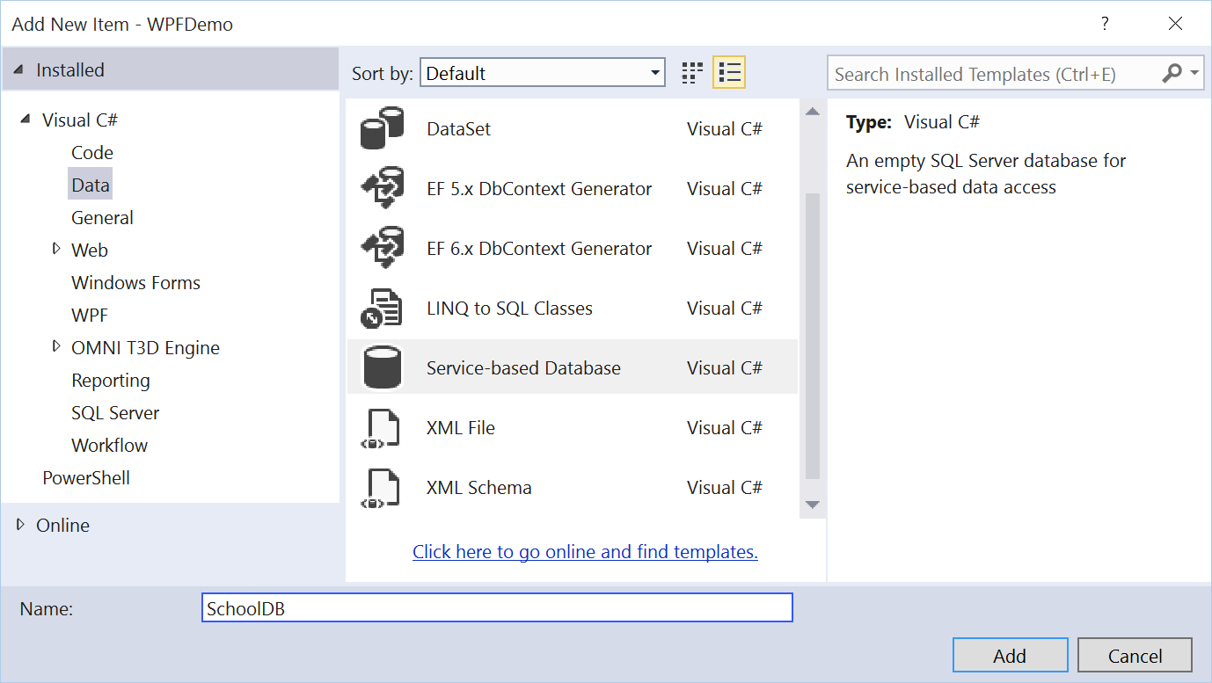
Creating a Database
You can add a database using add new item.
Service-based Database = SQL Server Database.

Slide 11
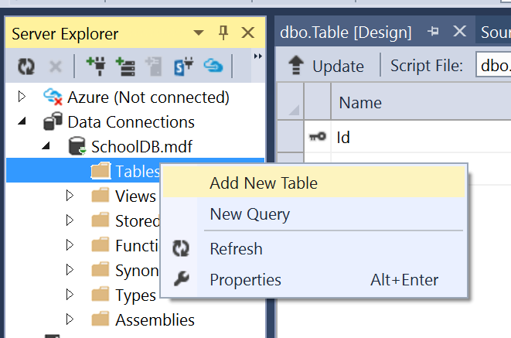
Visual Studio provides a database management tool.

Slide 12
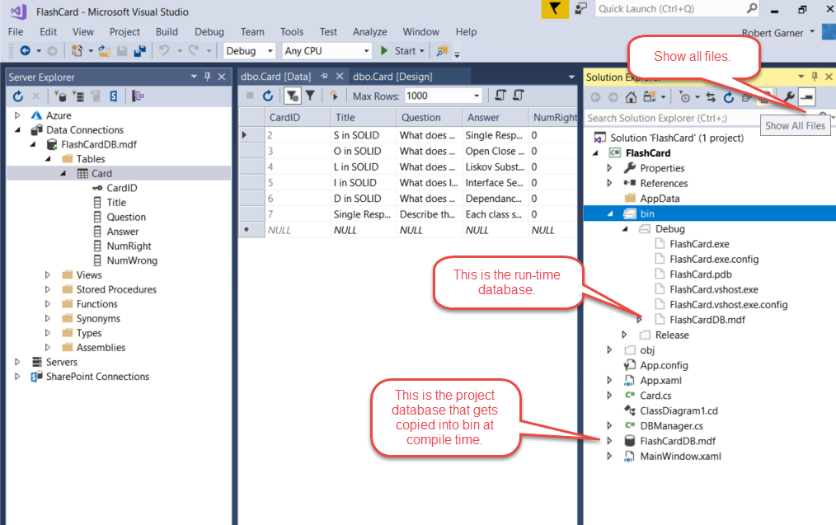
Where is my database?

Slide 13
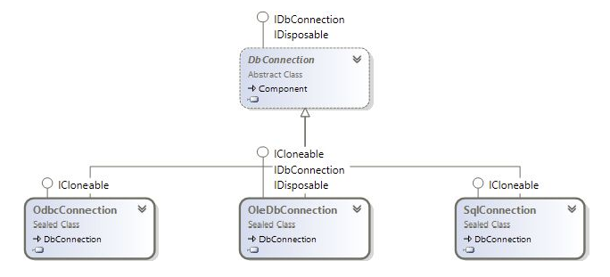
Database Connections
You need a connection string to connect to a database.
The following classes are used to create a connection:

Slide 14
Database Connection Syntax
using System.Data.SqlClient;
string source = "server =(local);" +
"integrated security = SSPI;" +
"database = Northwind";
SqlConnection conn = new SqlConnection(source);
conn.Open();
// Do something useful
conn.Close();
Workflow:
Use System.Data.SqlClient namespace
Build a string with information you need for connection string
Instantiate an SqlConnection
Open the connection
Work with database
Close connection

Slide 15
Connection String Format
"server =(local);"
Denotes the database server to connect to.
SQL Server permits a number of separate database server instances to be running on the same machine.
Here, you are connecting to the default SQL Server instance.
If you are using SQL Express, change the server part to server =./ sqlexpress.

Slide 16
Connection String Format
"integrated security = SSPI;"
This uses Windows Authentication to connect to the database, which is highly recommended over using a username and password within the source code.

Slide 17
Connection String Format
"database = Northwind";
This describes the database instance to connect to
Each SQL Server process can expose several database instances.
Learn more about connection strings at: http://www.connectionstrings.com/

Slide 18
Managing Connection Strings
Hard coding connection strings each time you use the is generally a bad idea
What happens if you need to change it?
You would have to change it everywhere!

Slide 19
Configuration Files
C# applications normally have an XML configuration file called app.config or web.config.
You can save your connection strings in this format:
<configuration>
…
<connectionStrings>
<add name ="Northwind"
providerName ="System.Data.SqlClient"
connectionString ="server =( local); integrated security = SSPI; database = Northwind"/>
</connectionStrings >
</configuration>

Slide 20
Accessing Configuration File
From Code
ConfigurationManager class provides access to items in the configuration file.
XML tags in the config file become properties in the ConfiguraitionManager class.
DbProvider class automates process of picking correct connection type.
If you know database type you can omit this and just open the right type of connection
using System.Configuration;
using System.Data.SqlClient;
using System.Data.Common;
private DbConnection GetDatabaseConnection (string name )
{
ConnectionStringSettings settings = ConfigurationManager.ConnectionStrings[name];
DbProviderFactory factory = DbProviderFactories.GetFactory(settings.ProviderName);
DbConnection conn = factory.CreateConnection();
conn.ConnectionString = settings.ConnectionString; return conn;
}

Slide 21
Using Connections Efficiently
Databases can have only a limited number of connections open at one time.
It is, therefore, important to keep connections open the minimum amount of time possible.

Slide 22
try… catch… finally
Use the catch block to catch any SqlExceptions
SqlExceptions can include:
  Database not available
  No available connections
  Etc.
Placing conn.Close() in the finally block ensures the connection will be closed whether or not there is an exception.
try
{
// Open the connection
conn.Open();
// Do something useful
}
catch ( SqlException ex )
{
// Log the exception
}
finally
{
// Ensure that the connection is freed
conn.Close();
}

Slide 23
Using directive
The using statement ensures that the object created in it will have it’s dispose method called if anything happens.
In the case of a connection, the connection objects dispose method will close the connection
Using is, therefore, another way to ensure a connection is closed!
string source = "server =( local);" +
"integrated security = SSPI;" +
"database = Northwind";
using (SqlConnection conn = new SqlConnection (source))
}
// Open the connection
conn.Open ( );
// Do something useful
}

Slide 24
Combination
You can, and probably should, combine both methods
try
{
using (SqlConnection conn = new SqlConnection(source))
{
// Open the connection
conn.Open();
// Do something useful
// Close it myself
conn.Close();
}
}
catch (SqlException ex)
{
// Log the exception
throw;
}

Slide 25
Database Commands
Explain how to use database commands.

Slide 26
Commands
ADO.NET provides you the capability to send SQL commands to databases and retrieve results.

Slide 27
Command Syntax
Use SqlCommand class to create a command by calling it’s constructor and passing in:
  A string with the SQL command
  An SqlConnection object
string select = "SELECT ContactName, CompanyName FROM Customers";
SqlConnection conn = new SqlConnection(source);
conn.Open();
SqlCommand cmd = new SqlCommand(select, conn);

Slide 28
Types of Commands
COMMANDTYPE | EXAMPLE
Text (default)
StoredProcedure
TableDirect
String select = "SELECT ContactName FROM Customers";
SqlCommand cmd = new SqlCommand(select, conn);
cmd.Parameters.AddWithValue("@CustomerID", "QUICK");
SqlCommand cmd = new SqlCommand("CustOrderHist", conn);
cmd.CommandType = CommandType.StoredProcedure;
cmd.Parameters.AddWithValue("@CustomerID", "QUICK");
OleDbCommand cmd = new OleDbCommand("Categories", conn);
cmd.CommandType = CommandType.TableDirect;
Only valid for OleDb

Slide 29
Adding Parameters
If you need to add a parameter for a SQL statement it may be tempting to use string concatenation:
Don’t do it! This introduces opportunity for SQL Injection.
Use the AddWithValue method to add SQL Parameters to your command.
String strCustID = Console.Readline();
String select = "SELECT ContactName FROM Customers WHERE CustomerID = " + strCustID;
SqlCommand cmd = new SqlCommand(select, conn);
String select = "SELECT ContactName FROM Customers WHERE CustomerID = @CustomerID";
SqlCommand cmd = new SqlCommand(select, conn);
cmd.Parameters.AddWithValue("@CustomerID", strCustID);

Slide 30
Executing Commands
ExecuteNonQuery – Executes the command but does not return any output.
ExecuteReader – Executes the command and returns a typed IDataReader
ExecuteScalar – Executes the command and returns the value from the first column of the first row of any result set
ExecuteXmlReader – Executes the command and returns an XmlReader object, which can be used to traverse the XML fragment returned from the database

Slide 31
ExecuteNonQuery()
Commonly used for UPDATE, INSERT, or DELETE statements (None of which return values).
static void ExecuteNonQuery()
{
string select = "UPDATE Customers " +
"SET ContactName = 'Bob' " +
"WHERE ContactName = 'Bill'";
SqlConnection conn = new SqlConnection(GetDatabaseConnection());
conn.Open();
SqlCommand cmd = new SqlCommand(select, conn);
int rowsReturned = cmd.ExecuteNonQuery();
Console.WriteLine("{0} rows returned.", rowsReturned);
conn.Close();
}

Slide 32
ExecuteReader()
Returns an ExecuteReader object that can be used to iterate through the records returned from your query.
static void ExecuteReader()
{
string select = "SELECT ContactName,CompanyName FROM Customers";
SqlConnection conn = new SqlConnection(GetDatabaseConnection());
conn.Open();
SqlCommand cmd = new SqlCommand(select, conn);
SqlDataReader reader = cmd.ExecuteReader();
while (reader.Read())
{
Console.WriteLine("Contact: {0,-20} Company: {1}",
reader[0], reader[1]);
}
}

Slide 33

Ouput

Slide 34
Data Reader
Explain how to use a data reader.

Slide 35
Data Reader
Simplest and fastest way to read data.
Can not directly instantiate a DataReader!
A SqlCommand object returns a DataReader after the SqlCommand.ExecuteReader() method is called.
SqlCommand cmd = new SqlCommand(select, conn);
using (SqlDataReader aReader = cmd.ExecuteReader())
{
while (aReader.Read())
{
Console.WriteLine("'{0}' from {1}", aReader.GetString(0), aReader.GetString(1));
}
aReader.Close();
}
Returns a SqlDataReader object!

Slide 36
Accessing Data from DataReader
You can use any of these methods:
object o = aReader[0];
object o = aReader["CategoryID"];
string s = aReader.GetString(0);
double num = GetDouble(0);
int num = GetInt32(0);
Etc…

Slide 37
Sql Access Speed
Different access methods have different speeds:
ACCESS METHOD | TIME FOR 1 MILLION ITERATIONS
Method call – reader.GetInt32(0) | 38 ms
Numeric indexer – reader[0] | 59 ms
String indexer – reader["field"] | 153 ms

Slide 38
Demonstration/Walkthrough
Demonstrate how to open and use database connections.
Demonstrate how to use database commands.
Demonstrate how to use a DataReader.

Slide 39
Summary
Database Connections
Database Commands
Data Reader

