Slide 1
Week 3
FRONT END WEB DEVELOPMENT COURSE

Slide 2
Data Types
We've already seen numbers, strings, booleans, and undefined. These are 4 of the 5 basic data types, or primitives, in JavaScript. The other is null, which represents nothingness. Don't worry about null for now - we'll learn more about it down the road.
Data Types
Number
Unsurprisingly, the number type represents numbers.
42
3.14
-10
0
NaN (stands for "not a number", but is considered a number)
Infinity
-Infinity
var favouriteNumber = 42;
You can use certain methods on numbers:
> 3.14159.toFixed(2); "3.14"

Slide 3
Continue..
String
As you've seen, the string type represents text.
"hello, world!"
var greeting = "hello, world!";
You can use certain methods on strings:
> "hello".toUpperCase(); "HELLO" > "hello".charAt(2); "l" > "hello".toUpperCase().charAt(2); "L"

Slide 4
Continue..
Boolean
Booleans can only hold 2 possible values - true or false.
> 5 > 3; true > 5 > 10; false > "hello".charAt(2) === "e"; false > var enrolledAtMoringa = true; You'll discover soon just how important booleans are to programming.
Undefined
The undefined data type has only one possible value - undefined.
When declaring a variable without giving it a value (var myNumber;), JavaScript creates the variable without a value, hence undefined. Even when declaring a variable and assigning it a value at the same time (var favoriteNumber = 42;), JavaScript actually creates the variable initially without a value, temporarily giving it a value of undefined, before then assigning it the value to the right of the equals sign. This is kind of a subtle point, so don't worry too much about it at the moment.
Additionally, there are some functions and methods that do not return any value, in which case the return value is actually undefined. (You'll learn more about this when we learn how to write our own methods and functions.)

Slide 5
Continue..
Data Type Detection
It's important to understand the difference between the number 5 and the string "5". To the computer, they are two entirely different things, as illustrated by this example:
> var myNumber = 5; > var myOtherNumber = 10; > var myText = "5"; > var myOtherText = "10"; > myNumber + myOtherNumber; 15 > myText + myOtherText; "510" When we added 10 to 5 we got 15, but when we added "10" to "5" it concatenated the two strings together.

Slide 6
Continue..
Likewise, the boolean true is not the same as the string "true". In the example above, somewhat confusingly, the + operator works on both numbers and strings - just differently. Usually methods will only work on a specific data type. For example, 48432.78.toExponential(); works just fine, but trying to do "48432.78".toExponential();results in an error because there is no toExponential() method that works on a string.
Likewise, "hello".charAt(2); works, but 314159.charAt(2); does not.
We can check the data type of a variable or value as follows:
> typeof 5; "number" > typeof "5"; "string" > typeof true; "boolean" > typeof "true"; "string" > var greeting = "hello world"; > typeof greeting; "string"

Slide 7
Continue..
Data Type Conversion
Often input from a web browser will come in as a string and we will need to convert it to a number before working with it.
We can convert a string to a number by passing a string to the parseInt() function (more on functions soon):
> var inputtedAge = "45"; > inputtedAge; "45" > typeof inputtedAge; "string" > var myAge = parseInt(inputtedAge); > myAge; 45 > typeof myAge; "number" Note that if you try to use parseInt() to convert a string not actually containing a number, the result is the "number" NaN.

Slide 8
Continue..
> var name = "Andrea"; > var nonsense = parseInt(name); > nonsense; NaN If you need to go the other way around, you can convert a number to a string by calling the toString() method on the number:
> var myNumber = 42; > myNumber; 42 > typeof myNumber; "number" > var convertedNumber = myNumber.toString(); > convertedNumber; "42" > typeof convertedNumber; "string"

Slide 9
Practice - Data Types
Goal: In the Data Types lesson, we learned:
5 data types - number, string, boolean, undefined, null
Methods are generally specific to a data type
How to use typeof to check data type
How to use parseInt() and .toString() to convert between numbers and strings
Explore these different data types and their corresponding methods by completing the exercises listed below.
Warm Up
What data type is NaN? What about Infinity?
How do we tell what data type something is?
Name one way to convert something of one data type into another data type.

Slide 10
Code
Practice checking and converting data types by doing the following:
Set a variable equal to your favorite number and check the data type.
Then, create a new variable converting the previous variable to a string. Check the data type again.
Next, create a third variable, converting this string variable back to a number. Check the data type one more time.
Compare the first and third variables using === to confirm that they are equal.
Compare the first and second variables or second and third variables to confirm that they are NOT equal.

Slide 11
Functions
So far, none of the JavaScript we've written has allowed us to interact with the browser. Let’s write some now in the JavaScript console:
> alert("Hey there!"); As soon as we hit Enter, a dialog box pops up that says, "Hey there!".
alert() is something called a function. Like a method, a function is something that performs an action. Functions are different from methods because they are called by themselves, whereas methods are actions that are called on something. For example, when we call 3.5.toFixed(), we are calling the .toFixed() method on the number 3.5. When we call alert("Hey there!"), it stands by itself. Like methods, functions can take arguments. The argument above was "Hey there!"

Slide 12
Continue..
Here's another JavaScript function that takes an argument:
> prompt("What is your favorite planet?"); // I'm going to type "Earth" "Earth" Try it out: hitting Enter on the prompt() function opens a dialog box containing a box where you can enter some text.
The // in the above code sample is the start of a comment, which is text in your code that is ignored by the computer. Comments are a convenient way to leave notes to yourself or other programmers to make your code easier to read or understand. In the above example, I used a comment to let you know that I typed "Earth" in the dialog box, which is why "Earth" printed on the next line.
"Earth" prints on the next line because the prompt() function returns your response. Here's a useful way we can use a return statement:
> var mySchool = prompt("Where do you go to school?"); // I'm going to type ”Goobsan School" undefined > mySchool; ”Goobsan School"

Slide 13
Continue..
Here, we created a variable named mySchool and set it equal to whatever the user types in the box.
The return statement is a string, so we can use it in the same way that we use a string:
> prompt("Are you ready to code?").toUpperCase(); // I'm going to type "yes!" "YES!" Another built-in function that lets the browser interact with the user is confirm(), which also takes a string as an argument:
> confirm("Would you like to continue?"); // I am going to press the OK button true

Slide 14
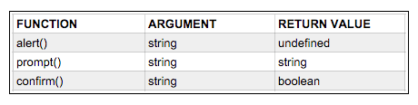
Continue..
Try it again for yourself. This time press the Cancel button and notice that it returns the false Boolean value.
It is good to be conscious of what arguments a function takes, and what data type it returns. Here is a table showing that information for the three built-in functions introduced in this lesson:
The alert() function does not return anything useful, which is fine because you would just use it to display some information to the user - it is a way of outputting information, not of collecting information. On the other hand, you would want to somehow collect the user's response to the prompt() or confirm() functions - likely by assigning the returned value to a variable as demonstrated above with var mySchool = prompt("Where do you go to school?");. That way you can actually do something with the inputted information rather than just ignoring it.

Slide 15
Practice - Functions
Goal: In the Functions lesson, we learned:
Functions perform actions in the browser
Examples of JavaScript functions are alert(), prompt(), and confirm()
Methods can be chained onto functions
Functions are an incredibly important part of programming, and you'll be using them constantly. Begin to get the hang of calling some common JavaScript functions by completing the practice exercises listed below.
Warm Up
How can we comment out code?
What happens when we run code that is commented out?
What are the differences between the alert(), confirm(), and prompt() functions in JavaScript?

Slide 16
Code
Practice using JavaScript functions:
Use alert() to pop up a dialog box with a warning for the user.
Use confirm() to ask a yes or no question.
Use prompt() to ask a question.
Save the response to the prompt() as a variable. All responses entered by a user in to a prompt input filed are saved as strings (even if the user enters 10, the value is saved as the string, "10"). Run at least 3 string methods of your choice on the string variable that you create from the prompt.
Ask a new question and save the response as a new variable and run 3 different string methods on it.

Slide 17
Parsing Integers
The most common error beginning JavaScript students experience is attempting to call functions meant for numbers on strings. This happens especially frequently because all values returned from a prompt are saved as strings. This is true even if the user enters a number into a prompt without quotation marks! Unfortunately, this is simply how JavaScript works. If we wanted to collect a value from a user with prompt(), and perform arithmetic with this value, we would need to convert it into a number with JavaScript's parseInt() function. If not, we would receive some very unexpected output.

Slide 18
CONTINUE..
Common Data Type Errors
Here's what can happen if you don't parse integers correctly. In the example below, we use prompt() to ask the user how old they are. The user enters 35. We then attempt to perform some arithmetic on age:
> var age = prompt("Enter your age: "); > age + age; 3535 Remember, all values returned from a prompt are strings! So, even though the user entered a number, age is actually equal to the string "35". Since the + operator can be used to concatenate strings age + age actually returns "3535", instead of 70.

Slide 19
CONTINUE..
Avoiding Data Type Errors
To make a string a number, we parse it using the parseInt() function like this:
> var number = parseInt("5"); > number; 5 So, to change our age from the example above into an integer, we do the following:
> var inputtedAge = prompt("Enter your age: "); > var age = parseInt(inputtedAge); > age + age; 70 Alternatively, the code does the exact same thing on a single line. Here we immediately pass the string returned by the .prompt() function as the argument to the .parseInt() function:
> var age = parseInt(prompt("Enter your age: ")); > age + age; 70

Slide 20
CONTINUE..
Additional Information
Note: The Int part of .parseInt() is short for integer, which means that it's a whole number. If we wanted to convert something into a number with a decimal, we'd use .parseFloat():
> var pi = "3.14"; > parseFloat(pi); 3.14 Floating point numbers are simply numbers with decimals. If you're parsing a whole number, use parseInt(), if you're parsing a number containing a decimal point, use parseFloat().

Slide 21
JSFiddle
In the Writing Functions lesson, we wrote all our functions in the JavaScript Console. This works for very simple functions that can be written on a single line, but it quickly becomes unwieldy as we want to write longer functions. There are a few solutions. You can write your functions in Atom and then copy & paste into the JavaScript console. Or you can try out JSFiddle This is an external link., a useful tool for experimenting with JavaScript. With JSFIddle, you can write code in the JavaScript box and then execute it by clicking the Run button on the menu bar at the top of the JSFiddle page.

Slide 22
Continue..
Type this out in the JavaScript box at JSFiddle
var saySomething = function(whatToSay) { alert(whatToSay); }; var add = function(number1, number2) { return number1 + number2; };
Writing out functions on multiple lines is clearer even with these simple functions; it will be essential when you begin writing more complex functions. Hit the Run button and ... nothing happens. This is because we have simply defined two functions and made them available for future use. We have not yet called the functions, so the code inside of them has not yet been executed. Now add this line after the other lines:
saySomething("hi"); Hit the Run button again and you should see an alert pop up.
Now add another line:
add(3, 5);

Slide 23
Continue..
Hit Run and you should still see your alert pop up, but the new line you added doesn't appear to do anything. This is because our add() method returns the result, but we don't do anything with that return value. When we run this code directly in the JavaScript console, the console automatically displays any return value. But in "real life" programming if we want to display something, we have to tell the computer to do that. We have a variety of options available to us. We could, for instance, assign the return value to a variable and then display it by calling the built-in JavaScript alert()function.
var result = add(3, 5); alert(result); Now when we hit Run we should get an alert with our result, 8. If you aren't seeing the alert, make sure that you didn't delete your add() function definition code. Let's update our little program to make use of both functions:
var saySomething = function(whatToSay) { alert(whatToSay); }; var add = function(number1, number2) { return number1 + number2; }; var result = add(3, 5); var outputText = "The sum is " + result + "."; saySomething(outputText);

Slide 24
Continue..
If desired, you could refactor those last three lines into one line:
var saySomething = function(whatToSay) { alert(whatToSay); }; var add = function(number1, number2) { return number1 + number2; }; saySomething("The sum is " + add(3,5) + "."); That refactored line calls the saySomething() function and passes it a string, which is concatenated together from 3 parts. The first part is just the string "The sum is " and the last part is just the string ".". The second part is the number 8 because that is the return value of the add() function when passed the arguments 3 and 5. Hence the concatenated string: "The sum is 8."

Slide 25
Writing Functions
In the last lesson, we learned how to use functions that are built into JavaScript. In this lesson, we'll learn to write our own.
Let's start by writing something simple, a function that will make an animal sound:
> function makeNoise() { alert("meow!"); } undefined Functions in JavaScript are defined by the keyword function, followed by:
The name of the function in lowerCamelCase.
A pair of parentheses. We will learn what goes inside of the parentheses in just a moment.
A pair of curly brackets.
The function code goes inside of the curly brackets.

Slide 26
Continue..
Note that we can hit Enter to insert a line break as we're writing the function because the console knows what a function should look like and will not execute any code.
We can call the function just like we called the built-in JavaScript functions: by typing the name of the function followed by parentheses. Here is how we call the makeNoise function:
> makeNoise(); undefined Every time we run makeNoise(), JavaScript will execute the code in between the curly brackets to give us an alert reading meow!. This function doesn't let us do very much, so let's make it a little more interesting:
> function makeNoise(animalSound) { alert(animalSound); } undefined > makeNoise("woof!"); undefined

Slide 27
Continue..
"woof!" in the above example is an argument to the makeNoise() function. It's data that we are passing to the function, just like the arguments we've used for methods and for predefined JavaScript functions. When we call makeNoise("woof!");, the function uses the value "woof!" inside of the function.
In the makeNoise() function, the value of the argument is assigned to the variable animalSound. We call this variable, animalSound, a parameter. Parameters and arguments are not the same thing: the parameter will take on the value of an argument. You can think of parameters as placeholders for arguments.
Let's take a look at another, more complex example:
> function subtract(firstNumber, secondNumber) { return firstNumber - secondNumber; } undefined > subtract(5,4); 1

Slide 28
Continue..
Notice that when we call subtract, the word undefined does not print on the next line. That's because we defined a return statement for the function as firstNumber - secondNumber. The return statement is what prints on the line after we call the function. When we don't define a return statement, the return statement is technically undefined, which is why undefined prints to the console.
We can use variables with functions, too. Let's look at one more example to illustrate the subtleties between arguments and parameters:
> function add(number1, number2) { return number1 + number2; } undefined > var five = 5; undefined > var six = 6; undefined >add(five, six); 11

Slide 29
Continue..
Let's step through what's going on here.
We create a function named add that takes two parameters, number1 and number2, and returns the sum of the two numbers
We create a variable named five with the value of 5
We create a variable named six with the value of 6
We call the add function and pass in five and six as the arguments
The add function runs, with number1 taking on the value of 5 and number2 taking on the value of 6
The add function returns the sum of five and six
There is another syntax used to define functions in JavaScript that you may run into:
var add = function(number1, number2) { return number1 + number2; }
Declaring a function like this is known as a function literal or function expression, whereas declaring a function like we do earlier in the lesson is called a function statement. There is a functional difference between the two, but it is subtle, and beyond the scope of this course. If you're interested in reading more about the difference, feel free to check out the documentation
Mozilla Developer Network or this post on JavaScript Weblog.

Slide 30
Practice - Writing Functions
Goal: In the previous lesson, we learned:
Arguments to functions can be assigned to variables called parameters
The return keyword tells JavaScript to return the result from the line of code
Don't abbreviate variable names because it can get confusing after time has passed
Begin familiarizing yourself with writing custom functions in JSFiddle by completing the exercises detailed below.
Warm Up
How do we call a function?
What is a parameter, and how do we provide one to a function?
When do we need to parse integers?
What is a return value? How do we tell our functions what value to return?
What method is responsible for parsing integers?

Slide 31
code
Write a custom function for each of the following prompts. Then, call the function providing the necessary parameters to see if your function successfully returns the correct value. And don't forget to parse integers when necessary!
Take somebody's name and say a greeting to them.
Write a function to subtract two numbers.
Now a function to multiply two numbers. Then create a new function called threeTimes to multiply three numbers together.
Now write one to divide two numbers. Then write a new function called remainder to find the remainder of two numbers.
Prompt the user to enter their age, another prompt to enter their name and another prompt to enter their favorite food. Pass these as arguments to a function that returns a sentence combining all of this information. Then display the returned string with an alert.

Slide 32
Business and User Interface Logic
Well-organized code is easier to debug, it appears more professional, and is easier to revisit later. Writing organized code is a highly-valued skill in the programming field. When working on a team, you'll often collaborate with other developers. Clean code is easier for others to understand and contribute to. Before we begin writing more complex JavaScript, let's make sure we understand how to organize our code using best, most professional practices from the very beginning.
One of the most important organizational rules to follow is keeping what is known as your user interface and business logic separate. We haven't written any user interface logic yet, but we will in upcoming lessons. In this lesson we'll explore what user interface and business logics are, and what each handles.

Slide 33
Continue..
User Interface and Business Logics
Consider a basic calculator application. Its code falls into two categories: code that performs calculations, and code responsible for interacting with the user.
The code that handles arithmetic is the back-end, or business logic. It's the 'inner workings' of the application that performs calculations and returns a value. It's what takes the numbers 4 and 5, adds them together, and arrives at 9. The functions we've explored so far are all back-end logic.
The code that handles interacting with user is the front-end or user interface logic. It retrieves information from the user and provides it to the business logic to calculate. While buttons on a calculator may be labeled with numbers, they're just visual buttons. User interface logic is what translates clicking on this area of the page:

Slide 34
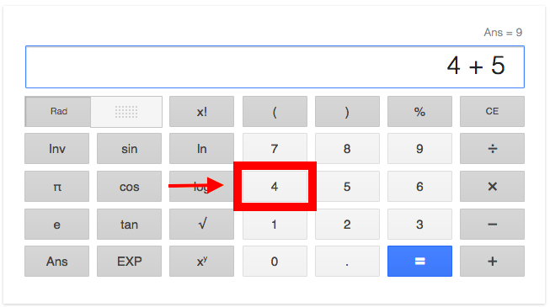
Continue..

Slide 35
Continue..
... into the number 4. After all, we cannot perform addition on buttons, but you can perform addition on numbers. The user interface logic registers that the user has pushed the button labelled "4". It then provides the number 4 to the back-end logic where we may perform calculations with it.
Let's say we also press the buttons labelled "+" and "5". The user interface logic also translates these interactions into the number 5 and recognizes it will need a method for addition. The back-end logic then adds the numbers 4 and 5 together and returns 9. The front-end/user interface logic can then display this result to the user:

Slide 36
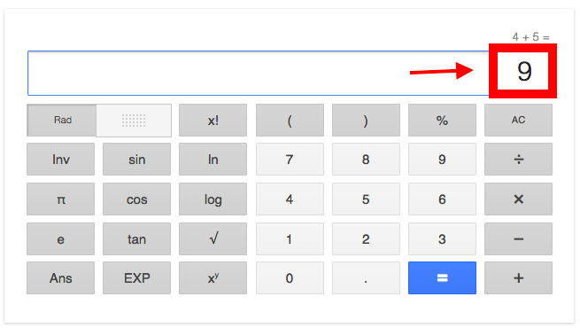
Continue..

Slide 37
Continue..
User interface/front-end logic handles interacting with the user; including displaying or gathering information. The business/back-end logic handles calculating or manipulation information 'behind the scenes'.
Separation of Logic
Remember, we want to write clean, well-organized code. Because user interface and business logics have separate purposes, their code should always be separate. So far, we've only written business logic, so we don't have much to worry about. But keep this rule in mind as we begin to explore user interface logic with jQuery in the coming lessons.
Also, it's okay if everything we discussed isn't entirely clear right now. Just understand the basic differences between these two logics and know they should be separate. Throughout the week we will see what this actually looks like in practice. By keeping this basic information in mind before we write more complex JavaScript, you'll learn the most professional practices from the very beginning!
You may check out this blog by Treehouse
for more information on front-end vs back-end in the context of web development.

Slide 38
Calculator: Business Logic
Now that we can write custom JavaScript functions, let's create a simple calculator application! We'll begin with the back-end, or business logic, and focus first on creating the ability to add numbers together. We'll later include subtraction, multiplication and division, and later add the user interface, or front-end logic.
Because we've not yet learned about user interface/front-end logic, the difference between front-end logic and back-end logic (or business and user interface logics) might not feel very clear. This is okay! For now, simply know that what we're creating here is business, or back-end logic because it handles the core functionality and computations of the application. In the future we'll learn about jQuery and creating user interfaces, and we'll revisit the differences between the two types of logic.
Let's write the whole thing in JSFiddle first, then we'll transfer it into our own project.

Slide 39
Continue..
Defining an Addition Function
We've already written an add() function, so let's use that as a starting point. Clear out your JSFiddle JavaScript box and put in just your custom add() function:
var add = function(number1, number2) { return number1 + number2; };
Add in a line at the bottom of your JSFiddle script, below the function definition. This line will call our add() function, passing it two arguments. The return value from that function is immediately passed to JavaScript's built-in alert() function. When the script is run, it should pop up a dialog box with the value that the add() function returns when passed those two arguments.
var subtract = function(number1, number2) { return number1 - number2; };
alert(subtract(10,5));

Slide 40
Continue..
Gathering User Input
Now we have a simple (addition-only) calculator, but it isn't very useful because we have to go in and modify the code every time we want to do a new calculation. Let's add in the ability to collect input from the user. Remember that we can collect input through the built-in prompt() function, which takes a string as an argument and returns a string containing the user's input.
var add = function(number1, number2) { return number1 + number2; }; var number1 = prompt("Enter a number:"); alert(number1);
Not very exciting. All we did was echo back to the user what they entered. But let's ask for two inputs and then use them as arguments to our function.
var add = function(number1, number2) { return number1 + number2; }; var number1 = prompt("Enter a number:"); var number2 = prompt("Enter another number:"); alert(add(number1, number2));

Slide 41
Continue..
Parsing Integers
Oops. We have the problem we previously encountered where the prompt() function returns strings, so the + operator we use inside of our add() function concatenates the two strings together rather than doing what we want. Because our add() function expects numbers as arguments rather than strings, we must convert the inputs into numbers before calling our add() function.
var add = function(number1, number2) { return number1 + number2; }; var number1 = parseInt(prompt("Enter a number:")); var number2 = parseInt(prompt("Enter another number:")); alert(add(number1, number2);
Now we're getting somewhere! In the next exercise, you'll add in support for subtraction, multiplication and division, but first let's move this code into a project so that we can save it and build on it without having to use JSFiddle. Do not exit JSFiddle yet. In the next lesson we'll migrate the code we've created here in JSFiddle into a new project directory in Atom.

Slide 42
Practical:Calculator Business Logic
Goal: Continue to practice writing JavaScript functions by beginning the business logic for a calculator app. Eventually, we'll add user interface logic too, and familiarize ourselves with the differences between code for each, and how to keep them separated and organized.
Warm Up
What is the difference between business and user interface logic?
What's another word for business logic? What about user interface logic?
How do you provide a function multiple arguments?

Slide 43
Code
Calculator
Follow along with the previous lesson to begin building a calculator app. Once you've written the code detailed in that lesson, create a project and migrate your code from JSFiddle into Atom by doing the following:
Create a calculator project folder on your computer.
Initialize a git repository in your newly created project folder.
Create js and css folders in your project folder.
Create an empty scripts.js file in your project's js subdirectory.
Copy the code from your JSFiddle into your scripts.js file to save it.
Create an HTML file in your project directory and include in it a link to your scripts file: <script src="js/scripts.js"></script> (see below for example HTML file)
Add a README.md file.
Add everything to your local git repository and commit the changes.
Create a calculator repository on GitHub and push your project to GitHub.

Slide 44
Continue..
Example HTML file:
<html> <head> <title>Calculator</title> </head> <body> <h1>Calculator</h1> <script src="js/scripts.js"></script> </body> </html> Example javascript file:
js/scripts.js
var add = function(number1, number2) { return number1 + number2; }; var number1 = parseInt(prompt("Enter a number:")); var number2 = parseInt(prompt("Enter another number:")); var result = add(number1, number2); alert(result);

Slide 45
Continue..
If you open your HTML file in the web browser, it should run your code just like it did on JSFiddle; popping up prompt boxes for input and then an alert with the calculated result. If this isn't working, check that you correctly link to your scripts.js file and that your scripts file includes both the add() function and code that actually calls that function. If something on your page isn't working right, an excellent initial troubleshooting step is to check the JavaScript Console to see if there are any helpful error messages that might point you in the right direction.
Next, create functions to subtract, multiply, and divide. Verify that all four work by changing the line near the bottom of the scripts.js (currently reads var result = add(number1, number2);) to call different functions. For now, you must manually change that line to choose between operations. In upcoming lessons we'll build a user interface for our calculator so that the user can choose between addition, subtraction, multiplication and division. Do not build out the user interface yet. For now, just focus on the business logic.
Additional Custom Functions Practice
(You can do these in JSFiddle)
Write a function that calculates body mass index (BMI) using two arguments. Then write another function that prompts the user for their height and weight, uses the BMI function and alerts the user of their BMI. Click here
for information on BMI calculation. Write a function that converts temperature between Celsius and Fahrenheit. Click here. for information on temperature conversion. Write functions to be used by a cooking app that converts between units. For example, a function that converts gallons to liters. Create a project for this like you did for the calculator so that you can return and build a front-end for this later.

Slide 46
Continue..
Further Exploration
If (and only if) you finish today's lessons and exercises with time to spare, spend the rest of your day exploring the following additional content. Do not worry about mastering regular expressions - remember that the goal for today is to practice using JavaScript.
Regular Expressions
Regular Expressions are search strings used to locate and manipulate content that matches a particular pattern. Here is an example of a variable set to a regular expression:
var sample_regex = /goobsanschool/gi

Slide 47
Continue..
The characters between the / slashes represent the regular expression. The characters following the regular expression, gi, are modifiers. The g stands for "global" and the "i" stands for case-insensitive. Let's try it out:
Go to Regular Expressions 101
In the Test String area, add this string: This is a big ol' long string with the word, Goobsan, in it. We'll also add school, School, SCHooL and SchOOL just for searching fun.
In the Regular Expression fields, add " GoobsanSchool " between the slashes / GoobsanSchool /.
Notice that all lowercase GoobsanSchool appears in blue in the Test String area. This indicates a match with the pattern of the regular expression.
Try adding the i modifier. What happens?
Try adding the g modifier now. What happens?
To learn all of the characters used when creating regular expressions, visit the MDN documentation
or just experiment on the Regex101 site paying attention the explanation area for what is happening. To use regular expressions to find and replace text that matches patterns, try using the built-in JavaScript method, .replace(). Here's an example from MDN that you can try in JSFiddle:
var str = 'Twas the night before Xmas...'; var newstr = str.replace(/xmas/i, 'Christmas'); alert(newstr); To practice how regular expressions create patterns, see how far you can get in the Regex Crossword

Slide 48
Control Flows
If you think about what we've been doing so far, we've been writing instructions for computers. That's all programming really is a list of instructions for computers. The main difficulty of being a developer is translating our ideas in human-speak into ideas in computer-speak.
In this lesson, we will start to learn how we can ask JavaScript to think like us and make decisions like us.
Let's start with human-speak. Many decisions we make everyday boil down to this sentence in some form:
"If something is true, let's do option 1, or else, if it is false, let's do option 2."

Slide 49
Continue..
This sentence looks fairly similar when we write it with JavaScript. See for yourself:
var enoughSleep = true; if (enoughSleep) { console.log("I'm ready to go!"); } else { console.log("I need a nap."); }
This code is called an if/else statement or branching. Here's how it works. If the variable enoughSleep is true, JavaScript will run the first code block and print "I'm ready to go!" to the console. Otherwise (else), the other code block will run and "I need a nap." will print.

Slide 50
Continue..
if statements are made of the keyword if, followed by a condition in parentheses. The condition must evaluate to either true or false. If the condition is true, then the code block following the condition is executed. Otherwise, JavaScript moves on. The else block does not need a condition because it acts as a catch-all for the if statement - the code inside of the else block will run if the if condition is false.
In general, JavaScript code runs from top to bottom, kind of like a car driving straight down the road. When the car encounters an if statement, it is like encountering a split in the road. You can't take both paths - if the condition is true, the car turns down the path and the if code runs; otherwise, the car keeps going down its current path and the else code runs.
The if condition must evaluate to either true or false - this means that we can use an expression in the parentheses. It does not need to be a single variable like in the previous example. if/else statements are even more powerful when we use comparison operators (for example, greater than > and less than <), like this:

Slide 51
Continue..
> var temperature = 30; < undefined > if (temperature < 20) { console.log("Don't forget a jacket!"); } else { console.log("Keep cool today!"); }
In the code above, we create a variable named temperature and set it equal to 30. Then we write our if/else statement: If the value of temperature is less than 20, print "Don't forget a jacket!". Else (that is to say, if the temperature is greater than 20), print "Keep cool today!". Because temperature equals 30, the message "Keep cool today!" logs to the console.

Slide 52
Continue..
What if we want more conditions? After all, there is a huge range of temperatures to prepare for, not just hot and cold! We can add another condition with else if. Let's see how it fits into our current else if statement:
if (temperature < 15) { console.log("Don't forget a jacket!"); } else if (temperature < 25) { console.log("Have a nice day :)"); } else { console.log("Keep cool today!"); }

Slide 53
Continue..
else if is just like an alternate if. It also has a condition to be checked in parenthesis next to it, and if that condition is true then the code in curly braces following it runs. But else if's condition is only checked when the if condition has already been found to be false.
For example, let's set our temperature variable equal to 23 and run the code. When JavaScript hits the first if statement, it checks the condition. Is temperature less than 15? No: temperature is 23, so the condition is false. JavaScript proceeds and skips the code block containing console.log("Don't forget a jacket!") and goes to the next condition in the else if. Is temperature less than 25? Yes, 23 is less than 25. The condition evaluates to true and the code block with the line console.log("Have a nice day :)"); runs. Then the if statement is complete and JavaScript moves on and skips the else code block.

Slide 54
Continue..
We can add as many else if statements as we like. For example, let's say we want to print a warning when the weather is extremely cold:
if (temperature < 0) { console.log("Brr! Don't freeze out there!"); } else if (temperature < 15) { console.log("Don't forget a jacket!"); } else if (temperature < 25) { console.log("Have a nice day :)"); } else { console.log("Keep cool today!"); }
We step through this sequence in the same way: first we check if temperature is less than 0, and if it's not, then we check if it's less than 15, and so on.

Slide 55
Control flows practice
Warm Up
Goal: In the Control flows we have learnt different control flows techniques such as if and else statements:
Describe the if and if-else statements. What types of expressions can be used as conditions?

Slide 56
code
Even Number calculator
Using the if and else statement in JSfiddle, Create a simple calculator that calculates if a number is even or not.
Cafe
Using if and else statements, create a simple program that prompts you to choose between coffee and tea.
Cafe Reloaded
Basing on the previous practice question on cafe, build on it by including more foods where the program program prompts you to choose a food variety. Here is an example of how the program should work: < What food would you like to be served?
> Burger
<Here is some burger for you. Anything else?
> No <Thanks you for choosing us
Grader
You are provided with the following grade score table,

Slide 57
Continue..
100 - 80 | A
79 - 60 | B
59 - 40 | C
39 - 20 | D
20 - 0 | E
Using JSFiddle This is an external link., Write a program that calculates the following grades. Pass a score then calculate the score using control flows

Slide 58
Logical Operators
So far, we've been able to translate some of our decisions into code with comparisons such as "Are these things equal?" with === and "Is this thing greater than this other thing?" with >.
We can make our decisions more complex by adding multiple comparisons to the mix. If we want to say, "Both of these things" or "Either of these things", we can translate those statements into JavaScript with logical operators.
Here are different logical operators and what they mean.
&&: both of these things must be true
||: either of these things may be true

Slide 59
Continue..
For example, let's expand on the example from the previous lesson and turn it into an application that will tell us what to wear based on the weather. We'll start with the first else if, which tells us to wear a jacket if the temperature is low. We should wear a jacket if it's cold out - but we should also wear one if it's raining.
Let's also create a variable named raining for whether or not it's raining. Because there are two possibilities (either it's raining or it's not raining), raining will be a boolean.

Slide 60
Continue..
var temperature = 10; var raining = true; if (temperature < 0) { console.log("Brr! Don't freeze out there!"); } else if (temperature < 15 && raining === true) { console.log("Don't forget a jacket!"); } else if (temperature < 25) { console.log("Have a nice day :)"); } else { console.log("Keep cool today!"); }

Slide 61
Continue..
When we run this code, "Don't forget a jacket!" print to the console because temperature is less than 15, and raining is true.
Change the temperature to 16 and run the code again. The code skips all the way to the else statement to print "Keep cool today!". However, I think that "Don't forget a jacket!" is still an appropriate message for this weather - it should print if temperature is less than 15 _or_ if it's raining. Here is how we would use the **OR** operator to accomplish this (I've used an ellipsis ... in the following code snippet to make the code sample shorter):

Slide 62
Continue..
} else if (temperature < 15 || raining === true) { console.log("Don't forget a jacket!"); }
We can add as many statements with logical operators as we need. For example, we can add a condition to make sure that the message "Don't forget a jacket" will not print if the temperature is greater than 25:
} else if (temperature < 15 || raining === true) { console.log("Don't forget a jacket!"); }

Slide 63
Continue..
Note: if/else statements check the "true-ness" or "false-ness" of an expression, so we can simplify the condition like this:
} else if (temperature < 15 || raining) { console.log("Don't forget a jacket!"); }
There's no need to say raining === true because raining by itself evaluates to true.
There's one more operator that we haven't mentioned: the ! (pronounced "bang") or not operator. To see how it works, let's pretend that we want to change the above code to execute if raining === false. Here's how we could use ! to say the same thing:

Slide 64
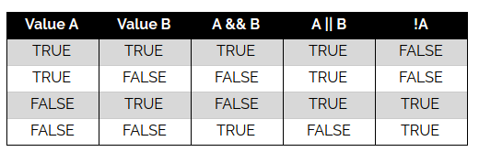
Continue..
} else if (temperature < 15 || ! raining) { console.log("Don't forget a jacket!"); }
Here is a table of various operations with logical operators for reference:

Slide 65
Practice - Control Flows with Logical Operators
Goal: Now that we have learned how to use control flows with if/else statements, and how to make logical decisions using &&, ||, and !, let's put them together to further our understanding of both and make even more complex decisions.
Warm Up
Discuss the following with your partner:
What is the && operator and how do we use it?
What is the || and how do we use it?
What about the ! operator?
What does the following statement check for? if (apples === 1 && oranges === 1 || bananas === 2)

Slide 66
code
What Should I Wear Today?
Extend on the weather app from the previous lessons so that the user can enter information about the day's weather (temperature, is it raining, and so on), and the app tells them what they should wear.
Personality Quiz
Are you familiar with personality quizzes, where you can answer a series of questions and you learn something about your personality? Buzzfeed has plenty of examples
This is an external link.. Create a personality quiz that asks users some questions, and based on those answers, tells them something about their personality.
Example: Which pet should you get?
Question 1: "Are you introverted or extroverted?"
Question 2: "Do you like the indoors or outdoors?"
Based on these answers, the quiz could return "cat", "dog", "both", or "neither".
This is just one example - get as creative and as complicated as you want!

Slide 67
JavaScript Arrays
Until now, we've always dealt with one piece of information at a time: one number, one string, and so on. But often, we need to group things together. For example, what if we wanted to have a list of the months of the year? We'd use an array, which is just a list of things grouped together. An array looks like this:
> var months = ["january", "february", "march", "april", "may", "june", "july", "august", "september", "november", "december"];
Here are some more arrays for you to try in the JavaScript console:
[2, 5, 7, 3423, 85, 65]
["e", "p", "i", "c", "o", "d", "u", "s"]
["word", 45, "blah", 123]

Slide 68
Continue..
You can put variables and expressions in your arrays, or even other arrays:
> var variable = "I'm a variable!";
> var things = [variable, "I'm not a variable!"];
> things; ["I'm a variable!", "I'm not a variable!"]
> var numbers = [62, 62 / 2]; > numbers; [62, 31]
> var confusingAssortmentOfThings = ["string", 123, ["another string", 456], 321, "yet another string"];
> confusingAssortmentOfThings; ["string", 123, Array[2], 321, "yet another string"]

Slide 69
Continue..
(That Array[2] just means that this element of the confusingAssortmentOfThings array is itself an array containing 2 elements. More on this later.)
Just like numbers and strings, arrays have methods. Here are a couple for you to start with:
> var fruits = ["apple", "orange", "passion fruit", "kiwi"];
> fruits.pop(); "kiwi"
> fruits; ["apple", "orange", "passion fruit"] > var numbers = [1, 2, 3];
> numbers.reverse(); [3,2,1]
> numbers; [3,2,1]

Slide 70
Continue..
Note that both the .pop() and .reverse() methods change the array on which they're called. The .pop() method removes the last item from the array AND returns it. The .reverse() method reverses the order of items in the array and returns that reversed array.
We can also add elements to an array, or combine two arrays:
> var greetings = [];
> greetings.push('hi’);
> greetings.push('hello’);
> greetings; ["hi", "hello"]
> greetings.concat(['hola', 'buenos dias']);
["hi", "hello", "hola", "buenos dias"]

Slide 71
Continue..
Note that while .push() adds an element to an array, the .concat() method doesn't actually change the original array, but rather returns a new array that combines the two. The greetings array still only contains the 2 elements pushed on to it:
> greetings;
["hi", "hello"]
If you want to access an element from an array, the syntax is a bit different from anything we've seen before:

Slide 72
Continue..
> var letters = ['e', 'p', 'i', 'c', 'o', 'd', 'u', 's’];
> letters[0] "e"
> letters[4] "o"
Just like with strings, we count array elements starting with zero. So the zeroth element of the array is e, and the fourth element is o.
Note that it is conventional for array variable names to be plural, thereby making it clear that the variable refers to a collection of things rather than a single thing. Following this convention will help with debugging your own code as well as making your code clearer for others.
Check out the MDN documentation for Mutator
This is an external link. and Accessor This is an external link. methods, and experiment using these methods on your own.

Slide 73
Array Methods
Comparing Arrays
Unlike other data types we've seen so far, it is not possible to compare two arrays by using the === comparison operator. In JavaScript, two primitive data type values can be the equal. For example, "abc" is the same as any other "abc". But arrays are different - no two arrays are the same, even if they have the same elements inside.
If you need to compare the contents of two arrays, one way to accomplish this is to transform the arrays into strings using the toString() function on each and comparing the return values. This will work when the elements are all data types that we have worked with previously, such as strings, numbers, and booleans.
Try this example in the console:

Slide 74
Continue..
> var a = [1,2,3]
> var b = [1,2,3]
> a === b false
> a.toString(); "1,2,3"
> a.toString() === b.toString();
true

Slide 75
Cloning Arrays
Here is another scenario where arrays may operate differently than we expect.
Suppose we have an array, and we want to keep in its original form, but we also need to manipulate in some ways. We might have one variable hold the original array and another variable with a copy of the same array that we can change.
Try this in the console:

Slide 76
Continue..
>var originalArray = [1,2,3,4,5]
> originalArray [1, 2, 3, 4, 5]
>var cloneArray = originalArray
>cloneArray [1, 2, 3, 4, 5]
>cloneArray.push(6)
6
>cloneArray
[1, 2, 3, 4, 5, 6]
What does originalArray look like now? We haven't touched it, so we may assume it would retain its original value of [1,2,3,4,5]. But if we check it again in the console, we see:
> originalArray
[1, 2, 3, 4, 5, 6]

Slide 77
Continue..
In JavaScript, the array is stored in memory, and the two variables original_array and clone_arrayare called pointers. A pointer references an object in memory but is not the object itself. Therefore, as the array is changed, the new value is reflected in all of the variables that point to it.
The way to clone an array without simply making another pointer is to create a new variable set to a new array:
var cloneArray = originalArray.slice()
This ensures that the new array really is an entirely separate entity, instead of simply a pointer to the original array.
Additional Resources
For more details on how the slice method works, check out MDN's Javascript documentation
on the Array.prototype.slice method.

Slide 78
Practice - JavaScript Arrays
Goal: In the Arrays section, we learned:
Arrays can contain numbers, strings, variables, expressions and other arrays
Arrays have methods like .pop(), .reverse(), and .push()
How to access an element from an array
Familiarize yourself with arrays by completing the exercises below by practicing creating and manipulating arrays in the JavaScript console.
Warm Up
What is a pointer? When might we see one when working with JavaScript arrays?
How can we use square bracket notation to isolate a single element in an array? What does this notation look like?
What is the difference between .pop() and .push()?
What types of objects can be placed into a JavaScript array?

Slide 79
code
Play around with arrays of your own by completing each of the following in the JavaScript console:
Make an array of your siblings' names or your favorite movie characters' names.
Make an array of your parents' names.
Combine these two arrays using concat().
Add your pets' names using push().
Reverse the order of the array.
Access one of your parents' names using the square bracket notation.
Update the name of one of your parents using the index and square bracket notation.
Check out methods from the MDN This is an external link. (stick to the accessor and mutator methods sections). Try at least five of them.

Slide 80
Looping in Arrays
Now that you've got the basics of arrays under your belt, let's turn to a more advanced concept: looping. Here's a very simple loop. Try it out in JSFiddle.:
var languages = ['HTML', 'CSS', 'JavaScript’];
languages.forEach(function(language) {
alert('I love ' + language + '!'); });

Slide 81
Continue..
Let's step through how this works:
Create an array of strings.
Call the forEach() method on the array.
Pass in a callback function to forEach, with a parameter called language.
Take the first element in the array, 'HTML' and assign it to language.
Pop up an alert that says you love HTML.
Repeat 4 and 5 for the other elements in languages.

Slide 82
Continue..
Adding Numbers with Loops
We can use loops for more interesting problems, too. For example, we've written code to add two numbers, but what if we wanted to add an arbitrary amount of numbers?
var total = 0;
var summands = [1, 2, 3, 4, 5];
summands.forEach(function(summand) {
total += summand; });
alert(total); // 15
We create a variable named total and set it to start out at 0. Each time through the loop we will increase its value so that this variable keeps track of the running total. The first time through the loop, the variable summand becomes 1, the second time it becomes 2, and so on.

Slide 83
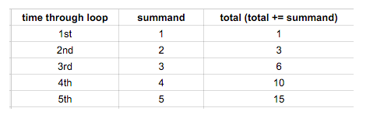
Continue..
Note: It's conventional that an array name is plural, and that the parameter to the function passed into forEach() have a singular name (e.g., summands for the array and summand for the argument to the function). But for all JavaScript cares, the array could be called summands and the argument to the function could be called apple, but that would make it slightly more difficult for other developers to pick up your code. Remember, we want to write clean, professional, easy-to-understand JavaScript.
You might be getting tired of me pointing out the indentation, but I'm going to do it again because it's something worth taking your time to do right: everything inside the forEach() method is indented two spaces, because it's code that's inside the callback function, and everything in a function gets indented so that it's obvious what's in the function and what's outside it.

Slide 84
Practice - Looping in Arrays
Goal: In the Looping section, we learned:
How to use a forEach() loop
Naming conventions for arrays and the parameter in a loop
As you saw, loops can be really powerful! They're an incredibly important programming concept, and we'll be using them from here on out. Begin becoming comfortable utilizing loops by completing the exercises listed below. We'll begin with several exercises in the console and then move on to creating and updating small projects.
Warm Up
If we used forEach() to loop through an array called "kittens", what should we call the parameter in the forEach() function? Why?
What does the += operator do?

Slide 85
Code
Looping Practice in the Console
Make an array of your friends' names. Loop through it and alert() a greeting to each.
Write a loop to multiply an arbitrary amount of numbers. This should look similar to the code to sum numbers from the lesson.
Additional Information
Remember: When choosing a name for the variables in your loop, remember that it is good practice to use a plural for the array and the singular form of that word for the loop.
> var languages = ['HTML', 'CSS', 'JavaScript’];
> languages.forEach(function(language) { alert('I love ' + language + '!'); });
The array is named languages and the parameter is the singular language.

Slide 86
Array Mapping
We just learned how to use the forEach() function to loop through every element of an array. Now let's briefly explore map(), a frequently-used array method that allows us to loop through every element of an array and do something to each element. Conveniently, the map() method does not actually change the array it's called on, but it returns a new transformed array.
Let's say that we want to double every number in an array. We could do it with forEach() this way:

Slide 87
Continue..
var numbers = [1,2,3,4,5]; var doubledNumbers = []; numbers.forEach(function(number) { doubledNumbers.push(number * 2); }); alert(doubledNumbers);

Slide 88
Continue..
This works fine, but by using .map() we can make the intent clearer, and our code even cleaner:
var numbers = [1,2,3,4,5]; var doubledNumbers = numbers.map(function(number) { return number * 2; }); alert(doubledNumbers);

Slide 89
Continue..
Here instead of looping through an array, we're simply saying that we want to transform one array into another. Note that the original array has not been changed:
> doubledNumbers;
[2, 4, 6, 8, 10]
> numbers;
[1, 2, 3, 4, 5]

Slide 90
Continue..
The logic inside of .map() can be as simple or as complicated as you want. Whatever you return will become the corresponding element of the new array. That is, when we say return number * 2; in the example above, we're saying that each individual element of the new array will be equivalent multiplying the corresponding element in the old array by two.
So, continuing with this example, the first element in the original array is 1. Since we're multiplying each element by 2 in the map() function, the first element in the new array will be 2. The second element in the original array is 2. So the second element in the new array will be 4, and so on.
Additional Resources
For more information, check out the map entry
in the Mozilla Developer Network's JavaScript documentation.

Slide 91
Practice - Arrays
Goal: In the Array Mapping lesson we learned how to use .map() to return a new array with some sort of manipulation or calculation performed on each element. Let's further hone our array mapping skills by completing the exercises detailed below.
Warm Up
What is a callback function? How is it different from a plain ol' everyday function?
What portion of the following code is the callback function? What does this particular callback function do? var tripledNumbers = numbers.map(function(number) { return number * 3; });
Does map() alter the array it is called upon?
Discuss with your partner when you would use forEach() and when it might be better to use map().

Slide 92
code
Complete the following in the JavaScript console or on JSFiddle:
Make an array of numbers, then use .map() to return an array containing each of the original numbers + 1.
Create an array of words. Use .map() to return an array of the same words in all uppercase.

Slide 93
Practice - forEach and Map
Goal: As we have seen, looping and mapping are powerful concepts that can manipulate large amounts of data relatively quickly. Practice each by completing the exercises below using forEach() and/or map().
Remember, understanding is the goal here. You're absolutely not expected to complete everything listed on this page. In fact, there is often intentionally more content than can reasonably be completed in a single day. (This also allows students an opportunity to later review concepts without having to repeat exercises they've previously done). Focus on understanding the concepts, not on speed.
Warm Up
What is the difference between forEach() and map(). When might you use one over another?

Slide 94
code
Groceries
Create function that allows a user to input items they need at the store, separating each item with a comma.
When the user submits their grocery list, log each item to the console on a separate line. Make sure that the commas do not display in the console log.
If you'd like to take this further, print the list in alphabetical order.
Hint: To do this, build an array of the inputted items. Read up on the string split method
This is an external link.. Explore the arrays entry This is an external link. of the Mozilla Developer Network JavaScript documentation to research what method might be used to sort arrays.
Word Play
Create a function where users may enter a sentence.
Turn that sentence into an array using the split method
This is an external link.. Then, loop through this array to build a new array out of every word in the sentence that is 3 or more characters in length. Finally, reverse the order of the new array, join This is an external link. it back together into a string, and print it to the console.

Slide 95
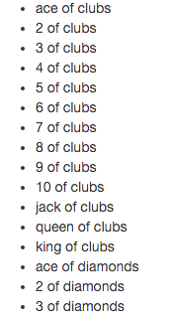
Continue..
Build a Deck
Use a forEach() loop within another forEach() loop to build an array representing a deck of cards. A deck consists of 52 cards - 13 ranks in each of 4 suits.
Then, display a list of every card in the deck. (Hint: Each element of the array should read something like "ace of spades" or "4 of hearts").
The start of your output should look something like this:

Slide 96
Continue..
Further Exploration
Filter, Reduce
Look into the Array filter
This is an external link. and reduce This is an external link. methods. Refactor some of the projects above to make use of these methods.
Word Order
Create a function that lets users input a block of text and returns a list of all the unique words and how many times they appeared.
For example, if the user inputs "hello world world", the console should show:
hello 1
world 2
If you finish, and feel comfortable with forEach() loops, try to complete the above exercise but instead order the list by the number of appearances - greatest to least. For words that appear the same amount of times, order by which word appeared first.

Slide 97
Continue..
Hint (and sneak peek at next week): Try creating and playing with an object hash and its contents in the JavaScript console:
> words = {programming: 2, fun: 5};
Object {programming: 2, fun: 5}
> Object.keys(words);
["programming", "fun"]
> words.programming
2
> words.fun 5
> words.nothing
undefined words.fun
>words.programming true

Slide 98
Continue..
Peer Code Review
Is the JavaScript business logic separate from the user interface logic?
Are variable names descriptive and easy to understand?
Is code properly indented throughout?
Are loops being used correctly? What about mapping?
Are there any loops that could instead be replaced with .map()?

Slide 99
Behaviour Driven Development (BDD)
One of the most difficult challenges facing us as developers is taking a problem we want to solve or a concept we want to realize and turning it into a set of specific programming tasks.
A common process to do this is called Behavior-Driven Development (or BDD
This is an external link.) and is used by developers across coding languages. In BDD, rather than thinking about the code first, the focus begins on the behaviors that we want to see in our final application. We identify what the program should do before determining how to make it do it.
To practice this, we'll imagine that we have been hired by a person born on February 29th. She would like to determine if any given year is a leap year (meaning it's a birthday year for her!). Here's a finished example of what she'd like:

Slide 100
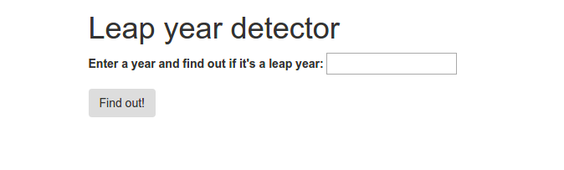
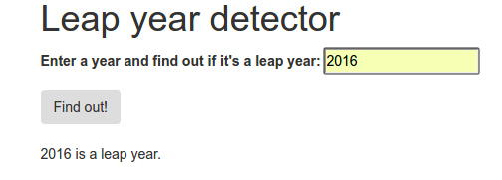
Continue..
And after hitting a leap year.

Slide 101
Continue..
Before we think about the programmatic elements, what should a leap year program do? At its most basic, it will need to be able to take a year from the user and answer true or false to the question: is this year a leap year? Our program will only be able to provide an answer once it successfully evaluates what the user provides as a year. Let's think of all of the possibilities we might get from a user and what the correct response should be for them.

Slide 102
Continue..
Specifications
Timeanddate.com offers us the 3 criteria that must be considered to determine if a year is a leap year:
The year is evenly divisible by 4;
If the year can be evenly divided by 100, it is NOT a leap year, unless;
The year is also evenly divisible by 400. Then it is a leap year.
Therefore, each time a user offers a year to evaluate, we will ultimately need to test the value against each of the leap year rules.
In BDD, our next step is to generate examples of these rules one-by-one. These examples are also known as specifications or specs. We can create a table that helps us sort out the details of the specifications for each rule using the following pieces of information:
the behavior that we'll need to write code to handle
a sample of input that would demonstrate the behavior
the expected output we'd get when the code is working correctly

Slide 103
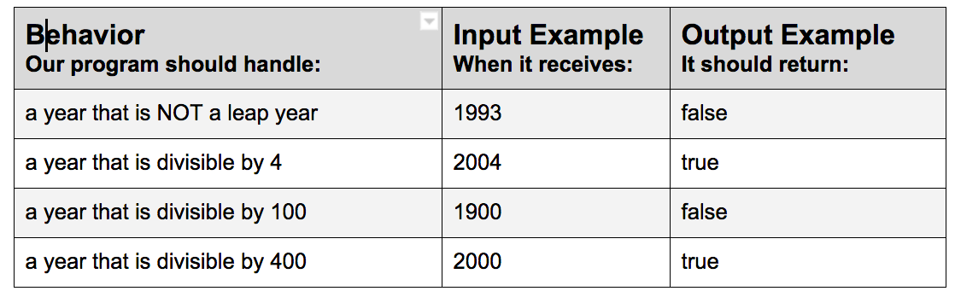
Continue..

Slide 104
Continue..
Although there are many other considerations for our final application (display, user interaction, form building, what if someone enters a letter?, etc), we will not worry about those until we have the core functionality in place. If we think of any additional functionality we need, we can add behaviors to our specification list as we go. When you code using BDD, it is good to get into the habit of making a note of all behaviors as you think of them, but staying focused on one task at a time.
Let's look at another example of specs organized on a table showing behavior, input and output.

Slide 105
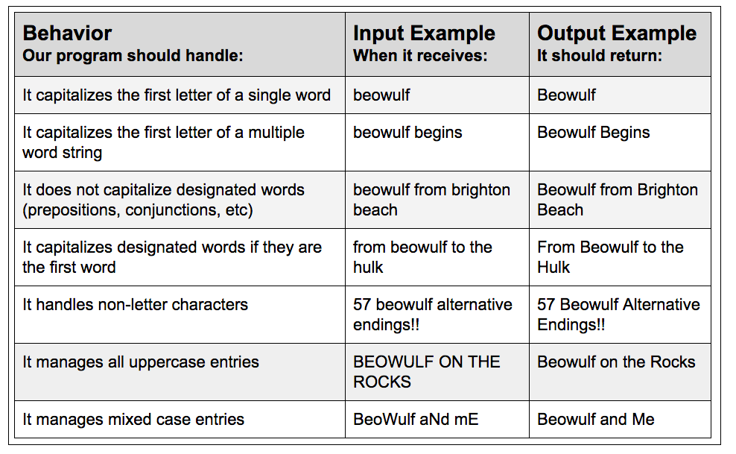
Title Case
In this example, we want to build an application that will take a user's string of words and convert them to title case - capitalizing letters like we'd find in a book title. There are a few more rules for creating title-cased words from strings than Leap Year. Let's brainstorm the first several:

Slide 106
Continue..
As we did with the leap year application, we choose the simplest first - one word gets capitalized - beowulf becomes Beowulf and go to the most complex. And as always, we may think of additional behaviors along the way: What if a user enters nothing? What about iPod or McDuff? Remember, let your brain keep brainstorming by adding new behaviors to your list but always stay focused on one specification at a time.

Slide 107
Practice - Leap Year, Pig Latin
Goal: Focus on breaking your project down into small behavior examples and coding one behavior (also known as a "specification" or "spec") at a time. Make a list of specifications with input and output examples before writing any code.
Warm Up
Pretend you have an application that counts the number of vowels in a string. This application has specs detailing each behavior it must exhibit. However, they're out of order! Reorder the following list of specs from the simplest possible behavior to the most complex behavior with your partner. Consult with other pairs, if necessary:

Slide 108
Continue..
The program recognizes vowels in a multiple-word sentence, regardless of capitalization.
Input Example: "CATS CATERED THE EVENT"
Output Example: 7
The program recognizes a single vowel in a multiple-character word.
Input Example: "cat"
Output Example: 1
The program recognizes a single vowel.
Input Example: "a"
Output Example: 1
The program recognizes multiple vowels in a single word.
Input Example: "cater"
Output Example: 2
The program recognizes a single vowel, regardless of case.
Input Example: "A"
Output Example: 1
The program recognizes all vowels in a multiple-word sentence, regardless of inconsistent capitalization.
Input Example: "CaTS CATEReD ThE EveNT"
Output Example: 7
The program ignores non-alphabetical characters, since they cannot be vowels.
Input Example: "4%"
Output Example: 0
The program recognizes vowels in a multiple-word sentence.
Input Example: "cats catered the event"
Output Example: 7

Slide 109
code
Leap Year
Follow along with the leap year lessons to build an application that identifies whether a given year is a leap year. Make each of the specs detailed in the leap year lessons "pass" (ie: your program returns the expected output for the expected input).
Specs from Leap Year Lessons
The program should return when a year is not a leap year.
Input Example: 1993
Output Example: false
The program should return 'true' for years divisible by 4, since those are leap years.
Input Example: 2004
Output Example: true
The program should return 'false' for years divisible by 100, since those are not leap years.
Input Example: 1900
Output Example: false
The program should return 'true' for years divisible by 400, since those are leap years.
Input Example: 2000
Output Example: true
All specs should be listed in the project's README.md file.

Slide 110
Continue..
Pig Latin
Write a Pig Latin translator or should we say an "igPay atinLay anslatorTray"? Read all instructions carefully before beginning.
How Pig Latin Works
First, here are the rules of Pig Latin:
For words beginning with a vowel, add "ay" to the end.
For words beginning with one or more consonants, move all of the first consecutive consonants to the end, and add "ay".
If the first consonants include "qu", move the "u" along with the "q". Don't forget about words like "squeal" where "qu" doesn't come first!
For words beginning with "y", treat "y" as a consonant.

Slide 111
Continue..
Instructions
Before writing any code, make a list of specs detailing each behavior your program will have. Start with the simplest possible behavior, and slowly move up in complexity. To get you started, the first two specs are provided below.
Have at least two other pairs check your specs before you begin coding. Ensure that each possible behavior is represented by a spec, and that they are ordered from simplest to most complex.
Place your specs (and their example inputs and outputs) in your project's README.
Create a basic function that accepts user input, and displays output. This will allow us to manually test each spec.
Slowly add business logic. Begin by focusing on the behavior outlined in your first, most simple spec. Implement the least amount of logic necessary to create this behavior.
Manually test this behaviour by inputting the example input described by the spec into your application, and confirm you receive the correct output.
Once behavior outlined by the first spec is successfully implemented, repeat steps 5 - 7 for each subsequent spec. Do not move onto the next spec until the previous one passes.

Slide 112
Continue..
Helpful Hints
When you get to consonants, don't try to solve it all at once. Instead, start with an example of a word that only has one consonant; then a word with two consonants; then a word with three; and then tackle the exceptions to the rule, like "qu" and "y". Once your application can successfully translate single words, work on translating entire sentences. The .slice() string method may also come in handy.
Specs
To get you started, below are the first two "plain English" specs:
The program does nothing to non-alphabetical characters, since they do not contain consonants or vowels.
Example Input: 3
Example Output: 3
The program adds "ay" to single-letter words beginning with a vowel.
Example Input: i
Example Output: iay

Slide 113
Further Exploration
If you are done with today's excercises, attempt the following as you explore further with regex.
Refactor with Regular Expressions
Refactor your code for the projects above using regular expressions
This is an external link.. A handy place to try using regular expressions before implementing them is at Rubular This is an external link..

Slide 114
Continue..
Bases
Binary: Write a method to convert numbers from binary to decimal. The input should be a string, and the output an integer. Decimal is the normal system we use for counting. We start at 0, increment until we reach 9, and then reset back to 0 and add another number to the left. In binary, we also start at zero, but we only increment until we reach 1. Then we reset back to zero and add another number to the left.
Here are some example of numbers in decimal and binary:

Slide 115
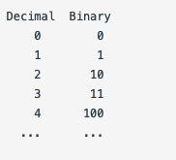
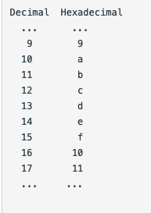
Continue..
Trinary: You get where I'm going, right?
Hexadecimal: Here's what happens after 9...

Slide 116
Continue..
If you get this far, write a method that takes two arguments: the number to be evaluated and the base you would like it to be evaluated in.
Peer Code Review
Are variable names descriptive and in lower camelCase?
Does the code have proper indentation and spacing throughout?
Are for loops being used correctly?
Are forEach loops being used correctly?
Is code broken down into plain English specs?
Do these specs accurately represent the behaviors required of the program?
Are there any additional specs you can think of?
Does the application work as expected?

Slide 117
Roman Numerals and Cryptosquare
Goal: If you have finished all of the exercises for the week, try these out for another challenge. Focus for these exercises (and all exercises going forward) on breaking your project down into small behavior examples and coding one behavior at a time. Make behavior grids before writing any code.
Warm Up
Explain what behavior-driven development is. Why is it so beneficial?
Review the specifications each partner wrote in the previous lesson and discuss the following:
Is each individual behavior listed as specific as possible? Does each represent one behavior, or multiple behaviors?
Is the simplest possible behavior listed first? If so, how do you know it's the simplest? If not, which one should come first?
How did you ensure you wrote the least amount of code possible to make each pass? What did that look like?

Slide 118
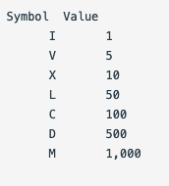
code
Roman Numerals
Write a method to convert numbers into Roman numerals. Roman numerals are based on seven symbols:

Slide 119
Continue..
The most basic rule is that you add the value of all the symbols: so II is 2, LXVI is 66, etc.
The exception is that there may not be more than three of the same characters in a row. Instead, you switch to subtraction. So instead of writing IIII for 4, you write IV (for 5 minus 1); and instead of writing LXXXX for 90, you write XC.
You also have to separate ones, tens, hundreds, and thousands. In other words, 99 is XCIX, not IC. You cannot count higher than 3,999 in Roman numerals.
Draft some specifications and input-output examples to brainstorm the behaviors that you'll want to capture in your application. Tackle them one-by-one, worrying only about the future behaviors once the current example is implemented. All specifications should be listed in the project's README.md file. Do not move on to the next exercise until you've completed the previous one
Cryptosquare
A classic method for composing secret messages is called a square code.
The spaces and punctuation are removed from the English text and the characters are written into a square (or rectangle) and the entire message is downcased. For example, the sentence "don't compare yourself to others, compare yourself to the person you were yesterday" is 69 characters long, so it is written into a rectangle with 9 rows and 8 columns.

Slide 120
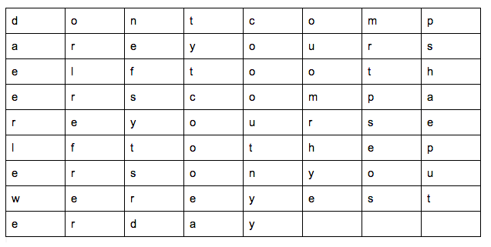
Continue..

Slide 121
Continue..
The coded message is obtained by reading down the columns going left to right. For example, the message above is coded as:
"daeer leweo rlref rerne fsyts rdtyt coooe acooo utnyy ouomr hyemr tpseo spsha eput"
Write a program that outputs the encoded version of a given block of text. Again, identify each individual behavior this application should demonstrate, and write a specification (including an input/output example) for each. Tackle writing code for one behavior at a time, and ensure your spec "passes" (you receive the correct output when you provide your input example) before moving to the next specification. List all specifications in the project's README.md file.
The size of the square (number of columns) should be decided by the length of the message. If the message is a length that creates a perfect square (e.g. 4, 9, 16, 25, 36, etc), use that number of columns. If the message doesn't fit neatly into a square, choose the number of columns that corresponds to the smallest square that is larger than the number of characters in the message.
Output the encoded text in groups of five letters. For example:
encrypt("Have a nice day. Feed the dog & chill out!");
# => "hifei acedl v..."

Slide 122
Continue..
Further Exploration
Go back and tackle any Further Exploration exercises from previous days this week that you have not yet completed.
Peer Code Review
Is code broken down into plain English specs? Do these specs accurately represent the behaviors required of the program?
Are variable names descriptive, and in lower camelCase?
Is code indented properly throughout?
Does the application work as expected?
Is the code clean, well-refactored, and generally easy to follow?

Slide 123
Independent Project - Triangle Tracker
TRIANGLE TRACKER
GOAL
For this week's Independent Project, we will be building an application that will help us know whether a triangle is isosceles, equilateral, scalene or NOT a triangle at all.
Based on the functionality of the application, key points to note are:
For an equilateral triangle, all sides must be equal.
For an isosceles triangle, two sides are exactly equal.
For a scalene triangle, none of the sides is equal. However, the sum of any two sides of the triangle must be greater than the third side.
Most importantly, if the sum of any two sides of the triangle is equal to or less than the third remaining side, then a triangle CANNOT be formed using those values. (For example, the values 9,4 & 3 cannot form a triangle.)

Slide 124
Continue..
USER STORY
As a user, I want to enter the length values of the three sides of my triangle in the application.
After submitting my values, the application should tell me what type of triangle my values will produce, whether an isosceles, equilateral, scalene or NO triangle at all.
HINT: For you to actualize your project, consider researching on how to use HTML input fields and how to link them to the business logic using javascript.
OBJECTIVES
The project will be evaluated based on the following objectives:
The project uses one or more javascript functions.
Appropriate control flows and logical operators are used in the project.
The project makes use of one or more arrays in javascript.
The project uses a HTML input to collect user data.
The project uses a custom CSS stylesheet that incorporates cascading, box model and floats.
The project works as expected, achieving the functionality required.
The project demonstrates an understanding of the week's concepts. If requested, you should be able to explain your code to your instructor.

Slide 125
Continue..
TECHNICAL REQUIREMENTS
The project contains a well-documented README file. This should have:
Project name.
Project description.
Author(s) information.
Setup instructions - includes any scripts that need to be run if necessary.
BDD.
Technologies used.
Contact information.
License and Copyright information.
The project code is consistently indented and follows the language syntax.
The project is submitted in time. It should be submitted before 6:00 pm Friday unless otherwise stated.
The project code is pushed to Github and the project is deployed to gh-pages.
The project name, description and URL to live site are provided on the Github repository.
Commits are made regularly with relevant and clear commit messages associated with them.
The project should be polished in a portfolio-quality state.

