Slide 1
Loops extrusion

Slide 2
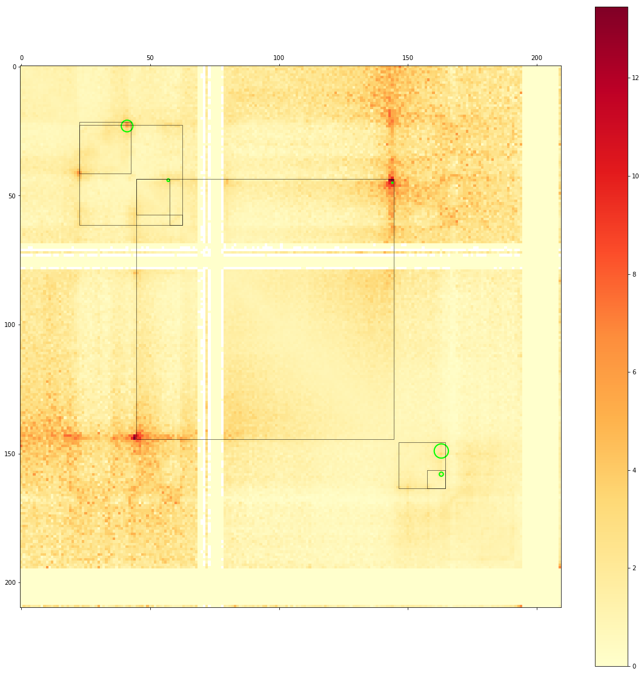
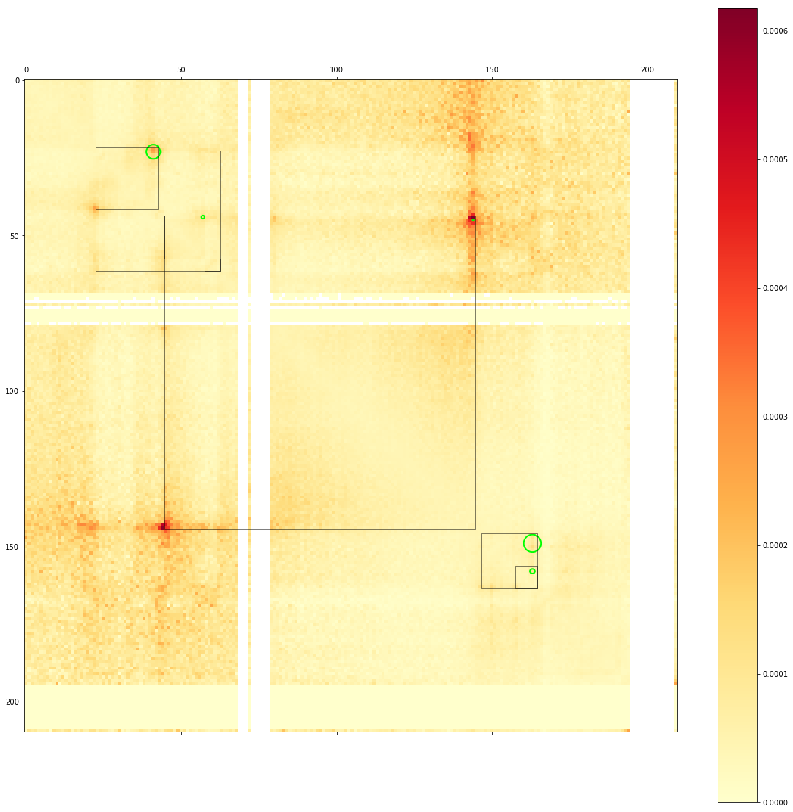
Rao Hi-C vs Rao Hi-C scaled

Slide 3
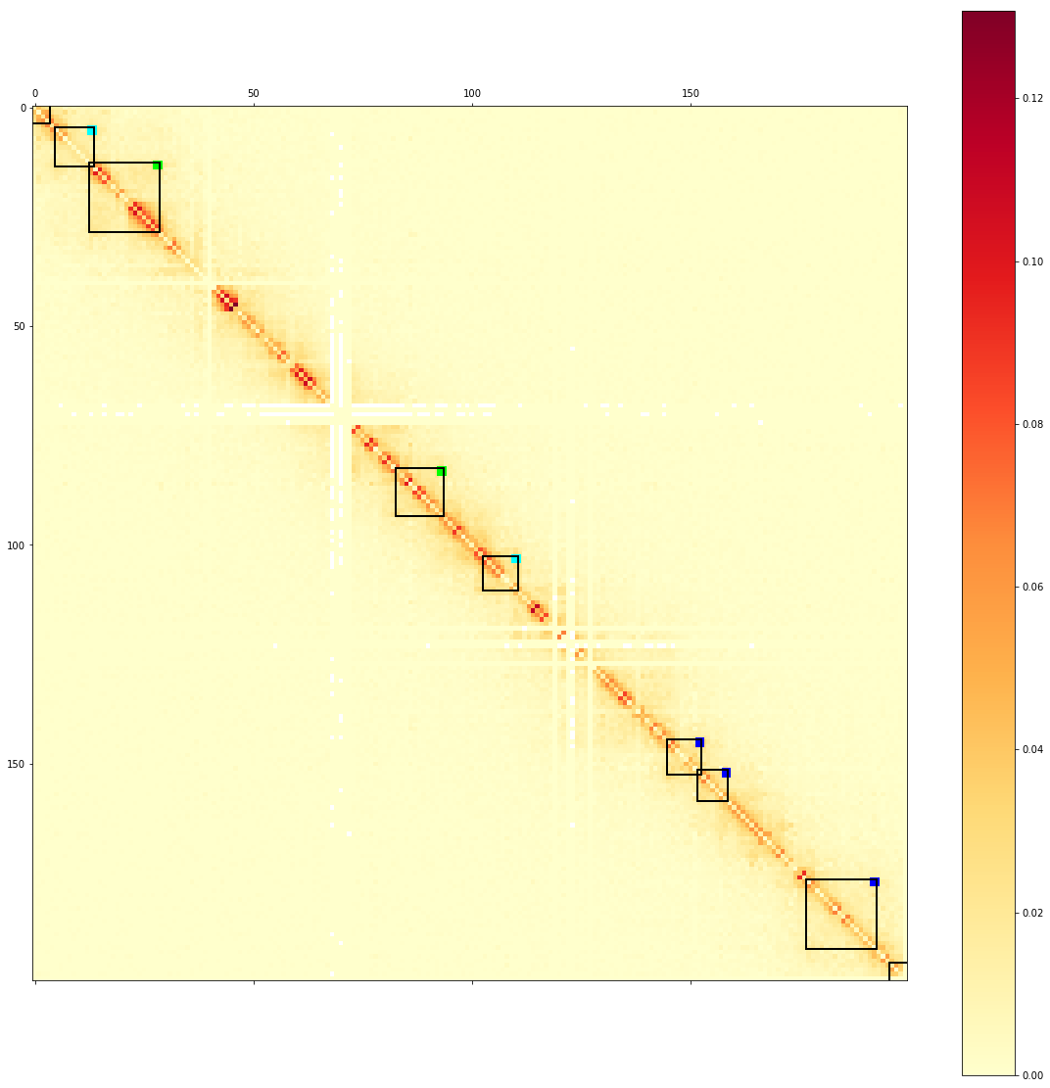
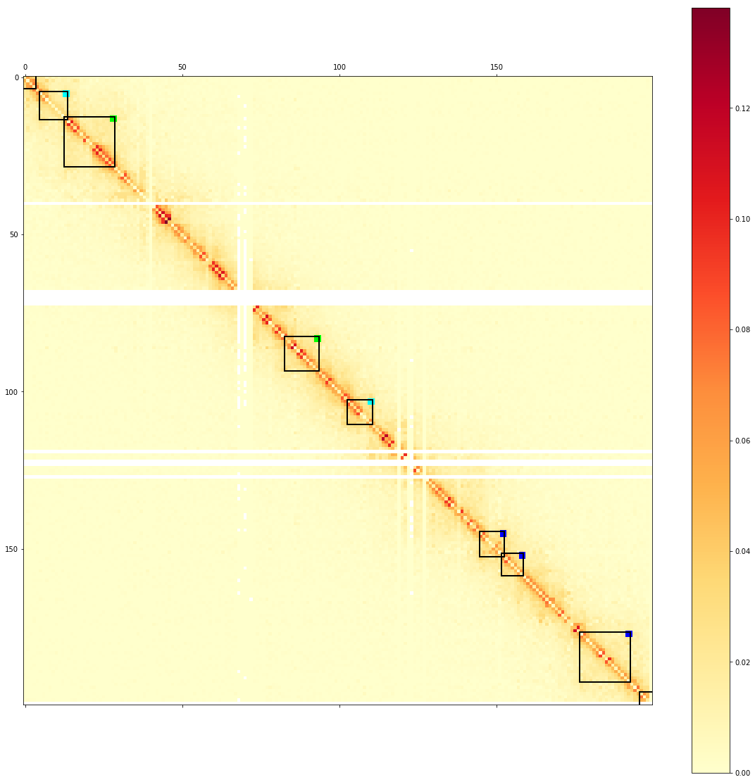
Dicty Hi-C vs Dicty scaled Hi-C

Slide 4
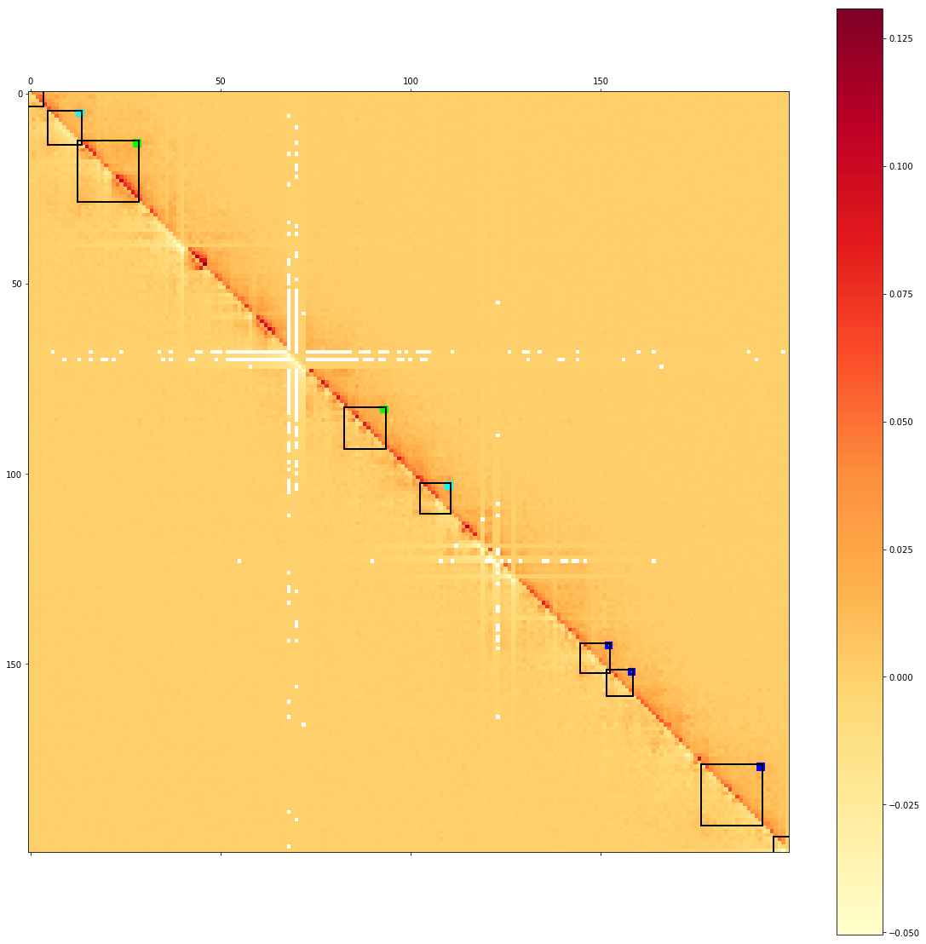
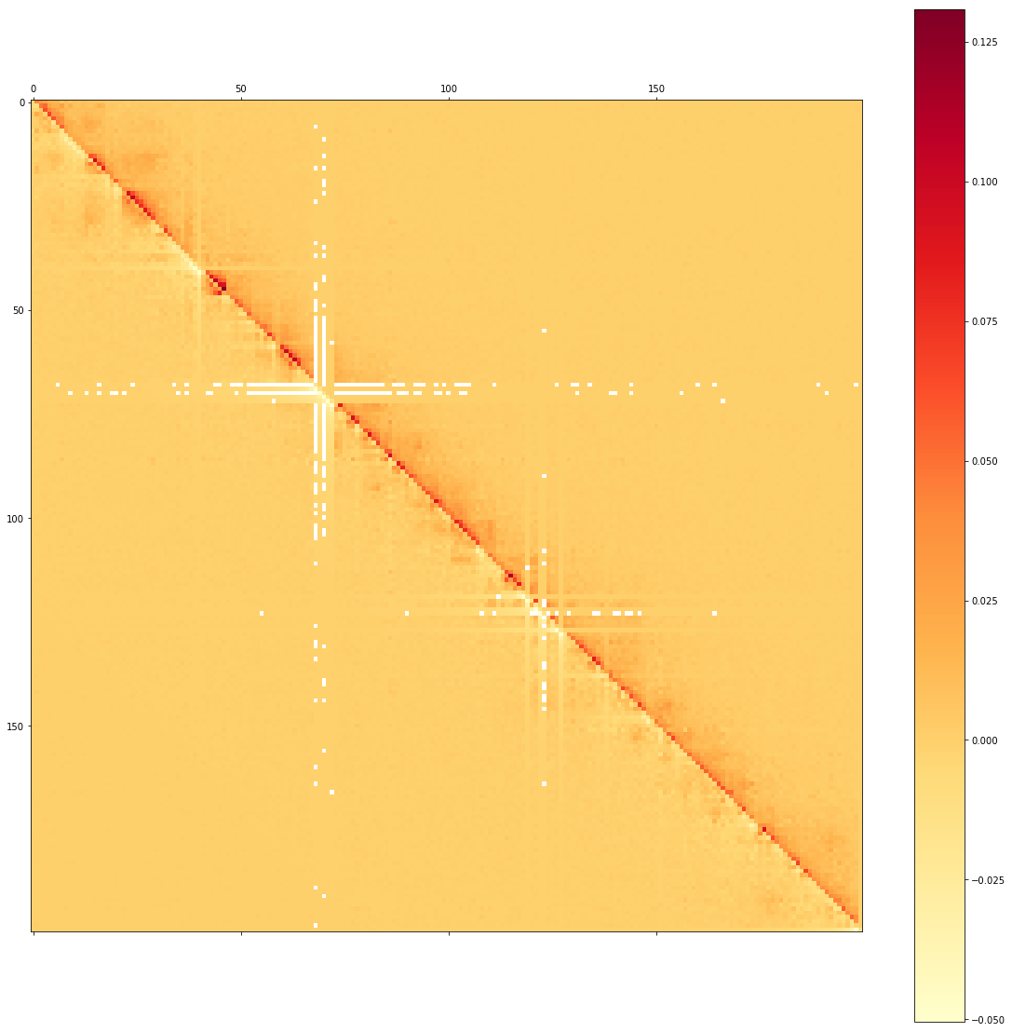
Dicty diagonal scale Hi-C

Slide 5
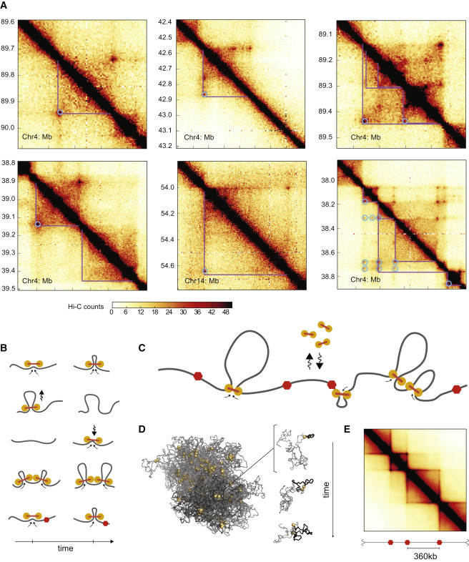

Slide 6
https://www.youtube.com/watch?v=8FW6gOx5lPI

Slide 7
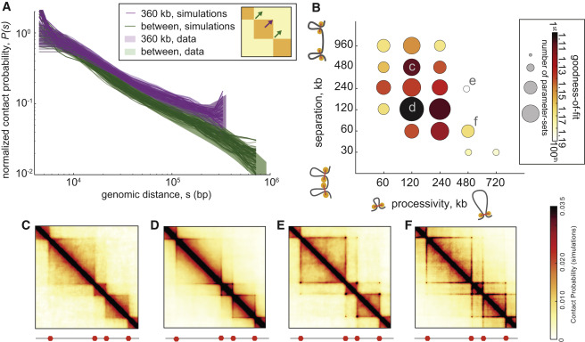

Slide 8
Minimal 3D Polymer Model
We performed simulations of a polymer chain consisting of eight groups of three TADs of 300, 600, and 1,200 monomers each, arranged sequentially (300; 600; 1,200; 300; …). Impermeable BEs were placed between neighboring TADs. For each parameter set, we collected 2,000 conformations to calculate P(s) and 10,000 for contact maps.
Parameter Sweep
We considered the following values for the five simulation parameters:
LEF processivity: 100; 200; 400; 800; 1,200; 1,600
LEF separation: 50; 100; 200; 400; 800; 1,600
3D-to-1D dynamics: 300/4; 1,000/4; 5,000/4
Stiffness: 0; 2; 4; 6
Density: 0.05; 0.2.

