Slide 1

Lecture 11:
Sequential Circuit Design

Slide 2
Outline
Sequencing
Sequencing Element Design
Max and Min-Delay
Clock Skew
Time Borrowing
Two-Phase Clocking
11: Sequential Circuits

Slide 3
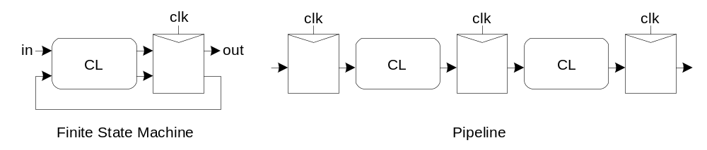
Sequencing
Combinational logic
  output depends on current inputs
Sequential logic
  output depends on current and previous inputs
  Requires separating previous, current, future
  Called state or tokens
  Ex: FSM, pipeline
11: Sequential Circuits

Slide 4
Sequencing Cont.
If tokens moved through pipeline at constant speed, no sequencing elements would be necessary
Ex: fiber-optic cable
  Light pulses (tokens) are sent down cable
  Next pulse sent before first reaches end of cable
  No need for hardware to separate pulses
  But dispersion sets min time between pulses
This is called wave pipelining in circuits
In most circuits, dispersion is high
  Delay fast tokens so they don’t catch slow ones.
11: Sequential Circuits

Slide 5
Sequencing Overhead
Use flip-flops to delay fast tokens so they move through exactly one stage each cycle.
Inevitably adds some delay to the slow tokens
Makes circuit slower than just the logic delay
  Called sequencing overhead
Some people call this clocking overhead
  But it applies to asynchronous circuits too
  Inevitable side effect of maintaining sequence
11: Sequential Circuits

Slide 6
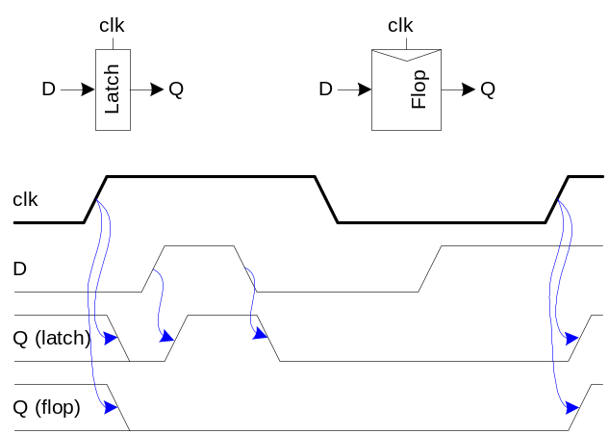
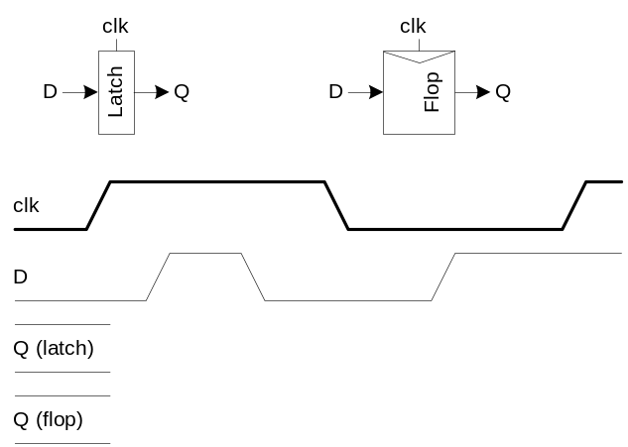
Sequencing Elements
Latch: Level sensitive
  a.k.a. transparent latch, D latch
Flip-flop: edge triggered
  A.k.a. master-slave flip-flop, D flip-flop, D register
Timing Diagrams
  Transparent
  Opaque
  Edge-trigger
11: Sequential Circuits

Slide 7
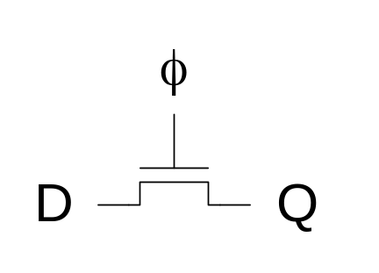
Latch Design
Pass Transistor Latch
Pros
  + Tiny
  + Low clock load
Cons
  V_{t} drop
  nonrestoring
  backdriving
  output noise sensitivity
  dynamic
  diffusion input
Used in 1970’s
11: Sequential Circuits

Slide 8
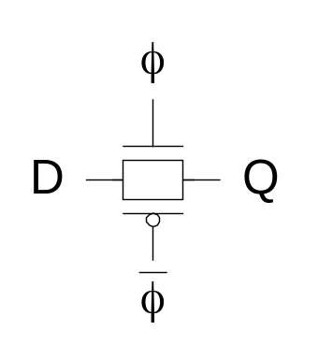
Latch Design
Transmission gate
  + No V_{t} drop
  - Requires inverted clock
11: Sequential Circuits

Slide 9
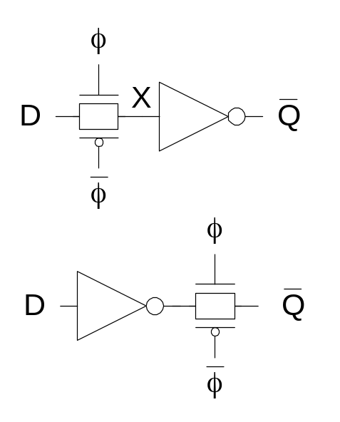
Latch Design
Inverting buffer
  + Restoring
  + No backdriving
  + Fixes either
    Output noise sensitivity
    Or diffusion input
  Inverted output
11: Sequential Circuits

Slide 10
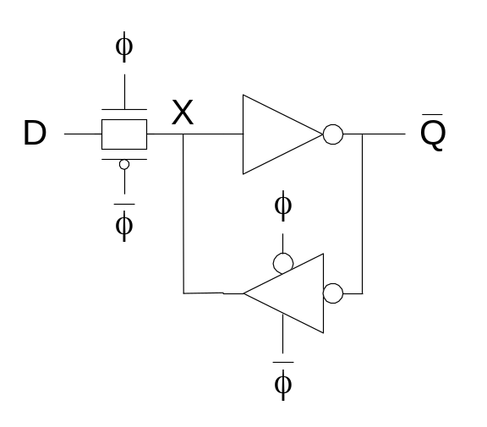
Latch Design
Tristate feedback
  + Static
  Backdriving risk
Static latches are now essential
because of leakage
11: Sequential Circuits

Slide 11
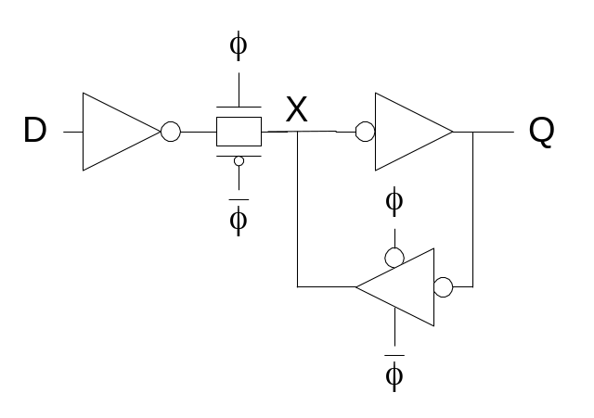
Latch Design
Buffered input
  + Fixes diffusion input
  + Noninverting
11: Sequential Circuits

Slide 12
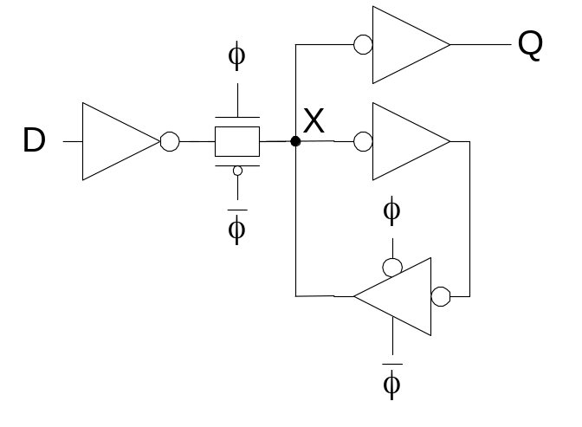
Latch Design
Buffered output
  + No backdriving
Widely used in standard cells
  + Very robust (most important)
  Rather large
  Rather slow (1.5 – 2 FO4 delays)
  High clock loading
11: Sequential Circuits

Slide 13
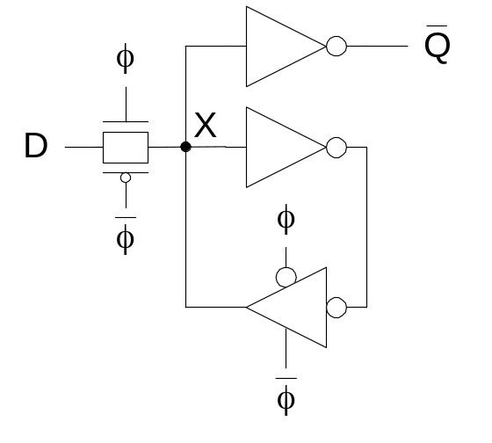
Latch Design
Datapath latch
  + smaller
  + faster
  - unbuffered input
11: Sequential Circuits

Slide 14
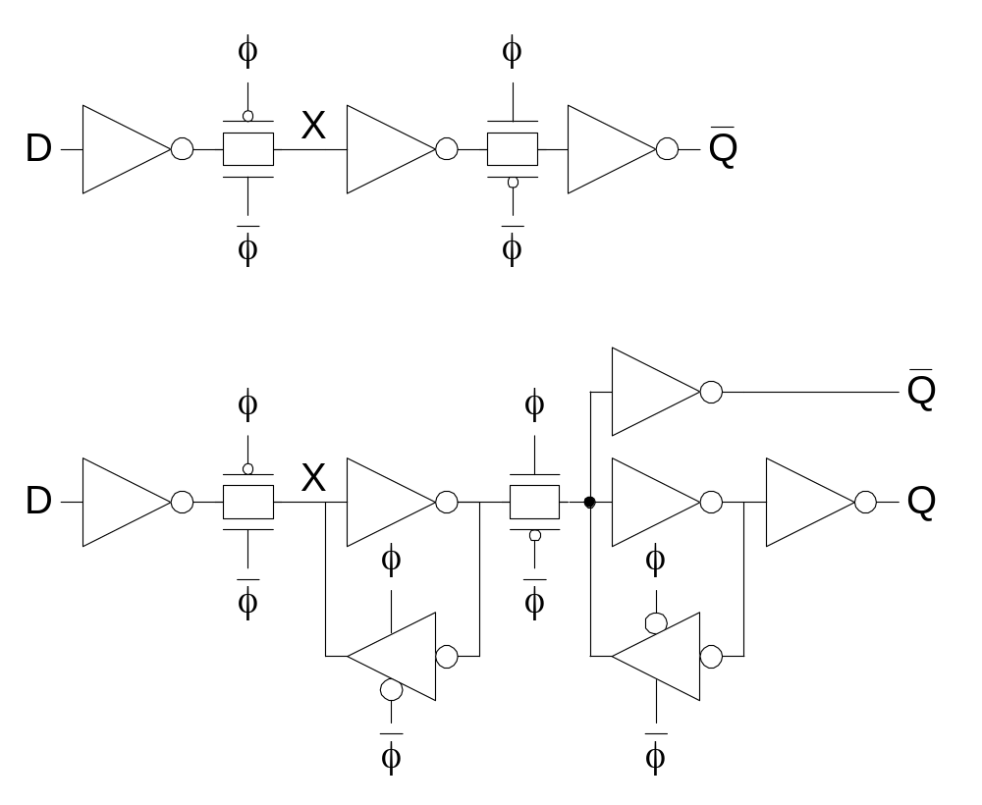
Flip-Flop Design
Flip-flop is built as pair of back-to-back latches
11: Sequential Circuits

Slide 15
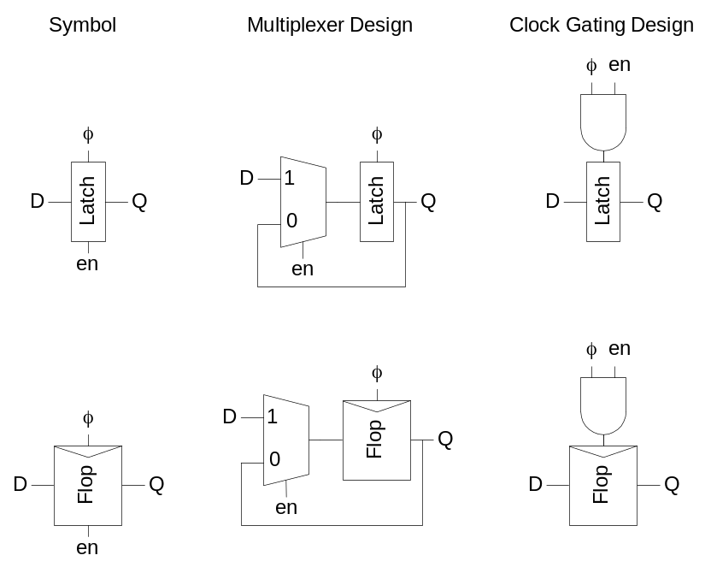
Enable
Enable: ignore clock when en = 0
  Mux: increase latch D-Q delay
  Clock Gating: increase en setup time, skew
11: Sequential Circuits

Slide 16
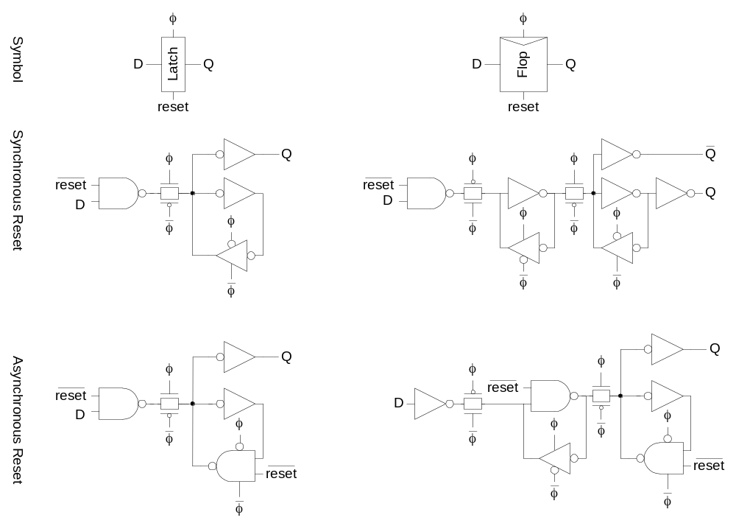
Reset
Force output low when reset asserted
Synchronous vs. asynchronous
11: Sequential Circuits

Slide 17
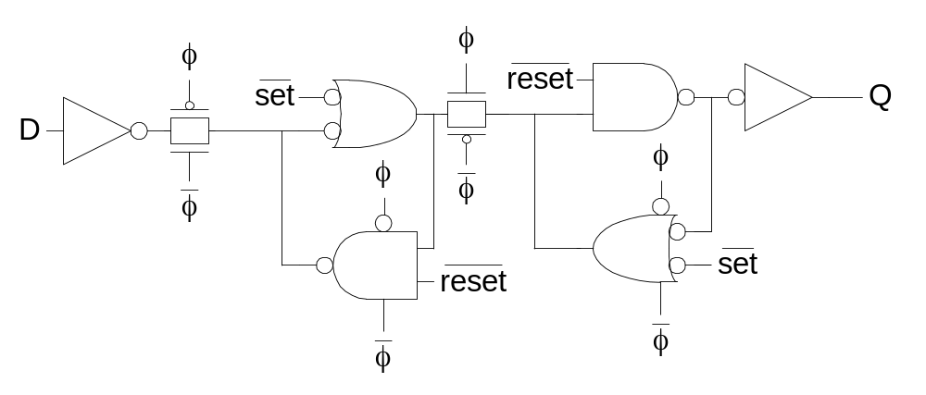
Set / Reset
Set forces output high when enabled
Flip-flop with asynchronous set and reset
11: Sequential Circuits

Slide 18
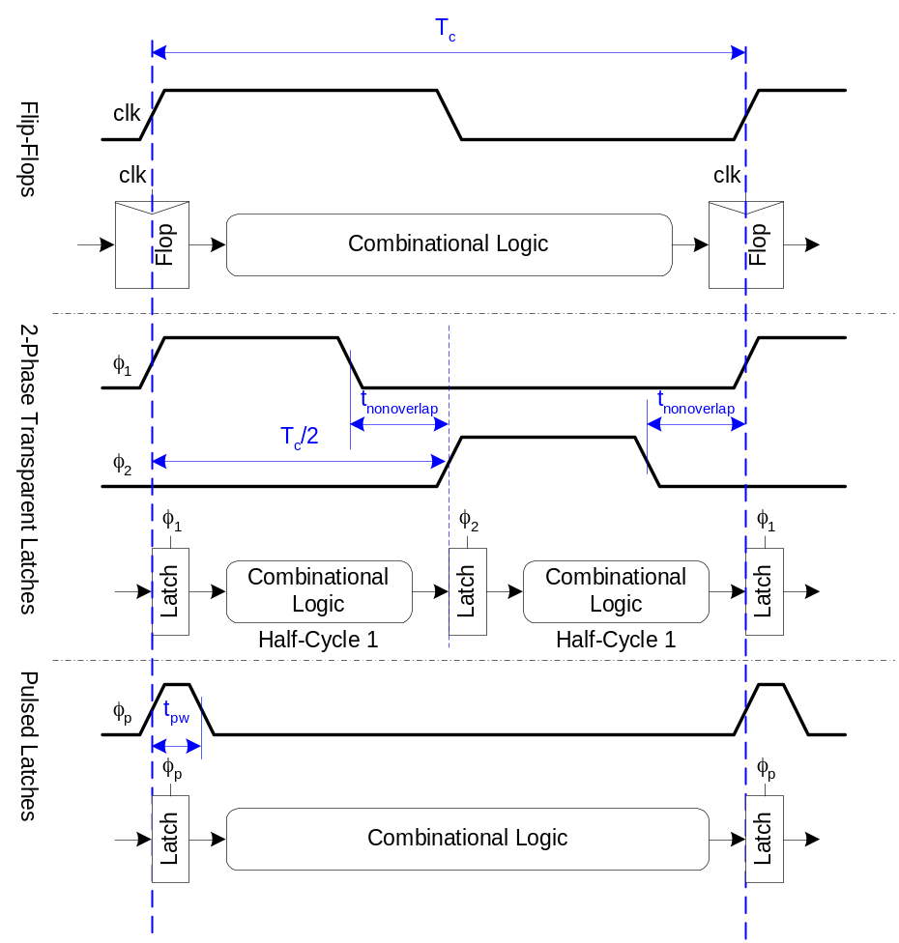
Sequencing Methods
Flip-flops
2-Phase Latches
Pulsed Latches
11: Sequential Circuits

Slide 19
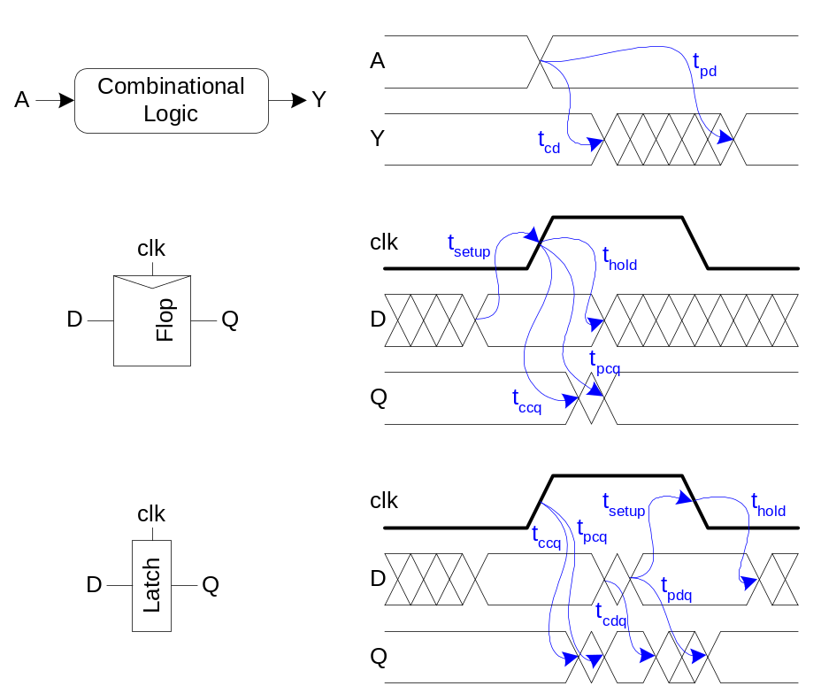
Timing Diagrams
Contamination and Propagation Delays
t_{pd} | Logic Prop. Delay
t_{cd} | Logic Cont. Delay
t_{pcq} | Latch/Flop Clk->Q Prop. Delay
t_{ccq} | Latch/Flop Clk->Q Cont. Delay
t_{pdq} | Latch D->Q Prop. Delay
t_{cdq} | Latch D->Q Cont. Delay
t_{setup} | Latch/Flop Setup Time
t_{hold} | Latch/Flop Hold Time
11: Sequential Circuits

Slide 20
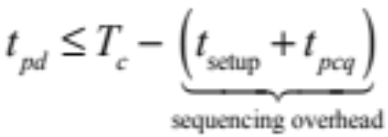
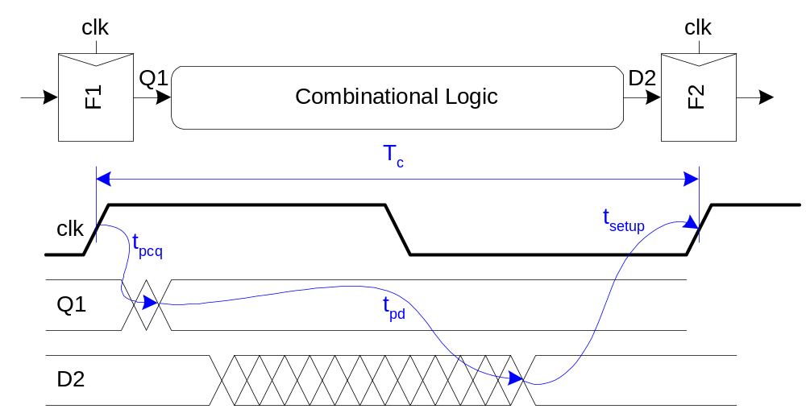
Max-Delay: Flip-Flops
11: Sequential Circuits

Slide 21
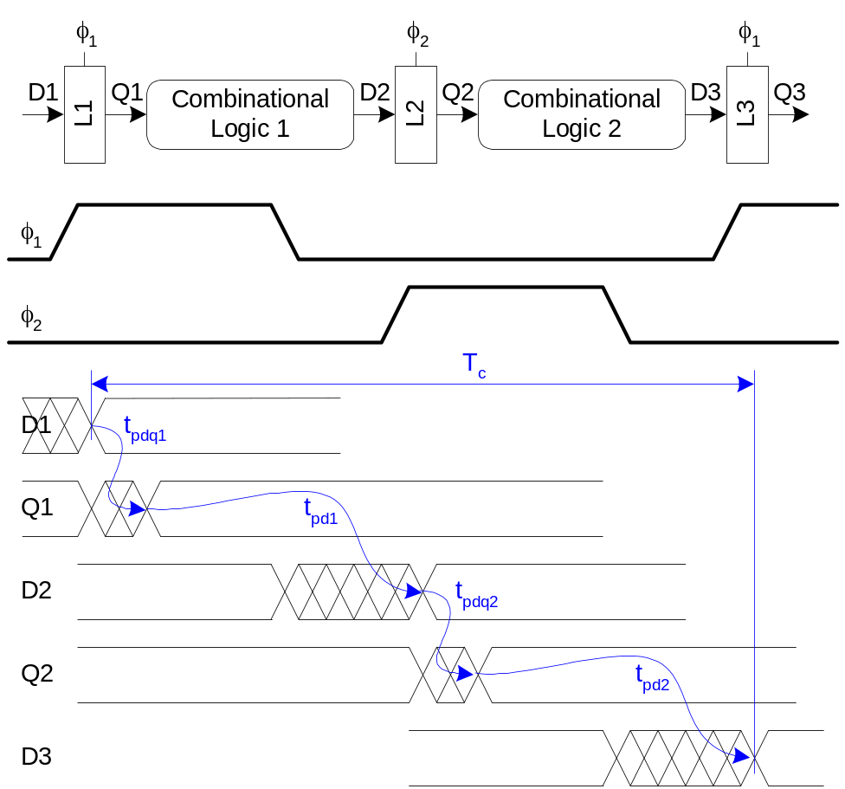
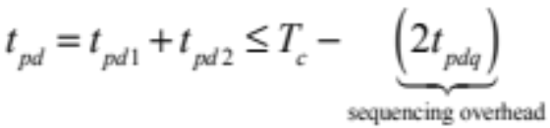
Max Delay: 2-Phase Latches
11: Sequential Circuits

Slide 22
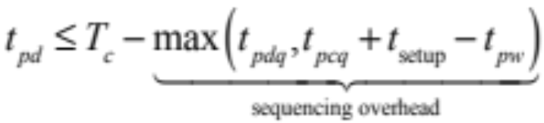
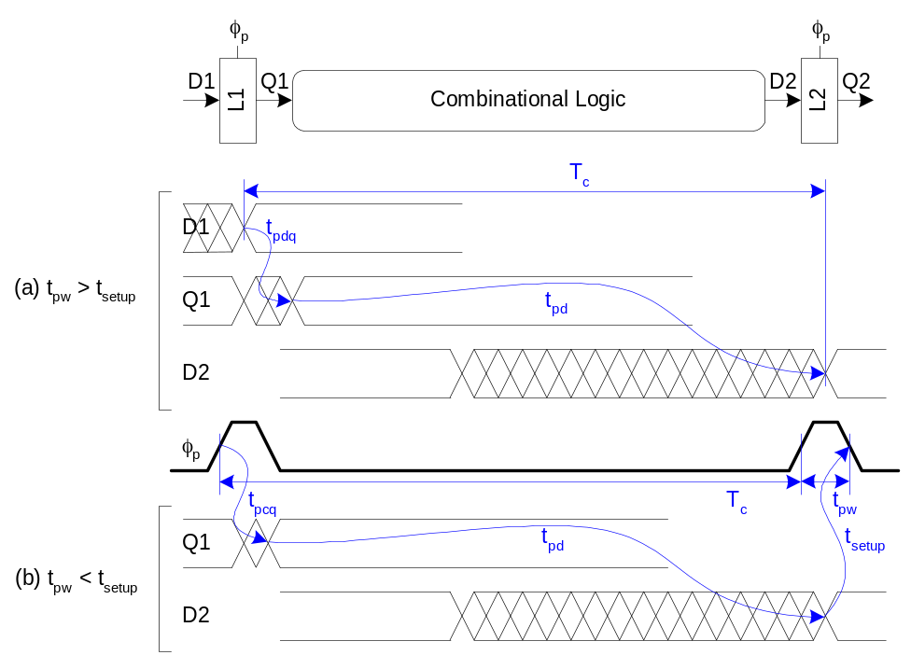
Max Delay: Pulsed Latches
11: Sequential Circuits

Slide 23
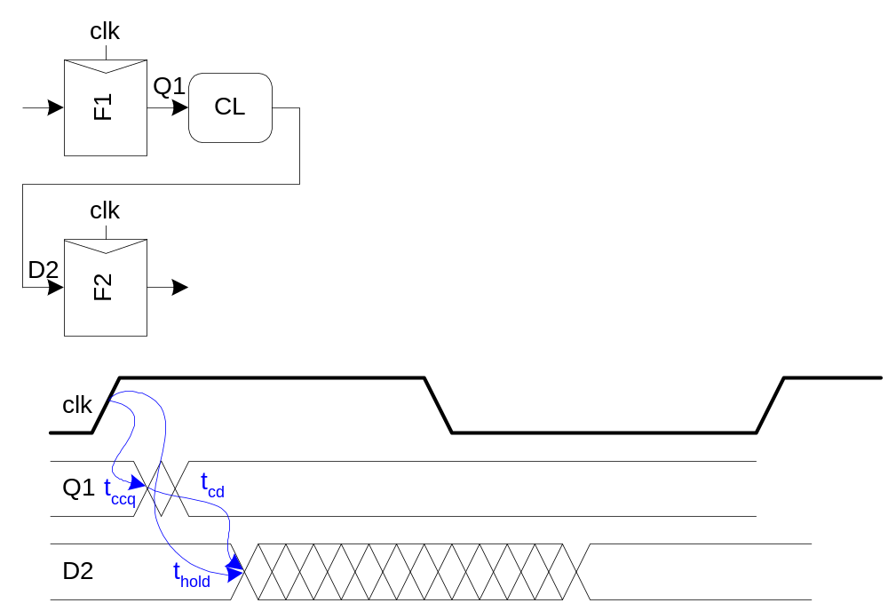

Min-Delay: Flip-Flops
11: Sequential Circuits

Slide 24
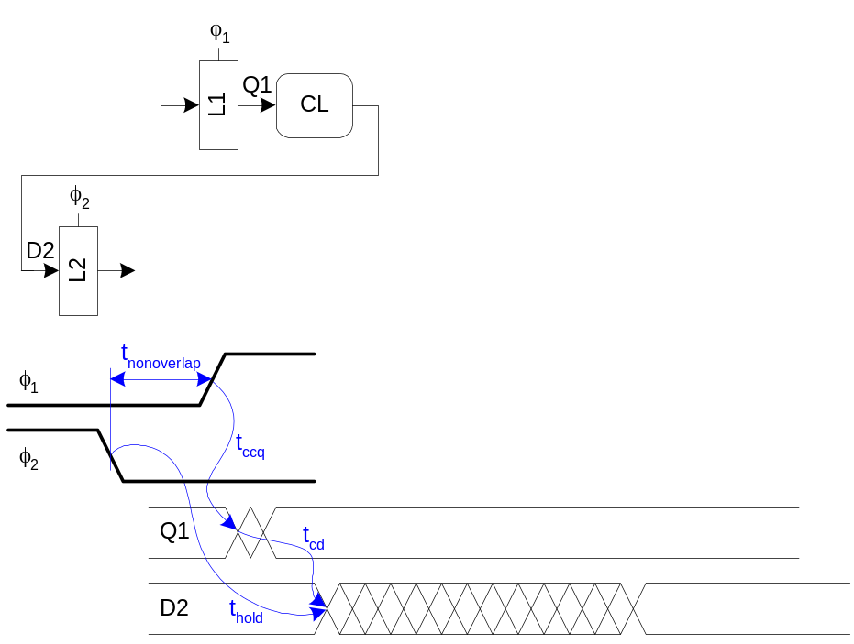

Min-Delay: 2-Phase Latches
Hold time reduced by nonoverlap
Paradox: hold applies twice each cycle, vs. only once for flops.
But a flop is made of two latches!
11: Sequential Circuits

Slide 25
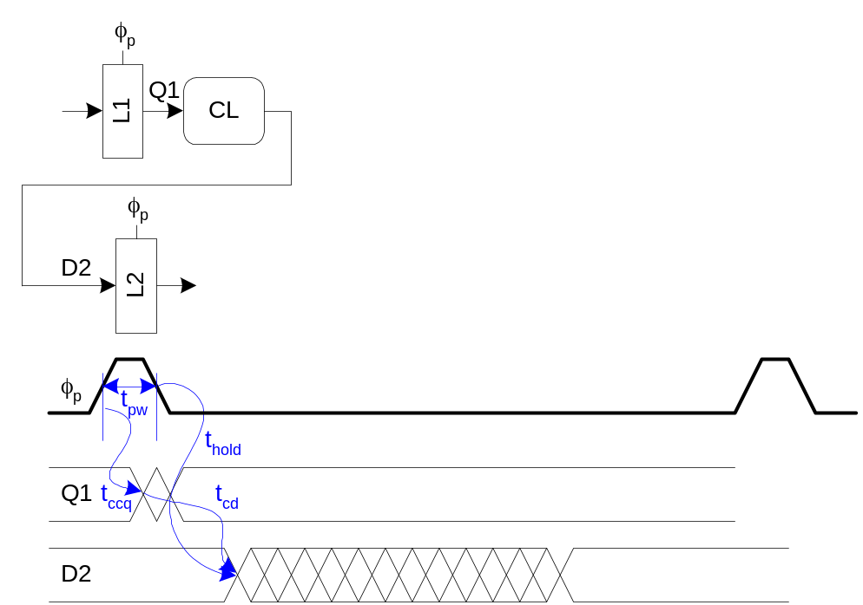

Min-Delay: Pulsed Latches
Hold time increased by pulse width
11: Sequential Circuits

Slide 26
Time Borrowing
In a flop-based system:
  Data launches on one rising edge
  Must setup before next rising edge
  If it arrives late, system fails
  If it arrives early, time is wasted
  Flops have hard edges
In a latch-based system
  Data can pass through latch while transparent
  Long cycle of logic can borrow time into next
  As long as each loop completes in one cycle
11: Sequential Circuits

Slide 27
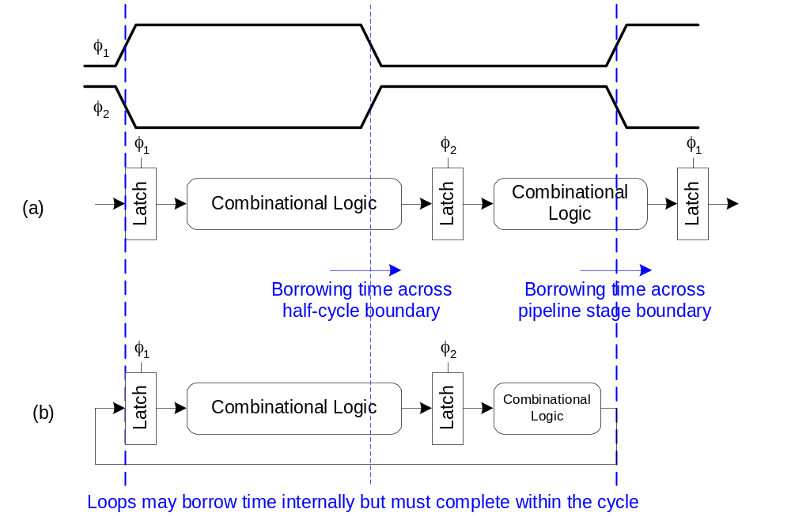
Time Borrowing Example
11: Sequential Circuits

Slide 28
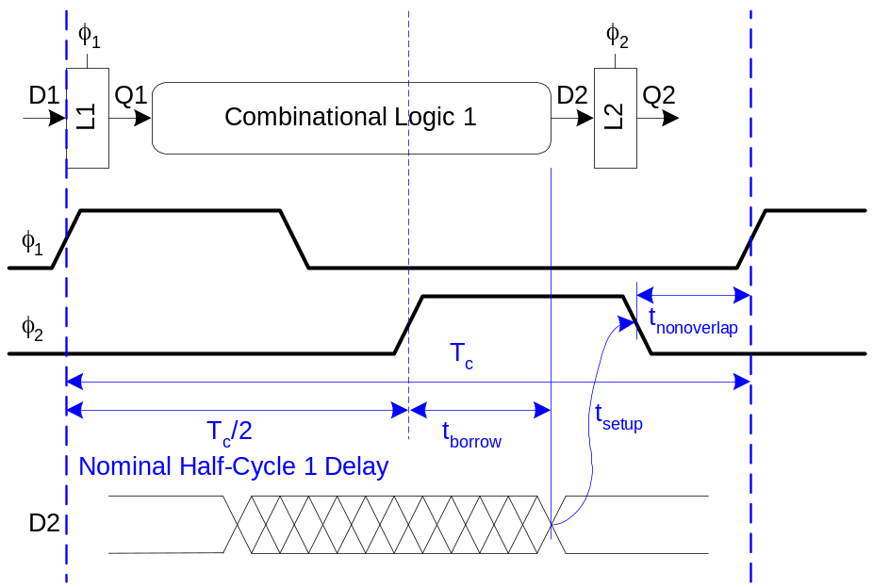
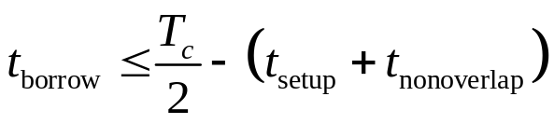

How Much Borrowing?
2-Phase Latches
Pulsed Latches
11: Sequential Circuits

Slide 29
Clock Skew
We have assumed zero clock skew
Clocks really have uncertainty in arrival time
  Decreases maximum propagation delay
  Increases minimum contamination delay
  Decreases time borrowing
11: Sequential Circuits

Slide 30
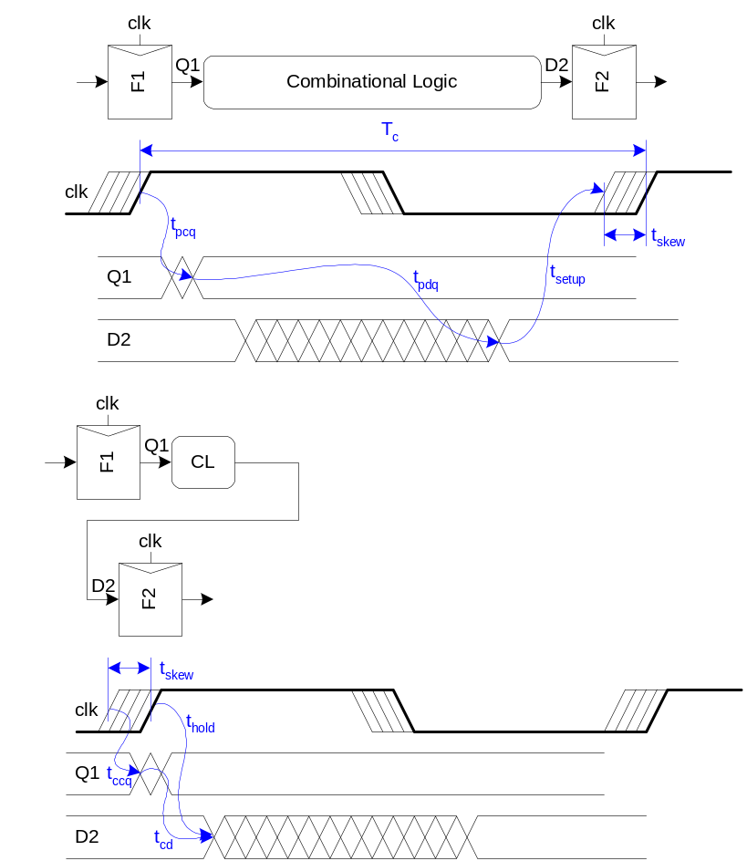
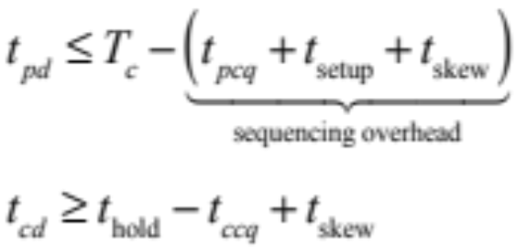
Skew: Flip-Flops
11: Sequential Circuits

Slide 31
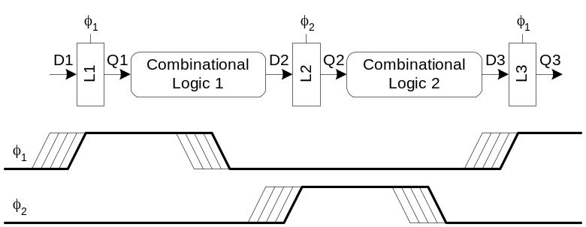
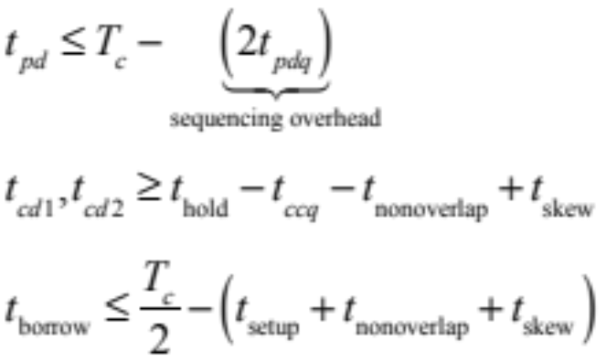
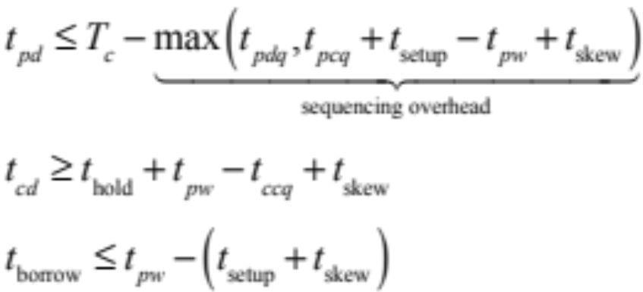
Skew: Latches
2-Phase Latches
Pulsed Latches
11: Sequential Circuits

Slide 32
Two-Phase Clocking
If setup times are violated, reduce clock speed
If hold times are violated, chip fails at any speed
In this class, working chips are most important
  No tools to analyze clock skew
An easy way to guarantee hold times is to use 2-phase latches with big nonoverlap times
Call these clocks φ₁, φ₂ (ph1, ph2)
11: Sequential Circuits

Slide 33
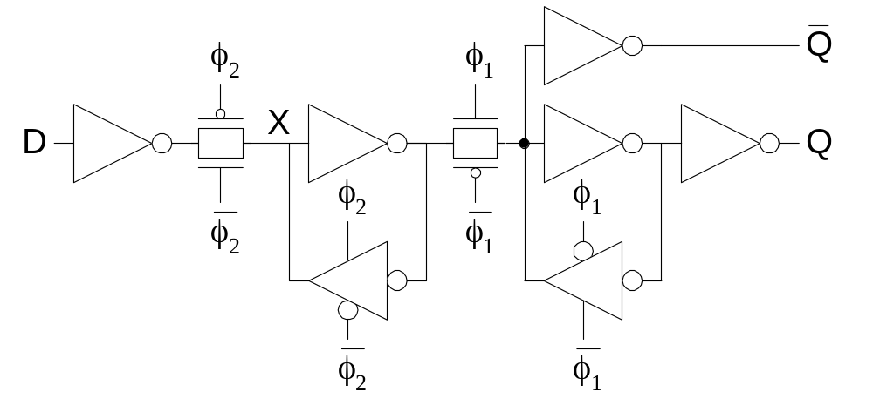
Safe Flip-Flop
Past years used flip-flop with nonoverlapping clocks
  Slow – nonoverlap adds to setup time
  But no hold times
In industry, use a better timing analyzer
  Add buffers to slow signals if hold time is at risk
11: Sequential Circuits

Slide 34
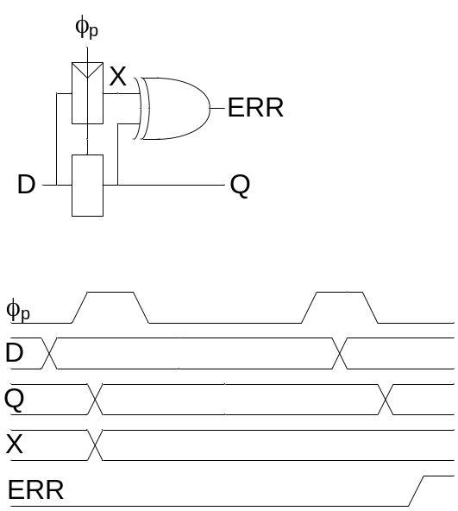
Adaptive Sequencing
Designers include timing margin
  Voltage
  Temperature
  Process variation
  Data dependency
  Tool inaccuracies
Alternative: run faster and check for near failures
  Idea introduced as “Razor”
    Increase frequency until at the verge of error
    Can reduce cycle time by ~30%
11: Sequential Circuits

Slide 35
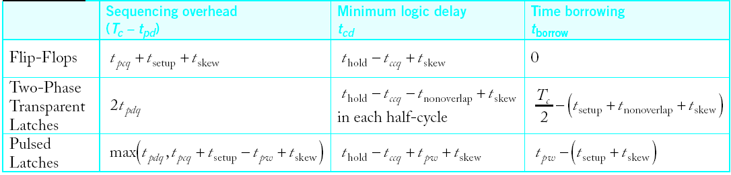
Summary
Flip-Flops:
  Very easy to use, supported by all tools
2-Phase Transparent Latches:
  Lots of skew tolerance and time borrowing
Pulsed Latches:
  Fast, some skew tol & borrow, hold time risk
11: Sequential Circuits

