Slide 1

Lecture 12:
Adders

Slide 2
Outline
Single-bit Addition
Carry-Ripple Adder
Carry-Skip Adder
Carry-Lookahead Adder
Carry-Select Adder
Carry-Increment Adder
Tree Adder
17: Adders

Slide 3
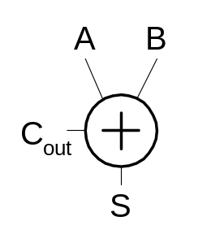
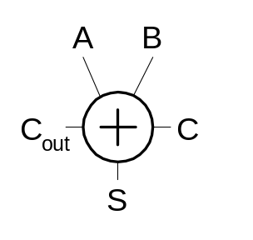
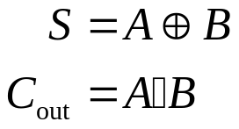
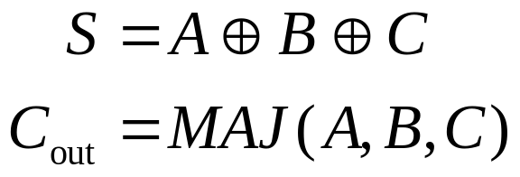
Single-Bit Addition
Half Adder Full Adder
A | B | C_{out} | S
0 | 0 | 0 | 0
0 | 1 | 0 | 1
1 | 0 | 0 | 1
1 | 1 | 1 | 0
A | B | C | C_{out} | S
0 | 0 | 0 | 0 | 0
0 | 0 | 1 | 0 | 1
0 | 1 | 0 | 0 | 1
0 | 1 | 1 | 1 | 0
1 | 0 | 0 | 0 | 1
1 | 0 | 1 | 1 | 0
1 | 1 | 0 | 1 | 0
1 | 1 | 1 | 1 | 1
17: Adders

Slide 4
PGK
For a full adder, define what happens to carries
    (in terms of A and B)
  Generate: C_{out} = 1 independent of C
    G = A • B
  Propagate: C_{out} = C
    P = A ⊕ B
  Kill: C_{out} = 0 independent of C
    K = ~A • ~B
17: Adders

Slide 5
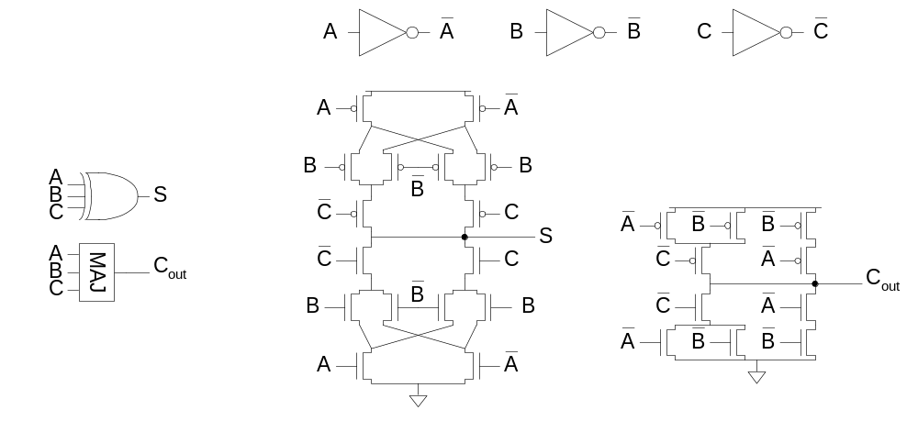
Full Adder Design I
Brute force implementation from eqns
17: Adders

Slide 6
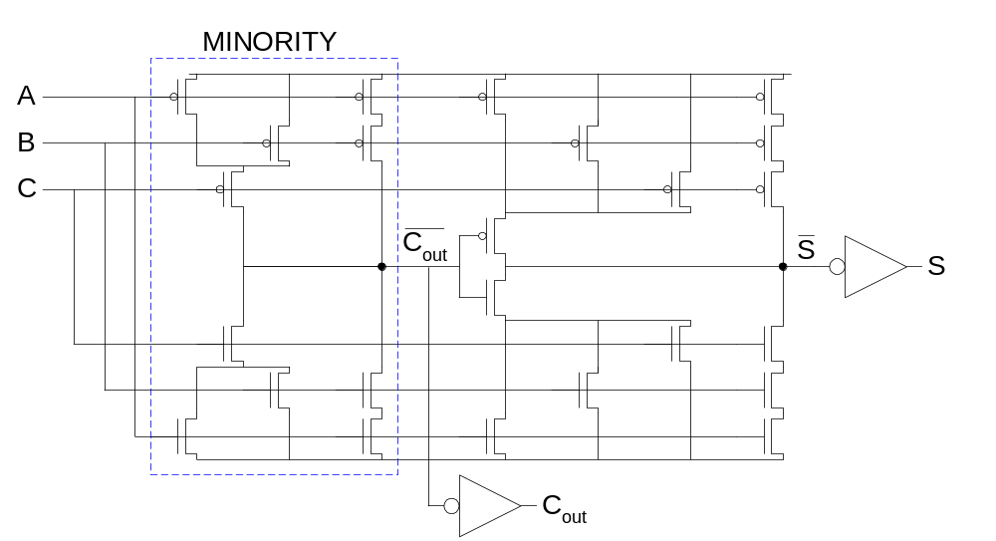
Full Adder Design II
Factor S in terms of C_{out}
S = ABC + (A + B + C)(~C_{out})
Critical path is usually C to C_{out} in ripple adder
17: Adders

Slide 7
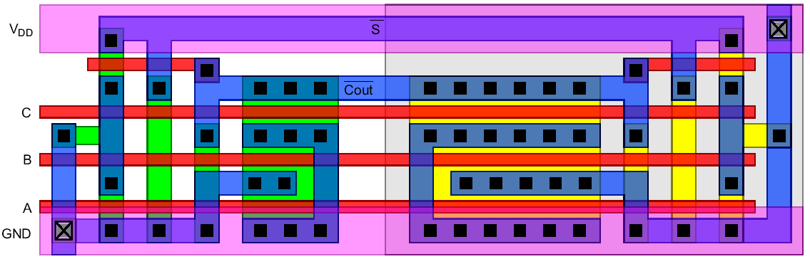
Layout
Clever layout circumvents usual line of diffusion
  Use wide transistors on critical path
  Eliminate output inverters
17: Adders

Slide 8
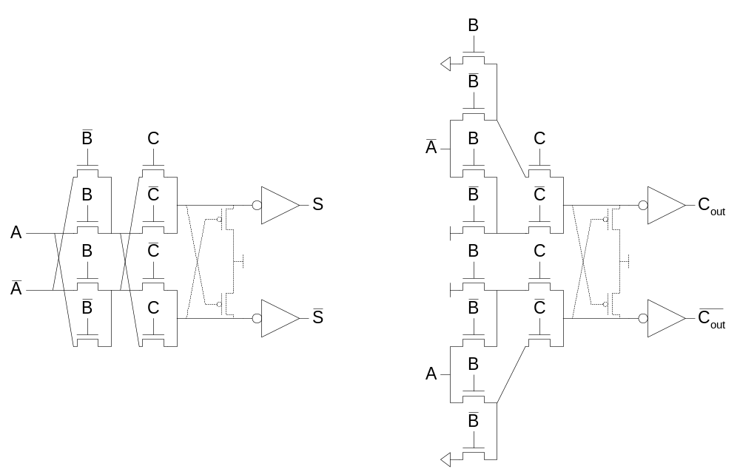
Full Adder Design III
Complementary Pass Transistor Logic (CPL)
  Slightly faster, but more area
17: Adders

Slide 9
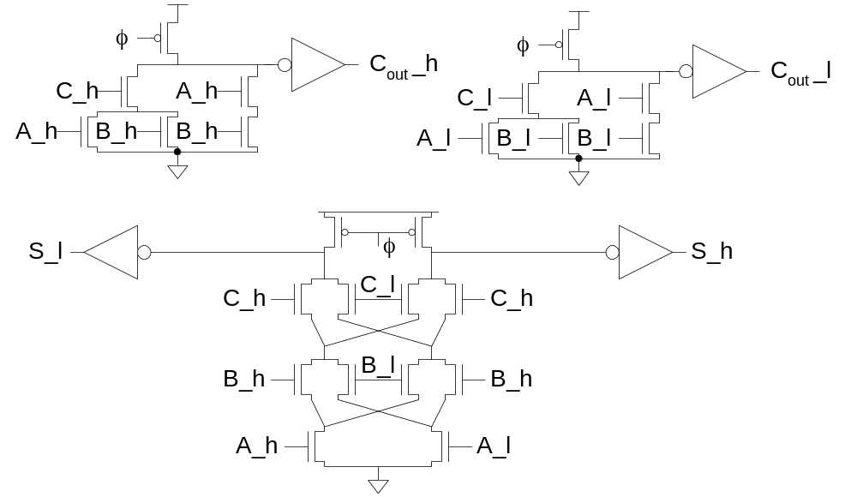
Full Adder Design IV
Dual-rail domino
  Very fast, but large and power hungry
  Used in very fast multipliers
17: Adders

Slide 10
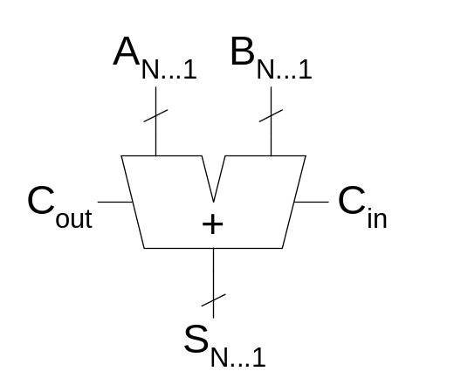
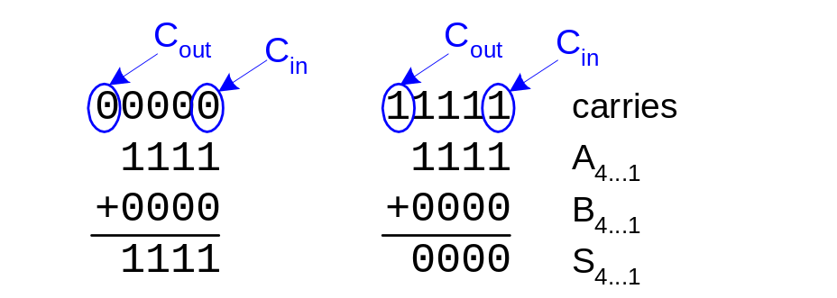
Carry Propagate Adders
N-bit adder called CPA
  Each sum bit depends on all previous carries
  How do we compute all these carries quickly?
17: Adders

Slide 11
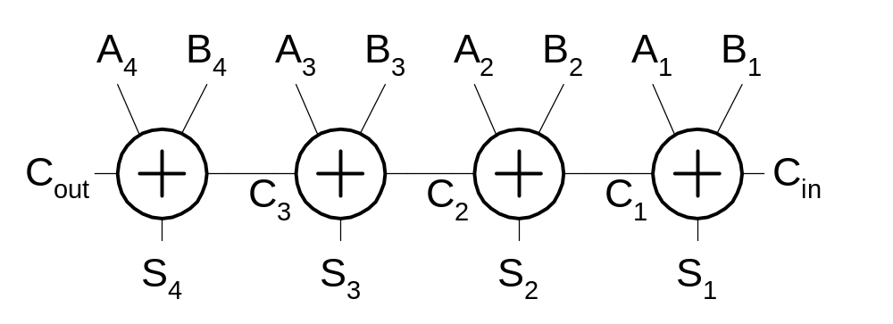
Carry-Ripple Adder
Simplest design: cascade full adders
  Critical path goes from C_{in} to C_{out}
  Design full adder to have fast carry delay
17: Adders

Slide 12
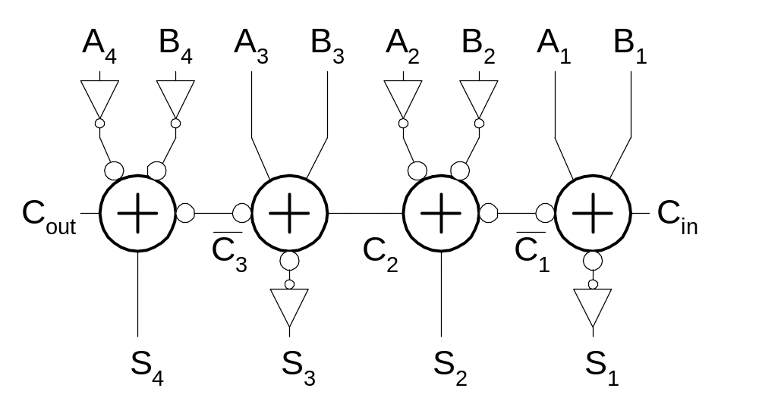
Inversions
Critical path passes through majority gate
  Built from minority + inverter
  Eliminate inverter and use inverting full adder
17: Adders

Slide 13
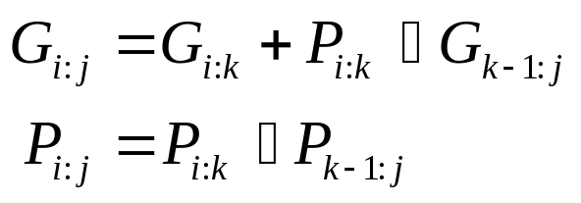
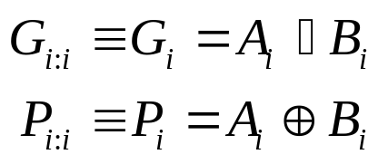
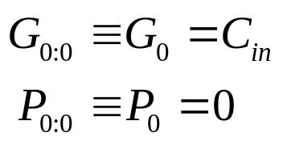

Generate / Propagate
Equations often factored into G and P
Generate and propagate for groups spanning i:j
Base case
Sum:
17: Adders

Slide 14
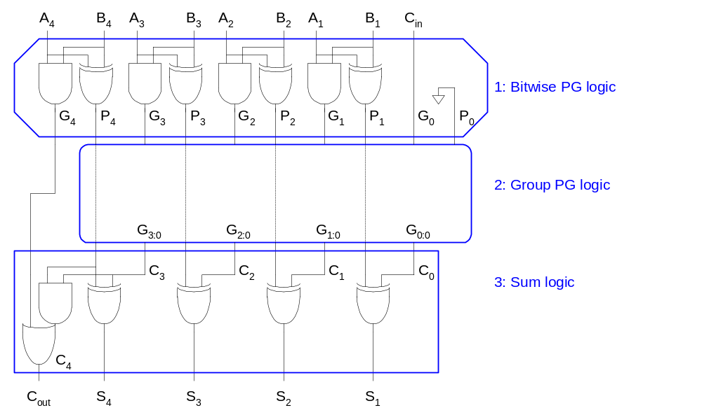
PG Logic
17: Adders

Slide 15
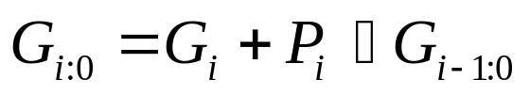
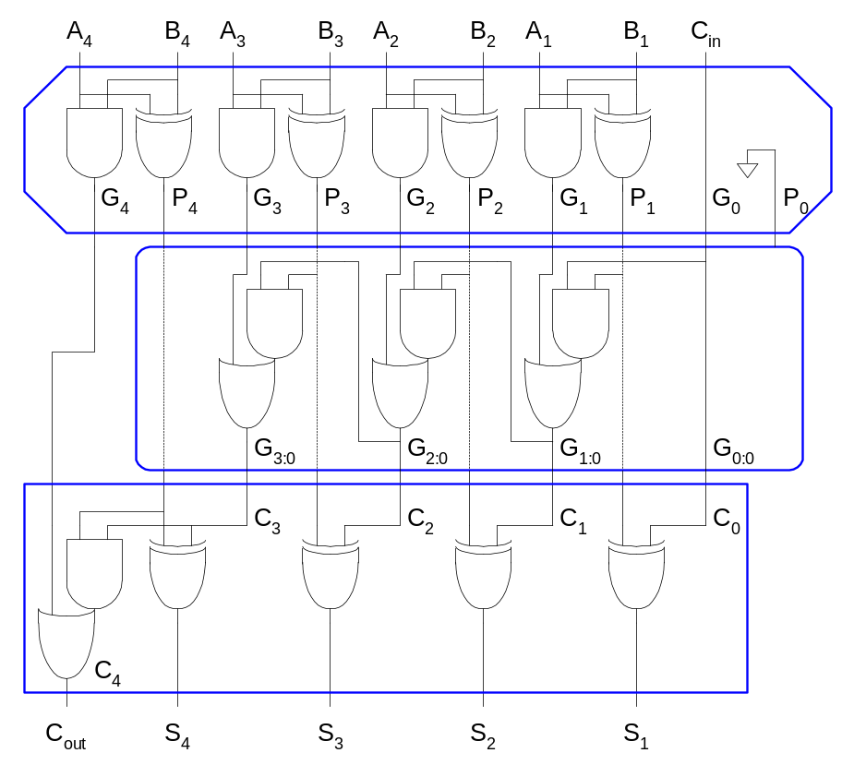
Carry-Ripple Revisited
17: Adders

Slide 16
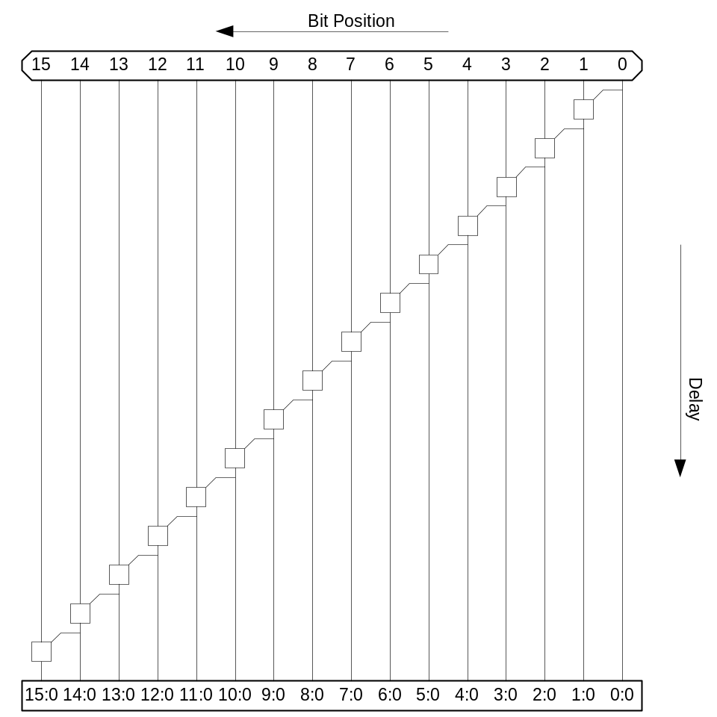

Carry-Ripple PG Diagram
17: Adders

Slide 17
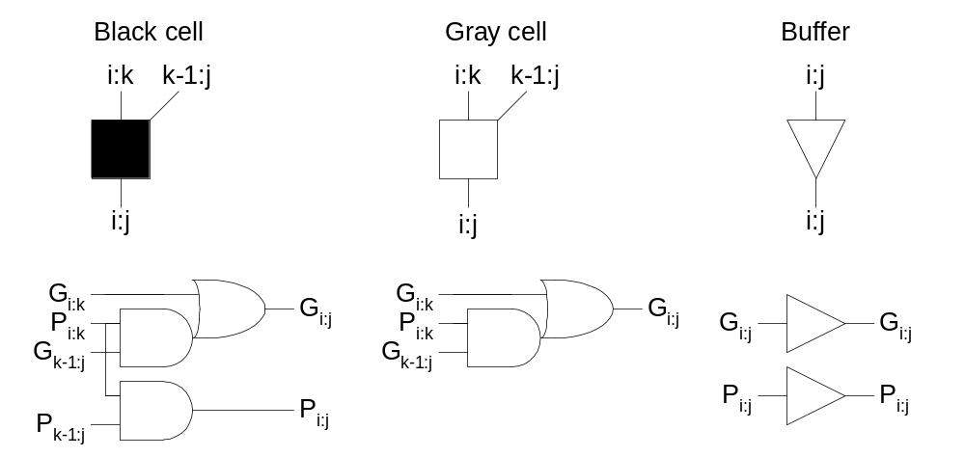
PG Diagram Notation
17: Adders

Slide 18
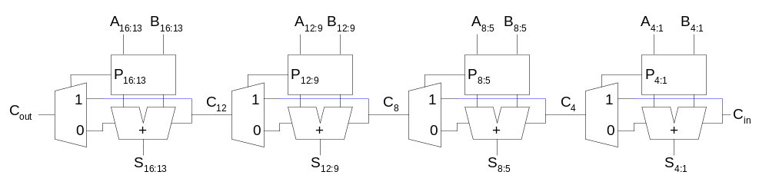
Carry-Skip Adder
Carry-ripple is slow through all N stages
Carry-skip allows carry to skip over groups of n bits
  Decision based on n-bit propagate signal
17: Adders

Slide 19
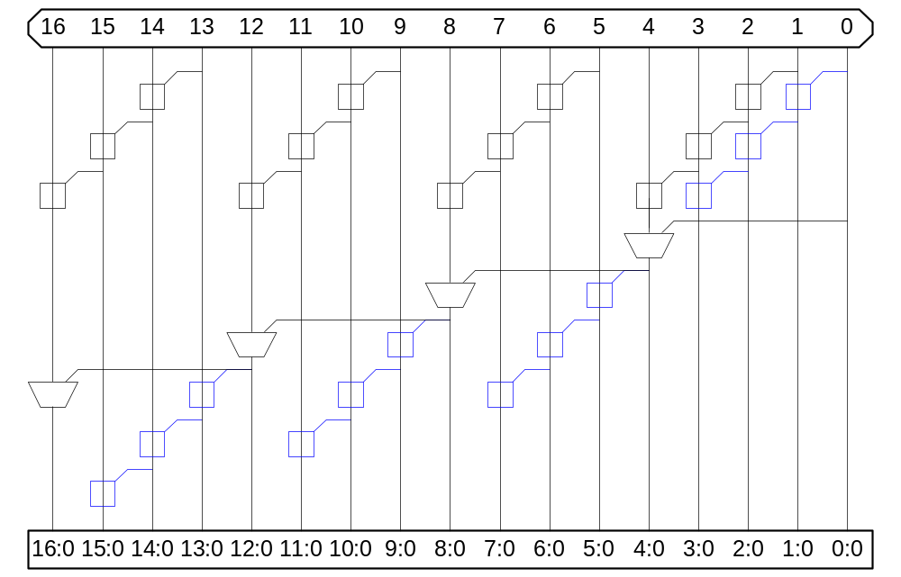
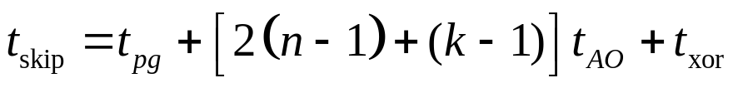
Carry-Skip PG Diagram
For k n-bit groups (N = nk)
17: Adders

Slide 20
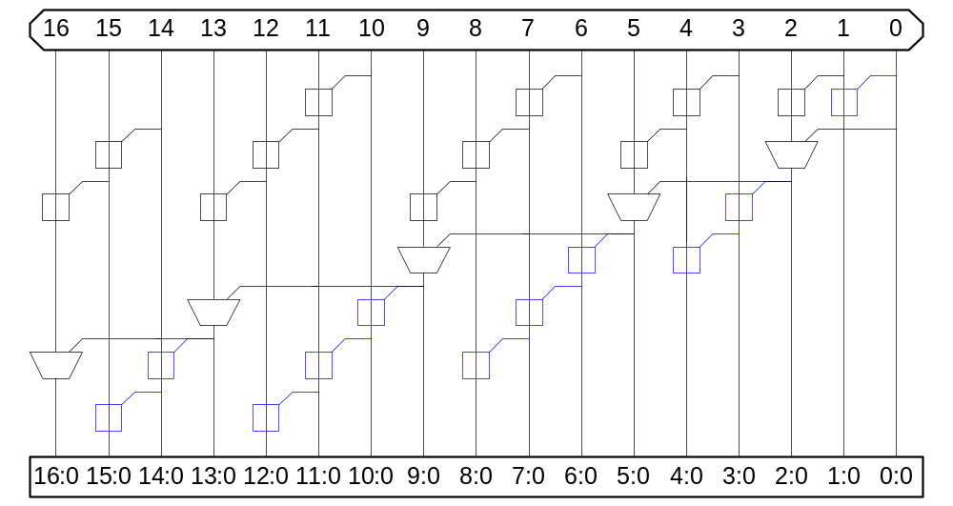
Variable Group Size
Delay grows as O(sqrt(N))
17: Adders

Slide 21
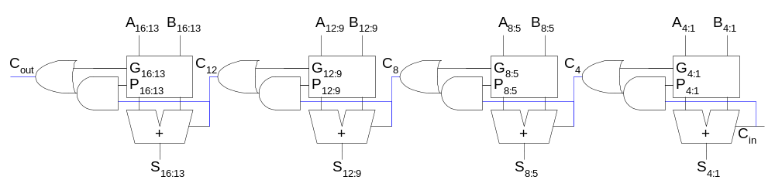
Carry-Lookahead Adder
Carry-lookahead adder computes G_{i:0} for many bits in parallel.
Uses higher-valency cells with more than two inputs.
17: Adders

Slide 22
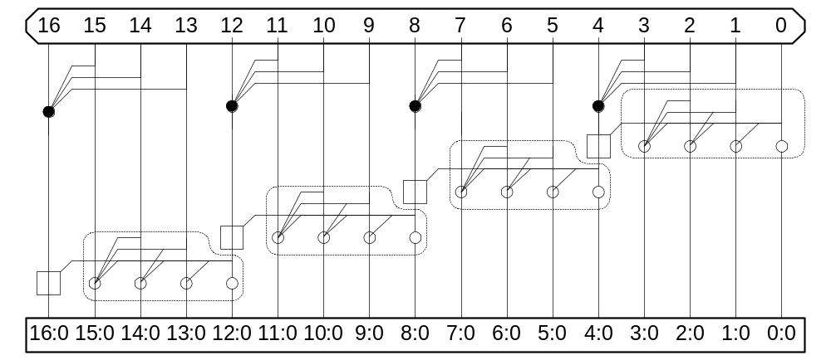
CLA PG Diagram
17: Adders

Slide 23
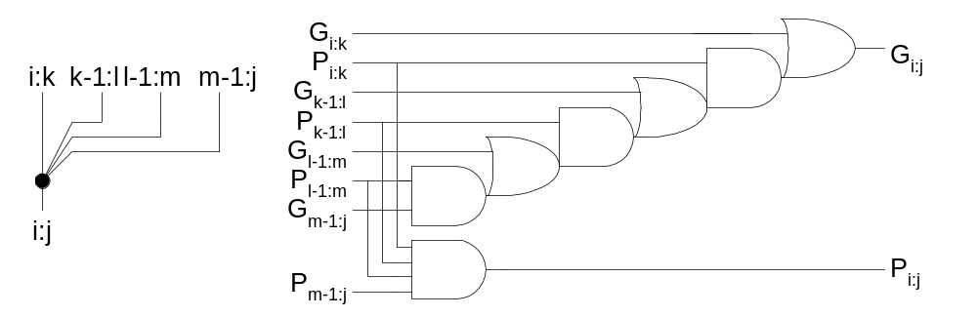
Higher-Valency Cells
17: Adders

Slide 24
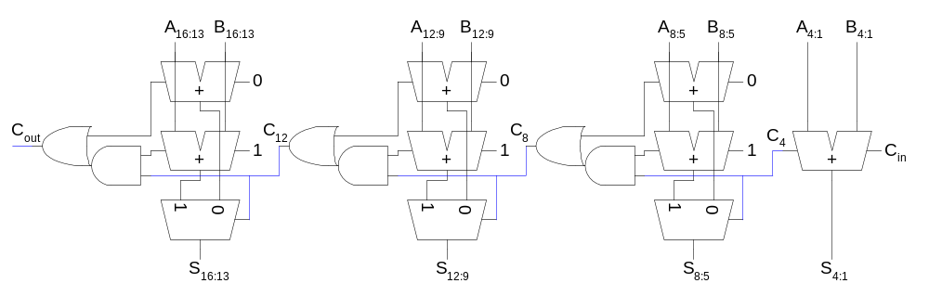
Carry-Select Adder
Trick for critical paths dependent on late input X
  Precompute two possible outputs for X = 0, 1
  Select proper output when X arrives
Carry-select adder precomputes n-bit sums
  For both possible carries into n-bit group
17: Adders

Slide 25
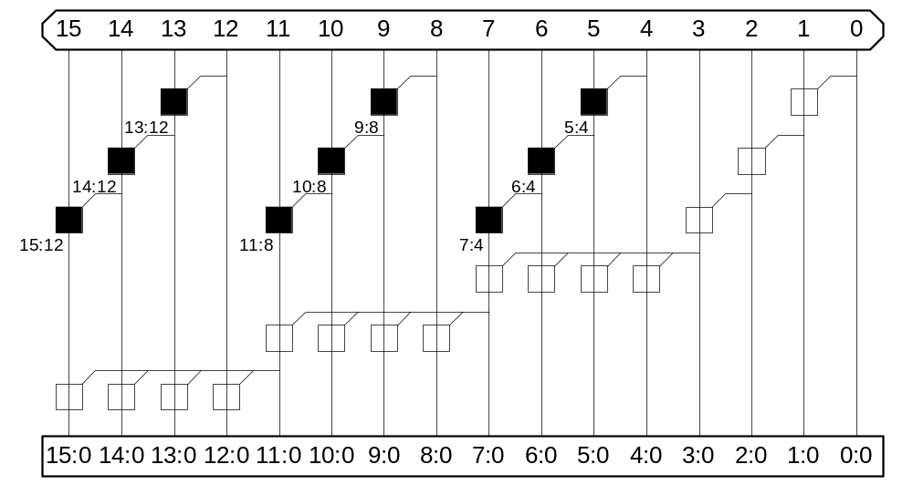
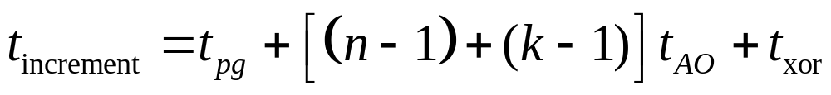
Carry-Increment Adder
Factor initial PG and final XOR out of carry-select
17: Adders

Slide 26
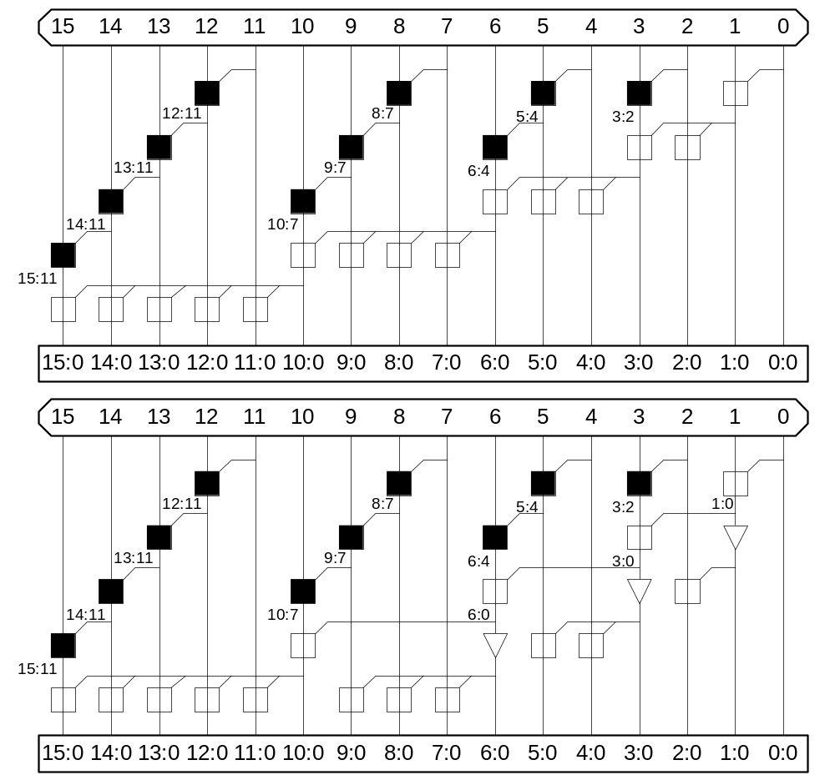
Variable Group Size
Also buffer
noncritical
signals
17: Adders

Slide 27
Tree Adder
If lookahead is good, lookahead across lookahead!
  Recursive lookahead gives O(log N) delay
Many variations on tree adders
17: Adders

Slide 28
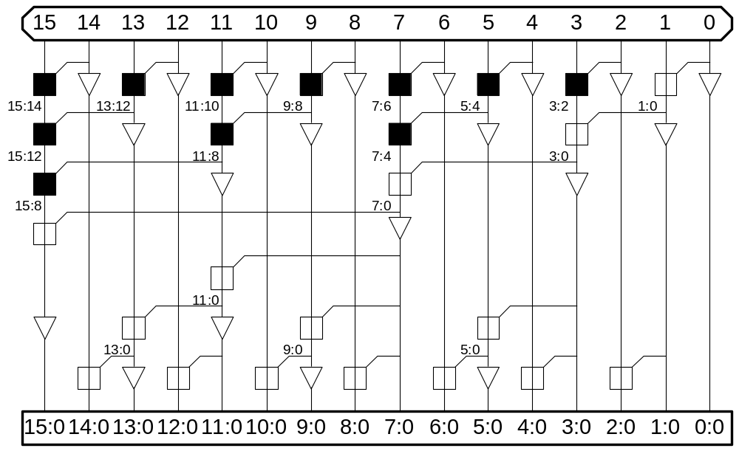
Brent-Kung
17: Adders

Slide 29
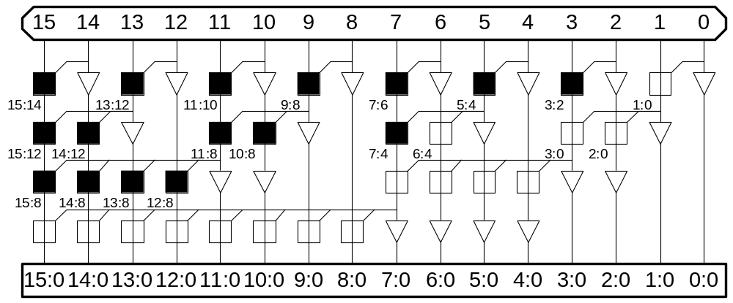
Sklansky
17: Adders

Slide 30
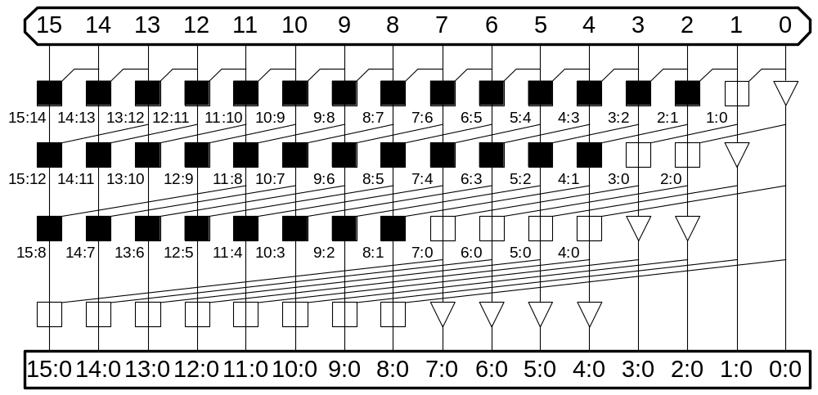
Kogge-Stone
17: Adders

Slide 31
Tree Adder Taxonomy
Ideal N-bit tree adder would have
  L = log N logic levels
  Fanout never exceeding 2
  No more than one wiring track between levels
Describe adder with 3-D taxonomy (l, f, t)
  Logic levels: L + l
  Fanout: 2^{f} + 1
  Wiring tracks: 2^{t}
Known tree adders sit on plane defined by
l + f + t = L-1
17: Adders

Slide 32
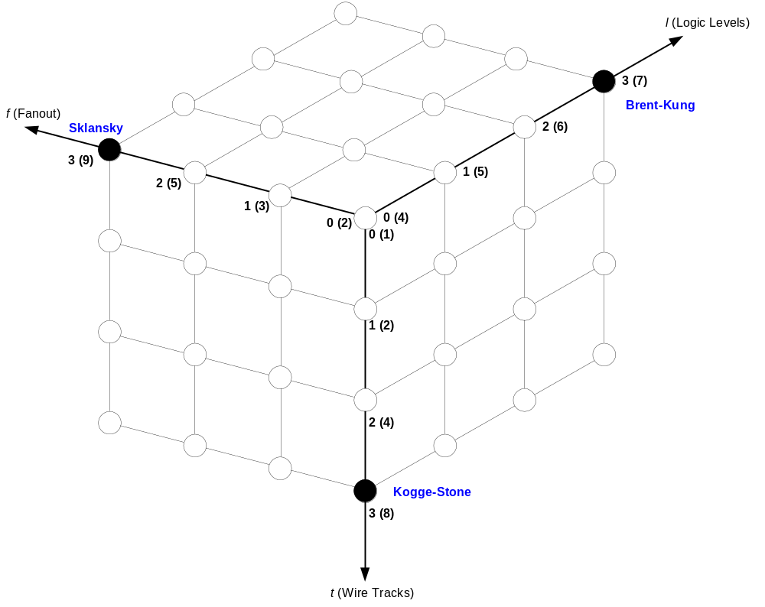
Tree Adder Taxonomy
17: Adders

Slide 33
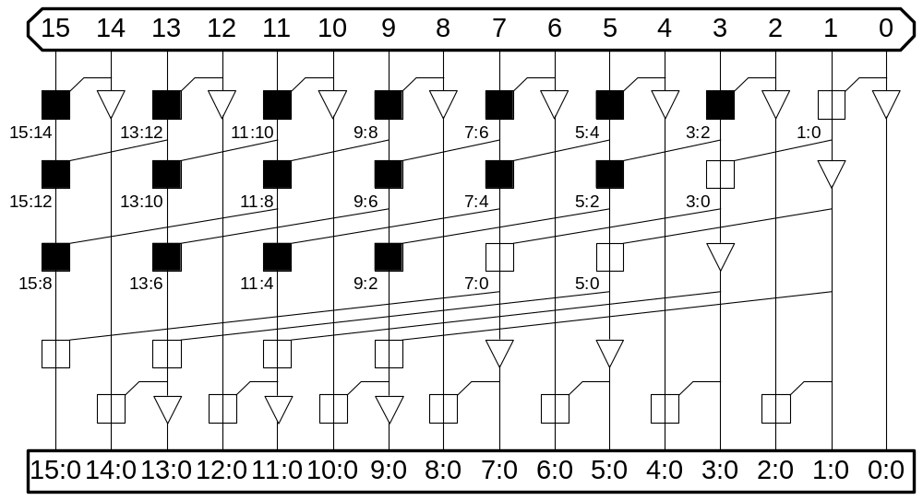
Han-Carlson
17: Adders

Slide 34

Knowles [2, 1, 1, 1]
17: Adders

Slide 35
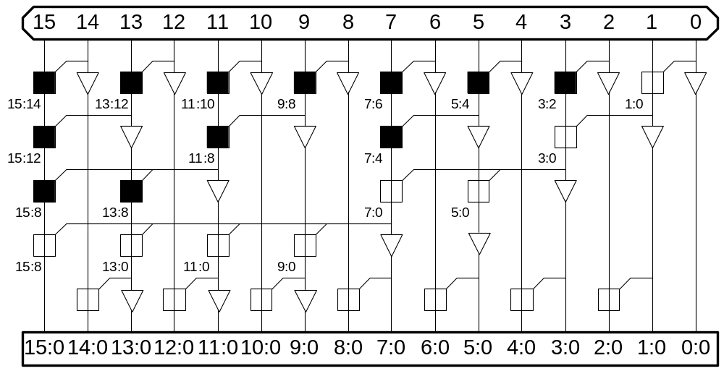
Ladner-Fischer
17: Adders

Slide 36
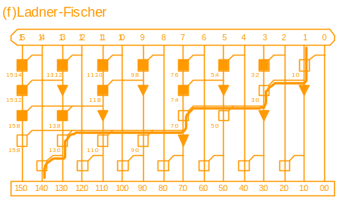
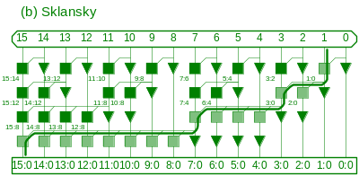
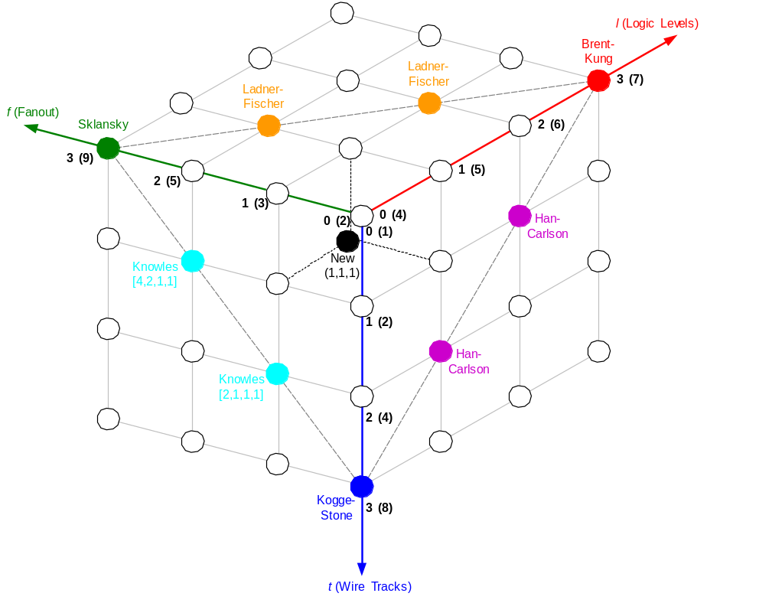
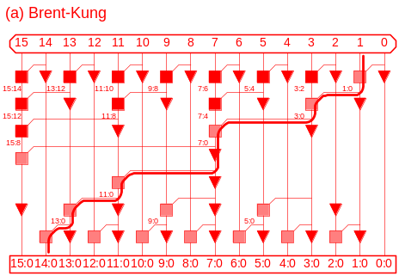
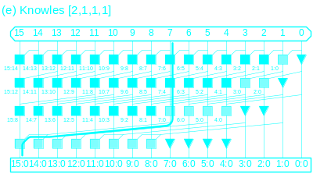
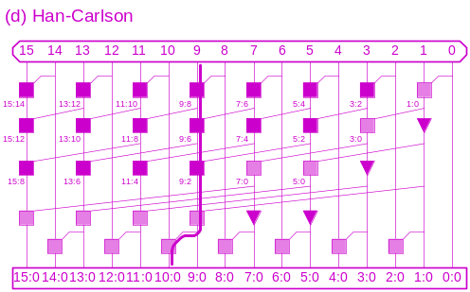
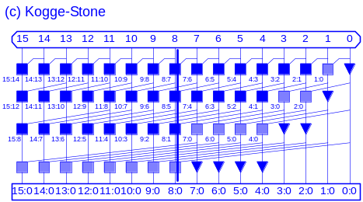
Taxonomy Revisited
17: Adders

Slide 37
Summary
Adder architectures offer area / power / delay tradeoffs.
Choose the best one for your application.
Architecture | Classification | Logic Levels | Max Fanout | Tracks | Cells
Carry-Ripple |  | N-1 | 1 | 1 | N
Carry-Skip n=4 |  | N/4 + 5 | 2 | 1 | 1.25N
Carry-Inc. n=4 |  | N/4 + 2 | 4 | 1 | 2N
Brent-Kung | (L-1, 0, 0) | 2log₂N – 1 | 2 | 1 | 2N
Sklansky | (0, L-1, 0) | log₂N | N/2 + 1 | 1 | 0.5 Nlog₂N
Kogge-Stone | (0, 0, L-1) | log₂N | 2 | N/2 | Nlog₂N
17: Adders

