Slide 1

Lecture 13:
Datapath
Functional
Units

Slide 2
Outline
Comparators
Shifters
Multi-input Adders
Multipliers
18: Datapath Functional Units

Slide 3
Comparators
0’s detector: A = 00…000
1’s detector: A = 11…111
Equality comparator: A = B
Magnitude comparator: A < B
18: Datapath Functional Units

Slide 4
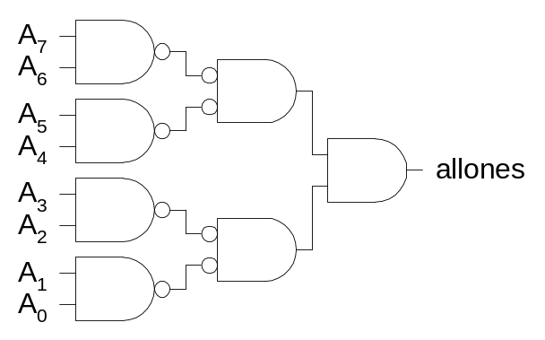
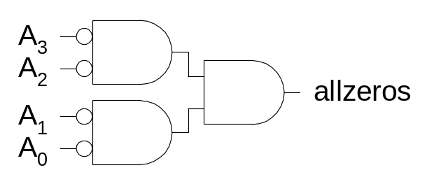
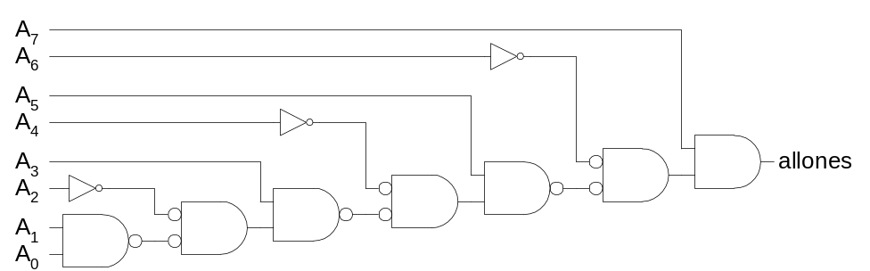
1’s & 0’s Detectors
1’s detector: N-input AND gate
0’s detector: NOTs + 1’s detector (N-input NOR)
18: Datapath Functional Units

Slide 5
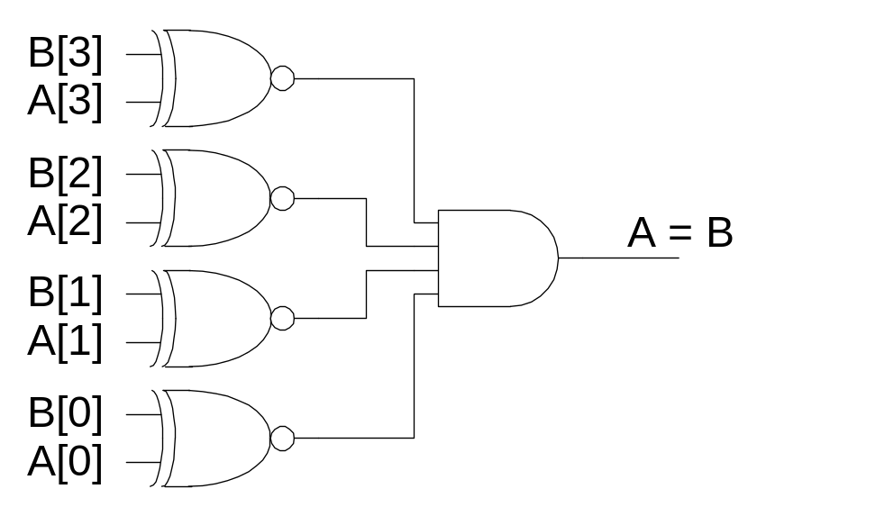
Equality Comparator
Check if each bit is equal (XNOR, aka equality gate)
1’s detect on bitwise equality
18: Datapath Functional Units

Slide 6
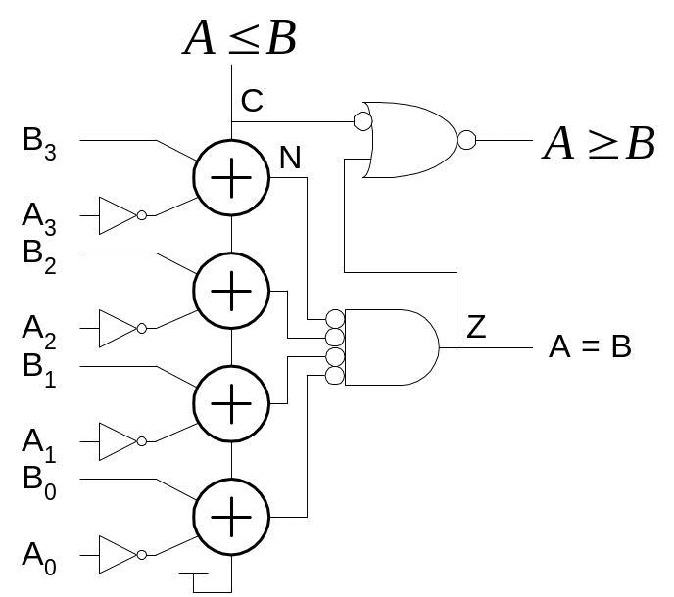
Magnitude Comparator
Compute B – A and look at sign
B – A = B + ~A + 1
For unsigned numbers, carry out is sign bit
18: Datapath Functional Units

Slide 7
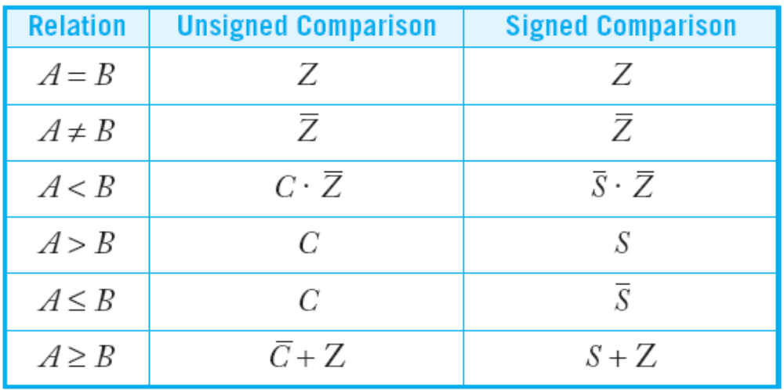
Signed vs. Unsigned
For signed numbers, comparison is harder
  C: carry out
  Z: zero (all bits of A – B are 0)
  N: negative (MSB of result)
  V: overflow (inputs had different signs, output sign ≠ B)
  S: N xor V (sign of result)
18: Datapath Functional Units

Slide 8
Shifters
Logical Shift:
  Shifts number left or right and fills with 0’s
    1011 LSR 1 = 0101 1011 LSL1 = 0110
Arithmetic Shift:
  Shifts number left or right. Rt shift sign extends
    1011 ASR1 = 1101 1011 ASL1 = 0110
Rotate:
  Shifts number left or right and fills with lost bits
    1011 ROR1 = 1101 1011 ROL1 = 0111
18: Datapath Functional Units

Slide 9
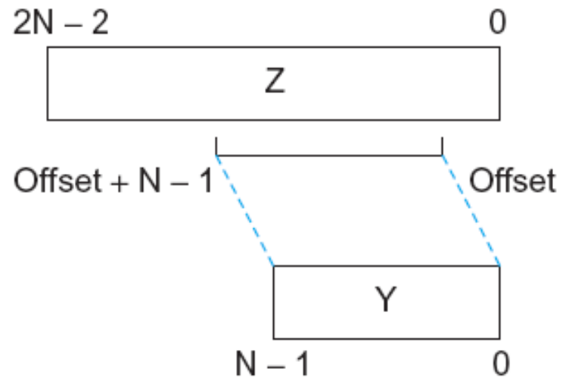
Funnel Shifter
A funnel shifter can do all six types of shifts
Selects N-bit field Y from 2N–1-bit input
  Shift by k bits (0 ≤ k < N)
  Logically involves N N:1 multiplexers
18: Datapath Functional Units

Slide 10
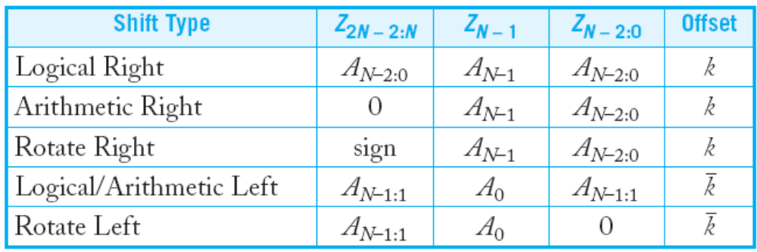
Funnel Source Generator
Rotate Right
Logical Right
Arithmetic Right
Rotate Left
Logical/Arithmetic Left
18: Datapath Functional Units

Slide 11
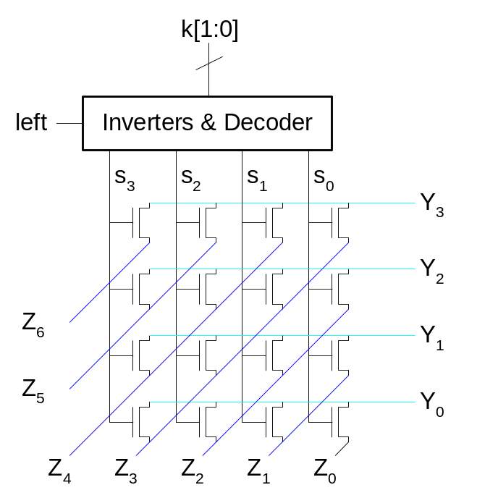
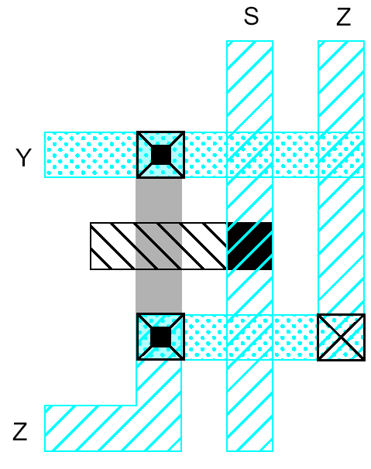
Array Funnel Shifter
N N-input multiplexers
  Use 1-of-N hot select signals for shift amount
  nMOS pass transistor design (V_{t} drops!)
18: Datapath Functional Units

Slide 12
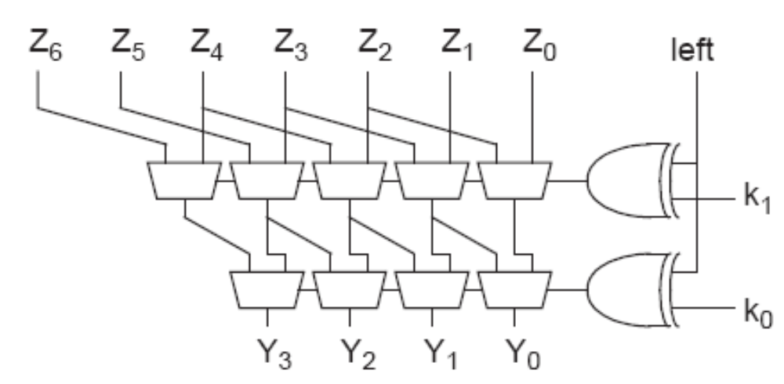
Logarithmic Funnel Shifter
Log N stages of 2-input muxes
  No select decoding needed
18: Datapath Functional Units

Slide 13
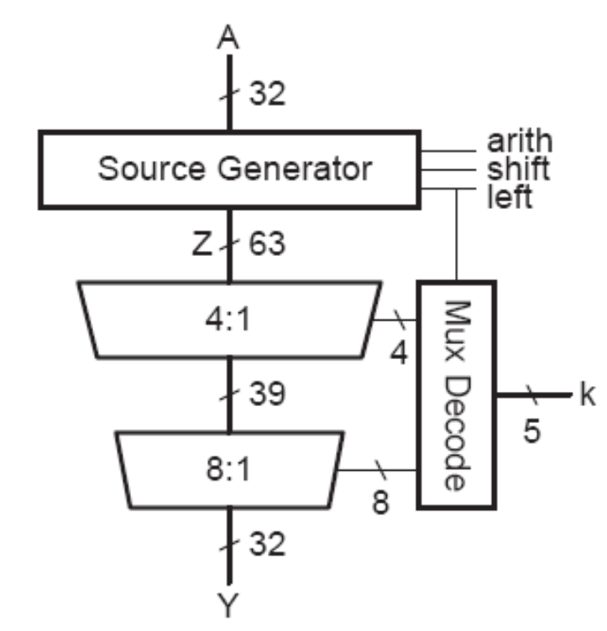
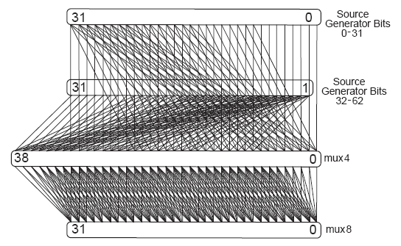
32-bit Logarithmic Funnel
Wider multiplexers reduce delay and power
Operands > 32 bits introduce datapath irregularity
18: Datapath Functional Units

Slide 14
Barrel Shifter
Barrel shifters perform right rotations using wrap-around wires.
Left rotations are right rotations by N – k = k + 1 bits.
Shifts are rotations with the end bits masked off.
18: Datapath Functional Units

Slide 15
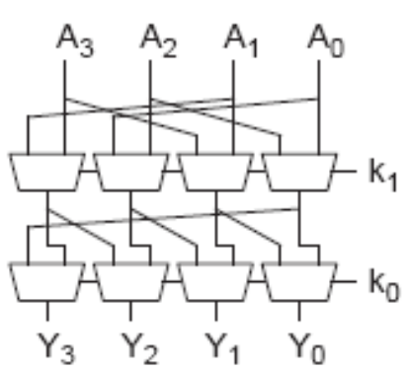
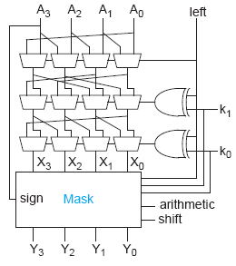
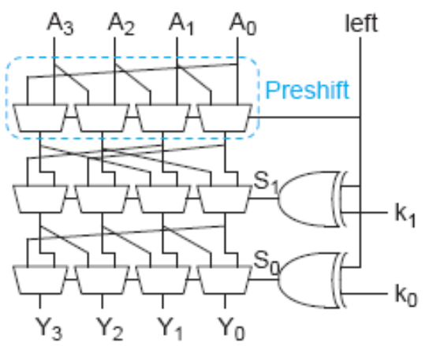
Logarithmic Barrel Shifter
Right shift only
Right/Left shift
Right/Left Shift & Rotate
18: Datapath Functional Units

Slide 16
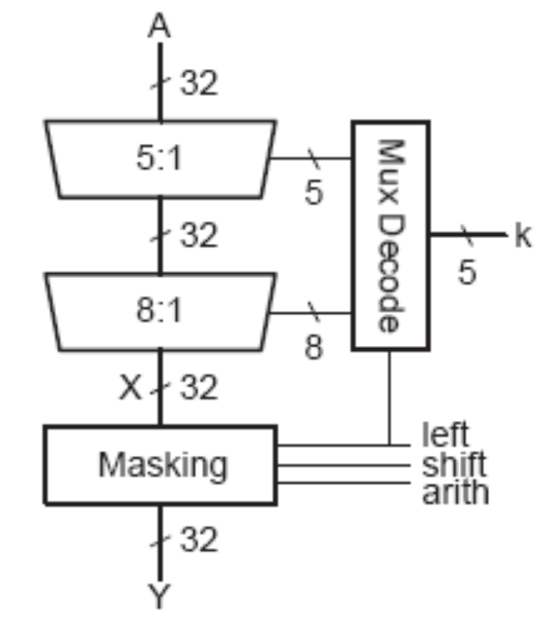
32-bit Logarithmic Barrel
Datapath never wider than 32 bits
First stage preshifts by 1 to handle left shifts
18: Datapath Functional Units

Slide 17
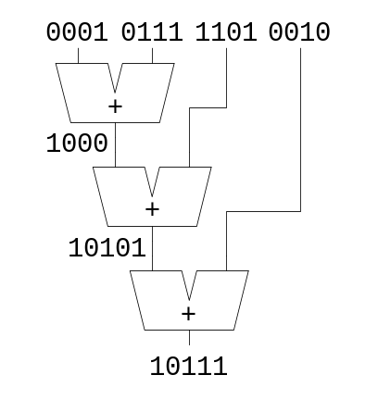
Multi-input Adders
Suppose we want to add k N-bit words
  Ex: 0001 + 0111 + 1101 + 0010 = 10111
Straightforward solution: k-1 N-input CPAs
  Large and slow
18: Datapath Functional Units

Slide 18
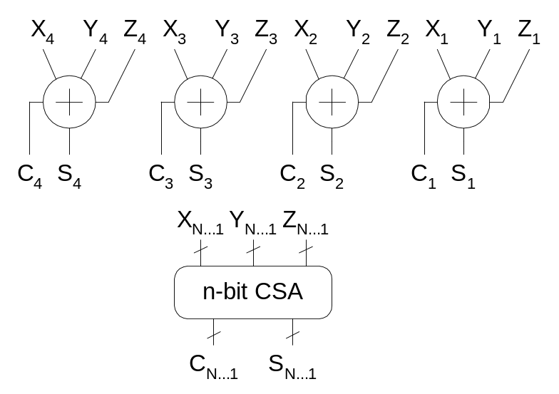
Carry Save Addition
A full adder sums 3 inputs and produces 2 outputs
  Carry output has twice weight of sum output
N full adders in parallel are called carry save adder
  Produce N sums and N carry outs
18: Datapath Functional Units

Slide 19
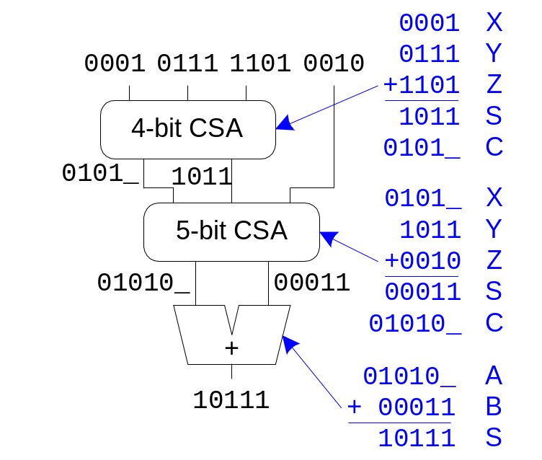
CSA Application
Use k-2 stages of CSAs
  Keep result in carry-save redundant form
Final CPA computes actual result
18: Datapath Functional Units

Slide 20
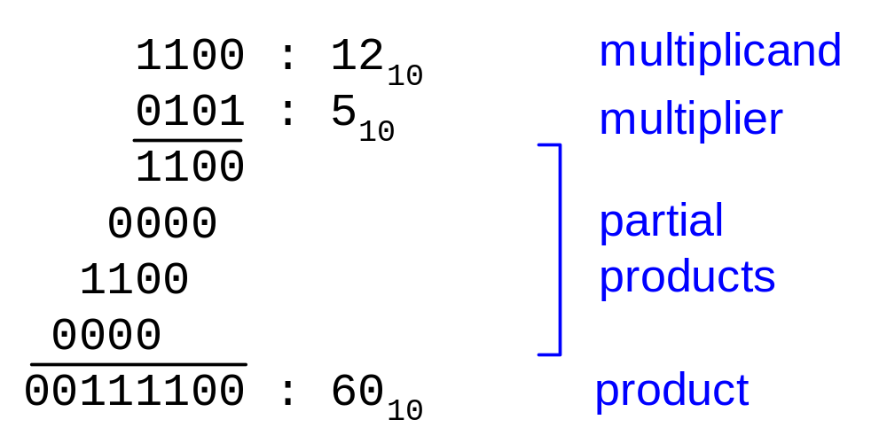
Multiplication
Example:
M x N-bit multiplication
  Produce N M-bit partial products
  Sum these to produce M+N-bit product
18: Datapath Functional Units

Slide 21
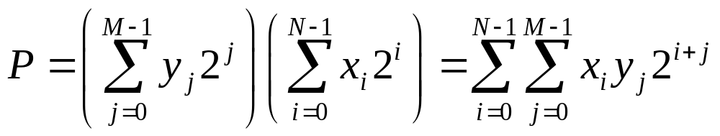
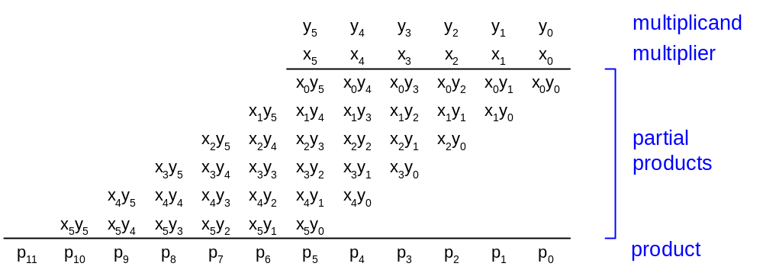
General Form
Multiplicand: Y = (y_{M-1}, y_{M-2}, …, y₁, y₀)
Multiplier: X = (x_{N-1}, x_{N-2}, …, x₁, x₀)
Product:
18: Datapath Functional Units

Slide 22
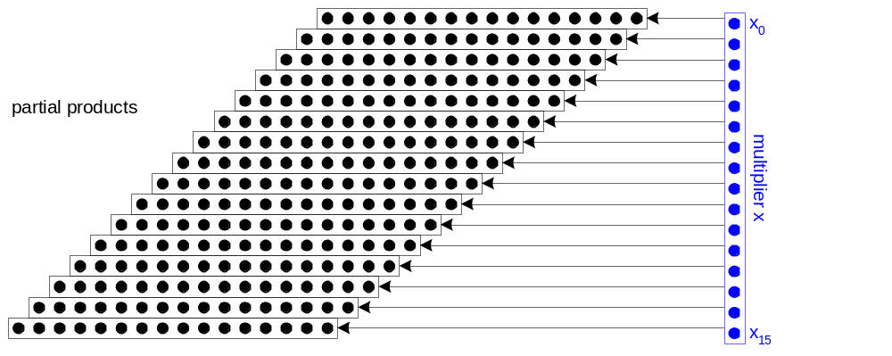
Dot Diagram
Each dot represents a bit
18: Datapath Functional Units

Slide 23
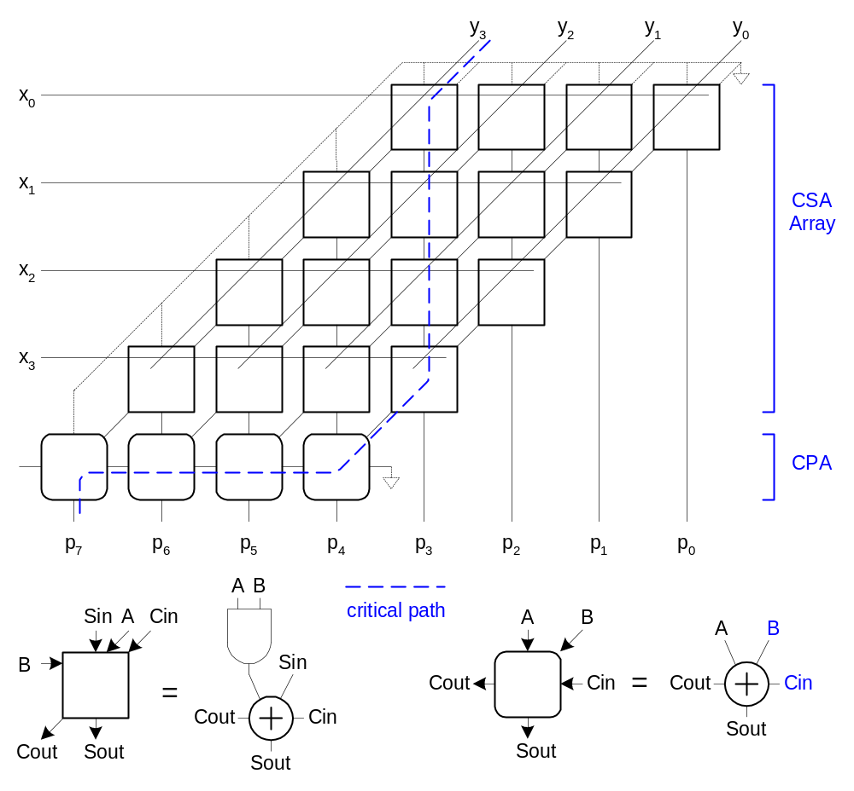
Array Multiplier
18: Datapath Functional Units

Slide 24
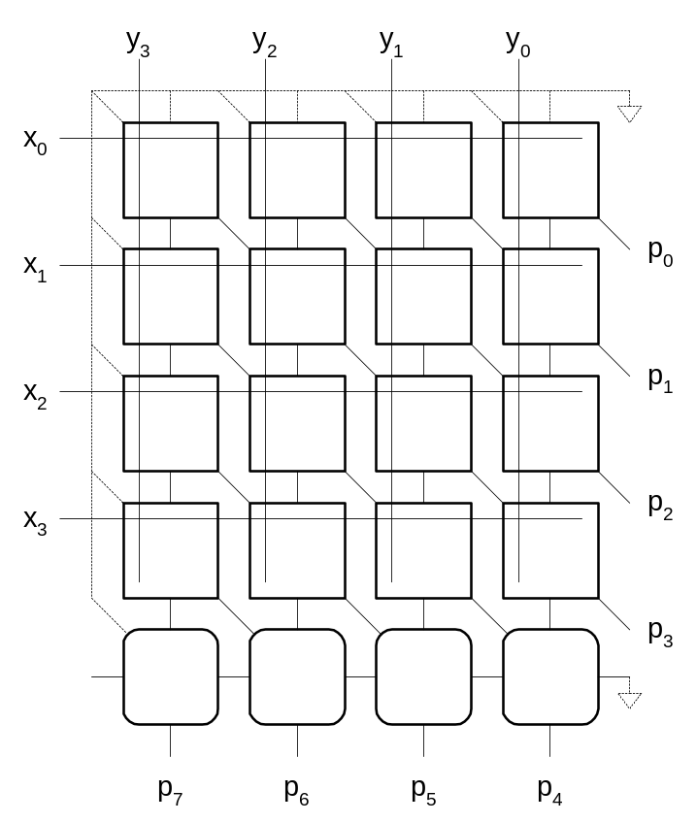
Rectangular Array
Squash array to fit rectangular floorplan
18: Datapath Functional Units

Slide 25
Fewer Partial Products
Array multiplier requires N partial products
If we looked at groups of r bits, we could form N/r partial products.
  Faster and smaller?
  Called radix-2^{r} encoding
Ex: r = 2: look at pairs of bits
  Form partial products of 0, Y, 2Y, 3Y
  First three are easy, but 3Y requires adder ☹
18: Datapath Functional Units

Slide 26
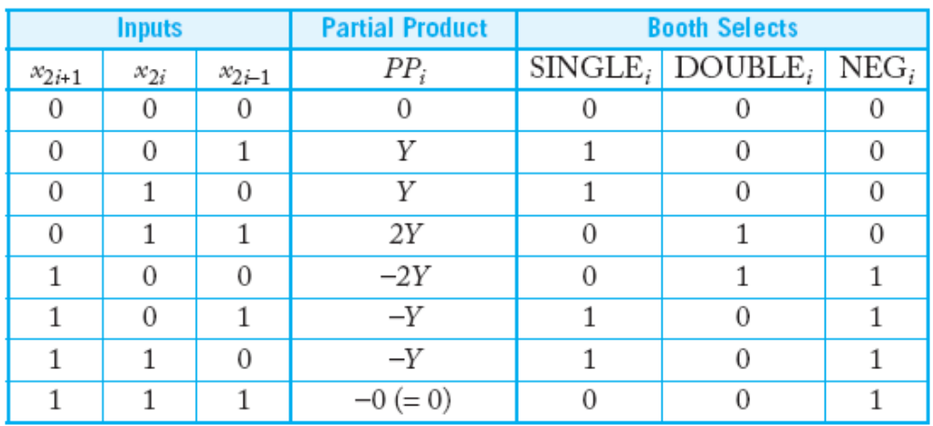
Booth Encoding
Instead of 3Y, try –Y, then increment next partial product to add 4Y
Similarly, for 2Y, try –2Y + 4Y in next partial product
18: Datapath Functional Units

Slide 27
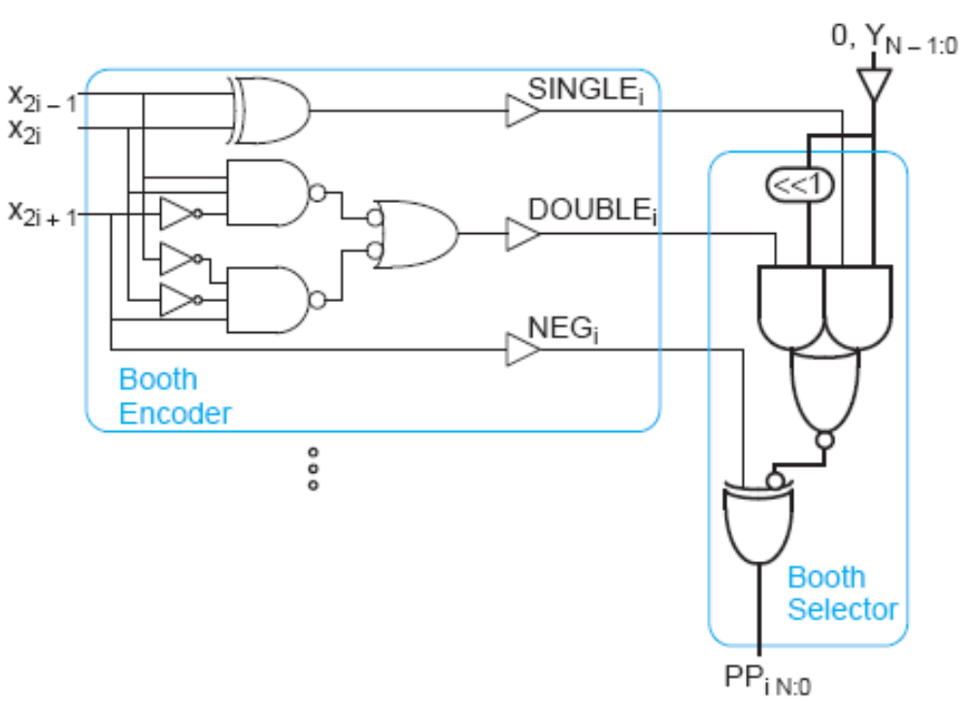
Booth Hardware
Booth encoder generates control lines for each PP
  Booth selectors choose PP bits
18: Datapath Functional Units

Slide 28
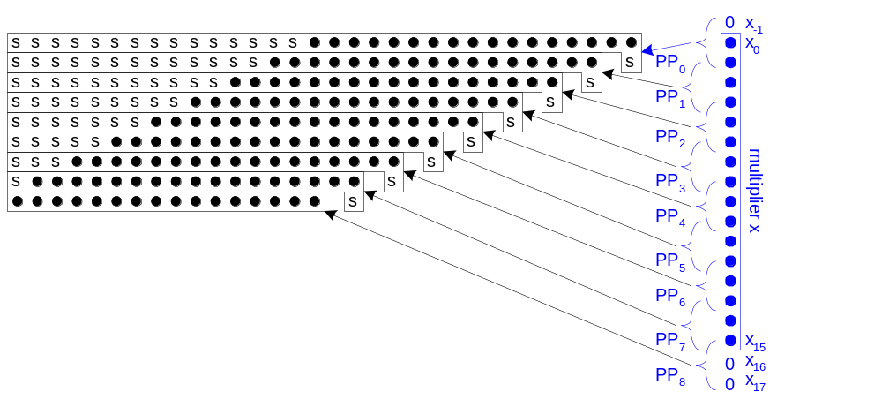
Sign Extension
Partial products can be negative
  Require sign extension, which is cumbersome
  High fanout on most significant bit
18: Datapath Functional Units

Slide 29
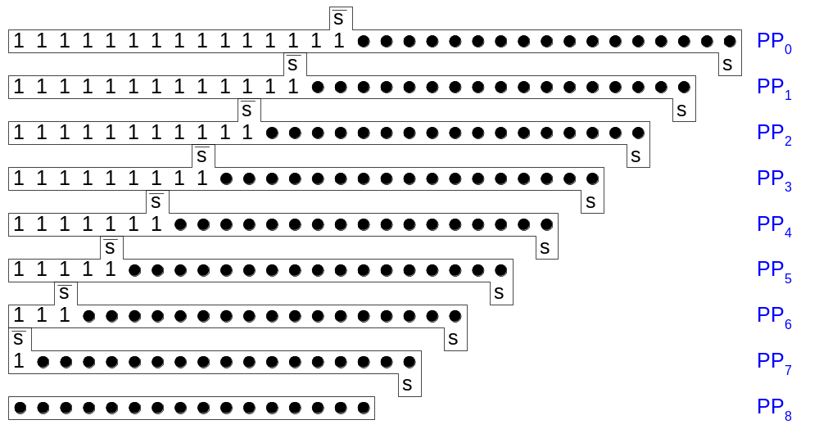
Simplified Sign Ext.
Sign bits are either all 0’s or all 1’s
  Note that all 0’s is all 1’s + 1 in proper column
  Use this to reduce loading on MSB
18: Datapath Functional Units

Slide 30
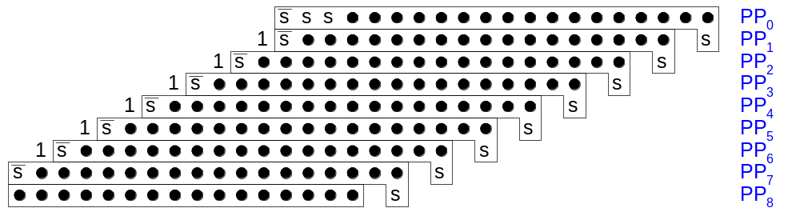
Even Simpler Sign Ext.
No need to add all the 1’s in hardware
  Precompute the answer!
18: Datapath Functional Units

Slide 31
Advanced Multiplication
Signed vs. unsigned inputs
Higher radix Booth encoding
Array vs. tree CSA networks
18: Datapath Functional Units

