Slide 1

Lecture 15:
SRAM

Slide 2
Outline
Memory Arrays
SRAM Architecture
  SRAM Cell
  Decoders
  Column Circuitry
  Multiple Ports
Serial Access Memories
19: SRAM

Slide 3
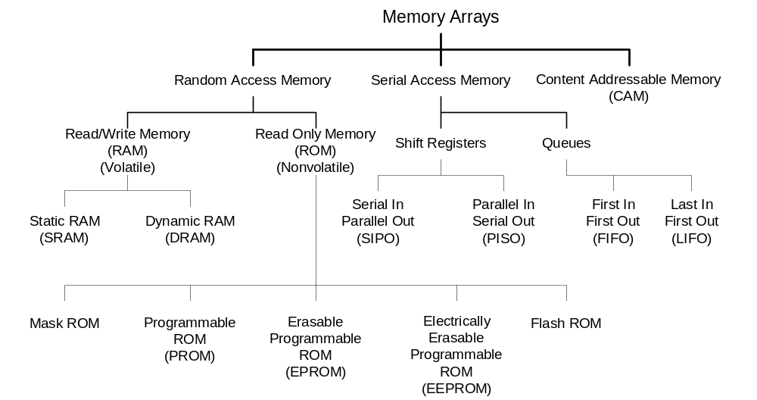
Memory Arrays
19: SRAM

Slide 4
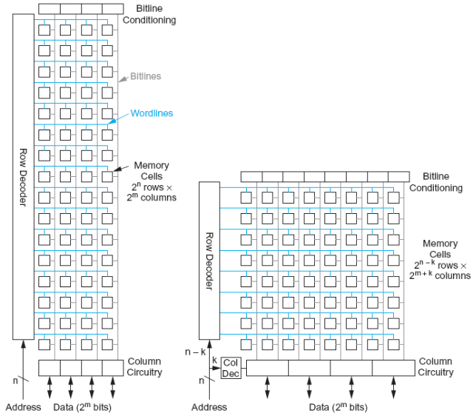
Array Architecture
2^{n} words of 2^{m} bits each
If n >> m, fold by 2^{k} into fewer rows of more columns
Good regularity – easy to design
Very high density if good cells are used
19: SRAM

Slide 5
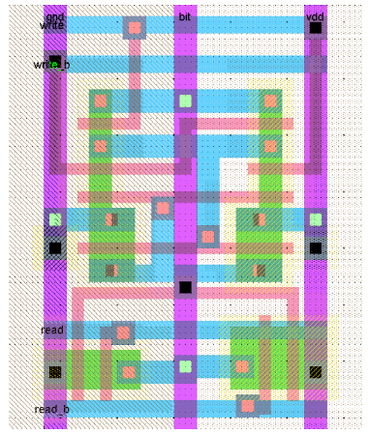
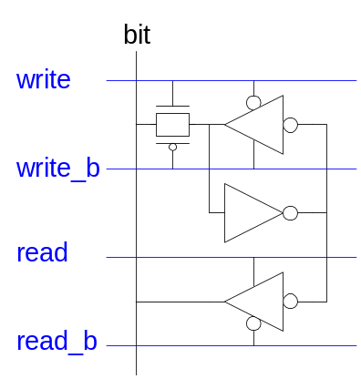
12T SRAM Cell
Basic building block: SRAM Cell
  Holds one bit of information, like a latch
  Must be read and written
12-transistor (12T) SRAM cell
  Use a simple latch connected to bitline
  46 x 75 λ unit cell
19: SRAM

Slide 6
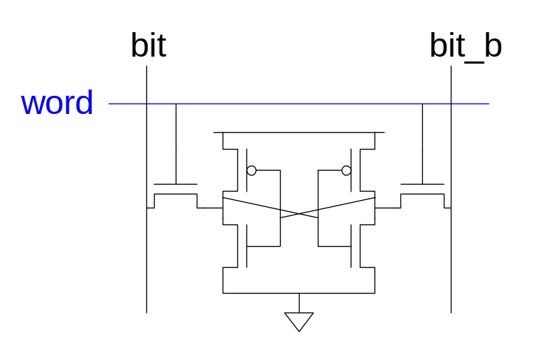
6T SRAM Cell
Cell size accounts for most of array size
  Reduce cell size at expense of complexity
6T SRAM Cell
  Used in most commercial chips
  Data stored in cross-coupled inverters
Read:
  Precharge bit, bit_b
  Raise wordline
Write:
  Drive data onto bit, bit_b
  Raise wordline
19: SRAM

Slide 7
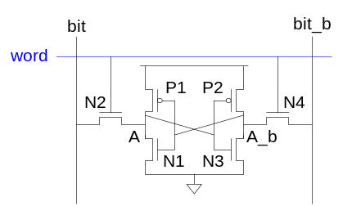
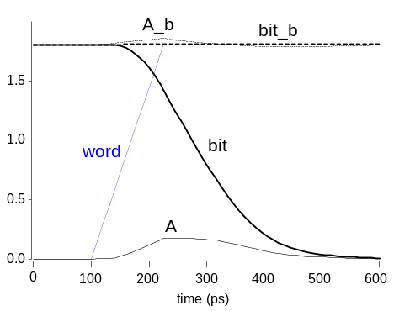
SRAM Read
Precharge both bitlines high
Then turn on wordline
One of the two bitlines will be pulled down by the cell
Ex: A = 0, A_b = 1
  bit discharges, bit_b stays high
  But A bumps up slightly
Read stability
  A must not flip
  N1 >> N2
19: SRAM

Slide 8
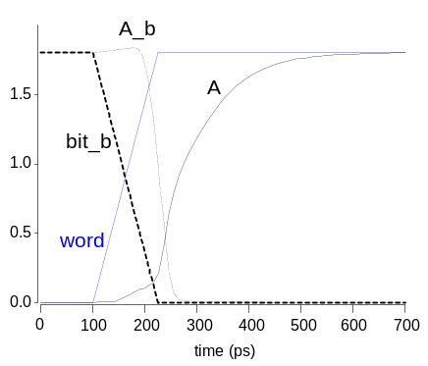
SRAM Write
Drive one bitline high, the other low
Then turn on wordline
Bitlines overpower cell with new value
Ex: A = 0, A_b = 1, bit = 1, bit_b = 0
  Force A_b low, then A rises high
Writability
  Must overpower feedback inverter
  N2 >> P1
19: SRAM

Slide 9
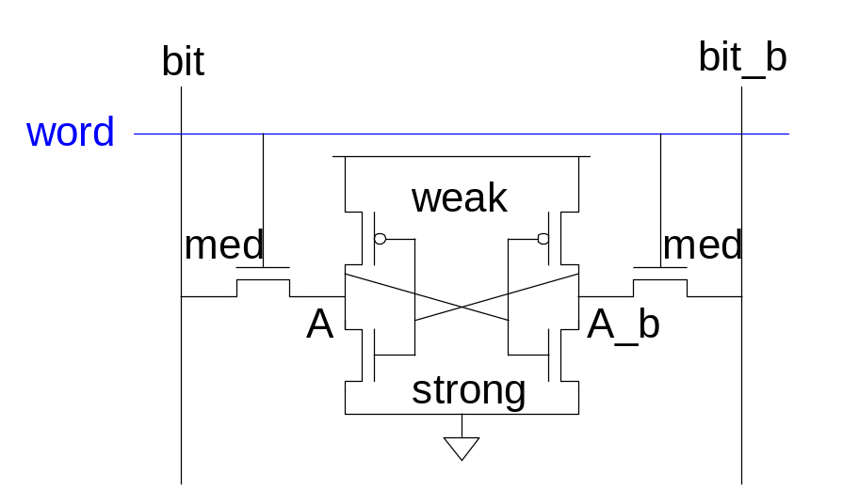
SRAM Sizing
High bitlines must not overpower inverters during reads
But low bitlines must write new value into cell
19: SRAM

Slide 10
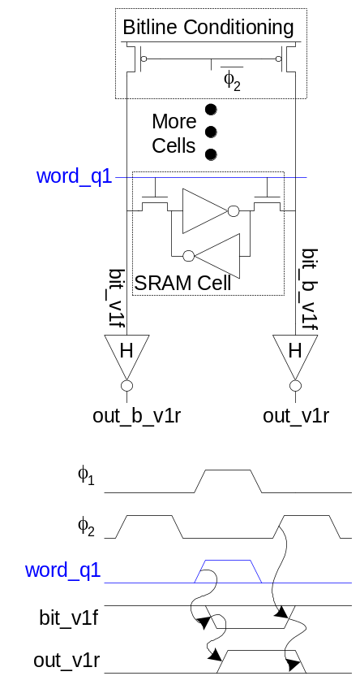
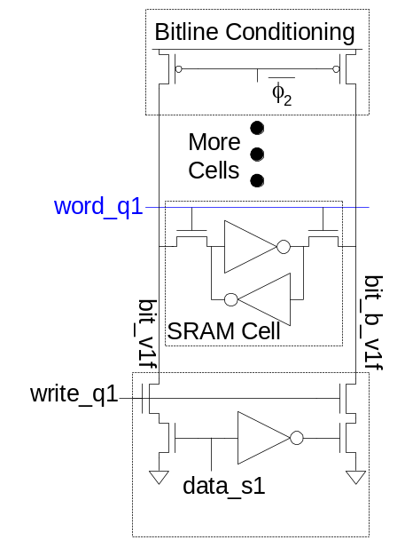
SRAM Column Example
Read Write
19: SRAM

Slide 11
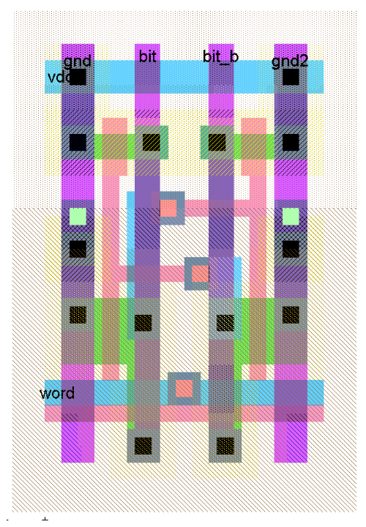
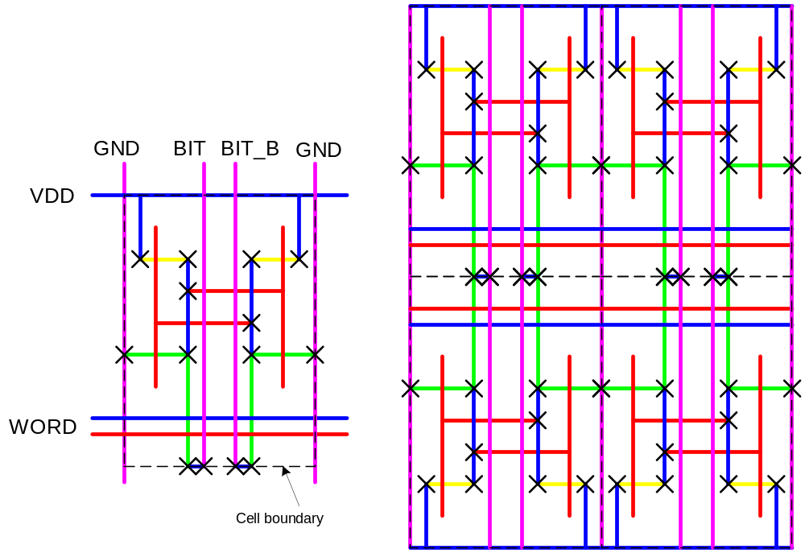
SRAM Layout
Cell size is critical: 26 x 45 λ (even smaller in industry)
Tile cells sharing V_{DD}, GND, bitline contacts
19: SRAM

Slide 12
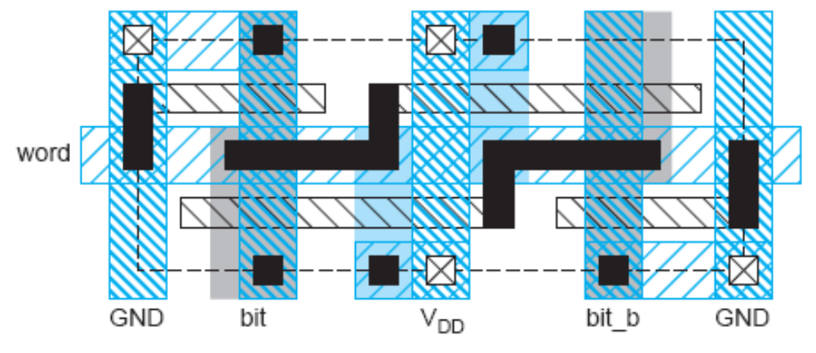
Thin Cell
In nanometer CMOS
  Avoid bends in polysilicon and diffusion
  Orient all transistors in one direction
Lithographically friendly or thin cell layout fixes this
  Also reduces length and capacitance of bitlines
19: SRAM

Slide 13
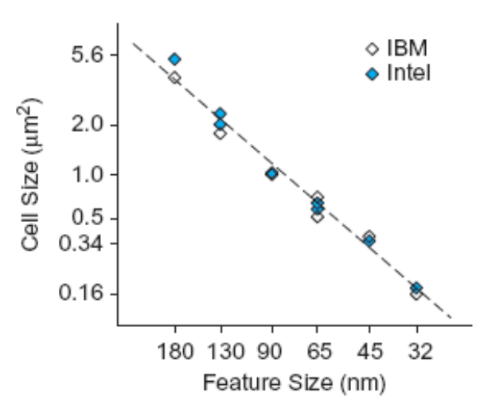
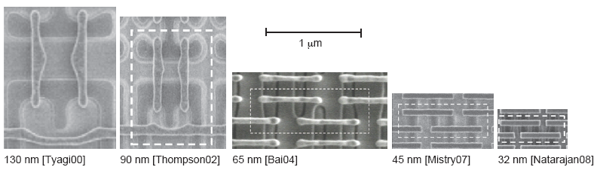
Commercial SRAMs
Five generations of Intel SRAM cell micrographs
  Transition to thin cell at 65 nm
  Steady scaling of cell area
19: SRAM

Slide 14
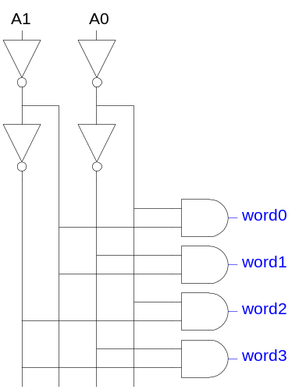
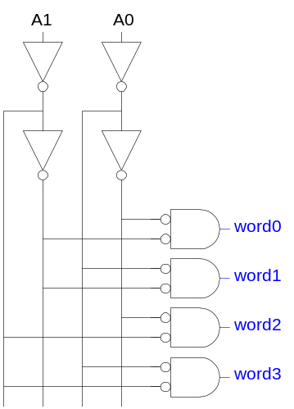
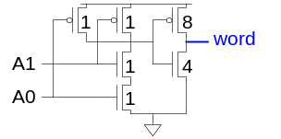
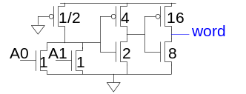
Decoders
n:2^{n} decoder consists of 2^{n} n-input AND gates
  One needed for each row of memory
  Build AND from NAND or NOR gates
Static CMOS Pseudo-nMOS
19: SRAM

Slide 15
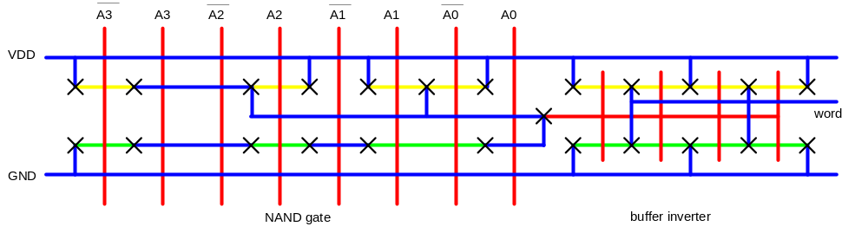
Decoder Layout
Decoders must be pitch-matched to SRAM cell
  Requires very skinny gates
19: SRAM

Slide 16
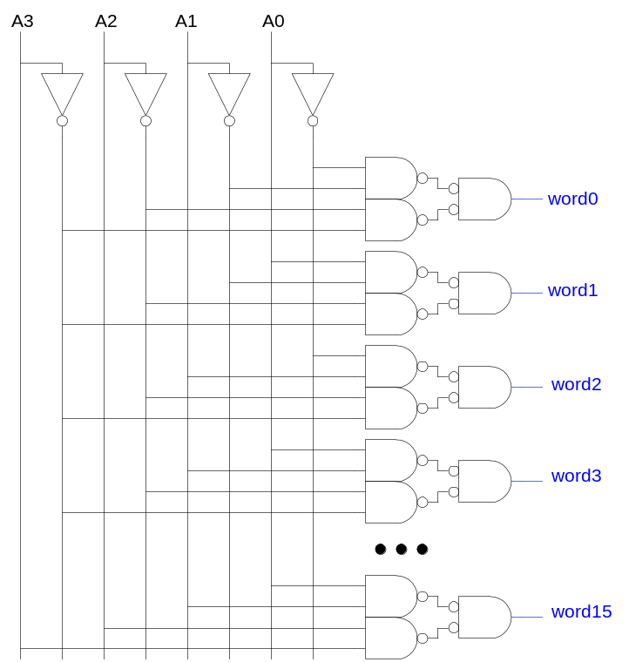
Large Decoders
For n > 4, NAND gates become slow
  Break large gates into multiple smaller gates
19: SRAM

Slide 17
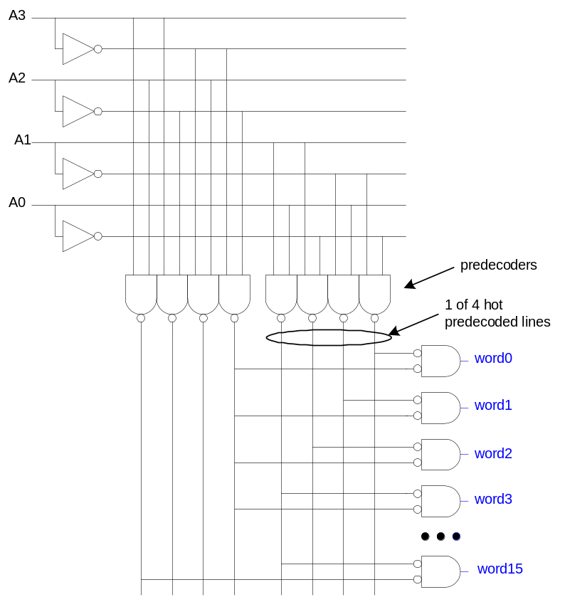
Predecoding
Many of these gates are redundant
  Factor out common
  gates into predecoder
  Saves area
  Same path effort
19: SRAM

Slide 18
Column Circuitry
Some circuitry is required for each column
  Bitline conditioning
  Sense amplifiers
  Column multiplexing
19: SRAM

Slide 19
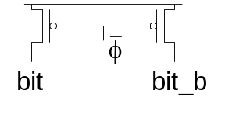
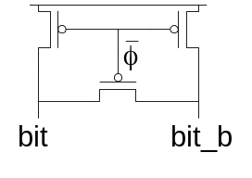
Bitline Conditioning
Precharge bitlines high before reads
Equalize bitlines to minimize voltage difference when using sense amplifiers
19: SRAM

Slide 20
Sense Amplifiers
Bitlines have many cells attached
  Ex: 32-kbit SRAM has 128 rows x 256 cols
  128 cells on each bitline
t_{pd} ~ (C/I) ΔV
  Even with shared diffusion contacts, 64C of diffusion capacitance (big C)
  Discharged slowly through small transistors (small I)
Sense amplifiers are triggered on small voltage swing (reduce ΔV)
19: SRAM

Slide 21
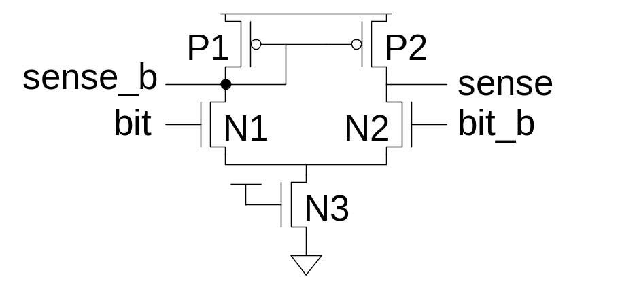
Differential Pair Amp
Differential pair requires no clock
But always dissipates static power
19: SRAM

Slide 22
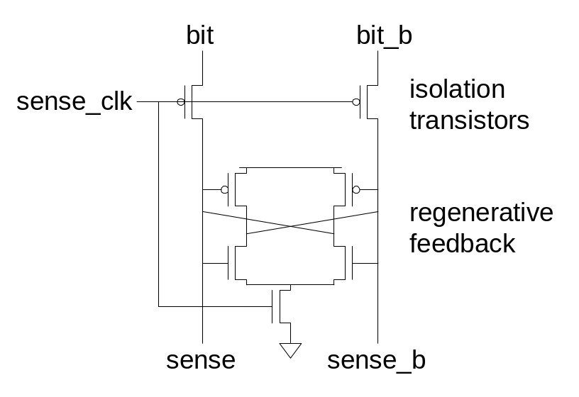
Clocked Sense Amp
Clocked sense amp saves power
Requires sense_clk after enough bitline swing
Isolation transistors cut off large bitline capacitance
19: SRAM

Slide 23
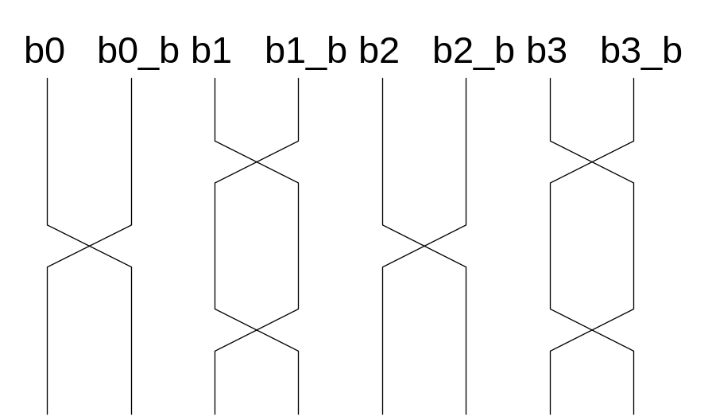
Twisted Bitlines
Sense amplifiers also amplify noise
  Coupling noise is severe in modern processes
  Try to couple equally onto bit and bit_b
  Done by twisting bitlines
19: SRAM

Slide 24
Column Multiplexing
Recall that array may be folded for good aspect ratio
Ex: 2 kword x 16 folded into 256 rows x 128 columns
  Must select 16 output bits from the 128 columns
  Requires 16 8:1 column multiplexers
19: SRAM

Slide 25
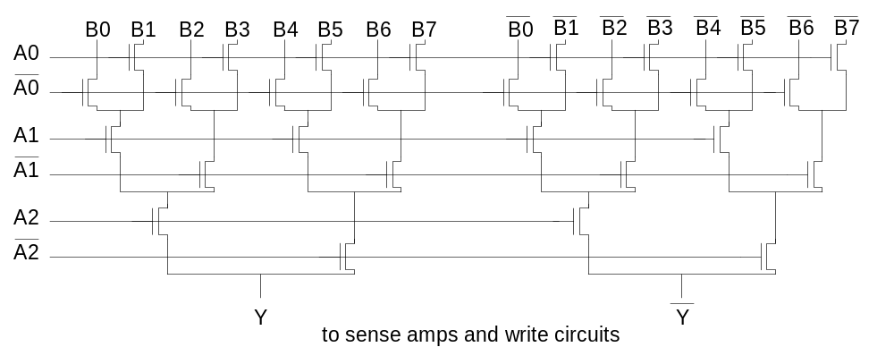
Tree Decoder Mux
Column mux can use pass transistors
  Use nMOS only, precharge outputs
One design is to use k series transistors for 2^{k}:1 mux
  No external decoder logic needed
19: SRAM

Slide 26
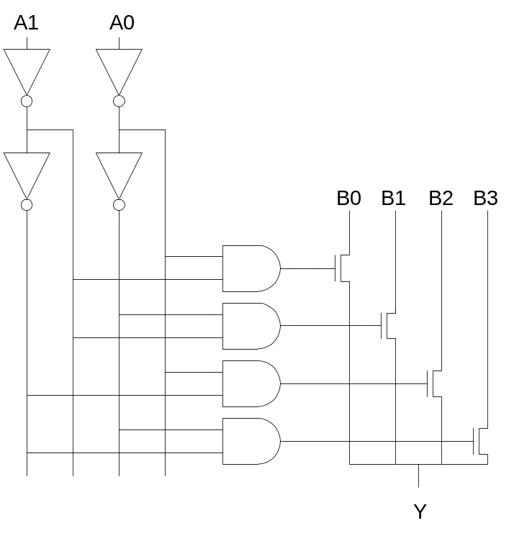
Single Pass-Gate Mux
Or eliminate series transistors with separate decoder
19: SRAM

Slide 27
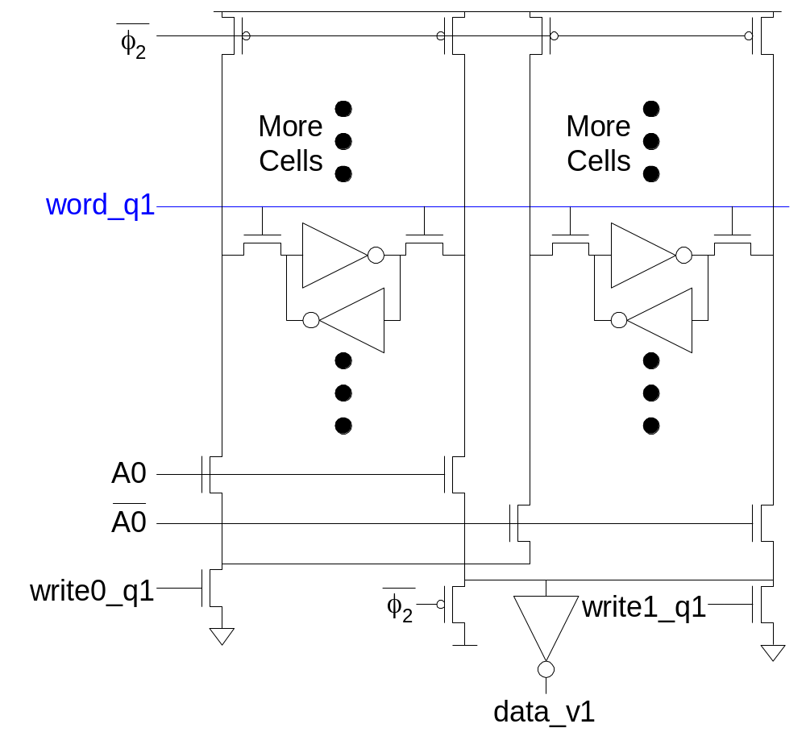
Ex: 2-way Muxed SRAM
19: SRAM

Slide 28
Multiple Ports
We have considered single-ported SRAM
  One read or one write on each cycle
Multiported SRAM are needed for register files
Examples:
  Multicycle MIPS must read two sources or write a result on some cycles
  Pipelined MIPS must read two sources and write a third result each cycle
  Superscalar MIPS must read and write many sources and results each cycle
19: SRAM

Slide 29
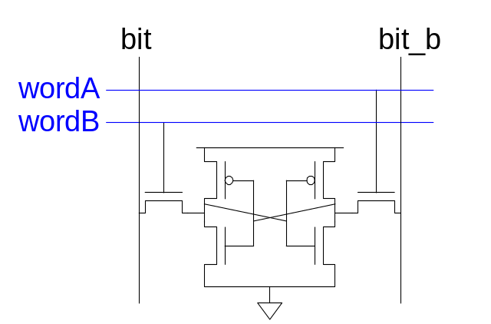
Dual-Ported SRAM
Simple dual-ported SRAM
  Two independent single-ended reads
  Or one differential write
Do two reads and one write by time multiplexing
  Read during ph1, write during ph2
19: SRAM

Slide 30
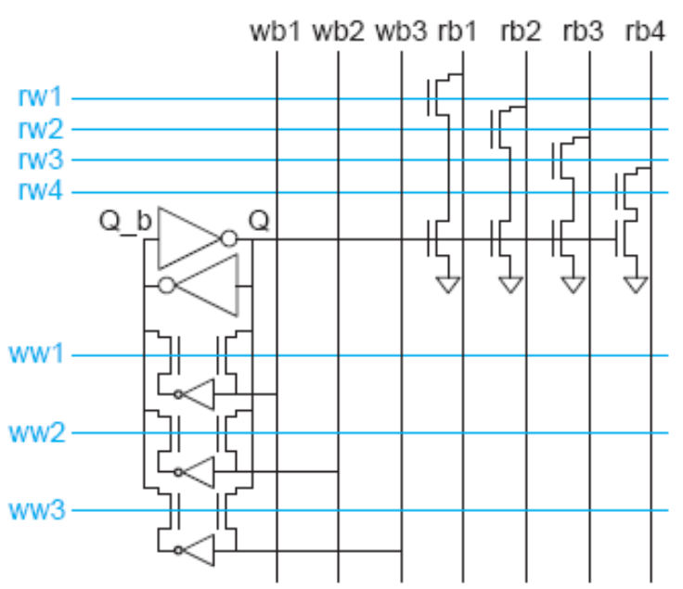
Multi-Ported SRAM
Adding more access transistors hurts read stability
Multiported SRAM isolates reads from state node
Single-ended bitlines save area
19: SRAM

Slide 31
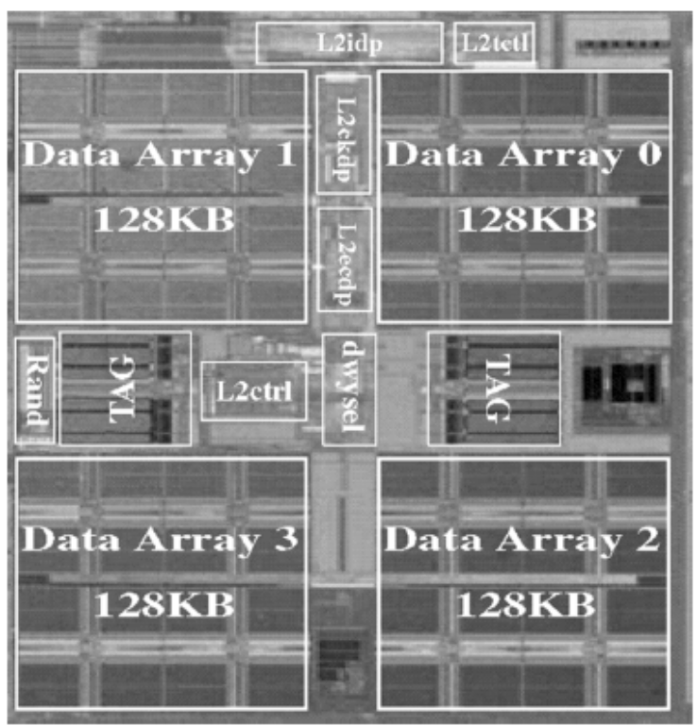
Large SRAMs
Large SRAMs are split into subarrays for speed
Ex: UltraSparc 512KB cache
  4 128 KB subarrays
  Each have 16 8KB banks
  256 rows x 256 cols / bank
  60% subarray area efficiency
  Also space for tags & control
[Shin05]
19: SRAM

Slide 32
Serial Access Memories
Serial access memories do not use an address
  Shift Registers
  Tapped Delay Lines
  Serial In Parallel Out (SIPO)
  Parallel In Serial Out (PISO)
  Queues (FIFO, LIFO)
19: SRAM

Slide 33
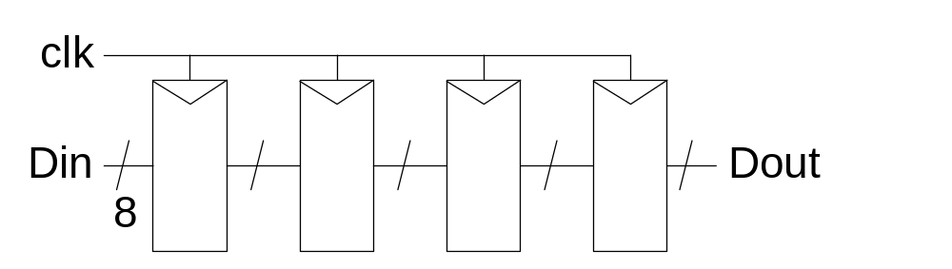
Shift Register
Shift registers store and delay data
Simple design: cascade of registers
  Watch your hold times!
19: SRAM

Slide 34
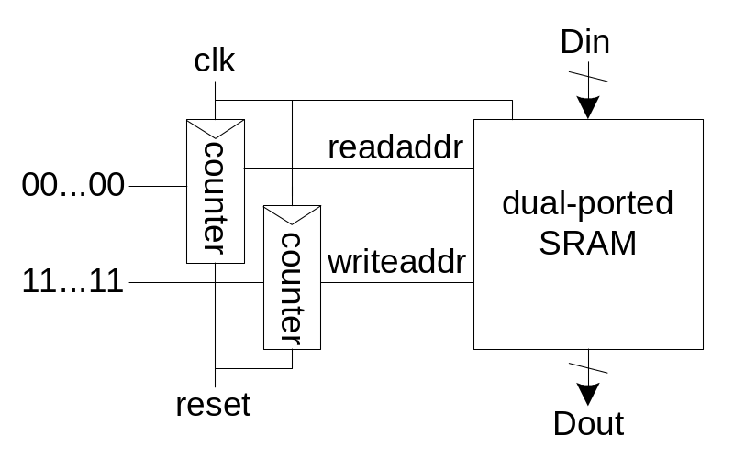
Denser Shift Registers
Flip-flops aren’t very area-efficient
For large shift registers, keep data in SRAM instead
Move read/write pointers to RAM rather than data
  Initialize read address to first entry, write to last
  Increment address on each cycle
19: SRAM

Slide 35
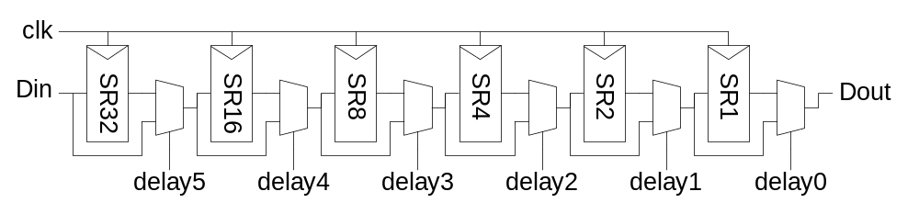
Tapped Delay Line
A tapped delay line is a shift register with a programmable number of stages
Set number of stages with delay controls to mux
  Ex: 0 – 63 stages of delay
19: SRAM

Slide 36
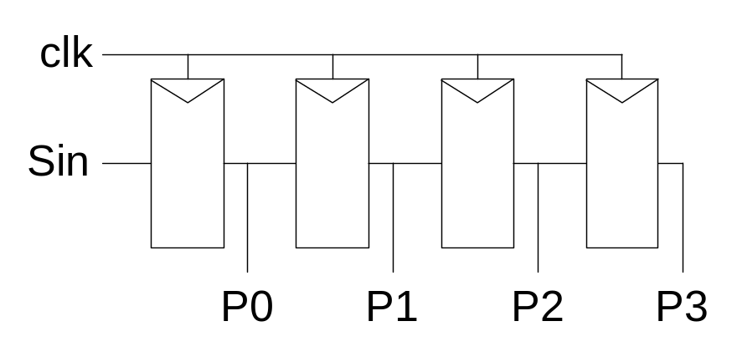
Serial In Parallel Out
1-bit shift register reads in serial data
  After N steps, presents N-bit parallel output
19: SRAM

Slide 37
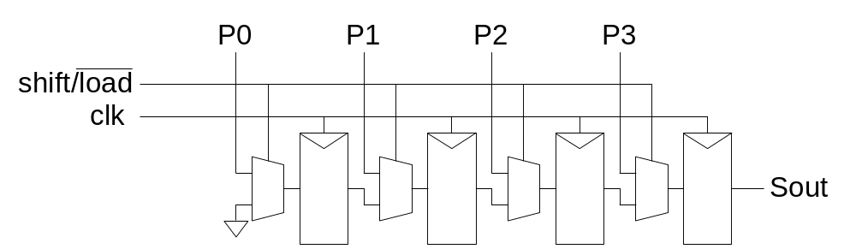
Parallel In Serial Out
Load all N bits in parallel when shift = 0
  Then shift one bit out per cycle
19: SRAM

Slide 38

Queues
Queues allow data to be read and written at different rates.
Read and write each use their own clock, data
Queue indicates whether it is full or empty
Build with SRAM and read/write counters (pointers)
19: SRAM

Slide 39
FIFO, LIFO Queues
First In First Out (FIFO)
  Initialize read and write pointers to first element
  Queue is EMPTY
  On write, increment write pointer
  If write almost catches read, Queue is FULL
  On read, increment read pointer
Last In First Out (LIFO)
  Also called a stack
  Use a single stack pointer for read and write
19: SRAM

