Slide 1

Lecture 17:
Scaling & Economics

Slide 2
Outline
Scaling
  Transistors
  Interconnect
  Future Challenges
Economics
15: Scaling and Economics

Slide 3
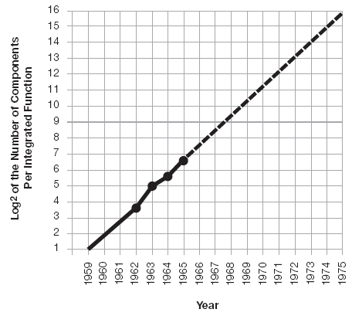
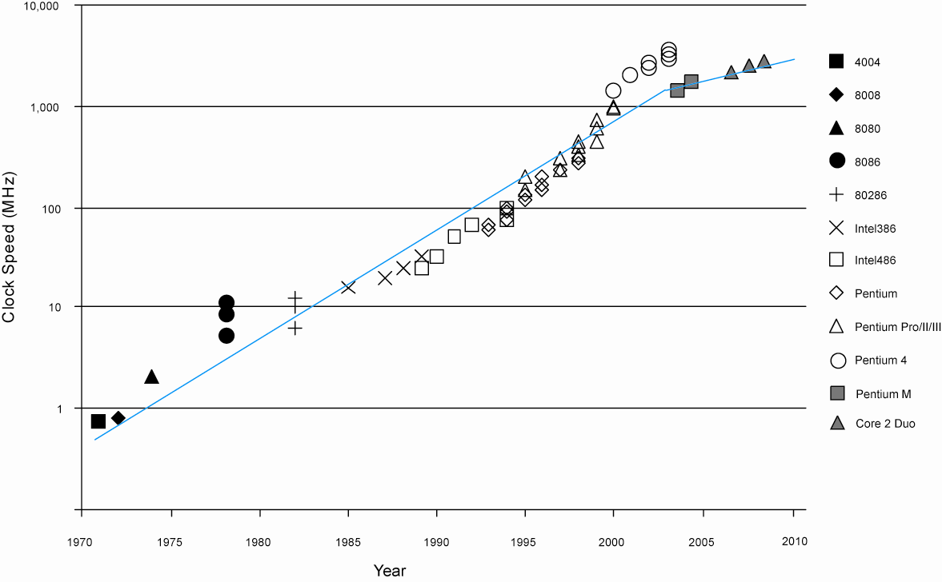
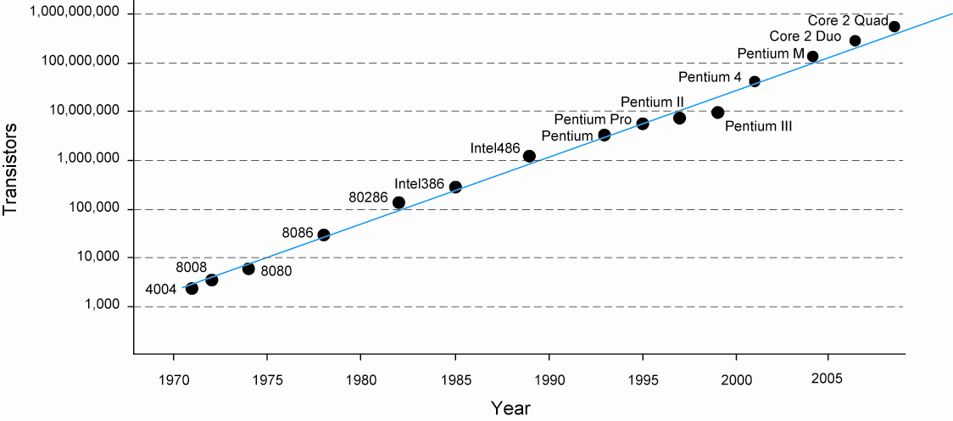
Moore’s Law
Recall that Moore’s Law has been driving CMOS
[Moore65]
Corollary: clock speeds have improved
Moore’s Law today
15: Scaling and Economics

Slide 4
Why?
Why more transistors per IC?
  Smaller transistors
  Larger dice
Why faster computers?
  Smaller, faster transistors
  Better microarchitecture (more IPC)
  Fewer gate delays per cycle
15: Scaling and Economics

Slide 5
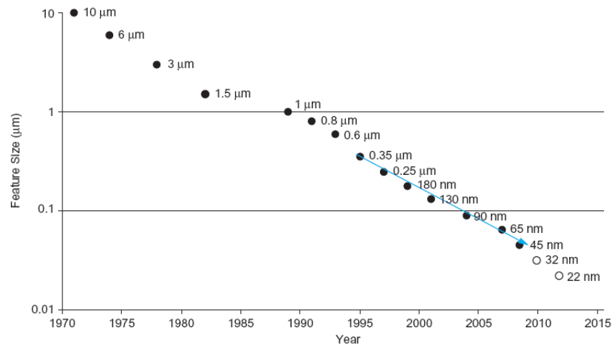

Scaling
The only constant in VLSI is constant change
Feature size shrinks by 30% every 2-3 years
  Transistors become cheaper
  Transistors become faster and lower power
  Wires do not improve
  (and may get worse)
Scale factor S
  Typically
  Technology nodes
15: Scaling and Economics

Slide 6
Dennard Scaling
Proposed by Dennard in 1974
Also known as constant field scaling
  Electric fields remain the same as features scale
Scaling assumptions
  All dimensions (x, y, z => W, L, t_{ox})
  Voltage (V_{DD})
  Doping levels
15: Scaling and Economics

Slide 7
Device Scaling
Parameter | Sensitivity | Dennard Scaling
L: Length |  | 1/S
W: Width |  | 1/S
t_{ox}: gate oxide thickness |  | 1/S
V_{DD}: supply voltage |  | 1/S
V_{t}: threshold voltage |  | 1/S
NA: substrate doping |  | S
β | W/(Lt_{ox}) | S
I_{on}: ON current | β(V_{DD}-V_{t})² | 1/S
R: effective resistance | V_{DD}/I_{on} | 1
C: gate capacitance | WL/t_{ox} | 1/S
τ: gate delay | RC | 1/S
f: clock frequency | 1/τ | S
E: switching energy / gate | CV_{DD}² | 1/S³
P: switching power / gate | Ef | 1/S²
A: area per gate | WL | 1/S²
Switching power density | P/A | 1
Switching current density | I_{on}/A | S
15: Scaling and Economics

Slide 8
Observations
Gate capacitance per micron is nearly independent of process
But ON resistance * micron improves with process
Gates get faster with scaling (good)
Dynamic power goes down with scaling (good)
Current density goes up with scaling (bad)
15: Scaling and Economics

Slide 9
Example
Gate capacitance is typically about 1 fF/μm
The typical FO4 inverter delay for a process of feature size f (in nm) is about 0.5f ps
Estimate the ON resistance of a unit (4/2 λ) transistor.
FO4 = 5 τ = 15 RC
RC = (0.5f) / 15 = (f/30) ps/nm
If W = 2f, R = 16.6 kΩ
  Unit resistance is roughly independent of f
15: Scaling and Economics

Slide 10
Real Scaling
t_{ox} scaling has slowed since 65 nm
  Limited by gate tunneling current
  Gates are only about 4 atomic layers thick!
  High-k dielectrics have helped continued scaling of effective oxide thickness
V_{DD} scaling has slowed since 65 nm
  SRAM cell stability at low voltage is challenging
Dennard scaling predicts cost, speed, power all improve
  Below 65 nm, some designers find they must choose just two of the three
15: Scaling and Economics

Slide 11
Wire Scaling
Wire cross-section
  w, s, t all scale
Wire length
  Local / scaled interconnect
  Global interconnect
    Die size scaled by D_{c} ≈ 1.1
15: Scaling and Economics

Slide 12
Interconnect Scaling
Parameter | Sensitivity | Scale Factor
w: width |  | 1/S
s: spacing |  | 1/S
t: thickness |  | 1/S
h: height |  | 1/S
D_{c}: die size |  | D_{c}
R_{w}: wire resistance/unit length | 1/wt | S²
C_{wf}: fringing capacitance / unit length | t/s | 1
C_{wp}: parallel plate capacitance / unit length | w/h | 1
C_{w}: total wire capacitance / unit length | C_{wf} + C_{wp} | 1
t_{wu}: unrepeated RC delay / unit length | R_{w}C_{w} | S²
t_{wr}: repeated RC delay / unit length | sqrt(RCR_{w}C_{w}) | sqrt(S)
Crosstalk noise | w/h | 1
E_{w}: energy per bit / unit length | C_{w}V_{DD}² | 1/S²
15: Scaling and Economics

Slide 13
Interconnect Delay
Parameter | Sensitivity | Local / Semiglobal | Global
l: length |  | 1/S | D_{c}
Unrepeated wire RC delay | l²t_{wu} | 1 | S²D_{c}²
Repeated wire delay | lt_{wr} | sqrt(1/S) | D_{c}sqrt(S)
Energy per bit | lE_{w} | 1/S³ | D^{c}/S²
15: Scaling and Economics

Slide 14
Observations
Capacitance per micron is remaining constant
  About 0.2 fF/μm
  Roughly 1/5 of gate capacitance
Local wires are getting faster
  Not quite tracking transistor improvement
  But not a major problem
Global wires are getting slower
  No longer possible to cross chip in one cycle
15: Scaling and Economics

Slide 15
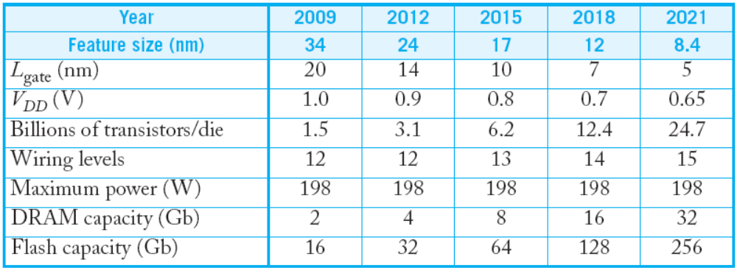
ITRS
Semiconductor Industry Association forecast
  Intl. Technology Roadmap for Semiconductors
15: Scaling and Economics

Slide 16
Scaling Implications
Improved Performance
Improved Cost
Interconnect Woes
Power Woes
Productivity Challenges
Physical Limits
15: Scaling and Economics

Slide 17
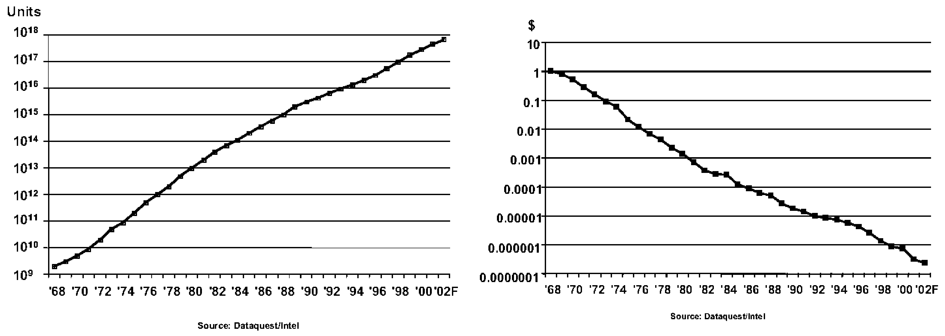
Cost Improvement
In 2003, $0.01 bought you 100,000 transistors
  Moore’s Law is still going strong
[Moore03]
15: Scaling and Economics

Slide 18
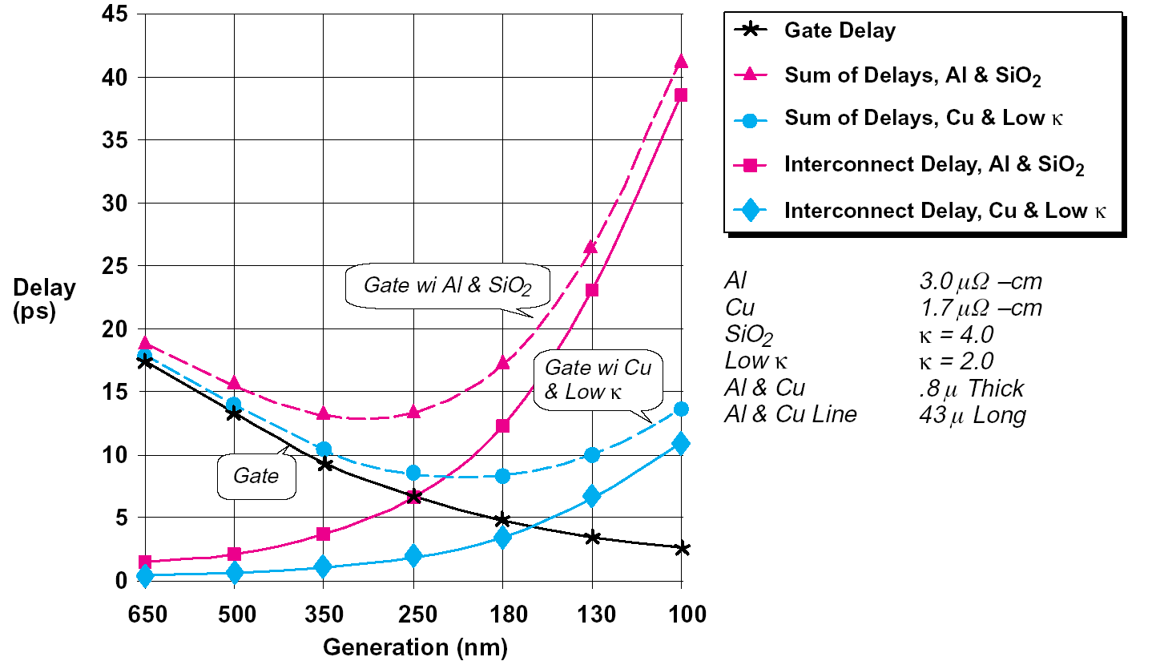
Interconnect Woes
SIA made a gloomy forecast in 1997
  Delay would reach minimum at 250 – 180 nm, then get worse because of wires
But…
  Misleading scale
  Global wires
100 kgate blocks ok
[SIA97]
15: Scaling and Economics

Slide 19
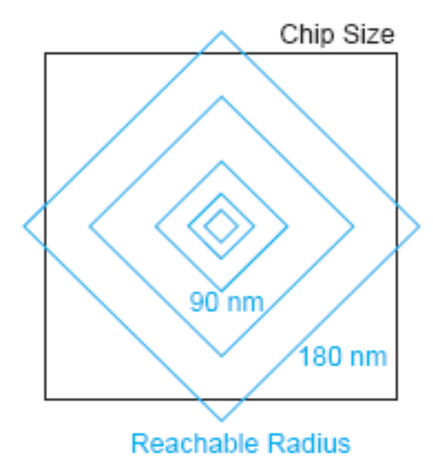
Reachable Radius
We can’t send a signal across a large fast chip in one cycle anymore
But the microarchitect can plan around this
  Just as off-chip memory latencies were tolerated
15: Scaling and Economics

Slide 20
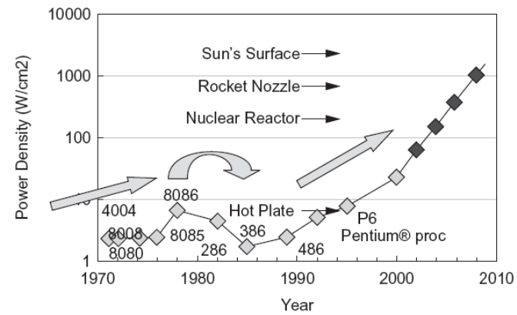
Dynamic Power
Intel VP Patrick Gelsinger (ISSCC 2001)
  If scaling continues at present pace, by 2005, high speed processors would have power density of nuclear reactor, by 2010, a rocket nozzle, and by 2015, surface of sun.
  “Business as usual will not work in the future.”
Attention to power is
increasing
[Intel]
15: Scaling and Economics

Slide 21
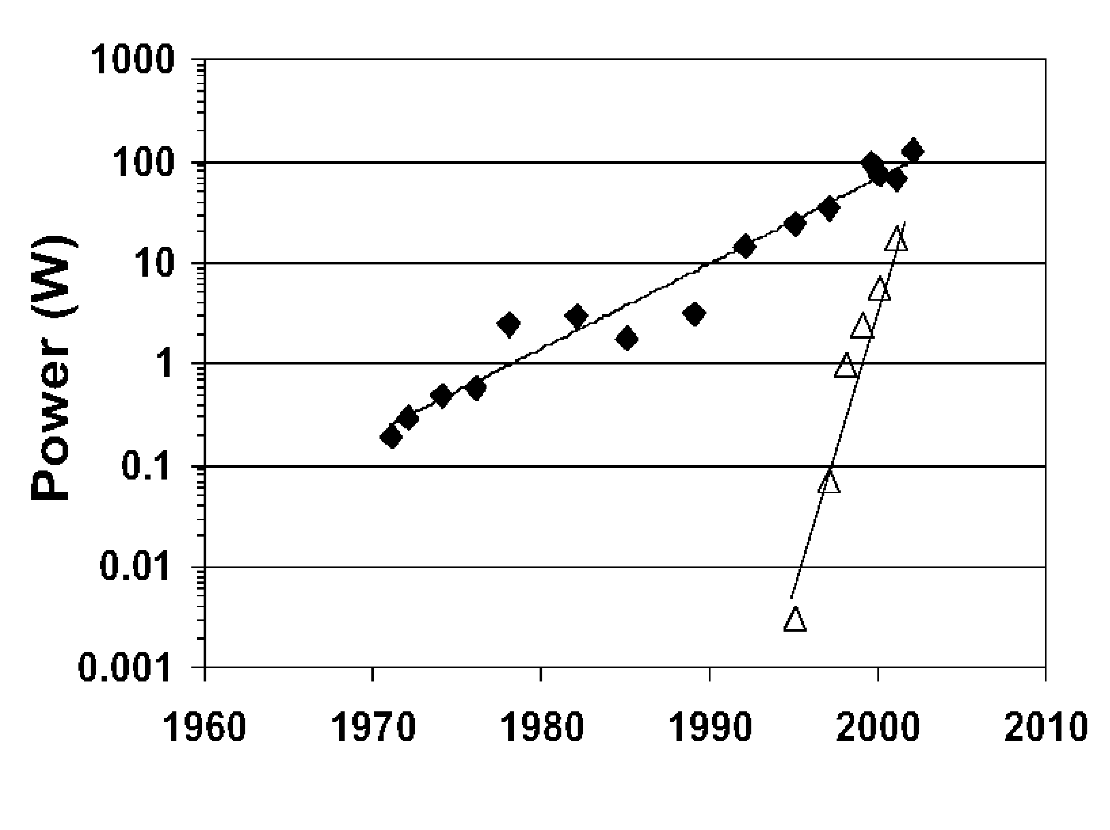
Static Power
V_{DD} decreases
  Save dynamic power
  Protect thin gate oxides and short channels
  No point in high value because of velocity sat.
V_{t} must decrease to
maintain device performance
But this causes exponential
increase in OFF leakage
Major future challenge
Dynamic
Static
[Moore03]
15: Scaling and Economics

Slide 22
Productivity
Transistor count is increasing faster than designer productivity (gates / week)
  Bigger design teams
    Up to 500 for a high-end microprocessor
  More expensive design cost
  Pressure to raise productivity
    Rely on synthesis, IP blocks
  Need for good engineering managers
15: Scaling and Economics

Slide 23
Physical Limits
Will Moore’s Law run out of steam?
  Can’t build transistors smaller than an atom…
Many reasons have been predicted for end of scaling
  Dynamic power
  Subthreshold leakage, tunneling
  Short channel effects
  Fabrication costs
  Electromigration
  Interconnect delay
Rumors of demise have been exaggerated
15: Scaling and Economics

Slide 24
VLSI Economics
Selling price S_{total}
  S_{total} = C_{total} / (1-m)
m = profit margin
C_{total} = total cost
  Nonrecurring engineering cost (NRE)
  Recurring cost
  Fixed cost
15: Scaling and Economics

Slide 25
NRE
Engineering cost
  Depends on size of design team
  Include benefits, training, computers
  CAD tools:
    Digital front end: $10K
    Analog front end: $100K
    Digital back end: $1M
Prototype manufacturing
  Mask costs: $5M in 45 nm process
  Test fixture and package tooling
15: Scaling and Economics

Slide 26
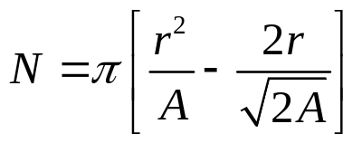
Recurring Costs
Fabrication
  Wafer cost / (Dice per wafer * Yield)
  Wafer cost: $500 - $3000
  Dice per wafer:
  Yield: Y = e^{-AD}
    For small A, Y ≈ 1, cost proportional to area
    For large A, Y ≈ 0, cost increases exponentially
Packaging
Test
15: Scaling and Economics

Slide 27
Fixed Costs
Data sheets and application notes
Marketing and advertising
Yield analysis
15: Scaling and Economics

Slide 28
Example
You want to start a company to build a wireless communications chip. How much venture capital must you raise?
Because you are smarter than everyone else, you can get away with a small team in just two years:
  Seven digital designers
  Three analog designers
  Five support personnel
15: Scaling and Economics

Slide 29
Solution
Digital designers:
  $70k salary
  $30k overhead
  $10k computer
  $10k CAD tools
  Total: $120k * 7 = $840k
Analog designers
  $100k salary
  $30k overhead
  $10k computer
  $100k CAD tools
  Total: $240k * 3 = $720k
Support staff
  $45k salary
  $20k overhead
  $5k computer
  Total: $70k * 5 = $350k
Fabrication
  Back-end tools: $1M
  Masks: $5M
  Total: $6M / year
Summary
  2 years @ $7.91M / year
  $16M design & prototype
15: Scaling and Economics

