Slide 1

Lecture 18:
Circuit Pitfalls

Slide 2
Outline
Variation
Noise Budgets
Reliability
Circuit Pitfalls
16: Circuit Pitfalls

Slide 3
Variation
Process
  Threshold
  Channel length
  Interconnect dimensions
Environment
  Voltage
  Temperature
Aging / Wearout
16: Circuit Pitfalls

Slide 4
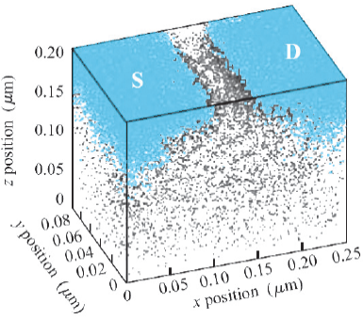
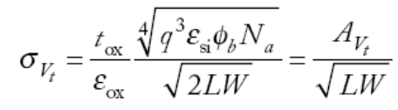
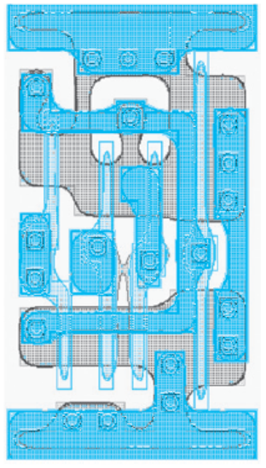
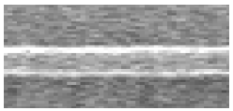
Process Variation
Threshold Voltage
  Depends on placement of dopants in channel
  Standard deviation inversely proportional to channel area
Channel Length
  Systematic across-chip linewidth variation (ACLV)
  Random line edge roughness (LER)
Interconnect
  Etching variations affect w, s, h
[Bernstein06]
Courtesy Texas Instruments
Courtesy Larry Pileggi
16: Circuit Pitfalls

Slide 5
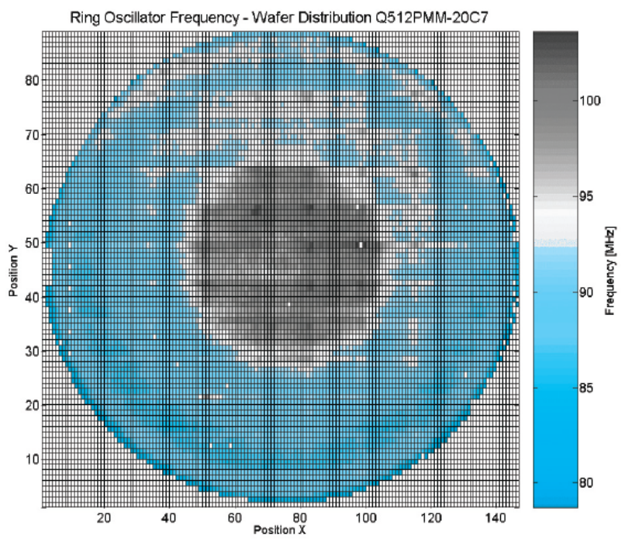
Spatial Distribution
Variations show spatial correlation
  Lot-to-lot (L2L)
  Wafer-to-wafer (W2W)
  Die-to-die (D2D) / inter-die
  Within-die (WID) / intradie
Closer transistors match better
Courtesy M. Pelgrom
16: Circuit Pitfalls

Slide 6
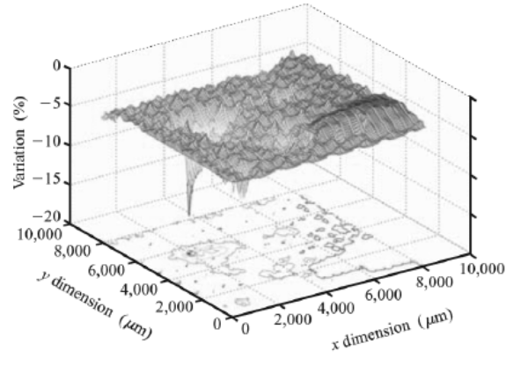
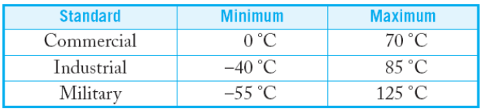
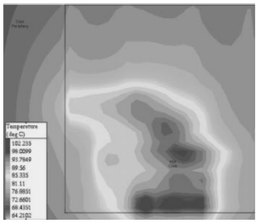
Environmental Variation
Voltage
  V_{DD} is usually designed +/- 10%
  Regulator error
  On-chip droop from
  switching activity
Temperature
  Ambient temperature ranges
  On-die temperature elevated
  by chip power consumption
Courtesy IBM
[Harris01b]
16: Circuit Pitfalls

Slide 7
Aging
Transistors change over time as they wear out
  Hot carriers
  Negative bias temperature instability
  Time-dependent dielectric breakdown
Causes threshold voltage changes
More on this later…
16: Circuit Pitfalls

Slide 8
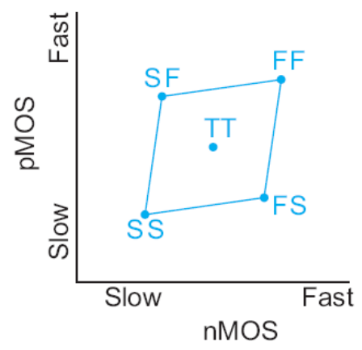
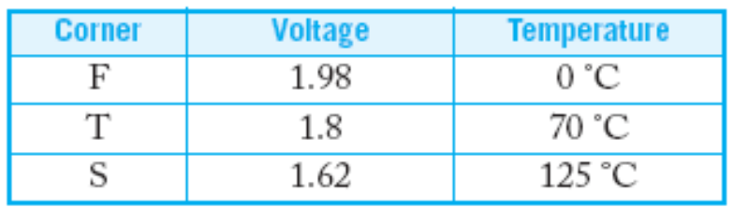
Process Corners
Model extremes of process variations in simulation
Corners
  Typical (T)
  Fast (F)
  Slow (S)
Factors
  nMOS speed
  pMOS speed
  Wire
  Voltage
  Temperature
16: Circuit Pitfalls

Slide 9
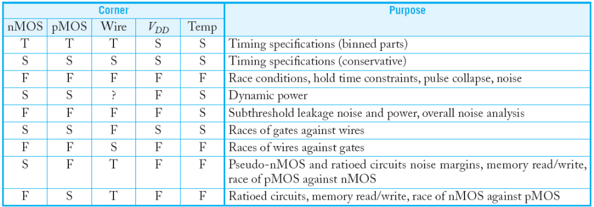
Corner Checks
Circuits are simulated in different corners to verify different performance and correctness specifications
16: Circuit Pitfalls

Slide 10
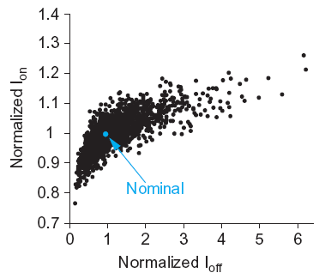
Monte Carlo Simulation
As process variation increases, the worst-case corners become too pessimistic for practical design
Monte Carlo: repeated simulations with parameters randomly varied each time
Look at scatter plot of results to predict yield
Ex: impact of V_{t} variation
  ON-current
  leakage
16: Circuit Pitfalls

Slide 11
Noise
Sources
  Power supply noise / ground bounce
  Capacitive coupling
  Charge sharing
  Leakage
  Noise feedthrough
Consequences
  Increased delay (for noise to settle out)
  Or incorrect computations
16: Circuit Pitfalls

Slide 12
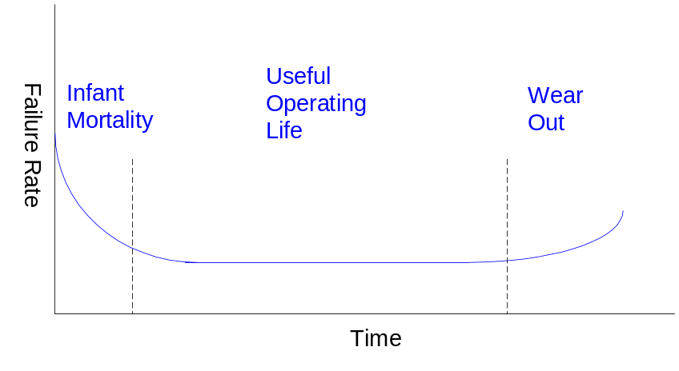
Reliability
Hard Errors
  Oxide wearout
  Interconnect wearout
  Overvoltage failure
  Latchup
Soft Errors
Characterizing reliability
  Mean time between failures (MTBF)
    # of devices ^{x} hours of operation / number of failures
  Failures in time (FIT)
    # of failures / thousand hours / million devices
16: Circuit Pitfalls

Slide 13
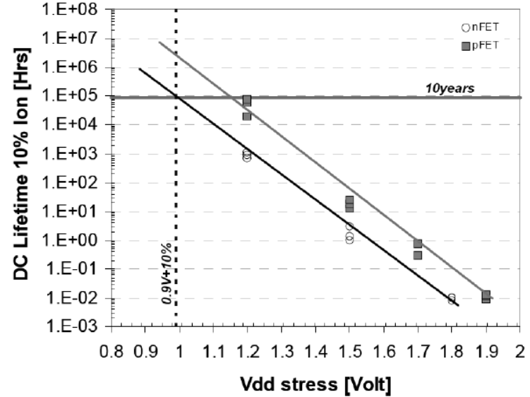
Accelerated Lifetime Testing
Expected reliability typically exceeds 10 years
But products come to market in 1-2 years
Accelerated lifetime testing required to predict adequate long-term reliability
[Arnaud08]
16: Circuit Pitfalls

Slide 14
Hot Carriers
Electric fields across channel impart high energies to some carriers
  These “hot” carriers may be blasted into the gate oxide where they become trapped
  Accumulation of charge in oxide causes shift in V_{t} over time
  Eventually V_{t} shifts too far for devices to operate correctly
Choose V_{DD} to achieve reasonable product lifetime
  Worst problems for inverters and NORs with slow input risetime and long propagation delays
16: Circuit Pitfalls

Slide 15
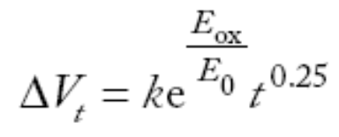
NBTI
Negative bias temperature instability
Electric field applied across oxide forms dangling bonds called traps at Si-SiO₂ interface
Accumulation of traps causes V_{t} shift
Most pronounced for pMOS transistors with strong negative bias (V_{g} = 0, V_{s} = V_{DD}) at high temperature
16: Circuit Pitfalls

Slide 16
TDDB
Time-dependent dielectric breakdown
  Gradual increase in gate leakage when an electric field is applied across an oxide
  a.k.a stress-induced leakage current
For 10-year life at 125 C, keep E_{ox} below ~0.7 V/nm
16: Circuit Pitfalls

Slide 17
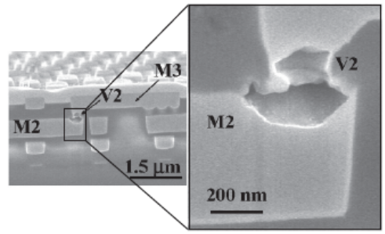
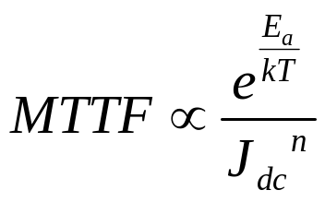
Electromigration
“Electron wind” causes movement of metal atoms along wires
Excessive electromigration leads to open circuits
Most significant for unidirectional (DC) current
  Depends on current density J_{dc} (current / area)
  Exponential dependence on temperature
  Black’s Equation:
  Typical limits: J_{dc} < 1 – 2 mA / μm²
[Christiansen06]
16: Circuit Pitfalls

Slide 18

Electromigration Video
16: Circuit Pitfalls

Slide 19
Electromigration Video 2
16: Circuit Pitfalls

Slide 20
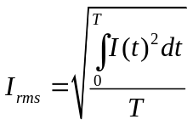
Self-Heating
Current through wire resistance generates heat
  Oxide surrounding wires is a thermal insulator
  Heat tends to build up in wires
  Hotter wires are more resistive, slower
Self-heating limits AC current densities for reliability
  Typical limits: J_{rms} < 15 mA / μm²
16: Circuit Pitfalls

Slide 21
Overvoltage Failure
High voltages can blow out tiny transistors
Electrostatic discharge (ESD)
  kilovolts from static electricity when the package pins are handled
Oxide breakdown
  In a 65 nm process, V_{g} ≈ 3 V causes arcing through thin gate oxides
Punchthrough
  High V_{ds} causes depletion region between source and drain to touch, leading to high current flow and destructive overheating
16: Circuit Pitfalls

Slide 22
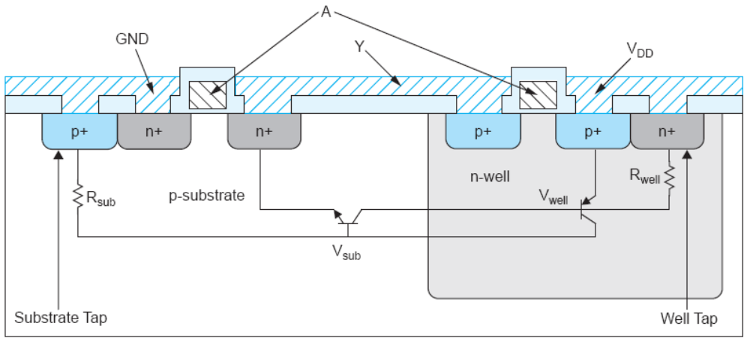
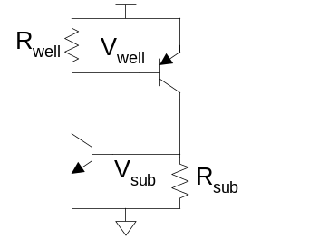
Latchup
Latchup: positive feedback leading to V_{DD} – GND short
  Major problem for 1970’s CMOS processes before
  it was well understood
Avoid by minimizing resistance of body to GND / V_{DD}
  Use plenty of substrate and well taps
16: Circuit Pitfalls

Slide 23
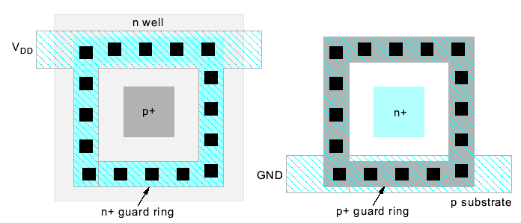
Guard Rings
Latchup risk greatest when diffusion-to-substrate diodes could become forward-biased
Surround sensitive region with guard ring to collect injected charge
16: Circuit Pitfalls

Slide 24
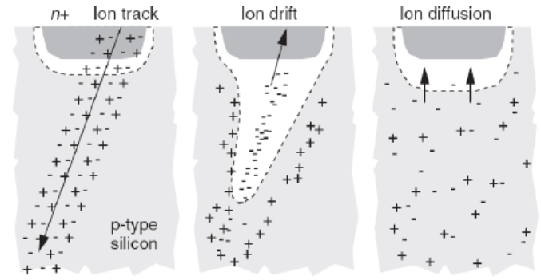
Soft Errors
In 1970’s, DRAMs were observed to randomly flip bits
  Ultimately linked to alpha particles and cosmic ray neutrons
Collisions with atoms create electron-hole pairs in substrate
  These carriers are collected on p-n junctions, disturbing the voltage
[Baumann05]
16: Circuit Pitfalls

Slide 25
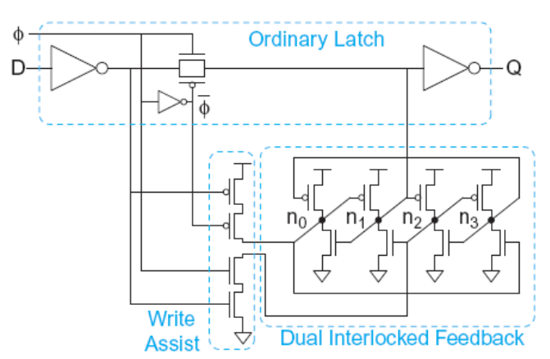
Radiation Hardening
Radiation hardening reduces soft errors
  Increase node capacitance to minimize impact of collected charge
  Or use redundancy
  E.g. dual-interlocked cell
Error-correcting codes
  Correct for soft errors that do occur
16: Circuit Pitfalls

Slide 26
Circuit Pitfalls
Detective puzzle
  Given circuit and symptom, diagnose cause and recommend solution
  All these pitfalls have caused failures in real chips
16: Circuit Pitfalls

Slide 27
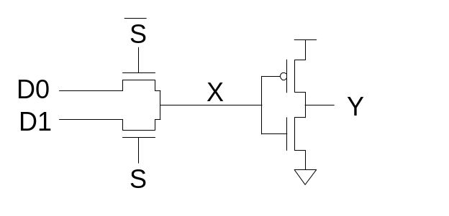
Bad Circuit 1
Circuit
  2:1 multiplexer
Symptom
  Mux works when selected D is 0 but not 1.
  Or fails at low V_{DD}.
  Or fails in SFSF corner.
Principle: Threshold drop
  X never rises above V_{DD}-V_{t}
  V_{t} is raised by the body effect
  The threshold drop is most serious as V_{t} becomes a greater fraction of V_{DD}.
Solution: Use transmission gates, not pass transistors
16: Circuit Pitfalls

Slide 28
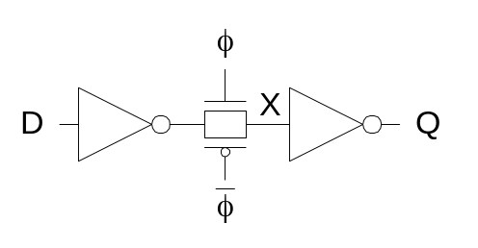
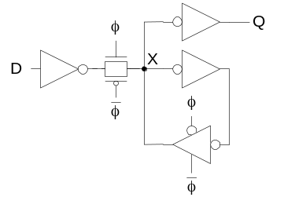
Bad Circuit 2
Circuit
  Latch
Symptom
  Load a 0 into Q
  Set φ = 0
  Eventually Q spontaneously flips to 1
Principle: Leakage
  X is a dynamic node holding value as charge on the node
  Eventually subthreshold leakage may disturb charge
Solution: Staticize node with feedback
  Or periodically refresh node (requires fast clock,
  not practical processes with big leakage)
16: Circuit Pitfalls

Slide 29
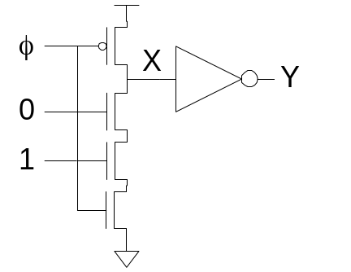
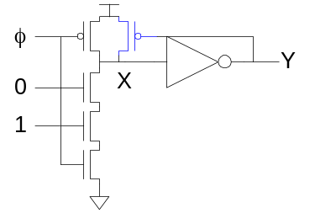
Bad Circuit 3
Circuit
  Domino AND gate
Symptom
  Precharge gate (Y=0)
  Then evaluate
  Eventually Y spontaneously flips to 1
Principle: Leakage
  X is a dynamic node holding value as charge on the node
  Eventually subthreshold leakage may disturb charge
Solution: Keeper
16: Circuit Pitfalls

Slide 30
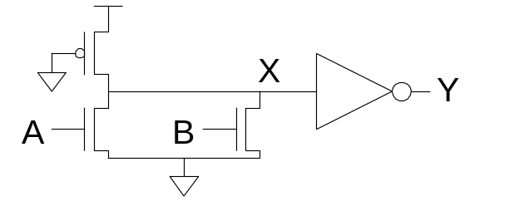
Bad Circuit 4
Circuit
  Pseudo-nMOS OR
Symptom
  When only one input is true, Y = 0.
  Perhaps only happens in SF corner.
Principle: Ratio Failure
  nMOS and pMOS fight each other.
  If the pMOS is too strong, nMOS cannot pull X low enough.
Solution: Check that ratio is satisfied in all corners
16: Circuit Pitfalls

Slide 31
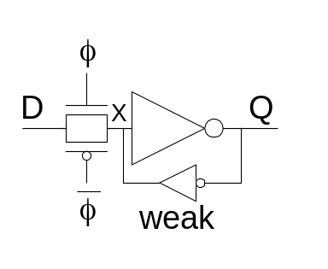
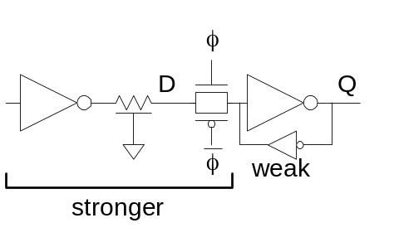
Bad Circuit 5
Circuit
  Latch
Symptom
  Q stuck at 1.
  May only happen for certain latches where input is driven by a small gate located far away.
Principle: Ratio Failure (again)
  Series resistance of D driver, wire
  resistance, and tgate must be much
  less than weak feedback inverter.
Solutions: Check relative strengths
  Avoid unbuffered diffusion inputs where driver is unknown
16: Circuit Pitfalls

Slide 32
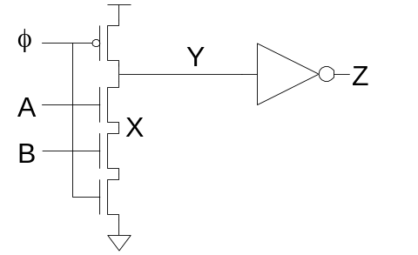
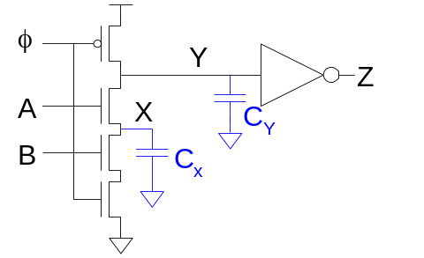
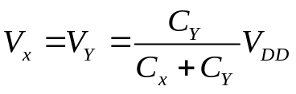
Bad Circuit 6
Circuit
  Domino AND gate
Symptom
  Precharge gate while
  A = B = 0, so Z = 0
  Set φ = 1
  A rises
  Z is observed to sometimes rise
Principle: Charge Sharing
  If X was low, it shares charge with Y
Solutions: Limit charge sharing
  Safe if C_{Y} >> C_{X}
  Or precharge node X too
16: Circuit Pitfalls

Slide 33
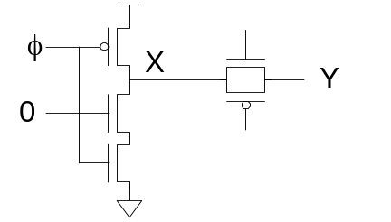
Bad Circuit 7
Circuit
  Dynamic gate + latch
Symptom
  Precharge gate while transmission gate latch is opaque
  Evaluate
  When latch becomes transparent, X falls
Principle: Charge Sharing
  If Y was low, it shares charge with X
Solution: Buffer dynamic nodes before
  driving transmission gate
16: Circuit Pitfalls

Slide 34
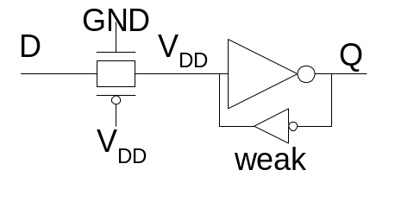
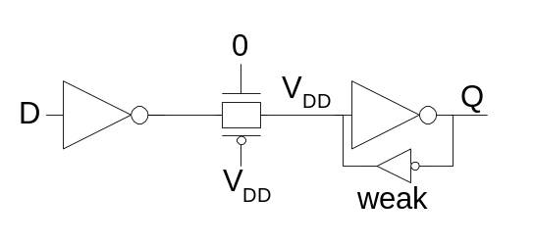
Bad Circuit 8
Circuit
  Latch
Symptom
  Q changes while latch is opaque
  Especially if D comes from a far-away driver
Principle: Diffusion Input Noise Sensitivity
  If D < -V_{t}, transmission gate turns on
  Most likely because of power supply noise or coupling on D
Solution: Buffer D locally
16: Circuit Pitfalls

Slide 35
Summary
Static CMOS gates are very robust
  Will settle to correct value if you wait long enough
Other circuits suffer from a variety of pitfalls
  Tradeoff between performance & robustness
Essential to check circuits for pitfalls
  For large chips, you need an automatic checker.
  Design rules aren’t worth the paper they are printed on unless you back them up with a tool.
16: Circuit Pitfalls

