Slide 1

Lecture 19:
Packaging, Power, & Clock

Slide 2
Outline
Packaging
Power Distribution
Clock Distribution
21: Package, Power, and Clock

Slide 3
Packages
Package functions
  Electrical connection of signals and power from chip to board
  Little delay or distortion
  Mechanical connection of chip to board
  Removes heat produced on chip
  Protects chip from mechanical damage
  Compatible with thermal expansion
  Inexpensive to manufacture and test
21: Package, Power, and Clock

Slide 4
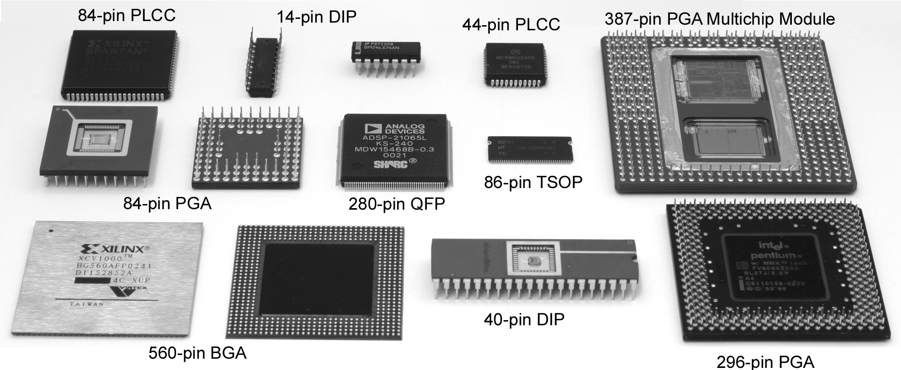
Package Types
Through-hole vs. surface mount
21: Package, Power, and Clock

Slide 5
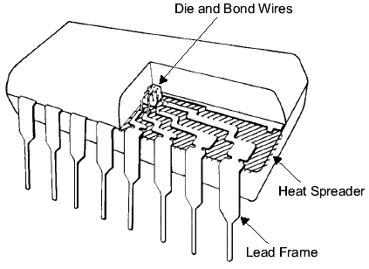
Chip-to-Package Bonding
Traditionally, chip is surrounded by pad frame
  Metal pads on 100 – 200 μm pitch
  Gold bond wires attach pads to package
  Lead frame distributes signals in package
  Metal heat spreader helps with cooling
21: Package, Power, and Clock

Slide 6
Advanced Packages
Bond wires contribute parasitic inductance
Fancy packages have many signal, power layers
  Like tiny printed circuit boards
Flip-chip places connections across surface of die rather than around periphery
  Top level metal pads covered with solder balls
  Chip flips upside down
  Carefully aligned to package (done blind!)
  Heated to melt balls
  Also called C4 (Controlled Collapse Chip Connection)
21: Package, Power, and Clock

Slide 7
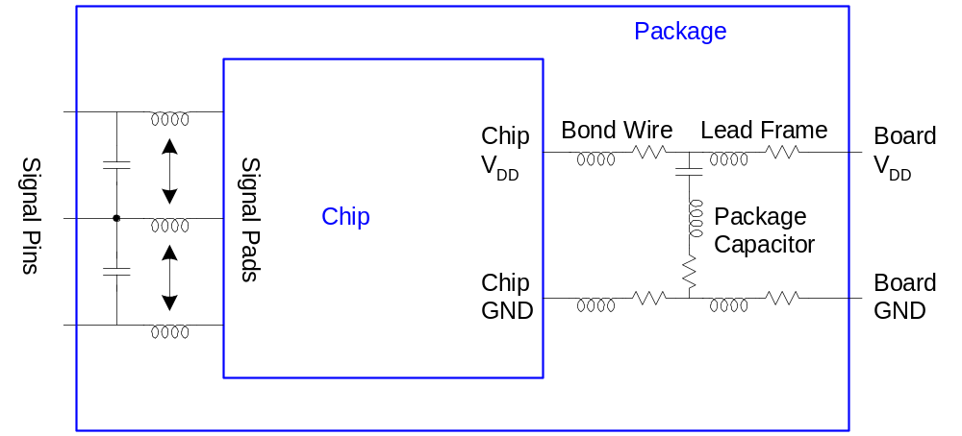
Package Parasitics
Use many V_{DD}, GND in parallel
  Inductance, I_{DD}
21: Package, Power, and Clock

Slide 8
Heat Dissipation
60 W light bulb has surface area of 120 cm²
Itanium 2 die dissipates 130 W over 4 cm²
  Chips have enormous power densities
  Cooling is a serious challenge
Package spreads heat to larger surface area
  Heat sinks may increase surface area further
  Fans increase airflow rate over surface area
  Liquid cooling used in extreme cases ($$$)
21: Package, Power, and Clock

Slide 9
Thermal Resistance
ΔT = Θ_{ja}P
  ΔT: temperature rise on chip
  Θ_{ja}: thermal resistance of chip junction to ambient
  P: power dissipation on chip
Thermal resistances combine like resistors
  Series and parallel
Θ_{ja} = Θ_{jp} + Θ_{pa}
  Series combination
21: Package, Power, and Clock

Slide 10
Example
Your chip has a heat sink with a thermal resistance to the package of 4.0° C/W.
The resistance from chip to package is 1° C/W.
The system box ambient temperature may reach 55° C.
The chip temperature must not exceed 100° C.
What is the maximum chip power dissipation?
(100-55 C) / (4 + 1 C/W) = 9 W
21: Package, Power, and Clock

Slide 11
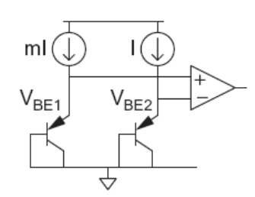
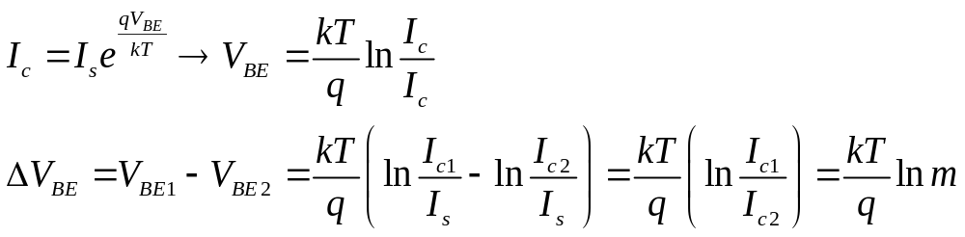
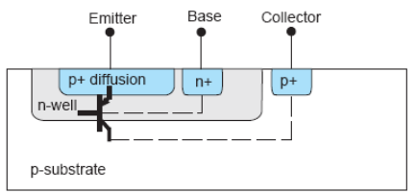
Temperature Sensor
Monitor die temperature and throttle performance if it gets too hot
Use a pair of pnp bipolar transistors
  Vertical pnp available in CMOS
Voltage difference is proportional to absolute temp
  Measure with on-chip A/D converter
21: Package, Power, and Clock

Slide 12
Power Distribution
Power Distribution Network functions
  Carry current from pads to transistors on chip
  Maintain stable voltage with low noise
  Provide average and peak power demands
  Provide current return paths for signals
  Avoid electromigration & self-heating wearout
  Consume little chip area and wire
  Easy to lay out
21: Package, Power, and Clock

Slide 13
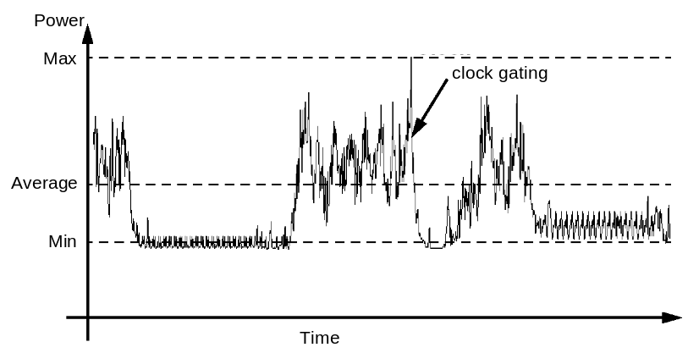
Power Requirements
V_{DD} = V_{DDnominal} – V_{droop}
Want V_{droop} < +/- 10% of V_{DD}
Sources of V_{droop}
  IR drops
  L di/dt noise
I_{DD} changes on many time scales
21: Package, Power, and Clock

Slide 14
IR Drop
A chip draws 24 W from a 1.2 V supply. The power supply impedance is 5 mΩ. What is the IR drop?
I_{DD} = 24 W / 1.2 V = 20 A
IR drop = (20 A)(5 mΩ) = 100 mV
21: Package, Power, and Clock

Slide 15
L di/dt Noise
A 1.2 V chip switches from an idle mode consuming 5W to a full-power mode consuming 53 W. The transition takes 10 clock cycles at 1 GHz. The supply inductance is 0.1 nH. What is the L di/dt droop?
ΔI = (53 W – 5 W)/(1.2 V) = 40 A
Δt = 10 cycles * (1 ns / cycle) = 10 ns
L di/dt droop = (0.1 nH) * (40 A / 10 ns) = 0.4 V
21: Package, Power, and Clock

Slide 16
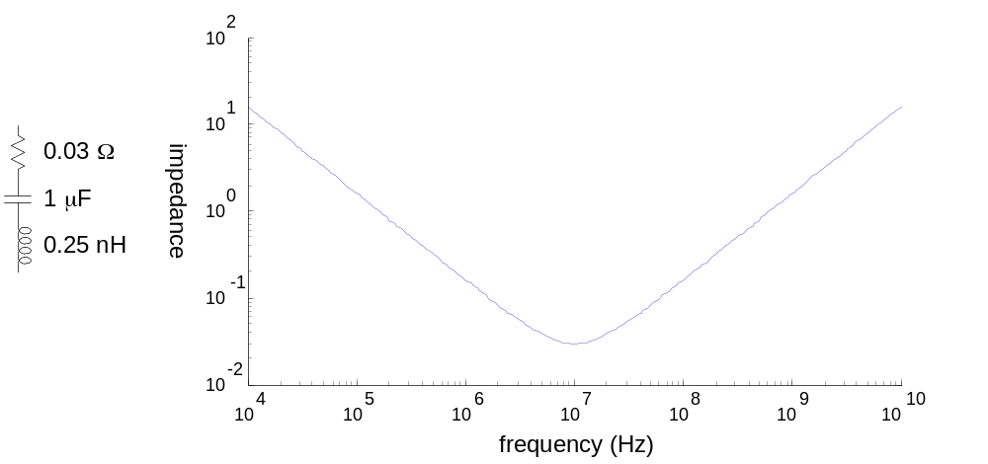
Bypass Capacitors
Need low supply impedance at all frequencies
Ideal capacitors have impedance decreasing with ω
Real capacitors have parasitic R and L
  Leads to resonant frequency of capacitor
21: Package, Power, and Clock

Slide 17
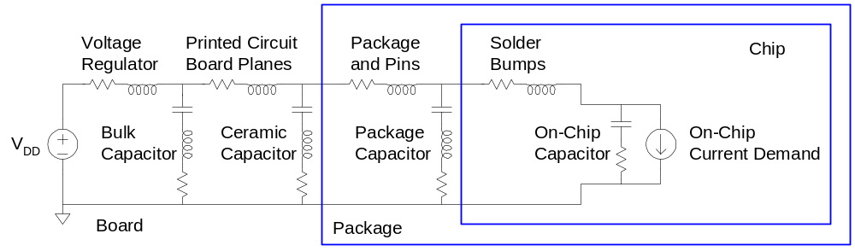
Power System Model
Power comes from regulator on system board
  Board and package add parasitic R and L
  Bypass capacitors help stabilize supply voltage
  But capacitors also have parasitic R and L
Simulate system for time and frequency responses
21: Package, Power, and Clock

Slide 18
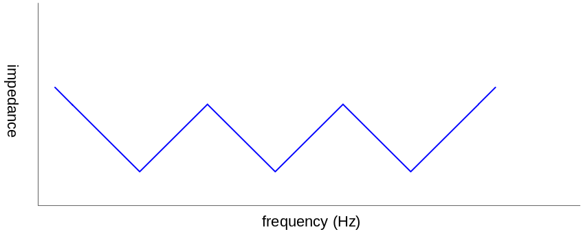
Frequency Response
Multiple capacitors in parallel
  Large capacitor near regulator has low impedance at low frequencies
  But also has a low self-resonant frequency
  Small capacitors near chip and on chip have low impedance at high frequencies
Choose caps to get low impedance at all frequencies
21: Package, Power, and Clock

Slide 19
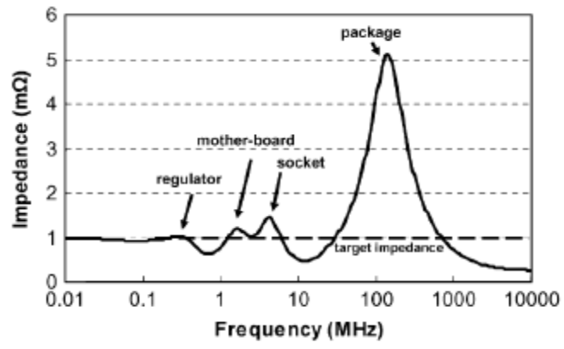
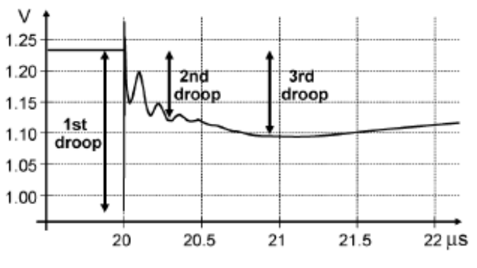
Example: Pentium 4
Power supply impedance for Pentium 4
  Spike near 100 MHz caused by package L
Step response to sudden supply current chain
  1st droop: on-chip bypass caps
  2nd droop: package capacitance
  3rd droop: board capacitance
[Xu08]
[Wong06]
21: Package, Power, and Clock

Slide 20
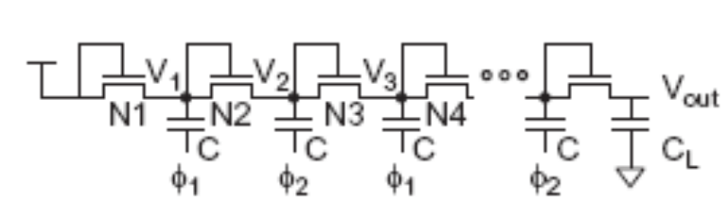
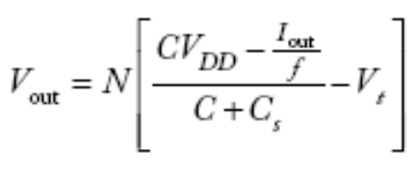
Charge Pumps
Sometimes a different supply voltage is needed but little current is required
  20 V for Flash memory programming
  Negative body bias for leakage control during sleep
Generate the voltage on-chip with a charge pump
21: Package, Power, and Clock

Slide 21
Energy Scavenging
Ultra-low power systems can scavenge their energy from the environment rather than needing batteries
  Solar calculator (solar cells)
  RFID tags (antenna)
  Tire pressure monitors powered by vibrational energy of tires (piezoelectric generator)
Thin film microbatteries deposited on the chip can store energy for times of peak demand
21: Package, Power, and Clock

Slide 22
Clock Distribution
On a small chip, the clock distribution network is just a wire
  And possibly an inverter for clkb
On practical chips, the RC delay of the wire resistance and gate load is very long
  Variations in this delay cause clock to get to different elements at different times
  This is called clock skew
Most chips use repeaters to buffer the clock and equalize the delay
  Reduces but doesn’t eliminate skew
21: Package, Power, and Clock

Slide 23
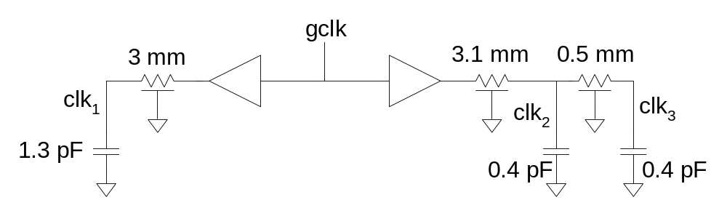
Example
Skew comes from differences in gate and wire delay
  With right buffer sizing, clk₁ and clk₂ could ideally arrive at the same time.
  But power supply noise changes buffer delays
  clk₂ and clk₃ will always see RC skew
21: Package, Power, and Clock

Slide 24
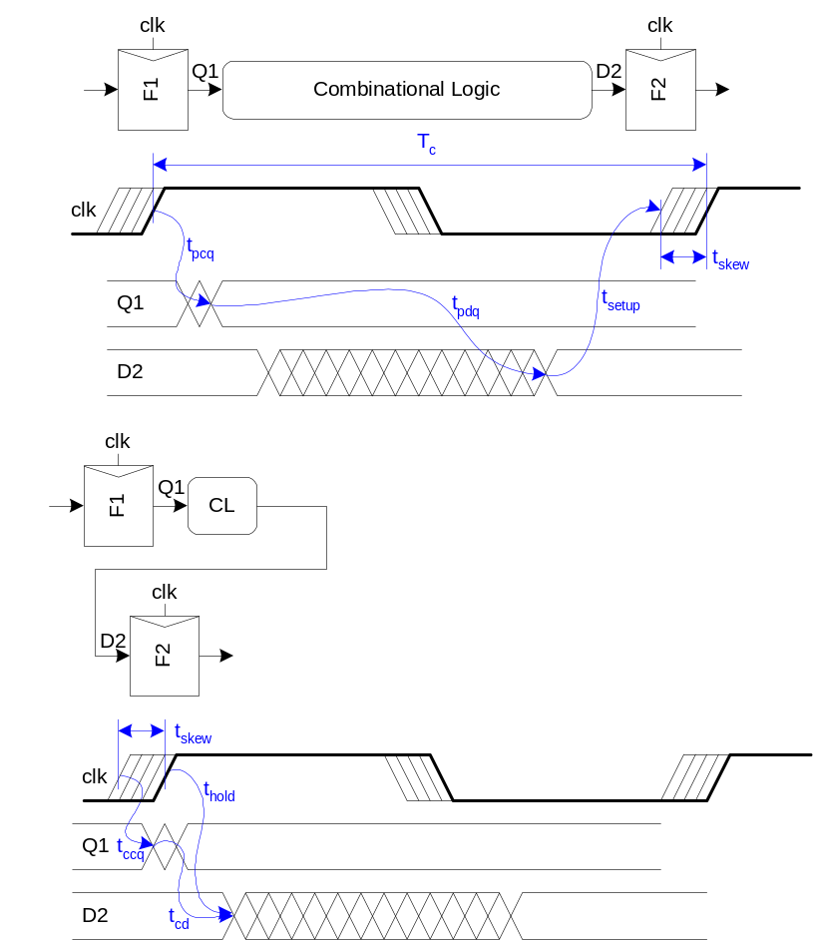
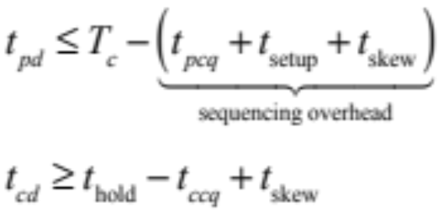
Review: Skew Impact
Ideally full cycle is
available for work
Skew adds sequencing
overhead
Increases hold time too
21: Package, Power, and Clock

Slide 25
Solutions
Reduce clock skew
  Careful clock distribution network design
  Plenty of metal wiring resources
Analyze clock skew
  Only budget actual, not worst case skews
  Local vs. global skew budgets
Tolerate clock skew
  Choose circuit structures insensitive to skew
21: Package, Power, and Clock

Slide 26
Clock Dist. Networks
Ad hoc
Grids
H-tree
Hybrid
21: Package, Power, and Clock

Slide 27
Clock Grids
Use grid on two or more levels to carry clock
Make wires wide to reduce RC delay
Ensures low skew between nearby points
But possibly large skew across die
21: Package, Power, and Clock

Slide 28
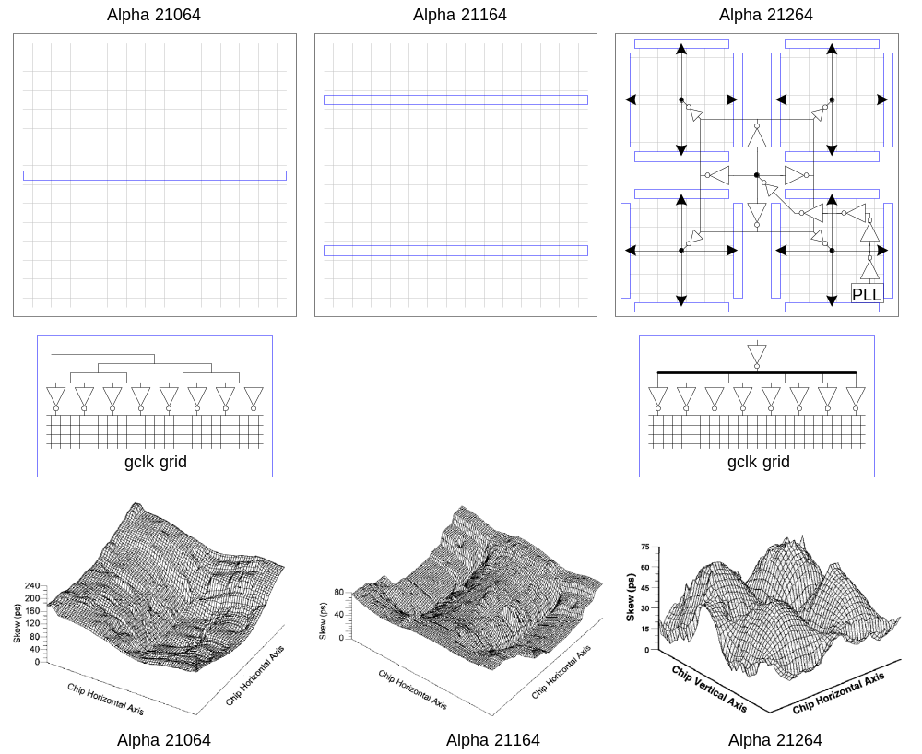
Alpha Clock Grids
21: Package, Power, and Clock

Slide 29
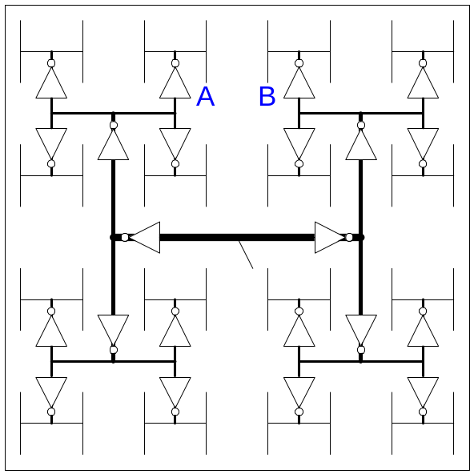
H-Trees
Fractal structure
  Gets clock arbitrarily close to any point
  Matched delay along all paths
Delay variations cause skew
A and B might see big skew
21: Package, Power, and Clock

Slide 30
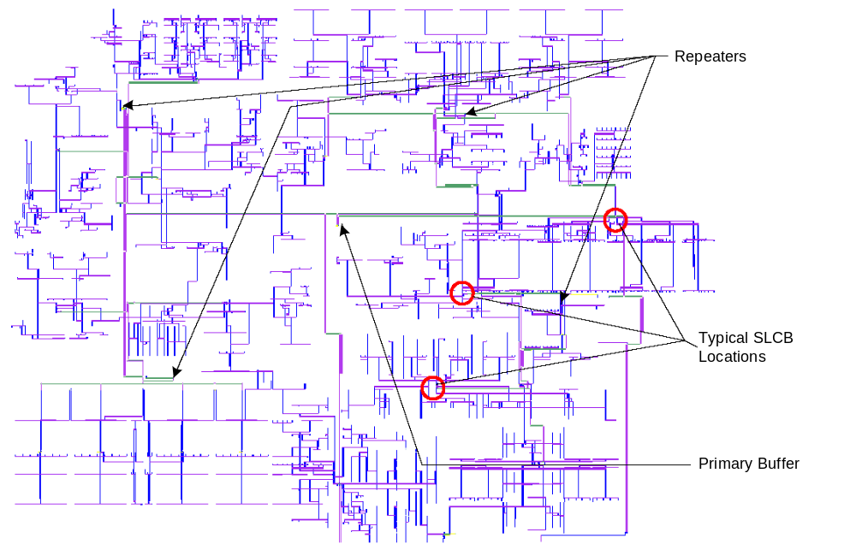
Itanium 2 H-Tree
Four levels of buffering:
  Primary driver
  Repeater
  Second-level
  clock buffer
  Gater
Route around
obstructions
21: Package, Power, and Clock

Slide 31
Hybrid Networks
Use H-tree to distribute clock to many points
Tie these points together with a grid
Ex: IBM Power4, PowerPC
  H-tree drives 16-64 sector buffers
  Buffers drive total of 1024 points
  All points shorted together with grid
21: Package, Power, and Clock

