Slide 1

Lecture 21:
Design for Testability

Slide 2
Outline
Testing
  Logic Verification
  Silicon Debug
  Manufacturing Test
Fault Models
Observability and Controllability
Design for Test
  Scan
  BIST
Boundary Scan
12: Design for Testability

Slide 3
Testing
Testing is one of the most expensive parts of chips
  Logic verification accounts for > 50% of design effort for many chips
  Debug time after fabrication has enormous opportunity cost
  Shipping defective parts can sink a company
Example: Intel FDIV bug (1994)
  Logic error not caught until > 1M units shipped
  Recall cost $450M (!!!)
12: Design for Testability

Slide 4
Logic Verification
Does the chip simulate correctly?
  Usually done at HDL level
  Verification engineers write test bench for HDL
    Can’t test all cases
    Look for corner cases
    Try to break logic design
Ex: 32-bit adder
  Test all combinations of corner cases as inputs:
    0, 1, 2, 2³¹-1, -1, -2³¹, a few random numbers
Good tests require ingenuity
12: Design for Testability

Slide 5
Silicon Debug
Test the first chips back from fabrication
  If you are lucky, they work the first time
  If not…
Logic bugs vs. electrical failures
  Most chip failures are logic bugs from inadequate simulation
  Some are electrical failures
    Crosstalk
    Dynamic nodes: leakage, charge sharing
    Ratio failures
  A few are tool or methodology failures (e.g. DRC)
Fix the bugs and fabricate a corrected chip
12: Design for Testability

Slide 6
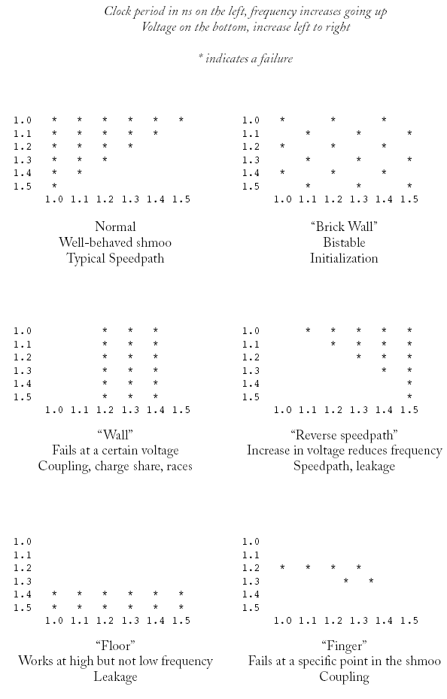
Shmoo Plots
How to diagnose failures?
  Hard to access chips
    Picoprobes
    Electron beam
    Laser voltage probing
    Built-in self-test
Shmoo plots
  Vary voltage, frequency
  Look for cause of
  electrical failures
12: Design for Testability

Slide 7
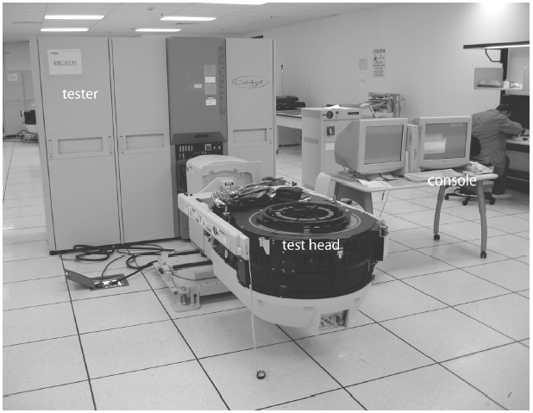
Manufacturing Test
A speck of dust on a wafer is sufficient to kill chip
Yield of any chip is < 100%
  Must test chips after manufacturing before delivery to customers to only ship good parts
Manufacturing testers are
very expensive
  Minimize time on tester
  Careful selection of
  test vectors
12: Design for Testability

Slide 8
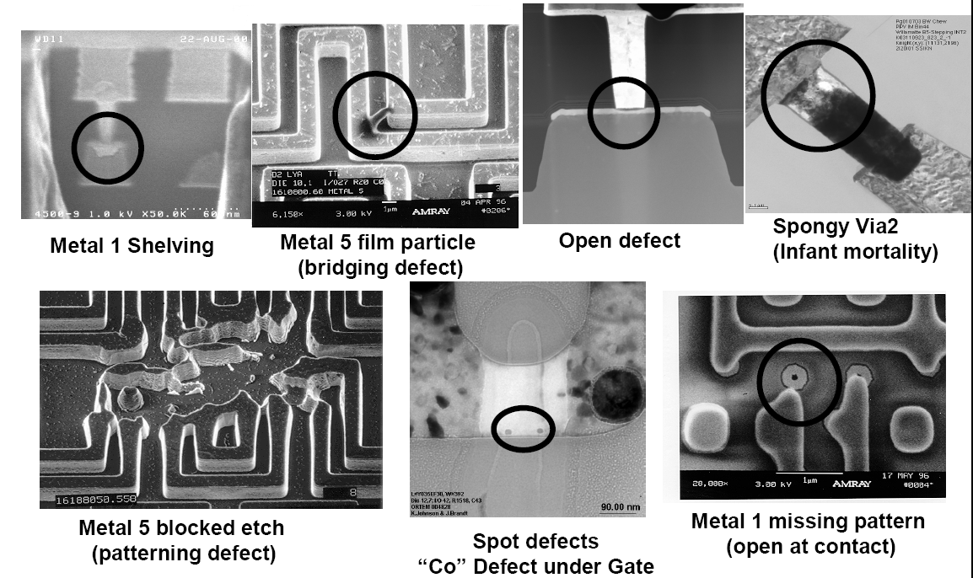
Manufacturing Failures
SEM images courtesy Intel Corporation
12: Design for Testability

Slide 9
Stuck-At Faults
How does a chip fail?
  Usually failures are shorts between two conductors or opens in a conductor
  This can cause very complicated behavior
A simpler model: Stuck-At
  Assume all failures cause nodes to be “stuck-at” 0 or 1, i.e. shorted to GND or V_{DD}
  Not quite true, but works well in practice
12: Design for Testability

Slide 10
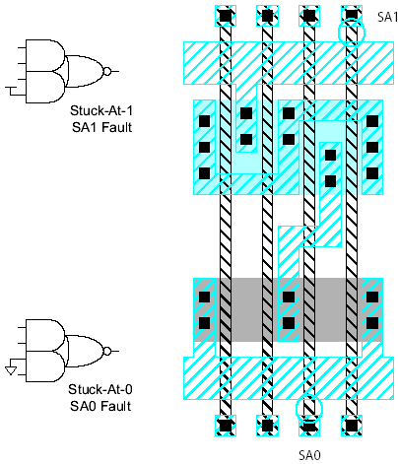
Examples
12: Design for Testability

Slide 11
Observability & Controllability
Observability: ease of observing a node by watching external output pins of the chip
Controllability: ease of forcing a node to 0 or 1 by driving input pins of the chip
Combinational logic is usually easy to observe and control
Finite state machines can be very difficult, requiring many cycles to enter desired state
  Especially if state transition diagram is not known to the test engineer
12: Design for Testability

Slide 12
Test Pattern Generation
Manufacturing test ideally would check every node in the circuit to prove it is not stuck.
Apply the smallest sequence of test vectors necessary to prove each node is not stuck.
Good observability and controllability reduces number of test vectors required for manufacturing test.
  Reduces the cost of testing
  Motivates design-for-test
12: Design for Testability

Slide 13
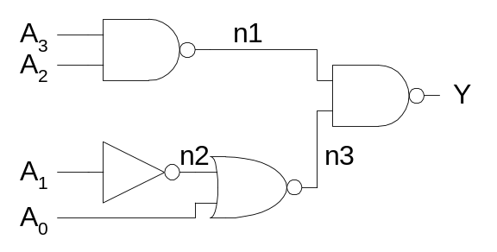
Test Example
    SA1 SA0
A₃ {0110} {1110}
A₂ {1010} {1110}
A₁ {0100} {0110}
A₀ {0110} {0111}
n1 {1110} {0110}
n2 {0110} {0100}
n3 {0101} {0110}
Y {0110} {1110}
Minimum set: {0100, 0101, 0110, 0111, 1010, 1110}
12: Design for Testability

Slide 14
Design for Test
Design the chip to increase observability and controllability
If each register could be observed and controlled, test problem reduces to testing combinational logic between registers.
Better yet, logic blocks could enter test mode where they generate test patterns and report the results automatically.
12: Design for Testability

Slide 15
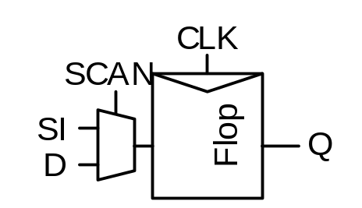
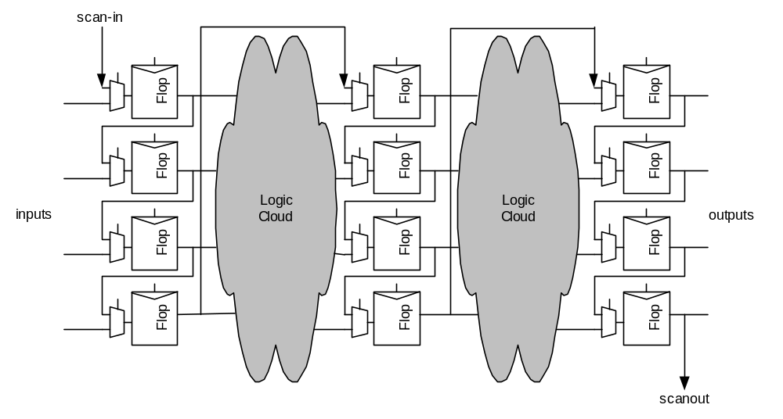
Scan
Convert each flip-flop to a scan register
  Only costs one extra multiplexer
Normal mode: flip-flops behave as usual
Scan mode: flip-flops behave as shift register
Contents of flops
can be scanned
out and new
values scanned
in
12: Design for Testability

Slide 16
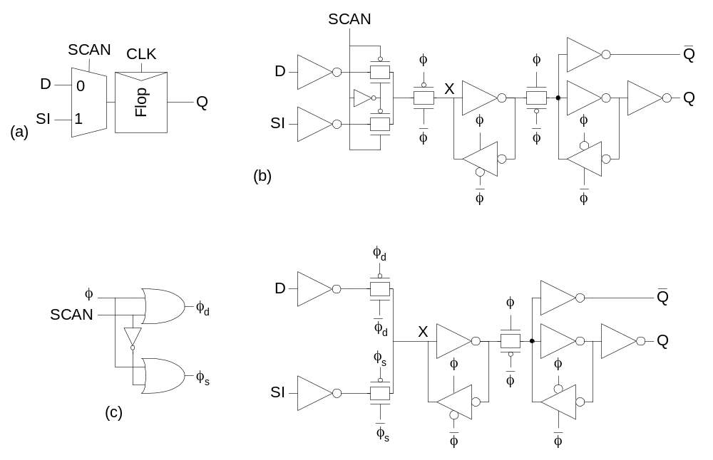
Scannable Flip-flops
12: Design for Testability

Slide 17
ATPG
Test pattern generation is tedious
Automatic Test Pattern Generation (ATPG) tools produce a good set of vectors for each block of combinational logic
Scan chains are used to control and observe the blocks
Complete coverage requires a large number of vectors, raising the cost of test
Most products settle for covering 90+% of potential stuck-at faults
12: Design for Testability

Slide 18
Built-in Self-test
Built-in self-test lets blocks test themselves
  Generate pseudo-random inputs to comb. logic
  Combine outputs into a syndrome
  With high probability, block is fault-free if it produces the expected syndrome
12: Design for Testability

Slide 19
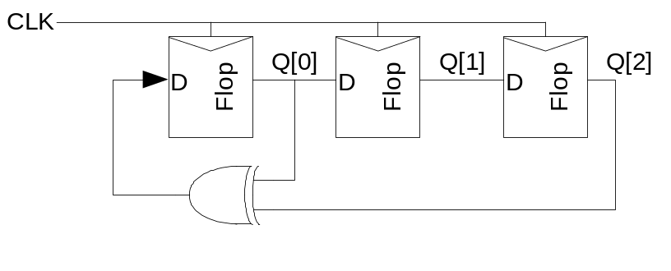
PRSG
Linear Feedback Shift Register
  Shift register with input taken from XOR of state
  Pseudo-Random Sequence Generator
Step | Y
0 | 111
1 | 110
2 | 101
3 | 010
4 | 100
5 | 001
6 | 011
7 | 111 (repeats)
Y
Flops reset to 111
12: Design for Testability

Slide 20
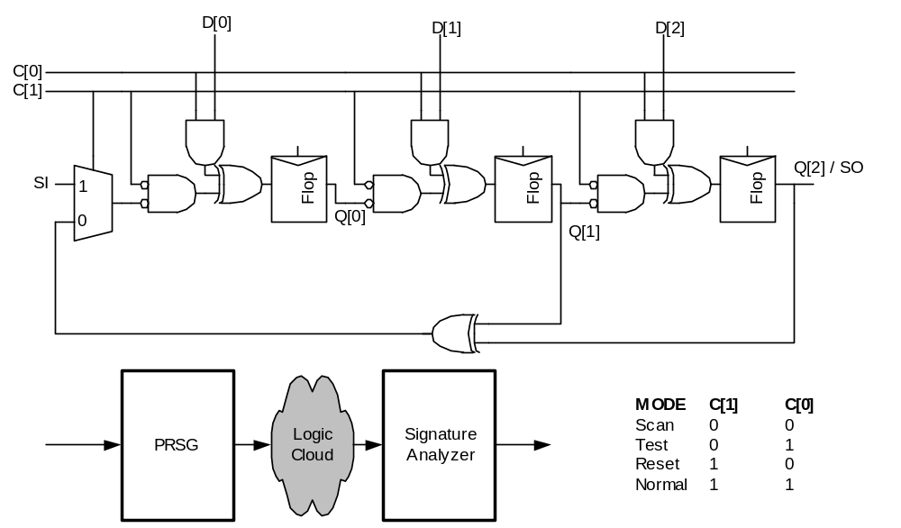
BILBO
Built-in Logic Block Observer
  Combine scan with PRSG & signature analysis
12: Design for Testability

Slide 21
Boundary Scan
Testing boards is also difficult
  Need to verify solder joints are good
    Drive a pin to 0, then to 1
    Check that all connected pins get the values
Through-hold boards used “bed of nails”
SMT and BGA boards cannot easily contact pins
Build capability of observing and controlling pins into each chip to make board test easier
12: Design for Testability

Slide 22
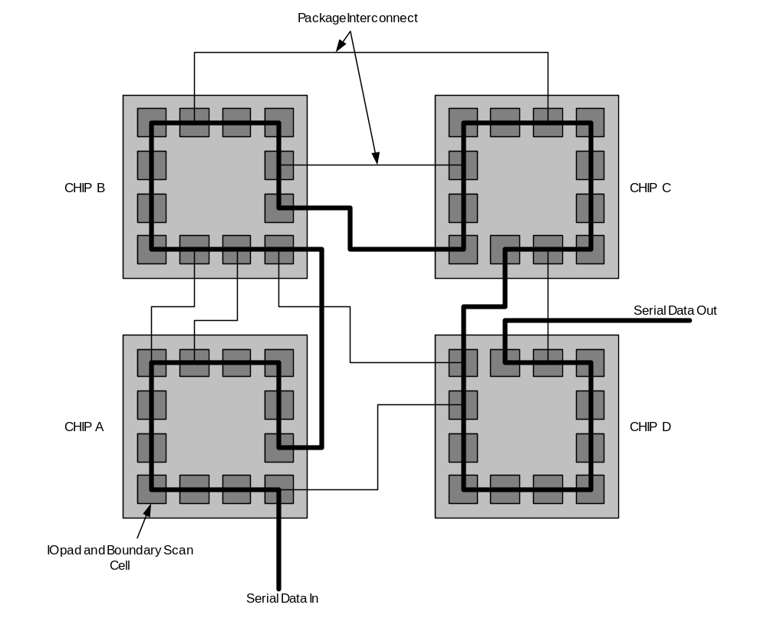
Boundary Scan Example
12: Design for Testability

Slide 23
Boundary Scan Interface
Boundary scan is accessed through five pins
  TCK: test clock
  TMS: test mode select
  TDI: test data in
  TDO: test data out
  TRST*: test reset (optional)
Chips with internal scan chains can access the chains through boundary scan for unified test strategy.
12: Design for Testability

Slide 24
Testing Your Class Project
Presilicon Verification
  Test vectors: corner cases and random vectors
  HDL simulation of schematics for functionality
  Use 2-phase clocking to avoid races
  Use static CMOS gates to avoid electrical failures
  Use LVS to ensure layout matches schematic
  Don’t worry about timing
Postsilicon Verification
  Run your test vectors on the fabricated chip
  Use a functional chip tester
  Potentially use breadboard or PCB for full system
12: Design for Testability

Slide 25
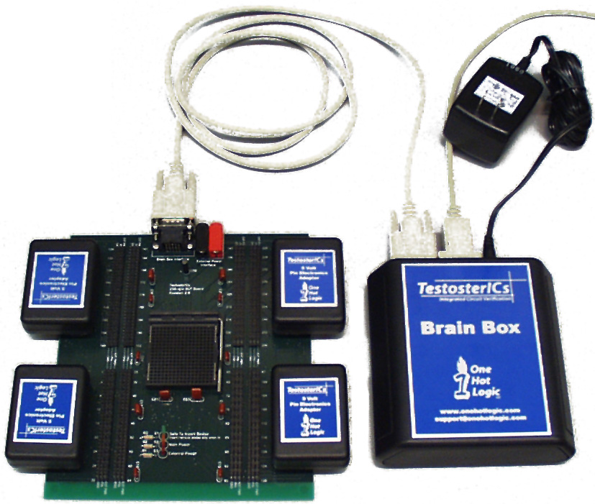
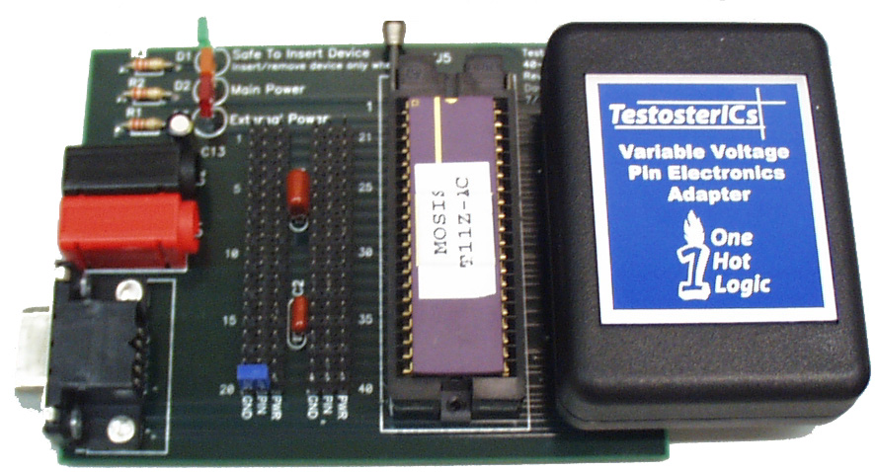
TestosterICs
TestosterICs functional chip tester
  Designed by clinic teams and David Diaz at HMC
  Reads your test vectors, applies them to your chip, and reports assertion failures
12: Design for Testability

Slide 26
Summary
Think about testing from the beginning
  Simulate as you go
  Plan for test after fabrication
“If you don’t test it, it won’t work! (Guaranteed)”
12: Design for Testability

