Slide 1

Lecture 22:
I/O

Slide 2
Outline
Basic I/O Pads
I/O Channels
  Transmission Lines
  Noise and Interference
High-Speed I/O
  Transmitters
  Receivers
Clock Recovery
  Source-Synchronous
  Mesochronous
23: I/O

Slide 3
Input / Output
Input/Output System functions
  Communicate between chip and external world
  Drive large capacitance off chip
  Operate at compatible voltage levels
  Provide adequate bandwidth
  Limit slew rates to control di/dt noise
  Protect chip against electrostatic discharge
  Use small number of pins (low cost)
23: I/O

Slide 4
I/O Pad Design
Pad types
  V_{DD} / GND
  Output
  Input
  Bidirectional
  Analog
23: I/O

Slide 5
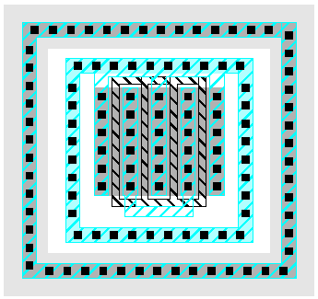
Output Pads
Drive large off-chip loads (2 – 50 pF)
  With suitable rise/fall times
  Requires chain of successively larger buffers
Guard rings to protect against latchup
  Noise below GND injects charge into substrate
  Large nMOS output transistor
  p+ inner guard ring
  n+ outer guard ring
    In n-well
23: I/O

Slide 6
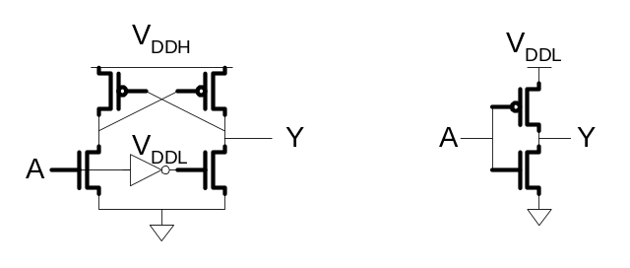
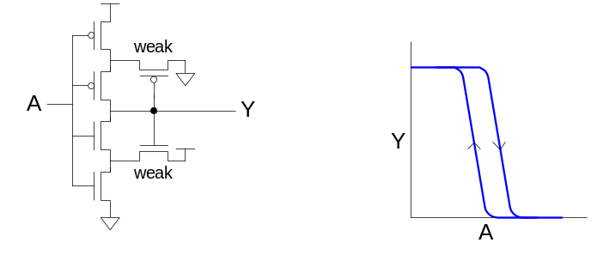
Input Pads
Level conversion
  Higher or lower off-chip V
  May need thick oxide gates
Noise filtering
  Schmitt trigger
  Hysteresis changes V_{IH}, V_{IL}
Protection against electrostatic discharge
23: I/O

Slide 7
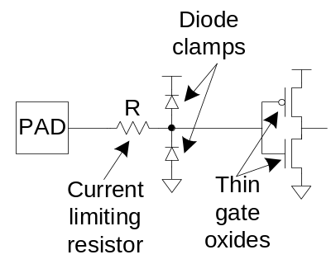
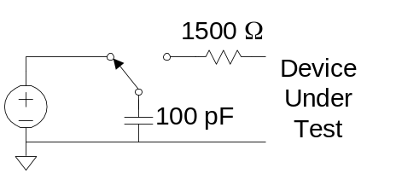
ESD Protection
Static electricity builds up on your body
  Shock delivered to a chip can fry thin gates
  Must dissipate this energy in protection circuits before it reaches the gates
ESD protection circuits
  Current limiting resistor
  Diode clamps
ESD testing
  Human body model
  Views human as charged capacitor
23: I/O

Slide 8
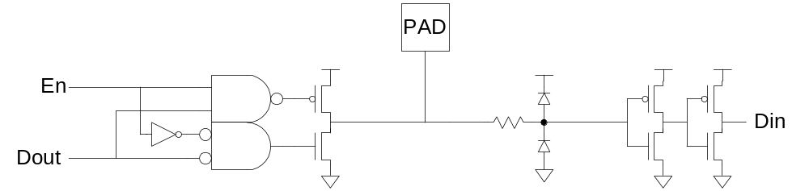
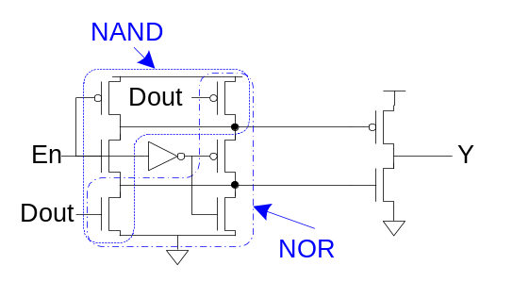
Bidirectional Pads
Combine input and output pad
Need tristate driver on output
  Use enable signal to set direction
  Optimized tristate avoids huge series transistors
23: I/O

Slide 9
Analog Pads
Pass analog voltages directly in or out of chip
  No buffering
  Protection circuits must not distort voltages
23: I/O

Slide 10
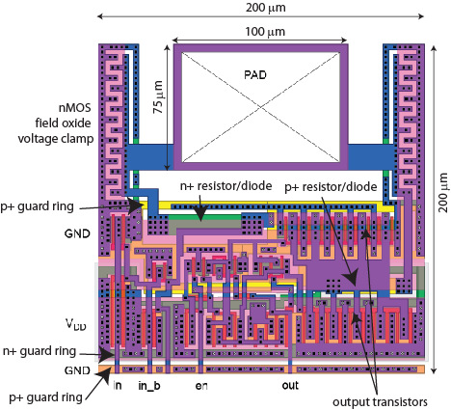
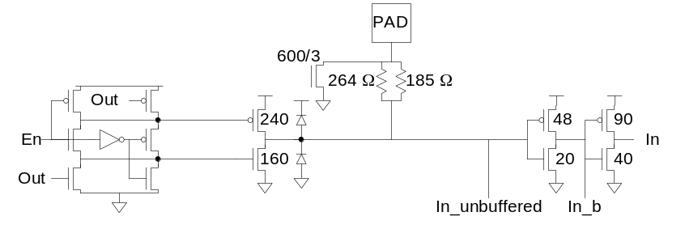
MOSIS I/O Pad
1.6 μm two-metal process
  Protection resistors
  Protection diodes
  Guard rings
  Field oxide clamps
23: I/O

Slide 11
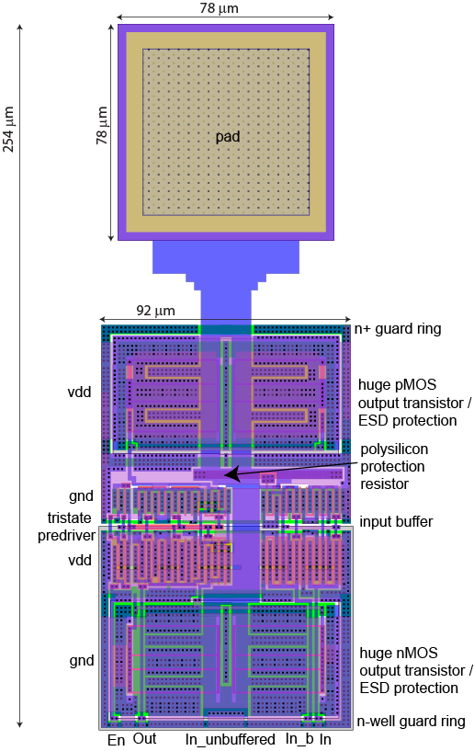
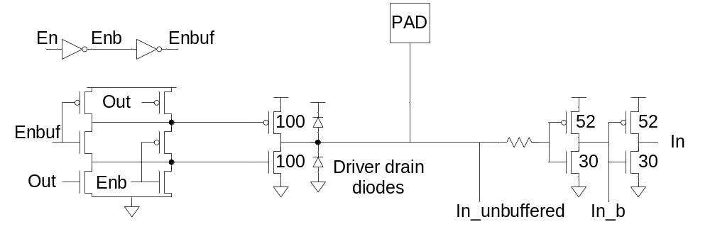
UofU I/O Pad
0.6 μm three-metal process
  Similar I/O drivers
  Big driver transistors provide ESD protection
  Guard rings around driver
23: I/O

Slide 12
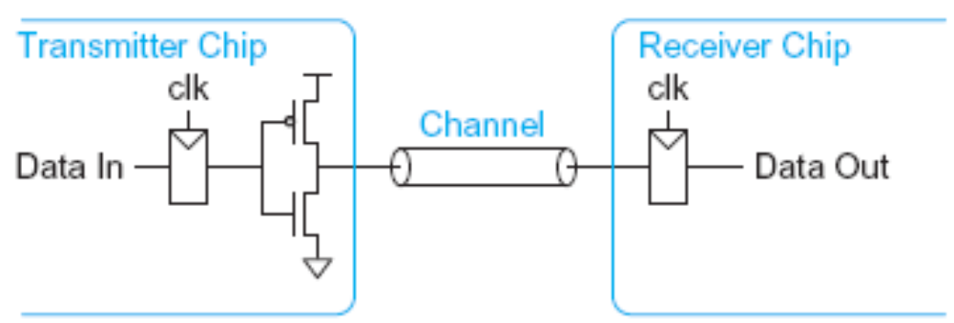
I/O Channels
I/O Channel: connection between chips
  Low frequency: ideal equipotential net
  High frequency: transmission line
Transmission lines model
  Finite velocity of signal along wire
  Characteristic impedance of wire
23: I/O

Slide 13
When is a wire a T-Line?
When propagation delay along the wire is comparable to the edge rate of the signal propagating
Depends on
  Length
  Speed of light in the medium
  Edge rate
23: I/O

Slide 14
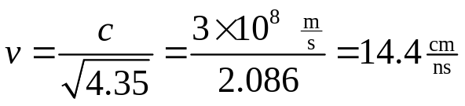
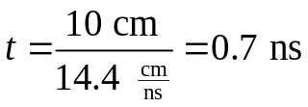
Example
When must a 10 cm trace on a PCB be treated as a transmission line
  FR4 epoxy has k = 4.35 (ε = kε₀)
  Assume rise/fall times are ¼ of cycle time
Signal propagation velocity
Wire flight time
Thus the wire should be treated as a transmission line when signals have a period < 2.8 ns (> 350 MHz)
23: I/O

Slide 15
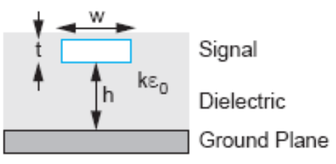
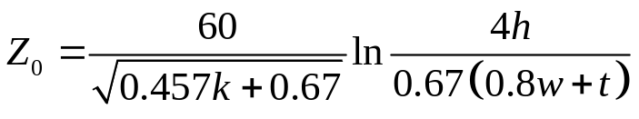
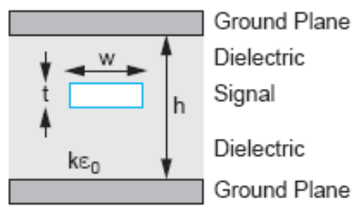
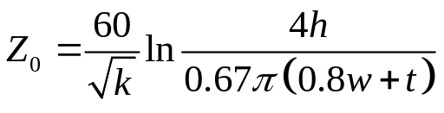
Characteristic Impedance
Z₀: ratio of voltage to current of a signal along the line
Depends on the geometry of the line
Microstrip: Outer layer of PCB
Stripline: Inner layer of PCB
23: I/O

Slide 16
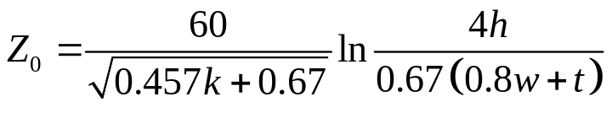
Example
A 4-layer PCB contains power and ground planes on the inner layers and signals on the outer layers. The board uses 1 oz copper (1.4 mils thick) and the FR4 dielectric is 8.7 mils thick. How wide should the traces be to achieve 50 Ω characteristic impedance?
This is a microstrip design. Solve for w with
  t = 1.4 mils
  h = 8.7 mils
  k = 4.35
  Z₀ = 50 Ω
w = 15 mils
23: I/O

Slide 17
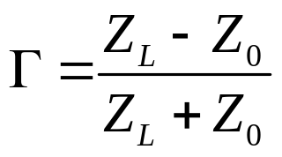
Reflections
When a wave hits the end of a transmission line, part of the energy will reflect if the load impedance does not match the characteristic impedance.
Reflection coefficient:
A wave with an amplitude of V_{reflected} = ΓV_{incident} returns along the line.
23: I/O

Slide 18
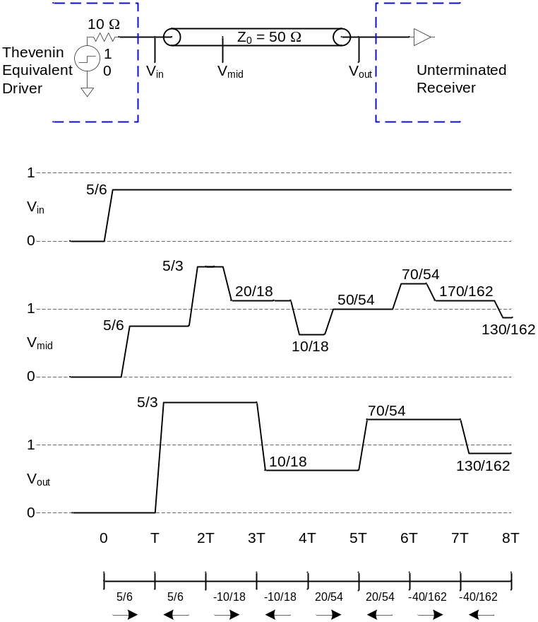
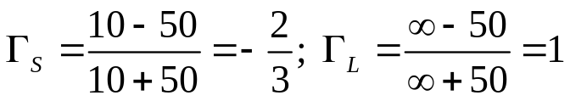
Example: Reflections
A strong driver with a Thevenin equivalent resistance of 10 Ω drives an unterminated transmission line with Z₀ = 50 Ω and flight time T. Plot the voltage at the 1/3 point and end of the line.
Reflection coefficients:
Initial wave: 50/(10+50) = 5/6
Observe ringing at load
23: I/O

Slide 19
Intersymbol Interference
Must wait until reflections damp out before sending next bit
Otherwise, intersymbol interference will occur
With an unterminated transmission line, minimum bit time is equal to several round trips along the line
23: I/O

Slide 20
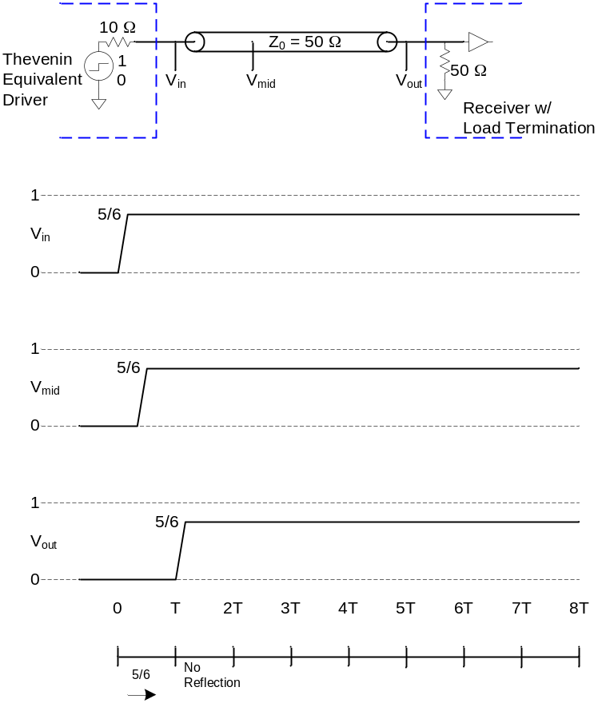
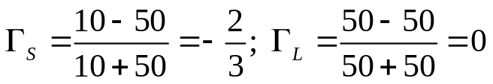
Example: Load Termination
Redo the previous example if the load is terminated with a 50 Ω resistor.
Reflection coefficients:
Initial wave: 50/(10+50) = 5/6
No ringing
Power dissipation in load resistor
23: I/O

Slide 21
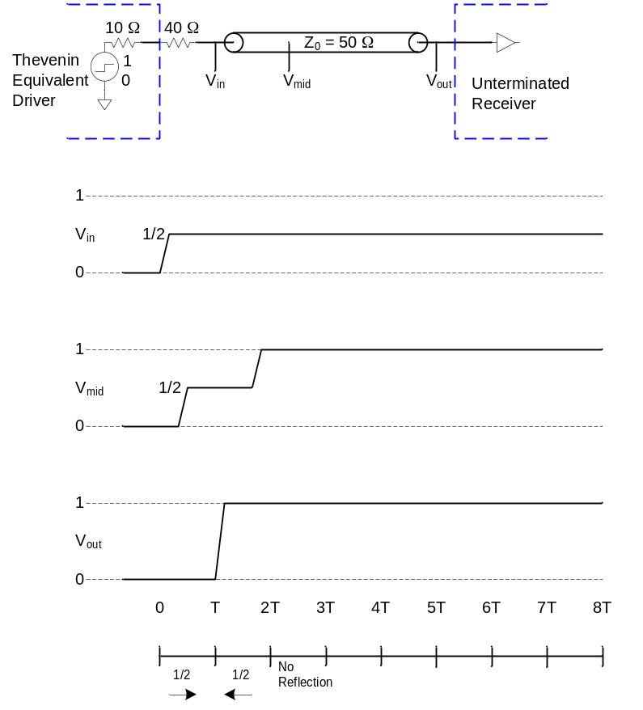
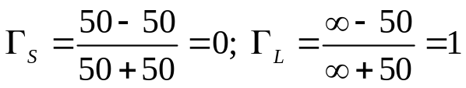
Example: Source Termination
Redo the previous example if the source is terminated with an extra 40 Ω resistor.
Reflection coefficients:
Initial wave: 50/(50+50) = 1/2
No ringing
No power dissipation in load
Taps along T-line momentarily see invalid levels
23: I/O

Slide 22
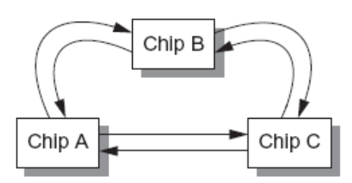
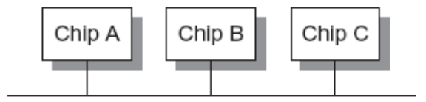
Termination Summary
For point-to-point links, source terminate to save power
For multidrop busses, load terminate to ensure valid logic levels
For busses with multiple receivers and drivers, terminate at both ends of the line to prevent reflections from either end
23: I/O

Slide 23
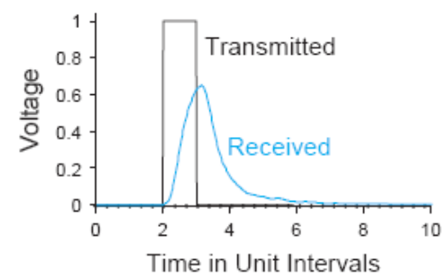
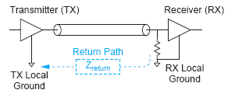
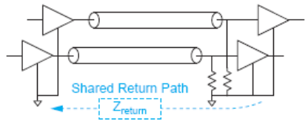
Noise and Interference
Other sources of intersymbol interference:
  Dispersion
    Caused by nonzero line resistance
  Crosstalk
    Capacitive or inductive coupling between channels
  Ground Bounce
    Nonzero return path impedance
  Simultaneous Switching Noise
23: I/O

Slide 24
High-Speed I/O
Transmit data faster than the flight time along the line
Transmitters must generate very short pulses
Receivers must be accurately synchronized to detect the pulses
23: I/O

Slide 25
High Speed Transmitters
How to handle termination?
  High impedance current-mode driver + load term?
  Or low-impedance driver + source termination
Single-ended vs. differential
  Single-ended uses half the wires
  Differential is Immune to common mode noise
Pull-only vs. Push-Pull
  Pull-only has half the transistors
  Push-pull uses less power for the same swing
23: I/O

Slide 26
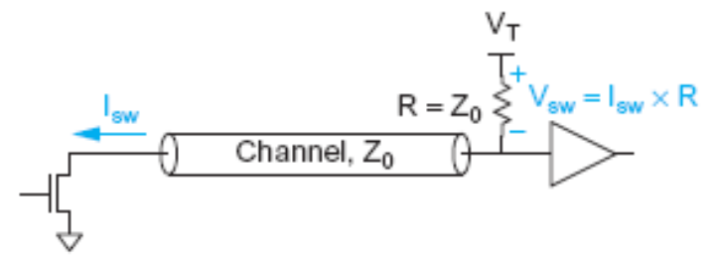
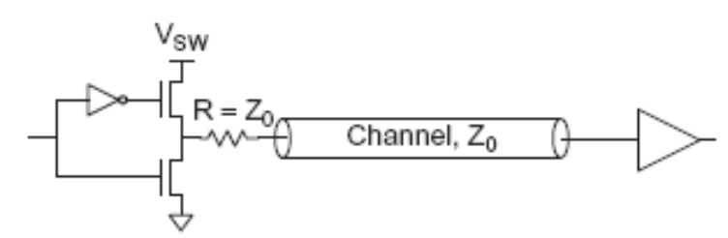
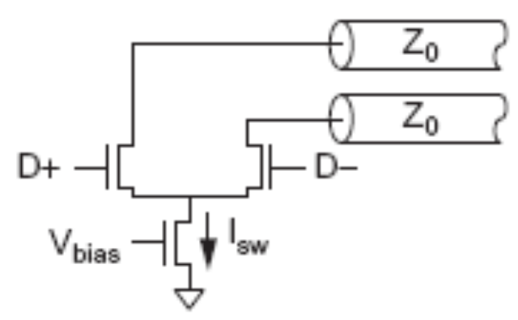
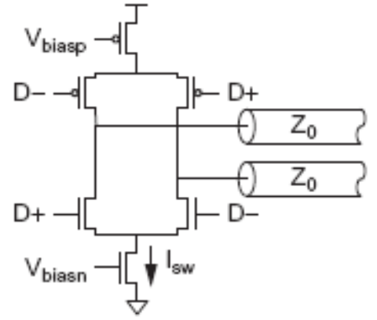
High-Speed Transmitters
 | Pull-Only | Push-Pull
Single-Ended
Differential
Gunning Transceiver
Logic (GTL)
Low-Voltage
Differential
Signalling
(LVDS)
Current Mode
Logic (CML)
23: I/O

Slide 27
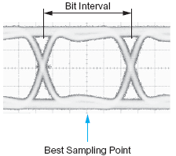
High-Speed Receivers
Sample data in the middle of the bit interval
How do we know when?
23: I/O

Slide 28
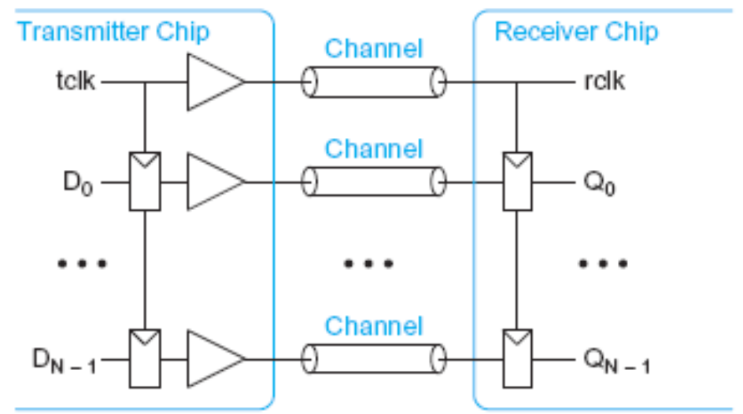
Source-Synchronous Clocking
Send clock with the data
Flight times roughly match each other
  Transmit on falling edge of tclk
  Receive on rising edge of rclk
23: I/O

Slide 29
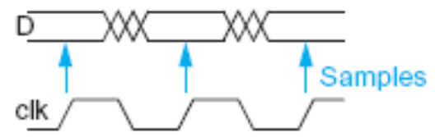
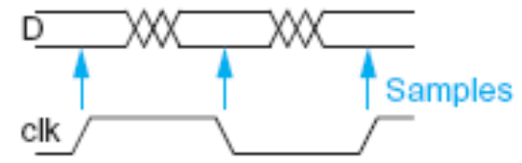
Single vs. Double Data Rate
In ordinary single data rate (SDR) system, clock switches twice as often as the data
If the system can handle this speed clock, the data is running at half the available bandwidth
In double-data-rate (DDR) transmit and receive on both edges of the clock
23: I/O

Slide 30
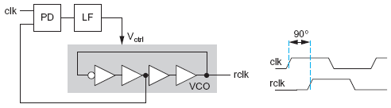
Phase Alignment
If the DDR clock is aligned to the transmitted clock, it must be shifted by 90º before sampling
Use PLL
23: I/O

Slide 31
Mesochronous Clocking
As speeds increase, it is difficult to keep clock and data aligned
  Mismatches in trace lengths
  Mismatches in propagation speeds
  Different in clock vs. data drivers
Mesochronous: clock and data have same frequency but unknown phase
  Use PLL/DLL to realign clock to each data channel
23: I/O

Slide 32
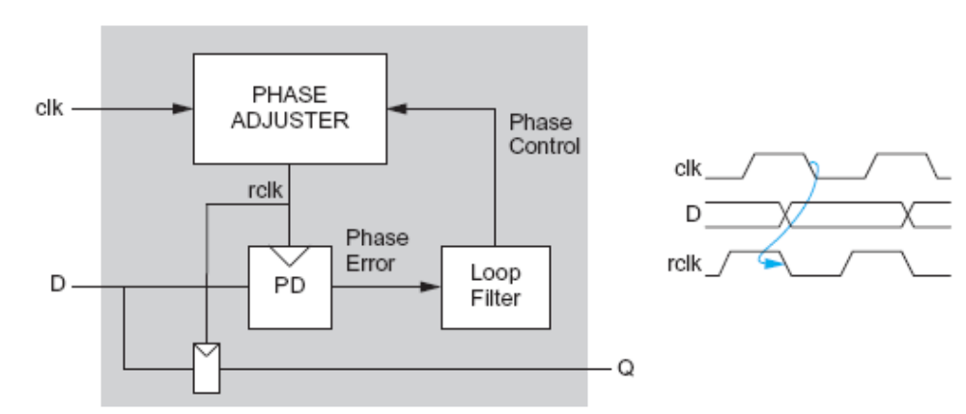
Phase Calibration Loop
Special phase detector compares clock & data phase
23: I/O

