Slide 1

Lecture 7:
Power

Slide 2
Outline
Power and Energy
Dynamic Power
Static Power
7: Power

Slide 3

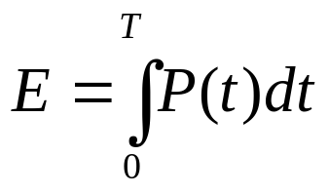
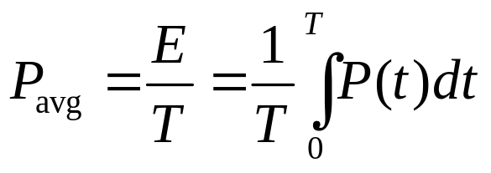
Power and Energy
Power is drawn from a voltage source attached to the V_{DD} pin(s) of a chip.
Instantaneous Power:
Energy:
Average Power:
7: Power

Slide 4
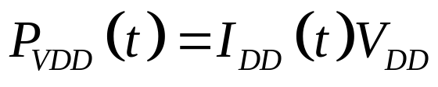
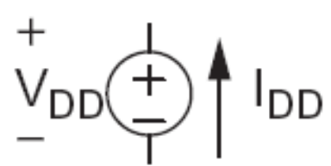
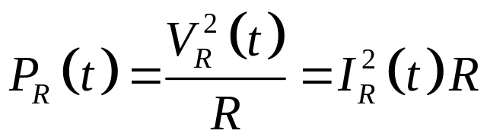
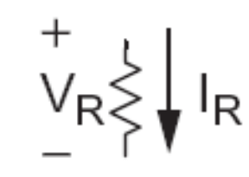
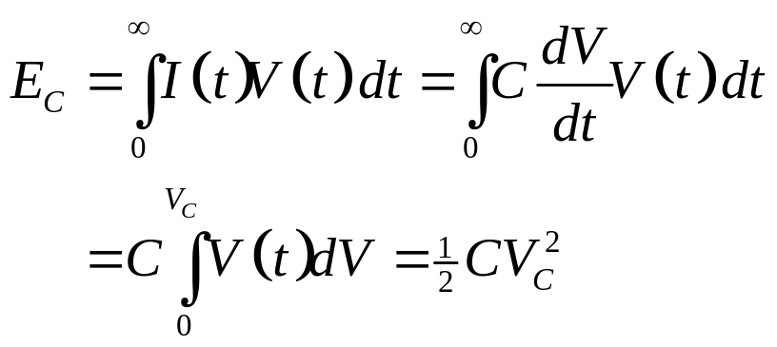

Power in Circuit Elements
7: Power

Slide 5
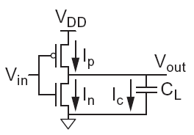

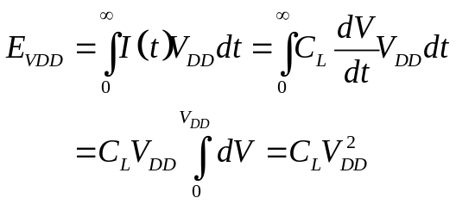
Charging a Capacitor
When the gate output rises
  Energy stored in capacitor is
  But energy drawn from the supply is
  Half the energy from V_{DD} is dissipated in the pMOS transistor as heat, other half stored in capacitor
When the gate output falls
  Energy in capacitor is dumped to GND
  Dissipated as heat in the nMOS transistor
7: Power

Slide 6
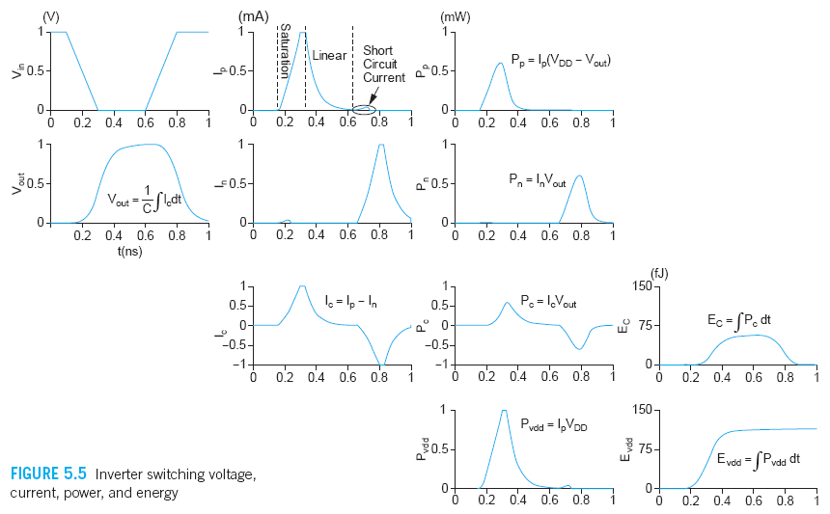
Switching Waveforms
Example: V_{DD} = 1.0 V, C_{L} = 150 fF, f = 1 GHz
7: Power

Slide 7
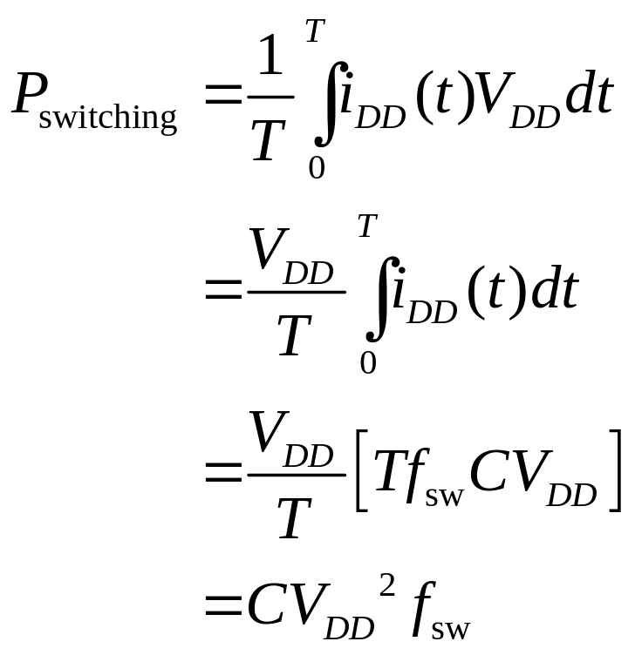
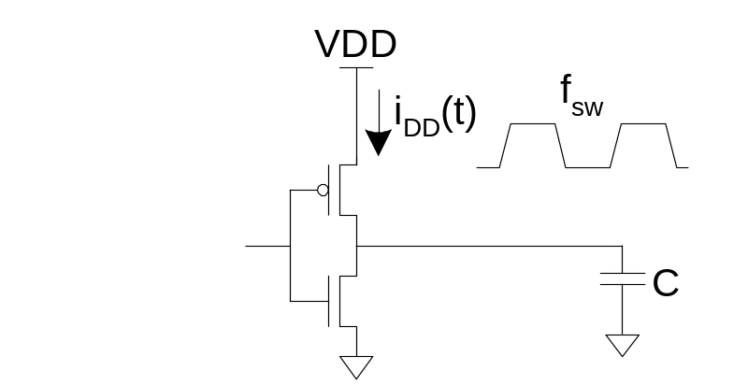
Switching Power
7: Power

Slide 8
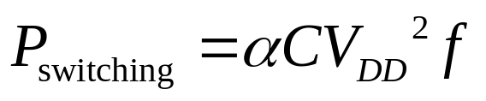
Activity Factor
Suppose the system clock frequency = f
Let f_{sw} = αf, where α = activity factor
  If the signal is a clock, α = 1
  If the signal switches once per cycle, α = ½
Dynamic power:
7: Power

Slide 9
Short Circuit Current
When transistors switch, both nMOS and pMOS networks may be momentarily ON at once
Leads to a blip of “short circuit” current.
< 10% of dynamic power if rise/fall times are comparable for input and output
We will generally ignore this component
7: Power

Slide 10
Power Dissipation Sources
P_{total} = P_{dynamic} + P_{static}
Dynamic power: P_{dynamic} = P_{switching} + P_{shortcircuit}
  Switching load capacitances
  Short-circuit current
Static power: P_{static} = (I_{sub} + I_{gate} + I_{junct} + I_{contention})V_{DD}
  Subthreshold leakage
  Gate leakage
  Junction leakage
  Contention current
7: Power

Slide 11
Dynamic Power Example
1 billion transistor chip
  50M logic transistors
    Average width: 12 λ
    Activity factor = 0.1
  950M memory transistors
    Average width: 4 λ
    Activity factor = 0.02
  1.0 V 65 nm process
  C = 1 fF/μm (gate) + 0.8 fF/μm (diffusion)
Estimate dynamic power consumption @ 1 GHz. Neglect wire capacitance and short-circuit current.
7: Power

Slide 12
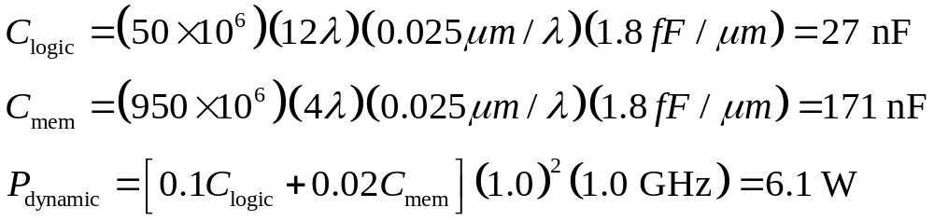
Solution
7: Power

Slide 13
Dynamic Power Reduction
Try to minimize:
  Activity factor
  Capacitance
  Supply voltage
  Frequency
7: Power

Slide 14
Activity Factor Estimation
Let P_{i} = Prob(node i = 1)
  P_{i} = 1-P_{i}
α_{i} = P_{i} * P_{i}
Completely random data has P = 0.5 and α = 0.25
Data is often not completely random
  e.g. upper bits of 64-bit words representing bank account balances are usually 0
Data propagating through ANDs and ORs has lower activity factor
  Depends on design, but typically α ≈ 0.1
7: Power

Slide 15
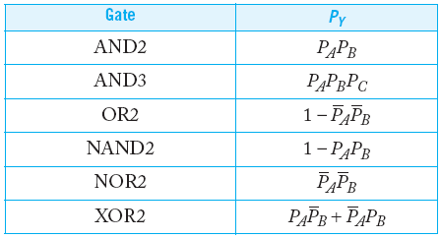
Switching Probability
7: Power

Slide 16
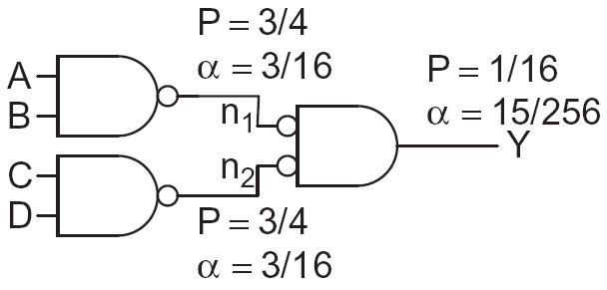
Example
A 4-input AND is built out of two levels of gates
Estimate the activity factor at each node if the inputs have P = 0.5
7: Power

Slide 17
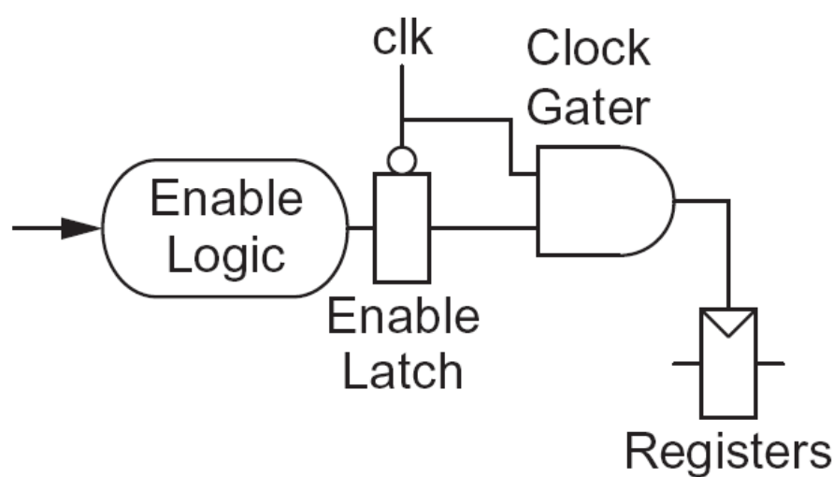
Clock Gating
The best way to reduce the activity is to turn off the clock to registers in unused blocks
  Saves clock activity (α = 1)
  Eliminates all switching activity in the block
  Requires determining if block will be used
7: Power

Slide 18
Capacitance
Gate capacitance
  Fewer stages of logic
  Small gate sizes
Wire capacitance
  Good floorplanning to keep communicating blocks close to each other
  Drive long wires with inverters or buffers rather than complex gates
7: Power

Slide 19
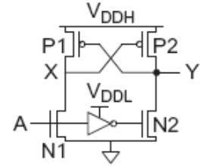
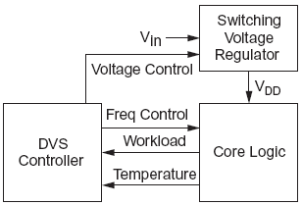
Voltage / Frequency
Run each block at the lowest possible voltage and frequency that meets performance requirements
Voltage Domains
  Provide separate supplies to different blocks
  Level converters required when crossing
  from low to high V_{DD} domains
Dynamic Voltage Scaling
  Adjust V_{DD} and f according to
  workload
7: Power

Slide 20
Static Power
Static power is consumed even when chip is quiescent.
  Leakage draws power from nominally OFF devices
  Ratioed circuits burn power in fight between ON transistors
7: Power

Slide 21
Static Power Example
Revisit power estimation for 1 billion transistor chip
Estimate static power consumption
  Subthreshold leakage
    Normal V_{t}: 100 nA/μm
    High V_{t}: 10 nA/μm
    High Vt used in all memories and in 95% of logic gates
  Gate leakage 5 nA/μm
  Junction leakage negligible
7: Power

Slide 22
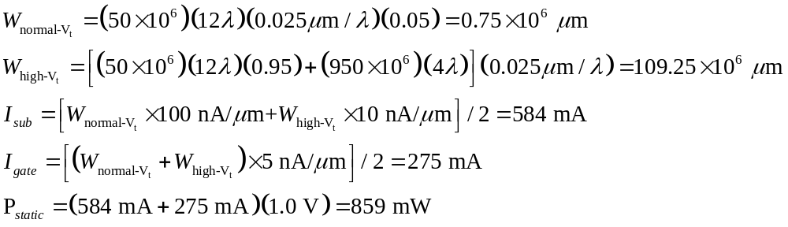
Solution
7: Power

Slide 23
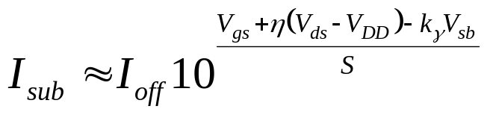
Subthreshold Leakage
For V_{ds} > 50 mV
I_{off} = leakage at V_{gs} = 0, V_{ds} = V_{DD}
Typical values in 65 nm
I_{off} = 100 nA/μm @ V_{t} = 0.3 V
I_{off} = 10 nA/μm @ V_{t} = 0.4 V
I_{off} = 1 nA/μm @ V_{t} = 0.5 V
η = 0.1
k_{γ} = 0.1
S = 100 mV/decade
7: Power

Slide 24
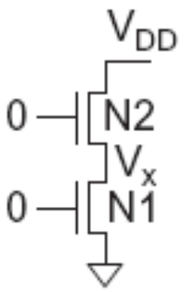
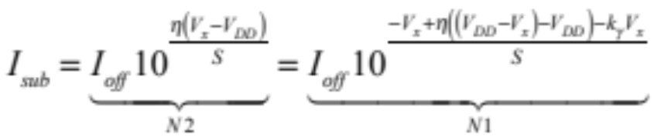
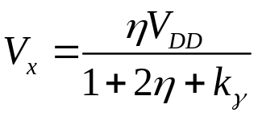
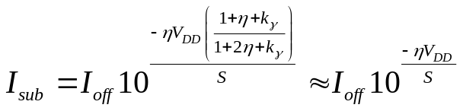
Stack Effect
Series OFF transistors have less leakage
  V_{x} > 0, so N2 has negative V_{gs}
  Leakage through 2-stack reduces ~10x
  Leakage through 3-stack reduces further
7: Power

Slide 25
Leakage Control
Leakage and delay trade off
  Aim for low leakage in sleep and low delay in active mode
To reduce leakage:
  Increase V_{t}: multiple V_{t}
    Use low V_{t} only in critical circuits
  Increase V_{s}: stack effect
    Input vector control in sleep
  Decrease V_{b}
    Reverse body bias in sleep
    Or forward body bias in active mode
7: Power

Slide 26
Gate Leakage
Extremely strong function of t_{ox} and V_{gs}
  Negligible for older processes
  Approaches subthreshold leakage at 65 nm and below in some processes
An order of magnitude less for pMOS than nMOS
Control leakage in the process using t_{ox} > 10.5 Å
  High-k gate dielectrics help
  Some processes provide multiple t_{ox}
    e.g. thicker oxide for 3.3 V I/O transistors
Control leakage in circuits by limiting V_{DD}
7: Power

Slide 27
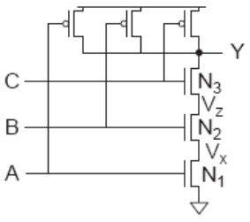
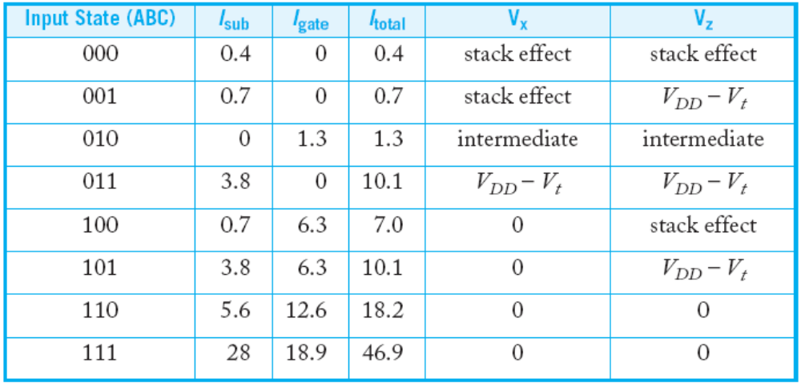
NAND3 Leakage Example
100 nm process
  I_{gn} = 6.3 nA I_{gp} = 0
  I_{offn} = 5.63 nA I_{offp} = 9.3 nA
Data from [Lee03]
7: Power

Slide 28
Junction Leakage
From reverse-biased p-n junctions
  Between diffusion and substrate or well
Ordinary diode leakage is negligible
Band-to-band tunneling (BTBT) can be significant
  Especially in high-V_{t} transistors where other leakage is small
  Worst at V_{db} = V_{DD}
Gate-induced drain leakage (GIDL) exacerbates
  Worst for V_{gd} = -V_{DD} (or more negative)
7: Power

Slide 29
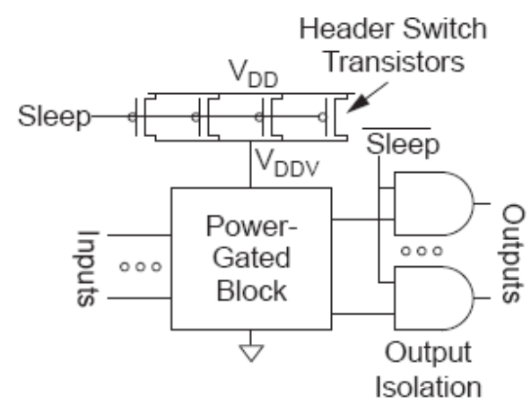
Power Gating
Turn OFF power to blocks when they are idle to save leakage
  Use virtual V_{DD} (V_{DDV})
  Gate outputs to prevent
  invalid logic levels to next block
Voltage drop across sleep transistor degrades performance during normal operation
  Size the transistor wide enough to minimize impact
Switching wide sleep transistor costs dynamic power
  Only justified when circuit sleeps long enough
7: Power

