Slide 1

Lecture 8:
SPICE Simulation

Slide 2
Outline
Introduction to SPICE
DC Analysis
Transient Analysis
Subcircuits
Optimization
Power Measurement
Logical Effort Characterization
8: SPICE Simulation

Slide 3
Introduction to SPICE
Simulation Program with Integrated Circuit Emphasis
  Developed in 1970’s at Berkeley
  Many commercial versions are available
  HSPICE is a robust industry standard
    Has many enhancements that we will use
Written in FORTRAN for punch-card machines
  Circuits elements are called cards
  Complete description is called a SPICE deck
8: SPICE Simulation

Slide 4
Writing Spice Decks
Writing a SPICE deck is like writing a good program
  Plan: sketch schematic on paper or in editor
    Modify existing decks whenever possible
  Code: strive for clarity
    Start with name, email, date, purpose
    Generously comment
  Test:
    Predict what results should be
    Compare with actual
    Garbage In, Garbage Out!
8: SPICE Simulation

Slide 5
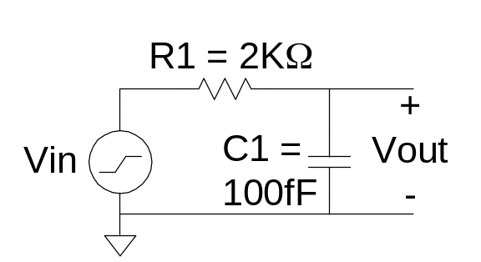
Example: RC Circuit
* rc.sp
* David_Harris@hmc.edu 2/2/03
* Find the response of RC circuit to rising input
*------------------------------------------------
* Parameters and models
*------------------------------------------------
.option post
*------------------------------------------------
* Simulation netlist
*------------------------------------------------
Vin in gnd pwl 0ps 0 100ps 0 150ps 1.0 1ns 1.0
R1 in out 2k
C1 out gnd 100f
*------------------------------------------------
* Stimulus
*------------------------------------------------
.tran 20ps 1ns
.plot v(in) v(out)
.end
8: SPICE Simulation

Slide 6
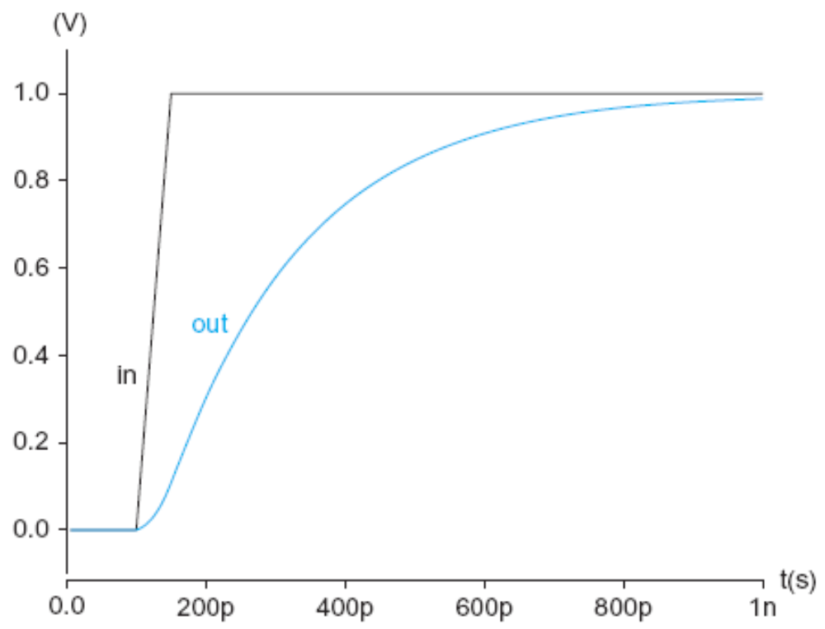
Result (Graphical)
8: SPICE Simulation

Slide 7
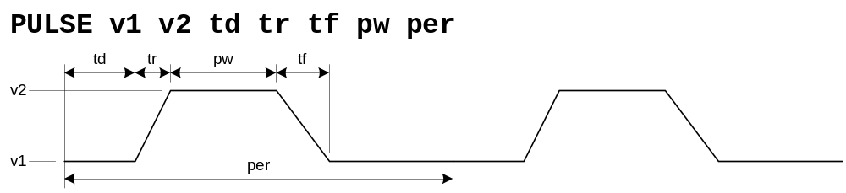
Sources
DC Source
  Vdd vdd gnd 2.5
Piecewise Linear Source
  Vin in gnd pwl 0ps 0 100ps 0 150ps 1.0 1ns 1.0
Pulsed Source
  Vck clk gnd PULSE 0 1.0 0ps 100ps 100ps 300ps 800ps
8: SPICE Simulation

Slide 8
SPICE Elements
Letter
Element
R
Resistor
C
Capacitor
L
Inductor
K
Mutual Inductor
V
Independent voltage source
I
Independent current source
M
MOSFET
D
Diode
Q
Bipolar transistor
W
Lossy transmission line
X
Subcircuit
E
Voltage-controlled voltage source
G
Voltage-controlled current source
H
Current-controlled voltage source
F
Current-controlled current source
8: SPICE Simulation

Slide 9
Units
Letter | Unit | Magnitude
a | atto | 10⁻¹⁸
f | fempto | 10⁻¹⁵
p | pico | 10⁻¹²
n | nano | 10⁻⁹
u | micro | 10⁻⁶
m | milli | 10⁻³
k | kilo | 10³
x | mega | 10⁶
g | giga | 10⁹
Ex: 100 femptofarad capacitor = 100fF, 100f, 100e-15
8: SPICE Simulation

Slide 10
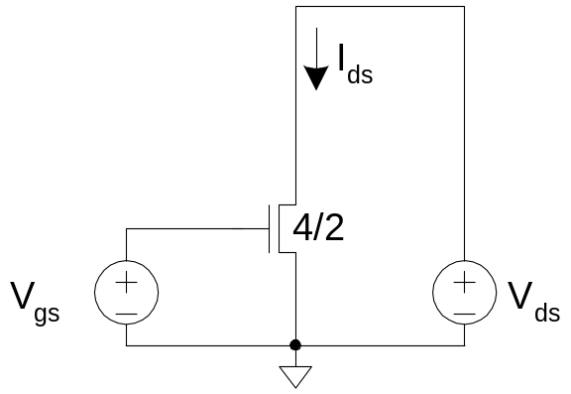
DC Analysis
* mosiv.sp
*------------------------------------------------
* Parameters and models
*------------------------------------------------
.include '../models/ibm065/models.sp'
.temp 70
.option post
*------------------------------------------------
* Simulation netlist
*------------------------------------------------
*nmos
Vgs g gnd 0
Vds d gnd 0
M1 d g gnd gnd NMOS W=100n L=50n
*------------------------------------------------
* Stimulus
*------------------------------------------------
.dc Vds 0 1.0 0.05 SWEEP Vgs 0 1.0 0.2
.end
8: SPICE Simulation

Slide 11
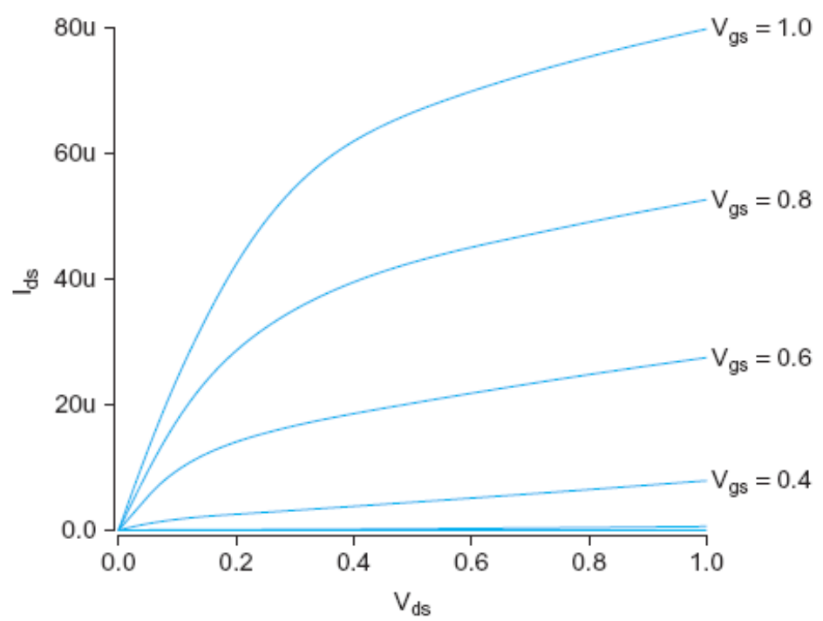
I-V Characteristics
nMOS I-V
  V_{gs} dependence
  Saturation
8: SPICE Simulation

Slide 12
MOSFET Elements
M element for MOSFET
Mname drain gate source body type
+ W=<width> L=<length>
+ AS=<area source> AD = <area drain>
+ PS=<perimeter source> PD=<perimeter drain>
8: SPICE Simulation

Slide 13
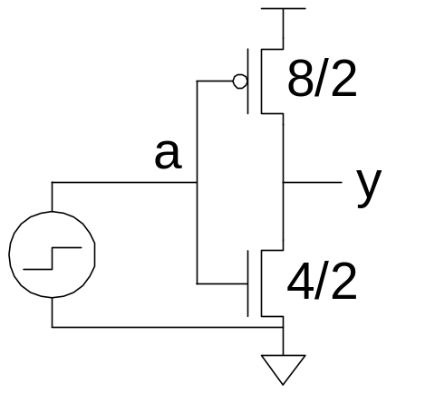
Transient Analysis
* inv.sp
* Parameters and models
*------------------------------------------------
.param SUPPLY=1.0
.option scale=25n
.include '../models/ibm065/models.sp'
.temp 70
.option post
* Simulation netlist
*------------------------------------------------
Vdd vdd gnd 'SUPPLY'
Vin a gnd PULSE 0 'SUPPLY' 50ps 0ps 0ps 100ps 200ps
M1 y a gnd gnd NMOS W=4 L=2
+ AS=20 PS=18 AD=20 PD=18
M2 y a vdd vdd PMOS W=8 L=2
+ AS=40 PS=26 AD=40 PD=26
* Stimulus
*------------------------------------------------
.tran 0.1ps 80ps
.end
8: SPICE Simulation

Slide 14
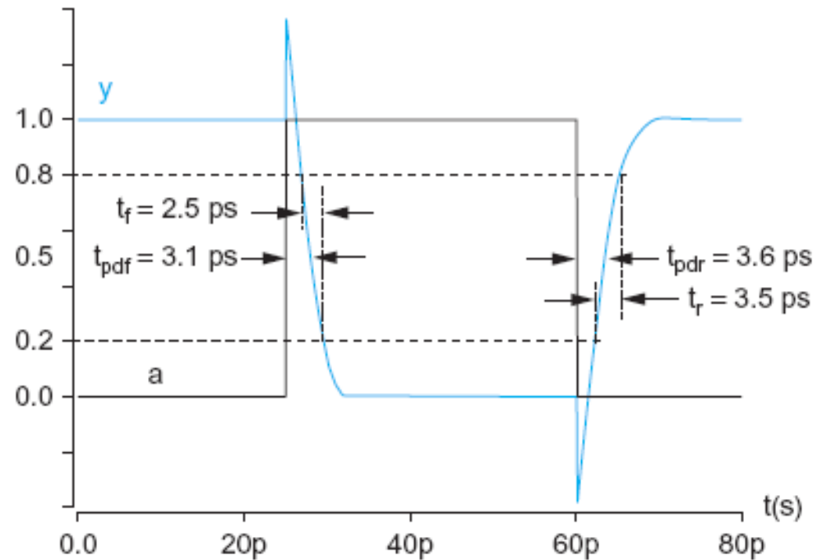
Transient Results
Unloaded inverter
  Overshoot
  Very fast
  edges
8: SPICE Simulation

Slide 15
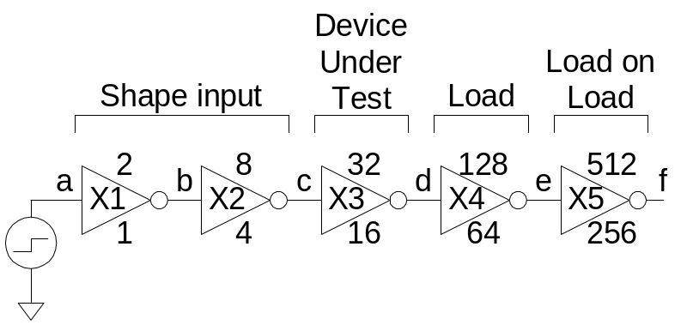
Subcircuits
Declare common elements as subcircuits
Ex: Fanout-of-4 Inverter Delay
  Reuse inv
  Shaping
  Loading
.subckt inv a y N=4 P=8
M1 y a gnd gnd NMOS W='N' L=2
+ AS='N*5' PS='2*N+10' AD='N*5' PD='2*N+10'
M2 y a vdd vdd PMOS W='P' L=2
+ AS='P*5' PS='2*P+10' AD='P*5' PD='2*P+10'
.ends
8: SPICE Simulation

Slide 16
FO4 Inverter Delay
* fo4.sp
* Parameters and models
*----------------------------------------------------------------------
.param SUPPLY=1.0
.param H=4
.option scale=25n
.include '../models/ibm065/models.sp'
.temp 70
.option post
* Subcircuits
*----------------------------------------------------------------------
.global vdd gnd
.include '../lib/inv.sp'
* Simulation netlist
*----------------------------------------------------------------------
Vdd vdd gnd 'SUPPLY'
Vin a gnd PULSE 0 'SUPPLY' 0ps 20ps 20ps 120ps 280ps
X1 a b inv * shape input waveform
X2 b c inv M='H' * reshape input waveform
8: SPICE Simulation
.end

Slide 17
FO4 Inverter Delay Cont.
X3 c d inv M='H**2' * device under test
X4 d e inv M='H**3' * load
x5 e f inv M='H**4' * load on load
* Stimulus
*----------------------------------------------------------------------
.tran 0.1ps 280ps
.measure tpdr * rising prop delay
+ TRIG v(c) VAL='SUPPLY/2' FALL=1
+ TARG v(d) VAL='SUPPLY/2' RISE=1
.measure tpdf * falling prop delay
+ TRIG v(c) VAL='SUPPLY/2' RISE=1
+ TARG v(d) VAL='SUPPLY/2' FALL=1
.measure tpd param='(tpdr+tpdf)/2' * average prop delay
.measure trise * rise time
+ TRIG v(d) VAL='0.2*SUPPLY' RISE=1
+ TARG v(d) VAL='0.8*SUPPLY' RISE=1
.measure tfall * fall time
+ TRIG v(d) VAL='0.8*SUPPLY' FALL=1
+ TARG v(d) VAL='0.2*SUPPLY' FALL=1
.end
8: SPICE Simulation

Slide 18
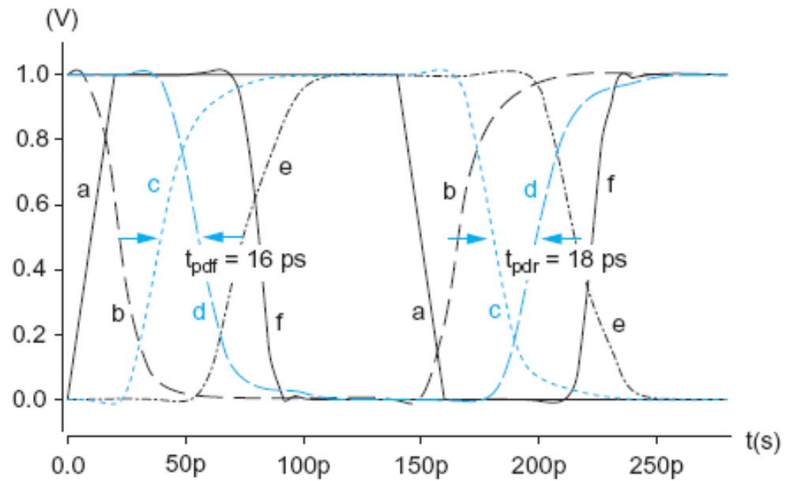
FO4 Results
8: SPICE Simulation

Slide 19
Optimization
HSPICE can automatically adjust parameters
  Seek value that optimizes some measurement
Example: Best P/N ratio
  We’ve assumed 2:1 gives equal rise/fall delays
  But we see rise is actually slower than fall
  What P/N ratio gives equal delays?
Strategies
  (1) run a bunch of sims with different P size
  (2) let HSPICE optimizer do it for us
8: SPICE Simulation

Slide 20
P/N Optimization
* fo4opt.sp
* Parameters and models
*----------------------------------------------------------------------
.param SUPPLY=1.0
.option scale=25n
.include '../models/ibm065/models.sp'
.temp 70
.option post
* Subcircuits
*----------------------------------------------------------------------
.global vdd gnd
.include '../lib/inv.sp'
* Simulation netlist
*----------------------------------------------------------------------
Vdd vdd gnd 'SUPPLY'
Vin a gnd PULSE 0 'SUPPLY' 0ps 20ps 20ps 120ps 280ps
X1 a b inv P='P1' * shape input waveform
X2 b c inv P='P1' M=4 * reshape input
X3 c d inv P='P1' M=16 * device under test
8: SPICE Simulation

Slide 21
P/N Optimization
X4 d e inv P='P1' M=64 * load
X5 e f inv P='P1' M=256 * load on load
* Optimization setup
*----------------------------------------------------------------------
.param P1=optrange(8,4,16) * search from 4 to 16, guess 8
.model optmod opt itropt=30 * maximum of 30 iterations
.measure bestratio param='P1/4' * compute best P/N ratio
* Stimulus
*----------------------------------------------------------------------
.tran 0.1ps 280ps SWEEP OPTIMIZE=optrange RESULTS=diff MODEL=optmod
.measure tpdr * rising propagation delay
+ TRIG v(c) VAL='SUPPLY/2' FALL=1
+ TARG v(d) VAL='SUPPLY/2' RISE=1
.measure tpdf * falling propagation delay
+ TRIG v(c) VAL='SUPPLY/2' RISE=1
+ TARG v(d) VAL='SUPPLY/2' FALL=1
.measure tpd param='(tpdr+tpdf)/2' goal=0 * average prop delay
.measure diff param='tpdr-tpdf' goal = 0 * diff between delays
.end
8: SPICE Simulation

Slide 22
P/N Results
P/N ratio for equal delay is 2.9:1
  t_{pd} = t_{pdr} = t_{pdf} = 17.9 ps (slower than 2:1 ratio)
  Big pMOS transistors waste power too
  Seldom design for exactly equal delays
What ratio gives lowest average delay?
  .tran 1ps 1000ps SWEEP OPTIMIZE=optrange RESULTS=tpd MODEL=optmod
  P/N ratio of 1.8:1
  t_{pdr} = 18.8 ps, t_{pdf} = 15.2 ps, t_{pd} = 17.0 ps
P/N ratios of 1.5:1 – 2.2:1 gives t_{pd} < 17.2 ps
8: SPICE Simulation

Slide 23
Power Measurement
HSPICE can measure power
  Instantaneous P(t)
  Or average P over some interval
  .print P(vdd)
  .measure pwr AVG P(vdd) FROM=0ns TO=10ns
Power in single gate
  Connect to separate V_{DD} supply
  Be careful about input power
8: SPICE Simulation

Slide 24
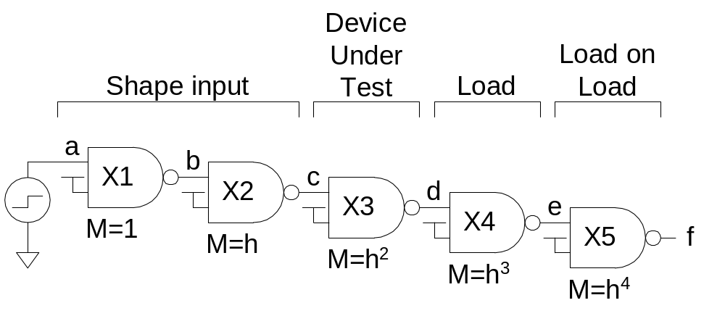
Logical Effort
Logical effort can be measured from simulation
  As with FO4 inverter, shape input, load output
8: SPICE Simulation

Slide 25
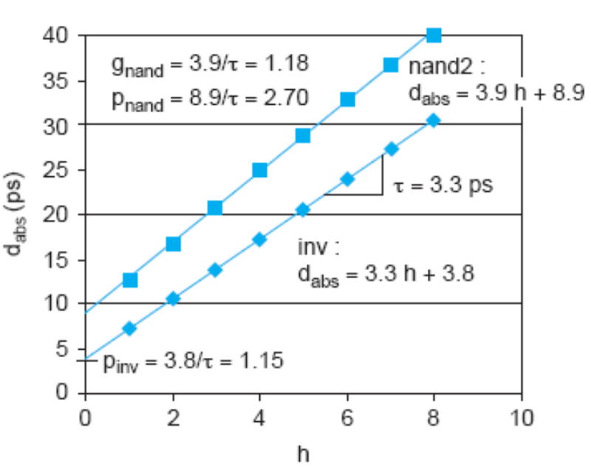
Logical Effort Plots
Plot t_{pd} vs. h
  Normalize by τ
  y-intercept is parasitic delay
  Slope is logical effort
Delay fits straight line
very well in any process
as long as input slope is
consistent
8: SPICE Simulation

Slide 26
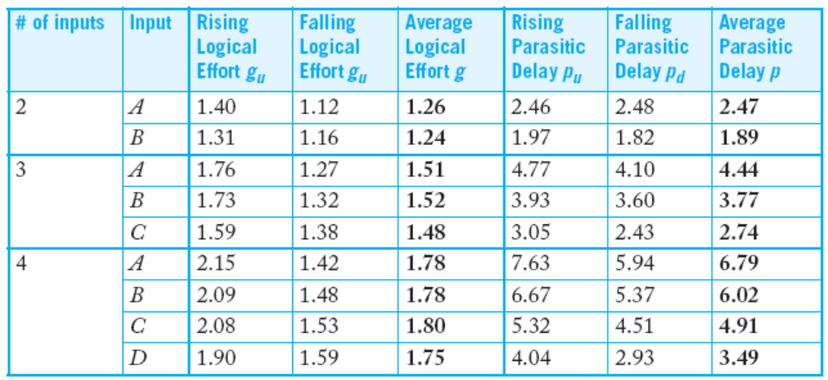
Logical Effort Data
For NAND gates in IBM 65 nm process:
Notes:
  Parasitic delay is greater for outer input
  Average logical effort is better than estimated
8: SPICE Simulation

Slide 27
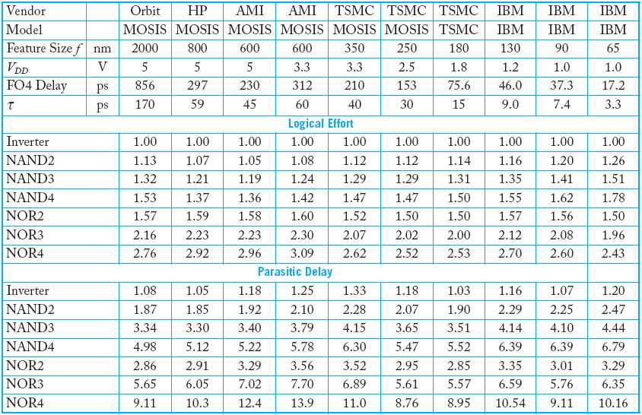
Comparison
8: SPICE Simulation

