Slide 1

Lecture 9:
Combinational Circuit Design

Slide 2
Outline
Bubble Pushing
Compound Gates
Logical Effort Example
Input Ordering
Asymmetric Gates
Skewed Gates
Best P/N ratio
10: Combinational Circuits

Slide 3
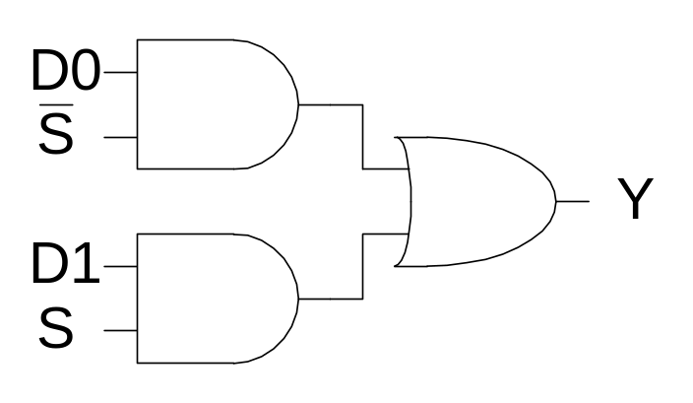
Example 1
module mux(input s, d0, d1,
output y);
assign y = s ? d1 : d0;
endmodule
1) Sketch a design using AND, OR, and NOT gates.
10: Combinational Circuits

Slide 4
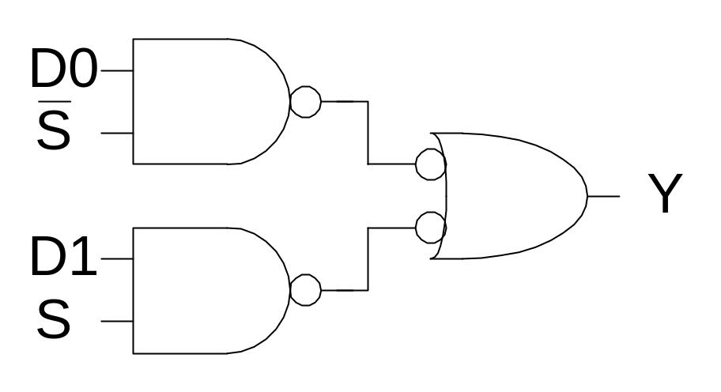
Example 2
2) Sketch a design using NAND, NOR, and NOT gates. Assume ~S is available.
10: Combinational Circuits

Slide 5
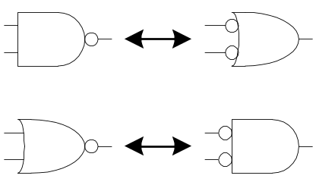
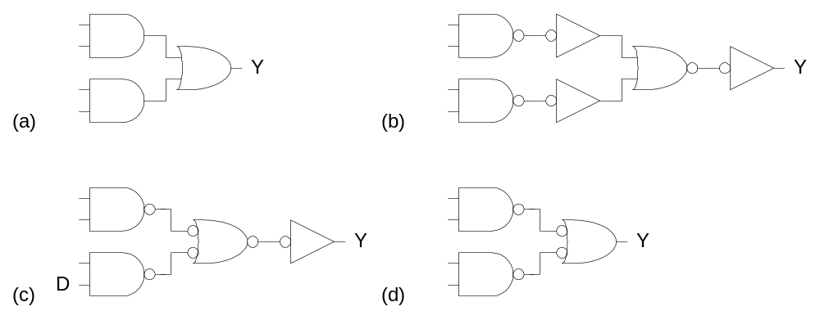
Bubble Pushing
Start with network of AND / OR gates
Convert to NAND / NOR + inverters
Push bubbles around to simplify logic
  Remember DeMorgan’s Law
10: Combinational Circuits

Slide 6
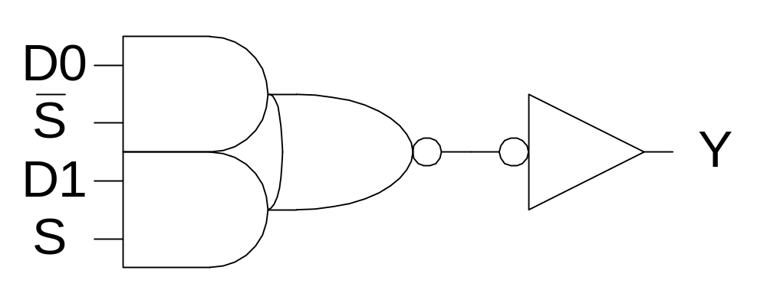
Example 3
3) Sketch a design using one compound gate and one NOT gate. Assume ~S is available.
10: Combinational Circuits

Slide 7
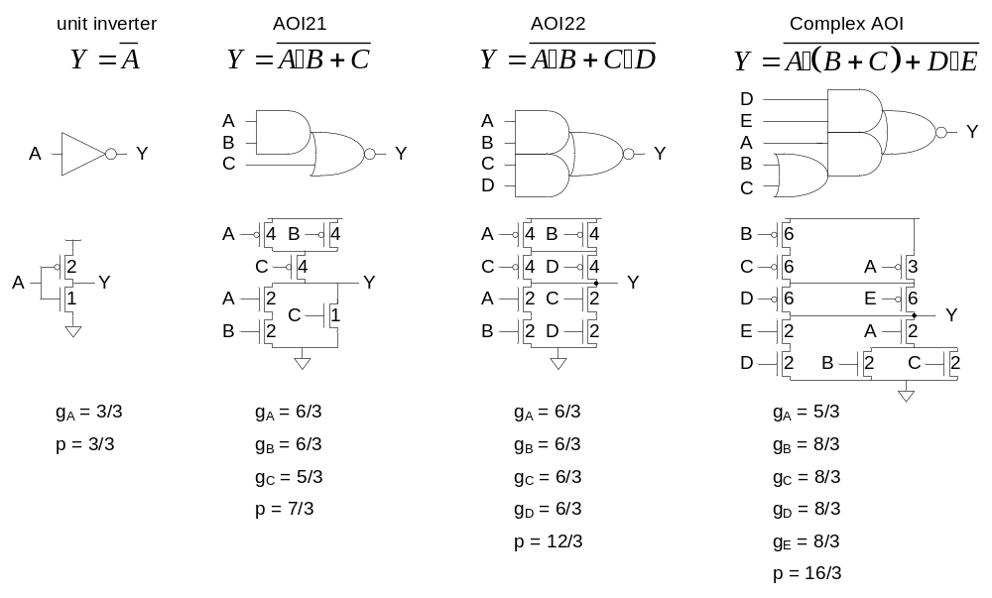
Compound Gates
Logical Effort of compound gates
10: Combinational Circuits

Slide 8
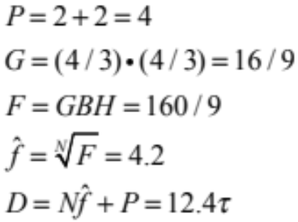
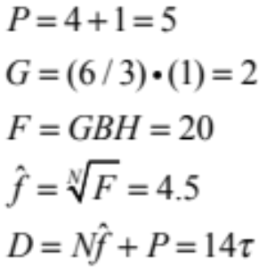
Example 4
The multiplexer has a maximum input capacitance of 16 units on each input. It must drive a load of 160 units. Estimate the delay of the two designs.
H = 160 / 16 = 10 B = 1 N = 2
10: Combinational Circuits

Slide 9
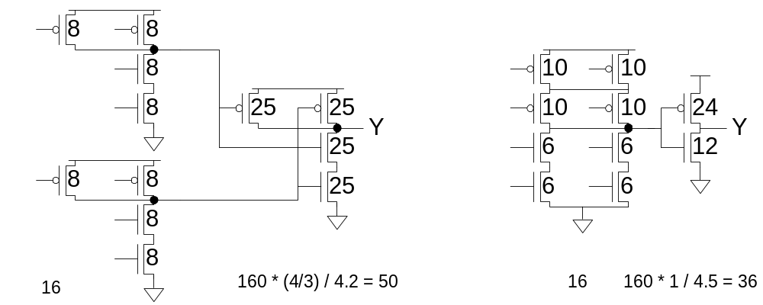
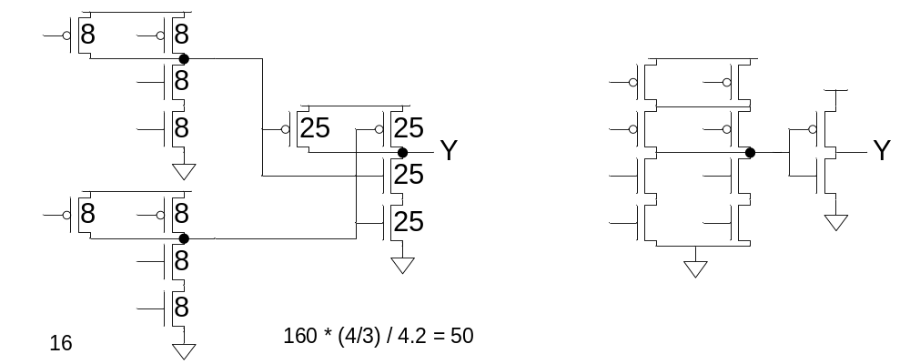
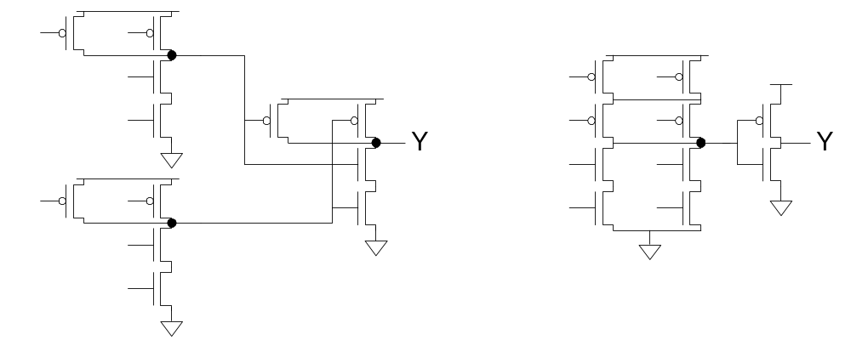
Example 5
Annotate your designs with transistor sizes that achieve this delay.
10: Combinational Circuits

Slide 10
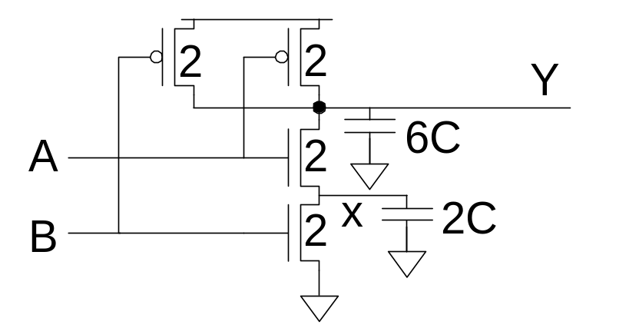
Input Order
Our parasitic delay model was too simple
  Calculate parasitic delay for Y falling
    If A arrives latest? 2τ
    If B arrives latest? 2.33τ
10: Combinational Circuits

Slide 11
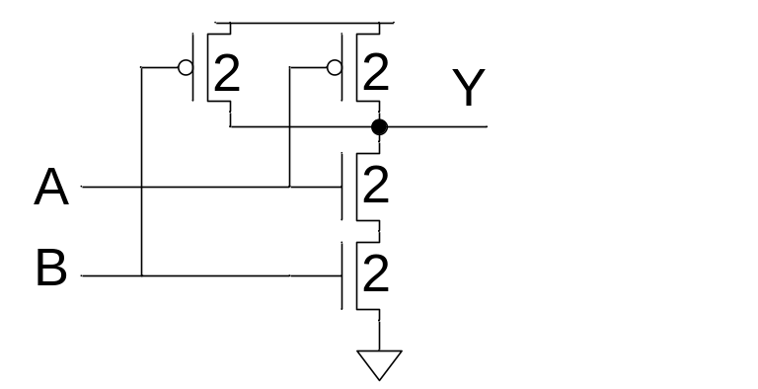
Inner & Outer Inputs
Inner input is closest to output (A)
Outer input is closest to rail (B)
If input arrival time is known
  Connect latest input to inner terminal
10: Combinational Circuits

Slide 12
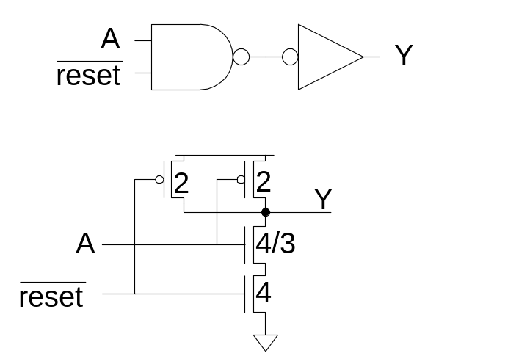
Asymmetric Gates
Asymmetric gates favor one input over another
Ex: suppose input A of a NAND gate is most critical
  Use smaller transistor on A (less capacitance)
  Boost size of noncritical input
  So total resistance is same
g_{A} = 10/9
g_{B} = 2
g_{total} = g_{A} + g_{B} = 28/9
Asymmetric gate approaches g = 1 on critical input
But total logical effort goes up
10: Combinational Circuits

Slide 13
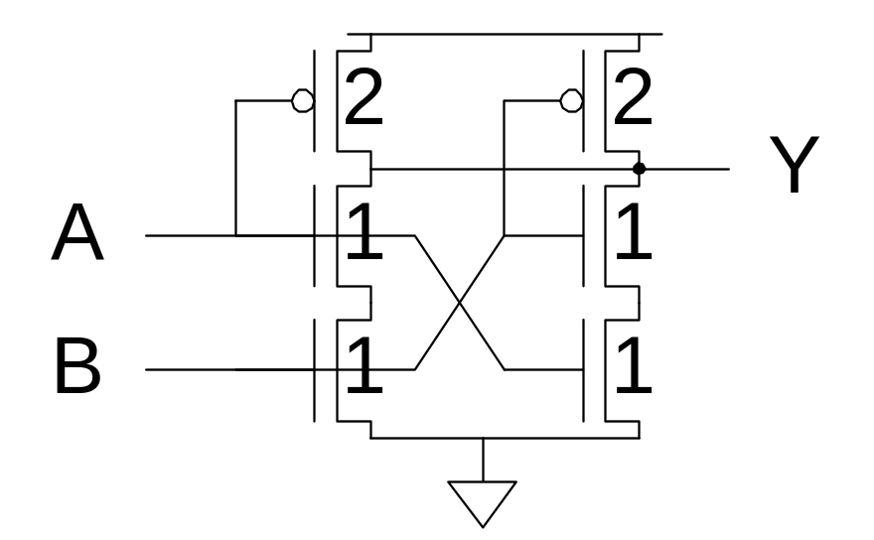
Symmetric Gates
Inputs can be made perfectly symmetric
10: Combinational Circuits

Slide 14
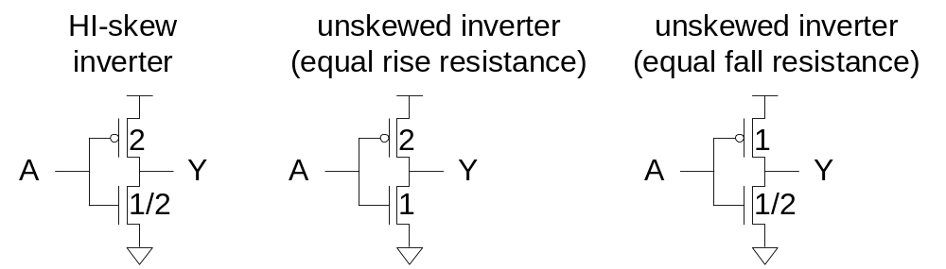
Skewed Gates
Skewed gates favor one edge over another
Ex: suppose rising output of inverter is most critical
  Downsize noncritical nMOS transistor
Calculate logical effort by comparing to unskewed inverter with same effective resistance on that edge.
  g_{u} = 2.5 / 3 = 5/6
  g_{d} = 2.5 / 1.5 = 5/3
10: Combinational Circuits

Slide 15
HI- and LO-Skew
Def: Logical effort of a skewed gate for a particular transition is the ratio of the input capacitance of that gate to the input capacitance of an unskewed inverter delivering the same output current for the same transition.
Skewed gates reduce size of noncritical transistors
  HI-skew gates favor rising output (small nMOS)
  LO-skew gates favor falling output (small pMOS)
Logical effort is smaller for favored direction
But larger for the other direction
10: Combinational Circuits

Slide 16
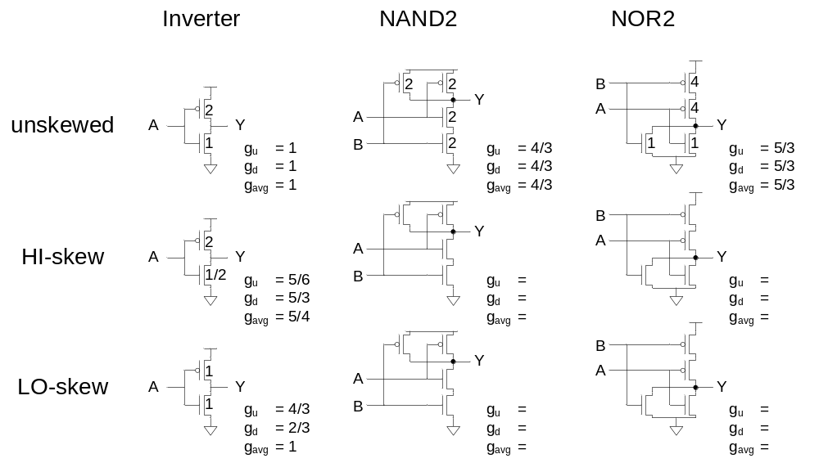
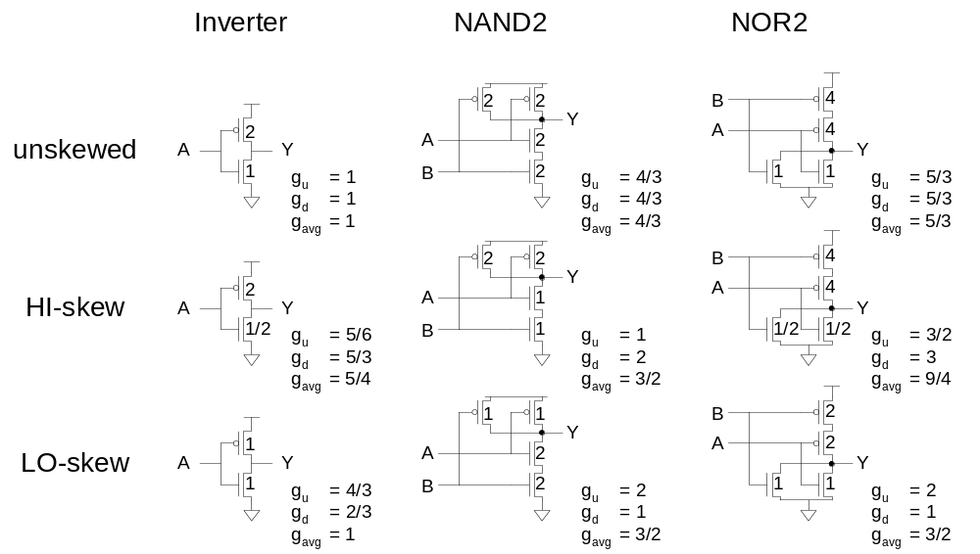
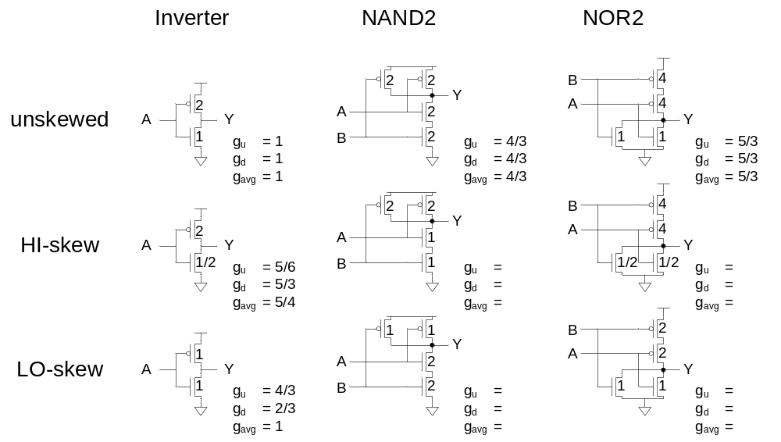
Catalog of Skewed Gates
10: Combinational Circuits

Slide 17

Asymmetric Skew
Combine asymmetric and skewed gates
  Downsize noncritical transistor on unimportant input
  Reduces parasitic delay for critical input
10: Combinational Circuits

Slide 18
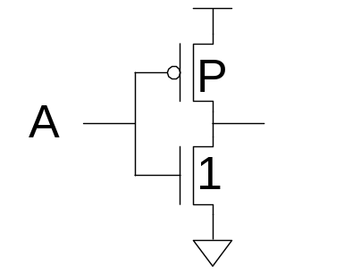
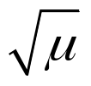
Best P/N Ratio
We have selected P/N ratio for unit rise and fall resistance (μ = 2-3 for an inverter).
Alternative: choose ratio for least average delay
Ex: inverter
  Delay driving identical inverter
  t_{pdf} = (P+1)
  t_{pdr} = (P+1)(μ/P)
  t_{pd} = (P+1)(1+μ/P)/2 = (P + 1 + μ + μ/P)/2
  dt_{pd} / dP = (1- μ/P²)/2 = 0
  Least delay for P =
10: Combinational Circuits

Slide 19
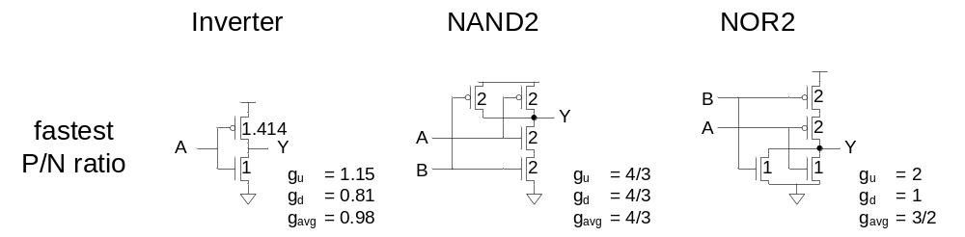
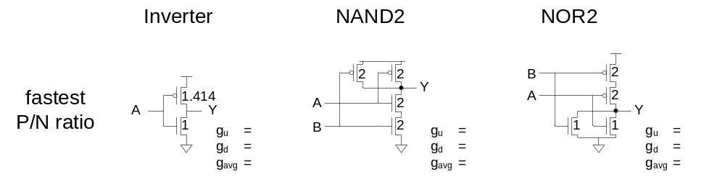
P/N Ratios
In general, best P/N ratio is sqrt of equal delay ratio.
  Only improves average delay slightly for inverters
  But significantly decreases area and power
10: Combinational Circuits

Slide 20
Observations
For speed:
  NAND vs. NOR
  Many simple stages vs. fewer high fan-in stages
  Latest-arriving input
For area and power:
  Many simple stages vs. fewer high fan-in stages
10: Combinational Circuits

