Slide 1
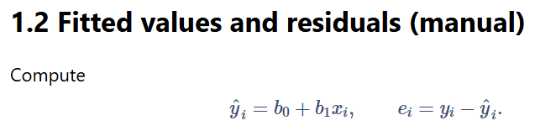
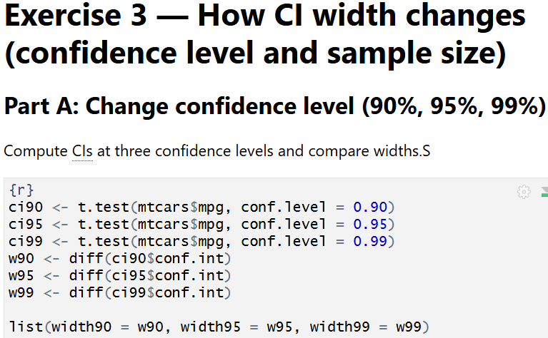
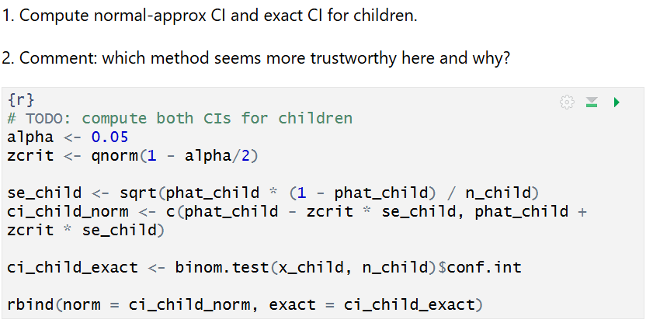

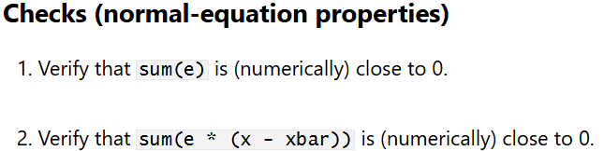

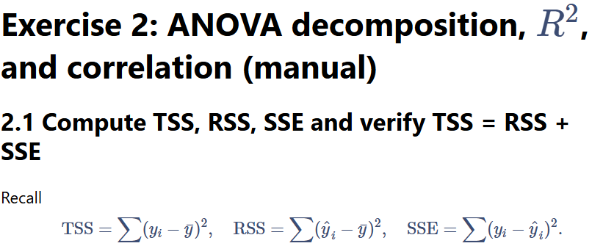
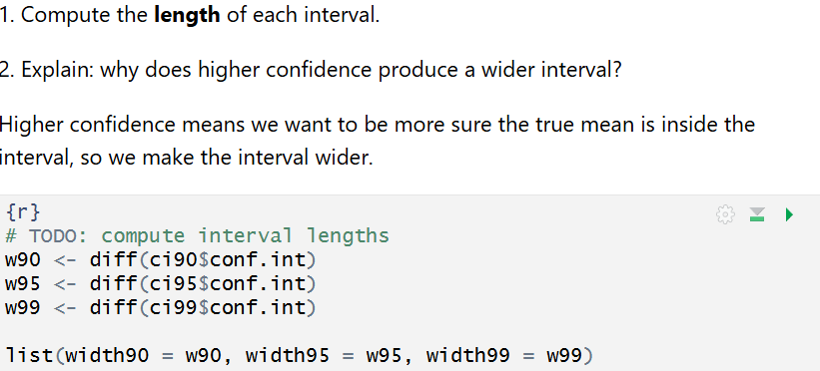
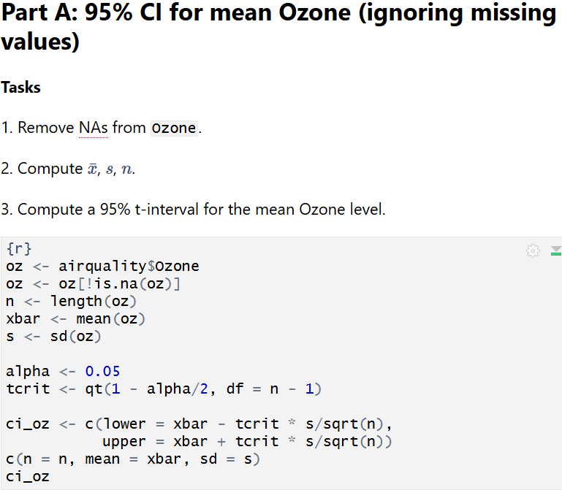
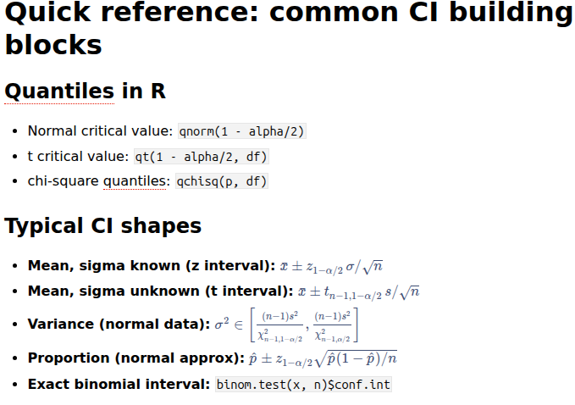
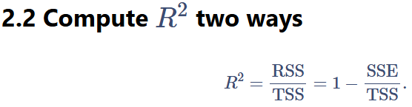
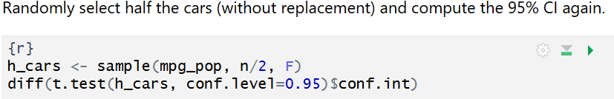
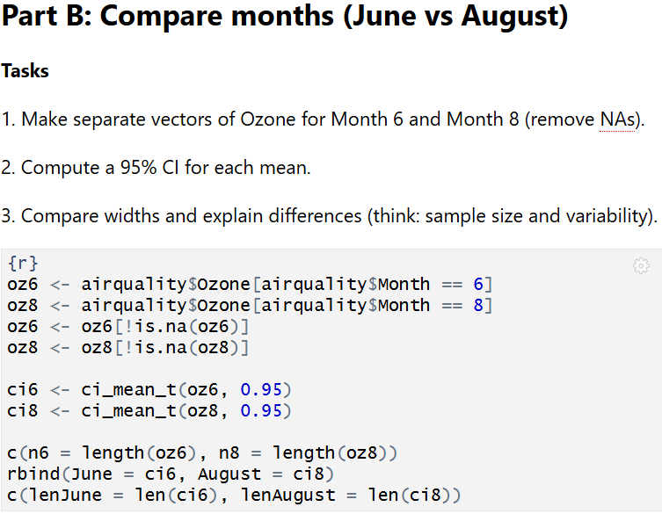
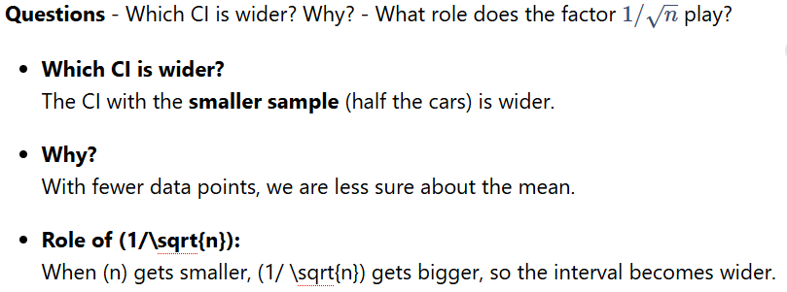


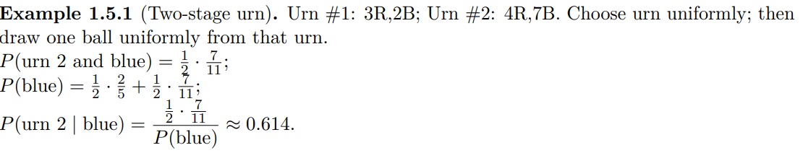
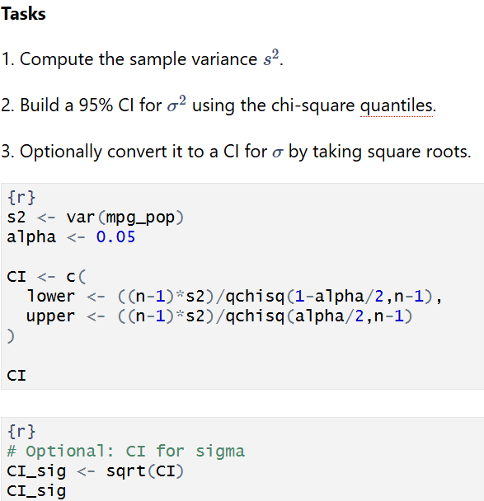

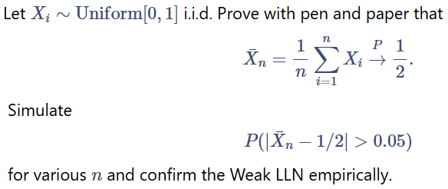
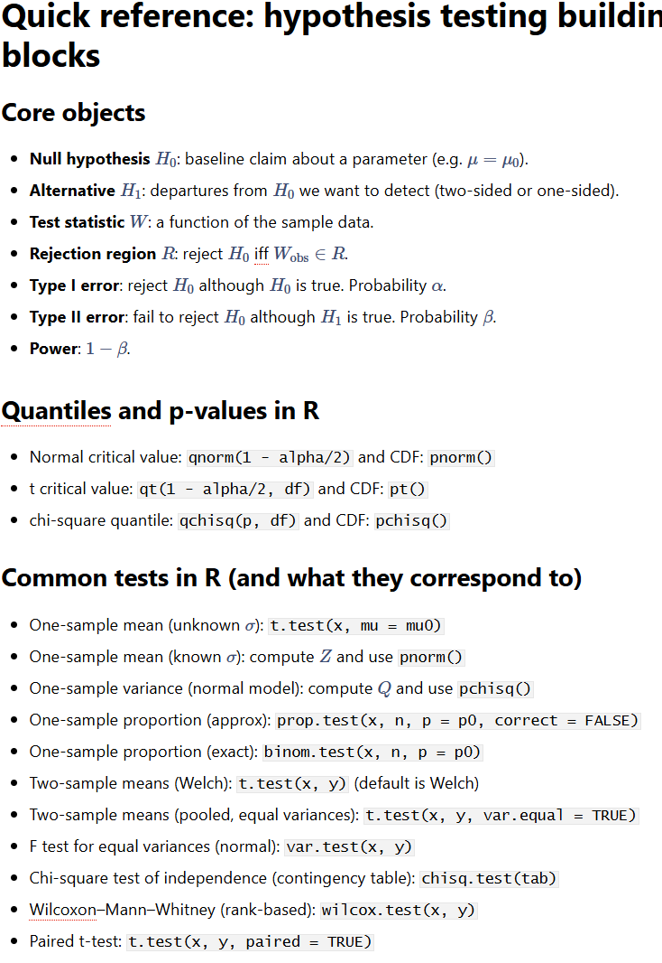
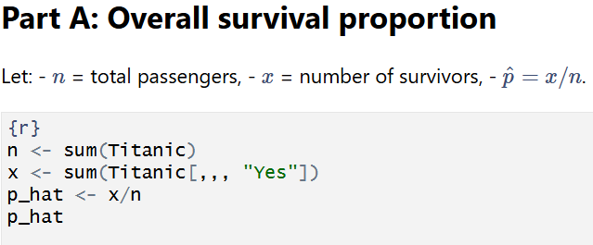
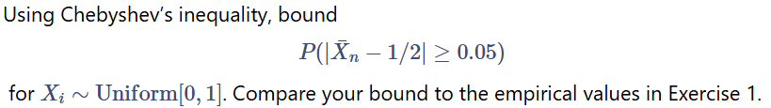
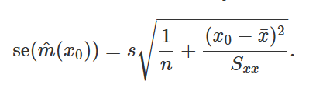
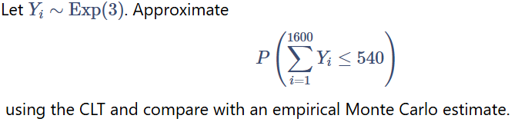
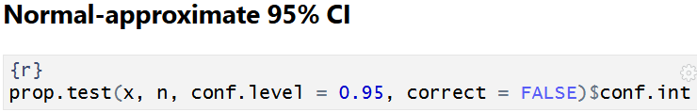
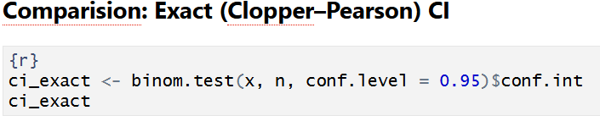


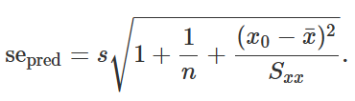


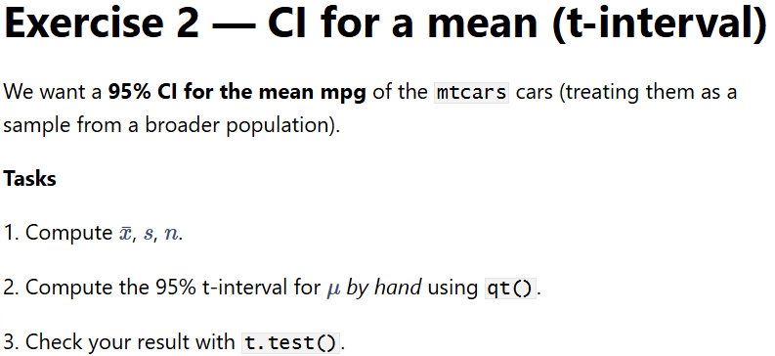


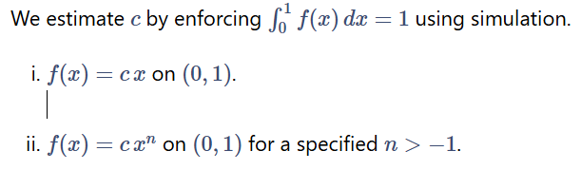

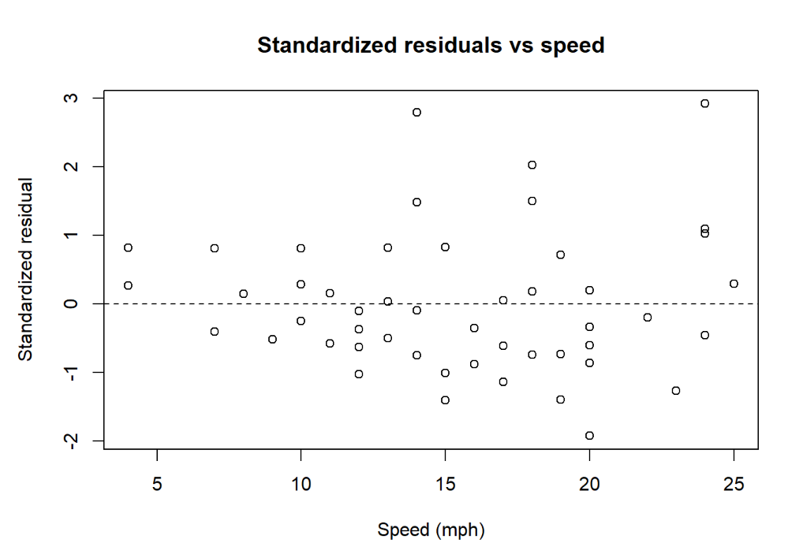




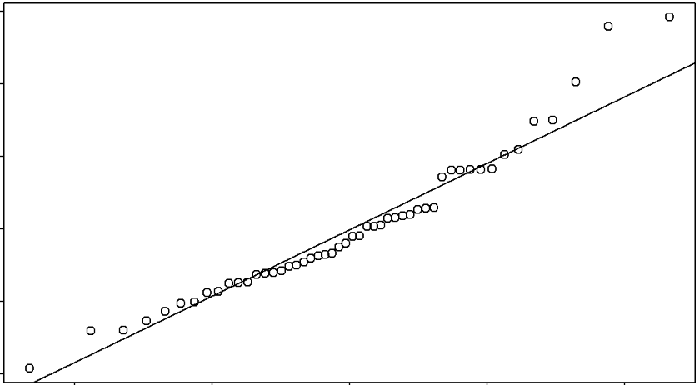
Simulate data from a linear model `y = 3 + 2x + e` where `x ~ N(0,1)` and `e ~ N(0,1)` for `n = 100`. Fit `lm(y ~ x)` and report the estimated coefficients, $R^2$, and residual standard error. Make a residuals vs fitted plot.
n <- 100x <- rnorm(n) e <- rnorm(n) y <- 3 + 2*x + efit <- lm(y ~ x) s <- summary(fit) coef_est <- coef(fit) R2 <- s$r.squared RSE <- s$sigma list(coef = round(coef_est, 3), R2 = round(R2, 3), RSE = round(RSE, 3))plot(fitted(fit), resid(fit), pch = 19, xlab = "Fitted values", ylab = "Residuals", main = "Residuals vs Fitted")abline(h = 0, lty = 2)
yhat <- b0 + b1 * x
e <- y - yhat
head(data.frame(x = x, y = y, yhat = yhat, e = e))
Let $X$ be the outcome of a fair die scaled by $1/6$, so $X\in\{1/6,\dots,1\}$. Estimate and plot the empirical cdf.
op <- par(mar = c(4, 4, 1, 1)); on.exit(par(op))
die <- sample(1:6, N, replace = TRUE)
X <- die / 6
plot(ecdf(X), main = "Empirical CDF of X = (die outcome)/6", xlab = "x", ylab = expression(F[X](x)))
abline(h = seq(0,1,by=1/6), lty = 3)
abline(v = (1:6)/6, lty = 3)
We verify cdf properties empirically: nondecreasing (by construction), right-continuous (step ecdf), limits near 0 and 1:
range_ecdf <- c(min(X), max(X))
c(min_X = range_ecdf[1], max_X = range_ecdf[2], F_at_0 = mean(X <= 0), F_at_1 = mean(X <= 1))
fit_lin <- lm(dist ~ speed, data = cars)
coef_lm <- coef(fit_lin)
c(manual_b0 = b0, manual_b1 = b1,
lm_b0 = unname(coef_lm[1]), lm_b1 = unname(coef_lm[2]),
diff_b0 = b0 - unname(coef_lm[1]),
diff_b1 = b1 - unname(coef_lm[2]))
Ω = {1, 2, 3} with P({1}) = 1 / 2 , P({2}) = 1 / 3 , P({3}) = 1 / 6 . (a) F? (b) P({1, 2})? (c) P({1, 2, 3})? (d) List all events A ∈ F with P(A) = ½
p <- c(`1`=.5, `2`=1/3, `3`=1/6) P_12 <- sum(p[c("1","2")]) P_all <- sum(p)subs <- list(c(), "1","2","3", c("1","2"),c("1","3"),c("2","3"), c("1","2","3"))vals <- sapply(subs, function(A) if(length(A)) sum(p[A]) else 0)names(vals) <- c("∅","{1}","{2}","{3}","{1,2}","{1,3}","{2,3}","Ω")list(P_12=P_12, P_all=P_all, events_P_eq_half=vals[abs(vals-.5)<1e-12])
sum(e)
sum(e * (x - xbar))
plot(y ~ x, xlab = "Speed (mph)", ylab = "Stopping distance (ft)")
abline(a = b0, b = b1, lwd = 2)
# From lm
SSE_lm <- sum(residuals(fit_lin)^2)
s_lm <- summary(fit_lin)$sigma
R2_lm <- summary(fit_lin)$r.squared
c(SSE_manual = SSE, SSE_lm = SSE_lm, diff_SSE = SSE - SSE_lm,
s_manual = s, s_lm = s_lm, diff_s = s - s_lm,
R2_manual = R2_from_RSS, R2_lm = R2_lm, diff_R2 = R2_from_RSS - R2_lm)
If you pick a random integer between 1 and 100 uniformly, what is the
probability that it is divisible by 3 or by 5?
N <- 1e5x <- sample(1:100, N, TRUE)est <- mean(x%%3==0 | x%%5==0)exact <- (floor(100/3)+floor(100/5)-floor(100/15))/100c(estimate=est, exact=exact)
If X ∼ N (0, 1), express P(2 < X < 7) and P(X ≤ −3) in terms of Φ and
evaluate numerically.
Xn <- rnorm(N, mean = 0, sd = 1)
p_a <- mean(Xn > 2 & Xn < 7)
p_b <- mean(Xn <= -3)
se_a <- sqrt(p_a*(1-p_a)/N)
se_b <- sqrt(p_b*(1-p_b)/N)
c(`P(2<X<7)` = p_a, SE_a = se_a, `P(X<=-3)` = p_b, SE_b = se_b)
Two dice: 36 outcomes; we are interested in the event that three ordered outcomes sum to 10 (4,6), (5,5), (6,4). So P(sum = 10) = 3/36 = 1/12.
p_exact <- 3/36N <- 1e6s <- rowSums(matrix(sample(1:6, 2*N, TRUE), ncol=2))p_mc <- mean(s==10)c(exact=p_exact, mc=p_mc)
TSS <- sum((y - ybar)^2)
RSS <- sum((yhat - ybar)^2)
SSE <- sum((y - yhat)^2)
c(TSS = TSS, RSS = RSS, SSE = SSE, check = TSS - (RSS + SSE))
Five-card hand from a 52-card deck. Probability of: (a) four aces plus the
king of spades; (b) all spades; (c) no pairs (all values distinct); (d) full house.
total <- choose(52,5) p_all_spades <- choose(13,5)/total p_no_pairs <- (choose(13,5) * 4^5) / total p_full_house <- (choose(13,1)*choose(4,3) * choose(12,1)*choose(4,2)) / total
If X ∼ Uniform[L, R] and Y = cX + d with c > 0, show Y ∼ Uniform[cL + d, cR + d]
op <- par(mar = c(4, 4, 1, 1)); on.exit(par(op))
L <- -2; R <- 5; c_coef <- 1.5; d_coef <- -0.25 # parameters
Xu <- runif(N, min = L, max = R)
Yt <- c_coef * Xu + d_coef
# Compare histogram to theoretical support
hist(Yt, breaks = 60, probability = TRUE, main = "Transformed Uniform: Y = cX + d", xlab = "y")
abline(v = c(c_coef*L + d_coef, c_coef*R + d_coef), lty = 2)
# Empirical check of bounds and flatness: simple KS test against Uniform[a,b]
a <- c_coef*L + d_coef; b <- c_coef*R + d_coef
ks <- suppressWarnings(ks.test((Yt - a)/(b - a), "punif"))
c(a = a, b = b, KS_p_value = ks$p.value)
summ <- summary(fit_lin)
se_lm_b1 <- summ$coefficients["speed", "Std. Error"]
t_lm_b1 <- summ$coefficients["speed", "t value"]
p_lm_b1 <- summ$coefficients["speed", "Pr(>|t|)"]
c(se_manual_b1 = se_b1, se_lm_b1 = se_lm_b1, diff_se = se_b1 - se_lm_b1,
t_manual = t_obs, t_lm = t_lm_b1, diff_t = t_obs - t_lm_b1,
p_manual = p_two_sided, p_lm = p_lm_b1)
R2_from_RSS <- RSS / TSS
R2_from_SSE <- 1 - SSE / TSS
c(R2_from_RSS = R2_from_RSS, R2_from_SSE = R2_from_SSE)
(Birthday problem). C people with birthdays equally likely among 365 days
(non-leap year). (a) C = 2: probability same birthday? (b) General C: probability all share the same birthday? (c) General C: probability some pair matches? (d) Smallest C where (c) exceeds 0.5? Surprising?
prob_match <- function(C, N=200){ anydup <- function(v) any(duplicated(v)) mean(replicate(N, anydup(sample(1:365, C, TRUE))))}Cs <- 2:60pm <- sapply(Cs, prob_match)Cs[which(pm>.5)[1]]
R2_from_RSS <- RSS / TSS
R2_from_SSE <- 1 - SSE / TSS
c(R2_from_RSS = R2_from_RSS, R2_from_SSE = R2_from_SSE)
If you flip three fair coins, what is the probability that the first coin shows
heads given that exactly two of the three coins are heads?
N <- 1e6 X <- matrix(sample(c("H","T"), 3*N, TRUE), ncol=3) E <- rowSums(X=="H")==2 mean(X[E,1]=="H")
s2 <- SSE / (n - 2)
s <- sqrt(s2)
c(s2 = s2, s = s, df = n - 2)
ci_lm <- confint(fit_lin, level = 0.95)["speed", ]
c(ci_manual_low = ci_b1[1], ci_manual_high = ci_b1[2],
ci_lm_low = ci_lm[1], ci_lm_high = ci_lm[2])
If X ∼ N (µ, σ2 ) and Y = cX + d with c ̸= 0, show Y ∼ N (cµ + d, c2σ 2 ).
op <- par(mar = c(4, 4, 1, 1)); on.exit(par(op))
mu <- 1.2; sigma <- 0.7; c_coef <- -2; d_coef <- 0.3
Xg <- rnorm(N, mean = mu, sd = sigma)
Yg <- c_coef * Xg + d_coef
c(sample_mean_Y = mean(Yg), sample_var_Y = var(Yg))
hist(Yg, breaks = 60, probability = TRUE, main = "Histogram of Y = cX + d (Normal case)", xlab = "y")
se_b1 <- s / sqrt(Sxx)
se_b0 <- s * sqrt(1/n + xbar^2 / Sxx)
c(se_b0 = se_b0, se_b1 = se_b1)
pred_ci <- predict(fit_lin, newdata = data.frame(speed = x0), interval = "confidence", level = 0.95)
pred_pi <- predict(fit_lin, newdata = data.frame(speed = x0), interval = "prediction", level = 0.95)
list(manual_mean_CI = ci_mean,
manual_pred_PI = pi_new,
lm_mean_CI = as.numeric(pred_ci[1, c("lwr", "upr")]),
lm_pred_PI = as.numeric(pred_pi[1, c("lwr", "upr")]))
p_blue <- 0.5*(2/5) + 0.5*(7/11)p_exact <- (0.5*(7/11)) / p_blueN <- 1e6urn <- sample(1:2, N, TRUE)draw_blue <- ifelse( urn==1, sample(c(rep("B",2),rep("R",3)), N, TRUE), sample(c(rep("B",7),rep("R",4)), N, TRUE))mean(urn==2 & draw_blue=="B")/mean(draw_blue=="B")
t_obs <- b1 / se_b1
p_two_sided <- 2 * pt(abs(t_obs), df = n - 2, lower.tail = FALSE)
c(t_obs = t_obs, p_two_sided = p_two_sided
Conceptual question - Does “non-overlapping 95% CIs” automatically imply a significant difference at 5%? (Discuss briefly.)
No. Non-overlapping 95% confidence intervals suggest a significant difference, but overlap does not automatically mean there is no significant difference.
Two dice: red and blue. Events A: equal numbers; B: sum = 12; C: red die
= 4; D: blue die = 4.
N <- 1e6r <- sample(1:6, N, TRUE)b <- sample(1:6, N, TRUE)A <- r==b; C <- r==4; D <- b==4c( A_and_C = mean(A & C), A_times_C = mean(A)*mean(C), C_and_D = mean(C & D), C_times_D = mean(C)*mean(D)
In 1–2 sentences each, define (in your own words): - population, sample, parameter, statistic.
Population: is the entire group of individuals or observations that you are interested in studying and about which you want to draw conclusions. Sample: is a subset of the population that is actually observed or measured, chosen to represent the population.
Parameter: is a numerical value that describes a characteristic of a population (for example, the true mean or variance), and it is usually unknown.
Statistic: A statistic is a numerical value calculated from a sample, used to estimate or make inferences about a population parameter.
Questions - Why do chi-square quantiles appear here? - What assumption is crucial for this variance CI to be exact?
Why chi-square quantiles?
Because for normal data the scaled sample variance (n−1)s2/σ2(n-1)s^{2/}\sigma2(n−1)s2/σ2 follows a chi-square distribution.
Crucial assumption:
The data are normally distributed; without normality, this variance CI is no longer exact.
alpha <- 0.05
tcrit <- qt(1 - alpha/2, df = n - 2)
ci_b1 <- c(b1 - tcrit * se_b1, b1 + tcrit * se_b1)
ci_b1
An urn contains 8 red and 12 blue balls (20 total). You draw 5 balls without
replacement. What is the probability of drawing exactly k red balls, for k = 0, 1, 2, 3, 4, 5?
k <- 0:5p_exact <- dhyper(k, m=8, n=12, k=5)N <- 2e5reds <- replicate(N, sum(sample(c(rep(1,8), rep(0,12)), 5)))p_mc <- table(factor(reds, levels=k))/Ncbind(k, exact=round(p_exact,6), mc=round(as.numeric(p_mc),6))
set.seed(1)
N <- 20000
eps <- 0.05
nvec <- c(10, 50, 100, 500, 1000, 5000)
prob_hat <- sapply(nvec, function(n){ X <- matrix(runif(N*n), nrow=N) mean(abs(rowMeans(X) - 0.5) > eps)})
data.frame(n = nvec, Empirical = prob_hat)
Mean response vs. prediction at a chosen speed
#Pick a speed value x0
x0 <- 20
Identify in this context: - population = ? - parameter $\mu$ = ? - a sample of size $n=10$ = ? - an estimator for $\mu$ = ? - an estimate = ?
Population: All mpg values of the cars in the mtcars dataset (treated here as the full population).
Parameter ( \mu ): The true mean mpg of that population, i.e. the mean of all mtcars$mpg values.
A sample of size ( n = 10 ): Any set of 10 mpg values randomly chosen from mtcars$mpg.
An estimator for ( \mu ): The sample mean ( \bar{x} ) of the 10 selected mpg values.
An estimate: The numerical value of ( \bar{x} ) computed from one конкретten (specific) sample of 10 mpg values.
Two fair dice are thrown; let $Y$ be the product. Estimate the pmf of $Y$ by simulation.
d1 <- sample(1:6, N, replace = TRUE)d2 <- sample(1:6, N, replace = TRUE)Y <- d1 * d2pmf_hat <- sort(prop.table(table(Y)))pmf_tbl <- data.frame(y = as.integer(names(pmf_hat)), pmf_est = as.numeric(pmf_hat))head(pmf_tbl, 10)tail(pmf_tbl, 10)
mhat0 <- b0 + b1 * x0
mhat0
varX <- 1/12
bound <- varX/(nvec*eps^2)
data.frame(n = nvec, Chebyshev_bound = bound, Empirical_prob = prob_hat)
We adopt the convention Z in {1,2,…} (number of trials until the first success). Set $p$ below as needed. p_geo <- 0.3 # <-- change if desired# simulate geometric: number of Bernoulli(p) trials until first success# R's rgeom returns failures before first success; add 1 to get trials count.Z <- rgeom(N, prob = p_geo) + 1Lprob_hat <- mean(Z >= 5 & Z <= 9)se_hat <- sqrt(prob_hat * (1 - prob_hat) / N)
se_mean <- s * sqrt(1/n + (x0 - xbar)^2 / Sxx)
ci_mean <- mhat0 + c(-1, 1) * tcrit * se_mean
ci_mean
lambda <- 3
n <- 1600
EY <- 1/lambda
VarY <- 1/lambda^2
ESn <- n*EY
sdSn <- sqrt(n*VarY)
p_clt <- pnorm((540-ESn)/sdSn)
p_clt
S_samples <- replicate(N, sum(rexp(n, lambda)))
p_mc <- mean(S_samples <= 540)
data.frame(CLT = p_clt, Empirical = p_mc)
Draw one random sample of size $n=10$ (with replacement) and compute the sample mean.
n <- 10
sample_mpg <- sample(mpg_pop, size = n, replace = TRUE)
xbar <- mean(sample_mpg)
xbar
We scan a grid of $p$ values, estimate $\mathbb{P}(X=11)$ for each by simulation, and report the maximizer.
grid <- seq(0, 1, by = 0.005)nrep <- 20000 # per-grid Monte Carlo sizep11_est <- numeric(length(grid))for (i in seq_along(grid)) { x <- rbinom(nrep, size = 12, prob = grid[i]) p11_est[i] <- mean(x == 11)}imax <- which.max(p11_est)data.frame(p_grid = grid[imax], P_Xeq11_est = p11_est[imax])
You can visualize the estimated curve:
op <- par(mar = c(4, 4, 1, 1)); on.exit(par(op))plot(grid, p11_est, type = "l", xlab = "p", ylab = "Estimated P(X=11)", main = "Binomial(12,p): Monte Carlo estimate of P(X=11)")abline(v = grid[imax], lty = 2)
Questions - Compare the widths: which interval is wider, and why is that expected? - Check the rule of thumb: are $n\hat p$ and $n(1-\hat p)$ at least 10?
Compare the widths:
The exact (Clopper–Pearson) CI is slightly wider than the normal-approximation CI.
Why is that expected?
The exact method guarantees the stated coverage for all (p), so it is more conservative, while the normal approximation relies on an approximation that can be a bit too optimistic.
Rule of thumb check:
(n\hat p \approx 2225 \times 0.323 \approx 719 \ge 10)
(n(1-\hat p) \approx 2225 \times 0.677 \approx 1506 \ge 10)
Both conditions are easily satisfied, so the normal approximation is appropriate here.
se_pred <- s * sqrt(1 + 1/n + (x0 - xbar)^2 / Sxx)
pi_new <- mhat0 + c(-1, 1) * tcrit * se_pred
pi_new
Explain briefly: why will your answer in (3) change if you re-run the code with a different random seed?
Because the sample is drawn randomly with replacement, a different random seed leads to a different set of sampled observations, and therefore a different sample mean. Only if the seed is fixed will the same random sample and the same mean be reproduced.
Compute P(U ≤ 1/2), P(U ∈ [1/3, 2/3]), P(U = 1)
U <- runif(N)p1 <- mean(U <= 0.5)p2 <- mean(U >= 1/3 & U <= 2/3)p3 <- mean(U == 1) # should be ~0 in simulation as well
par(mar = c(4, 4, 2, 1)) # bottom, left, top, right margins
nvec2 <- c(1, 5, 20, 100, 500)
par(mfrow=c(2,3))
for(n in nvec2){ X <- rnorm(20000, mean=0, sd=sqrt(1/n))
hist(X, breaks=50, prob=TRUE, main=paste("n =", n))
curve(dnorm(x,0,1/sqrt(n)), add=TRUE, col="red", lwd=2)
}par(mfrow=c(1,1))
lambda <- 4Z <- rexp(N, rate = lambda)p_gt5 <- mean(Z > 5)p_2to5 <- mean(Z > 2 & Z <= 5)se_gt5 <- sqrt(p_gt5*(1-p_gt5)/N)se_2to5 <- sqrt(p_2to5*(1-p_2to5)/N)
alpha <- 0.05
xbar <- mean(mpg_pop)
s <- sd(mpg_pop)
n <- length(mpg_pop)
df <- n – 1
tcrit <- qt(1 - alpha/2, df = df)
ci_hand <- c(xbar - tcrit * s/sqrt(n), xbar + tcrit * s/sqrt(n))
ci_hand
t.test(mpg_pop, conf.level = 0.95)$conf.int
Find $c$ so that $f$ is a valid density Show which constants c make the function a valid density: (i) f(x) = cx on
(0, 1); (ii) f(x) = cxn on (0, 1).
# (i) f(x)=c xx <- runif(N) # MC points on (0,1)int_hat <- mean(x) # estimate of ∫_0^1 x dxc_hat_i <- 1 / int_hatc_hat_i# (ii) f(x)=c x^nn_power <- 2 # <-- change n here (must be > -1)if (n_power <= -1) { stop("For simulation-based normalization we require n > -1 to ensure integrability.")} x <- runif(N)int_hat_n <- mean(x^n_power)c_hat_ii <- 1 / int_hat_nc_hat_ii
Dataset used throughout
data(cars)
dat <- cars
x <- dat$speed # predictor (mph)
y <- dat$dist # response (ft)
n <- nrow(dat)
head(dat)
summary(dat)
h <- 1/n + (x - xbar)^2 / Sxx
r <- e / (s * sqrt(1 - h))
summary(r)
plot(r ~ x,
xlab = "Speed (mph)",
ylab = "Standardized residual",
main = "Standardized residuals vs speed")
abline(h = 0, lty = 2)
Why do we use a *t* critical value instead of a *z* critical value?
We use a *t* critical value because the population standard deviation is unknown and is estimated from the sample, which introduces extra uncertainty that is accounted for by the *t* distribution.
Correct frequentist interpretation of the 95% confidence interval:
If we were to repeatedly draw samples in the same way and construct a confidence interval each time, about 95% of those intervals would contain the true population mean.
xbar <- mean(x)
ybar <- mean(y)
Sxx <- sum((x - xbar)^2)
Sxy <- sum((x - xbar) * (y - ybar))
b1 <- Sxy / Sxx
b0 <- ybar - b1 * xbar
qqnorm(r, main = "Normal Q–Q plot of standardized residuals")
qqline(r)

Slide 2
Statistics 2026
Befehl | Beschreibung | Gruppe
set.seed(n) | Legt den Startwert für den Zufallsgenerator fest, damit Ergebnisse reproduzierbar sind. | Objects, Assignment, and Basic Arithmetic
a %/% b | quotient
a %% b | remainer
a^b | a to the power of b
floor(x) | rundet das Ergebnis auf die nächstkleinere ganze Zahl ab.
rm() | delete b
seq(0,1,0.01) | erzeugt eine Zahlenfolge von 0 bis 1 in Schritten von 0,01.
max() | gibt den größten Wert eines numerischen Vektors oder Objekts zurück (optional unter Ignorieren von NA).
mean() | mean / Durchschnitt
sqrt() | berechnet die Quadratwurzel der übergebenen Zahl(en).
abs() | berechnet den Absolutbetrag einer Zahl bzw. eines numerischen Vektors. (Abstand zur 0)
%>% | Pipeline
as.Date(df$MESS_DATUM) | wandelt die Spalte MESS_DATUM aus dem Data Frame df in ein Date-Objekt um.
sum() | berechnet die Summe aller Elemente eines numerischen Vektors oder Objekts (optional ohne NA).
count(wet) | zählt, wie oft jeder unterschiedliche Wert in der Variable wet vorkommt, und gibt die Häufigkeiten aus.
mean(x%%3==0 | x%%5==0) | Berechnet den Anteil (relative Häufigkeit) der Elemente in x, die durch 3 oder 5 teilbar sind da TRUE als 1 und FALSE als 0 gemittelt wird. | Vectors and Vectorized Operations
mean(A & C) | berechnet den Anteil der Elemente, bei denen sowohl A als auch C TRUE sind — also die gemeinsame Wahrscheinlichkeit (Schnittmenge) beider Bedingungen.
var() | variation
sd() | standard deviation / Standartabweichung
iseven <- x %% 2 == 0 | logical Vector
identical(x, y) | Prüft, ob zwei Objekte vollständig identisch sind (Werte, Typen, Länge etc.).
list(poly = poly, stats = stats) | list of contents
y[2:4] | Select elements 2 through 4 of a vector
y[-1] | Exclude element 1 of a vector
y + c(1, 2) | Add the vector c(1,2) to y (gets repeated to the number of digits needed for sum)
any() | prüft, ob mindestens ein Element in einem logischen Vektor TRUE ist, und gibt entsprechend TRUE oder FALSE zurück.
duplicated(v) | gibt für jedes Element in v TRUE zurück, wenn es schon früher im Vektor vorkam, also ein Duplikat ist, sonst FALSE.
sort() | ordnet die Elemente eines Vektors standardmäßig aufsteigend (optional auch absteigend).
which.max() | liefert den Index des größten Werts im Vektor
median() | berechnet den Median, also den mittleren Wert eines numerischen Vektors.
factor(other) | converts vector in factors (same elements get the same number) | Factors and Tables
table(other) | frequency table (insert factors)
prop.table(other, modifyer) | proportion table (modifier = 1 -> row-wise ; modifier = 2 -> column-wise) (insert counts)
matrix(1:9, nrow = 3, byrow = TRUE) | Creates a 3×3 matrix M filled by rows with the numbers 1 to 9. | Matrices and Matrix Algebra
t(M) | gegenmatrix
M %*% t(M) | matrix multiplication
cbind(o1,o2) | fügt die Objekte o1 und o2 spaltenweise zu einer Matrix oder einem Data Frame zusammen.
rowSums(M) | berechnet die Summe der Werte jeder Zeile der Matrix oder des Data Frames M.
cbind() | fügt mehrere Vektoren, Matrizen oder Data Frames spaltenweise zusammen und erstellt daraus eine Matrix oder einen Data Frame.
M[, 2] | Extract the second column of matrix
M[Row,Column] | Select one entry
sweep() | wendet eine Operation (z. B. +, −, , /) zeilen- oder spaltenweise auf ein Array/Matrix an, meist zum Addieren, Subtrahieren, Multiplizieren oder Dividieren mit einem Vektor.
nrow() | gibt die Anzahl der Zeilen eines Data Frames oder einer Matrix zurück.
rnorm(5) | 5 normalverteilte zufällige Zahlen | Lists and Data Frames
dnorm(x, mean, sd) | Liefert die theoretische Dichtefunktion der Normalverteilung N(mean, sd).
rep("MS", 5) | string 5 mal in vector speichern
data.frame(x = x, initials = initials) | create a data frame (normale Tabelle) data.frame() requires columns (vectors) of the same length; matrices with different dimensions cannot be combined directly without reshaping.
DF$x | Select elements from data frame (selects x from DF)
read.csv("path/to/your/file.csv", sep = ";") | Reading a CSV File with a Different Delimiter (standard is ",") | Reading/Writing
write.csv(df, "D:\\Bobdata.csv", row.names=FALSE) | Export a Data Frame to a CSV File
fp <- tempfile(fileext = ".csv") | create a temporary file to write the contents to
selectDWD() | filtert und wählt passende DWD-Datensätze bzw. Stationen anhand von Kriterien wie Parameter, Zeitraum oder Stations-ID aus.
dataDWD(meta, read = FALSE) | lädt die zu den Metadaten meta gehörenden DWD-Dateien herunter, ohne sie direkt einzulesen, und gibt stattdessen Dateipfade bzw. Dateiinformationen zurück.
readDWD(file) | liest eine DWD-Datendatei aus einer lokalen Datei ein und gibt die enthaltenen Wetterdaten als Data Frame/Tibble zurück.
plot(DF2$x, DF2$y, pch = 19, main = "Scatter with LS line", xlab = "x", ylab = "y") | create a simple plot with descriptions | Plotting
hist(x, breaks, freq, main) | erstellt ein Histogramm, das die Häufigkeitsverteilung von numerischen Daten grafisch darstellt.
abline(lm(y ~ x, data = DF2)) | fitted least‑squares line
curve(expr, add = TRUE) | Zeichnet eine Funktion (z. B. Dichtekurve dnorm) in ein bestehendes Diagramm.
par(mar = c(4,4,2,1)) | legt die Plot-Ränder in R fest (unten, links, oben, rechts) in Zeilenbreite.
matplot() | stellt mehrere Spalten einer Matrix gleichzeitig in einem Diagramm dar, typischerweise als Linien oder Punkte.
ggplot(bwt, aes(x = bwt)) + geom_histogram(binwidth = 100) + ggtitle("Age with width = 100 and ggplot") | erstellt mit ggplot2 ein Histogramm der Variable bwt, verwendet Klassenbreite 100 und setzt den Titel des Diagramms auf „Age with width = 100 and ggplot“.
ggplot(bwt, aes(x = bwt)) + stat_ecdf() | erstellt mit ggplot2 die empirische Verteilungsfunktion (ECDF) der Variable bwt, also den Anteil der Beobachtungen ≤ einem gegebenen Wert.
ggplot(aes(x = t_mean, colour = season))+ stat_ecdf(na.rm = TRUE) | erstellt mit ggplot2 empirische Verteilungsfunktionen (ECDFs) der Variable t_mean, getrennt nach season, und ignoriert NA-Werte.
ggplot(aes(x = t_mean, colour = season))+ geom_boxplot(na.rm = TRUE) | erstellt mit ggplot2 Boxplots der Variable t_mean, getrennt nach season, und ignoriert NA-Werte. | Plotting
ggplot(aes(x = wet, colour = season))+ geom_bar() | erstellt mit ggplot2 ein Balkendiagramm, das die Häufigkeiten der Werte von wet darstellt, farblich getrennt nach season.
ggplot(diag_tbl, aes(x = .fitted, y = .resid)) + geom_point() + geom_hline(yintercept = 0, linetype = "dashed") + labs( title = "Residuals vs Fitted", x = "Fitted values", y = "Residuals" ) | erstellt ein Residuen-gegen-Vorhersage-Diagramm, um Muster, Heteroskedastizität oder Modellfehler im linearen Regressionsmodell zu erkennen.
z_score <- function(x) { CODE } | funktion mit x als attribut | Control Flow and Functions
replicate(n, expr) | führt den Ausdruck expr n-mal aus und speichert die Ergebnisse (meist in einem Vektor oder einer Matrix)
which(pm > 0.5)[1] | liefert den Index des ersten Elements im Vektor pm, das größer als 0.5 ist.
length() | gibt die Anzahl der Elemente eines Vektors, einer Liste oder eines ähnlichen Objekts zurück.
tail(pmf_hat, 1) | gibt das letzte Element des Vektors oder Data Frames pmf_hat zurück.
seq_along(grid) | erzeugt eine Zahlenfolge von 1 bis zur Länge von grid, also die passenden Indizes für grid
select(-eor) | entfernt die Spalte eor aus einem Data Frame (typischerweise mit dplyr::select). | Pipeline Functions
na.omit() | entfernt alle Zeilen, die mindestens einen NA-Wert enthalten, aus einem Objekt (z. B. Data Frame oder Vektor).
mutate() | fügt neue Spalten zu einem Data Frame hinzu oder verändert bestehende Spalten, meist auf Basis bereits vorhandener Variablen (aus dplyr).
select() | wählt gezielt Spalten aus einem Data Frame aus oder schließt bestimmte Spalten aus (typischerweise aus dem Paket dplyr).
filter() | wählt Zeilen aus einem Data Frame aus, die eine oder mehrere logische Bedingungen erfüllen (typischerweise aus dem Paket dplyr).
filter(!is.na(wet)) | entfernt alle Zeilen, in denen die Variable wet den Wert NA hat, und behält nur vollständige Beobachtungen für wet.
case_when() | erstellt neue Variablen anhand mehrerer Wenn-Dann-Bedingungen und weist je nach erfüllter Bedingung entsprechende Werte zu (aus dplyr).
as_tibble() | wandelt ein Objekt (z. B. Data Frame oder Matrix) in ein Tibble um, eine moderne, übersichtlichere Form eines Data Frames (aus tibble).
summarise(across(everything(), ~sum(is.na(.)))) | zählt für jede Spalte eines Data Frames die Anzahl der NA-Werte und gibt das Ergebnis als eine Zeile zurück.
apply() | Wendet eine Funktion auf Zeilen oder Spalten einer Matrix oder eines Dataframes an. | The apply Family
lapply() | Wendet eine Funktion auf jedes Listenelement an und gibt eine Liste zurück.
sapply() | Wie lapply(), versucht aber das Ergebnis in einen Vektor oder eine Matrix zu vereinfachen.
vapply() | Wie sapply(), aber mit vordefiniertem Rückgabetyp (sicherer).
tapply() | Wendet eine Funktion auf Gruppen eines Vektors an, die durch einen Faktor definiert sind.
mapply() | Wendet eine Funktion auf mehrere Vektoren oder Listen gleichzeitig an (mehrere Argumente).
rapply() | Rekursive Variante von lapply() für verschachtelte Listen.
eapply() | Wendet eine Funktion auf alle Objekte in einem Environment an.
fit <- lm(y ~ x) | Erstellt ein lineares Regressionsmodell (y abhängig von x). | Simple Linear Models and Diagnostics
summary(fit) | Zeigt detaillierte Modellzusammenfassung (Koeffizienten, R², Standardfehler etc.).
tidy(fit) | wandelt die Ergebnisse eines Modellobjekts (z. B. aus lm()) in eine übersichtliche Tabellenform um, mit Koeffizienten, Standardfehlern, t-Werten und p-Werten (aus dem Paket broom).
glance(fit) | liefert eine kompakte Zusammenfassung des Modells (z. B. R², adj. R², AIC, BIC, Residualstandardfehler) in einer einzigen Tabellenzeile (aus broom).
augment(fit) | ergänzt die ursprünglichen Daten um modellbezogene Werte, z. B. Vorhersagen, Residuen und Hebelwerte, und gibt sie als Tabelle zurück (aus broom).
p <- c("1" = 1/2, "2" = 1/3, "3" = 1/6) | setzt die Wahrscheinlichkeiten für die Ereignisse {1}, {2} und {3}. | Probabilities
P_12 = sum(p[c("1","2")]) | wählt die Wahrscheinlichkeiten für die Ereignisse {1} und {2} aus. | Ergibt also c(1/2, 1/3).
choose(deck,cards) | die Anzahl der möglichen Kombinationen, wenn man cards Karten ohne Zurücklegen und ohne Reihenfolge aus einem deck von 52 Karten zieht.
dhyper(x, m=8, n=12, k=5) | berechnet die Wahrscheinlichkeitsdichte der hypergeometrischen Verteilung – also die Wahrscheinlichkeit, genau k Erfolge zu ziehen, wenn man 5 Objekte ohne Zurücklegen aus einer Gesamtmenge von 20 (8 Erfolge, 12 Misserfolge) zieht.
pnorm(2) | gibt die Wahrscheinlichkeit an, dass eine standardnormalverteilte Zufallsvariable kleiner oder gleich 2 ist (also P(X≤2)P(X \le 2)P(X≤2)).
pnorm(6) - pnorm(2) | Zwischen 2 und 7
ecdf(x) | erstellt die empirische Verteilungsfunktion der Daten in x, also eine Funktion, die für jeden Wert den Anteil der Beobachtungen ≤ diesem Wert angibt.
sample(1:100,N, replace = TRUE) | wählt zufällig N verschiedene Zahlen aus dem Bereich 1 bis 100 aus | Random Numbers
sample(c("H","T"), 3*N, TRUE) | erzeugt eine Zufallsauswahl aus "H" und "T" (z. B. Kopf oder Zahl) mit insgesamt 3 × N Ziehungen, mit Zurücklegen.
rgeom(n, prob = p) | erzeugt n Zufallswerte aus der geometrischen Verteilung mit Erfolgswahrscheinlichkeit p (Anzahl der Fehlversuche vor dem ersten Erfolg).
rbinom () | erzeugt Zufallszahlen aus der Binomialverteilung, also die Anzahl der Erfolge in einer festen Anzahl von Versuchen mit gegebener Erfolgswahrscheinlichkeit.
runif(N) | erzeugt N gleichverteilte Zufallszahlen im Intervall [0,1]
rexp(n, lambda) | erzeugt n Zufallswerte aus der Exponentialverteilung mit Rateparameter lambda.
summary(bwt$bwt) | gibt eine statistische Zusammenfassung der Variable bwt aus, also Minimum, 1. Quartil, Median, Mittelwert, 3. Quartil und Maximum. | Data distribution
quantile(bwt$lwt, 0.75) | berechnet das 75%-Quantil (3. Quartil) der Variable lwt
quantile(bwt$lwt, 0.25) | berechnet das 25%-Quantil (1. Quartil) der Variable lwt
(quantile(bwt$lwt, 0.75) - quantile(bwt$lwt, 0.25) | Interquartile Range (IQR), also die Spannweite zwischen dem 3. und 1. Quartil.
cor.test(test,test2) | führt einen statistischen Test auf Korrelation zwischen den beiden numerischen Vektoren test und test2 durch und liefert Korrelationskoeffizient, p-Wert und Konfidenzintervall. positives r → positiver Zusammenhang |r| klein (~0.2) → schwacher Zusammenhang
curve(dnorm(x, 0, 1), add = TRUE)
names(vals) | gets or sets the names of vals
 | 👉 Wenn du einfach nur jede Zeile aufsummieren willst → rowSums()
 | 👉 Wenn du Zeilen nach Gruppen zusammenfassen willst → rowsum()
Geometric(p)
Exponential(λ)
Hypergeometric(N, M, n)
Models the number of successes in n draws from a finite population without
replacement.
Example: Drawing n = 5 cards from a deck of N = 52 containing M = 13 hearts; X = number of hearts drawn.
Normal
rgeom(N, prob = Probability)
rexp(vector length, rate = λ)
Values spread with the probability of the normalization curve.
Models the number of failures before the first success in repeated Bernoulli trials.
Example: Number of times a die shows a non-six before the first six (p = 1 6 ).
Models waiting times between independent Poisson events; has the memoryless property.
Example: Time between two consecutive arrivals in a queue with average rate λ = 2 per minute.
rnorm(n,MEAN,Standard Deviation)
dnorm for exactly one x
pnorm for WK <= x
Example:
Smaller or equal 2:
pnorm(2)
Bigger then 2:
1-pnorm(2)
Between 2 und 7:
pnorm(6) - pnorm(2)
Negative Binomial (NegBin)(r, p)
Counts the number of failures before r successes occur; generalizes the geometric law (r = 1).
Example: Number of defective items found before r = 3 acceptable items are produced, with p = 0.8.
Uniform[L, R]
Bernoulli(p)
Models a single binary outcome such as success/failure, yes/no, or coin toss.
Example: Tossing a biased coin with success probability p = 0.7 gives P(X = 1) = 0.7.
Poisson(λ)
Models counts of rare, independent events in a fixed interval of time or space.
Example: Number of emails received per hour with an average rate λ = 5.
Degenerate
Represents a deterministic outcome; used as a limiting case or baseline distribution.
Example: If X always equals 5, then P(X = 5) = 1.
Models complete uncertainty within an interval, where all outcomes are equally likely.
Example: The position of a dart thrown uniformly at random along a stick of length 1, X ∼ Uniform[0, 1].
Binomial(n, p)
runif(vector length)
Models the number of successes in n independent Bernoulli trials.
Example: Number of heads in n = 10 tosses of a fair coin (p = 0.5)
rbinom(vector length, number of trials, probability of success on each trial)

Slide 3
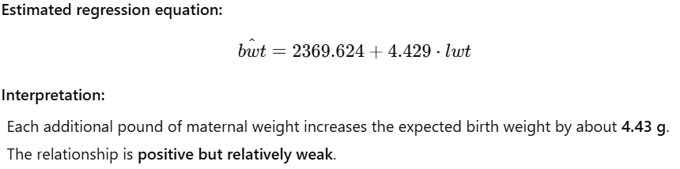

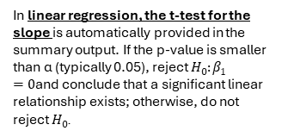
Corelation: cor(x,y)
Correlation value | Interpretation
~0 | No linear relationship
0.1 – 0.3 | Weak relationship
0.3 – 0.5 | Moderate relationship
> 0.5 | Strong relationship
pred_ci <- predict(fit_lin, newdata = data.frame(speed = x0), interval = "confidence", level = 0.95)
pred_pi <- predict(fit_lin, newdata = data.frame(speed = x0), interval = "prediction", level = 0.95)
list(manual_mean_CI = ci_mean,
manual_pred_PI = pi_new,
lm_mean_CI = as.numeric(pred_ci[1, c("lwr", "upr")]),
lm_pred_PI = as.numeric(pred_pi[1, c("lwr", "upr")]))
plot(r ~ x,
xlab = "Speed (mph)",
ylab = "Standardized residual",
main = "Standardized residuals vs speed")
abline(h = 0, lty = 2)
β0​ = intercept
qqnorm(r, main = "Normal Q–Q plot of standardized residuals")
qqline(r)
In linear regression, the t-test for the slope is automatically provided in the summary output. If the p-value is smaller than α (typically 0.05), reject $H_{0}:β_{1}=0$and conclude that a significant linear relationship exists; otherwise, do not reject $H_{0}$.
The estimator is the formula using the random variables
The estimate is the number you get when you plug your observed data into that formula.
In 1–2 sentences each, define (in your own words): - population, sample, parameter, statistic.
Population: is the entire group of individuals or observations that you are interested in studying and about which you want to draw conclusions. Sample: is a subset of the population that is actually observed or measured, chosen to represent the population.
Parameter: is a numerical value that describes a characteristic of a population (for example, the true mean or variance), and it is usually unknown.
Statistic: A statistic is a numerical value calculated from a sample, used to estimate or make inferences about a population parameter.
Sign:
Positive → As the mother’s weight increases, birth weight tends to increase.
Negative → Higher mother’s weight would be associated with lower birth weight
If the null value is outside the 95% CI, the result is significant at α = 0.05.
Prediction intervals are always wider than confidence intervals because they include individual variability.
A 95% confidence interval gives the range of plausible values for the true population mean.
Higher confidence → wider CI. Larger sample → narrower CI.

Slide 4
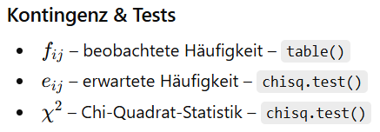
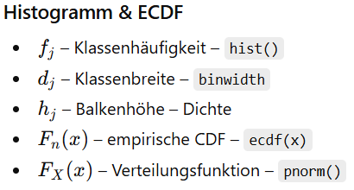
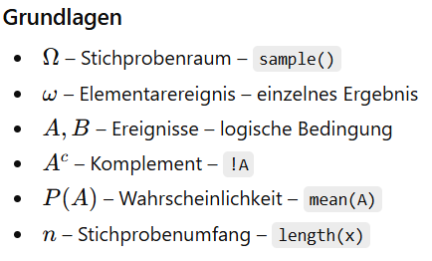
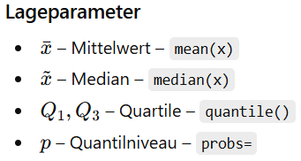
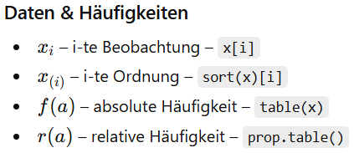
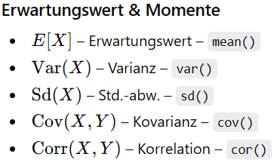
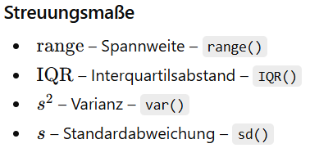
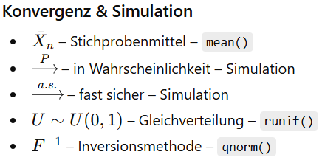
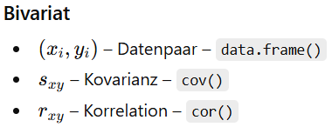
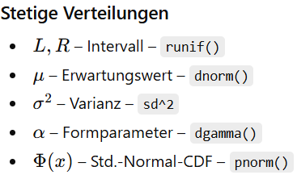
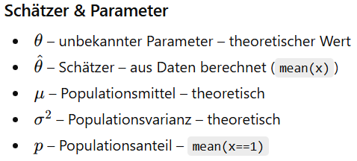
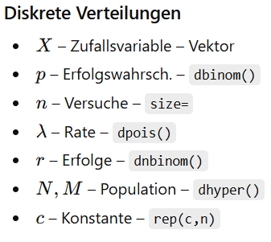
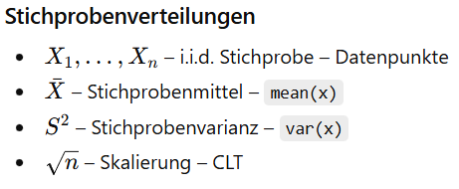
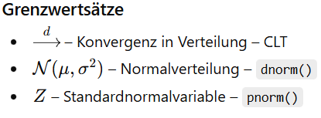
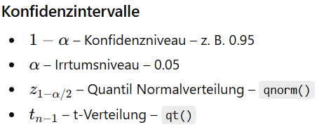
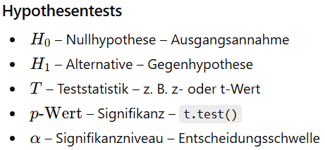
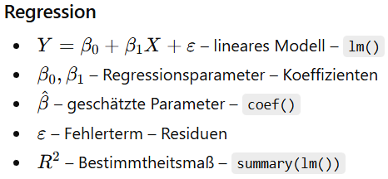
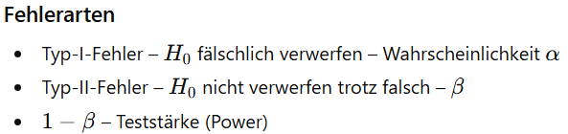
β0​ = intercept
Corelation: cor(x,y)
The estimator is the formula using the random variables
The estimate is the number you get when you plug your observed data into that formula.
Correlation value | Interpretation
~0 | No linear relationship
0.1 – 0.3 | Weak relationship
0.3 – 0.5 | Moderate relationship
> 0.5 | Strong relationship
pred_ci <- predict(fit_lin, newdata = data.frame(speed = x0), interval = "confidence", level = 0.95)
pred_pi <- predict(fit_lin, newdata = data.frame(speed = x0), interval = "prediction", level = 0.95)
plot(r ~ x,
xlab = "Speed (mph)",
ylab = "Standardized residual",
main = "Standardized residuals vs speed")
abline(h = 0, lty = 2)
qqnorm(r, main = "Normal Q–Q plot of standardized residuals")
qqline(r)
In linear regression, the t-test for the slope is automatically provided in the summary output. If the p-value is smaller than α (typically 0.05), reject $H_{0}:β_{1}=0$and conclude that a significant linear relationship exists; otherwise, do not reject $H_{0}$.
If the null value is outside the 95% CI, the result is significant at α = 0.05.
In 1–2 sentences each, define (in your own words): - population, sample, parameter, statistic.
Population: is the entire group of individuals or observations that you are interested in studying and about which you want to draw conclusions. Sample: is a subset of the population that is actually observed or measured, chosen to represent the population.
Parameter: is a numerical value that describes a characteristic of a population (for example, the true mean or variance), and it is usually unknown.
Statistic: A statistic is a numerical value calculated from a sample, used to estimate or make inferences about a population parameter.
Sign:
Positive → As the mother’s weight increases, birth weight tends to increase.
Negative → Higher mother’s weight would be associated with lower birth weight
Prediction intervals are always wider than confidence intervals because they include individual variability.
A 95% confidence interval gives the range of plausible values for the true population mean.
Higher confidence → wider CI. Larger sample → narrower CI.

Slide 5
floor(x) | rundet ab.
seq(0,1,0.01) | Zahlenfolge von 0 bis 1 in Schritten von 0,01.
max() | größten Wert
sqrt() | Quadratwurzel
abs() | Abstand zur 0
mean(x%%3==0 | x%%5==0) | relative Häufigkeit der Elemente in x, die durch 3 oder 5 teilbar sind
mean(A & C) | gemeinsame Wahrscheinlichkeit (Schnittmenge) beider Bedingungen.
iseven <- x %% 2 == 0 | logical Vector
which.max() | liefert den Index des größten Werts im Vektor
factor(other) | converts vector in factors (same elements get the same number)
table(other) | frequency table (insert factors)
prop.table(other, modifyer) | proportion table (modifier = 1 -> row-wise ; modifier = 2 -> column-wise) (insert counts)
rowSums(M) | berechnet die Summe der Werte jeder Zeile der Matrix oder des Data Frames M.
nrow() | gibt die Anzahl der Zeilen eines Data Frames oder einer Matrix zurück.
abline(lm(y ~ x, data = DF2)) | fitted least‑squares line
ggplot(bwt, aes(x = bwt)) + geom_histogram(binwidth = 100) + ggtitle("Age with width = 100 and ggplot") | erstellt mit ggplot2 ein Histogramm der Variable bwt, verwendet Klassenbreite 100 und setzt den Titel des Diagramms auf „Age with width = 100 and ggplot“.
ggplot(bwt, aes(x = bwt)) + stat_ecdf() | ecdf
ggplot(aes(x = t_mean, colour = season))+ stat_ecdf(na.rm = TRUE) | Ecdf getrennt nach season
ggplot(aes(x = t_mean, colour = season))+ geom_boxplot(na.rm = TRUE) | boxplot
ggplot(aes(x = wet, colour = season))+ geom_bar() | balkendiagramm
ggplot(diag_tbl, aes(x = .fitted, y = .resid)) + geom_point() + geom_hline(yintercept = 0, linetype = "dashed") + labs( title = "Residuals vs Fitted", x = "Fitted values", y = "Residuals") | Residuen gegen Vorhersage Diagramm.
z_score <- function(x) { CODE } | funktion mit x als attribut
replicate(n, expr) | führt den Ausdruck expr n-mal aus
which(pm > 0.5)[1] | liefert den Index des ersten Elements im Vektor pm, das größer als 0.5 ist.
na.omit() | entfernt alle Zeilen, die mindestens einen NA-Wert enthalten
mutate() | fügt neue Spalten zu einem Data Frame hinzu oder verändert bestehende Spalten,
select() | wählt gezielt Spalten aus einem Data Frame aus
filter() | wählt Zeilen aus einem Data Frame aus, die eine oder mehrere logische Bedingungen erfüllen
summarise(across(everything(), ~sum(is.na(.)))) | zählt für jede Spalte eines Data Frames die Anzahl der NA-Werte und gibt das Ergebnis als eine Zeile zurück.
sapply() | versucht aber das Ergebnis in einen Vektor oder eine Matrix zu vereinfachen.
tapply() | Wendet eine Funktion auf Gruppen eines Vektors an, die durch einen Faktor definiert sind.
fit <- lm(y ~ x) | Erstellt ein lineares Regressionsmodell
summary(fit) | (Koeffizienten, R², Standardfehler etc.).
p <- c("1" = 1/2, "2" = 1/3, "3" = 1/6) | setzt die Wahrscheinlichkeiten für die Ereignisse {1}, {2} und {3}.
P_12 = sum(p[c("1","2")]) | wählt die Wahrscheinlichkeiten für die Ereignisse {1} und {2} aus. | Ergibt also c(1/2, 1/3).
choose(deck,cards) | die Anzahl der möglichen Kombinationen, wenn man cards Karten ohne Zurücklegen und ohne Reihenfolge aus einem deck von 52 Karten zieht.
pnorm(2) | gibt die Wahrscheinlichkeit an, dass eine standardnormalverteilte Zufallsvariable kleiner oder gleich 2 ist (also P(X≤2)P(X \le 2)P(X≤2)).
pnorm(6) - pnorm(2) | Zwischen 2 und 7
ecdf(x) | erstellt die empirische Verteilungsfunktion der Daten in x, also eine Funktion, die für jeden Wert den Anteil der Beobachtungen ≤ diesem Wert angibt.
quantile(bwt$lwt, 0.75) | berechnet das 75%-Quantil (3. Quartil) der Variable lwt
(quantile(bwt$lwt, 0.75) - quantile(bwt$lwt, 0.25) | Interquartile Range (IQR), also die Spannweite zwischen dem 3. und 1. Quartil.
cor.test(test,test2) | führt einen statistischen Test auf Korrelation zwischen den beiden numerischen Vektoren test und test2 durch und liefert Korrelationskoeffizient, p-Wert und Konfidenzintervall. positives r → positiver Zusammenhang |r| klein (~0.2) → schwacher Zusammenhang
names(vals) | gets or sets the names of vals
rep("MS", 5) | string 5 mal in vector speichern
read.csv("path/to/your/file.csv", sep = ";") | Reading a CSV File with a Different Delimiter (standard is ",")
write.csv(df, "D:\\Bobdata.csv", row.names=FALSE) | Export a Data Frame to a CSV File
fp <- tempfile(fileext = ".csv") | create a temporary file to write the contents to
plot(DF2$x, DF2$y, pch = 19, main = "Scatter with LS line", xlab = "x", ylab = "y") | create a simple plot with descriptions
hist(x, breaks, freq, main) | erstellt ein Histogramm, das die Häufigkeitsverteilung von numerischen Daten grafisch darstellt.
Wenn du einfach nur jede Zeile aufsummieren willst → rowSums()
Wenn du Zeilen nach Gruppen zusammenfassen willst → rowsum()
Geometric(p)
Uniform[L, R]
rgeom(N, prob = Probability)
runif(vector length)
curve(dgeom(floor(x), prob = 0.3), from = 0, to = 20, add = TRUE)
curve(dunif(x, min = 0, max = 1), add = TRUE)
Exponential(λ)
Normal
sapply() | Wie lapply(), versucht aber das Ergebnis in einen Vektor oder eine Matrix zu vereinfachen.
rexp(vector length, rate = λ)
rnorm(n,MEAN,Standard Deviation)
curve(dexp(x, rate = 0.5), add = TRUE)
curve(dnorm(x, 0, 1), add = TRUE)

