Slide 1
L6.2: Matched Case-Control Studies
BIOS 6612 Julia Wrobel

Slide 2
Overview
Today, we cover:
Matched Case-Control Studies
Intro to conditional logistic regression
Review of laws of probability
Optional readings:
Agresti: 7.3, 11.2

Slide 3
Matched case-control studies
Matching is one manner in which investigators can control for confounding and bias and also increase precision. Matching consists of pairing or grouping subjects based on pre-specified characteristics. It is a form of stratification that is implemented in the design stage.
In a matched case-control study, each person with disease who is included in the study as a case is matched with one or more disease-free people (the controls).
Matched based on covariate(s) of interrest, often age, ethnicity
Can also match on residential area or workplace to account for confounding variables that are not easily measured

Slide 4
Matched case-control studies
Design with M controls per case is known as a 1:M matched study
The matched set refers to the case and each of the M controls matched to that case
Ususally $1≤M≤5$ (does not have to be the same for all cases)
Can also have more than one case

Slide 5
Example: Herniated Discs and Driving
We are interested in understanding if driving motor vehicles leads to increased risk of lower back pain due to acute herniated lumbar intervertebral discs.
1:1 matching was used in this study (Kelsey and Hardy, 1975)
Cases were selected from people aged 20-64 in Connecticut who were diagnosed as having herniated discs and had recently acquired symptoms
Controls were sampled from patients admitted to the same hospital/clinic as a case with a condition not related to the spine
Age (age of a case and control were within 10 years) and sex were used to further match
Total of 217 matched pairs
After individual was selected for inclusion, data on driving habits and place of residence (the exposures of interest) was obtained for each.

Slide 6
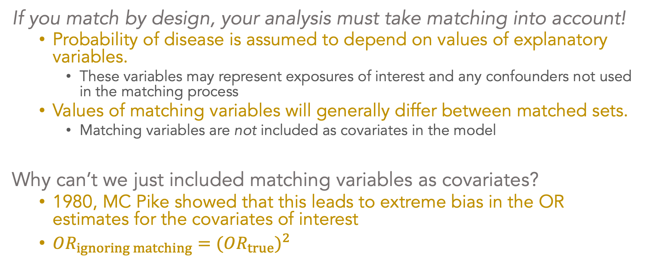
Modeling data from matched studies
If you match by design, your analysis must take matching into account!
Probability of disease is assumed to depend on values of explanatory variables.
These variables may represent exposures of interest and any confounders not used in the matching process
Values of matching variables will generally differ between matched sets.
Matching variables are not included as covariates in the model
Why can’t we just included matching variables as covariates?
1980, MC Pike showed that this leads to extreme bias in the OR estimates for the covariates of interest
$OR_{ignoring matching}=(OR_{true})^{2}$

Slide 7
Some notation
Let $p_{k}(X_{ik})$ represent the probability that the ith person in the kth matched set has disease
$k∈(1,2,3,…K)$ indicates the current matched set
$i∈(0,1,2,…M+1)$ indicates individual in the current matched set
$i=0$ is the case
$X_{ik}$ is vector of covariates for the ith person in the kth matched set
$X_{ik}=X_{ik1},X_{ik2},…,X_{ikp}$
These are NOT the covariates that were matched on, those are implicitly included in the model via stratification

Slide 8
Modeling data from matched studies
The model is
$$logit\left\{p_{k}(X_{ik})\right\}=α_{k}+β_{1}X_{ik1}+β_{2}X_{ik2}+…+β_{p}x_{ikp}$$
Note that each matched set/pair has a different intercept, $α_{j}$
$α_{k}$ summarizes the effect of the matching variables on the probability of disease
$β_{p}$ is the logOR for diseased comparing those exposed to covariate $p$ to those unexposed to covariate $p$

Slide 9
Constructing likelihood to find beta coefficients
By definition, all individuals in a matched set will have the same values for the matching variables.
Probability of selection for inclusion in the study will depend on these matching variables
Selection probability must still be independent of the other explanatory variables in the model
We need to construct a conditional likelihood to take account of the matching in the analysis.
This is a product of n independent terms
Each of these is the conditional probability that the case in a particular matched set is the one with a particular observed value for the explanatory variables
Conditional on the values of all the explanatory variables observed in that particular matched set

Slide 10
Constructing the conditional likelihood
How do we construct a likelihood function that allows us to find estimates for the parameters of interest, $β$?
Find the conditional likelihood for the $k$th stratum/matched set
Combine likelihoods to obtain likelihood over all strata
Essentially, likelihood in $k$th stratum = P(observed covariates | number of subjects in $k$th stratum, number of cases in $k$th stratum)

Slide 11
Conditional logistic regression
The logistic model that we will construct will assume the underlying log odds of disease may differ from pair to pair, but that the log odds ratio comparing the exposed to the unexposed subject will remain the same across all matched pairs.
This means that the underlying odds of disease can be different from one pair (or set) to another, but the effect of the (non-matched) predictor is the same in all matched pairs

Slide 12
Laws of Probability
A refresher on laws of probability that we’ll need to derive the likelihood for conditional logistic regression. Take events $A$ and $B$.
$P(A|B)$ is the conditional probability that event A occurs given that event B occurs
$P(A∩B)$ is the joint probability that events A and B occur together
$$P(A|B)=\frac{P(A∩B)}{P(B)}$$
If events A and B are independent, then their joint probability is
$$P(A∩B)=P(A)P(B)$$

Slide 13
Law of Total Probability
Let $B_{1},B_{2},…,B_{n}$ be a set of mutually exclusive events such that $\sum_{j}^{n}{P}(B_{j})=1$. The law of total probability states that:
$$\begin{matrix}P(A) & =P(A|B_{1})P(B_{1})+P(A|B_{2})P(B_{2})+…P(A|B_{n})P(B_{n}) \\ & =\sum_{j}^{n}{P}(A|B_{j})P(B_{j})\end{matrix}$$

Slide 14
Bayes’ Theorem
Bayes’ Theorem states that
$$P(B_{j}|A)=\frac{P(A|B_{j})P(B_{j})}{P(A)};i=1,…,n$$
Using the law of total probability, we can substitue $P(A)$ in the denominator to get
$$P(B_{j}|A)=\frac{P(A|B_{j})P(B_{j})}{\sum_{j}^{n}{P}(A|B_{j})P(B_{j})}$$

