Slide 1
L6.3: Conditional Logistic Regression
BIOS 6612 Julia Wrobel

Slide 2
Overview
Today, we cover:
Likelihood derivation for conditional logistic regression
Optional readings:
Agresti: 7.3, 11.2

Slide 3
Modeling data from matched studies
The model for matched data is
$$logit\left\{p_{k}(X_{ik})\right\}=α_{k}+β_{1}X_{ik1}+β_{2}X_{ik2}+…+β_{p}x_{ikp}$$
$p_{k}(X_{ik})$ represent the probability that the ith person in the kth matched set has disease
$k∈(1,2,3,…K)$ indicates the current matched set
$i∈(0,1,2,…M+1)$ indicates individual in the current matched set
$i=0$ is the case
$X_{ik}$ is vector of covariates for the ith person in the kth matched set
$X_{ik}=X_{ik1},X_{ik2},…,X_{ikp}$

Slide 4
Constructing the conditional likelihood
How do we construct a likelihood function that allows us to find estimates for the parameters of interest, $β$?
Find the conditional likelihood for the $k$th stratum/matched set
Combine likelihoods to obtain likelihood over all strata

Slide 5
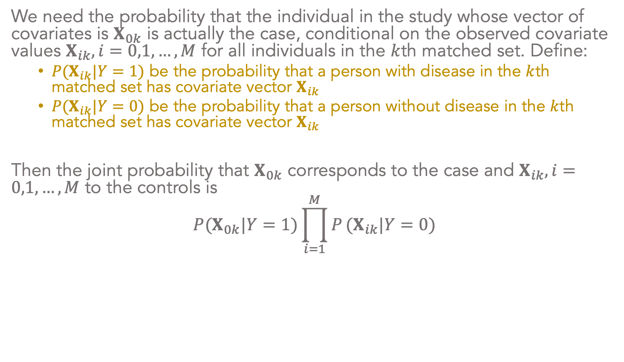
Constructing the conditional likelihood
We need the probability that the individual in the study whose vector of covariates is $X_{0k}$ is actually the case, conditional on the observed covariate values $X_{ik},i=0,1,…,M$ for all individuals in the $k$th matched set. Define:
$P(X_{ik}|Y=1)$ be the probability that a person with disease in the $k$th matched set has covariate vector $X_{ik}$
$P(X_{ik}|Y=0)$ be the probability that a person without disease in the $k$th matched set has covariate vector $X_{ik}$
Then the joint probability that $X_{0k}$ corresponds to the case and $X_{ik},i=0,1,…,M$ to the controls is
$$P(X_{0k}|Y=1)\prod_{i=1}^{M}{P}(X_{ik}|Y=0)$$

Slide 6
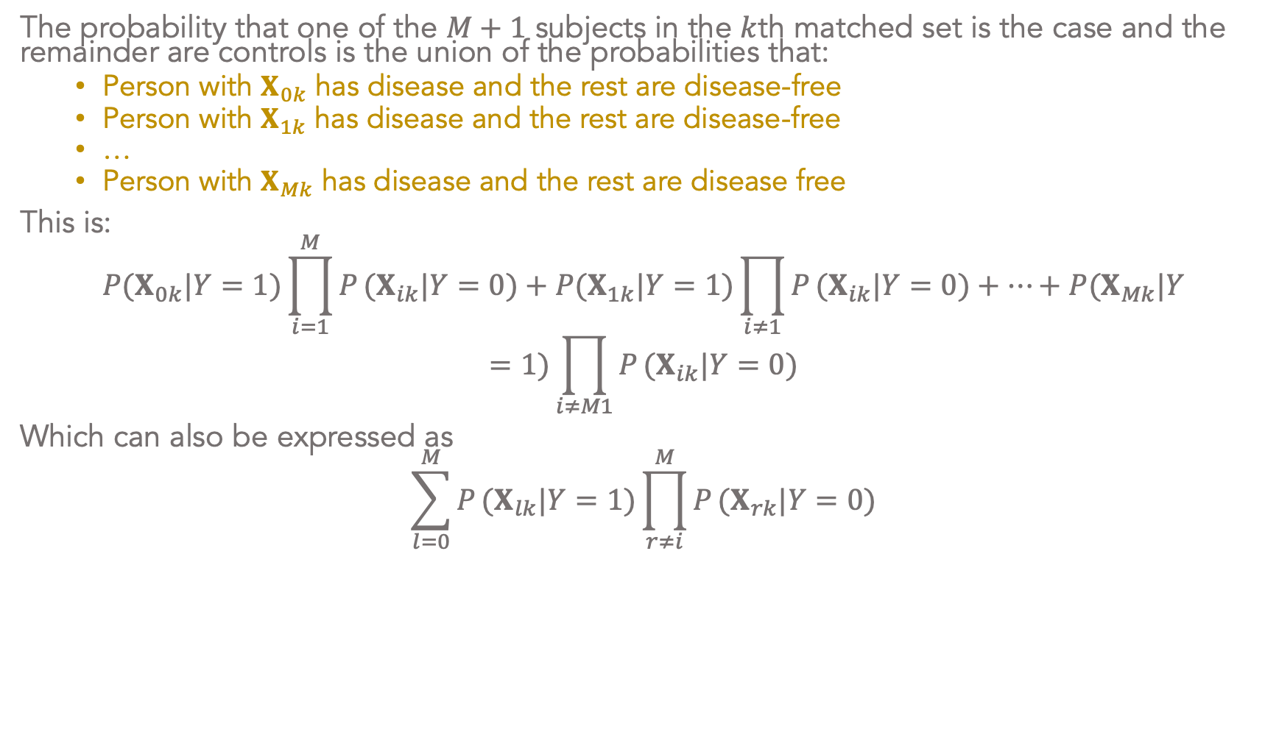
Constructing the conditional likelihood
The probability that one of the $M+1$ subjects in the $k$th matched set is the case and the remainder are controls is the union of the probabilities that:
Person with $X_{0k}$ has disease and the rest are disease-free
Person with $X_{1k}$ has disease and the rest are disease-free
…
Person with $X_{Mk}$ has disease and the rest are disease free
This is:
$$P(X_{0k}|Y=1)\prod_{i=1}^{M}{P}(X_{ik}|Y=0)+P(X_{1k}|Y=1)\prod_{i≠1}^{​}{P}(X_{ik}|Y=0)+…+P(X_{Mk}|Y=1)\prod_{i≠M1}^{​}{P}(X_{ik}|Y=0)$$
Which can also be expressed as
$$\sum_{l=0}^{M}{P}(X_{lk}|Y=1)\prod_{r≠i}^{M}{P}(X_{rk}|Y=0)$$

Slide 7
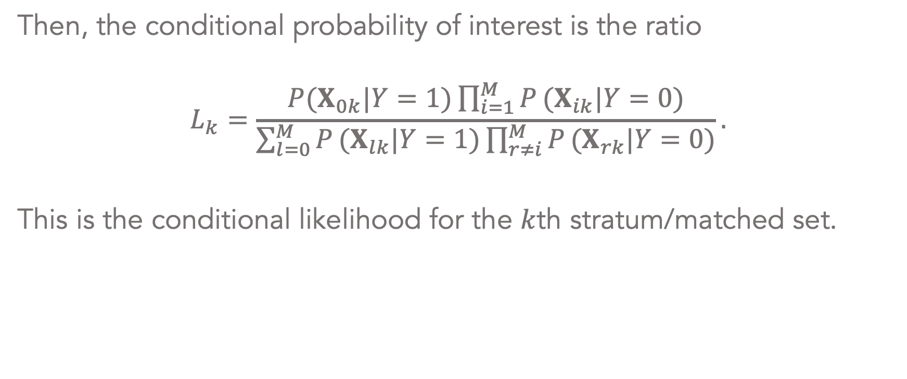
Constructing the conditional likelihood
Then, the conditional probability of interest is the ratio
$$L_{k}=\frac{P(X_{0k}|Y=1)\prod_{i=1}^{M}{P}(X_{ik}|Y=0)}{\sum_{l=0}^{M}{P}(X_{lk}|Y=1)\prod_{r≠i}^{M}{P}(X_{rk}|Y=0)}.$$
This is the conditional likelihood for the $k$th stratum/matched set.

Slide 8
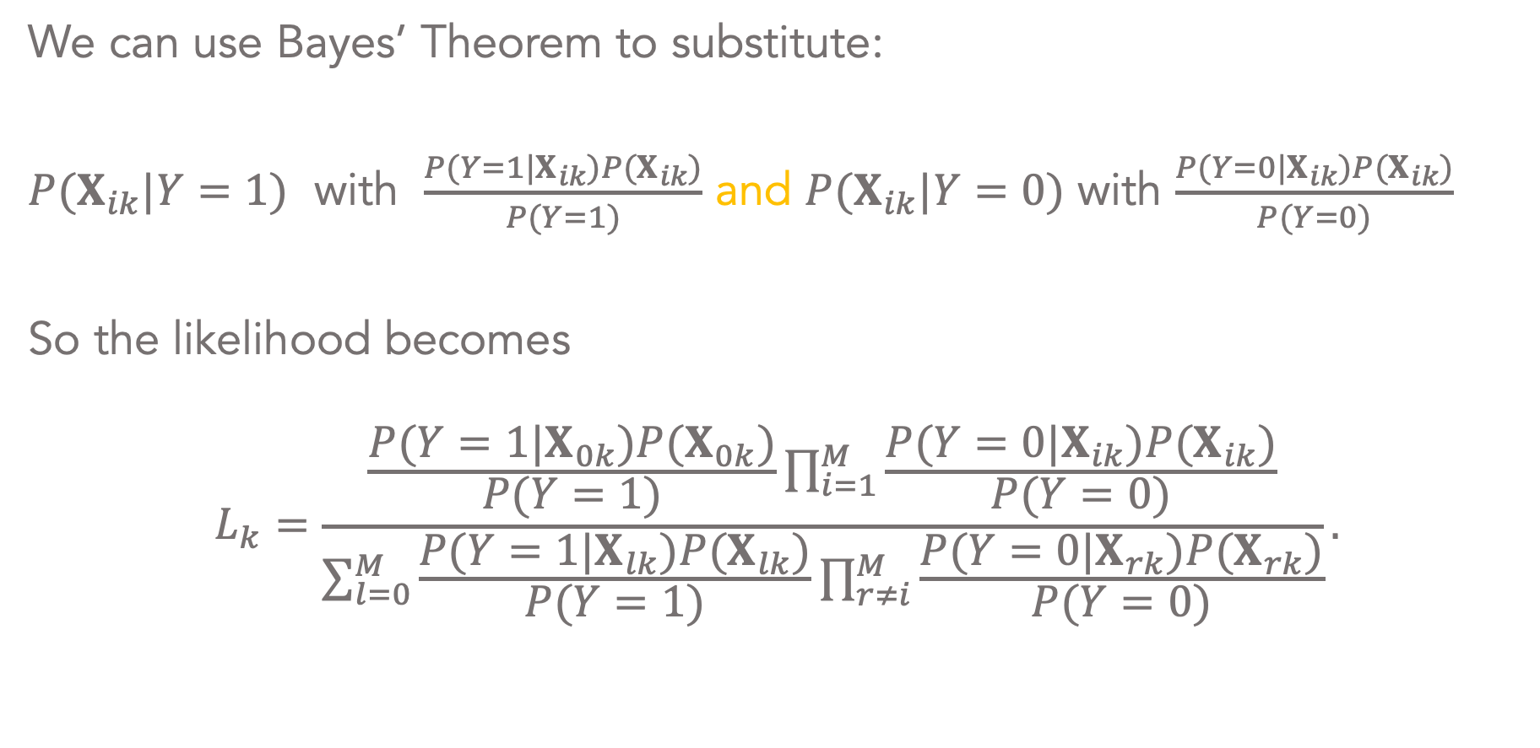
Constructing the conditional likelihood
We can use Bayes’ Theorem to substitute:
$P(X_{ik}|Y=1)$ with $\frac{P(Y=1|X_{ik})P(X_{ik})}{P(Y=1)}$ and $P(X_{ik}|Y=0)$ with $\frac{P(Y=0|X_{ik})P(X_{ik})}{P(Y=0)}$
So the likelihood becomes
$$L_{k}=\frac{\frac{P(Y=1|X_{0k})P(X_{0k})}{P(Y=1)}\prod_{i=1}^{M}{\frac{P(Y=0|X_{ik})P(X_{ik})}{P(Y=0)}}}{\sum_{l=0}^{M}{\frac{P(Y=1|X_{lk})P(X_{lk})}{P(Y=1)}}\prod_{r≠i}^{M}{\frac{P(Y=0|X_{rk})P(X_{rk})}{P(Y=0)}}}.$$

Slide 9
Constructing the conditional likelihood
The factor $\frac{\prod_{i}^{M}{P}(X_{ik})}{P(Y=1)P(Y=0)^{M}}$ appears in both the numerator and denominator and will cancel out, so the the likelihood reduces to
$$L_{k}=\frac{P(Y=1|X_{0k})\prod_{i=1}^{M}{P}(Y=0|X_{ik})}{\sum_{l=0}^{M}{P}(Y=1|X_{lk})\prod_{r≠i}^{M}{P}(Y=0|X_{rk})}$$

Slide 10
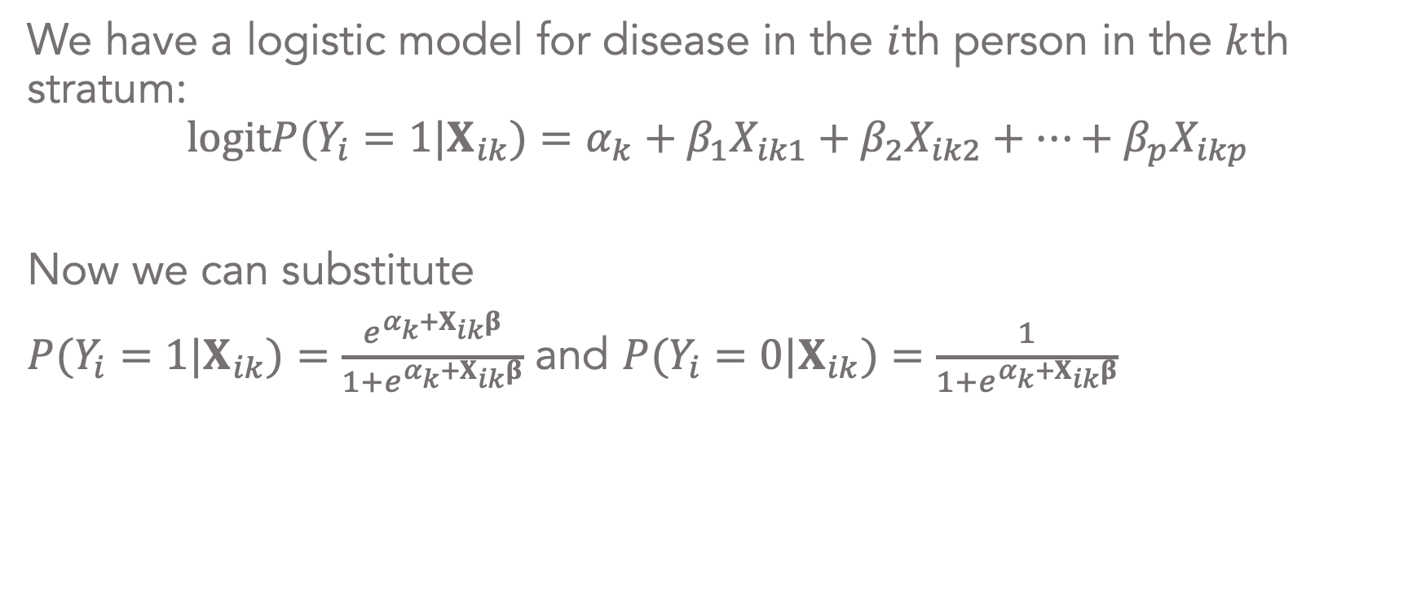
Constructing the conditional likelihood in terms of Betas
We have a logistic model for disease in the $i$th person in the $k$th stratum:
$$logitP(Y_{i}=1|X_{ik})=α_{k}+β_{1}X_{ik1}+β_{2}X_{ik2}+…+β_{p}X_{ikp}$$
Now we can substitute
$P(Y_{i}=1|X_{ik})=\frac{e^{α_{k}+X_{ik}β}}{1+e^{α_{k}+X_{ik}β}}$ and $P(Y_{i}=0|X_{ik})=\frac{1}{1+e^{α_{k}+X_{ik}β}}$

Slide 11
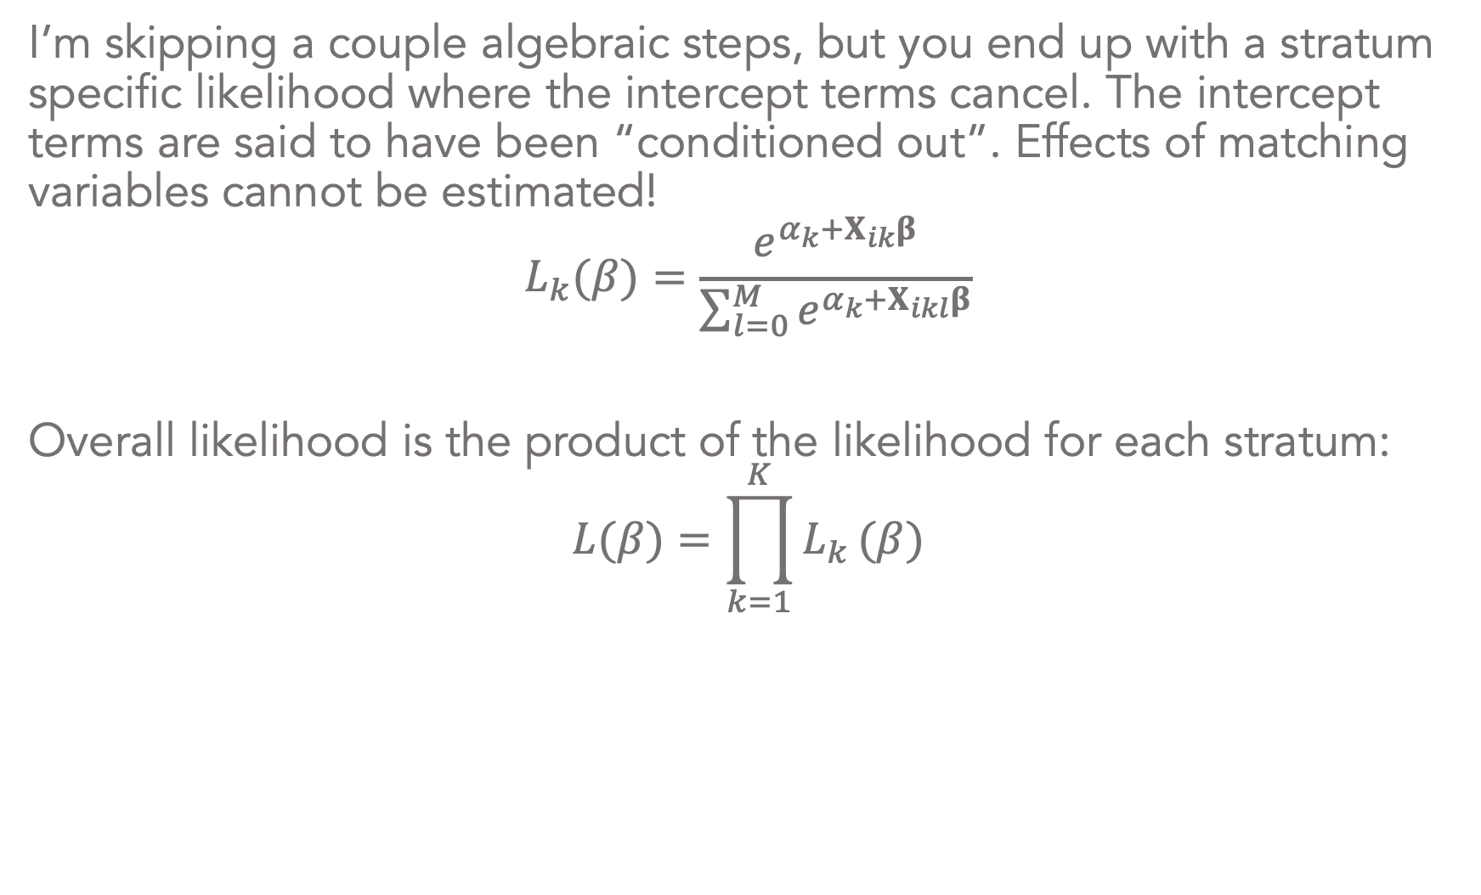
Constructing the conditional likelihood in terms of Betas
I’m skipping a couple algebraic steps, but you end up with a stratum specific likelihood where the intercept terms cancel. The intercept terms are said to have been “conditioned out”. Effects of matching variables cannot be estimated!
$$L_{k}(β)=\frac{e^{α_{k}+X_{ik}β}}{\sum_{l=0}^{M}{e^{α_{k}+X_{ikl}β}}}$$
Overall likelihood is the product of the likelihood for each stratum:
$$L(β)=\prod_{k=1}^{K}{L_{k}}(β)$$

Slide 12
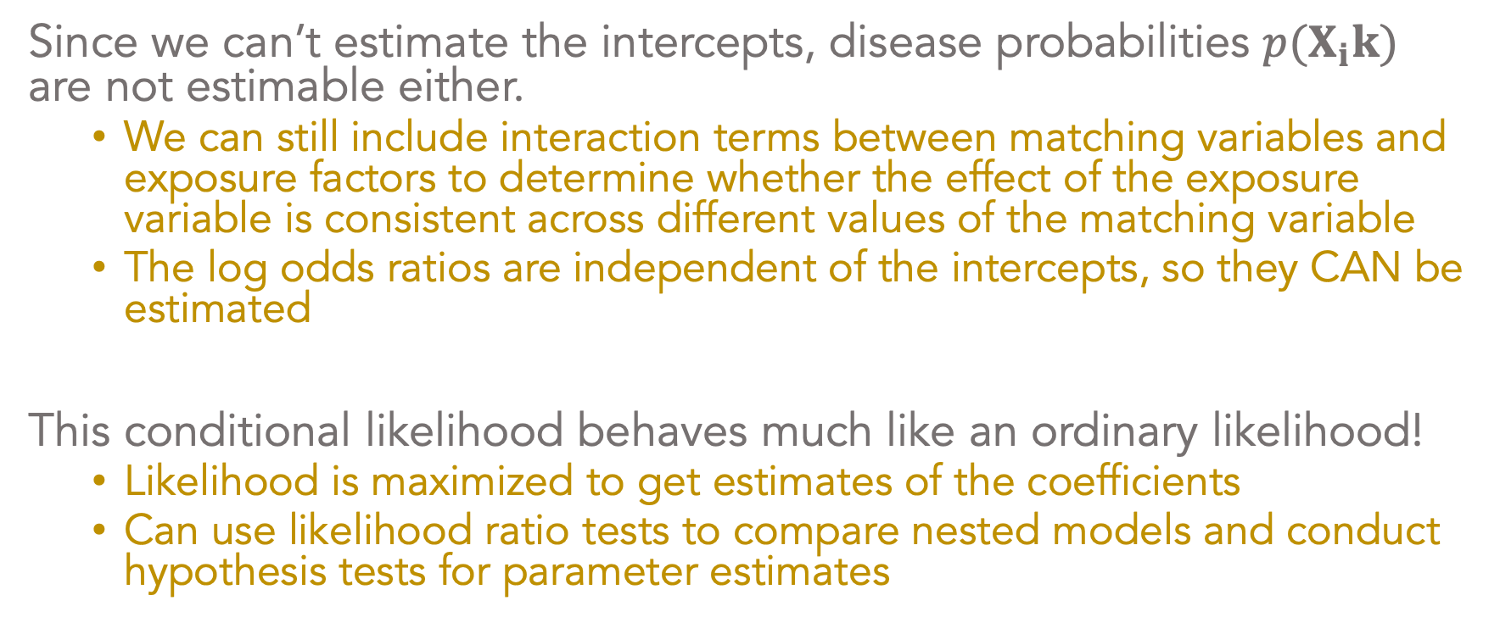
Conditional likelihood for matched case-control data
Since we can’t estimate the intercepts, disease probabilities $p(X_{i}k)$ are not estimable either.
We can still include interaction terms between matching variables and exposure factors to determine whether the effect of the exposure variable is consistent across different values of the matching variable
The log odds ratios are independent of the intercepts, so they CAN be estimated
This conditional likelihood behaves much like an ordinary likelihood!
Likelihood is maximized to get estimates of the coefficients
Can use likelihood ratio tests to compare nested models and conduct hypothesis tests for parameter estimates

