Slide 1
Add “SAS” snippet

Slide 2
1. Copy this codes
```{r include=FALSE}
sasopts <- "-nosplash -linesize 75"
saspath <- "C:/Program Files/SASHome/SASFoundation/9.4/sas.exe"
knitr::opts_chunk(engine = "sas", engine.path = saspath, engine.opts = sasopts, comment = NA)
```
```{sas}
\* YOUR SAS CODES*\
```
```{r engine='R', include=FALSE}
knitr::opts_chunk(engine="R", engine.path=NULL, engine.opts=NULL, comment=NA)
```

Slide 3
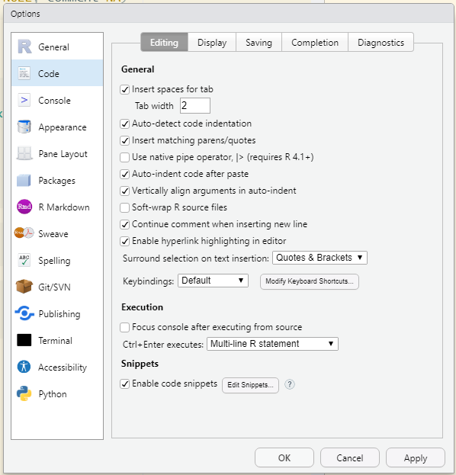
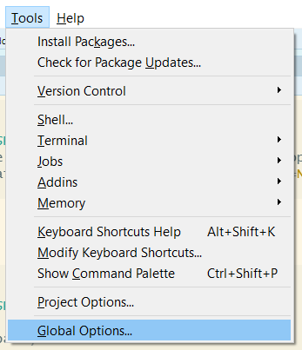
2 Open snippet in Rstudio
Tools => Global Options… => Code => Snippets

Slide 4
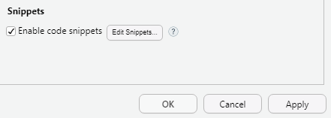
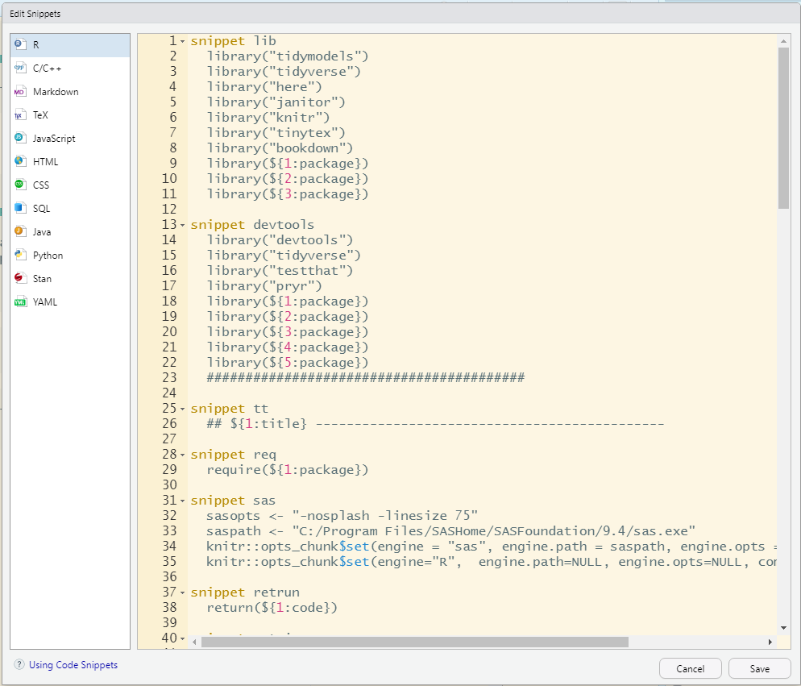
3 Open Edit Snippets…
Select Markdown

Slide 5
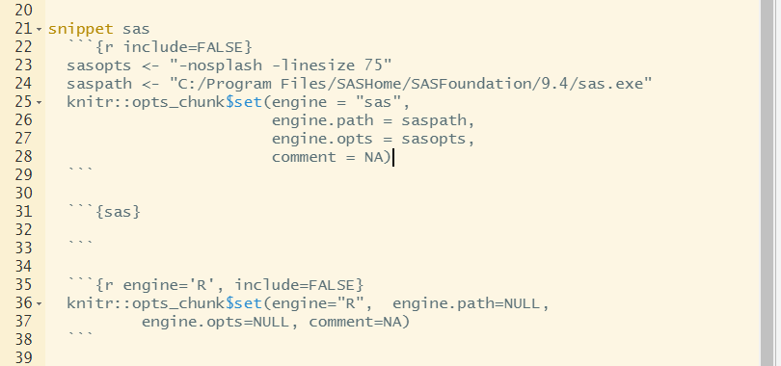

4 Paste Snippet, Save it, and APPLY

Slide 6
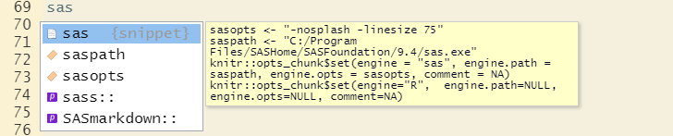
5 Go to Rstudio
Type “sas” and keep in that same line
Press both Shift and Tab
You can see the snippet
Ready to use SASrmarkdown
```{r engine="sas", engine.path="C:/Program Files/SASHome/SASFoundation/9.4/sas.exe", engine.opts="-nosplash -linesize 75", comment=NA, collectcode=TRUE}
```
OR design another one☺

Slide 7
More about snippet
https://support.rstudio.com/hc/en-us/articles/204463668-Code-Snippets?version=1.4.1717&mode=desktop

