Slide 1
Explorations and Experiments on INLA with NHANES data, PartII
BIOS 7720 Randy

Slide 2
Random Walk and Smoothing functions
$$∫(f^{(m)}(x))^{2}dx ≈ d^{−(2m−1)}\sum_{i=m+1}^{n}{[}∇^{m}f(x_{i})]^{2}$$
$d$ is the samll and equal space for $d_{i}=x_{i}−x_{i−1}$; $m^{th}$ derivative of $f$ is continuous; $∇^{m}$ is the $m^{t}h$ order backward difference operator: $∇^{1}f(x)=f(x_{i})−f(x_{i−1})$ $∇^{2}f(x)=f(x_{i})−2f(x_{i−1})+f(x_{i−2})$

Slide 3
Random Walk and Smoothing functions
$$∇^{m}f(x_{i}) \overset{iid}{∼} Normal(0, σ_{f}^{2} ), i=m+1, ..., n.$$
$$\sqrt{\frac{∥Q_{m}∥_{+}}{2πσ_{f}^{2}}}exp(−\frac{1}{2σ_{f}^{2}}f^{⊤}Q_{m}f)$$

Slide 4
simulation and comparison
library(INLA) library(brinla) library(tidyverse) library(mgcv) set.seed(555) n <- 100 x <- seq(0, 1, , n) f.true <- (sin(2 * pi * x^3))^3 y <- f.true + rnorm(n, sd = 0.2)

Slide 5
RW1 and RW2
data.inla <- data.frame(y = y, x = x) formula1 <- y ~ -1 + f(x, model = "rw1", constr = FALSE) system.time(result1 <- inla(formula1, data = data.inla))
## user system elapsed ## 0.56 0.75 2.68
formula2 <- y ~ -1 + f(x, model = "rw2", constr = FALSE) system.time(result2 <- inla(formula2, data = data.inla))
## user system elapsed ## 0.29 0.56 1.72
# names(inla.models()$latent)

Slide 6
RW1 and RW2
head(result1$summary.random$x) %>% round(4)
## ID mean sd 0.025quant 0.5quant 0.975quant mode kld ## 1 0.0000 0.0139 0.1329 -0.2471 0.0138 0.2754 0.0135 0 ## 2 0.0101 0.0605 0.1151 -0.1661 0.0605 0.2867 0.0606 0 ## 3 0.0202 0.0827 0.1109 -0.1353 0.0826 0.3007 0.0825 0 ## 4 0.0303 0.1124 0.1117 -0.1062 0.1120 0.3329 0.1112 0 ## 5 0.0404 -0.0182 0.1127 -0.2419 -0.0175 0.2016 -0.0160 0 ## 6 0.0505 0.0553 0.1090 -0.1590 0.0552 0.2697 0.0551 0
head(result2$summary.random$x) %>% round(4)
## ID mean sd 0.025quant 0.5quant 0.975quant mode kld ## 1 0.0000 0.0504 0.1373 -0.2202 0.0506 0.3199 0.0509 0 ## 2 0.0101 0.0583 0.1073 -0.1526 0.0582 0.2693 0.0581 0 ## 3 0.0202 0.0635 0.0904 -0.1145 0.0635 0.2412 0.0635 0 ## 4 0.0303 0.0645 0.0832 -0.0991 0.0645 0.2281 0.0645 0 ## 5 0.0404 0.0600 0.0809 -0.0988 0.0599 0.2193 0.0597 0 ## 6 0.0505 0.0563 0.0805 -0.1015 0.0560 0.2152 0.0556 0

Slide 7
cubic
#### smooth_spline() ---------- fit.ss <- smooth.spline(x, y) res <- (fit.ss$yin - fit.ss$y) / (1 - fit.ss$lev) fhat3 <- fit.ss$y ## lower bound f.lb3 <- fhat3 - 2 * sd(res) * sqrt(fit.ss$lev) ## upper bound f.ub3 <- fhat3 + 2 * sd(res) * sqrt(fit.ss$lev)

Slide 8
mgcv gam
#### gam() Sun Apr 04 09:19:51 2021 --------- system.time(fit.gam <- gam(y ~ s(x)))
## user system elapsed ## 0.02 0.00 0.01
res.gam <- predict(fit.gam, se.fit = TRUE) ## fitted curve fhat4 <- res.gam$fit ## lower bound f.lb4 <- res.gam$fit - 2 * res.gam$se.fit ## upper bound f.ub4 <- res.gam$fit + 2 * res.gam$se.fit
gridExtra::grid.arrange(plot1, plot2, plot3, plot4, nrow = 2)

Slide 9
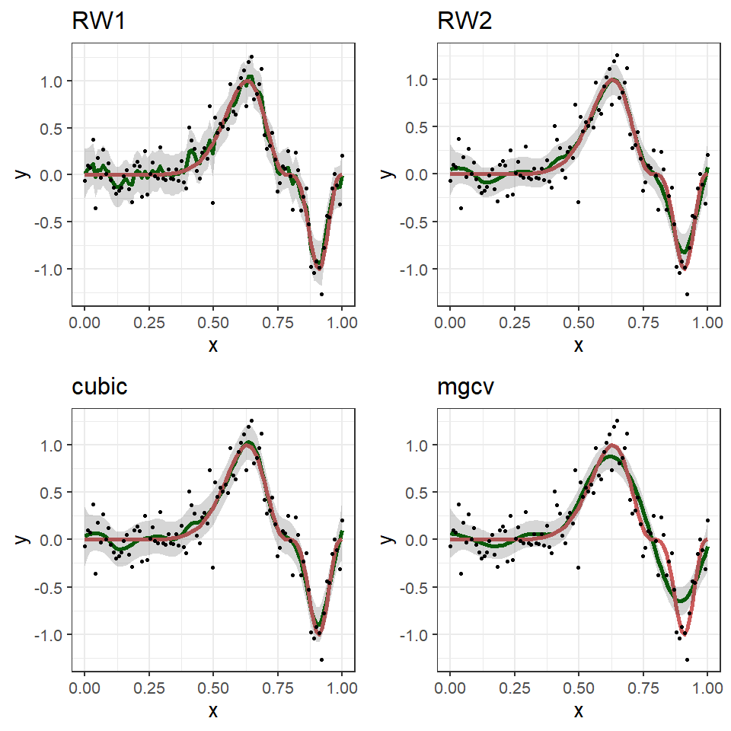

Slide 10
the cherry on the top - prior
To allow the data to speak for themselves, weakly informative or non-informative priors are often used in this situation.
a1 <- 3 b1 <- 5e-5 a2 <- -0.5 b2 <- 5e-5 lgprior1 <- list(prec = list(param = c(a1, b1))) lgprior2 <- list(prec = list(param = c(a2, b2))) formula5 <- y ~ -1 + f(x, model = "rw2", constr = FALSE, hyper = lgprior2) system.time( result5 <- inla(formula5, data = data.inla, ## used to specify the prior on delta ## and hyper in f() in f() on tao control.family = list(hyper = lgprior1)) )
## user system elapsed ## 0.17 0.81 2.85

Slide 11
the cherry on the top - prior
the resulting posterior distributions do not differ much from those given by the default priors
## posterior mean fhat <- result5$summary.random$x$mean ## 2.5% percentile f.lb <- result5$summary.random$x$"0.025quant" ## 97.5% percentile f.ub <- result5$summary.random$x$"0.975quant" data.plot5 <- data.frame(y = y, x = x, f.true = f.true, fhat = fhat, f.lb = f.lb, f.ub = f.ub) plot5 <- data.plot5 %>% ggplot(aes(x = x, y = y)) + geom_line(aes(y = fhat), size = 2, color = "darkgreen") + geom_line(aes(y = f.true), size = 2, color = "indianred") + geom_ribbon(aes(ymin = f.lb, ymax = f.ub), alpha = 0.2) + geom_point(aes(y = y)) + theme_bw(base_size = 20) + ggtitle("prior")
gridExtra::grid.arrange(plot2, plot4, plot5, nrow = 1)

Slide 12
