Slide 1
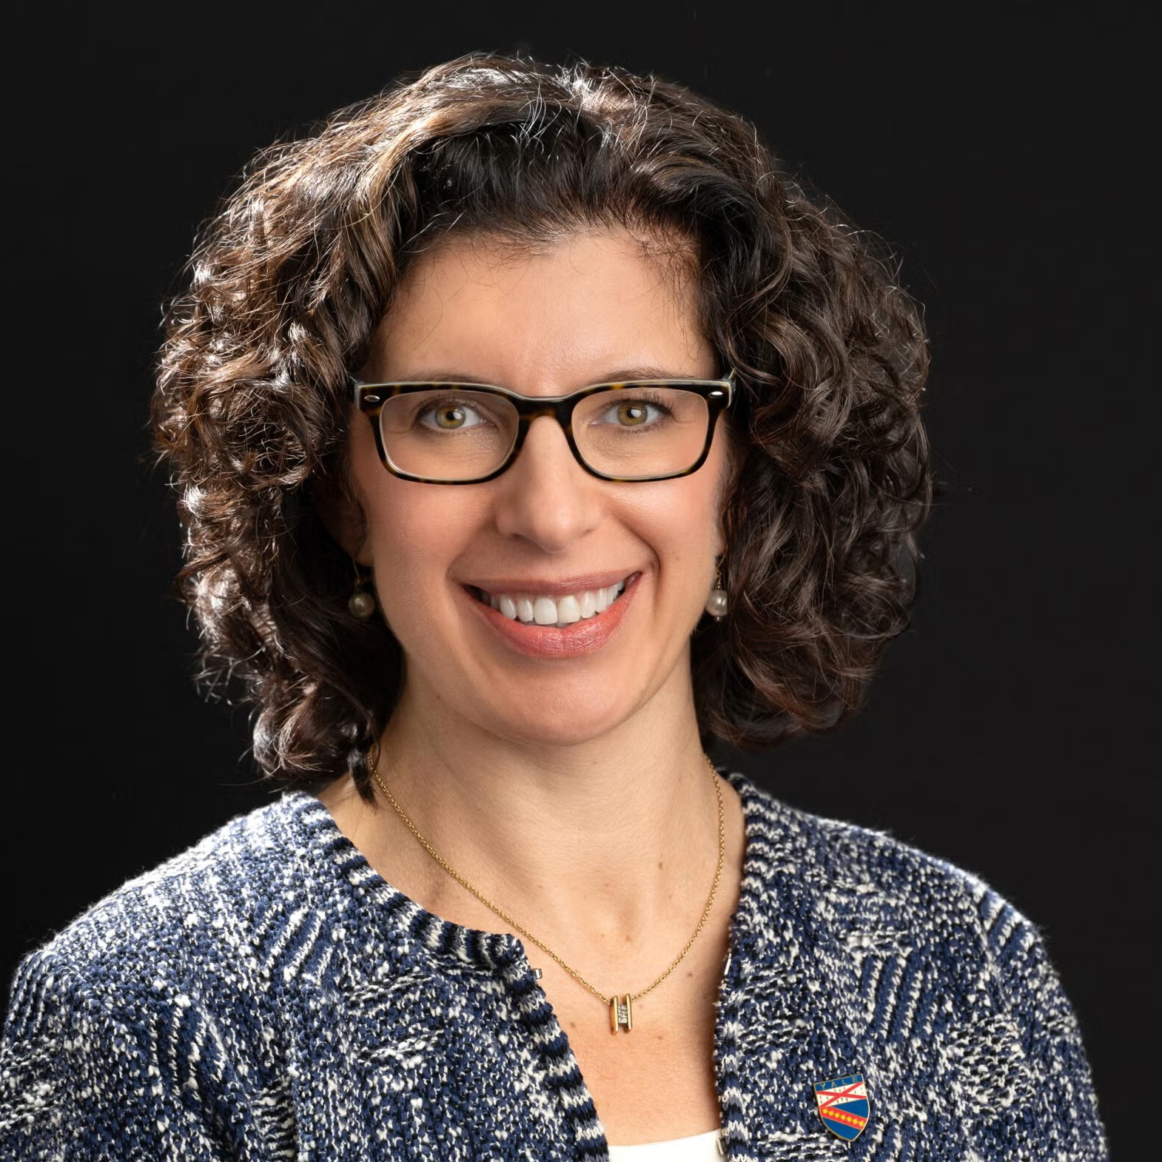
YSPH Dean Ranney’s current views on AI in public health and education:
➔
An obligation to positively declare where AIs can provide value
➔
An obligation to disclose when we use AIs — what model, what purpose — the same way we cite our data analytic tools
Dr. Megan Ranney
Dean, Yale School of
Public Health
➔
An obligation to evaluate AI: accuracy, equity, better predictions, better access, fewer negative health consequences
➔
A deep obligation to help students do what only humans can: listen, strategize, stay curious, collaborate, think critically
➔
An obligation to be honest about what we don’t yet know
Note: I used AI in creating this slide!

