Slide 1
BIS629 Advanced Methods In Implementation Science
Lecture 1: Introduction and Motivation
Donna Spiegelman, Sc.D.
Susan Dwight Bliss Professor of Biostatistics and
Inaugural Director, Center for Methods in Implementation and Prevention Science (CMIPS)
https://ysph.yale.edu/cmips/
Notes:
On behalf of leadership team; I lead implementation science at Yale, and this design is about implementation; H-index 122, > 750 pubs, statistical research and collaborative work, statistician on many RCTs, interacting with many DSMBs, PI of numerous NIH grants
With co-Is Lok, Nevo

Slide 2
BIS629 Advanced Methods In Implementation Science
Lecture 1: Introduction and Motivation
Teaching assistant: Can Meng
PhD Candidate
Department of Biostatistics
Yale School of Public Health
Can.meng@yale.edu
Notes:
On behalf of leadership team; I lead implementation science at Yale, and this design is about implementation; H-index 122, > 750 pubs, statistical research and collaborative work, statistician on many RCTs, interacting with many DSMBs, PI of numerous NIH grants
With co-Is Lok, Nevo

Slide 3
BIS629 Advanced Methods In Implementation Science
Lecture 1: Introduction and Motivation
Teaching assistant: Chiedozie Arum
PhD Candidate
Department of Epidemiology of Microbial Diseases
Yale School of Public Health
chiedozie.arum@yale.edu
Notes:
On behalf of leadership team; I lead implementation science at Yale, and this design is about implementation; H-index 122, > 750 pubs, statistical research and collaborative work, statistician on many RCTs, interacting with many DSMBs, PI of numerous NIH grants
With co-Is Lok, Nevo

Slide 4
Why implementation science?

Slide 5


Slide 6
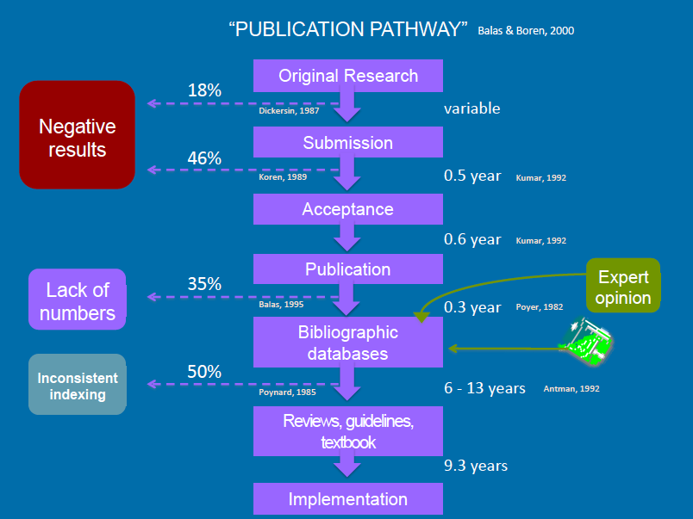

Slide 7
It takes 17 years to turn 14 percent of original research to the benefit of patient care

Slide 8
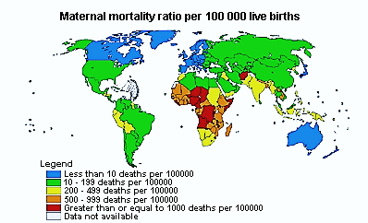
Example: Maternal Mortality – the world’s
greatest health disparity (WHO)

Slide 9
Example: Maternal Mortality – the world’s
greatest health disparity (WHO)
100-fold disparity between Northern Europe and
Central Africa

Slide 10
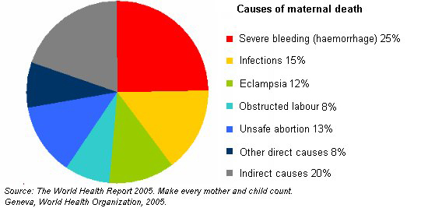
Maternal mortality is nearly entirely preventable
Notes:
Nearly 3/4s of maternal deaths are due to hemorrhage, infections, eclampsia, obstructed labor and unsafe abortion. Again, the clinical and preventive solutions to each of these causes is well known.

Slide 11
Proposal: Multi-factorial CRT (cluster-randomized trial) to prevent maternal mortality
2x2x2 factorial design will be sufficiently powered for each intervention
Unit of randomization could be village, district, or individual
No new science needed!
Interventions:
 | RR
TBA training & supplies (infections, obstructed labor) | 0.74
Calcium supplement (eclampsia) | 0.17
Oral misoprostol (bleeding) | 0.33
Combined effect | 0.04
Notes:
I propose a 2x2x2 randomized factorial trial to prevent maternal mortality. The unit of randomization could be the village, district or individual. The factorial design makes it possible to study all 3 interventions with the sample size needed to study one, and could be conducted in any of the countries on the previous slide with the sample sizes given – ranging from 40,000 in Tanzania, or 120,000 in Pakistan. 96% of maternal deaths are expected to be prevented by the combined effect of these 3 interventions, which target the top 4 causes of maternal mortality, one by one.
Emailed Wanda Barfield today, Director of the Division of Reproductive Health of the National Center for Chronic Disease Prevention and Health Promotion at the Centers for Disease Control in Atlanta, invited for talk!

Slide 12
Definitions of Implementation Science
“A systematic, scientific approach to ask and answer questions about how to get ‘what works’ to people who need it with greater speed, fidelity, efficiency, quality and relevant coverage”
  settings.” “The scientific study of programs and interventions which promote the systematic uptake of clinical research findings and other evidence-based approaches into routine clinical practice and public health policy, hence improving the quality (effectiveness, reliability, safety, appropriateness, equity, efficiency) of health care.”
  “Implementation science is about determining what works, in real-life at full-scale

Slide 13
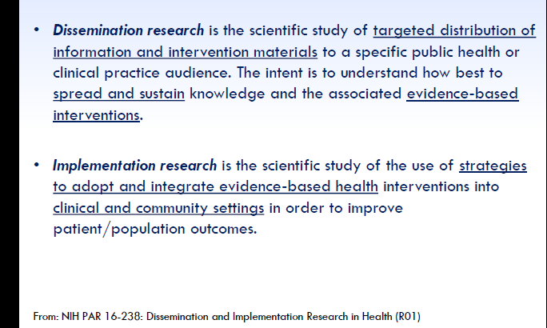

Slide 14
Features of Implementation and Dissemination Research
Theory-driven (CFIR, RE-AIM, …)
Mixed methods
Adaptation vs. Fidelity
Contextual (?when? ?where?) vs. External validity
Economic evaluation/cost-effectiveness
Sustainability
Diffusion (network science)

Slide 15
Implementation science studies should be…
Rigorous
Rapid
Relevant

Slide 16
Implementation science study design should consider…
Guided by implementation science theory, models and frameworks
Multilevel interventions and strategies (no magic bullet)
  e.g., health care system, policy makers, organizational leaders, health care providers, clients and their families and social networks
Dynamic
  Implementation process goes through stages (prevention, screening & treatment cascade)
  Timing of delivery of intervention components along the cascade can be as important as delivery itself
Implications for Design:
  group-level assignment(s) are necessary to study intervention components at district, hospital, facility, practice, provider or community level(s)
  *Chamberlain, P, Brown, CH, Saldana, L. Observational Measure of Implementation Progress: The Stages of Implementation Completion (SIC), Implementation Science, 6(116), 1-8, 2011.

Slide 17
Selecting a Study Design
Research Question(s)
Type of Clinical/Public Health Intervention
Type of Implementation Strategy
Feasibility
Cost/Personnel
Setting
Stakeholders
Logistics
Target Population(s)
Timeline
Ethics
Data availability
Funding Opportunity

Slide 18
Experimental Study Designs in Implementation Science
Randomized controlled trial (RCT) – individually randomized
Cluster RCT (CRTs)
Stepped-wedge cluster RCT (SWD)
Pragmatic trials – can be any of the above – usually CRTs and SWDs
Brown, C.H., Curran, G., Palinkas, L.A., Aarons, G.A., Wells, K.B., Jones, L., Collins, L.M., Duan, N., Mittman, B.S., Wallace, A. and Tabak, R.G. (2017). An overview of research and evaluation designs for dissemination and implementation. Annual review of public health, 38, pp.1-22.

Slide 19
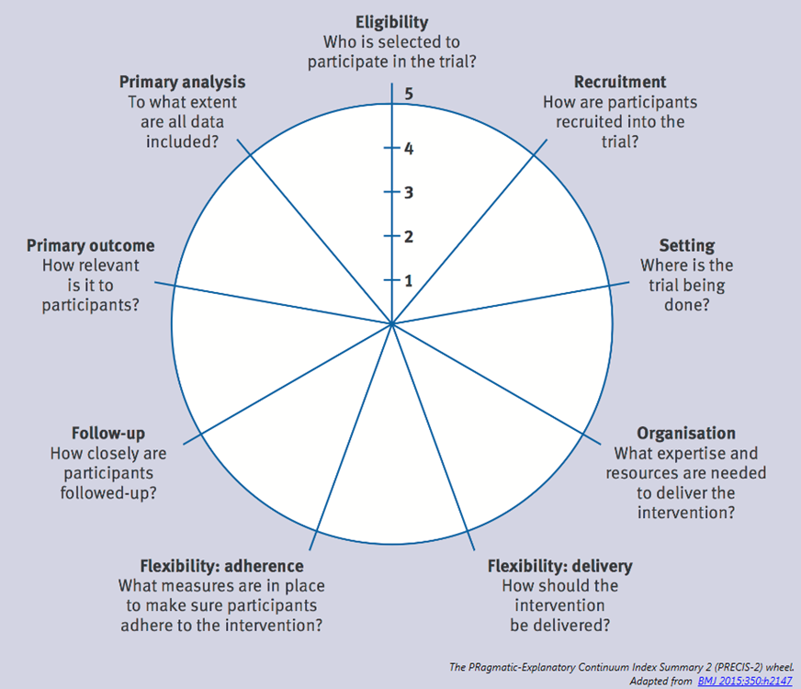
Pragmatic Study Designs
Pragmatic-Explanatory Continuum Indicator Summary (PRECIS)
PRECIS-2
9 constructs to consider
Guidance for coding
Maximize the applicability of the intervention to usual care across a wide range of local and distant settings
Less focused on highly specialized care settings
Thorpe, K.E., Zwarenstein, M., Oxman, A.D., Treweek, S., Furberg, C.D., Altman, D.G., Tunis, S., Bergel, E., Harvey, I., Magid, D.J. and Chalkidou, K., 2009. A pragmatic–explanatory continuum indicator summary (PRECIS): a tool to help trial designers. Journal of clinical epidemiology, 62(5), pp.464-475.
Loudon, K., Treweek, S., Sullivan, F., Donnan, P., Thorpe, K.E. and Zwarenstein, M., 2015. The PRECIS-2 tool: designing trials that are fit for purpose. BMJ, 350, p.h2147.

Slide 21

Case Study:
The Familia Salama study
Dar es Salaam, Tanzania
2x2 cluster-randomized trial
Enhanced community health worker vs. standard of care
  Primary outcome – 4 or more ANC visits (WHO “EBI”)
  Regan M, Cheng C, Mboggo E, Larson E, Lema IA, Magesa L, Machumi L, Ulenga N, Sando D, Mwanyika-Sando M, Barnhart DA, Hong B, Mungure E, Li N, Siril H, Mujinja P, Naburi H, Kilewo C, Ekström AM, Geldsetzer P, Fawzi W, Bärnighausen T, Sudfeld CR, Spiegelman D. The impact of a community health worker intervention on uptake of antenatal care: a cluster-randomized pragmatic trial in Dar es Salaam. Health Policy Plan. 2023 Mar 16;38(3):279-288. doi: 10.1093/heapol/czac100. PMID: 36377764; PMCID: PMC10019560.
Option A vs. Option B among HIV+ mothers
a. Primary outcome – PMTCT HIV incidence rate

Slide 22
60 Wards in 2 of 3 districts in Dar es Salaam were randomized to one of four arms in this cluster-randomized implementation trial
60 wards
Community intervention:
36 wards
No community intervention:
24 wards
Option B: 22 wards
(36,540 pregnancies)
Option A: 14 wards (35,622 pregnancies)
Option B: 10 wards (44,424 pregnancies)
Option A: 14 wards
(37,098 pregnancies)
Expected: 80,964 B vs. 77,720 A
Observed: 89,014 B vs. 98,419 A
Expected: 72,162 CHW vs. 81,522 SOC
Observed: 103,628 CHW vs. 83,805 SOC
Notes:
Highlight that Option A is the standard of care in Tanzania
Mention that Option B in our trial is AZT + 3TC + EFV

Slide 23
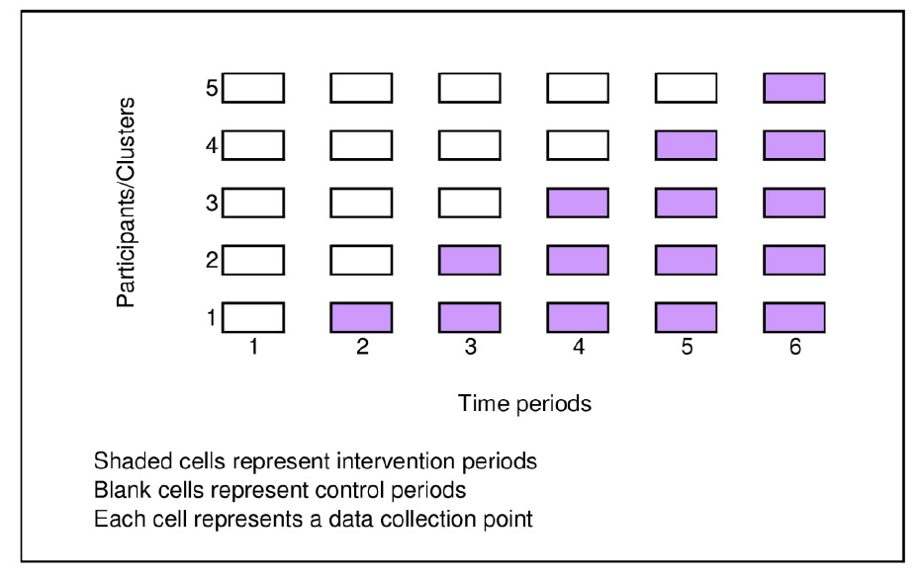
Stepped-Wedge Cluster RCTs
Brown, C. A., & Lilford, R. J. (2006). The stepped wedge trial design: a systematic review. BMC medical research methodology, 6(1), 54.

Slide 24
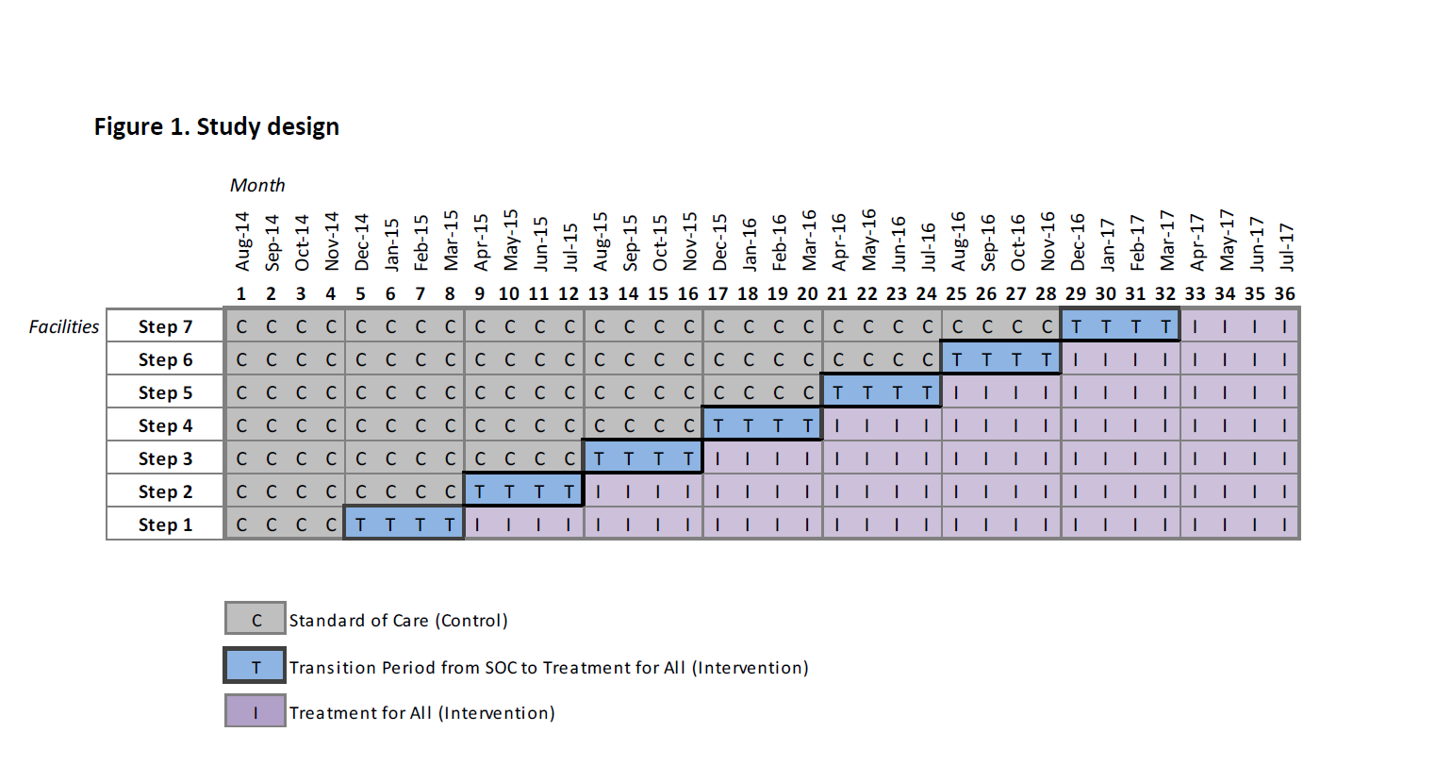
Early Access to ART in Swaziland, CHAI
Impact of early initiation versus national standard of care of antiretroviral therapy in Swaziland’s public sector health system: the MaxART stepped-wedge randomized trial
Khan S, Spiegelman D, Walsh F, Mazibuko S, Pasi M, Chai B, Reis R, Mlambo K, Delva W, Khumalo G, Zwane M, Fleming Y, Mafara E, Hettema A, Lejeune C, Barnighausen T, Okello V. Universal test and treat (UTT) versus standard of care for access to antiretroviral therapy in HIV clients: the MaxART stepped-wedge randomized controlled health systems trial in Swaziland. Journal of the International Aids Society. 2018;21:161-162.

Slide 25
Stepped Wedge Design Benefits/Cautions
Preferable when:
  There is evidence in support of the intervention, and/or resistance to a parallel design where half do not receive the treatment
  The intra-cluster correlation (ICC) is high
    Can increase efficiency over parallel design
  It is logistically challenging to start all intervention clusters at the same time
Deserves caution when:
  Clusters may not be able to follow randomization schedule
  Concerns about informative censoring for sustained interventions as is usually the case

Slide 26
What if you can’t randomize to the implementation condition?

Slide 27
Quasi-Experimental Study Designs
Before-After (Pre-post) Design
Controlled Before-After Design (Difference-in-difference design)
Interrupted Time Series (ITS)
  Multiple assessments prior to and following introduction of intervention
  More accurate assessment of outcomes or behavior than single pre-post assessments
  Controlled ITS design
Regression Discontinuity Design
  Individuals/groups assigned to intervention or control based on a priori score or metric
Shadish, W.R., Cook, T.D. and Campbell, D.T. (2002). Experimental and quasi-experimental designs for generalized causal inference. Wadsworth Cengage learning.

Slide 28
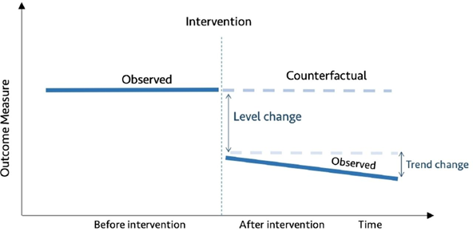
Interrupted Time Series
One of the strongest quasi-experimental designs.
Increasingly advocated for use in the evaluation of health system quality improvement (QI) interventions when randomization is not possible.
Hategeka, C., Ruton, H., Karamouzian, M., Lynd, L. D., & Law, M. R. (2020). Use of interrupted time series methods in the evaluation of health system quality improvement interventions: a methodological systematic review. BMJ Global Health, 5(10), e003567.

Slide 29

Causal Impact of Affordable Care Act on Colorectal Cancer Incidence and Mortality: An ITS study based on EHR
Objectives
  Evaluate the causal impact of ACA on CRC incidence and CRC-related mortality using a controlled interrupted time series design. In addition, investigate possible effect modification by race/ethnicity, age, and/or gender.
  Conduct mediation analysis where screening status is the mediator, to further strengthen evidence for causality
Utilize the vast electronic medical records database of Kaiser Permanente of Northern California
  Kaiser Permanente of Northern California is an integrated health care delivery system with over 4 million members who are representative of the regional population. For this study, we used an open cohort of KPNC members who were 50 years or older between January 1, 2000 and December 31, 2017.
  >1M unique KPNC members; >220M person-months of follow-up
  Incidence:
    19,177 events; crude incidence rate ≈ 100 cases per 100,000 person-years
  Mortality:
    2,623 deaths; crude mortality rate ≈13.8 deaths per 100,000 person-year

Slide 30
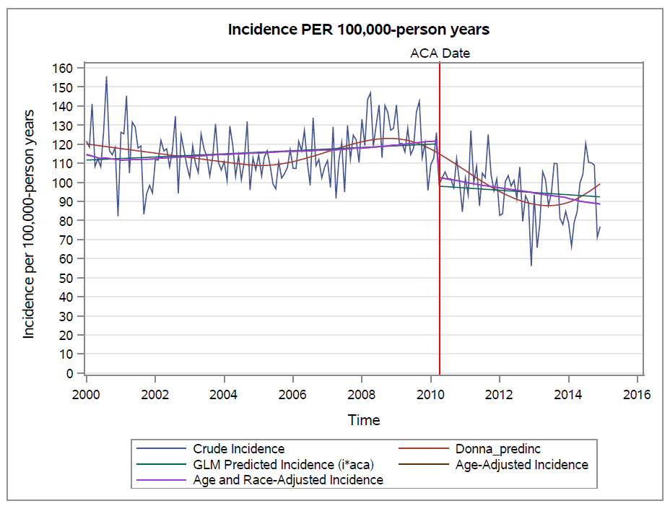

Slide 31
Some emerging innovative designs for implementation science
Multiphase Optimization Strategy (MOST)
Sequential Multiple Assignment Randomized Trial (SMART)
Learn-as-you-GO Design (LAGO)

Slide 32
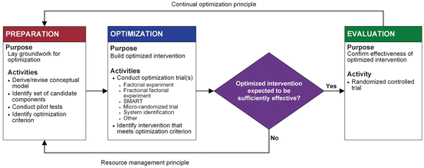
Multiphase Optimization Strategy
Collins, L. M. (2018). Conceptual introduction to the multiphase optimization strategy (MOST). In Optimization of behavioral, biobehavioral, and biomedical interventions (pp. 1-34). Springer, Cham.
Guastaferro, K., and Collins, L.M. (2019). Achieving the goals of translational science in public health intervention research: the Multiphase Optimization Strategy (MOST). American Journal of Public Health: S128-S129.

Slide 33
The end product of implementation efforts should emphasize overall value to stakeholders (systems, organizations, providers, patients) rather than only intervention effects
Adaptation should address adaptation to intervention, outer context, inner context, and bridging factors as needed
Implementation strategies can be construed as a method to create fit between EBIs and context
von Thiele Schwarz, U., Aarons, G. A., & Hasson, H. (2019). The Value Equation: Three complementary propositions for reconciling fidelity and adaptation in evidence-based practice implementation. BMC Health Services Research, 19(1), 868.

Slide 34
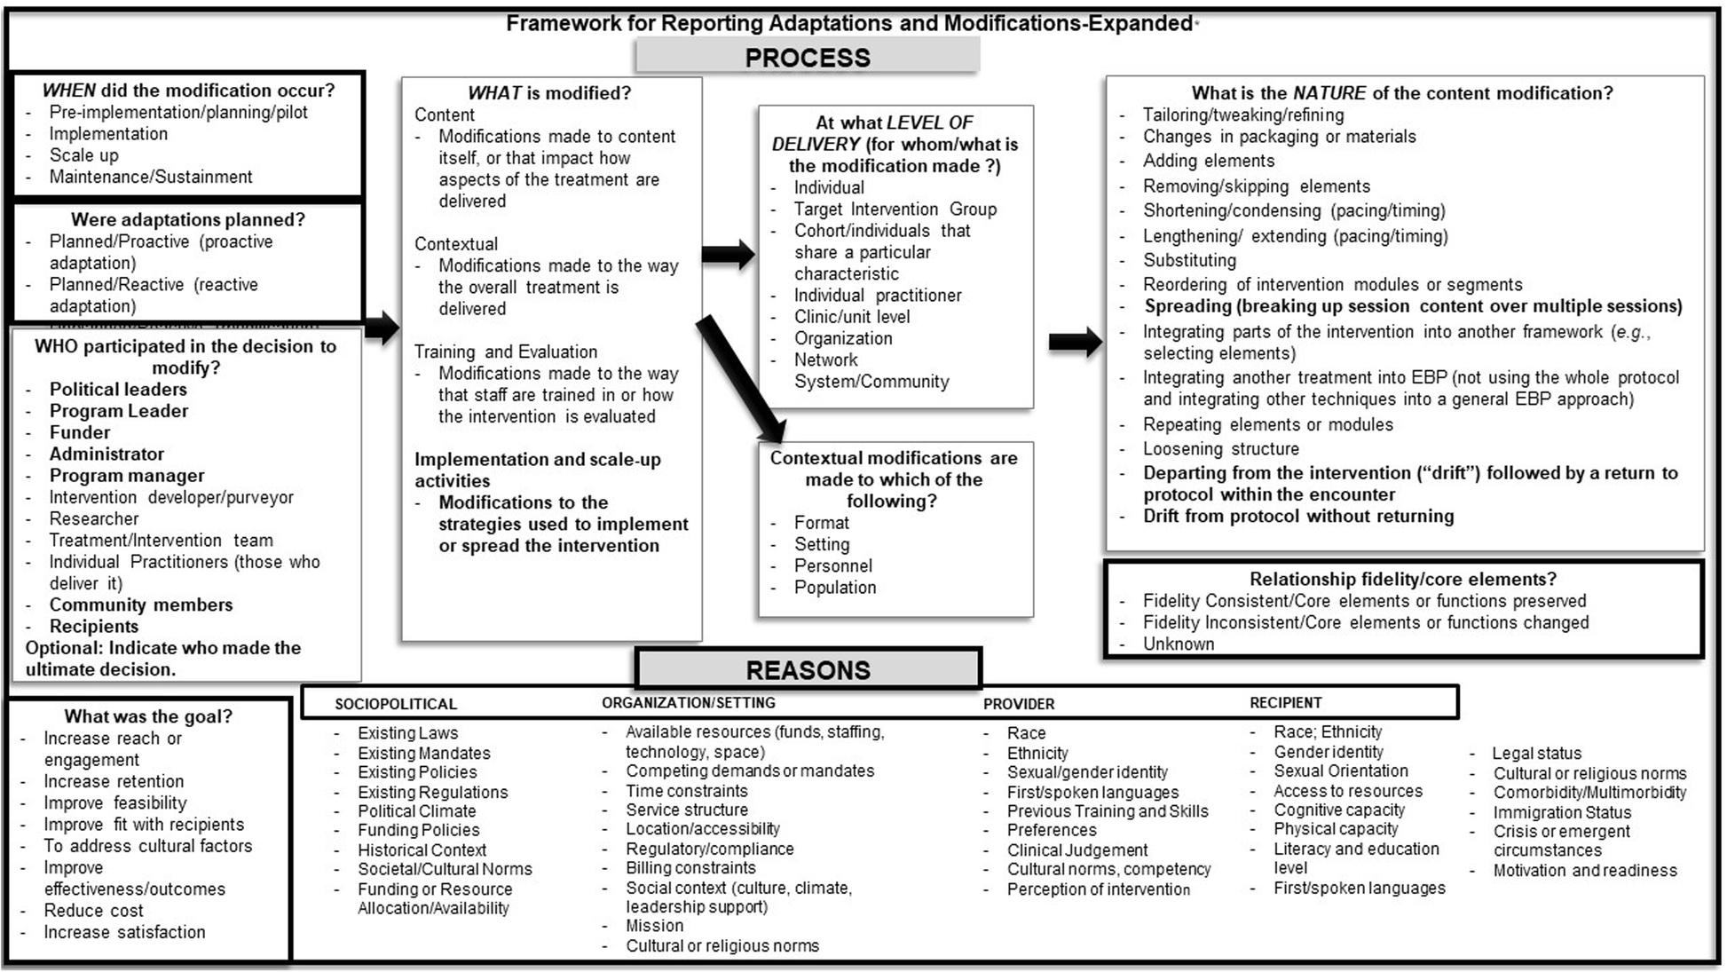
Stirman, S. W., Baumann, A. A., & Miller, C. J. (2019). The FRAME: an expanded framework for reporting adaptations and modifications to evidence-based interventions. Implementation Science, 14(1), 58.
Miller, C., Barnett, M.L., Baumann, A.A. et al. The FRAME-IS: a framework for documenting modifications to implementation strategies in healthcare. Implementation Sci 16, 36 (2021). https://doi.org/10.1186/s13012-021-01105-3
Notes:
https://dcricollab.dcri.duke.edu/sites/impact/Knowledge%20Repository/2023-01-20-GR-Slides-IMPACT.pdf is a presentation elaborating on the use of FRAME to check out

Slide 35






Learn As You Go (LAGO) Designs
Intervention is a package consisting of multiple components
Can include combinations e.g., treatment, a device, care organization, multiple stakeholders
Data are analyzed after each stage
Intervention package is reconfigured based on analyses
Nevo, D., Lok, J.J., & Spiegelman, D. (2021). Analysis of “learn-as-you-go”(LAGO) studies. The Annals of Statistics, 49(2), 793-819.
Revised intervention package is rolled out in the next stage
Intervention package in later stages depends on the outcomes from previous stages and all data utilized for final outcome assessment
An effective intervention package is sought, while minimizing intervention package cost.
Cost of the intervention is minimized and the probability of desired outcome maximized

Slide 36
Learn As You Go (LAGO) BetterBirth Example
Multi-center study in Uttar Pradesh, India
Test a multiple component intervention package to improve process and outcomes for mothers and newborns
Components: Launch duration, Coaching visits, audit and feedback, district/facility leader engagement
Stage 1 (pilot 2 centers), Stage 2 (pilot 4 centers), Stage 3 (RCT 30 centers); Quant & Qual data used to guide adaptation
Outcomes (120 sites, 24 districts, n=157,689)
WHO Safe Child Birth checklist (e.g., used during at least 90% of the births)
Adherence to oxytocin administration
7-day mortality (mother and/or child)
Costs (e.g., cost per coaching session)
Nevo, D., Lok, J.J., & Spiegelman, D. (2021). Analysis of “learn-as-you-go”(LAGO) studies. The Annals of Statistics, 49(2), 793-819.
Ante Bing, Donna Spiegelman, Daniel Nevo, Judith J Lok, Learn-As-you-GO (LAGO) trials: optimizing treatments and preventing trial failure through ongoing learning, Biometrics, Volume 81, Issue 2, June 2025, ujaf061, https://doi.org/10.1093/biomtc/ujaf061
Hirschhorn, L. R., Semrau, K., Kodkany, B., Churchill, R., Kapoor, A., Spector, J., ... & Gawande, A. (2015). Learning before leaping: integration of an adaptive study design process prior to initiation of BetterBirth, a large-scale randomized controlled trial in Uttar Pradesh, India. Implementation science, 10:117.

Slide 37
Effectiveness-Implementation Hybrid Designs
Dual focus a priori on assessing intervention effectiveness and implementation
Type 1, Type 2, Type 3
Overall goal is to accelerate transition from effectiveness trials to implementation trials
Hybrid designs are unique to implementation research
Curran, G.M., Bauer, M., Mittman, B., Pyne, J.M. and Stetler, C., 2012. Effectiveness-implementation hybrid designs: combining elements of clinical effectiveness and implementation research to enhance public health impact. Medical care, 50(3), p.217.
Owen MA, Curran GM, Smith JD, Tedla Y, Cheng C, Spiegelman D. Power and Sample Size Calculations for Cluster Randomized Hybrid Type 2 Effectiveness-Implementation Studies. Stat Med. 2025 Feb 28;44(5):e70015. doi: 10.1002/sim.70015. PMID: 39930740.

Slide 38
Hybrid Designs
Clinical
Effectiveness
Research
Implementation
Research
Hybrid
Type I
Hybrid
Type II
Hybrid
Type III
Test clinical intervention
observe/gather information on implementation
Test clinical effectiveness
Test implementation strategy
Test implementation strategy
observe/gather information on clinical outcomes
Adapted from Curran, G. M., Bauer, M., Mittman, B., Pyne, J. M., & Stetler, C. (2012). Effectiveness-implementation hybrid designs: combining elements of clinical effectiveness and implementation research to enhance public health impact. Medical care, 50(3), 217.

Slide 39
Observational Study Designs
Studying or assessing phenomena as they occur naturally
Policy initiatives can rarely be randomized
Cohort study, e.g. from electronic health records
Cross-sectional study, e.g. from electronic health records
Two-stage designs, e.g. from electronic health records enhanced with sub-samples of more detailed data
Harrison, M. B., Graham, I. D., Van Den Hoek, J., Dogherty, E. J., Carley, M. E., & Angus, V. (2013). Guideline adaptation and implementation planning: a prospective observational study. Implementation science, 8(1), 49.
Lau, A. S., Rodriguez, A., Bando, L., Innes-Gomberg, D., & Brookman-Frazee, L. (2020). Research community collaboration in observational implementation research: Complementary motivations and concerns in engaging in the study of implementation as usual. Administration and Policy in Mental Health and Mental Health Services Research, 47(2), 210-226.
DiPietro, N. A. (2010). Methods in epidemiology: observational study designs. Pharmacotherapy: The Journal of Human Pharmacology and Drug Therapy, 30(10), 973-984.

Slide 40
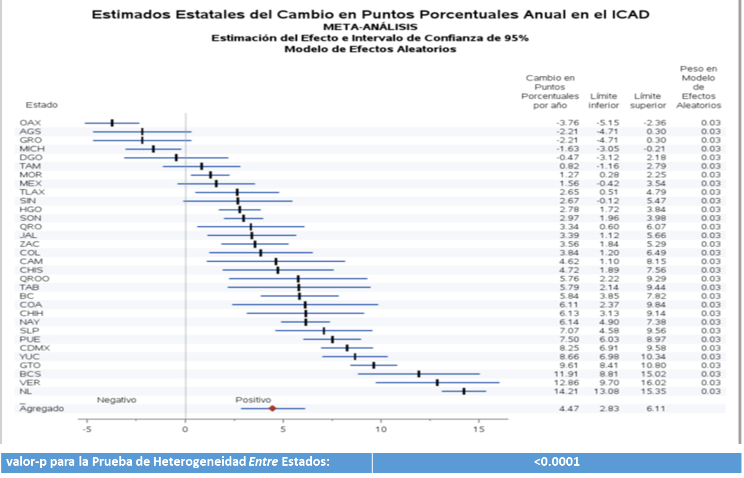
CASALUD: Are there disparities in quality of cardiometabolic care by state in Mexico? A cross-sectional EHR-based study
Index for the quality of care for the prevention, screening and treatment of diabetes(ICAD)
Unit of observation – one facility-month
Ranges From 0-100
Electronic medical records for chronic disease prevention, screening and care
1,782,293 patients who have had a least one clinic visit that included a chronic disease* diagnosis
12,375 health facilities in the country
June 2016 – July 2018
Hypertension, diabetes, dyslipidemia, obesity

Slide 41



A Few Take Home Points
Implementation studies require consideration of context, multiple levels, multiple components; timing matters
Identify and rank potential study designs then decide
Consider randomization in real-world roll-outs when possible to increase rigor
Consider innovative approaches if relevant to your
study
If randomization is not possible, there are
quasi-experimental and observational designs
available – this is the focus of causal inference
Notes:
Go to syllabus from here

