Slide 1


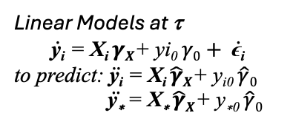

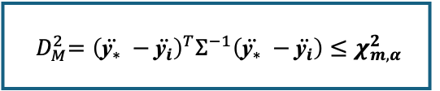
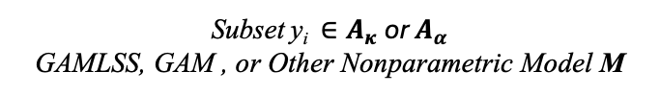

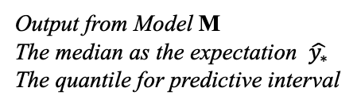
Start
Testing Baseline S_{test} = {X*, y_{*0} }
Training Set: S_{train} = {T_{i}, X_{i}, y_{i} },
Anchor time: τ = {τ₁, … , τ_{m}};
For individual i = 1, …, N
Brokenstick Model
$$\text{y}\text{i}\text{ = }\text{Φ}\text{(}\text{t}\text{i} \text{)}\text{T}\text{ (}\text{β} \text{+ }\text{b}\text{i} \text{) + }\text{ϵ}\text{i}$$
to predict: $\dot{\text{y}\text{i}}\text{ =} \text{Φ}\text{(}\text{t} \text{)}\text{T}\text{ (}\hat{β}\text{+}\hat{b}i\text{)}$
Linear Models at τ
$$\dot{\text{y}\text{i}}\text{ =} \text{X}\text{i} γX\text{+ }\text{yi}\text{0 }γ0+ \dot{\text{ϵ}\text{i}}$$ to predict: $\ddot{\text{y}\text{i}} \text{=} \text{X}\text{i} \hat{γ}X\text{+ }\text{yi}\text{0 }\hat{γ}0$
$\ddot{\text{y}\text{∗}} \text{=} \text{X}\text{∗} \hat{γ}X\text{+ }\text{y}\text{∗0 }\hat{γ}0$
Single
Single Anchor
τ = τ₁
Multiple
$\text{D}\text{abs}=\left\|\ddot{{\text{y}}_{∗}} −\ddot{{\text{y}}_{i}}\right\|$_{t}
Euclidean
Which distance
Mahalanobis
$$D_{E}=\sqrt{{(\ddot{{\text{y}}_{∗}} −\ddot{{\text{y}}_{i}})}^{2}}$$
Which Criteria
α or κ
κ
$$D_{M}=\sqrt{{(\ddot{{\text{y}}_{∗}} −\ddot{{\text{y}}_{i}})}^{T}Σ^{−1}(\ddot{{\text{y}}_{∗}} −\ddot{{\text{y}}_{i}})}$$
κ
${ D}_{M}^{2}={\left(\ddot{{\text{y}}_{∗}} −\ddot{{\text{y}}_{i}}\right)}^{T}Σ^{−1}\left(\ddot{{\text{y}}_{∗}} −\ddot{{\text{y}}_{i}}\right)≤χ_{m,α}^{2}$
κ
α
Subset ${\text{y}\text{i} ∈A}_{κ}$ or $A_{α}$ GAMLSS, GAM , or Other Nonparametric Model M
Output from Model M The median as the expectation $\hat{y_{∗}}$
The quantile for predictive interval
Stop

