Slide 1

Applied Machine Learning
HW_6_PCA
Group 02 - Alpha Team

Slide 2
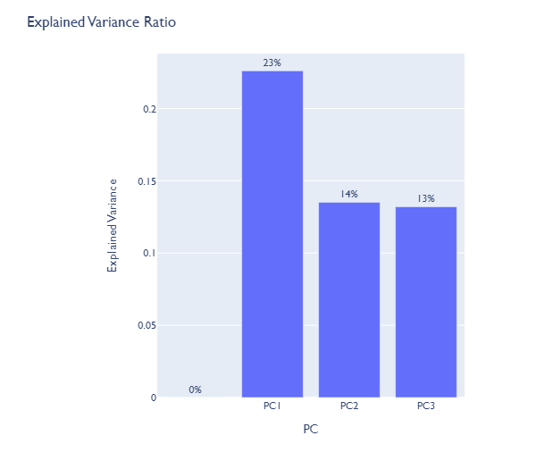
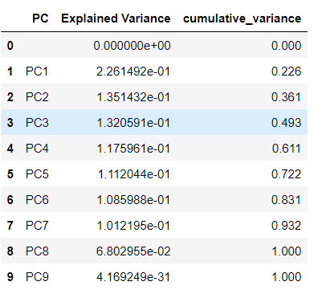
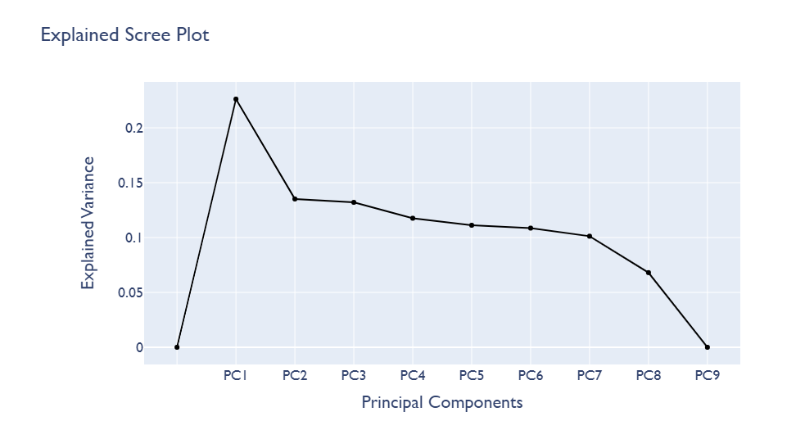
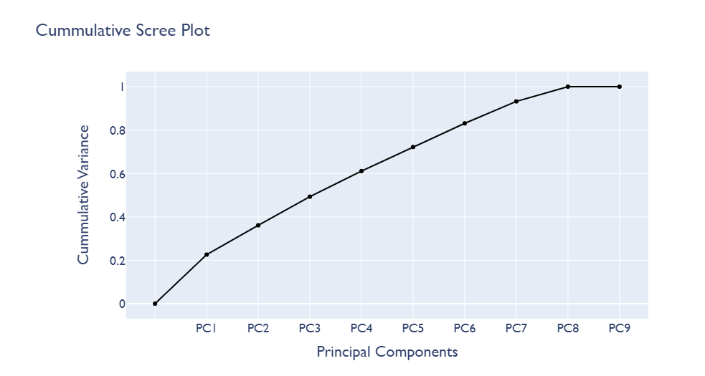
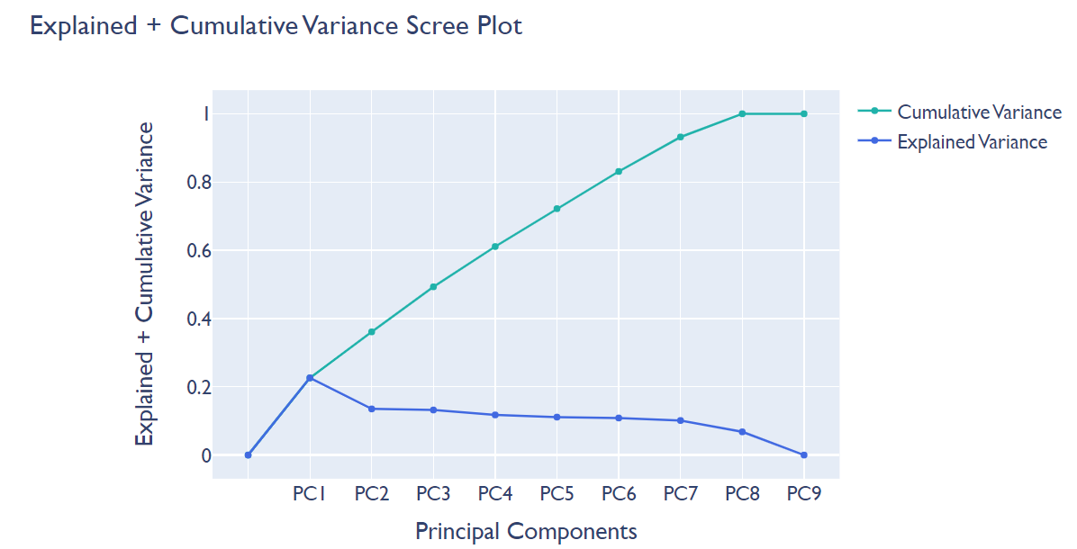
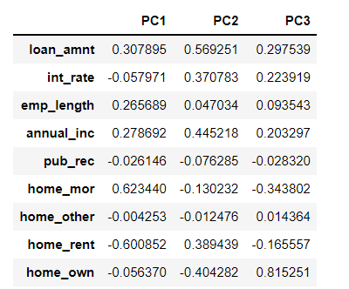
Task 1
A). Choose number of principal components
With this Explained variance ratio we can tell how much variance each principal component explains
PC1 contributed 23% overall variance of to the dataset
PC2 contributed 14% overall variance of to the dataset
PC3 contributed 13% overall variance of to the dataset
Only with this three PC we have accounted 50% explained variance of the dataset.
Explained and Cumulative Variance Ratio
Here we combined the Explained and cumulative variance to easily understand as following
The cumulative variance starts from 0 and goes to PC1’s explained variance which is same result.
Then cumulative variance will add roughly 14% to become 36%
Cumulative will add roughly 13% to become 50%.
We will get 100% finally.
From the three components we can understand the following
In the PC1 column int_rate, pub_rec, home_other, home_rent and home_own are negatively correlated to each other.
In the PC2 column pub_rec, home_mor,home_other ,home_own are negatively correlated to each other.
In the PC3 column pub_rec, home_mor and home_rent are negatively correlated to each other.

Slide 3
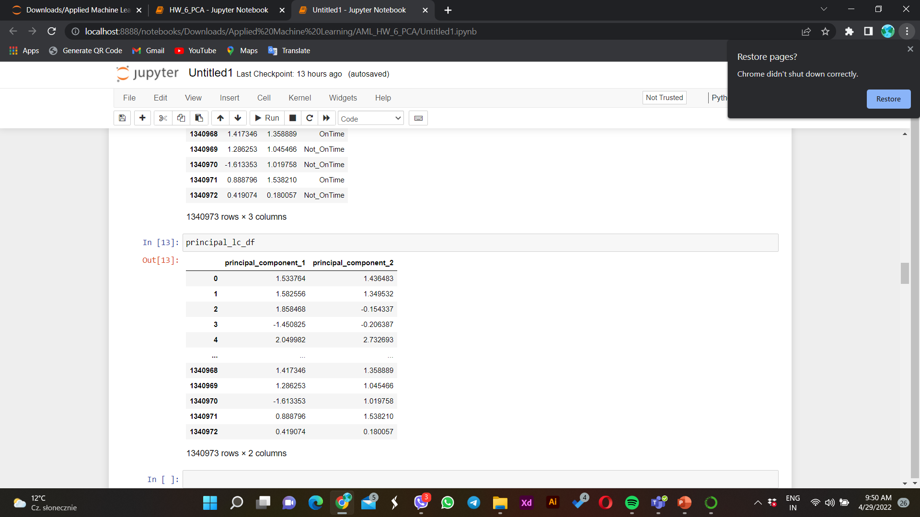
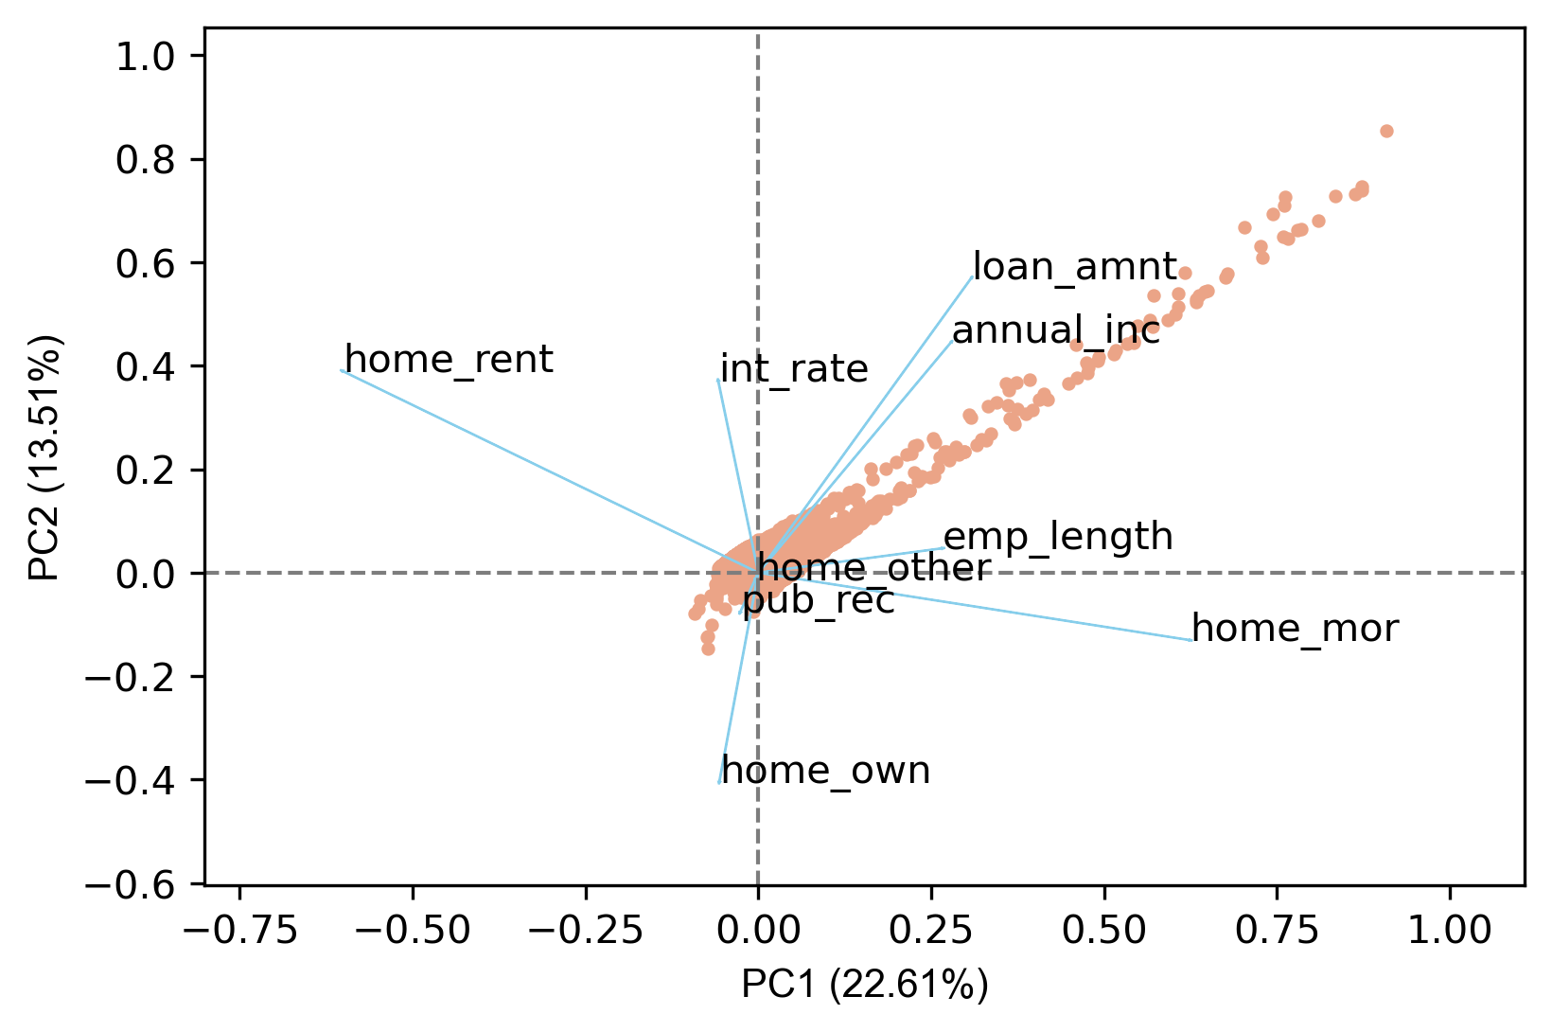
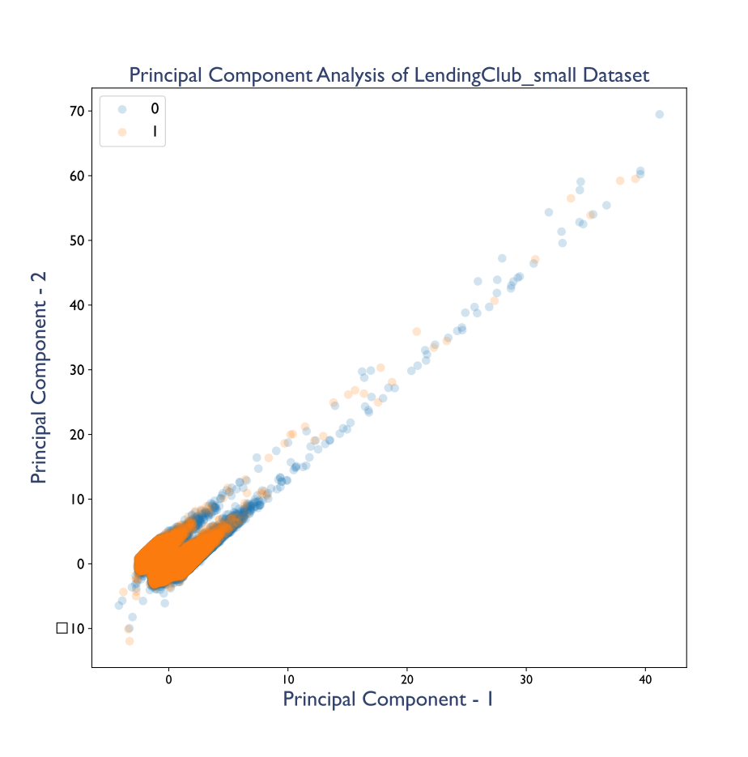
B). Create and Interpret biplot
Note:
From biplot we can get number of information such as the correlation of the variables and which variable affects the principal components
Task 1
Variables affecting PC
Visualize Principal Components
Interpret biplot
If the length of the variables is short(close to (0,0) axis) that means its not important variable.
If the variable is inclined to the PC, we can say that the variable is very strong on that PC.
Based on the above information we can say the following :
loan_amnt is growing with the growing PC2, In the other hand home_own is falling with PC2
Correlation between pairs of variables
If the angel between variables is 90 degree that means they are not correlated variables
If the angel between variables is less than 90 degrees that means the variables are highly correlated .
If the angel between variables is more than 90 degree that means the variables are negatively correlated also if the variables are pulling each other in opposite direction, that shows the variable are negatively correlated too.
Based on the above information we can say the following :
loan_amnt and annual_inc are highly correlated variables
home_mor and home_own varaiables are not correlated
home_rent and home_mor variables are negatively correlated

Slide 4
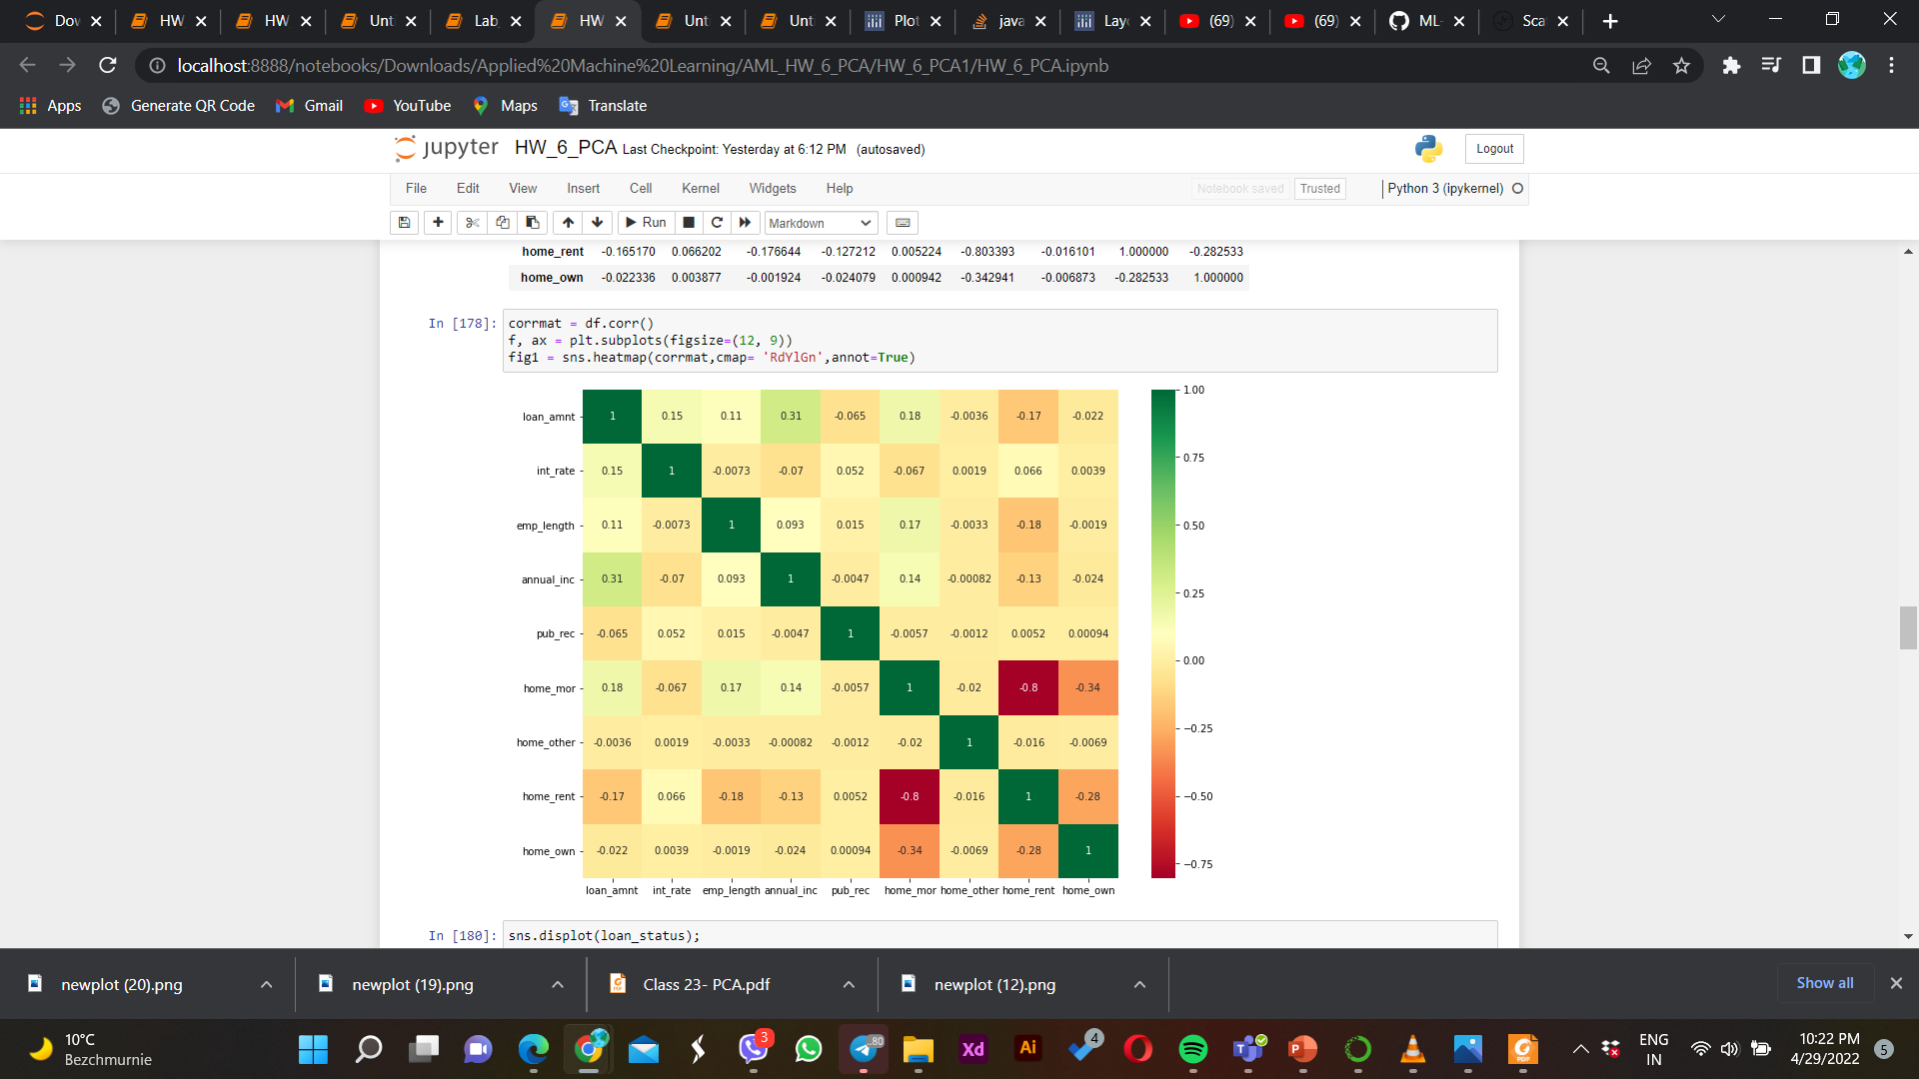
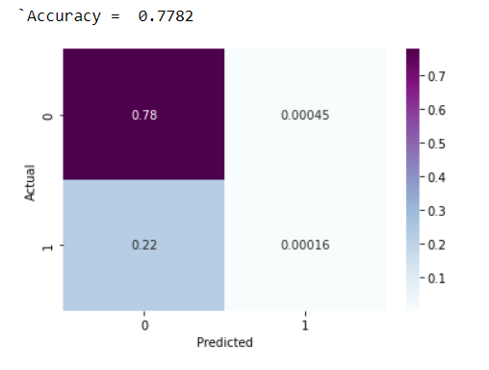
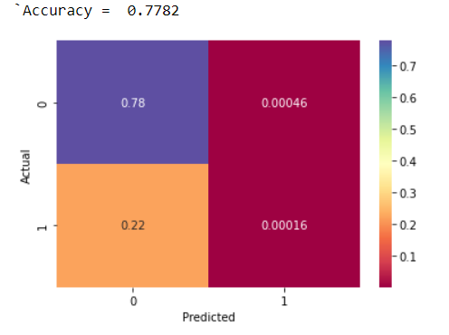
Task 2:
A). Compare Logistic regression model performance with and without PCA processing
Checking correlated features
Performance logistic regression of the model without PCA
Performance logistic regression of the model with PCA
Performance of the model without PCA |  | Performance of the model with PCA
Accuracy | 0.7782 | Accuracy | 0.7782
There is slight multicollinearity between home_rent and home_mor variables but we decided to keep them because
the collinearity is not high.
We tried to use different numbers of components while using PCA but we did not get higher accuracy by increasing the number of components it gets much lower.
Confusion matrix and the accuracies are almost the same for the Logistic regression model performance with and without PCA.

Slide 5
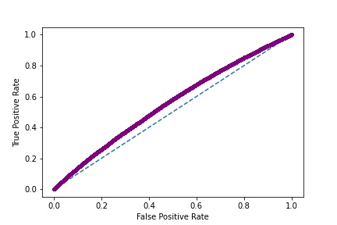
Task 3:
Choose threshold for PCA + logistic regression model using ROC
Analyzing
ROC Curve for model without PCA
Performance logistic regression of the model with PCA |  | Performance logistic regression of the model without PCA
Accuracy | 0.7782 | Accuracy | 0.7782
 |  | After ROC Curve
 |  | Thresholds | Accuracies
 |  | 0.2 | 0.5445
 |  | 0.5 | 0.7785
 |  | roc_auc_score | 0.5
Without PCA we got 0.7782 accuracy
With PCA we got 0.7782 accuracy
We choose 0.5 threshold for logistic regression model which data has not pre processed by PCA and we got 0.7785 accuracy.
Generally we can say that with and without performing PCA with 2 number of components, we have roughly similar accuracy which is 0.7785.

Slide 6

Thank You

