Slide 1

Applied Machine Learning
HW_2_classification_logit_HR_data
Group 02 - Alpha Team

Slide 2
State what parameters sign You Expect ?
No. | Parameters(Variables ) | Sign we expected. Positive(+), Negative(-) | Explanation
1 | satisfaction_level | - | More satisfaction level will decreases leaving the company.
2 | last_evaluation | + | If there is high evaluation it increases the likelihood of leaving the company
3 | number_project | - | The more the number of projects in the company the more employees leave the company.
4 | average_montly_hours | + | If this is high employees will increase the likelihood of leaving the company.
5 | time_spend_company
6 | Work_accident | - | If there is high work accident this will increase the likelihood of leaving the company.
7 | promotion_last_5years | - | If there is a high promotion in company the employees tends to stay.
8 | job_IT | - | More IT jobs will decrease the likelihood of leaving the company.
9 | job_RandD | - | More management jobs will decrease the likelihood of leaving the company.
10 | job_accounting | - | More management jobs will decrease the likelihood of leaving the company.
11 | job_hr | - | More management jobs will decrease the likelihood of leaving the company.
12 | job_management | - | More management jobs will decrease the likelihood of leaving the company.
13 | job_product_mng | - | More product mng jobs will decrease the likelihood of leaving the company.
14 | job_sales | - | More sales jobs will decrease the likelihood of leaving the company.
15 | job_support | - | More support jobs will decrease the likelihood of leaving the company.
16 | job_technical | - | More technical jobs will decrease the likelihood of leaving the company.
17 | salary_high | - | The more the high salary the more the employees to stay in the company.
18 | salary_low | + | Low salary will increase the likelihood of leaving the company.
Factors that decreases the likelihood of leaving the company
Factors that increases the likelihood of leaving the company
Factors that has no significance.
As mentioned above, highaverage_monthly hours can lead to the people leaving, because they can be exhausted easily without having enough time to rest.
Also high last_evaluation can frustrate people and lead them to leave the Company.

Slide 3
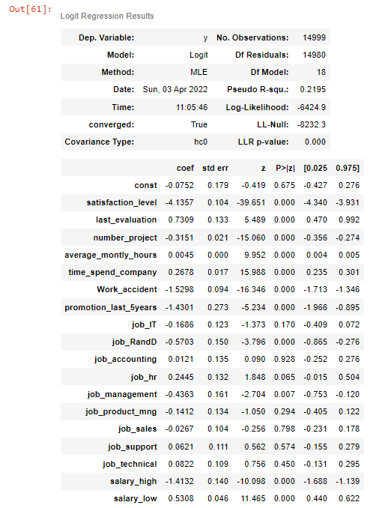
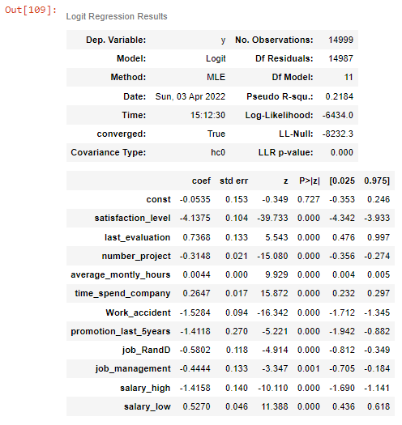
Initial model regression summary.
Final model regression summary after removing non-significant variables
Comments on our expectations bases on regression summary
Variables | Expected | Result
average_montly_hours | - | +
job_accounting | - | +
job_hr | - | +
job_support | - | +
job_technical | - | +
Reasons why we expected above signs
We were expecting average_montly_hours to have negative impact cause most people don’t want to work too much.
We simply guessed negative impact on all of the jobs cause we don’t have much information on the company, but except job_RandD and job_management the rest doesn't have significance.
time_spend_company have significance.
Beside our comments almost all the parameters(variables) of the final model are statistically significant.

Slide 4
Explain how you calculated the optimal threshold for classification?
Initially we have to approach the test and train method to keep almost same proportion of categories, in our case its 0’s and 1’s.
Summarized procedures are below:
Define the test and train set and split into train and test sets.
Define the model using logistic regression
Fit the model on the training dataset
Calculate the confusion matrix
Get Accuracy
Improve the model by using ROC curves to get thresholds
Predict probabilities and apply to the test data

Slide 5
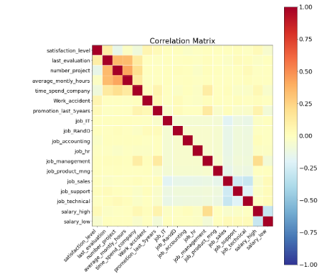
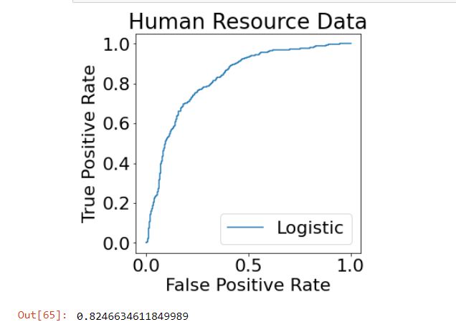
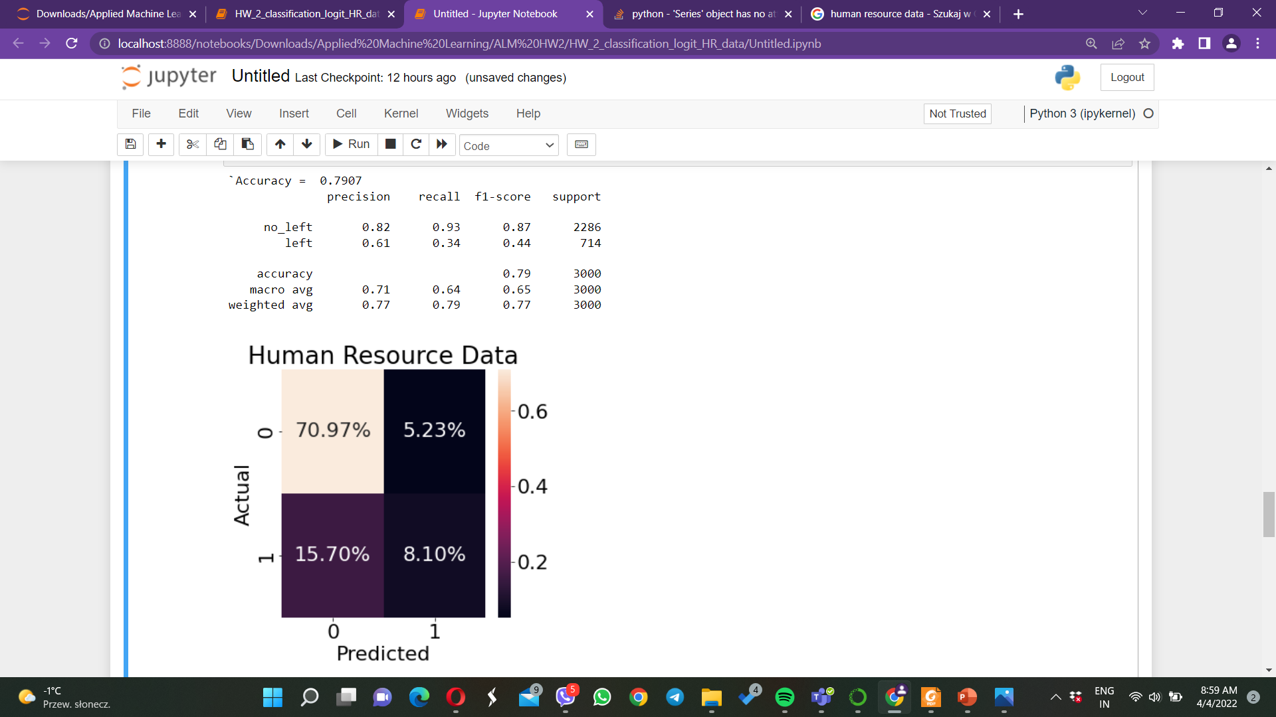
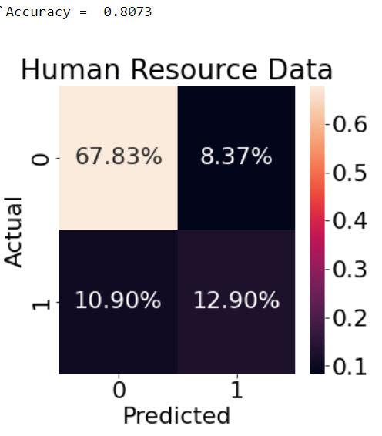
Graphical Representations
Correlation matrix heatmap
ROC curve
Classification Report & Confusion Matrix.
With 0.5 threshold
To summarize
After 0.4 threshold
Our base model in the test observation was 0.238, after
some calculation the result become 0.7907. So this
means we improved our model by almost 5%.
True Positive Rate: when its actually yes, how often does it predict yes?
TP/actual yes = 8.1/15.7+8.1 = 0.34
Also know as “Sensitivity” or “Recall”
False Positive Rate: when its actually no, how often does it predict yes?
FP/actual no = 70.97/70.97+5.23=0.93
True Negative Rate: when its actually no, how often does it predict no?
TN/actual no = 100/110 = 0.61
Equivalent to 1 minus False Positive Rate
Also know as “Specificity”

Slide 6

Thank You

