Slide 1

Applied Machine Learning
HW_4_RF_Boosting
Group 02 - Alpha Team

Slide 2
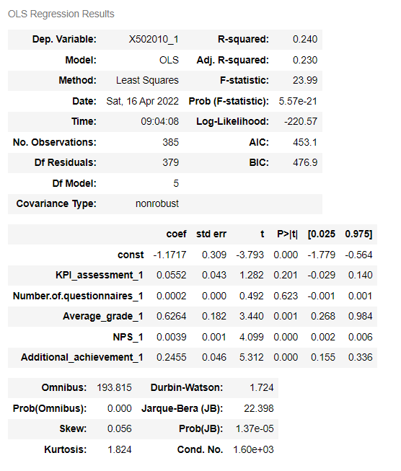


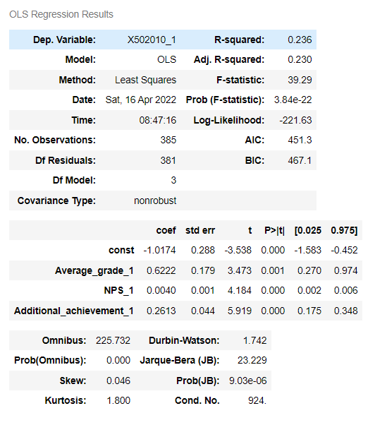
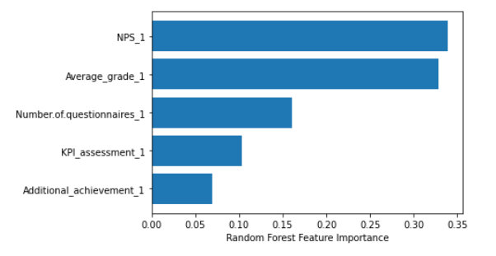
Checking Significance of variables Using OLS Regression
Initial Model
Adjusted Model
Comments on the models
The log-likelihood for the initial model is higher.
On the adjusted model even if keeping the most less significant variable which is KPI_assessment the log-likelihood gets lower.
No difference in the Adj-R-squared
Based on this we decided to perform Random Forest on the initial model
Analyze Variable Importance
We don’t have big tree but NPS_1 is most important variable.

Slide 3
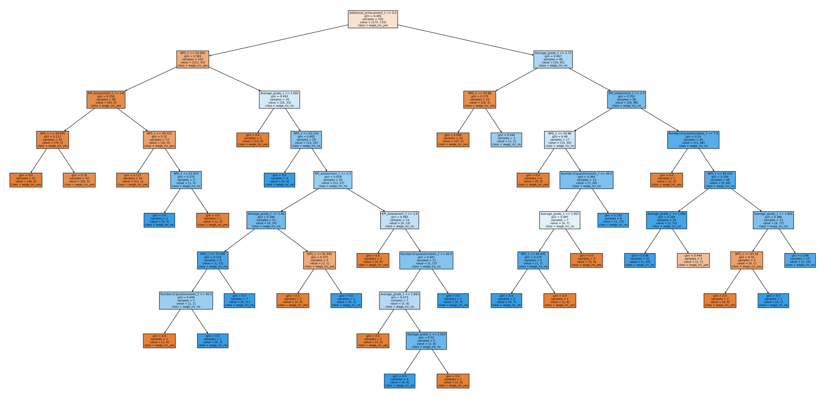
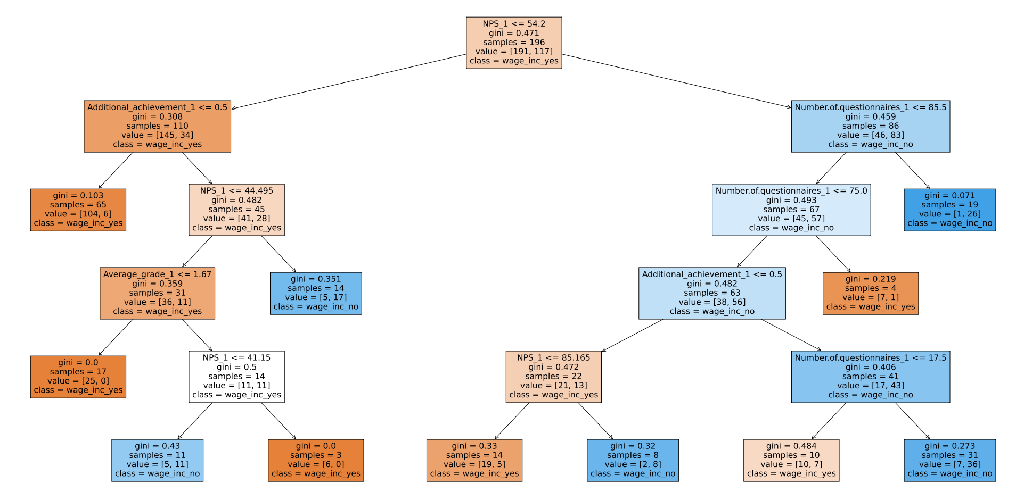
Random forest to forecast and to calculating test set accuracy
Before Cross Validation
After Cross Validation
Random Forest | Parameters Description
Random Forest Accuracy | 0.73
parameters | max_depth=None n_estimators=200 random_state=200 ccp_alpha=0 bootstrap = True
Random Forest | Parameters Description
Random Forest Accuracy | 0.73
parameters | max_depth=80 n_estimators=100 random_state=3 ccp_alpha=0.01 bootstrap = True
Random Forest Accuracy: 0.7273

Slide 4
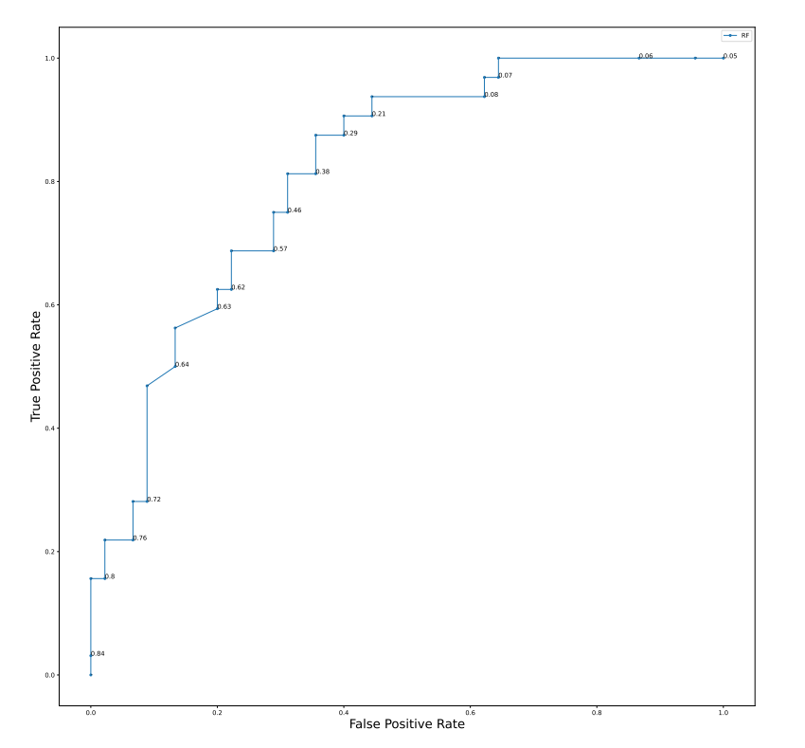
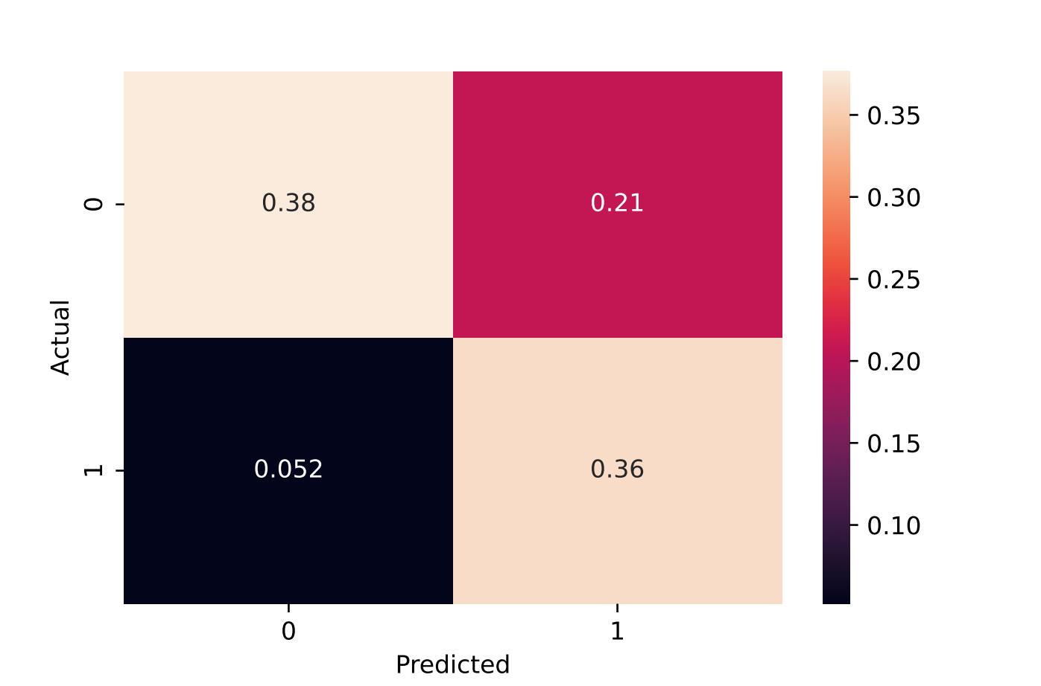
ROC Curve and Confusion Matrix for Cross-validated Random Forest model |  | Confusion of matrix After Accuracy
Threshold | 0.5 | Threshold | 0.3
Accuracy | 0.73 | Accuracy | 0.74
Summery
We got same accuracies After performing with and with out cross validating, with the listed parameters for the model, which is 0.73.
We calculated the ROC curve and confusion matrix and got 0.74 accuracy using 0.3.
From this we can understand that using the ROC curve with 0.3 threshold we can get higher accuracy.

Slide 5
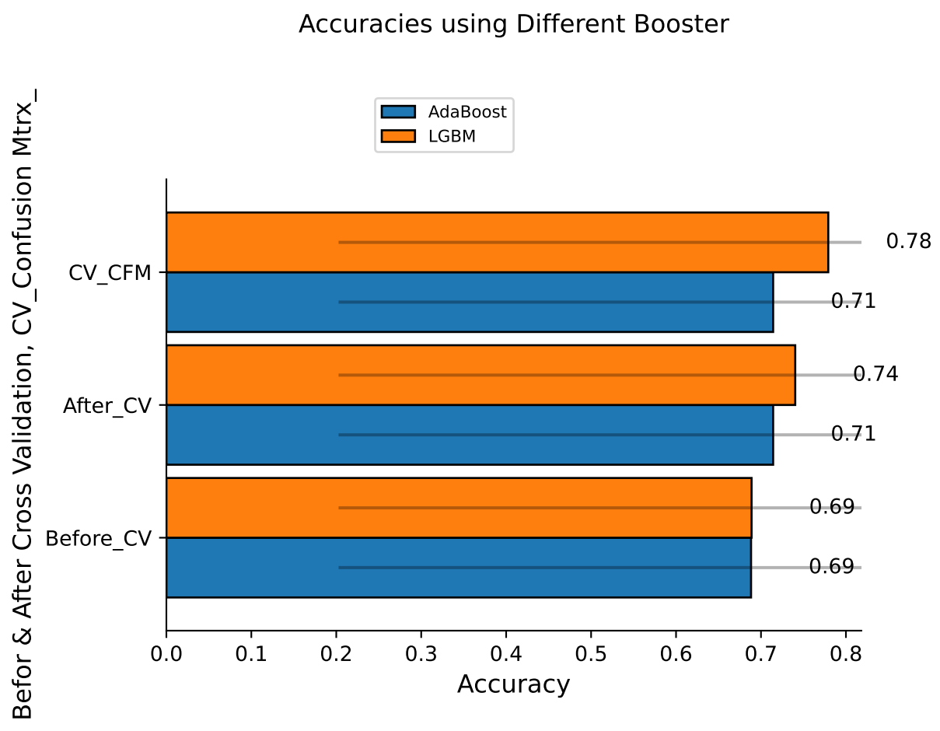
Tabular & Graphical presentation for two of the Boosting classifiers(Light GBM and AdaBoost)
Before Cross Validation
After Cross Validation
ROC and Threshold For Cross Validated
LGBM | Accuracy | Parameters
 | 0.69 | max_depth= -1 n_estimators= 100 random_state= None
AdaBoost | 0.69 | n_estimators = 200 random_state = 123 learning_rate = 0.1
LGBM | Accuracy | Parameters
 | 0.74 | max_depth = 2 n_estimators = 200 random_state = None
AdaBoost | 0.71 | n_estimators = 200 random_state = 200 learning_rate = 0.1
LGBM | Accuracy | Threshold | roc_auc_score
 | 0.78 | 0.6 | 0.83
AdaBoost | 0.71 | 0.5 | 0.79
Graphical Presentation
Summery
For Random Forest we used boosting classifiers like, Light GBM and AdaBoost.
Based on this, the model has the following properties:-
Performing the above boosting classifiers before cross validating the model, we got 0.69 accuracy for both classifiers.
With the listed parameters, we performed the cross validation and we got 0.74 and 0.71 accuracies respectively.
We calculated the ROC curve to get better accuracies and we got 0.78 for 0.6 threshold for LGBM and for AdaBoost we got 0.71 accuracy using 0.5 threshold.
The roc_auc_score becomes 0.83 and 0.79 respectively.
From this information we can understand that the model can have high accuracy when we use cross validated LGBM boosting classifiers with 0.6 threshold.

Slide 6

Thank You

