Slide 1

Applied Machine Learning
AML_HW_5_clustering
Group 02 - Alpha Team

Slide 2
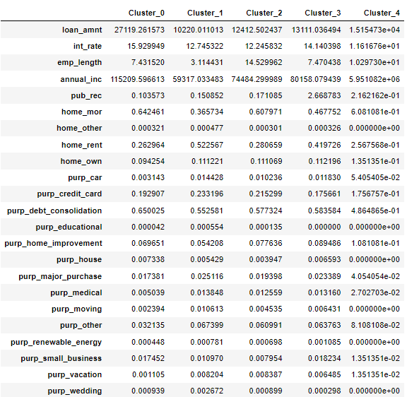
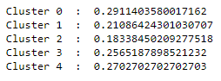
Number of Cluster = 5
Features with high value for Bad cluster(cluster_0) comparing with Good cluster(cluster_2)
Bad Cluster
Good Cluster
Summery
People who have high loan_amnt are found in bad cluster (cluster_0).
 | Values | High Features | Values
Bad Cluster | 27119.26 | loan_amnt | 12412.50 | Good Cluster
 | 15.92% | int_rate | 12.24%
 | 115209.59 | annual_inc | 74484.29
 | 0.642% | home_mor | 0.60%
 | 0.00032% | home_other | 0.00030%
 | 0.65% | purp_debt_consolidation | 0.577%
 | 0.007% | purp_house | 0.0039%
 | 0.017% | purp_small_business | 0.007%
 | 0.00093 | purp_wedding | 0.00089%
Bad Cluster | Good Cluster
0.291 | 0.183

Slide 3
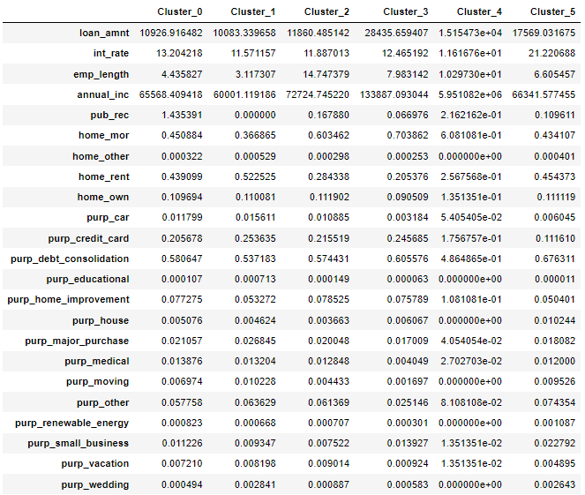
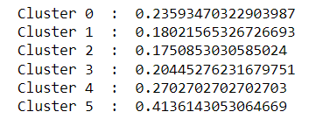
Number of Cluster = 6
Features with high value for Bad cluster(cluster_5) comparing with Good cluster(cluster_2)
Good Cluster
Bad Cluster
Summery
People who have high loan_amnt are found in bad cluster (cluster_5).
 | Values | High Features | Values
Bad Cluster | 17569.03 | loan_amnt | 11860.4 | Good Cluster
 | 21.2% | int_rate | 11.8%
 | 0.00040% | home_other | 0.00029%
 | 0.45% | home_rent | 0.28%
 | 0.67% | purp_debt_consolidation | 0.57%
 | 0.01% | purp_house | 0.003%
 | 0.0095% | purp_moving | 0.004%
 | 0.074% | purp_other | 0.061%
 | 0.001% | purp_renewable_energy | 0.0007%
 | 0.022% | purp_small_business | 0.007%
 | 0.0026% | purp_wedding | 0.0008%
Bad Cluster | Good Cluster
0.413 | 0.175

Slide 4
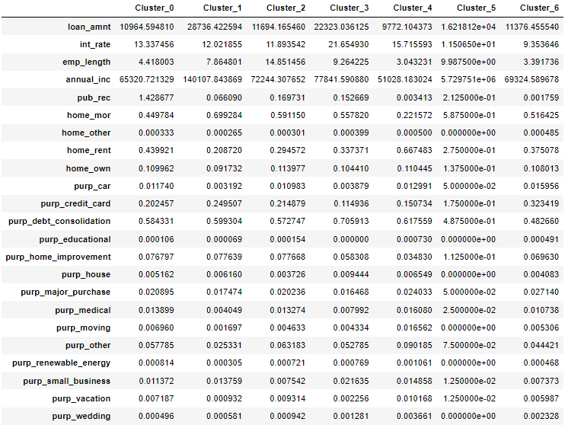
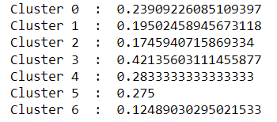
Number of Cluster = 7
Features with high value for Bad cluster(cluster_3) comparing with Good cluster(cluster_6)
Bad Cluster
Good Cluster
Summery
People who have high loan_amnt are found in bad cluster (cluster_3).
 | Values | High Features | Values
Bad Cluster | 22323.03 | loan_amnt | 11376.45 | Good Cluster
 | 21.65% | int_rate | 9.35%
 | 9.26% | emp_length | 3.39%
 | 77841.59 | annual_inc | 69324.58
 | 0.15% | pub_rec | 0.001%
 | 0.55% | home_mor | 0.51%
 | 0.70% | purp_debt_consolidation | 0.482%
 | 0.009% | purp_house | 0.004%
 | 0.052% | purp_other | 0.044%
 | 0.00076% | purp_renewable_energy | 0.00046%
Bad Cluster | Good Cluster
0.421 | 0.124

Slide 5
Note
Analyzing
we performed K-means with three different
number of clusters and we tried to compare
bad and good clusters, for our case we focused on
what kind of features are causing bad cluster, so
that we can easily tell people having such kind of
features will led them to bad or good.
Cluster 1
Number of Cluster = 5
 | Values | High Features | Values
Bad Cluster | 27119.26 | loan_amnt | 12412.50 | Good Cluster
 | 15.92% | int_rate | 12.24%
 | 115209.59 | annual_inc | 74484.29
 | 0.642% | home_mor | 0.60%
 | 0.00032% | home_other | 0.00030%
 | 0.65% | purp_debt_consolidation | 0.577%
 | 0.007% | purp_house | 0.0039%
 | 0.017% | purp_small_business | 0.007%
 | 0.00093 | purp_wedding | 0.00089%
Cluster 3
Feature Differences
Number of Cluster = 7
Following features have high value in three of clusters
  purp_debt_consolidation
  purp_house
  Int_rate
Features most occurred in three of clusters
  purp_small_business
  purp_wedding
  purp_renewable_energy
Features are least occurred in three of clusters
  home_rent
  home_other
  purp_other
Bad Cluster | Good Cluster
0.291 | 0.183
 | Values | High Features | Values
Bad Cluster | 22323.03 | loan_amnt | 11376.45 | Good Cluster
 | 21.65% | int_rate | 9.35%
 | 9.26% | emp_length | 3.39%
 | 77841.59 | annual_inc | 69324.58
 | 0.15% | pub_rec | 0.001%
 | 0.55% | home_mor | 0.51%
 | 0.70% | purp_debt_consolidation | 0.482%
 | 0.009% | purp_house | 0.004%
 | 0.052% | purp_other | 0.044%
 | 0.00076% | purp_renewable_energy | 0.00046%
Cluster 2
Number of Cluster = 6
 | Values | High Features | Values
Bad Cluster | 17569.03 | loan_amnt | 11860.4 | Good Cluster
 | 21.2% | int_rate | 11.8%
 | 0.00040% | home_other | 0.00029%
 | 0.45% | home_rent | 0.28%
 | 0.67% | purp_debt_consolidation | 0.57%
 | 0.01% | purp_house | 0.003%
 | 0.0095% | purp_moving | 0.004%
 | 0.074% | purp_other | 0.061%
 | 0.001% | purp_renewable_energy | 0.0007%
 | 0.022% | purp_small_business | 0.007%
 | 0.0026% | purp_wedding | 0.0008%
Bad Cluster | Good Cluster
0.421 | 0.124
Conclusion
So, we can say that, people with high value in these feature, they tends to default.
Bad Cluster | Good Cluster
0.413 | 0.175

Slide 6

Thank You

