Slide 1

Applied Machine Learning
AML_final_project on RMP dataset
Group 02 - Alpha Team

Slide 2
Objectives
Using RMP(ratemyprofessor.com) dataset extracting useful knowledge
We are going to use our own labels which in our opinion, these labels are fit to extract “Effective teaching and learning” from the students review
Train two zero-shot classifications based on the dataset
Compare these two models result using cross-tabulation

Slide 3

In our opinion with these the selected labels, we can extract the information about “Effective teaching and learning”.
Based on information we got “good instructors have several qualities in common. They are prepared, set clear and fair expectations, have a positive attitude, are patient with students, and assess their teaching on a regular basis. They are able to adjust their teaching strategies to fit both the students and the material, recognizing that different students learn in different ways” and detailed information about “Effective teaching and learning” from https://education.ky.gov/curriculum/standards/teachtools/Pages/Characteristics-of-Highly-Effective-Teaching-and-Learning-(CHETL).aspx#:~:text=effectively%20allocates%20time%20for%20students,a%20natural%20part%20of%20learning.
We selected three labels regarding the course and three labels regarding the professor.
Labels
Labels
"show up to class room on time or never misses class"
Regarding
"strong knowledge and solid education or patient and caring"
Professor
Labels
"encourages the students to question"
Regarding
"using real world example or exercises real world problems"
Course
"clear or sufficient syllabus"
"course have useful topics or updated topics"

Slide 4

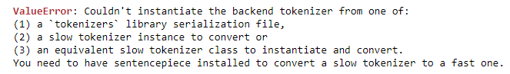

Choosing two zero-shot classification models from huggingface
From zero-shot classification section we chose two models
valhalla/distilbart-mnli-12-1
Narsil/deberta-large-mnli-zero-cls
Most models we tried were not compatible, errors below

Slide 5
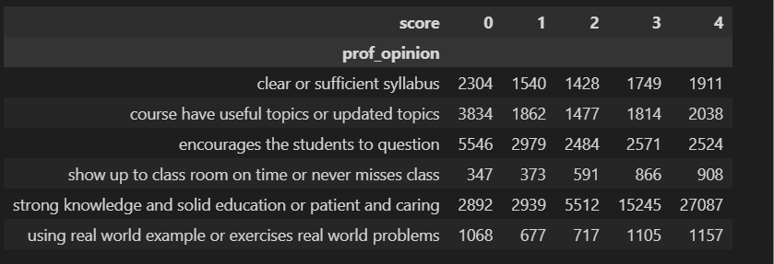
Comments on the result both regarding Professor and course labels using valhalla/distilbart-mnli-12-1 model
After training the dataset we got the cross-tabulation
Comments on the result, labels regarding to the professors
Comments on the result, labels regarding to the course
If a professor have a “strong knowledge and solid education or patient and caring” students tends to give score of 4.
When ever the professor “show up to class room on time or never misses class” most student gives these professors high score
Interesting part we found is if a professor “encourages the students to question” students tends to give 0 score.
If a course have a “clear or sufficient syllabus” students tends to give score of 0.
If the course is all about “using real world examples or exercises real world problems” students give this course high score and also almost same amount of students don’t want to use “real world examples or exercises real world problems” in a course.
Courses which have “useful topics or updated topics” are given 0 score.

Slide 6
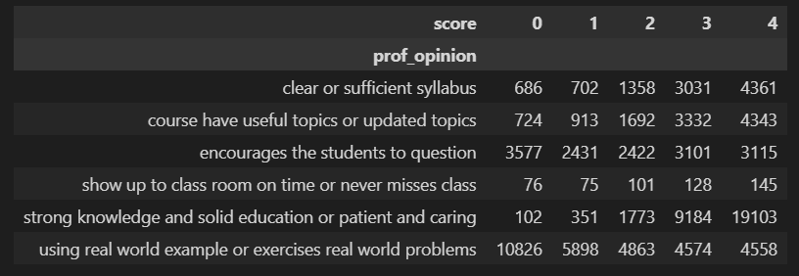
Comments on the result both regarding Professor and course labels using Narsil/deberta-large-mnli-zero-cls model
After training the dataset we got the cross-tabulation
Comments on the result regarding to the professors
Comments on the result, regarding to the course
If a professor have a “strong knowledge and solid education or patient and caring” students tends to give score of 4.
When ever the professor “show up to class room on time or never misses class” most student gives these professors high score of 4.
Interesting part we found is if a professor “encourages the students to question” students tends to give 0 score.
If a course have a “clear or sufficient syllabus” students tends to give score of 4.
If the course is all about “using real world examples or exercises real world problems” students give this course low score and
Courses which have “useful topics or updated topics” are given 4 score.

Slide 7
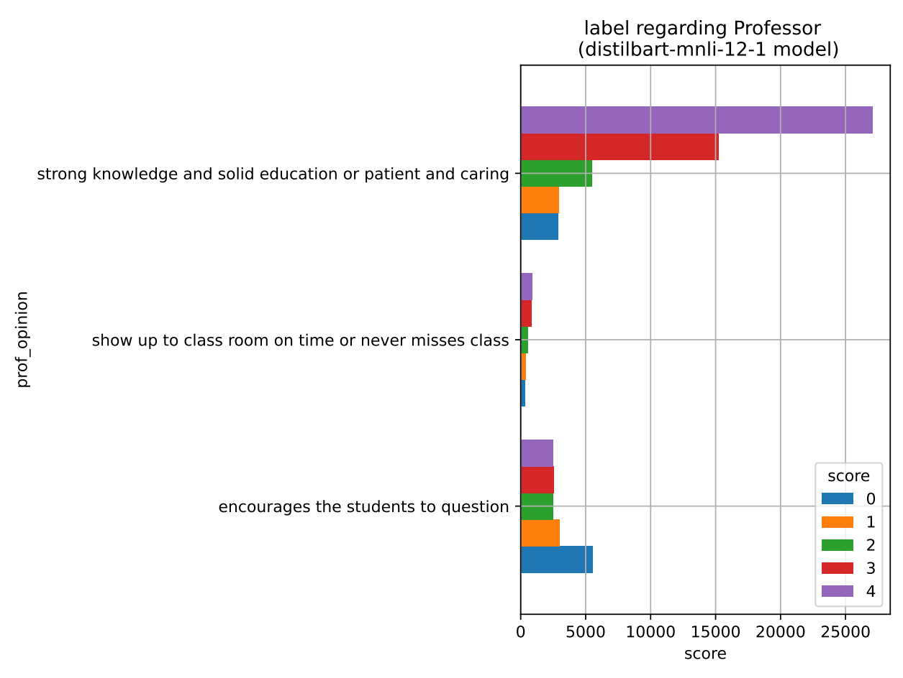
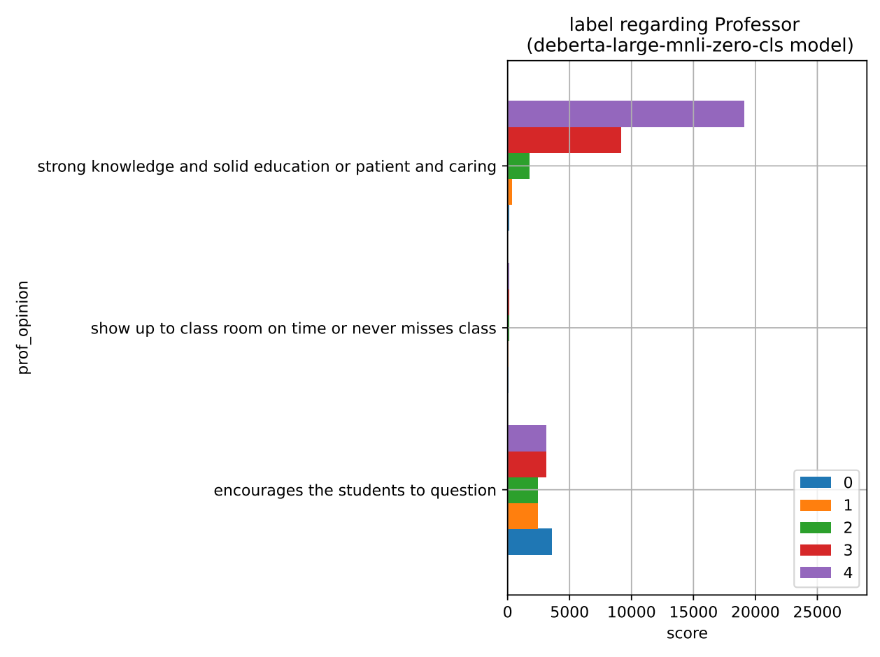
Data Visualization
"show up to class room on time or never misses class"
"strong knowledge and solid education or patient and caring"
Labels regarding professor
"strong knowledge and solid education or patient and caring"
"encourages the students to question"
Using valhalla/distilbart-mnli-12-1 model
Using Narsil/deberta-large-mnli-zero-cls model

Slide 8
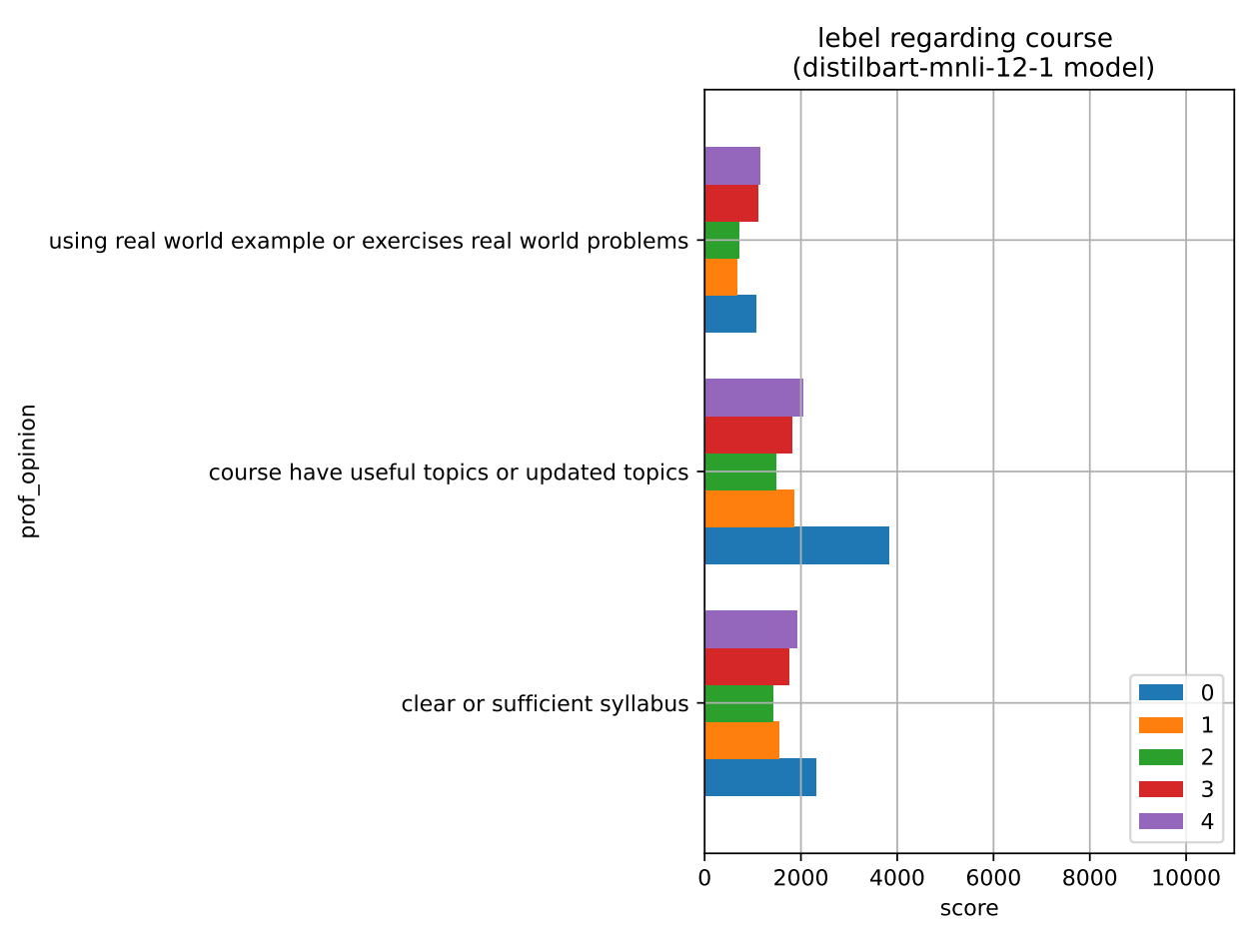
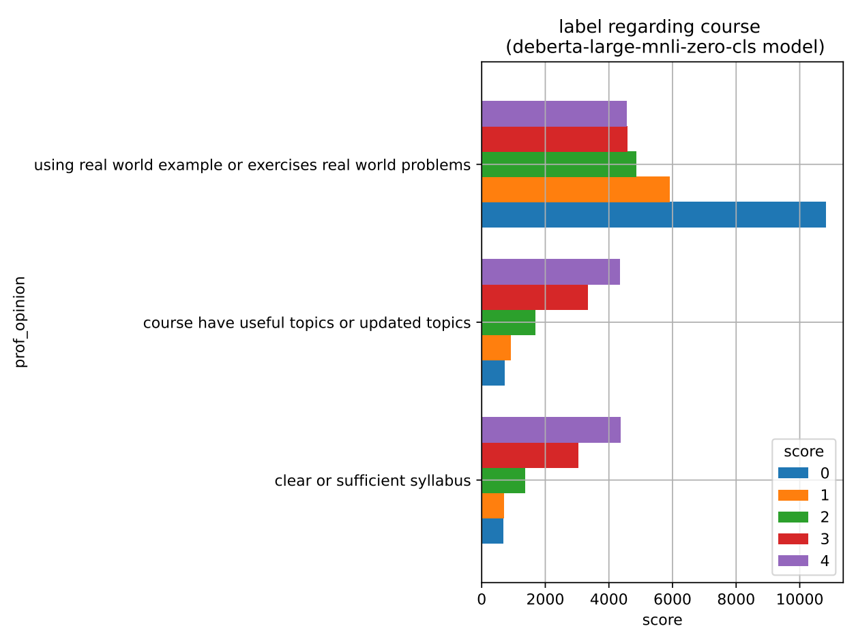
Data Visualization
"using real world example or exercises real world problems"
"clear or sufficient syllabus"
Labels regarding course
"course have useful topics or updated topics"
Using valhalla/distilbart-mnli-12-1 model
Using Narsil/deberta-large-mnli-zero-cls model

Slide 9

Conclusion
On both models we have observed that the results regarding to the professor labels, are almost similar.
A professor with “strong knowledge and solid education or patient and caring” characteristics receives high rating score.
A professor who “encourages the students to question ” receives lowest rating score.
A professor who “show up to class room on time or never misses class” (this label doesn't have that much significance comparing to others), even though with a little review from student a professor still gets high rating score.
On both models we observed that the results regarding to the course, are completely different which is hard to conclude.
We can guess that students don’t preferer a course which is all about “using real world examples or exercises real world problems” cause in both model students tends to give this course lowest rating score.
For other labels its really hard to conclude, because they have totally different results.
From this conclusion, university’s management department can hire a professor who is (have) “strong knowledge and solid education or patient and caring” and who can “show up to class room on time or never misses class” and also by discussing with professors to reduce “encourages the students to question”, it might be finding another solution to interact with students, they can improve the effectiveness of teaching and learning system.
Based on Narsil/deberta-large-mnli-zero-cls model if professors have “clear or sufficient syllabus” and try to conduct another way of “using real world examples or exercises real world problems” and have “useful topics or updated topics”. This leads to effective teaching and learning system.
Model | Performance (Time)
valhalla/distilbart-mnli-12-1 model | 3:20 hours
Narsil/deberta-large-mnli-zero-cls model | 5:38 hours

Slide 10

Thank You

