Slide 1
Who Am I & Who Is the Client?
Role: Data Science Undergraduate Student
Client: Erin Robinson
Socially responsible real-estate investor
Goal: Improve housing quality without luxury-driven gentrification
Notes:
I introduce myself as a data science undergraduate and frame the problem from a client perspective. The goal is to apply data analysis to a real-world business and social problem, not just explore the dataset.

Slide 2
Dataset Description
Dataset: King County Housing Data
Location: Seattle & surrounding King County areas
Size: ~21,000 house sales
Time span: Multiple years of recorded transactions
Notes:
This slide explains the scope of the data: where it comes from, how large it is, and the geographic and temporal context. This helps justify whether conclusions are generalizable.

Slide 3
Data Overview
Target variable: House price
Key features: size, condition, location, renovation status
Mostly numerical variables with minimal missing data
0 values in renovation year treated as not renovated
Notes:
Here I summarize the structure of the dataset, key variables, and how missing values were handled. Treating yr_renovated = 0 as missing avoids misinterpretation.

Slide 4
Research Questions & Hypotheses
H1: Poor-condition houses offer strong renovation leverage
H2: Some zipcodes are undervalued despite similar house characteristics
H3: Latitude & longitude reveal undervalued housing areas away from Seattle center.
Notes:
These hypotheses guide the exploratory analysis. Each hypothesis is tested using visual and descriptive statistics rather than predictive modeling.

Slide 5
Data Cleaning
Missing Values df.isna().sum() yr_renovated == 0 → Not renovated (keep)
No big reason to drop rows unless critical fields missing
id 0
bedrooms 0
bathrooms 0
sqft_living 0
sqft_lo 0
floors 0
waterfront 2391
view 63
condition 0
grade 0
sqft_above 0
sqft_basement 452
yr_built 0
yr_renovated 3848
zipcode 0
lat 0
long 0
sqft_living15 0
sqft_lot15 0
date 0
price 0
dtype: int64

Slide 6
Remove Obvious Outliers
Extremely large houses are not relevant for this client. df = df[df['price'] < 2_000_000] df = df[df['sqft_living'] < 6000] df['yr_renovated'] = df['yr_renovated'].replace(0, np.nan)
5–7% of data removed (mostly luxury properties)

Slide 7
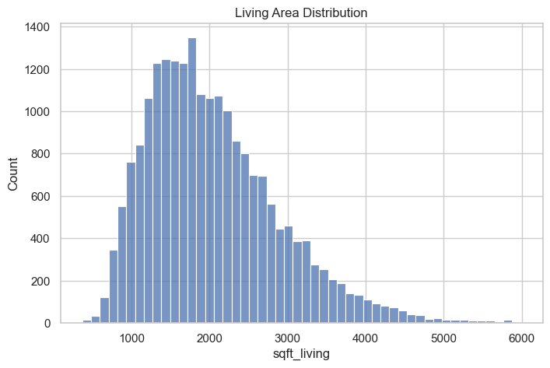
Observation:
Typical homes: 1,000–2,500 sqft
Large mansions are mostly excluded → filtered out

Slide 8
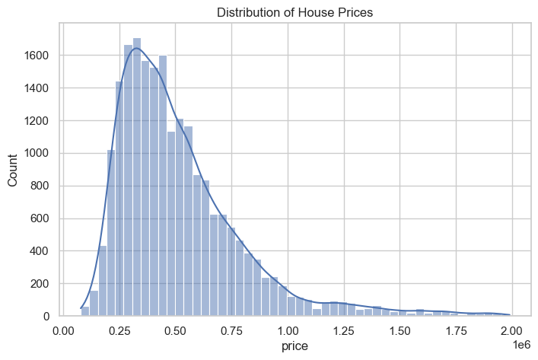
Exploring Distributions
Target Variable – Price
Observation:
Strong right skew
Majority of homes priced below approx.$750 000
Suitable for value-based investing

Slide 9
Price comparison: renovated vs not renovated renovated = df[df['yr_renovated'].notna()]['price'] not_renovated = df[df['yr_renovated'].isna()]['price'] renovated.mean(), not_renovated.mean()
(np.float64(685485.3668061367), np.float64(511673.4697931302))

Slide 10
Renovated vs Non‑Renovated Houses
Notes:
Updated Hypothesis 3 to match the visualization.
H3: Renovated houses sell for higher prices than non‑renovated houses, showing that quality improvements add value without relying on luxury locations.
The bar chart clearly shows a higher average price for renovated homes, supporting this hypothesis.

Slide 11
Renovated vs Non‑Renovated Houses
Renovated houses sell for substantially higher prices
Distance-based affordability does not imply poor housing quality
Notes:
Updated Hypothesis 3 to match the visualization.
H3: Renovated houses sell for higher prices than non‑renovated houses, showing that quality improvements add value without relying on luxury locations.
The bar chart clearly shows a higher average price for renovated homes, supporting this hypothesis.

Slide 12
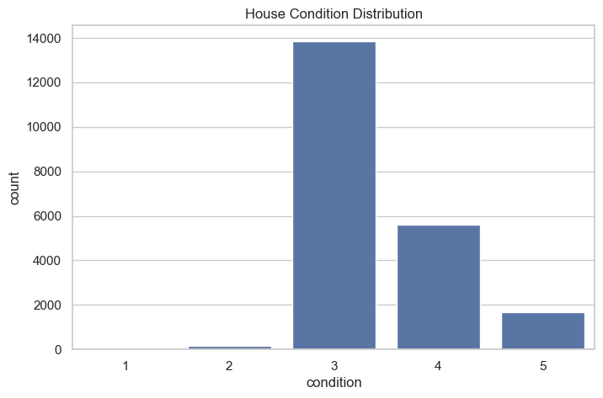
Observation:
Most houses rated 3 (average)
Few of them in very poor or excellent condition one can see a good Opportunity to upgrade house condition cheaply

Slide 13
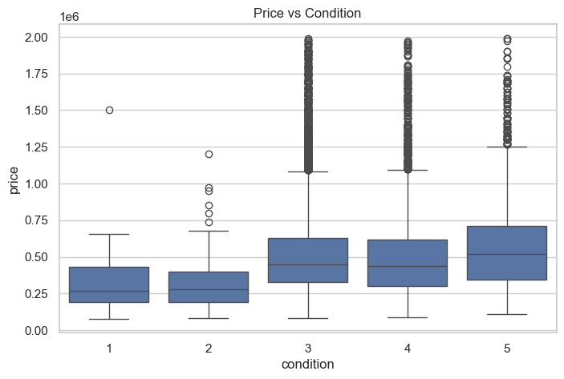
Hypothesis Analysis
Condition vs Price
Insight:
Price does not rise sharply with condition
Renovations can increase resale value more than cost

Slide 14
H1 Result: Average Price by House Condition
Notes:
This chart shows average prices by condition. Prices do not increase linearly with condition, indicating potential renovation leverage.

Slide 15
H1 Interpretation
House condition has a weak relationship with price
Price differences are small compared to renovation costs
Supports Hypothesis 1 (renovation leverage exists)
Notes:
This interpretation connects the visual result directly back to Hypothesis 1 and explains why it matters for investment decisions.

Slide 16
Zipcode-Level Pricing zip_price = df.groupby('zipcode')['price'].median().sort_values() zip_price.head(10)
Insight:
Some zipcodes are consistently undervalued
Ideal for socially responsible investing
Zipcode

Slide 17
H2 Result: Undervalued Zipcodes (Median Price)
Notes:
This slide highlights zipcodes with the lowest median prices, suggesting undervalued neighborhoods after controlling for basic characteristics.

Slide 18
H2 Interpretation
Several zipcodes show significantly lower median prices
Price differences not fully explained by house quality
Supports Hypothesis 2 (location effects are strong)
Notes:
This supports Hypothesis 2 by showing that location plays a strong role in pricing beyond physical house features.

Slide 19
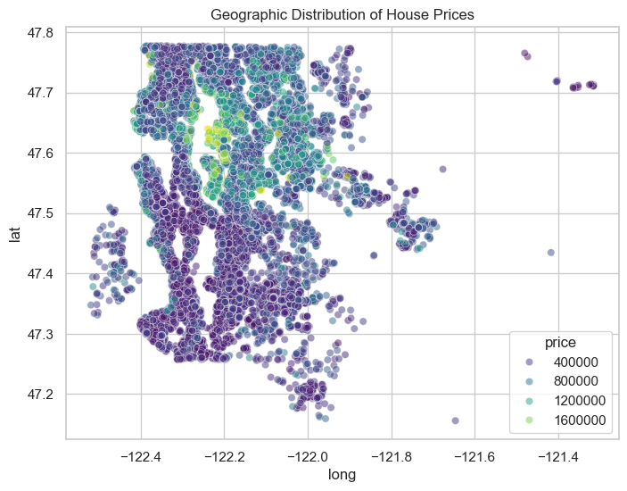
Geographical Insight: Supports Hypothesis 3
Lower prices cluster south & southeast of Seattle
These areas still have:
1.Similar house sizes
2.Comparable conditions
3.Best locations for ethical flipping

Slide 20
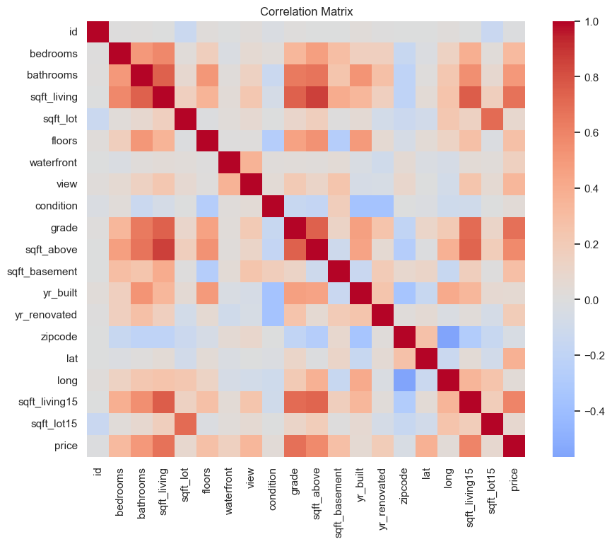
Key Findings:
sqft_living ↔ price → strong positive
grade ↔ price → very strong
condition ↔ price → weak
→ Condition upgrades = cheap leverage

Slide 21
Correlation Matrix (Key Variables)
Notes:
This slide summarizes correlations between key variables and house price.
Sqft_living and grade show strong positive correlations, meaning larger and higher-quality homes tend to be more expensive.
Condition shows a weak correlation, which supports the idea that improving condition through renovation can increase value without large upfront costs.
Correlation does not imply causation; this is exploratory analysis.

Slide 22
Key Findings:
sqft_living ↔ price → strong positive
grade ↔ price → very strong
condition ↔ price → weak
→ Condition upgrades = cheap leverage

Slide 23
Insights for the Client
Renovation provides measurable financial uplift
Zipcode selection is more important than house condition
Southern King County presents ethical investment opportunities
Notes:
This slide translates data findings into high-level insights that are useful for decision-making rather than technical analysis.

Slide 24
Recommendations
Target homes in condition 2–3
Focus on 1,200–2,500 sqft houses
Prioritize undervalued southern zipcodes
Avoid luxury renovations and waterfront properties
Notes:
These recommendations directly follow from the EDA results and align with the client’s social responsibility goals.

Slide 25
Conclusion
EDA supports all three hypotheses
Data-driven strategy aligns profitability with social impact
Further modeling could improve investment predictions
Notes:
The conclusion summarizes findings, reiterates hypothesis support, and acknowledges that further modeling could strengthen results.

