Slide 1

UK Road Safety Vehicle Dataset Analysis (2020 - 2024)
Group 5 : Big Data Module
Names: Iyenoma Goodnews Osabuohien, Tharsana Kanakarasa, Chukwuemeka Ohiaeri, Ahanaf Pervez
Notes:
Introduce the project and the 2020–2024 period. Each row is a vehicle involved in a police-reported personal-injury collision.

Slide 2

Dataset Scope and Research Questions
Source: DfT Road Safety Open Data – GOV.UK
Scope: 2020–2024 | 920,692 rows | 32 columns
Unit: one vehicle involved in a police-reported personal-injury collision
Questions
1. Which vehicle and driver groups dominate?
2. How did counts and composition change?
3. What patterns appear for e-scooters and multi- vehicle collisions?
4. Is data completeness stable by year?
KINDLY FIND THE GOOGLE COLAB LINK FOR DATASET ANALYSIS:
Google Colab – Dataset Analysis
Notes:
Explain the unit of analysis before the research questions. Stress that this is not the whole driving population.
[Sources]
- https://www.gov.uk/government/statistical-data-sets/road-safety-open-data (DfT road safety open data; accessed 2026-08-10)
- https://assets.publishing.service.gov.uk/media/68373908e11dd1e85b0cbb24/STATS20_2024_specification.pdf (DfT STATS20 2024 code definitions; accessed 2026-08-10)
- Corrected_UK_Road_Safety_Vehicle_Analysis_2020_2024_final_2 (1).ipynb (analysis and chart output)
[/Sources]

Slide 3

Data Quality and Cleaning
Decode coded values
DFT codes were converted to clear labels; unknowns stayed explicit.
Use valid denominators
Invalid ages and engine values were excluded only from relevant analyses.
Check record identity
Duplicate vehicle keys were checked; none were found.
Validate final data
The base dataset retained all 920,692 rows; each analysis then applied field-specific validity rules. PySpark results were checked before plotting.
Notes:
Combine data quality and cleaning here. Explain decoding, valid denominators, duplicate checking and final validation. No code needs to be shown.
[Sources]
- https://www.gov.uk/government/statistical-data-sets/road-safety-open-data (DfT road safety open data; accessed 2026-08-10)
- https://assets.publishing.service.gov.uk/media/68373908e11dd1e85b0cbb24/STATS20_2024_specification.pdf (DfT STATS20 2024 code definitions; accessed 2026-08-10)
- Corrected_UK_Road_Safety_Vehicle_Analysis_2020_2024_final_2 (1).ipynb (analysis and chart output)
[/Sources]

Slide 4
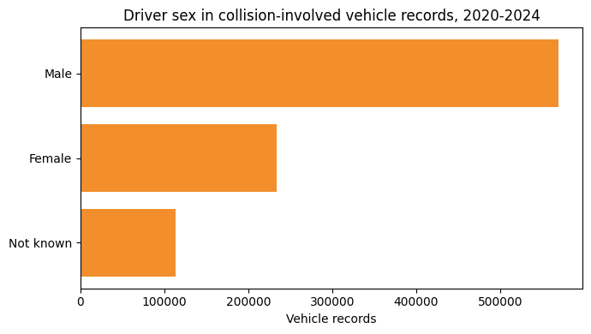
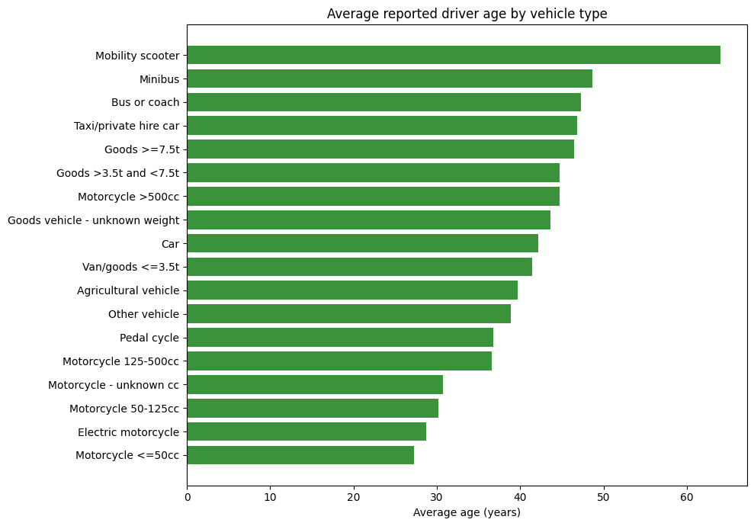
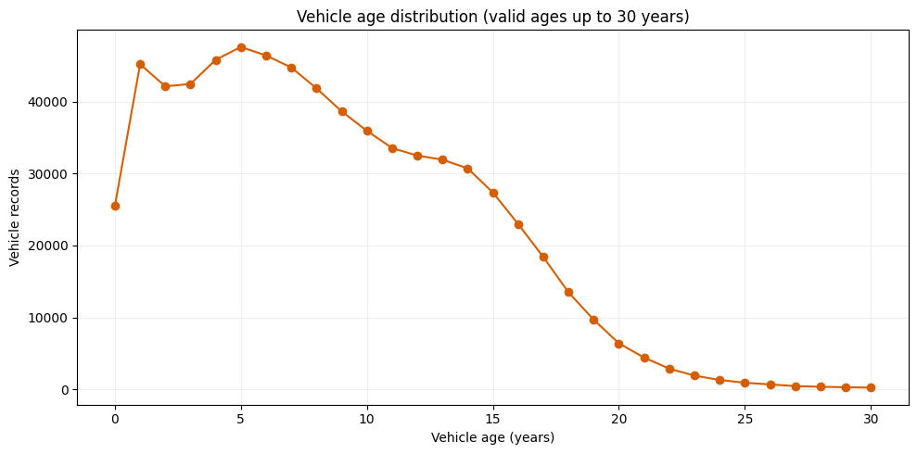
Exploratory Data Analysis (EDA)
PySpark processed 920,692 records. EDA examined driver demographics and vehicle characteristics before the main findings.
Notes:
Explain that PySpark and SQL were used behind the scenes. Focus the presentation on the exploratory charts, the patterns they reveal, and what those patterns mean rather than showing code.
[Sources]
- https://www.gov.uk/government/statistical-data-sets/road-safety-open-data (DfT road safety open data; accessed 2026-08-10)
- https://assets.publishing.service.gov.uk/media/68373908e11dd1e85b0cbb24/STATS20_2024_specification.pdf (DfT STATS20 2024 code definitions; accessed 2026-08-10)
- Corrected_UK_Road_Safety_Vehicle_Analysis_2020_2024_final_2 (1).ipynb (analysis and chart output)
[/Sources]

Slide 5
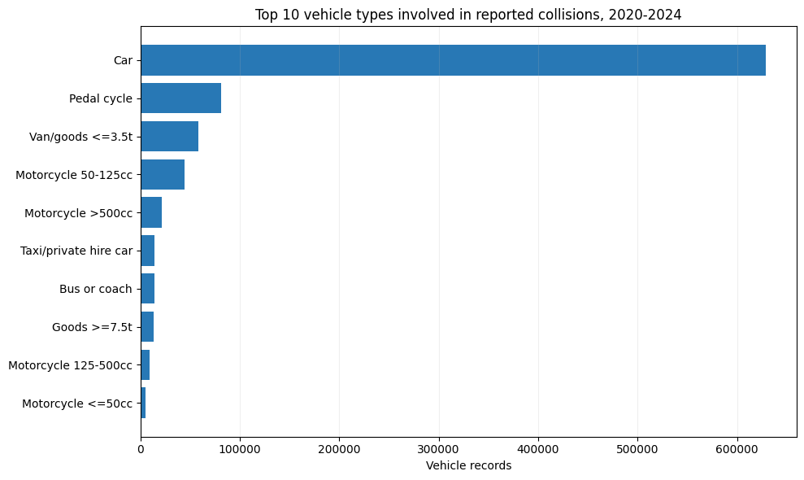
Cars dominate the recorded vehicle mix
D → I → K
Data:
Top 10 decoded vehicle types across 2020 - 2024.
Information:
Cars account for 628,614 records 68.8% of valid vehicle types.
Knowledge:
Common passenger vehicles dominate the file. Exposure-adjusted rates are needed before claiming that a vehicle type is riskier.
Notes:
Data: decoded type counts. Information: cars form 68.8%. Knowledge: volume is not risk without exposure.
[Sources]
- https://www.gov.uk/government/statistical-data-sets/road-safety-open-data (DfT road safety open data; accessed 2026-08-10)
- https://assets.publishing.service.gov.uk/media/68373908e11dd1e85b0cbb24/STATS20_2024_specification.pdf (DfT STATS20 2024 code definitions; accessed 2026-08-10)
- Corrected_UK_Road_Safety_Vehicle_Analysis_2020_2024_final_2 (1).ipynb (analysis and chart output)
[/Sources]

Slide 6
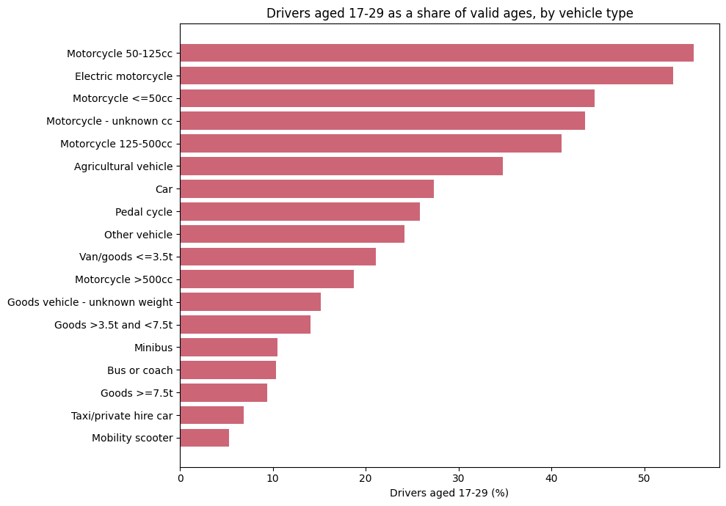
Young-driver representation differs sharply
D → I → K
Data:
Drivers aged 17- 29 as a share of valid ages, by vehicle type.
Information:
50 - 125cc motorcycles: 55.3%; cars: 27.4%; large goods vehicles: 9.4%.
Knowledge:
Driver age profiles differ by vehicle type. Tailored education may help, but these shares do not measure collision risk.
Notes:
Compare the 17–29 shares. Use this to show that a single average age would hide important differences.
[Sources]
- https://www.gov.uk/government/statistical-data-sets/road-safety-open-data (DfT road safety open data; accessed 2026-08-10)
- https://assets.publishing.service.gov.uk/media/68373908e11dd1e85b0cbb24/STATS20_2024_specification.pdf (DfT STATS20 2024 code definitions; accessed 2026-08-10)
- Corrected_UK_Road_Safety_Vehicle_Analysis_2020_2024_final_2 (1).ipynb (analysis and chart output)
[/Sources]

Slide 7
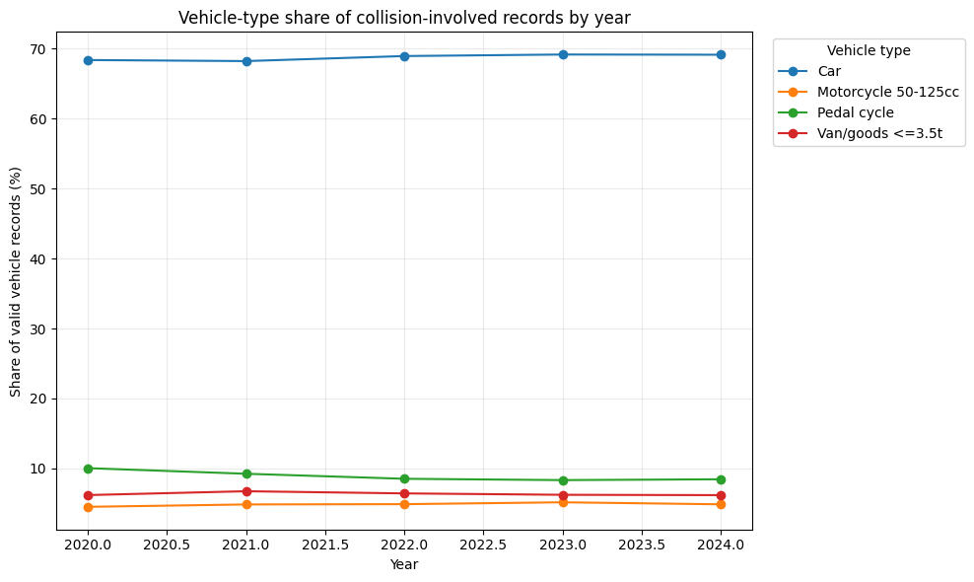
Vehicle composition changed modestly by year
D → I → K
Data:
Annual shares for cars, pedal cycles, 50 - 125cc motorcycles and light goods vehicles.
Information:
Car share rose 68.39%→69.15%; pedal-cycle share fell 10.04%→8.45%.
Knowledge:
Annual mix can reflect travel patterns and reporting. Context is needed before attributing the change to safety.
Notes:
Point to the small but consistent rise in car share and fall in pedal-cycle share. Avoid claiming a cause.
[Sources]
- https://www.gov.uk/government/statistical-data-sets/road-safety-open-data (DfT road safety open data; accessed 2026-08-10)
- https://assets.publishing.service.gov.uk/media/68373908e11dd1e85b0cbb24/STATS20_2024_specification.pdf (DfT STATS20 2024 code definitions; accessed 2026-08-10)
- Corrected_UK_Road_Safety_Vehicle_Analysis_2020_2024_final_2 (1).ipynb (analysis and chart output)
[/Sources]

Slide 8
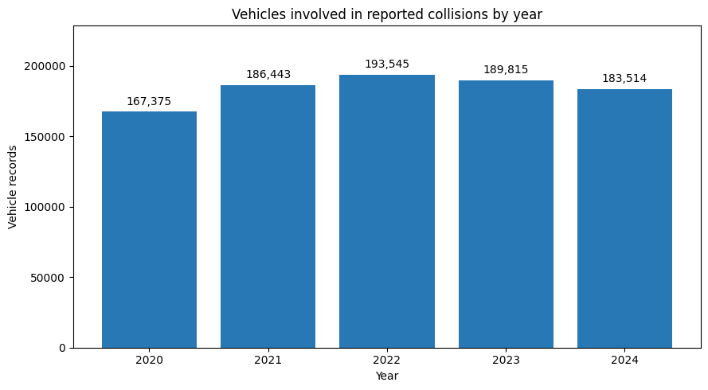
Recorded vehicle counts peaked in 2022
D → I → K
Data:
Annual vehicle records rose from 167,375 in 2020 to 193,545 in 2022.
Information:
Counts fell to 183,514 in 2024 - 5.2% below the 2022 peak.
Knowledge:
This is involvement volume, not a collision rate. Traffic exposure and reporting can change the trend.
Notes:
The 2022 maximum is 193,545 records. The 2024 count is lower, but this remains an involvement count rather than a rate.
[Sources]
- https://www.gov.uk/government/statistical-data-sets/road-safety-open-data (DfT road safety open data; accessed 2026-08-10)
- https://assets.publishing.service.gov.uk/media/68373908e11dd1e85b0cbb24/STATS20_2024_specification.pdf (DfT STATS20 2024 code definitions; accessed 2026-08-10)
- Corrected_UK_Road_Safety_Vehicle_Analysis_2020_2024_final_2 (1).ipynb (analysis and chart output)
[/Sources]

Slide 9
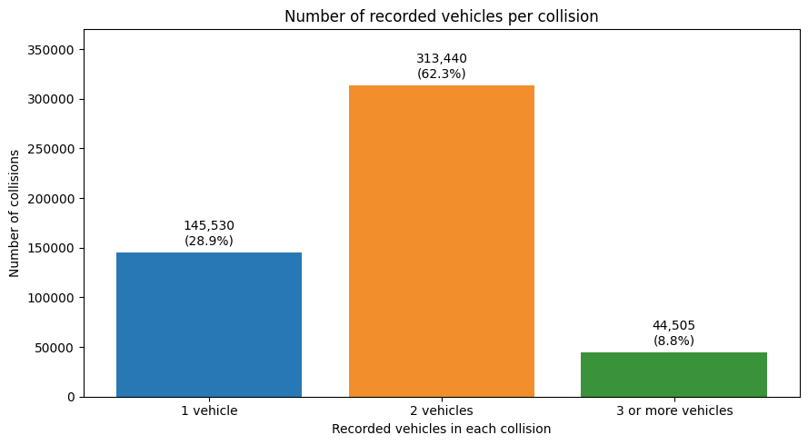
Most collisions recorded two vehicles
D → I → K
Data:
Distinct collisions grouped by one, two, or three-or-more recorded vehicles.
Information:
313,440 collisions (62.3%) recorded two vehicles; 28.9% one; 8.8% three+.
Knowledge:
Two-vehicle involvement is typical, but a one-vehicle record can still involve a pedestrian or other non-vehicle user.
Notes:
Two recorded vehicles is the most common structure. Clarify that one recorded vehicle does not necessarily mean no other road user was involved.
[Sources]
- https://www.gov.uk/government/statistical-data-sets/road-safety-open-data (DfT road safety open data; accessed 2026-08-10)
- https://assets.publishing.service.gov.uk/media/68373908e11dd1e85b0cbb24/STATS20_2024_specification.pdf (DfT STATS20 2024 code definitions; accessed 2026-08-10)
- Corrected_UK_Road_Safety_Vehicle_Analysis_2020_2024_final_2 (1).ipynb (analysis and chart output)
[/Sources]

Slide 10
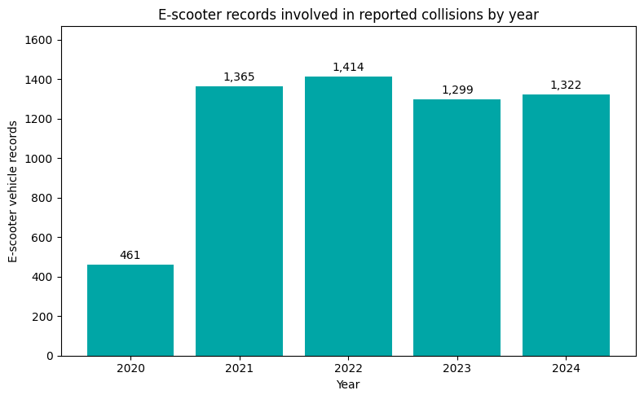
E-scooter involvement jumped after 2020
D → I → K
Data:
Recorded e-scooter vehicles: 461 in 2020, 1,365 in 2021, then 1,299 - 1,414 per year.
Information:
Involvement increased 196.1% from 2020 to 2021, then remained near 1,300 - 1,400.
Knowledge:
Usage, rental trials and reporting may explain the jump. Without exposure data, this is not a risk estimate.
Notes:
The largest change is between 2020 and 2021. Rental trials, usage and reporting are plausible context, but the dataset cannot isolate causes.
[Sources]
- https://www.gov.uk/government/statistical-data-sets/road-safety-open-data (DfT road safety open data; accessed 2026-08-10)
- https://assets.publishing.service.gov.uk/media/68373908e11dd1e85b0cbb24/STATS20_2024_specification.pdf (DfT STATS20 2024 code definitions; accessed 2026-08-10)
- Corrected_UK_Road_Safety_Vehicle_Analysis_2020_2024_final_2 (1).ipynb (analysis and chart output)
[/Sources]

Slide 11
D → I → K Synthesis
Raw coded records become useful knowledge only after cleaning, aggregation and careful interpretation:
DATA
INFORMATION
KNOWLEDGE
Vehicle type counts
Cars = 68.8% of valid types
Compare exposure before claiming risk
Valid driver ages
17- 29 share varies by vehicle
Tailor education; avoid causal claims
Annual record counts
2022 peak; 2024 down 5.2%
Interpret with traffic and reporting context
E-scooter flag by year
+196.1% from 2020 to 2021
Involvement is not exposure-adjusted risk
Vehicles per collision
Two vehicles in 62.3%
One vehicle may still involve non-drivers
Unknown codes by year
Missingness rises in 2024
Use transparent valid denominators
Notes:
Use one row to explain the full Data → Information → Knowledge journey, then scan the other examples.
[Sources]
- https://www.gov.uk/government/statistical-data-sets/road-safety-open-data (DfT road safety open data; accessed 2026-08-10)
- https://assets.publishing.service.gov.uk/media/68373908e11dd1e85b0cbb24/STATS20_2024_specification.pdf (DfT STATS20 2024 code definitions; accessed 2026-08-10)
- Corrected_UK_Road_Safety_Vehicle_Analysis_2020_2024_final_2 (1).ipynb (analysis and chart output)
[/Sources]

Slide 12


Conclusion and Limitations
Scale and reproducibility:
PySpark processed 920,692 vehicle records across 32 columns and produced reproducible grouped queries and charts.
Strongest findings:
Cars dominate; records peaked in 2022; 62.3% of collisions recorded two vehicles; e-scooters rose sharply after 2020.
Interpret carefully:
These are police-reported involvement counts - not rates or causes. Missingness increased in 2024 and denominators vary.
Recommended next step:
Join the collision and casualty files to analyse severity, weather, speed limit and casualties, then add exposure measures.
Notes:
Close with the two new insights, then state the limitations clearly. The next analytical step is a join to collision and casualty data.
[Sources]
- https://www.gov.uk/government/statistical-data-sets/road-safety-open-data (DfT road safety open data; accessed 2026-08-10)
- https://assets.publishing.service.gov.uk/media/68373908e11dd1e85b0cbb24/STATS20_2024_specification.pdf (DfT STATS20 2024 code definitions; accessed 2026-08-10)
- Corrected_UK_Road_Safety_Vehicle_Analysis_2020_2024_final_2 (1).ipynb (analysis and chart output)
[/Sources]

