Slide 1
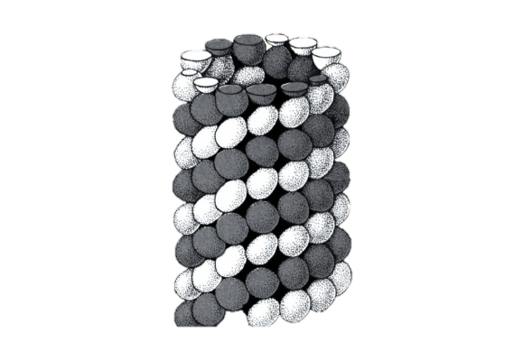


Using STADIA to quantify dynamic instability in microtubules
Shant Mahserejian, Ph.D. Pacific Northwest National Laboratory Holly Goodson, Ph.D. University of Notre Dame
Tutorial by Michael Sinclair, M.A., NBCT Kalamazoo Area Mathematics and Science Center
Last updated on 12/28/2020 by Jared Scripture, Ava Mauro, and Holly Goodson

Slide 2
STADIA:
The Statistical Tool for Automated Dynamic Instability Analysis ― STADIA ― is a MATLAB™-based program designed to quantify and characterize dynamic instability behavior in microtubules in a more objective, precise, and reproducible way than is presently possible. This tutorial will guide you through the process of using STADIA.

Slide 3
Three key issues:
1. This program is not a Matlab™ tutorial; you are expected to have a working knowledge of Matlab™ in order to run it. 2. Once STADIA is running, do not use the computer; please allow the program to run to completion. 3. Due to differences in operating systems, Macs and PCs will have slightly different layouts.

Slide 4
Objectives:
This new dynamic instability (DI) measurement method is designed to:
1. Pinpoint exact moments of any dynamic change. 2. Look for any intermediate dynamics beyond growth and shortening.
3. Calculate dynamic instability metrics more accurately.

Slide 5
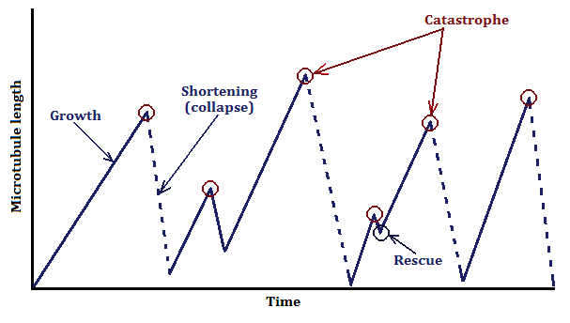
“Standard” microtubule behavior.
Traditional models of microtubule growth and shortening follow dynamic instability, with growth driven by the concentration of tubulin and “death” induced by a catastrophic drop-off leading to microtubule shortening caused by GTP to GDP hydrolysis before polymerization begins again.

Slide 6
“Standard” microtubule behavior.
In other words, catastrophe is the change from growth to shortening while rescue is the change from shortening to growth. It is also important to note that rescues are rare, and the mechanism driving them is not yet understood.

Slide 7
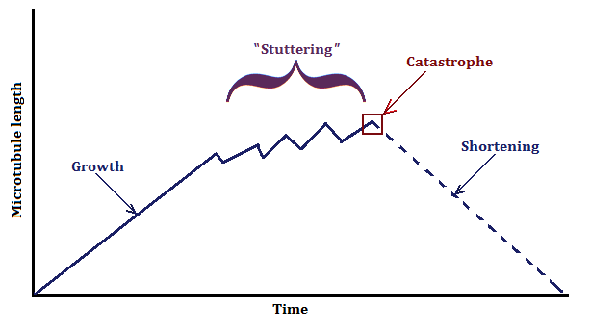
“Stuttering”.
So the fundamental question is: Where does growth end and shortening begin? The STADIA program ― when applied to experimental and simulated data ― shows compelling evidence that, just prior to collapse, microtubules can exhibit stuttering, where there appears to be another phase within dynamic instability.

Slide 8
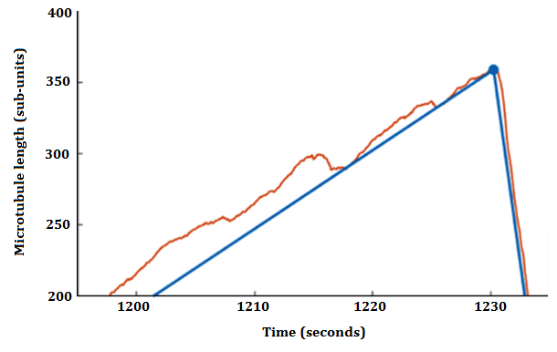
Old vs. new approach.
The standard approach ― when analyzing data collected with high acquisition rates (up to 1000 events per second) ― is to assume that only strictly growth and shortening periods exist when approximating the behavior. But it is clear that more inconspicuous behavior can be missed with this process.

Slide 9
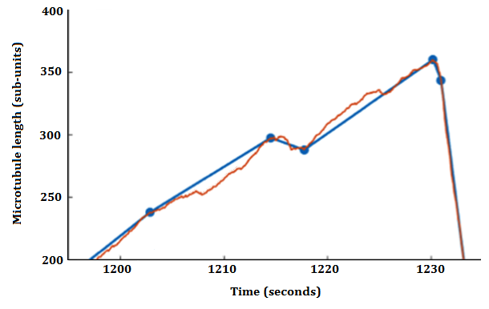
Old vs. new approach.
The approach employed here uses more precise piece-wise linear approximations in order to better study rapid, low-amplitude fluctuations. It can also reveal more subtle effects not previously seen.

Slide 10
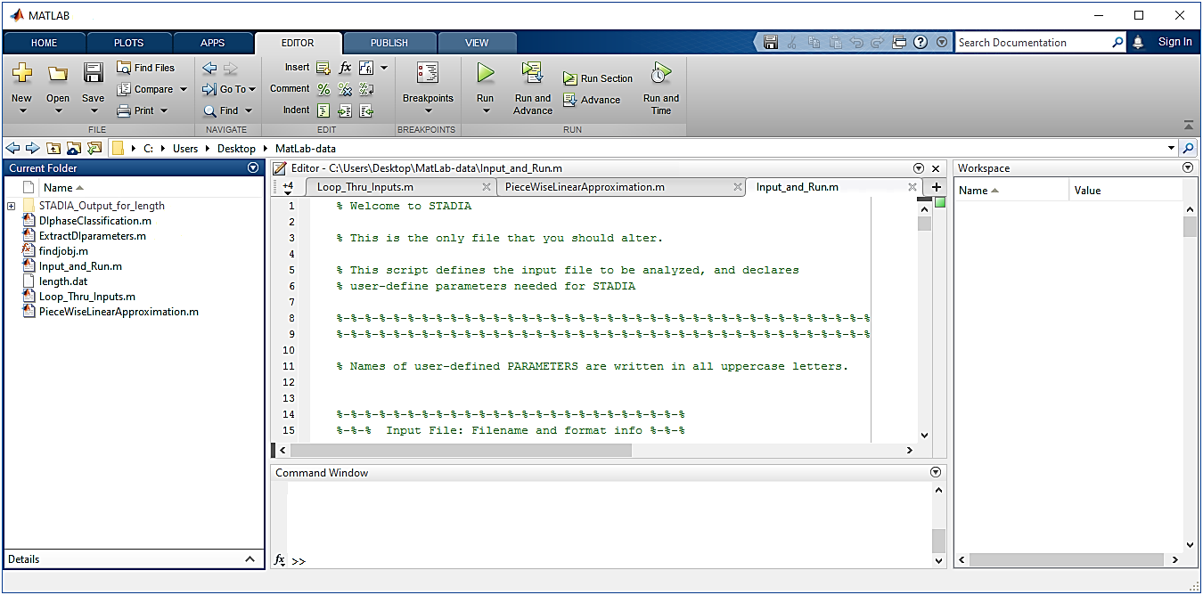
Getting started.
This is the window (with Input_and_Run.m as the start folder) you see when you open up the MatLab™ STADIA program with a PC:

Slide 11
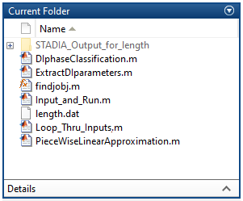
Getting started.
First, you will need seven (7) files in the folder you are going to work with; 1. Input_and_Run.m,
2. Loop_Thru_Inputs.m, 3. PieceWiseLinearApproximation.m, 4. DIphaseClassification.m, 5. ExtractDIparameters.m, and 6. findjobj.m. You will also need a length history input file(s) (in .dat, .txt, or .csv form). It is recommended that this file be in the same directory as the STADIA files listed above. This is shown at right.

Slide 12
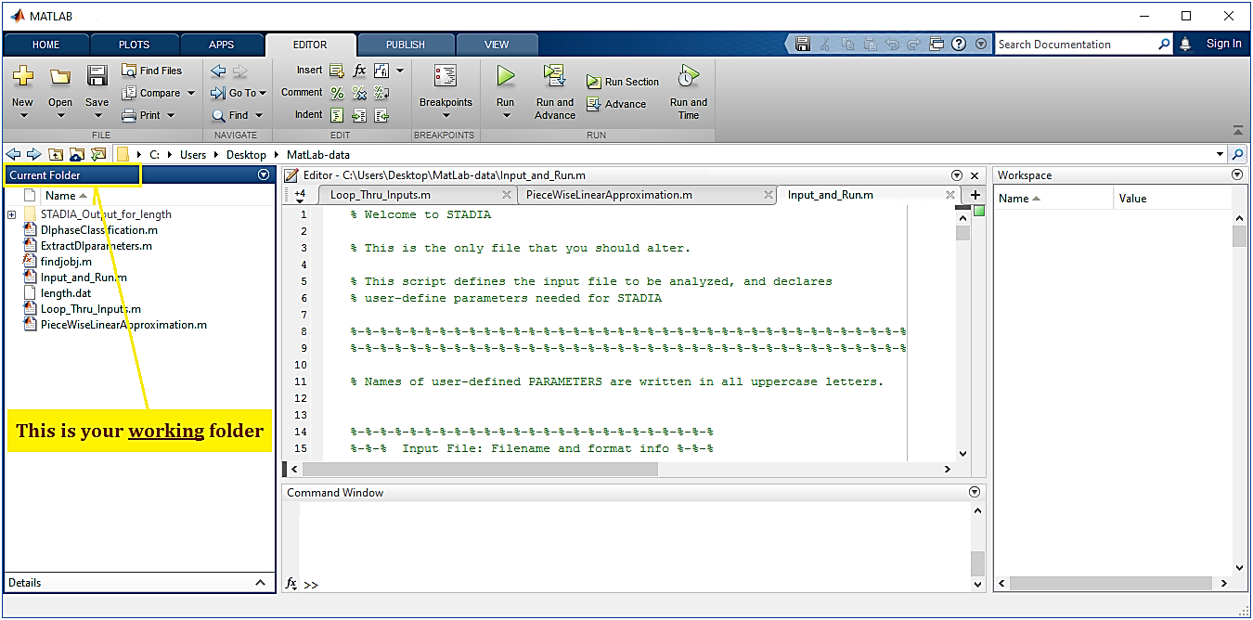
Getting started.
Find the Current Folder on the MatLab™ open page; be sure those six files are in the folder along with your length data ― in .dat, .txt , or .csv ― files (shown for a PC). You should have a total of seven (7) files.

Slide 13
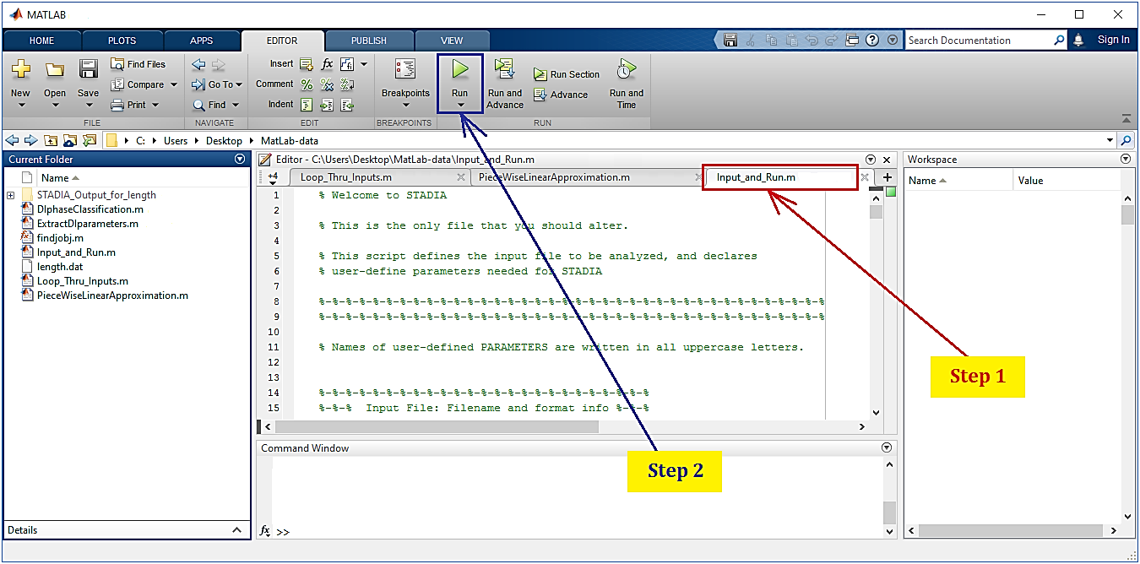
Getting started.
Click on the Input_and_Run.m folder (Step 1), then simply click on Run (Step 2) to operate the program for the chosen method parameters:

Slide 14
Program stages.
The MatLab™ STADIA program runs through three (3) steps or stages with an “initialization” phase:
Step Process
0 Initialization; file name, reading the file, and defining method parameters.
1 Linear approximation of microtubule growth and shortening.
2 Classification of microtubule stages.
3 Analysis of the data.

Slide 15
Step 0: Initialization.

Slide 16
Step 0: Initialization.
SKIP_FILE_READ = 0;
If this file is set at 0, it erases the previous run(s) (i.e., “flushes” STADIA) and starts the program over from scratch. This also saves time.
Otherwise, if you are running a large data file, set = 1. The default setting for this is 0.

Slide 17
Step 0: Initialization.
FILE_NAME_INPUT = {'test_data.dat'};.
This is the name of the length history input file or files. You can name it with whatever system you prefer, but just be sure to identify each file name in single quotes (' ') and the list of file names must be in a set of brackets ({ }). Remember, the file must end with either a .dat, .txt, or .csv suffix. Typical file names look like these:
{'LengthHistory_Joe_10uM_1hr_070917_run1.dat'}
{'Length_Ann_run24_12uM_20min_071817.txt'}.

Slide 18
Step 1: Linear approximation.

Slide 19
Step 1: Linear approximation.
FIRST_DATA_ROW = 2;
This annotates which row of the input file indicating the beginning of the data content that you wish to analyze.
MT_LENGTH_COLUMN_INDICES = 2;
This variable allows you to select which set or sets of input files (your data) that you wish to examine. If multiple columns of the file contain microtubule lengths, then the length history plots that are created will be “stitched together” with only the first column of data corresponding to the actual time values in the original file; the rest will be shifted to further time steps. In addition, you can select specific subsets to run through the program. For example, if
MT_LENGTH_COLUMN_INDICES = 2:128;
then the program will use data in all columns from 2 through 128. If
MT_LENGTH_COLUMN_INDICES = [2:5, 8, 11:18];
then the program will use only data in columns 2 through 5, column 8, and columns 11 through 18.

Slide 20
Step 1: Linear approximation.
TIME_COLUMN = 1;
This places the time values in the first column; do not use more than one column for time.
TIME_CONVERSION_FACTOR = 1;
If you’re using step numbers instead of time, then you will need to convert the steps to seconds; simply list the frame rate of your input data. If time is in minutes or hours, convert to seconds by multiplying by 60 and 3600, respectively. If the time values in the data are in seconds, then the default value = 1.
For example, if your input data is in minutes, then
TIME_CONVERSION_FACTOR = 60;

Slide 21
Step 1: Linear approximation.
INPUT_FILE_DELIMETER = ' ';
This tells the program how you’ve separated data in your input file. The example above is when each data point is simply separated by a space (1 1 2 3 5 8 13…). On the other hand, if the data is listed using commas (such as = 1, 1, 2, 3, 5, 8, 13, …), then
INPUT_FILE_DELIMETER = ',';
needs a comma between the single quotes so that the program looks for it in order to identify each data point. If you use a semi-colon (1; 1; 2; 3; 5; 8; 13; …), then
INPUT_FILE_DELIMETER = ';';

Slide 22
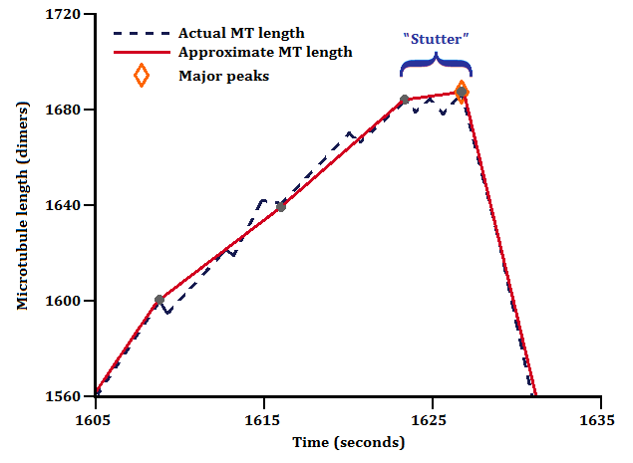
Step 1: Linear approximation.
MIN_SEGMENT_DURATION_INPUT = 0.1;
ERROR_TOLERANCE_LEVEL = 20;
These are the two critical parameters in the linear approximation phase of the program. You are attempting to “balance” the minimum time used to differentiate segment vertices vs. the margin of error.
If the Minimum Segment
Duration and/or
Maximum Error
Tolerance is reasonably ideal (the best fit), then the resulting graph will be accurate enough to see stutters if they exist.

Slide 23

Step 1: Linear approximation.
For example, suppose you set the following: MIN_SEGMENT_DURATION_INPUT = 0.1;
ERROR_TOLERANCE_LEVEL = 1; In this case, you’ve set the Minimum Segment Duration and Maximum Error Tolerance as too small, with the resulting graph being “too accurate” and effectively
looking like the original
data.

Slide 24
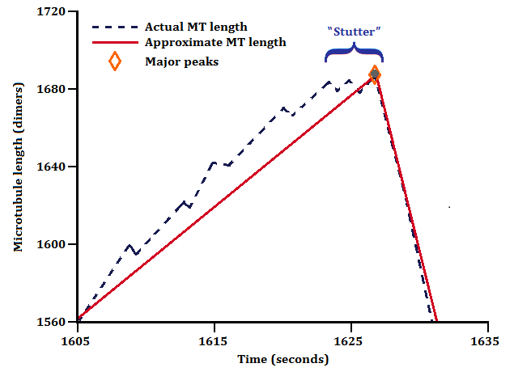
Step 1: Linear approximation.
On the other hand, suppose you use these values: MIN_SEGMENT_DURATION_INPUT = 1;
ERROR_TOLERANCE_LEVEL = 30;
Now the Minimum Segment Duration and Maximum Error Tolerance are too large, with the resulting graph not be accurate enough to see subtle changes like stuttering.

Slide 25
Step 1: Linear approximation.
Note that it is not always possible to satisfy both the Minimum Segment Duration and the Maximum Error Tolerance. In cases where these parameters are in conflict, STADIA will first attempt to find a neighboring point by ‘nudging’ the vertex in the direction that would increase the segment duration (thus trying to find a point that satisfies the Maximum Error Tolerance without violating the Minimum Segment Duration). If attempts to reconcile the conflict with nudging fails five times, STADIA produces ‘irreconcilable errors.’ Warnings to the user are outputted in the command window for both vertex nudges and irreconcilable errors.

Slide 26
Step 2: Classification.

Slide 27
Step 2: Classification.
FLATSTUT_MAX_SEGMENTHEIGHT_THRESHOLD_INPUT = 1;
FLATSTUT_MAX_SEGMENTSLOPE_THRESHOLD_INPUT = 0.5;
NUC_HEIGHT_THRESHOLD_INPUT = 75;
These parameters enable you to classify the behavior of growth and shortening.

Slide 28
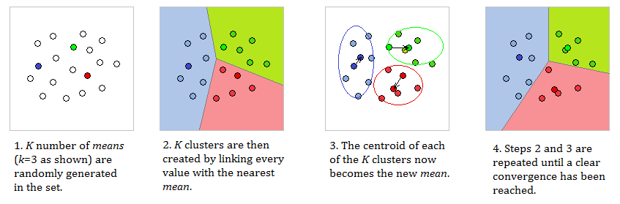
Step 2: Classification.
STADIA uses K-means clustering to classify the piecewise linear segments into phase classes. Generically, K-means clustering is an algorithm designed to partition n data points into k clusters. It does this by assigning each data point to the cluster with the “nearest” mean. The next part of the program organizes the data into clusters that can be identified as growth, stutter, or shortening.

Slide 29
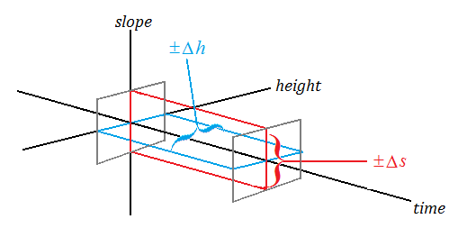
Step 2: Classification.
FLATSTUT_MAX_SEGMENTHEIGHT_THRESHOLD_INPUT = 1;
FLATSTUT_MAX_SEGMENTSLOPE_THRESHOLD_INPUT = 0.5;
These are geometrical restrictions that classifies the change in height of the microtubule along with the “flatness” of the slope with respect to time. Since these inputs limit both changes simultaneously, it allows the researcher to identify where flat stutters occur during the growth phase.

Slide 30
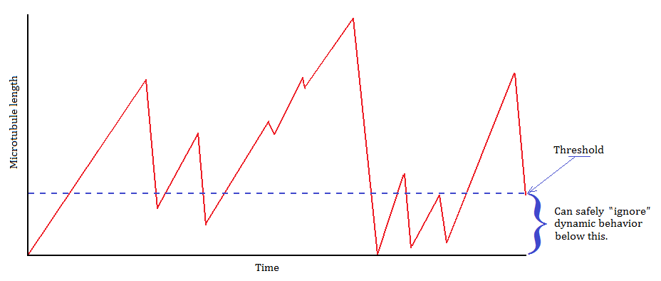
Step 2: Classification.
NUC_HEIGHT_THRESHOLD_INPUT = 75;
This is a threshold where you effectively “ignore” dynamic behavior below this minimum. This is analogous to the length of the microtubule being “too short” for anything to be seen experimentally; in other words, it is too close to the microtubule seed to analyze any changes.

Slide 31
Step 2: Classification.
KMEANS_DIAGNOSTIC_AllFLAG = 0;
KMEANS_DIAGNOSTIC_PosSlopeFLAG = 0;
KMEANS_DIAGNOSTIC_NegSlopeFLAG = 0;
AllFLAG will generate plots to develop K-means for all segments, while PosSlopeFLAG and NegSlopeFLAG will do the same for positive and negative slopes, respectively. The default for all three parameters is 0 (off) while 1 turns it on.

Slide 32
Step 2: Classification.
KMEANS_NumClust_PosSlope = #;
KMEANS_NumClust_NegSlope = #;
These commands set the number of clusters used to identify all dynamic instability phases. The PosSlope and NegSlope values are limited to 1, 2, or 3 and do not have to be the same.

Slide 33
Step 2: Classification.
KMEANS_Pos2_Option = 'A';
KMEANS_Neg2_Option = 'B';
These are K-means classification options only if k = 2 is chosen.
For the positive slope segments, 'A' uses two growth phases (long and brief growth) and 'B' uses one up-stutter phase and one long growth phase.
For the negative slope segments, 'A' uses two shortening phases (long and brief shortening) and 'B' uses one down-stutter phase and one long shortening phase.

Slide 34
Step 3: Analysis.

Slide 35
Step 3: Analysis.
STADIA will produce seven (7) plots:
1 – Microtubule length history plot
2 – Clustered results for scaled and standardized slope segments
3 – Classification results within the DI phase variable space
4 – Length history plot with color labels of DI phases for each segment 5 – Average measurements for the different DI phase segments
6 – Total measurements for the different DI phase segments
7 – Resulting measurements for the possible changes in DI phase
Note: Macs will automatically open all the figures while PCs will generate them but you will need to Maximize each plot in order to see them on the screen.

Slide 36
Step 3: Analysis.
Two key commands are:
PLOT_FIG_# = 1;
Set = 1 plots the figures while 0 does not. The default setting is 1.
SAVE_FIG_# = 1;
Set = 1 opens the figures while 0 saves and closes the figures. Default is 1.
Note: SAVE_FIG_3_movie = 0; creates an animated GIF file in .gif file format that spins a 3D plot of the DI classification.

Slide 37
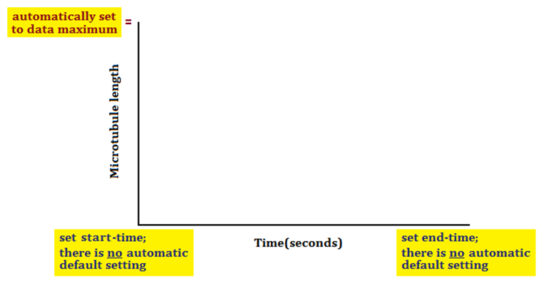
Step 3: Analysis.
FIG_WINDOW_START = #;
FIG_WINDOW_END = #;
These set the viewing window for Figures 1 and 4 in time values. The MT height window is automatically set to the data maximum. There is no initial default setting for the start-time or end-time. Be sure to set the start-time and end-times before running STADIA.

Slide 38
Step 3: Analysis.
SAVE_MATLAB_WORKSPACE = 0;
Set = 1 if you wish to save the variables in the MatLab™ workspace as a .mat file; the time and length data from the input data files won’t be saved because they are already in your input files.

Slide 39
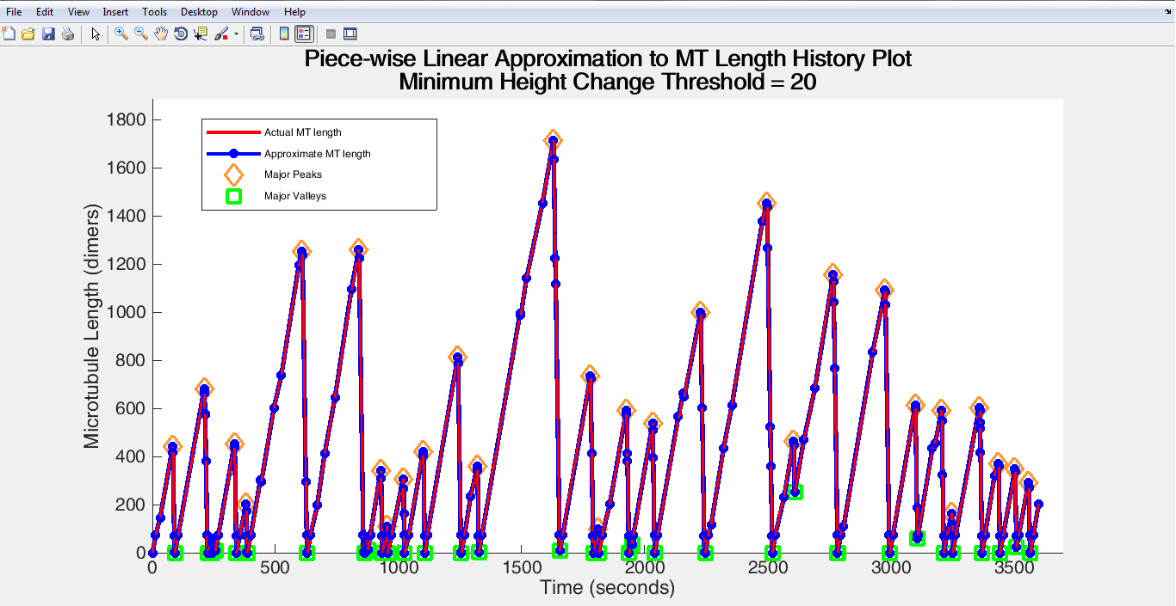
Step 3: Analysis.
The first figure (Figure 1 below) is the microtubule length history plot with the actual lengths in red and linear approximations in blue. Major peaks and valleys are also plotted.

Slide 40
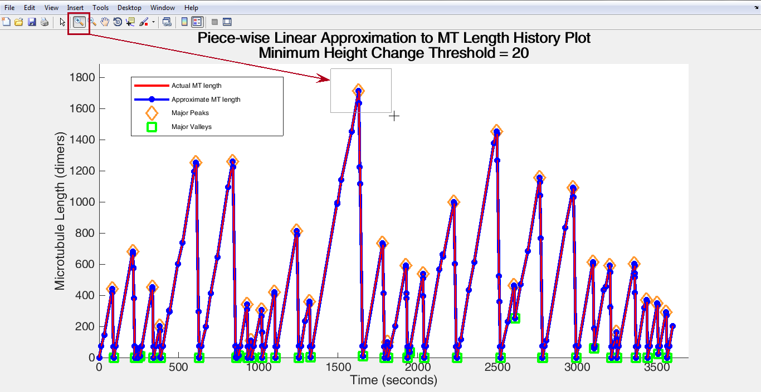
Step 3: Analysis.
You can use the zoom tool (upper left as shown) to progressively hone in on points you wish to study. Another way of scaling up the image is to use x- and y-limits in the MatLab™ command window, as illustrated in Slide 45.

Slide 41
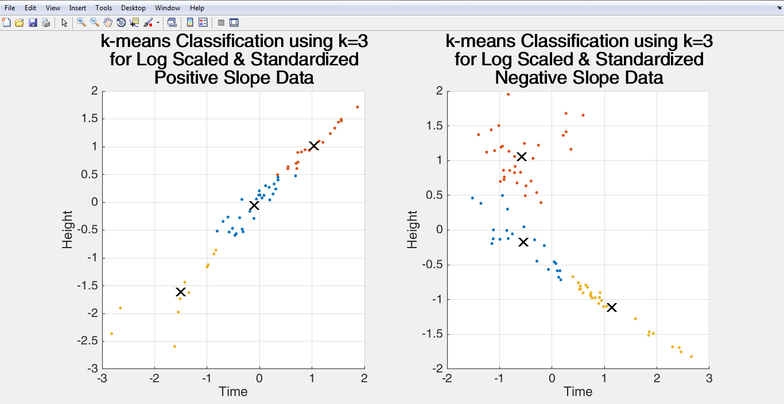
Step 3: Analysis.
Figure 2. Since we are working with three different behaviors (growth, stutter, and shortening), the K-means classification uses k = 3. These plots show the means for each cluster.

Slide 42
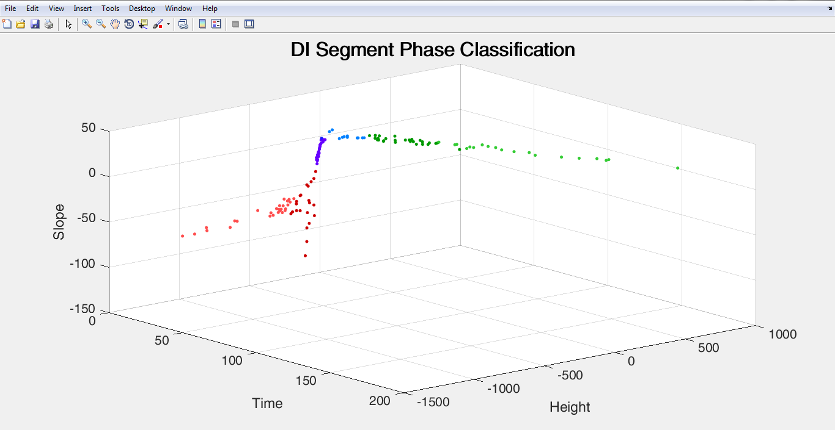
Step 3: Analysis.
Figure 3 shows classification results within the dynamic instability phase variable space; illustrating growth, stutter, and shortening phases within their k-means clusters using green, blue, and red, respectively.

Slide 43
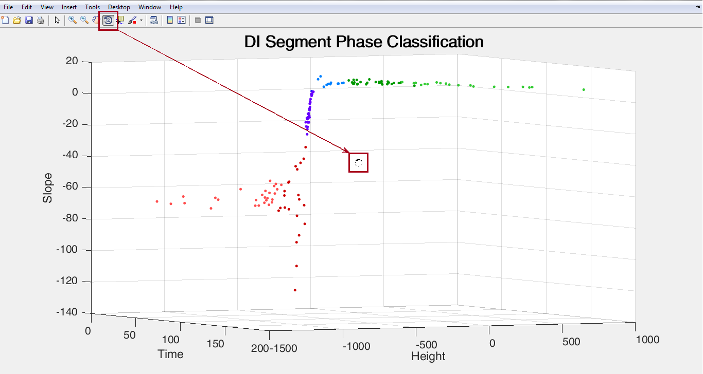
Step 3: Analysis.
Since this is a 3-D plot, you can use the rotate tool (shown below) to view the relationships between slope, height, and time from different perspectives in order to clarify growth and shortening behavior.

Slide 44
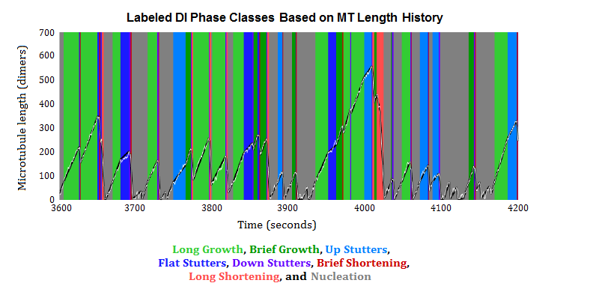
Step 3: Analysis.
Figure 4. The key intervals in the dynamic instability phase classes are those labeled in blue; they represent stutters. As you can see, they do not occur at every growth-to-shortening transition, but they do occur often enough to be worth closer examination.

Slide 45
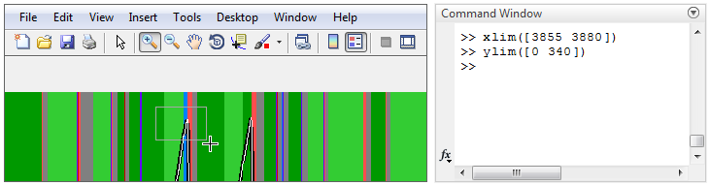
Step 3: Analysis.
By changing the observing window, either by “zooming in” on the region where stuttering appears to occur (shown at bottom left in the actual generated plot) or by direct command (in the MatLab™ Command Window, below right), you can then focus in on those transition regions.

Slide 46
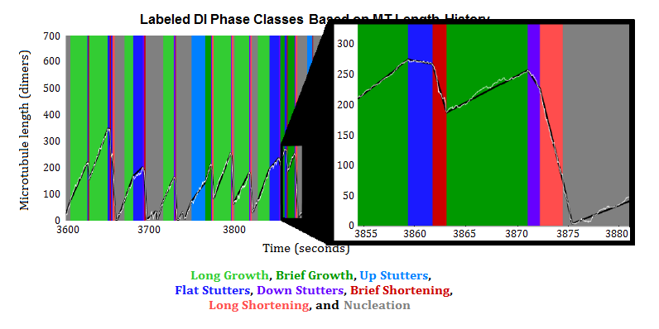
Step 3: Analysis.
By zooming in, you can see more subtle transitions from growth to shortening of microtubules as well as compare the linear approximation to the actual data.

Slide 47
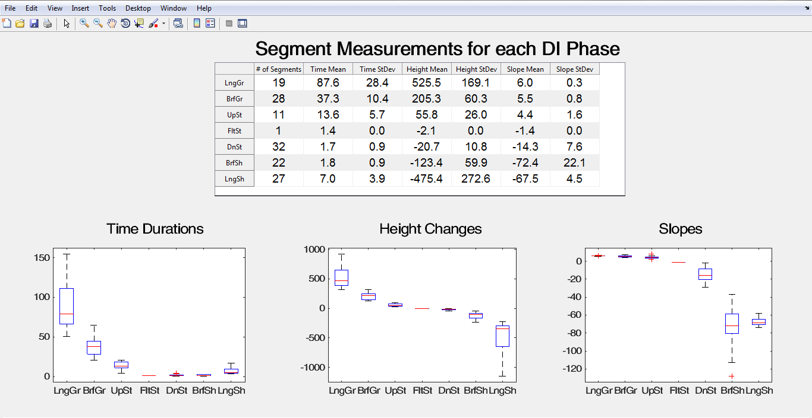
Step 3: Analysis.
The last three figures yield graphs and tables suitable for more advanced statistical analysis. Figure 5, for example, shows time, height, and slope means and standard deviations with a set of whisker plots for each.

Slide 48
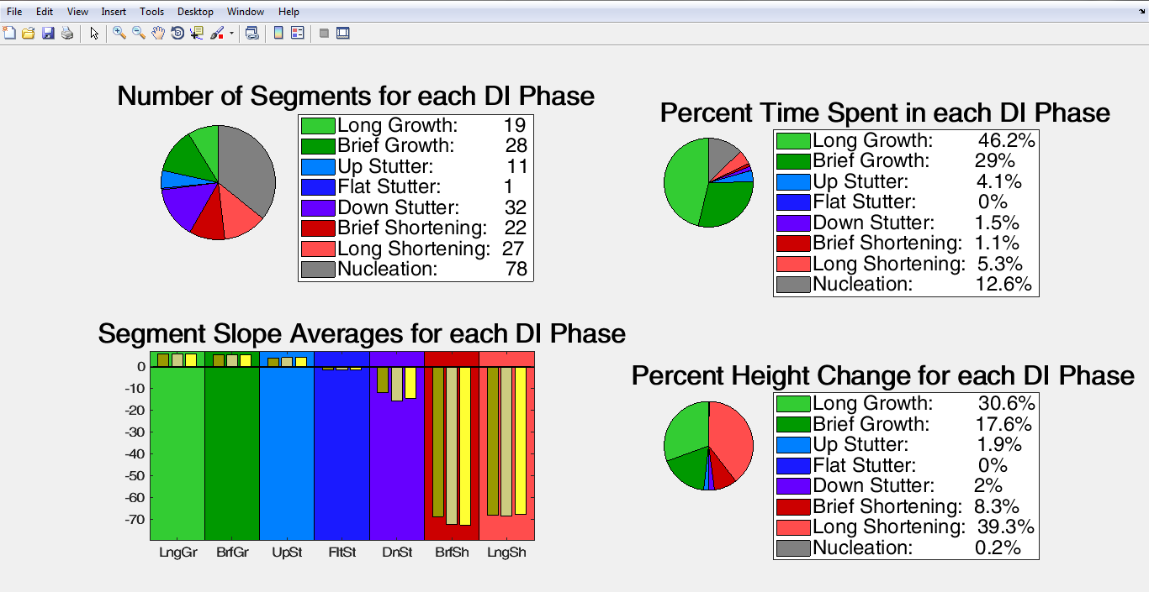
Step 3: Analysis.
Figure 6 lists measurements for the different dynamic instability phase segments, including % time and height changes as well as the actual number of segments for each phase (growth, stutter, and shortening).

Slide 49
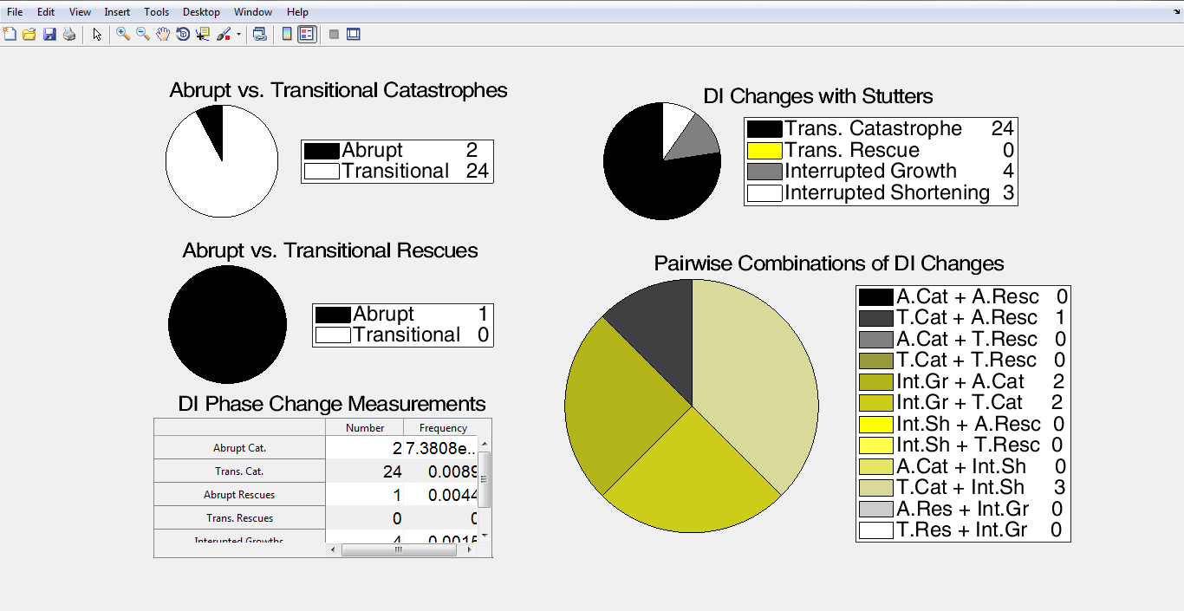
Step 3: Analysis.
And, finally, Figure 7 illustrates abrupt vs. transitional catastrophes and dynamic instability changes with stutters along with phase change measurements and pairwise combinations of sets of changes.

Slide 50
And the rest is up to you...
All that’s left is for you to input your files, set your parameters, let the program run, analyze the data, and publish your results.
We hope this tutorial will assist you in your research using this new dynamic instability measurement method, and please let us know how the program works, any bugs you’ve run across, and any improvements to the MatLab™ STADIA program and the tutorial you’d like to see.
Thank you.

Slide 51



Contributors.
Dr. Shant Mahserejian
Research scientist Applied Statistics and Computational Modeling Group Pacific Northwest National Laboratory
shant.mahserejian@pnnl.gov
Dr. Holly Goodson
Professor of Biochemistry Department of Chemistry and Biochemistry University of Notre Dame
holly.v.goodson.1@nd.edu
Kristopher Murray Integrated Biomedical Sciences Department of Chemistry and Biochemistry University of Notre Dame
kmurray5@nd.edu

Slide 52

Contributors.
Michael Sinclair
Tutorial author
Physics & calculus instructor
Kalamazoo Area Mathematics and Science Center
dragonphysics@gmail.com All illustrations by Mahserejian and Sinclair, 2019.
Contributing members of the team:
Jared Scripture
University of Notre Dame
Riya Patel
Penn High School and Indiana University
Peter Martin
Trinity School at Greenlawn
Contributors to design and development of STADIA code:
Shant Mahserejian
Ava Mauro
Jared Scripture
Jun Li
Erin Jonasson
Mark Alber
Holly Goodson

Slide 53
References.
Shant M. Mahserejian, Jared P. Scripture, Ava J. Mauro, Elizabeth J. Lawrence, Erin M. Jonasson, Kristopher S. Murray, Jun Li, Melissa Gardner, Mark Alber, Marija Zanic, Holly V. Goodson. Quantification of Microtubule Stutters: Dynamic Instability Behaviors that are Strongly Associated with Catastrophe. bioRxiv. 2020. doi: https://doi.org/10.1101/2019.12.16.878603
Patel, Riya J., Kristopher S. Murray, Peter O. Martin, Michael Sinclair, Jared P. Scripture, Holly V. Goodson, and Shant M. Mahserejian. 2020. “Using STADIA to Quantify Dynamic Instability in Microtubules.” In Methods in Cell Biology, 158:117–43. Academic Press Inc. https://doi.org/10.1016/bs.mcb.2020.03.002

