Slide 1
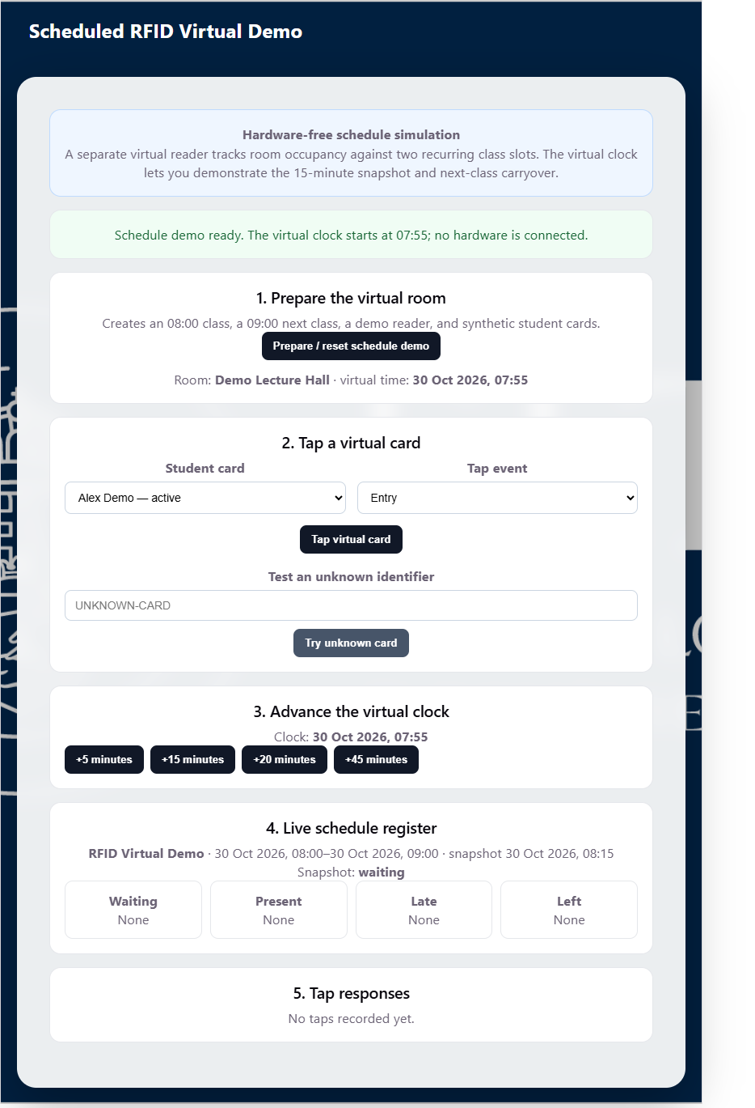
SMART ATTENDANCE SYSTEM / RFID UPGRADE
Scheduled RFID
Attendance
End-to-end process guide
Roles, timing rules, scenarios and lecturer workflow
SCREENSHOT-BASED GUIDE
Sample lecturer persona: Dr. Peter Kiss (demo identity)
Smart Attendance System | Process guide | Demo data only
01

Slide 2
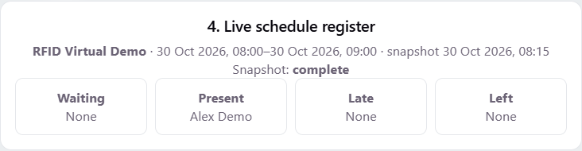
OVERVIEW
What changed in this upgrade
Before: attendance centered on lecturer-started QR sessions and manual check-in.
New: room-based RFID tap events feed a register aligned to recurring course schedules.
Lecturers associate a course with a room, weekday and start/end time; the reader tracks room occupancy.
The existing QR workflow remains available; it is not replaced by this prototype.
The central change is automatic, schedule-timed attendance classification?not simply a different way to check in.
Smart Attendance System | Process guide | Demo data only
02

Slide 3
PEOPLE AND ACCESS
Who is using the system?
LECTURER
Role responsibilities
Dr. Peter Kiss
Lecturer: configure recurring class slots and review attendance workflows.
Sample/demo lecturer persona used to explain the workflow.
The dashboard currently shows the page role, but does not display the signed-in email/name in its header. Do not treat this sample identity as a verified active account.
Reader: posts entry/exit taps for its registered room; reader state is shown on a kiosk-style page.
Administrator: registers reader hardware/credentials and maintains institutional setup.
Smart Attendance System | Process guide | Demo data only
03

Slide 4
SYSTEM FLOW
End-to-end operating model
1
2
3
4
5
Course + time slot
>
Card tap
>
Room state
>
Snapshot
>
Register
Lecturer assigns course, room, weekday and time.
Reader sends an entry or exit event.
System tracks who remains inside.
At start + 15 min, occupants are classified.
Lecturer reviews course attendance.
HARDWARE-FREE DEMO: the virtual reader simulates taps and time; it does not emulate radio hardware. Once compatible physical hardware is connected, the reader integration will be implemented and validated.
Smart Attendance System | Process guide | Demo data only
04

Slide 5
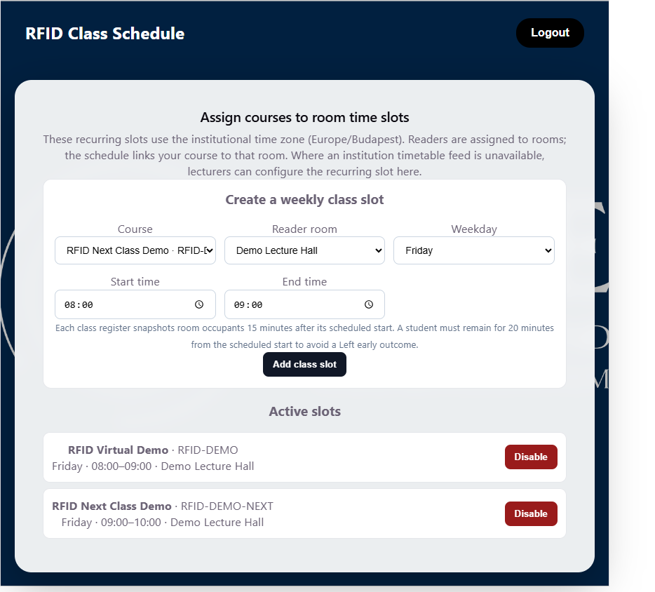
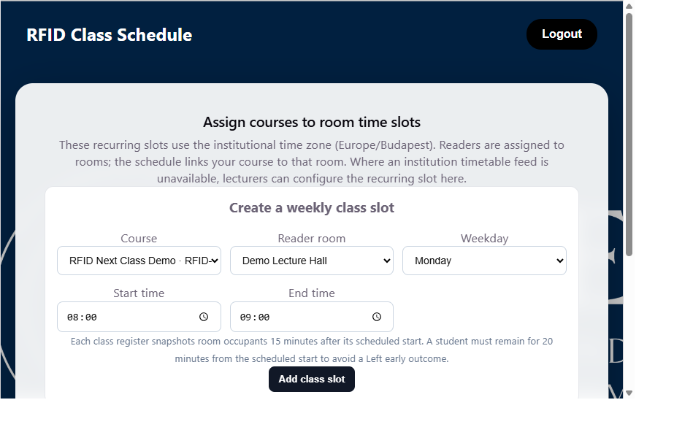
SETUP
Lecturer setup: link course, room and time
Choose an assigned course and a registered reader room.
Set a recurring weekday and class start/end time in Europe/Budapest.
When an institutional timetable feed is not available, the lecturer can configure the recurring slot here.
The register snapshots 15 minutes after the scheduled start; the 20-minute rule determines early departure.
Smart Attendance System | Process guide | Demo data only
05

Slide 6
DEMO MODE
Hardware-free walkthrough: virtual room
Synthetic active and revoked student cards make the scenarios repeatable.
The virtual clock advances independently of wall-clock time.
A two-slot sequence makes waiting, official snapshot and next-class carryover visible.
This is a process demonstration only; no physical RFID reader or card radio exchange is connected.
Smart Attendance System | Process guide | Demo data only
06

Slide 7
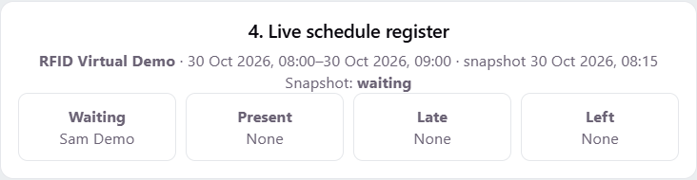
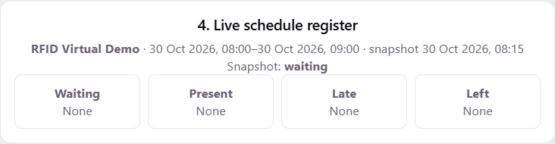
SCENARIO 1
Before the official snapshot: waiting is provisional
07:55 entry -> waiting list
Exit before snapshot -> removed
The 08:00 class is not official yet. An early arrival remains provisional rather than being counted immediately.
Sam leaves at 08:00. Because Sam is no longer in the room at 08:15, the student is not added to that class register.
Smart Attendance System | Process guide | Demo data only
07

Slide 8
SCENARIO 2
08:15 snapshot: occupants become present
OFFICIAL SNAPSHOT
At 08:15, Alex is still in the room and is classified Present in the 08:00 register.
The snapshot is scheduled start + 15 minutes. It evaluates current room occupancy for that class; it is not a manual lecturer roll call.
Smart Attendance System | Process guide | Demo data only
08

Slide 9
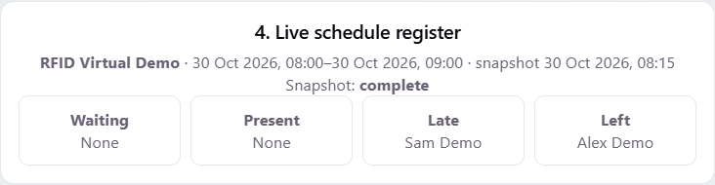
SCENARIO 3
Late arrivals and early departures
LATE
Sam enters at 08:20, after the 08:00 class start, and is marked Late.
LEFT EARLY
Alex exits at 08:15, only 15 minutes after the scheduled start, and is marked Left early (<20 minutes).
Smart Attendance System | Process guide | Demo data only
09

Slide 10
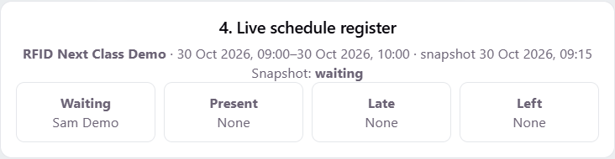
SCENARIO 4A
A student still inside at the next class start
09:00
Sam did not exit before the 09:00 slot. Sam carries into the next class as Waiting until its official snapshot.
No manual re-entry is needed for the carryover case. The active course is resolved by the room schedule.
Smart Attendance System | Process guide | Demo data only
10

Slide 11
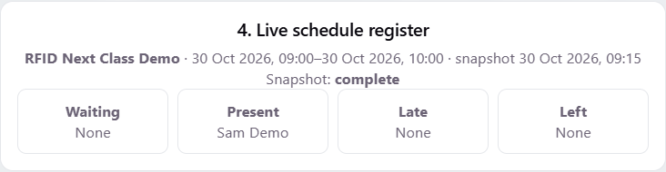
SCENARIO 4B
09:15 snapshot: carryover becomes present
Sam remains in the room at 09:15 and is now Present in the 09:00 register.
The old class and new class have distinct schedule windows and snapshot times.
Smart Attendance System | Process guide | Demo data only
11

Slide 12
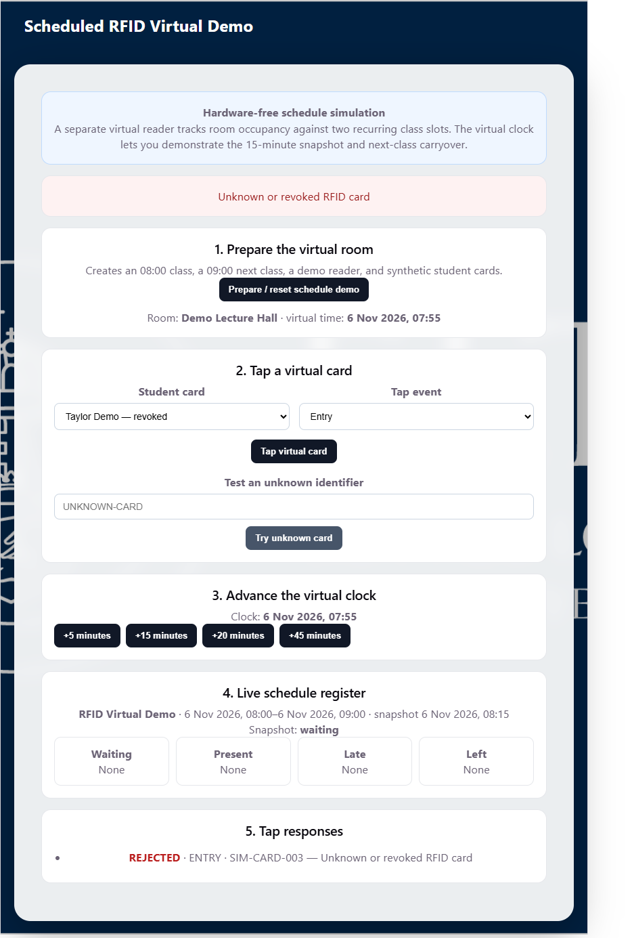
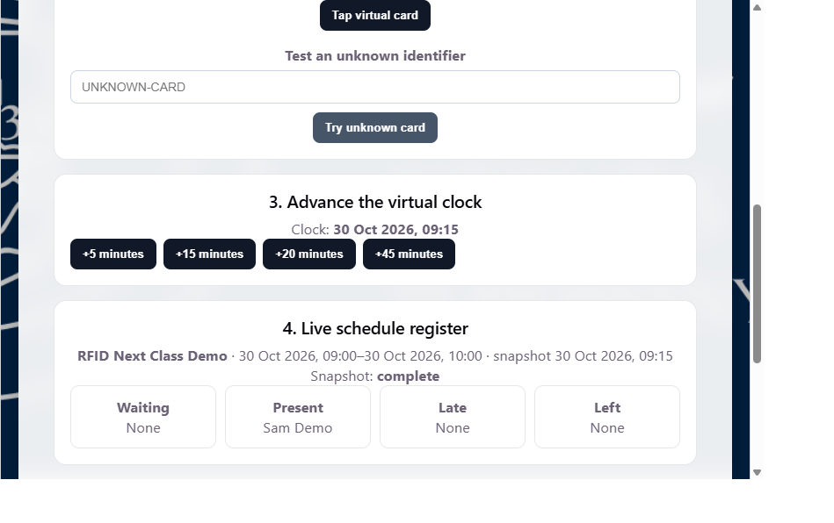
SCENARIO 5
Invalid or revoked card: reject and log
A tap with a revoked or unknown card is rejected; it must not enter the attendance register.
The reader event list records a rejected result for traceability.
In this demo, Taylor is synthetic and the credential is intentionally revoked.
Smart Attendance System | Process guide | Demo data only
12

Slide 13
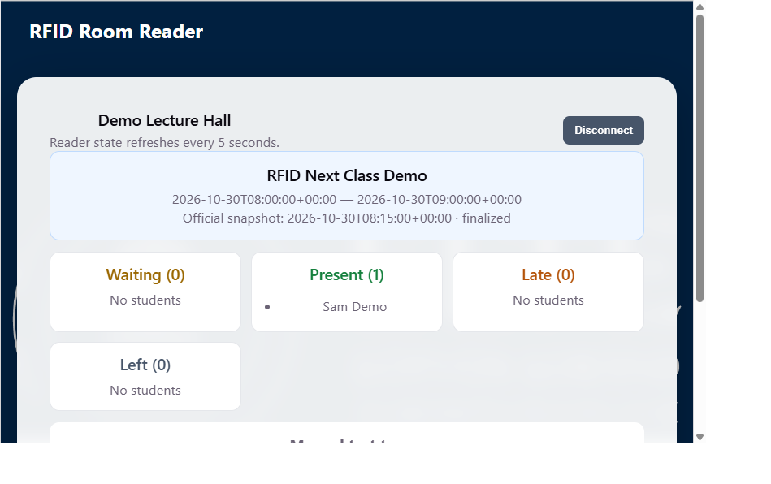
ROOM VIEW
Reader display: live room occupancy
Connect the kiosk page with the registered reader ID and API key.
Reader state refreshes every five seconds.
Waiting, Present, Late and Left lists are shown for the active scheduled class.
The page includes a manual test tap for hardware-free checks; deployed gateways should post taps to the API.
Smart Attendance System | Process guide | Demo data only
13

Slide 14
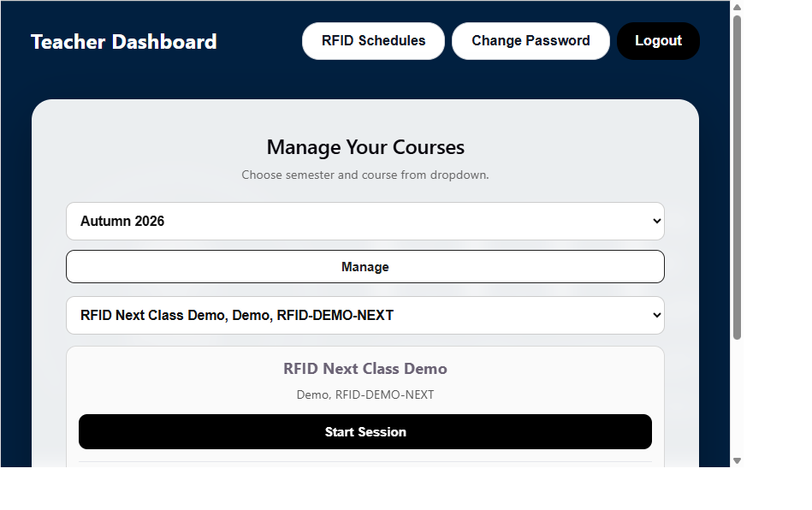
LECTURER VIEW
Lecturer course workflow
Open the Teacher Dashboard and choose the semester and course.
Use RFID Schedules to create or disable recurring room time slots.
Start Session is part of the existing live QR workflow; it is separate from the scheduled RFID register.
The current lecturer page does not display the signed-in user name/email in its header.
Smart Attendance System | Process guide | Demo data only
14

Slide 15
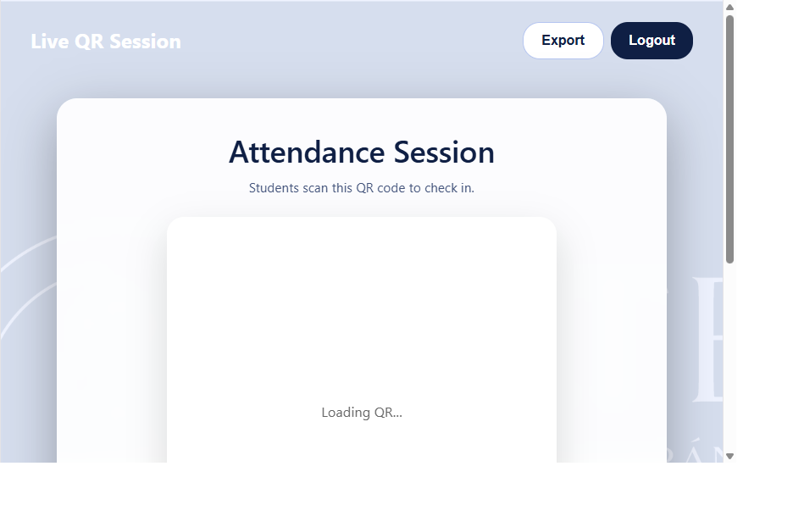
EXPORT GUIDE
How a lecturer downloads the attendance sheet
Current Live QR session CSV
Open the live session page.
Select Export in the upper-right of the page.
The browser downloads a CSV for that session.
Important: scheduled RFID registers do not yet have a dedicated lecturer export control. Do not use the QR export as if it were the RFID schedule export.
Smart Attendance System | Process guide | Demo data only
15

Slide 16
SCENARIO SUMMARY
Use cases covered by the prototype
USE CASE
EXPECTED BEHAVIOR
Arrives before 08:00 / remains inside
Waiting before the 08:15 snapshot; Present if still inside at snapshot.
Leaves before official snapshot
Removed from the waiting pool; not recorded as present.
Arrives after scheduled start
Marked Late when included in the class register.
Leaves in under 20 minutes
Marked Left early.
Stays into next scheduled class
Carries into next slot as Waiting; Present if still inside at next snapshot.
Unknown/revoked card
Tap rejected and event logged.
Smart Attendance System | Process guide | Demo data only
16

Slide 17
SCOPE AND LIMITS
What is demonstrated vs. still to implement
DEMONSTRATED
NOT YET INTEGRATED
Recurring lecturer-configured course slots and room mapping.
Physical RFID hardware and a deployed reader gateway are not connected in this demo.
Virtual entry/exit events and synthetic card validation.
Compatible hardware integration is planned once devices are connected and available for testing.
15-minute official snapshot, late/left outcomes and next-class carryover.
Scheduled RFID attendance needs its own lecturer export/download action.
Room occupancy view and current Live QR session CSV export.
The signed-in identity is not currently shown in the lecturer dashboard header.
Smart Attendance System | Process guide | Demo data only
17

Slide 18
VALIDATION
Test run: process checks completed
The browser walkthrough used a clean temporary database, synthetic learners and a virtual clock.
Verified early arrival waiting, exit before snapshot, and 08:15 on-time snapshot.
Verified an 08:20 late arrival and a 15-minute early departure outcome.
Verified 09:00 next-slot waiting and 09:15 carryover present classification.
Verified a revoked credential is rejected and visible in the reader event log.
Captured separate lecturer schedule, course dashboard, live export control and room reader screenshots.
All people, cards, courses and times shown in the demo are synthetic.
Smart Attendance System | Process guide | Demo data only
18

Slide 19
TAKEAWAY
Schedule-driven attendance is now demonstrable end to end.
Lecturers define the class window; the room reader captures presence; the scheduled snapshot applies consistent attendance rules.
Next: connect compatible RFID hardware, validate real-device events, and add a lecturer export for scheduled RFID registers.
Smart Attendance System | Process guide | Demo data only
19

