Slide 1
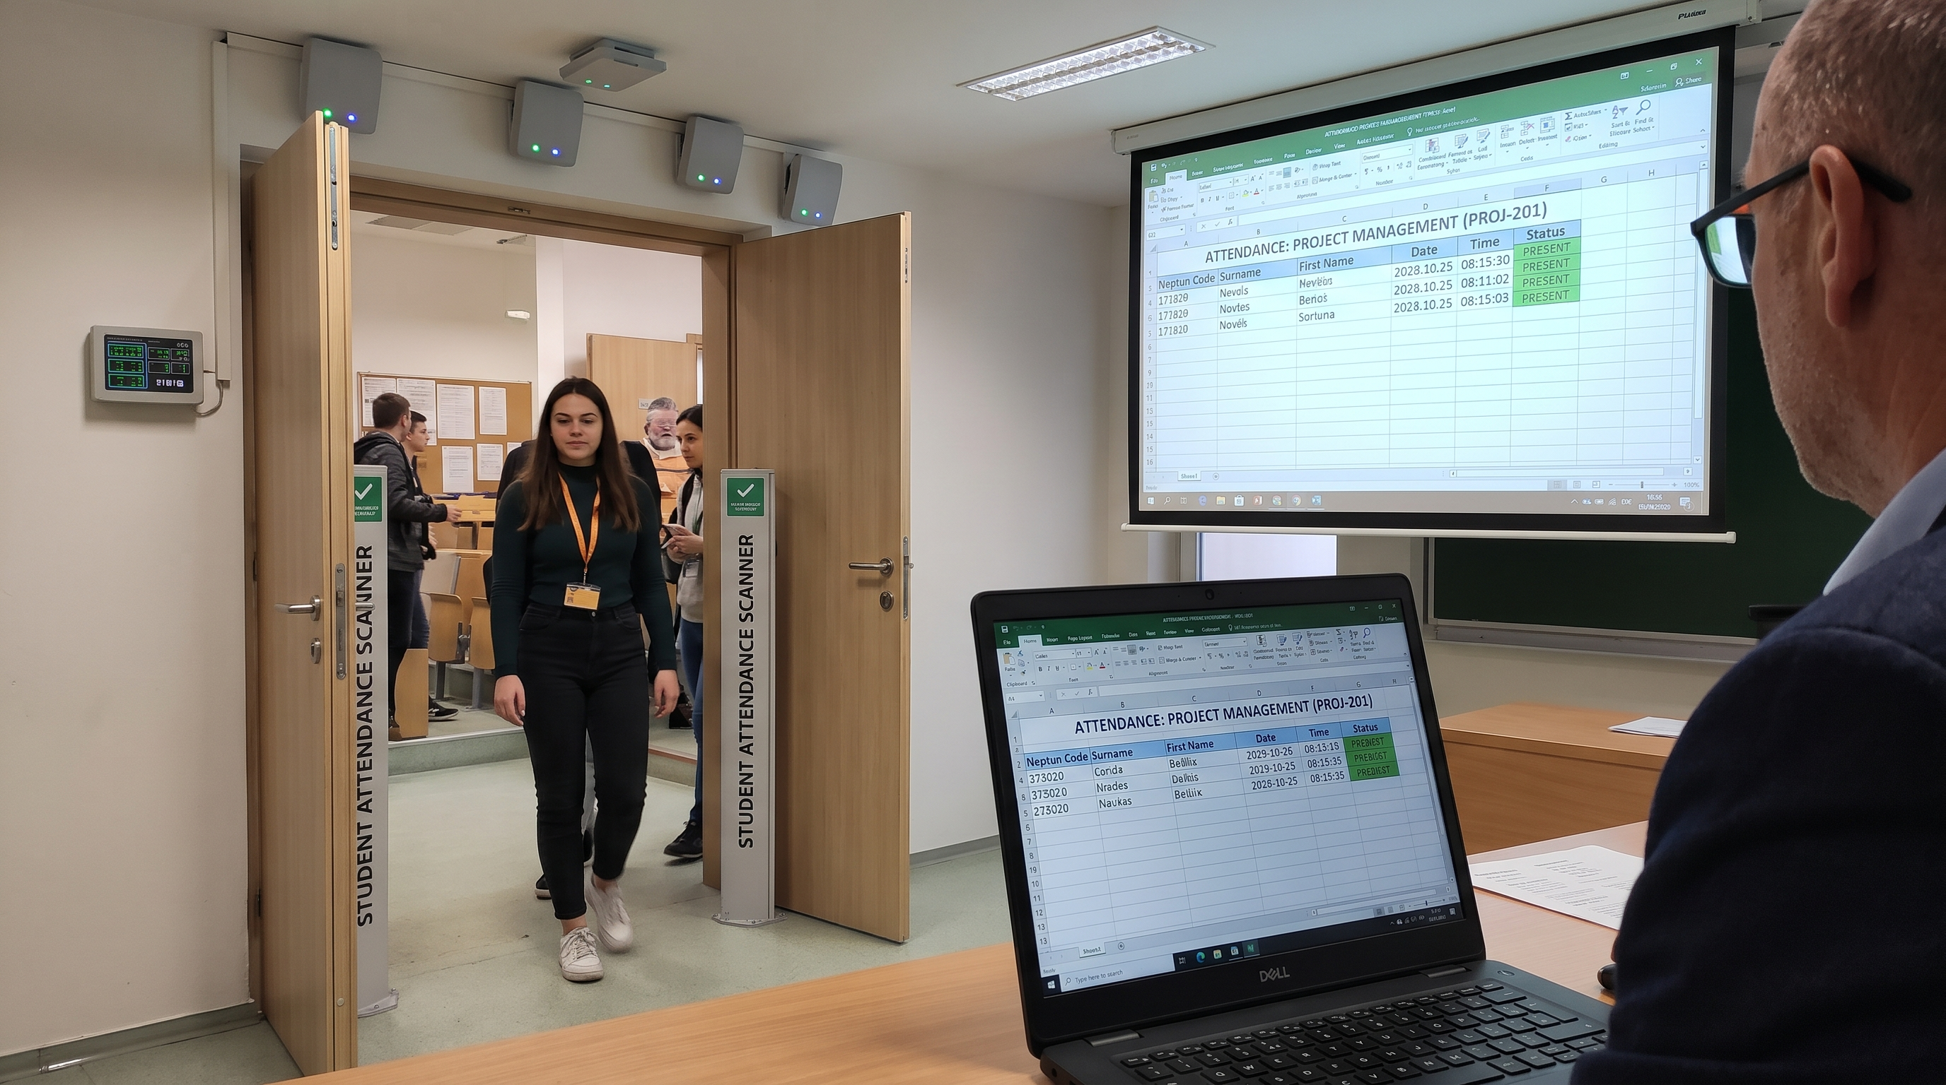
PROJECT UPGRADE | 2026
Smart RFID
Attendance
Entry + exit tracking with a virtual-reader demo
A hardware-free proof of concept built on the existing FastAPI + React system
Concept reference: reader options shown in the project concepts folder
RFID EVENT FLOW -> SIMULATED HARDWARE

Slide 2
THE CHANGE
From camera QR to card-tap attendance
TODAY
UPGRADE
Rotating QR scan
RFID entry + exit
Student signs in and scans a short-lived course QR token.
Browser device ID is used for duplicate prevention.
Attendance is currently an entry/presence record.
Reader tap resolves a card credential to a student on the server.
One entry and one exit event per student/session.
QR remains a temporary entry-only fallback.
SMART ATTENDANCE | RFID UPGRADE
02

Slide 3
ARCHITECTURE
One attendance path, two reader inputs
The real-reader API and virtual simulator share the same validation and persistence service.
Student card
>
Reader / simulator
>
FastAPI
>
Database
>
Export
opaque card ID
authenticated tap
card + session + roster checks
credential + event + summary
entry / exit / source
REAL READER
VIRTUAL READER
X-Reader-ID + X-Reader-Key
Local demo UI -> same event service
SMART ATTENDANCE | RFID UPGRADE
03

Slide 4
DATA MODEL
Keep identity, card, and event data separate
Users
StudentCardCredential
RfidReader
AttendanceEvent
ELTE identity and role
Course roster remains authoritative
user_id + keyed HMAC
active / revoked timestamps
raw card ID is not stored
reader ID + hashed API key
active state; key shown once
session + user + ENTRY/EXIT
source + reader + server time
unique event type per session
AttendanceLog remains the per-student/session summary and now holds checked_out_at + source.
SMART ATTENDANCE | RFID UPGRADE
04

Slide 5
ATTENDANCE WORKFLOW
Entry and exit are explicit, ordered events
01
02
03
04
05
Tap at entry
>
Validate
>
Record entry
>
Tap at exit
>
Record exit
Reader sends card ID, session, ENTRY.
Reader + card + session + student + roster.
Create attendance summary and ENTRY event.
Same card sends EXIT for that session.
Require entry; set checked_out_at; append event.
Second entry, exit-before-entry, second exit, revoked/unknown card, and closed-session taps are rejected.
SMART ATTENDANCE | RFID UPGRADE
05

Slide 6
VIRTUAL DEMO
Demo run: no physical hardware required
LOCAL SETUP
08:00 and 09:00 class slots; virtual clock starts 07:55
Exit before snapshot: removed from waiting list
Entry after snapshot: marked late
Exit before 08:20: left early (20 min from 08:00)
Remain in room: carryover to next class register
RFID_CREDENTIAL_HMAC_KEY=your-random-secret
RFID_SIMULATOR_ENABLED=true
Open /rfid-demo
Prepare schedule demo; tap virtual cards and advance the clock through 08:15.
Synthetic students only; no physical hardware required.
SMART ATTENDANCE | RFID UPGRADE
06

Slide 7
GUARDRAILS
Security and privacy are part of the design
Minimize card data
Store a keyed HMAC; do not retain raw UID or personal details on the card.
Authenticate readers
Provision per-reader random API keys; store only the key hash.
Validate server-side
Check active session, student role, roster, credential state, and event order.
Be honest about UID
A static card UID can be cloned; stronger assurance needs secure challenge-response cards.
Constrain demo mode
Simulator is disabled by default and uses synthetic students only.
SMART ATTENDANCE | RFID UPGRADE
07

Slide 8
OUTCOME
What the upgrade demonstrates
IMPLEMENTED IN THIS VERSION
NEXT INTEGRATION / PILOT
Recurring course schedules with room-bound readers.
15-minute snapshot, waiting/present/late/left states, and next-class carryover.
20-minute early-exit rule; event history and register source are retained.
Lecturer schedule UI, separate reader view, and virtual schedule demo.
Connect lecturer-created slots to the institutional timetable feed.
Pilot supported RFID cards/readers; test range and tap latency.
Plan offline/network failures and room-change operations.
Deploy with production secrets, monitoring, and retention policy.
Project team: Khoa Goodwill | Gonzalez Salvador Omar Francisco | Zhao Boning | Akylbek Kyzy Asel | Gultekin Elif
SMART ATTENDANCE | RFID UPGRADE
08

Slide 9
SCHEDULED ATTENDANCE
Automatic registers follow active room schedules, not manual resets
Lecturer-defined weekly slots; room-bound readers. Each class has a register; event history is retained.
08:00
08:00-08:15
08:15
Scheduled start
>
Waiting list
>
Official snapshot
ATTENDANCE RULES
CARRYOVER + CURRENT STATUS
Still inside at 08:15: present/on time
Students inside at the next slot start join its waiting list.
Exit before 08:15: removed from waiting list
At the new snapshot, those still inside enter the next register.
Entry after 08:15: marked late
Exit before 08:20: left early (20 min from 08:00)
Exit moves a student to Left; the outcome stays auditable.
Next integration: institutional timetable import and physical reader pilot.
SMART ATTENDANCE | RFID UPGRADE
09

