Slide 1
AG Accident Choice PlusSM
Accidental Injury Insurance
Helps provide clients with pocketbook protection
and peace of mind

Slide 2
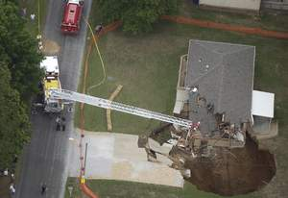
A financial sink hole . . .
they never saw it coming . . .

Slide 3
Accidents aren’t planned, but happen all the time. Financial impact can be devastating
Accidents aren’t planned, but happen all the time. Financial impact can be devastating
About 60% of bankruptcies are medically related
  (Medical Bankruptcy in the US, 2007. Results of a National Study, the American Journal of Medicine, August 2009)
About 1 in 9 Americans seek medical attention for an injury each year.
  (National Safety Council, Injury Facts – 2011 Edition. Not all injuries will result in a benefit payment)
The economic impact of unintentional injuries in 2009 amounted to about $2,300 per person.
  (National Safety Council, Injury Facts – 2011 Edition. Not all injuries would result in a benefit payment)
Over 26 million people were treated in hospital emergency rooms for injuries.
  (National Safety Council, Injury Facts – 2011 Edition. Not all injuries would result in benefit payments.)
Approximately 49.2 million visits to physician offices were due to unintentional injuries.
  (National Safety Council, Injury Facts – 2010 Edition. Not all injuries would result in benefit payments.)

Slide 4
Accidental Injury insurance is often overlooked and not part of financial planning
Accidental injury insurance is often overlooked and not part of financial planning
Most people plan for:
Life insurance (“death” insurance)
Major medical (physician and hospital expenses)
Disability Income insurance (has elimination periods, pays only a % of income)
401k and IRAs (retirement with potential withdrawal penalties)

Slide 5
Can fill gaps in client’s medical coverage
About 60% of bankruptcies due to medical bills*
Most of the families filing bankruptcy were well-educated homeowners with middle-class occupations
More than 75% of them had health insurance
92% had medical bills over $5,000 or 10% pretax family income
"Our study is fairly shocking, we found that, too often, private health insurance is an umbrella that melts in the rain.“
Steffie Woolhandler
Associate professor of medicine at Harvard Medical School
Chicago Tribune interview, need date/time
*Medical Bankruptcy in the US, 2007. Results of a National Study, the American Journal of Medicine, August 2009

Slide 6
AG Accident Choice Plus
Supplemental Accidental Injury Insurance
Accident benefit amounts of $5,000, $10,000, $15,000, $20,000, $25,000
  Benefit amount is maximum per “coverage group” in policy. Policy insured is one group, spouse is one group, and all children are in one group (for family plans).
3 deductible options: $100, $300, $500
Individual or family coverage available (children covered through age 25)
Issue age 0 – 64, Guaranteed renewable to age 65
Unisex rates with 5 age bands
Three riders available:
  Critical Illness: one time lump sum payout of $5k-$50k in $5k increments for heart attack, invasive cancer, stroke
  Accidental Death & Dismemberment: one time lump sum payout up to $50k (per unit) for primary, $25k per unit for spouse, $12.5k (per unit) for children
  Accidental Disability Income: primary insured must be 18 years old and work at least 30 hours a week

Slide 7
AG Accident Choice Plus
Target Audience
Adults aged 30 - 55 with school aged children (children are categorized up to age 25)
Small business owners with a high deductible major medical plan
Employees of small business without any employer-sponsored major medical plan

Slide 8
AG Accident Choice Plus
Producer Benefits
Attractive compensation - not affected by health care reform
Guaranteed issue – no underwriting, no medical exam required
Customizable policy – critical illness and other riders available (varies by state)
Simplified process – online applications with eSignature and voice signature available*
Multiple payment options - including recurring credit card and EFT
New opportunities - great cross sell for life insurance customers
*Voice signature set up process required American General approval.

Slide 9
AG Accident Choice Plus
Consumer Benefits
Dollar-for-dollar reimbursement - up to the calendar year maximum
No coordination with major medical – pays benefits related to accidents regardless of other health coverage
No network restrictions – access any hospital, physician or medical facility
Pays money directly to clients – not medical providers
No waiting period to use benefits – submit claims immediately
No lifetime limit – no matter how many accidents client has

Slide 10
AG Accident Choice Plus
Benefit Payment Information
Calendar year deductible, not per claim
Must seek care within 72 hours of accident
Covered accident expenses up to 45 days after accident include but are not limited to:
  Emergency Room
  Hospital
  Urgent Care Center
  Surgery
  Major Diagnostic Exams
  X-Rays
  Physical Therapy
  Physician Charges
Benefits do not coordinate with client’s major medical coverage
No occupational exclusions except professional athletes
24 hour coverage

Slide 11
What is an Accidental Injury?
Activity | Non accidental injury | Accidental injury
Shoveling snow | Straining back or herniating disk from weight of snow | Slipping on ice breaking arm
Playing baseball | Tearing rotator cuff from wear and tear of repetitive pitching | Getting hit on the wrist by a ball, resulting in a fracture
Jogging | Straining or tearing ligament from regular running routine | Misstepping, having a fall and fracturing an ankle

Slide 12
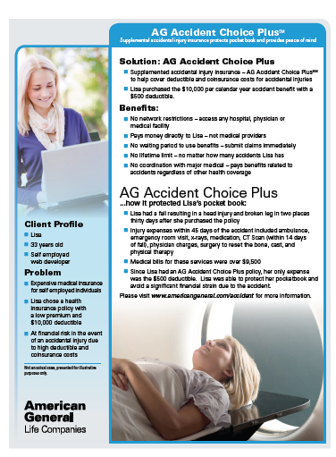
Case Study
Client Profile: Lisa
33 years old, self employed web developer
Problem
Expensive medical insurance for self employed individuals
Lisa purchased health insurance policy with a low premium and $10,000 deductible
Lisa supplemented major medical with AG Accident Choice Plus for $10,000 per calendar year accident benefit with a $500 deductible.
How it works:
Lisa’s fall = head injury + broken leg in 2 places
Injury services = ambulance, ER visit, x-rays, medication, CT Scan, physician charges, surgery, cast, & PT
Injury bills = $9,500
Total out- of- pocket expense = $500
Notes:
Lisa fell: head injury + broken leg in two places 30 days after policy purchase
Injury expenses within 45 days of accident included ambulance, emergency room visit, x-rays, medication, CT Scan (within 14 days of fall), physician charges, surgery, cast, & PT
Medical bills for were over $9,500
Lisa’s total out- of- pocket expense was $500

Slide 13
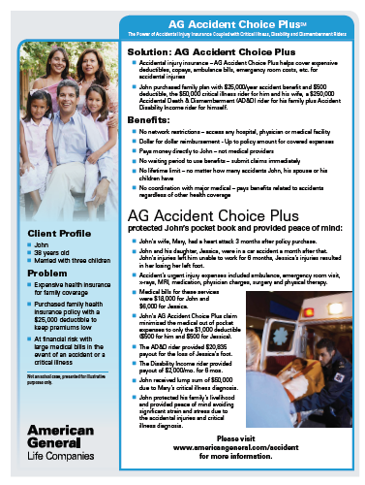
Case Study
Client Profile: John
38 years old, married with 3 children
Problem
Expensive health insurance for family coverage
Purchased family health insurance policy with a $25,000 deductible to keep premiums low
At financial risk with large medical bills in the event of an accident or a critical illness
How it works:
John’s wife suffers heart attack
John’s car accident = John unable to work for 6 months and daughter losing left foot
Injury services = ambulance, ER visit, x-rays, MRI, medication, doctor charges, surgery, & PT
Injury bills = $24,000
Total out-of-pocket expense = $1000
Disability Income rider pays $2k for 6 mos
AD&D rider pays $20,835
Critical Illness rider pays $50,000
Notes:
Lisa fell: head injury + broken leg in two places 30 days after policy purchase
Injury expenses within 45 days of accident included ambulance, emergency room visit, x-rays, medication, CT Scan (within 14 days of fall), physician charges, surgery, cast, & PT
Medical bills for were over $9,500
Lisa’s total out- of- pocket expense was $500

Slide 14
More information
Website: www.americangeneral.com/accident
Marketing Materials: www.americangeneral.com/acp
Health Care Reform video series: www.youtube.com/americangeneralco

Slide 15
AG Accident Choice Plus
Application Process

Slide 16
What Happens Next . . .
eSigned application package transferred to American General Life
New business team enters data into mainframe and reviews the forms
Policy status will be available at eStation.americangeneral.com as soon as data is on mainframe
Policies typically issued within 72 hours
Policy is issued and either (1) eDelivered or (2) printed and mailed (according to agency preferences)
Delivery receipt may be required (depending on state)
Notes:
So what happens next?
Once the agent or client clicks submit … (read text)

Slide 17
It’s Easy to Apply!
Get a quote
Complete a brief questionnaire and let our software automatically populate the required forms
Sign forms electronically using one-click “eSignature” technology:
  eSign face-to-face with client
  Or, client can eSign remotely
1-2-3 … It’s that easy!
Notes:
And now, it’s even easier to apply.
With our new eSignature technology, agents can generate a quote, fill out a few simple forms, and our online software will automatically populate the entire forms package.
Then, with one click, the agent and the client can indicate their signatures on the required forms and click submit.
There are two options for eSigning:
If the client is with the agent, the agent simply turns the mouse over to the client to review the forms and click to sign.
Or, if the client and agent are not together – with a phone sale or Internet transaction, for example – our system will generate an e-mail inviting them to eSign online.
1-2-3. It’s that easy.
Let me demonstrate.

Slide 18
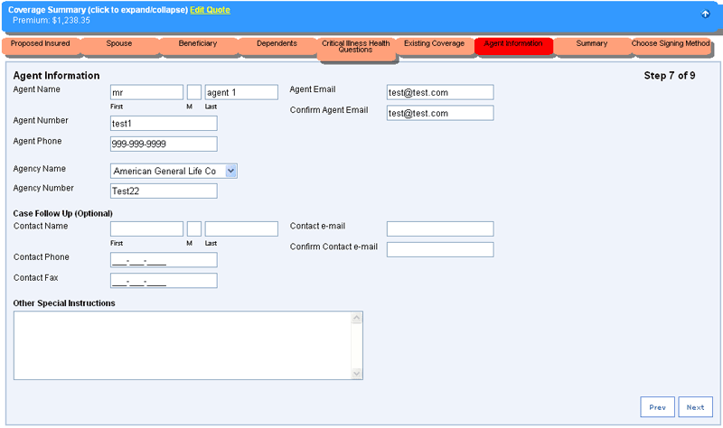
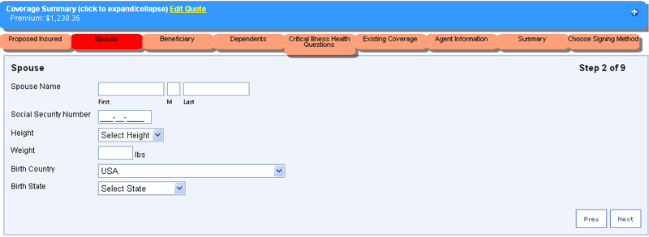
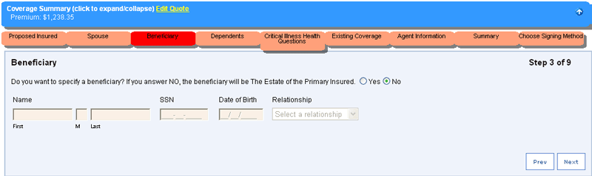
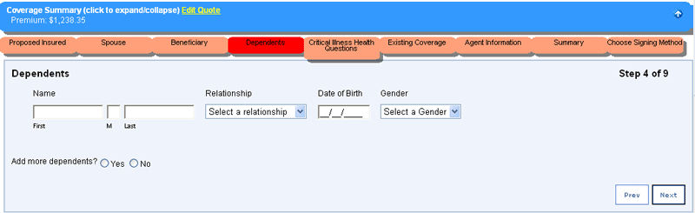
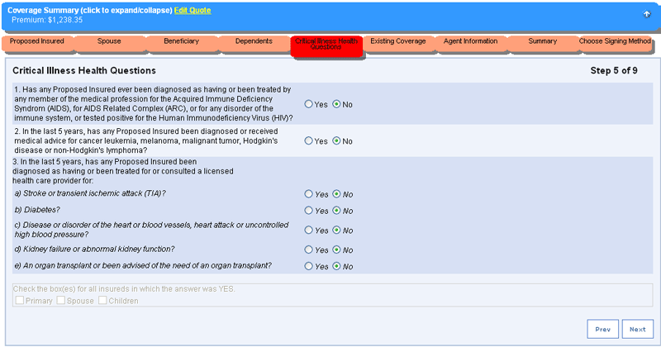
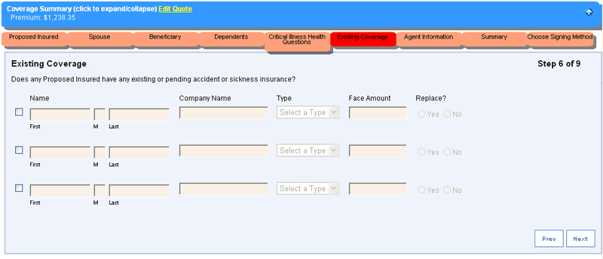
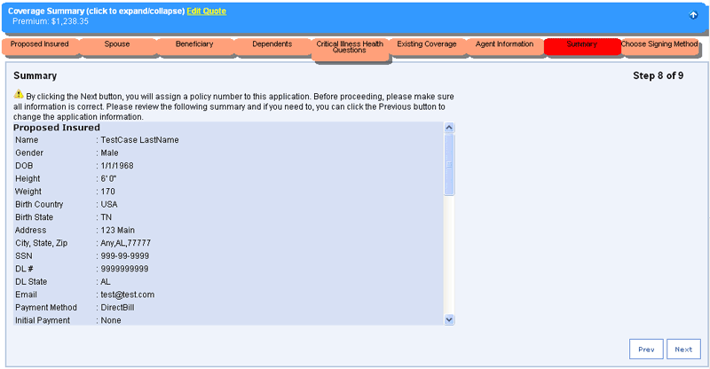
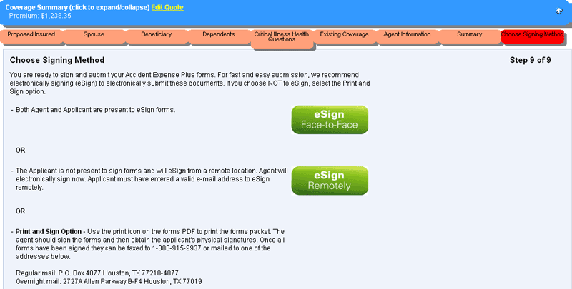
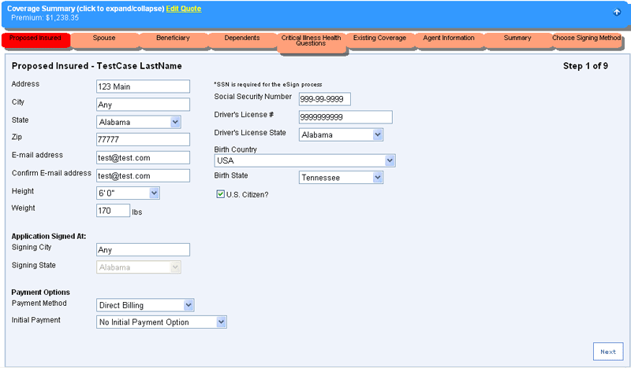
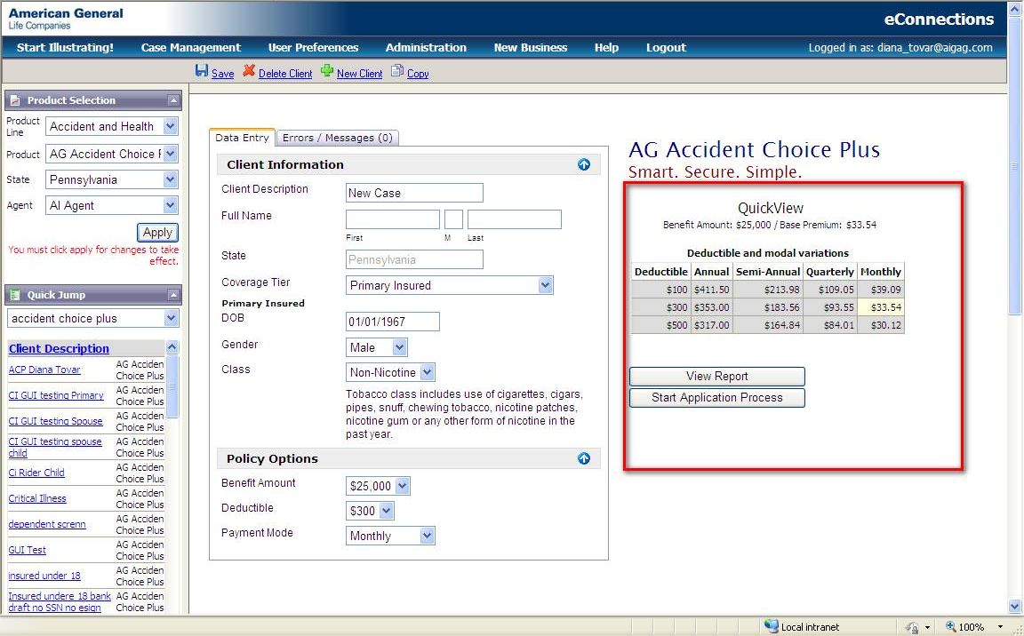
#1 … Get a Quote
#2 … Complete Questionnaire
#3 … Sign and Submit!
FOR PRODUCER USE ONLY – NOT FOR DISSEMINATION TO THE PUBLIC
Notes:
First, to run a quick quote, you enter in the applicant’s name, age and gender and the benefits they’re applying for:
Is it an individual or spouse and family policy?
How much accident coverage do they want?
What’s the deductible amount?
How do they want to pay their premiums?
And finally, do they want optional critical illness coverage?
(click)
The system will automatically generate a quote and the modal options as you enter in the information.
(click)
If the client is happy with the quote, then you’re ready to start the application process.
(click)
So here we have a series of short forms. The software will use the information collected here to automatically populate the application and other required forms in the applicant’s state.
First, you enter basic demographic for the primary insured and payment information.
Depending on the number of insureds, the state of application, the payment method and whether or not your client selected the optional Critical Illness rider, you could have between 6 to 12 steps to complete this part of the process. In this example, we have 9 steps since the client opted for spouse and children coverage, selected critical illness coverage and opted for direct billing (which does not require any extra forms like bank draft or credit card authorizations).
(click)
Next you enter demographic information on the spouse.
(click)
Enter a beneficiary if there is one
(click)
Demographic information for covered children
(click)
The Critical Illness Rider is simplified issue so the proposed insureds answer three simple health questions required to qualify for critical illness coverage. If an applicant answers yes to any of these questions, the system will advise you that the applicant does not qualify for the critical illness rider and give you the option to review your answers or revise the benefit selections.
(click)
Does the client have any existing or pending accident or sickness insurance? If no, just click next to keep going.
(click)
Enter agent information and a case contact if applicable.
(click)
Here is your opportunity to review the client and policy summary. If everything looks correct, click next to assign a policy number to this case and to begin the eSignature process.
(click)
As I mentioned before, there are two options for eSignature:
(click)
If both agent and applicant are together, select eSign Face-to-Face. The client takes control of the computer and follows the instructions to review and eSign each form. Then it’s the agent’s turn to review and eSign the required forms. (click)
If the applicant is not present, choose eSign Remotely. The agent reviews and eSigns the required forms. Then, the system will generate an e-mail to the client with instructions to log on to a secure Website, where the client can complete the eSignature process and submit the application. The agent will get an e-mail alert from the system when the client logs on to the eSignature Website and again once the client has clicked submit.
There is a third option as well. At this point, the agent can print the completed application and agent and client can sign the old-fashioned way (with a pen) and then either fax or mail the signed application to American General.
Now, let’s take a closer look at the eSignature process.
(click)

Slide 19
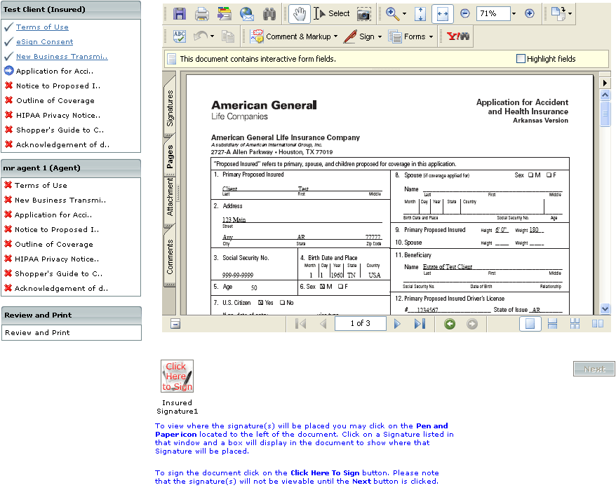
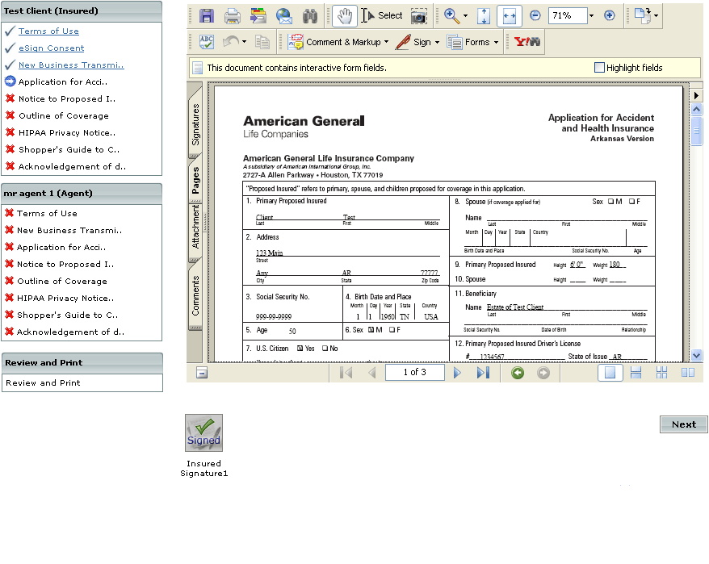
✓
FOR PRODUCER USE ONLY – NOT FOR DISSEMINATION TO THE PUBLIC
Notes:
So here we see the eSignature interface. In the left-hand column, there is a table of contents of the forms to be reviewed. As you progress through the eSignature process, (click) a green check mark will indicate that the client has reviewed and/or eSigned the form.
(click)
The blue arrow indicates the form you are currently reviewing.
(click)
And a red “X” indicates the forms that have not been reviewed.
If a signature is not required on a form, the client simply reviews the forms and clicks next. If a signature is required, (click) you will see a “Click here to Sign” button.
(click)
The client clicks the button and (click) the form is eSigned!
(click)
The client then clicks the “next” button to move on to the next form.
In this example, we are eSigning Face-to-Face so the client will eSign first and then the agent will complete the process. When eSigning remotely, the order is switched and the agent signs first, and the client eSigns last.
(click)

Slide 20
AG Accident Choice Plus
Recurring Credit Card
eConnections/eSignature Processing

Slide 21
Key Points
Recurring credit card available for all payment modals
Electronic app process consists of three basic steps:
  Select “credit card” as a payment option
  Enter in the credit card info (via the Chase Portal which automatically pops up with the credit card selection)
  Validate credit card info

Slide 22
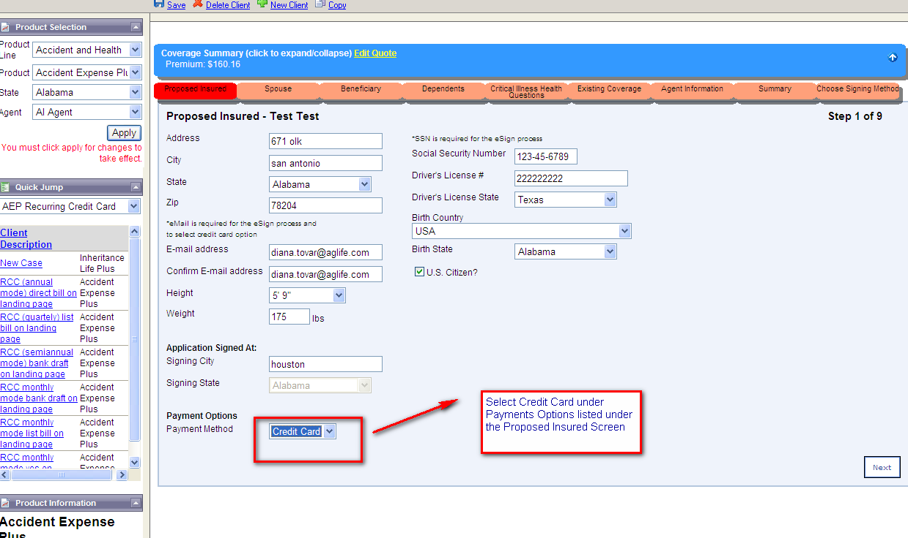
Selecting the Credit Card Option
Select Credit Card under Payment Options listed under the Proposed Insured screen
Accident Choice Plus

Slide 23
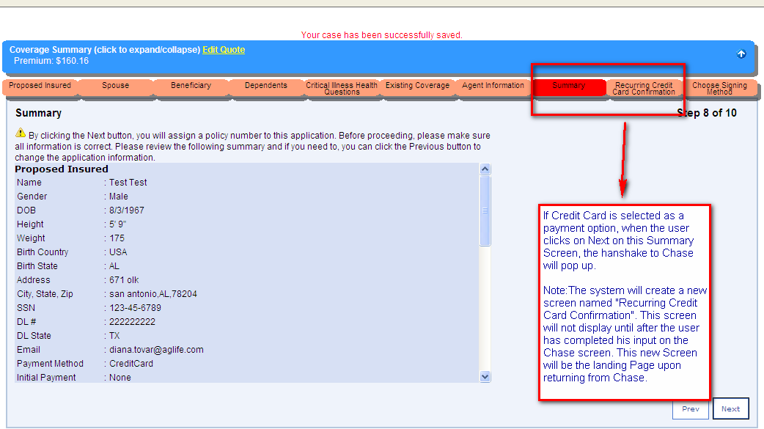
Summary Prior to Credit Card Processing
If Credit Card is selected as a payment option, when the user clicks on Next on this Summary screen, the handshake to Chase will pop up.
Note: The system will create a new screen named “Recurring Credit Card Confirmation”. This screen will not display until after the user has completed his/her input on the Chase screen. The new screen will be the landing page upon returning from Chase.

Slide 24
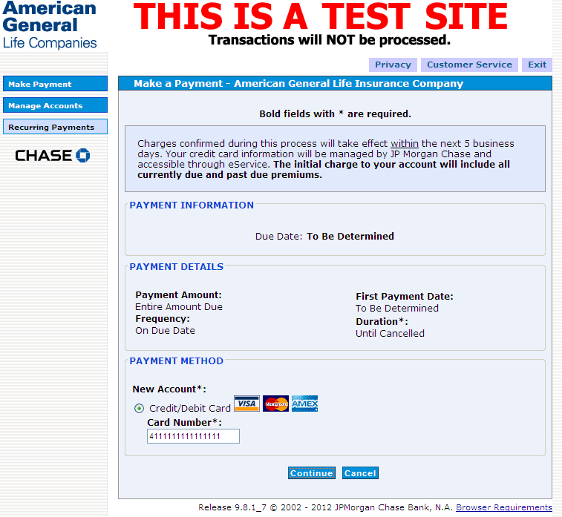
Chase Landing Page
The Chase landing page will display and the user will see this screen once he/she is navigated here from eConn web:
The User will input the Credit Card Number on the above screen and click on Continue.

Slide 25
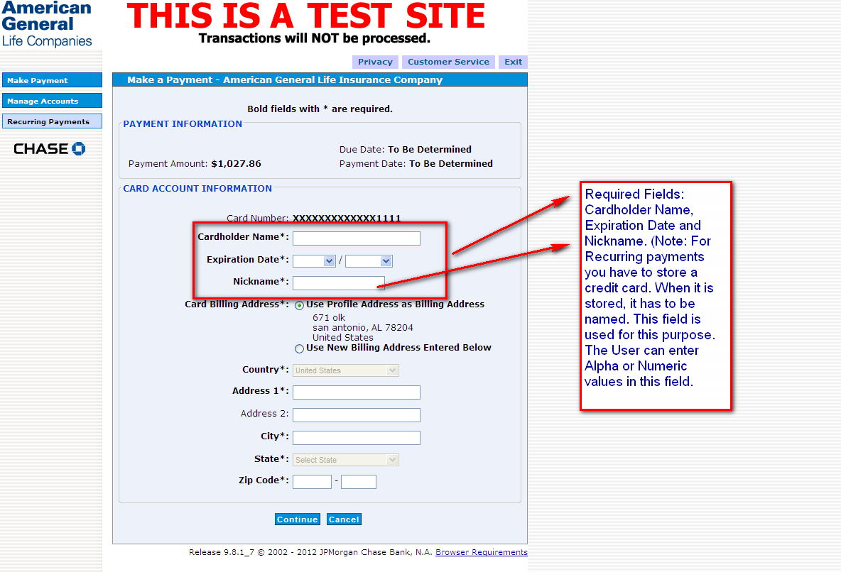
Chase Site – Card Account Information
Since this is an external site the name and address are not carried over from eConnections.
Note: User has option for different cardholder from Primary Insured or different billing address than the one in eConnections Web.
Click continue once data entry is complete

Slide 26
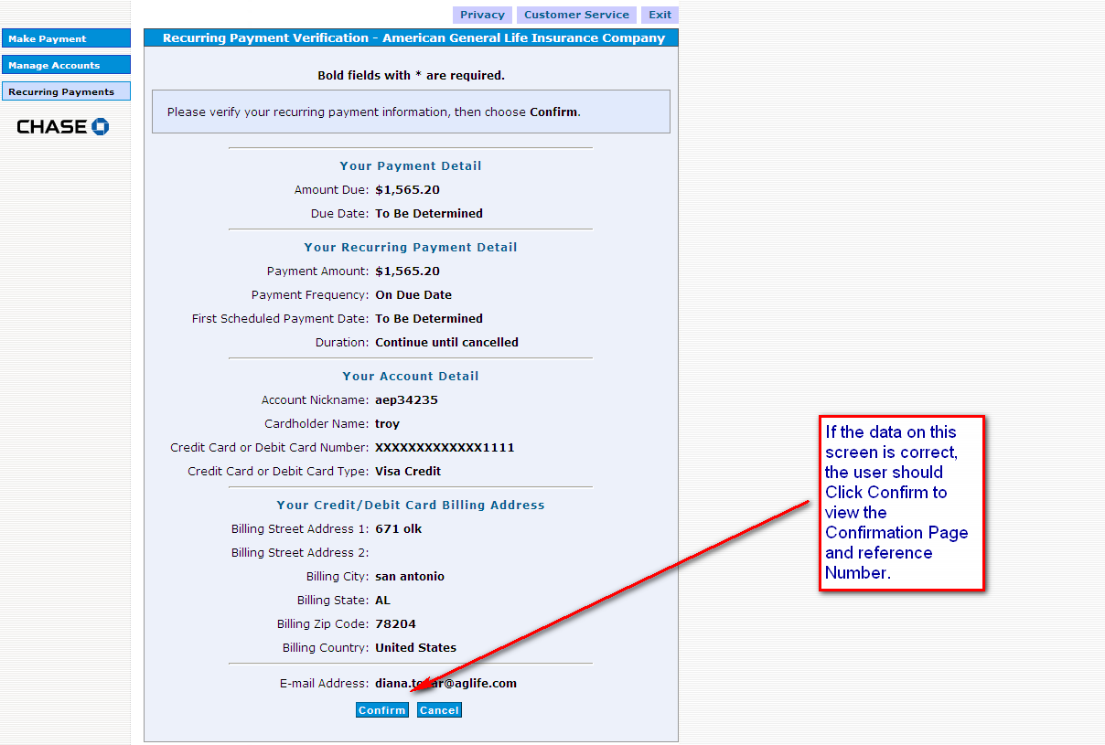
Chase Site – Summary Screen
Good place to include credit card authorization language noted on the next slide.
If the data on this screen is correct, the user should click Confirm to view the Confirmation Page and Reference Number

Slide 27
Script for Recurring Credit Cards
You authorize American General Life Insurance Company to charge your {credit / debit} card ending in (repeat last four digits of credit/debit card number) in the amount of {$XX} on a {monthly, quarterly, semi-annual, annual} basis for premiums due on the insurance policy on (NAME OF PRIMARY INSURED).”
“You will receive an e-mail at the time of the charge to your account. The charge appearing on your credit / bank card statement as well as the e-mail confirmation will be your receipt of payment. Charges on your credit card statement will appear as AGL*INSPYMT. If the charge is dishonored by your credit / bank card company for any reason, your coverage may lapse for nonpayment of premium and you will be notified by us in order to provide payment.”
“Do you agree?” (MUST get an affirmative “YES”)

Slide 28
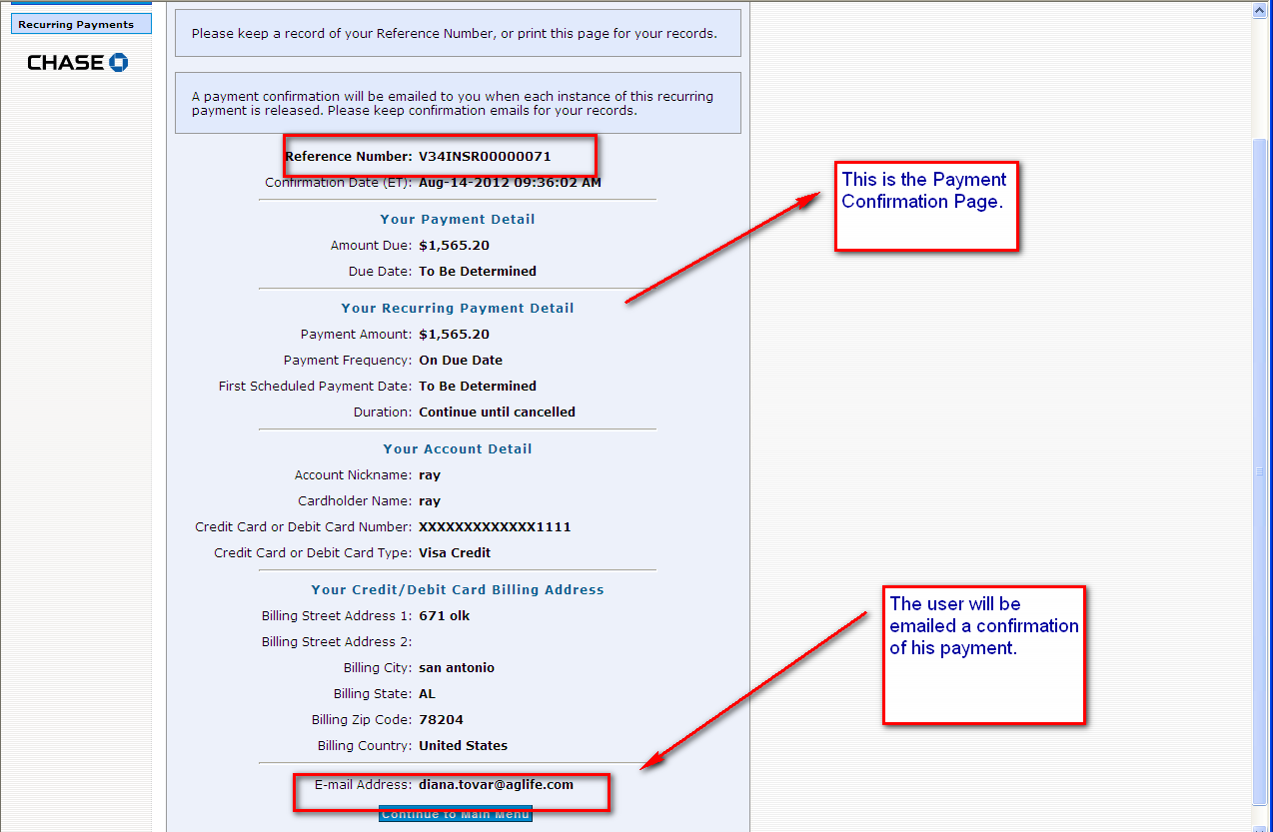
Chase Site – Payment Confirmation Screen
To ensure that the transaction has been completed, AG recommends that you make a note of this in your records and read it to your customer
The User will be emailed a confirmation of his/her payment.

Slide 29
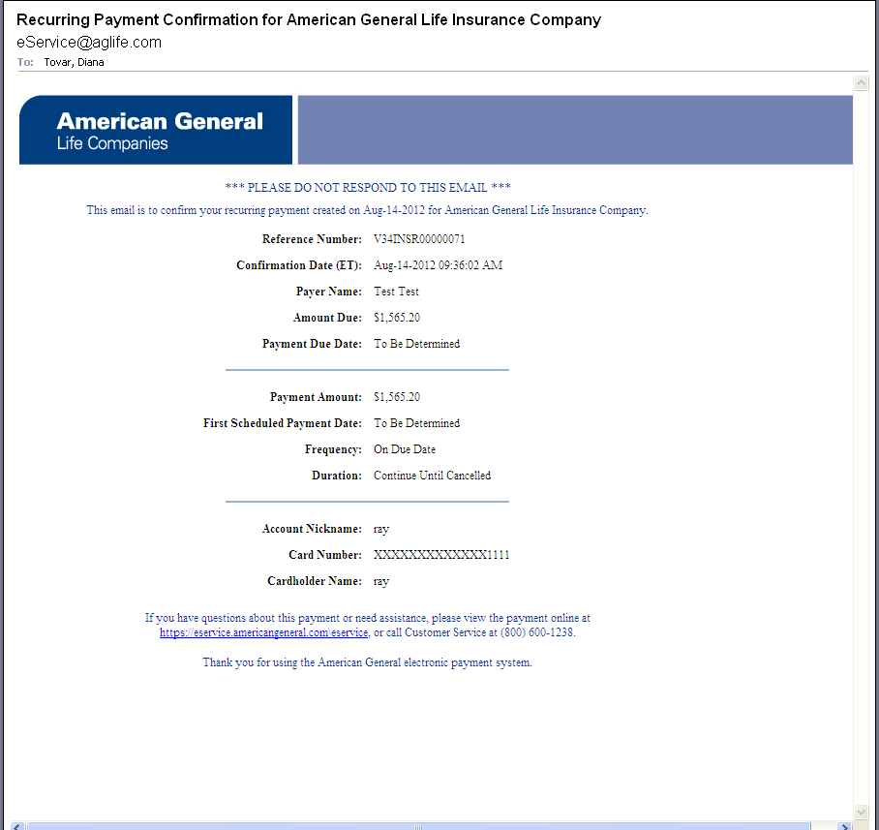
Email Confirmation
This is a copy of the e-mail that will be sent to the cardholder (payor)

Slide 30
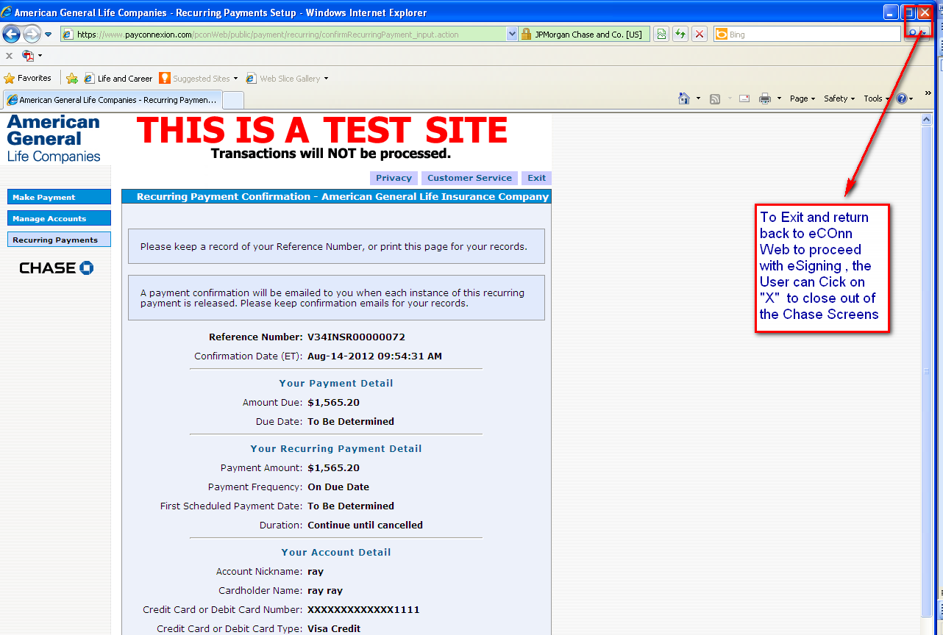
Chase Site - Confirmation Screen
The User Clicks on the X shown above on the Chase Confirmation Page to return to the eConn Web landing page. Note: Email may be delayed in some situations. So the User can click the X button once they receive the Payment Confirmation page at CHASE. They don’t have to wait for the email.

Slide 31
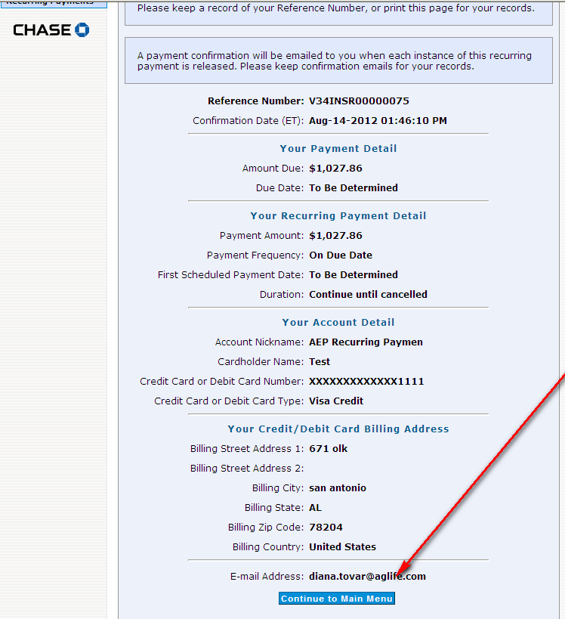
If User Clicks on the Wrong Box . . .
If the User clicks on this button instead of clicking on the X to close the Chase screens, he/she will see the following 2 screens

Slide 32
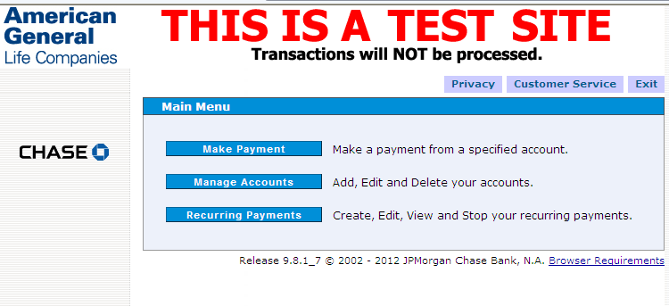
. . . There is an EXIT option on the next screen
The User is required to click Exit to leave this screen and he/she will be navigated to the following screen:

Slide 33
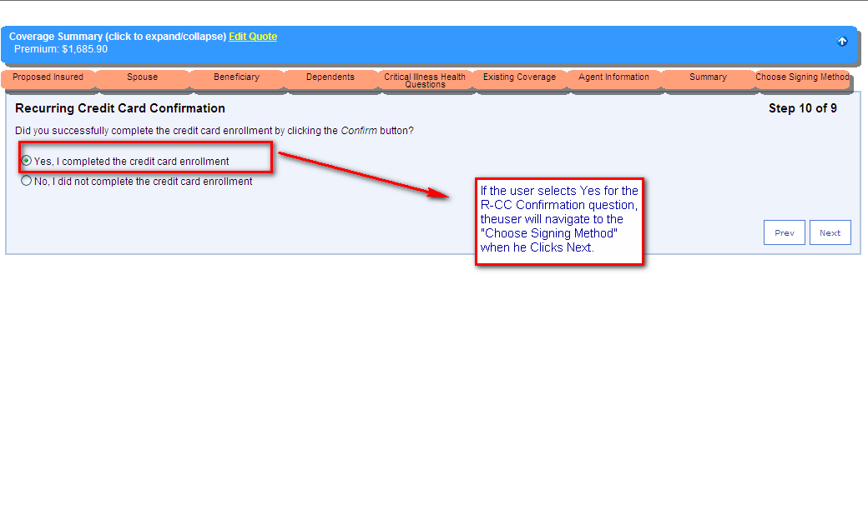
Completing Credit Card Enrollment
If the User selects Yes for the R-CC Confirmation question, the User will navigate to the “Choose Signing Method” when he/she clicks Next

Slide 34
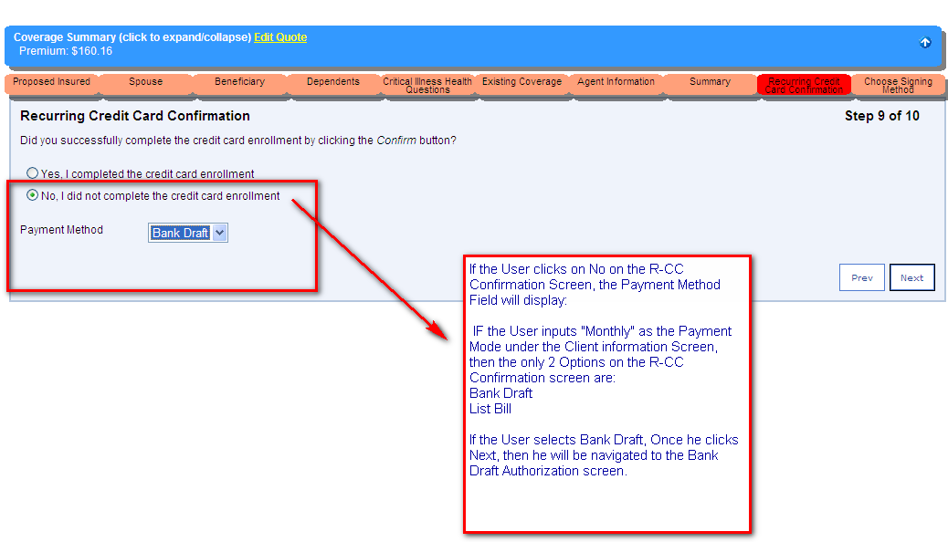
If Credit Card Enrollment is Not Completed . . .
If the User selects No on the R-CC Confirmation screen, the Payment Method field will display:
IF the User inputs “Monthly” as the payment mode under the Client Information screen, then the only 2 options on the R-CC Conformation screen are:
Bank Draft
List Bill
If the User selects Bank Draft, once he/she clicks Next, then he/she will be navigated to the Bank Draft Authorization screen

