Slide 1
How did you manage your project?
EMEE20002 Management Assessment

Slide 2
Contents
Project Summary and Charter
Team Structure
Planning
Executing
Outcomes
Lessons Learned

Slide 3
Project Summary and charter
EEME20002

Slide 4
Project Summary
Who we are
Functional Description
Task overview
Receive command, process and return result
Data Processor
Find the information of peak
Command Processor
NNN detect
Control TX, RX and DP

Slide 5
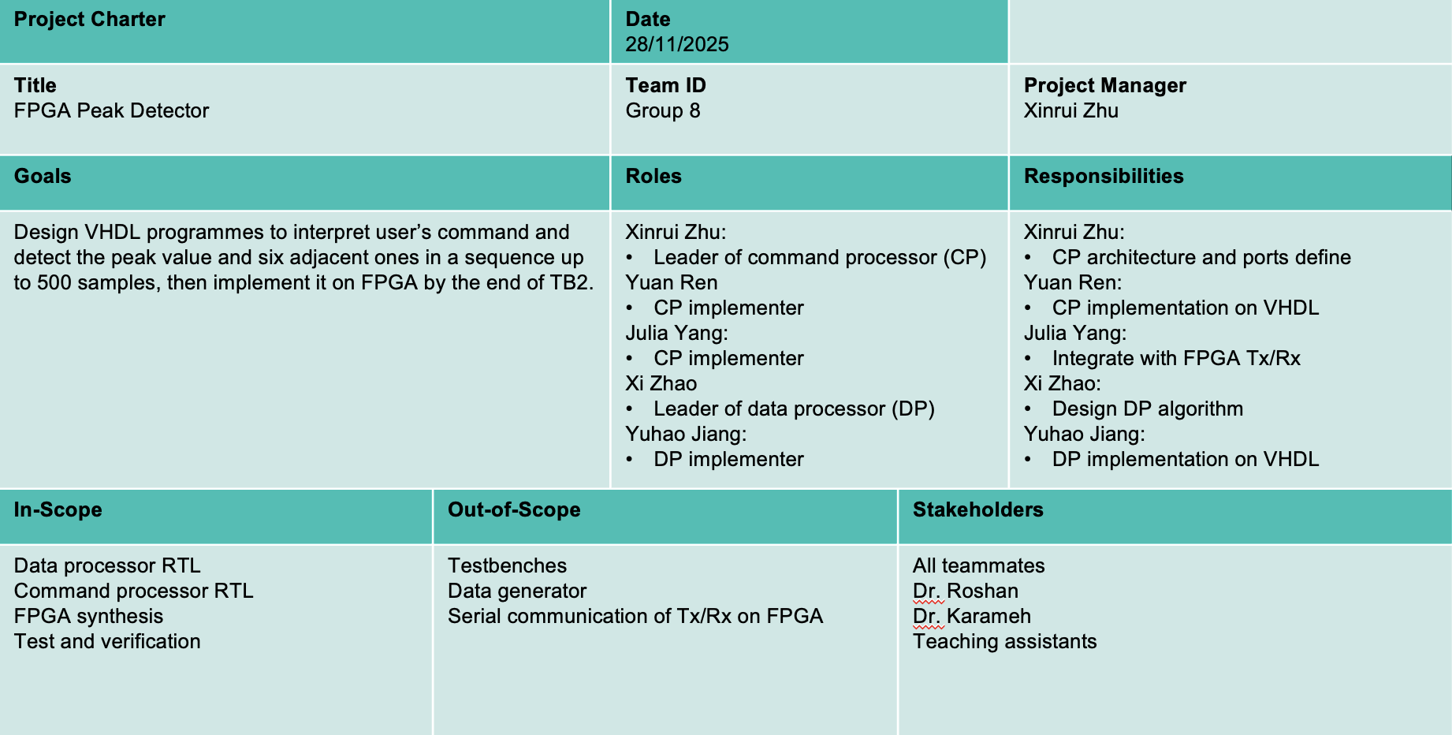
Project Charter: Overall

Slide 6
Project Charter: In Scope
DP & CP development
From algorithm to HDL
From simulation to synthesis & on board
Testbench for internal small modules
Integration with provided modules
Documentation

Slide 7
Project Charter: Out of Scope
Data generator
TX, RX
Testbenches
Only for some internal small submodules
Power, area
Performance
Only latency considered

Slide 8
Project Charter: Constraints
Specifications
100MHz at minimum
Hardware
Specified FPGA model
Limited computation resources
Compatibility with provided modules
Deadline
16th, April

Slide 9
Project Charter: Deliverables & Targets
Deliverables
VHDL source code
Technical report
Video on group management
Targets
Learn digital design process
Learn group collaboration

Slide 10
TEAM structure
EEME20002

Slide 11
Team Structure: Overall
Data Processor Team
Yuan Ren
Julia Yang
Command Processor Team
Xinrui Zhu
Yuhao Jiang
Xi Zhao

Slide 12
Team Structure: Yuan Ren
Lead
VHDL implementation
Code review
Report documentation
Support
Simulation and debugging
Meeting organisation

Slide 13
Team Structure: Julia Yang
Lead
Algorithm & FSM design
Simulation and debugging
Report Writing (DP part)
Support
System integration
Liaison with teaching staff

Slide 14
Team Structure: Xinrui Zhu
Lead
System architecture design
Core FSM/ASM design
System integration
GitHub repository management
Support
VHDL implementation
Code review

Slide 15
Team Structure: Yuhao Jiang
Lead
IO controller design
VHDL implementation
Support
Simulation and debugging
Progress tracking
Report documentation (CP part)

Slide 16
Team Structure: Xi Zhao
Lead
Simulation and debugging
Report Writing (CP part)
Progress tracking
Support
VHDL implementation
Code review

Slide 17
planning
EEME20002

Slide 18
Planning: Methodology
Task division
Work breakdown structure (WBS)
Timeline & stage deliverables
Gantt chart
Risk control
Risk register table

Slide 19
Planning: Work Breakdown Structure
FPGA peak Detector
Algorithm level
Register level
Assemble
Synthesis
Submission
DP pseudocode
CP FSM
Port define
Logic design
Interconnection
CP VHDL
Design & Simulate
DP VHDL
Write code
Packaged VHDL
Link generator
FPGA Bitstream
Link Rx & Tx
Timing constraint
Report
FPGA Product
Video
Design testbench
Simulate
Test & verify

Slide 20
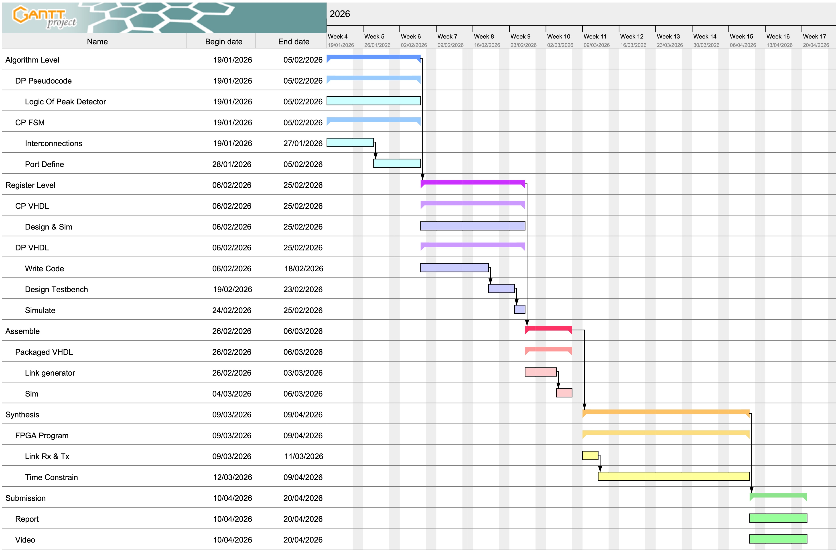
Planning: Gantt Chart

Slide 21
Planning: Risk Register
Date | Raised By | Description | Likelihood | Severity | Risk | Mitigation | Owner
28/11/2025 | Xi Zhao | Member doesn’t complete his own work before a certain deadline. | 2 | 2 | 4 | Arrange weekly meeting to check individual’s progress. | Xi Zhao
28/11/2025 | Xinrui Zhu, Yuan Ren | Simulation result doesn’t meet expectation. (e.g. can’t detect peak) | 4 | 4 | 16 | Draft the code after the algorithm is finished, pay attention to syntax errors. | Xinrui Zhu
28/11/2025 | Xinrui Zhu | FPGA timing doesn’t converge | 4 | 5 | 20 | Get familiar with FPGA workflow from lectures. | Xinrui Zhu
28/11/2025 | Yuan Ren | Team member becomes unavailable (e.g. accidentally injured) | 1 | 5 | 5 | Optimise work distribution and prepare for online collaboration. | Yuan Ren
29/11/2025 | Yuhao Jiang | FPGA board is malfunctioned or damaged | 1 | 5 | 5 | Test the functions at first time, contact university staff for replacement early. | Yuhao Jiang
01/12/2025 | Julia Yang | Inconsistent coding styles of developers leads to inconsistent module interfaces | 3 | 1 | 3 | Write ReadMe document to define essential specs, add comments next to critical code sections. | Julia Yang

Slide 22
Planning: Limitations
Limited task information available
Limited familiarity with FPGA development process

Slide 23
executing
EEME20002

Slide 24
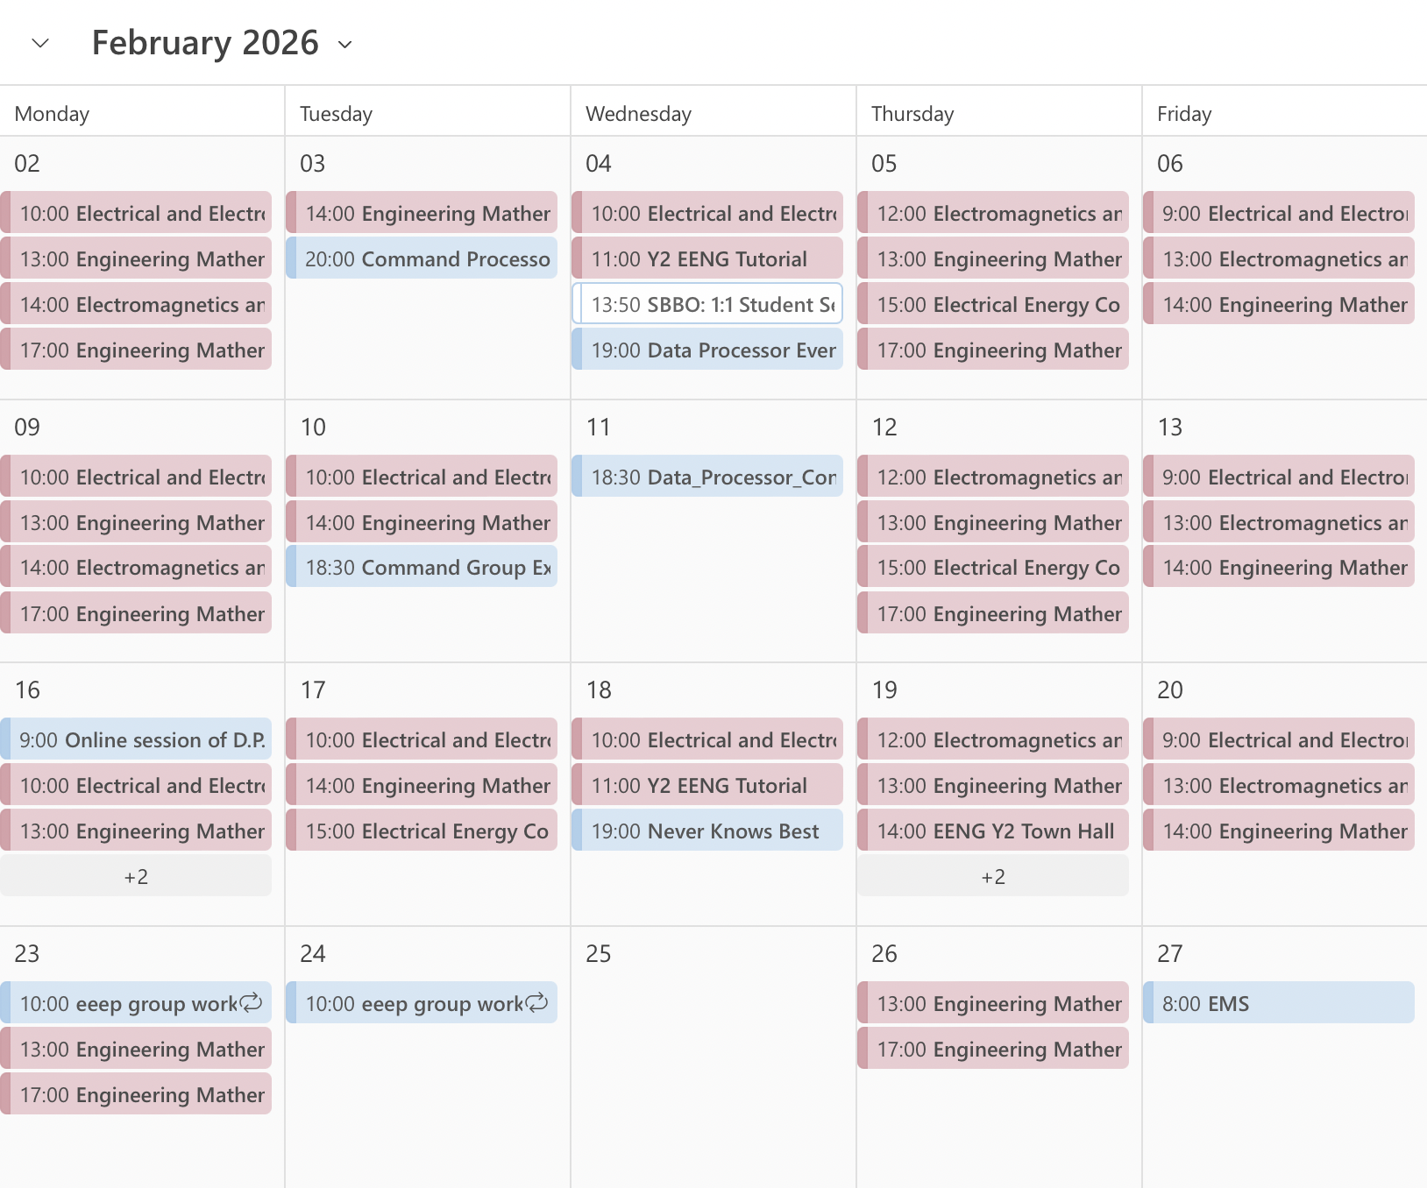
Executing: Coordination
Meetings in person
Two three-hour sessions
Focus on project development
Online meetings on Teams
Learn, evaluate and prepare for next-step
GitHub: code collaboration
GoofyAsh6795395/FPGA-peak-detector

Slide 25
Executing: Coordination
Meetings in person
Two three-hour sessions
Focus on project development
Online meetings on Teams
Learn, evaluate and prepare for next-step
GitHub: code collaboration
GoofyAsh6795395/FPGA-peak-detector

Slide 26
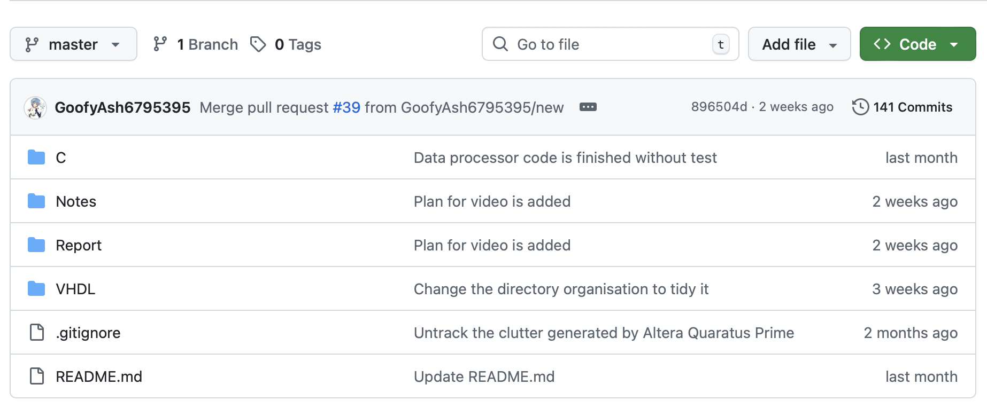
Executing: Coordination
Meetings in person
Two three-hour sessions
Focus on project development
Online meetings on Teams
Learn, evaluate and prepare for next-step
GitHub: code collaboration
GoofyAsh6795395/FPGA-peak-detector

Slide 27
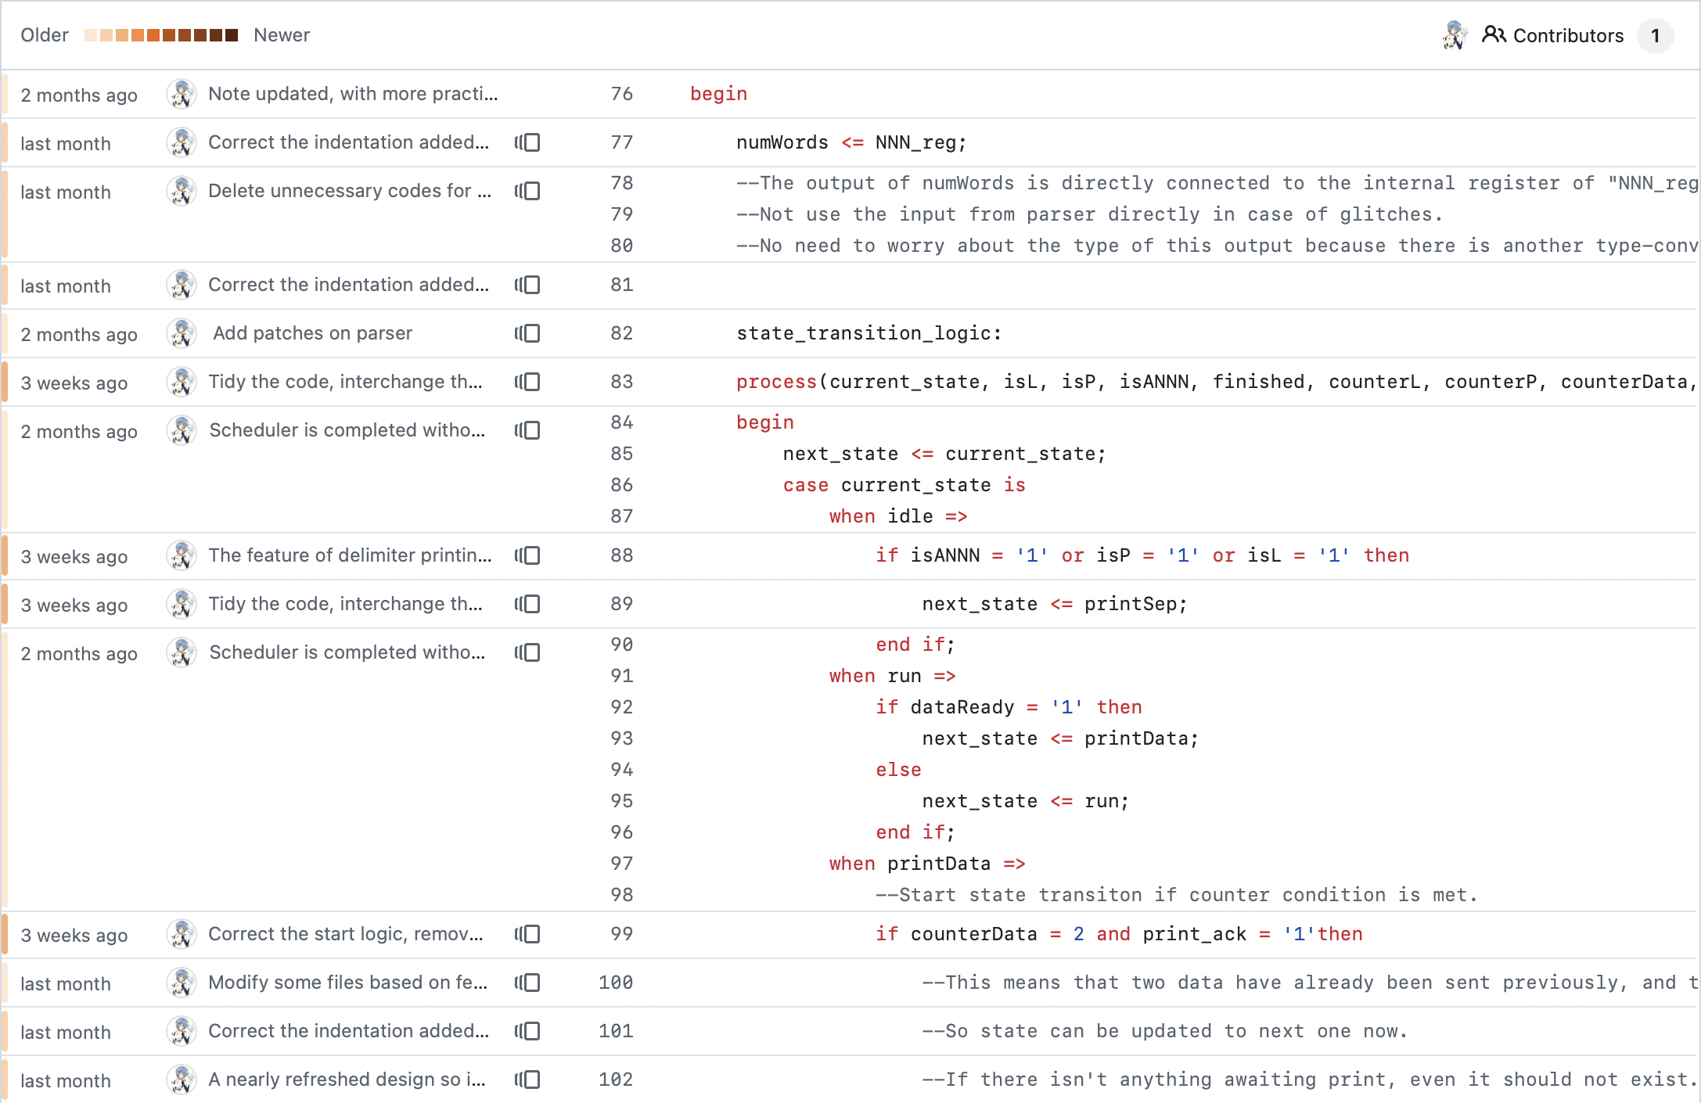
Executing: Progress Tracking
Report orally in person
Communicate on IM software
On GitHub
Blame
Pull requests
Commit and File changes
In-code development log
Rationale, outstanding tasks

Slide 28
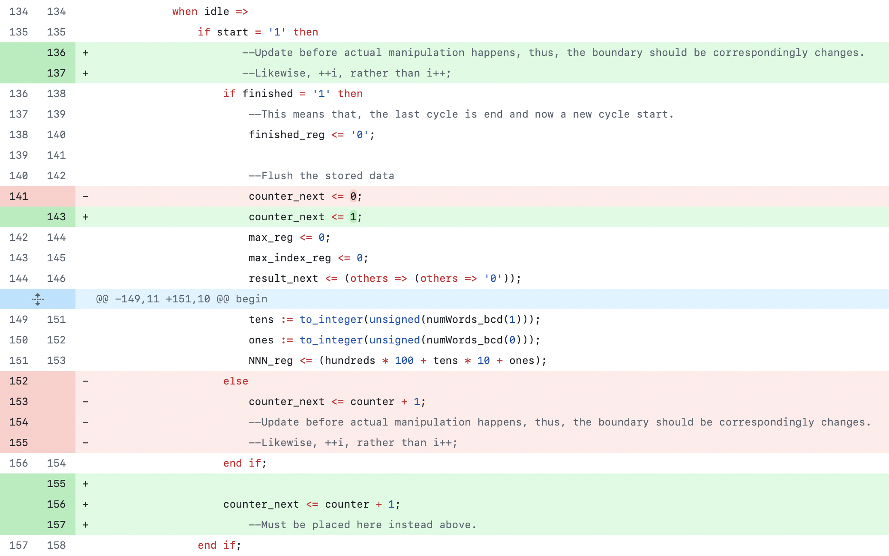
Executing: Progress Tracking
Report orally in person
Communicate on IM software
On GitHub
Blame
Pull requests
Commit and File changes
In-code development log
Rationale, outstanding tasks

Slide 29
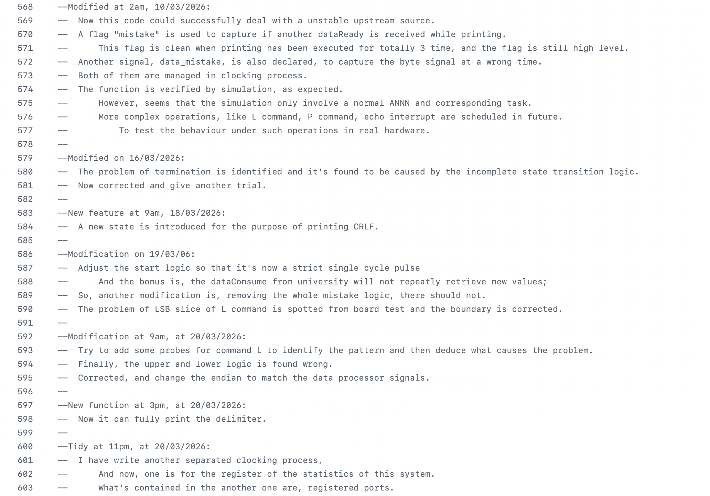
Executing: Progress Tracking
Report orally in person
Communicate on IM software
On GitHub
Blame
Pull requests
Commit and File changes
In-code development log
Rationale, outstanding tasks

Slide 30
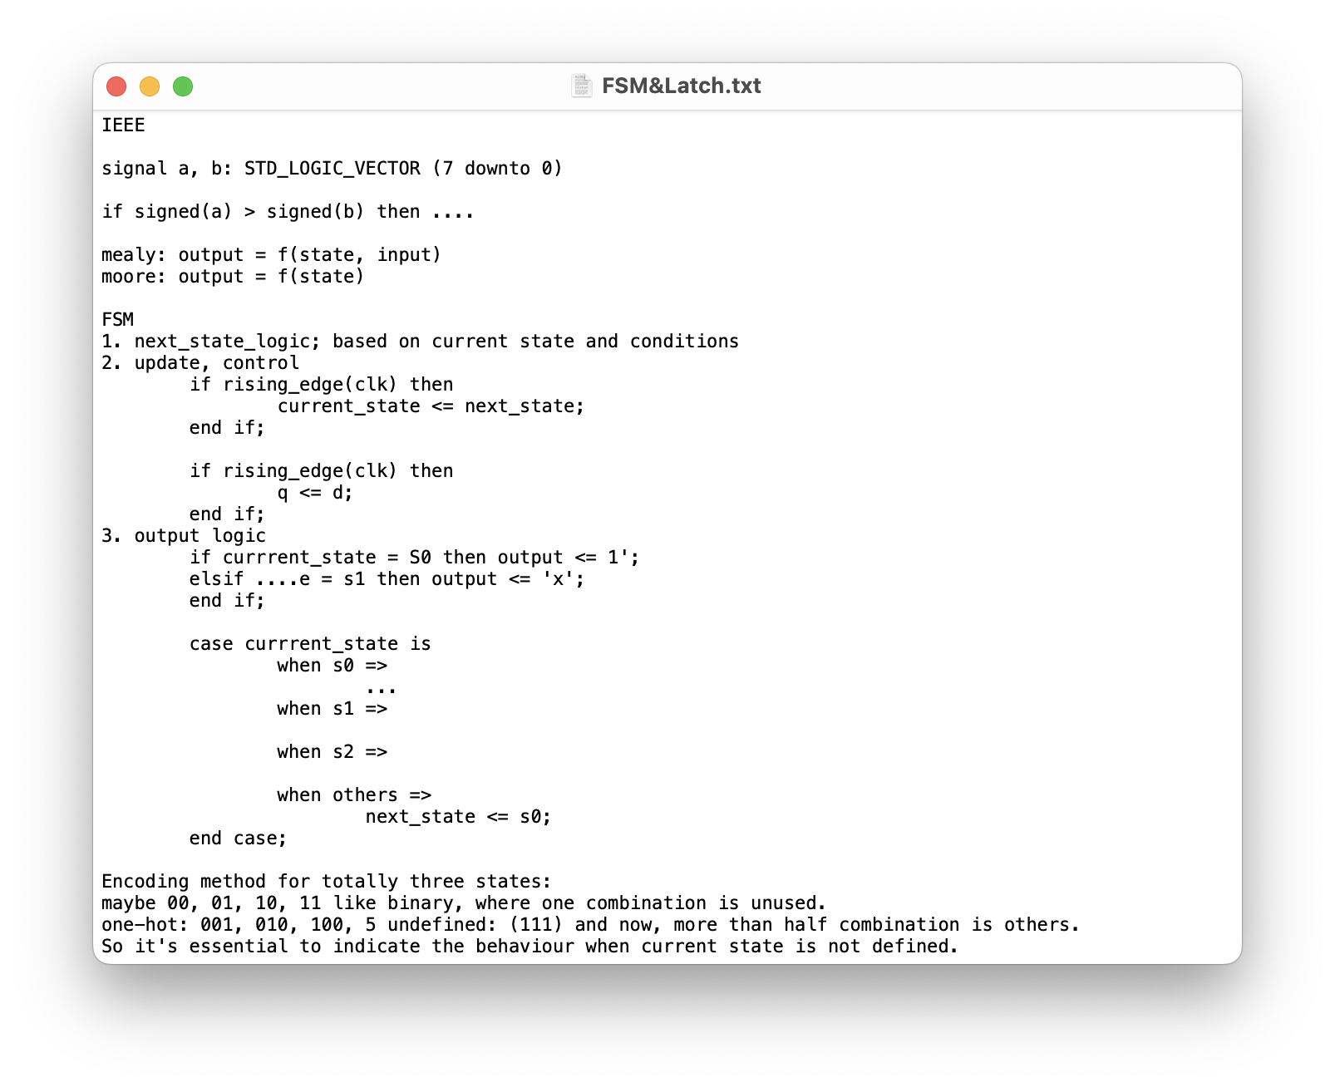
Executing: Technical Issues
Limited familiarity with GitHub
Centralised management
Uneven retention of VHDL
Limited prior exposure to Vivado
Targeted online tutorials

Slide 31
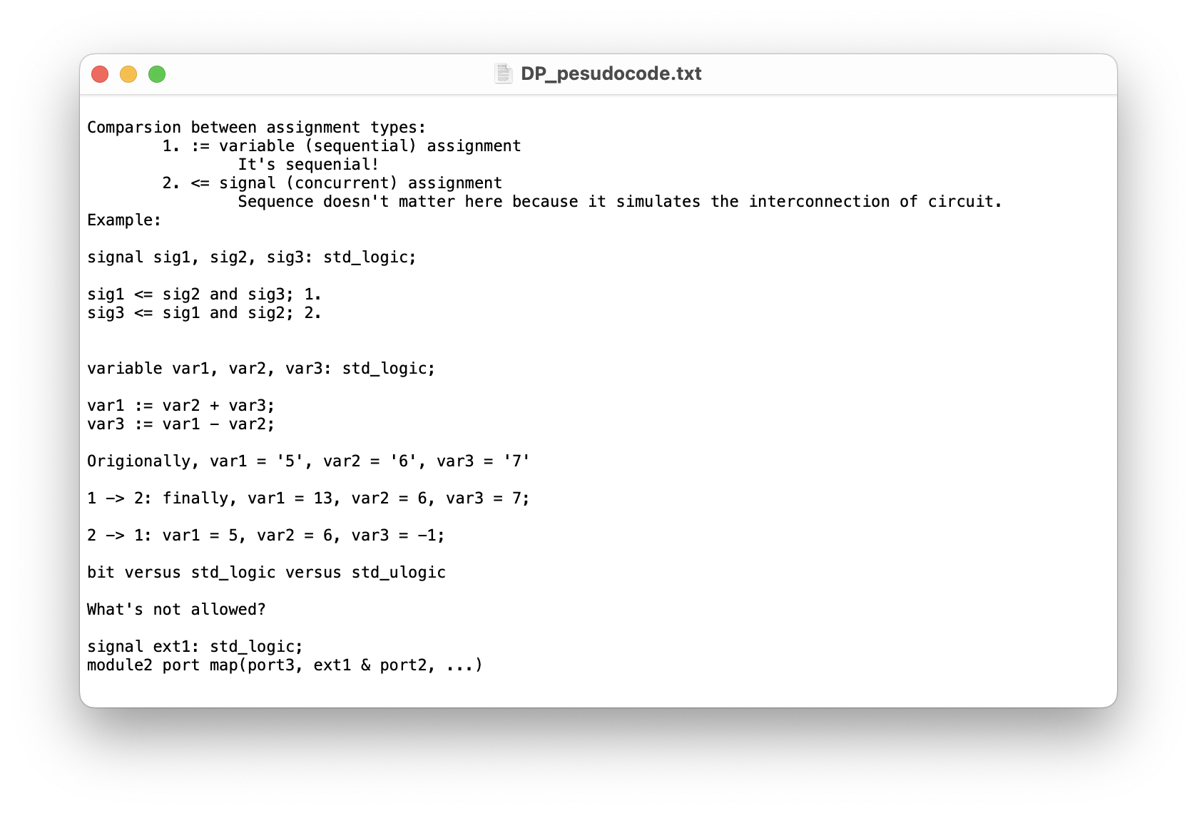
Executing: Technical Issues
Limited familiarity with GitHub
Centralised management
Uneven retention of VHDL
Limited prior exposure to Vivado
Targeted online tutorials

Slide 32
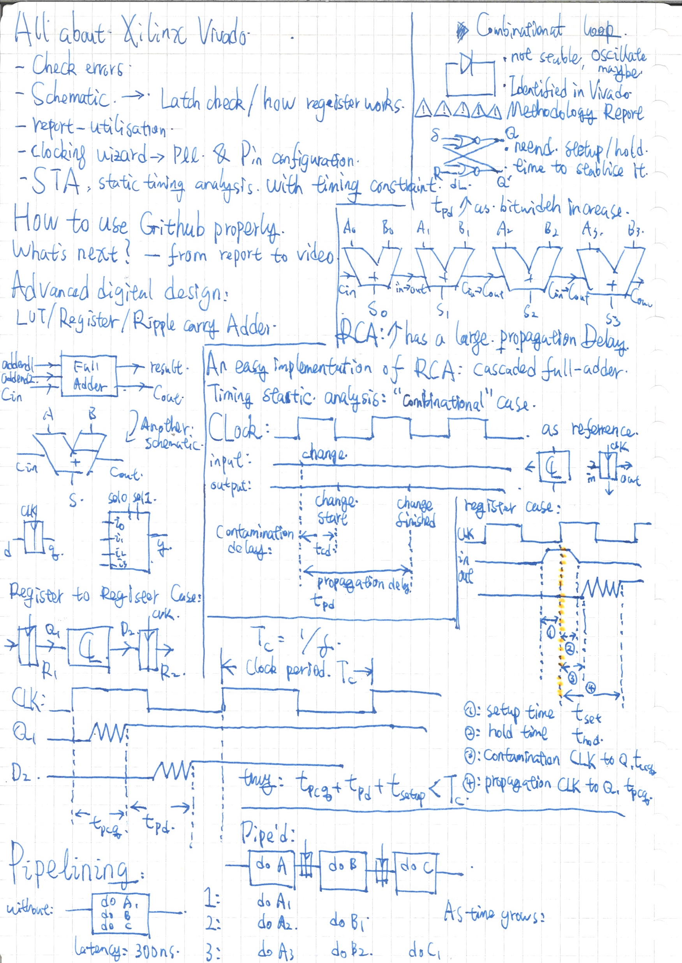
Executing: Technical Issues
Limited familiarity with GitHub
Centralised management
Uneven retention of VHDL
Limited prior exposure to Vivado
Targeted online tutorials

Slide 33
Executing: Management Issues
Inaccurate time estimation
Longer than expectation
Algorithm & Simulation
Short than expectation
Assemble
Incomplete task division
Video & Report part
Re-evaluate the task
Based on progress and difficulty
Leave time slack for some deliverables
Update WBS, Gantt Chart

Slide 34
outcomes
EEME20002

Slide 35
Outcomes: FPGA Product
Functional requirements satisfied
Enhanced echo function
Not interrupted by output stream
Higher frequency than expected
CP: 183 MHz
DP: 175 MHz
Overall: 151 MHz

Slide 36
Outcomes: Team collaboration
Clear task allocation
Regular meetings
Internal knowledge sharing

Slide 37
LESSONS learned
EEME20002

Slide 38
Lessons Learned: In Summary
Project management tools
Gantt chart, WBS, risk register
Collaboration tools
Teams, GitHub
Technical
Digital design approach: VHDL syntax, FSM/ASM design
Industrial toolchain
Questa: VHDL writing, simulation
Xilinx Vivado Design Suite: synthesis, implementation

Slide 39
Lessons Learned: In Future
Better task interpretation before planning
A more detailed plan
Include non-technical tasks
Improve communication efficiency
Prepare before meeting
Take actions after meeting

