Slide 1

We’ll be starting the session shortly!
Please keep yourself on MUTE.

Slide 2
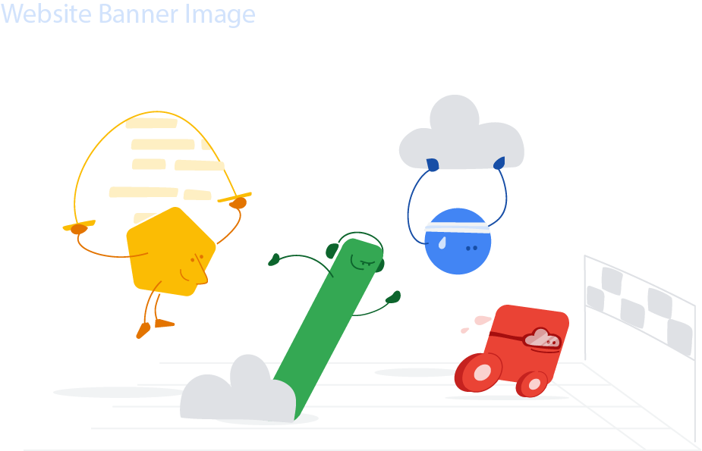
30 Days of Google Cloud
For the GDSC India Campuses
Info Session

Slide 3
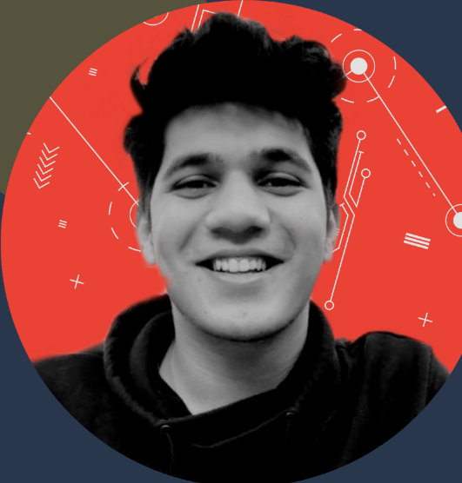
Maaz Modak
Facilitator,
#30DaysofGoogleCloud

Slide 4
Session Agenda
1
5 min
Recent events
2
10 min
Intro
3
15 min
Syllabus of the program
4
5 min
Schedule
5
5 min
Rewards 👀
6
15 min
Q&A
Notes:
recent events
intro
syllabus
schedule
rewards
qna

Slide 5
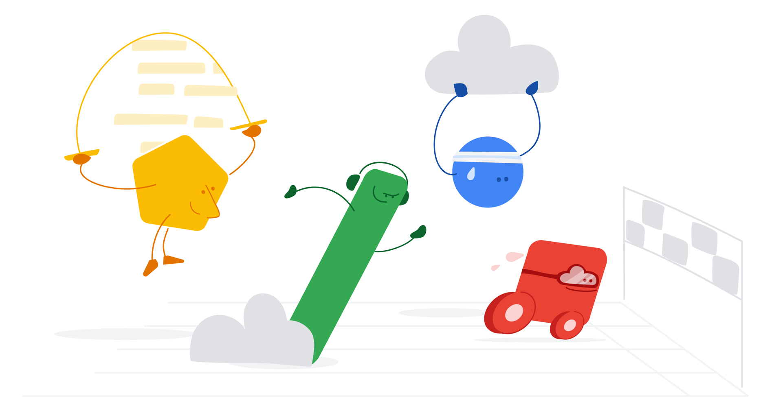
Introduction to
30 Days Of Google Cloud
Notes:
To get those industry skills, let’s begin your journey with the 30 Days of Google Cloud program. Let us tell you how your program journey would look like.
Begin your journey to cloud with 30 Days of Google Cloud.

Slide 6
Unlock your benefits in 30 days
Gain hands-on experience
Learn real-world skills on the Google Cloud console using Qwiklabs
Prove you have in-demand skills
Take the challenge lab at the end to prove that you have the required skills
Share your accomplishments
Share your skill badges with your network and on your resume
Notes:
After you acquire them, do remember to add them on your resume and professional profiles and share it with your network to prove that you have the in-demand skills. We have a total of 6 skills badges to be earned for each track!

Slide 7
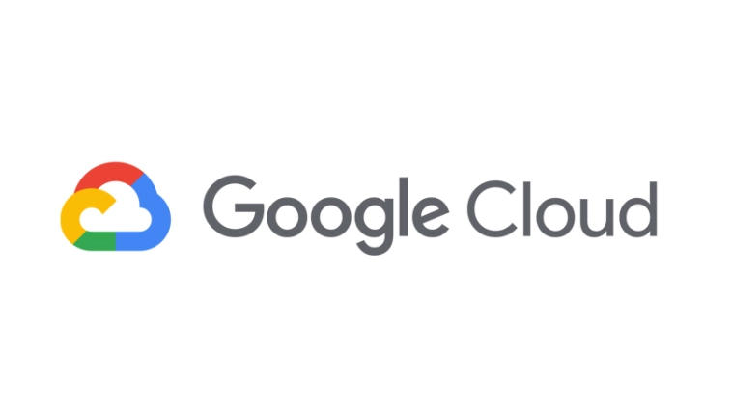

What is Qwiklabs?

Slide 8
Contents of the program
Track 1: Cloud Engineering
Here are the 2 tracks
Track 2: Data Science & Machine Learning
Now let’s go over the different tracks that we have in the program on which you will be trained.
Notes:
[Read the content on the screen]
Let’s go over each track one by one.

Slide 9
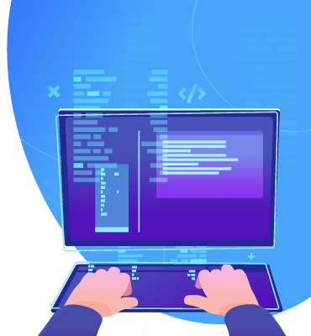
Track 1: Cloud Engineering
Explore and deploy solution elements, including infrastructure components such as networks, systems, and applications services.
Getting Started: Create and Manage Cloud Resources
Perform foundational infrastructure tasks in Google Cloud
Setup and Configure a Cloud Environment in Google Cloud
Deploy and Manage Cloud Environments with Google Cloud
Build and Secure Networks in Google Cloud
Deploy to Kubernetes in Google Cloud
Notes:
First track that we have in the program is the “Cloud Engineering” track. By completing the quests under the Cloud Engineering track, you will learn to explore and deploy solution elements, including infrastructure components such as networks, systems, and applications services.
We have a total of 6 quests under this track that will be covered through training sessions starting next week.
Let’s take a look at the second track!

Slide 10
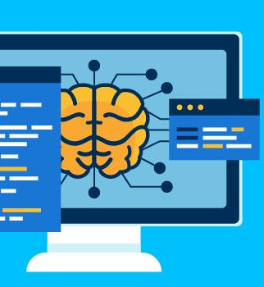
Track 2: Data Science & Machine Learning
Learn & demonstrate proficiency in key data & ML topics to prepare for roles in data, marketing & business.
Getting Started: Create and Manage Cloud Resources
Perform Foundational Data, ML, and AI Tasks in Google Cloud
Insights from Data with BigQuery
Engineer Data in Google Cloud
Integrate with Machine Learning APIs
Explore Machine Learning Models with Explainable AI
Notes:
For Track 2, we have the “Data Science & Machine Learning” track. By completing the quests in this track, you will learn and demonstrate proficiency in key topics related to big data and machine learning to prepare for roles such as data analyst, marketing analyst, business intelligence professional, and data engineer. This track also consists of 6 quests.
I am sure you are curious to know about the campaign timelines and training schedules. You hear more about it in the slides ahead.

Slide 11
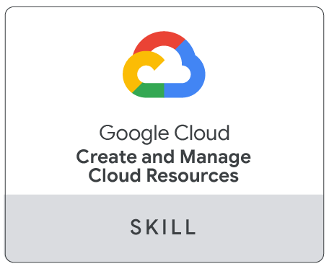
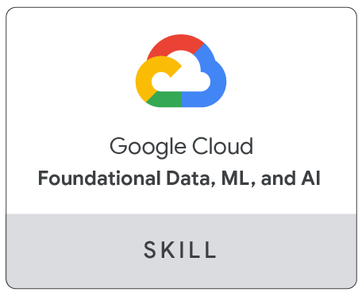
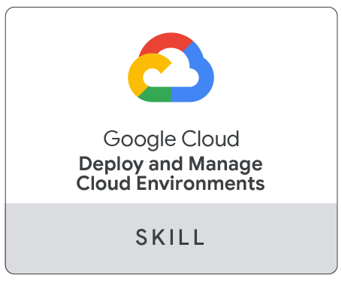
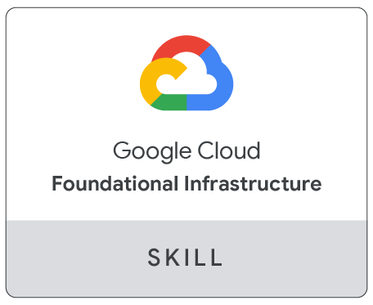
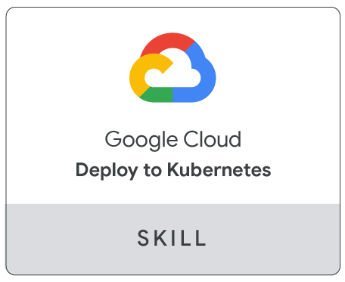
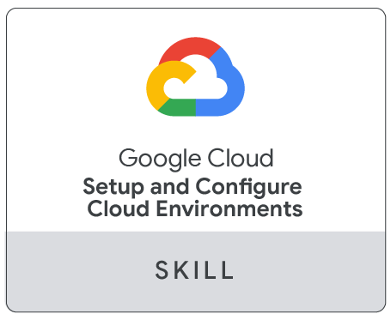
Google Cloud Skill Badges
What is a skill badge?
An exclusive digital Google Cloud skill badge demonstrates your growing Google Cloud recognized skillset.
How do I earn a skill badge?
Show your cloud skills by completing a series of hands on labs, including a final assessment challenge lab, to test your skills and earn a Google Cloud skill badge to share with your network.
Show us your skills
by earning all of them!
Notes:
After completing each quest from either of the tracks, you have a chance of earning Google Cloud Skill Badges. Skill badges are used to show that you have actually applied your new learned skills using a challenge lab at the end where you have to take your new learned skills for a test drive.

Slide 12
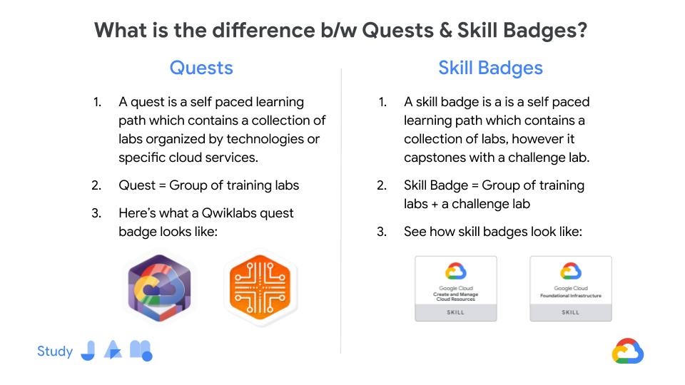

Slide 13
Campaign
Schedule

Slide 14
Timelines of the program
Info session on:
Sep 25th
30 Days of Google Cloud campaign: Sep 27th - Oct 27th
Drive completions by: Oct 27th
to be eligible for
your rewards
Notes:
Okay moving on to how the program schedule would look like once you are done with your training? After this training session, you will have to complete either of the tracks yourself and start onboarding your peers - we will tell you how you can do this at the end of this call, so don’t worry about this right now.
After onboarding them, we would leave it upto you on how you want to drive the program - conduct study jams, drop emails to your peers, message them etc.
As soon as everything is done, we will send you your certificates and also goodies to you and your peers!!

Slide 15
How the program schedule would look like?
 |  | Week 0 (Sep 25) | Week 1 (Oct 1 - Oct 3) | Week 2 (Oct 8 - Oct 10) | Week 3 (Oct 15 - Oct 17) | Week 4 (Oct 22 - Oct 27)
For Students | Friday (4.30 - 6pm) |  | Track 1 Module 1 & 2 | Track 1 Module 3 & 4 | Track 1 Module 5 & 6 | Drive Campaign completion
 | Saturday (4 - 6 pm) | Info Session We are here | Track 2 Module 1 & 2 | Track 2 Module 3 & 4 | Track 2 Module 5 & 6
 | Sunday (4 - 6pm)

Slide 16
Learning
30 Days Of
Building
Sharing
Growing

Slide 17
Rewards for students

Slide 18
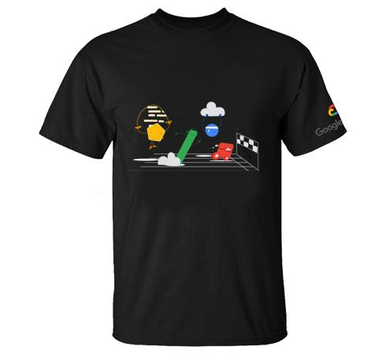
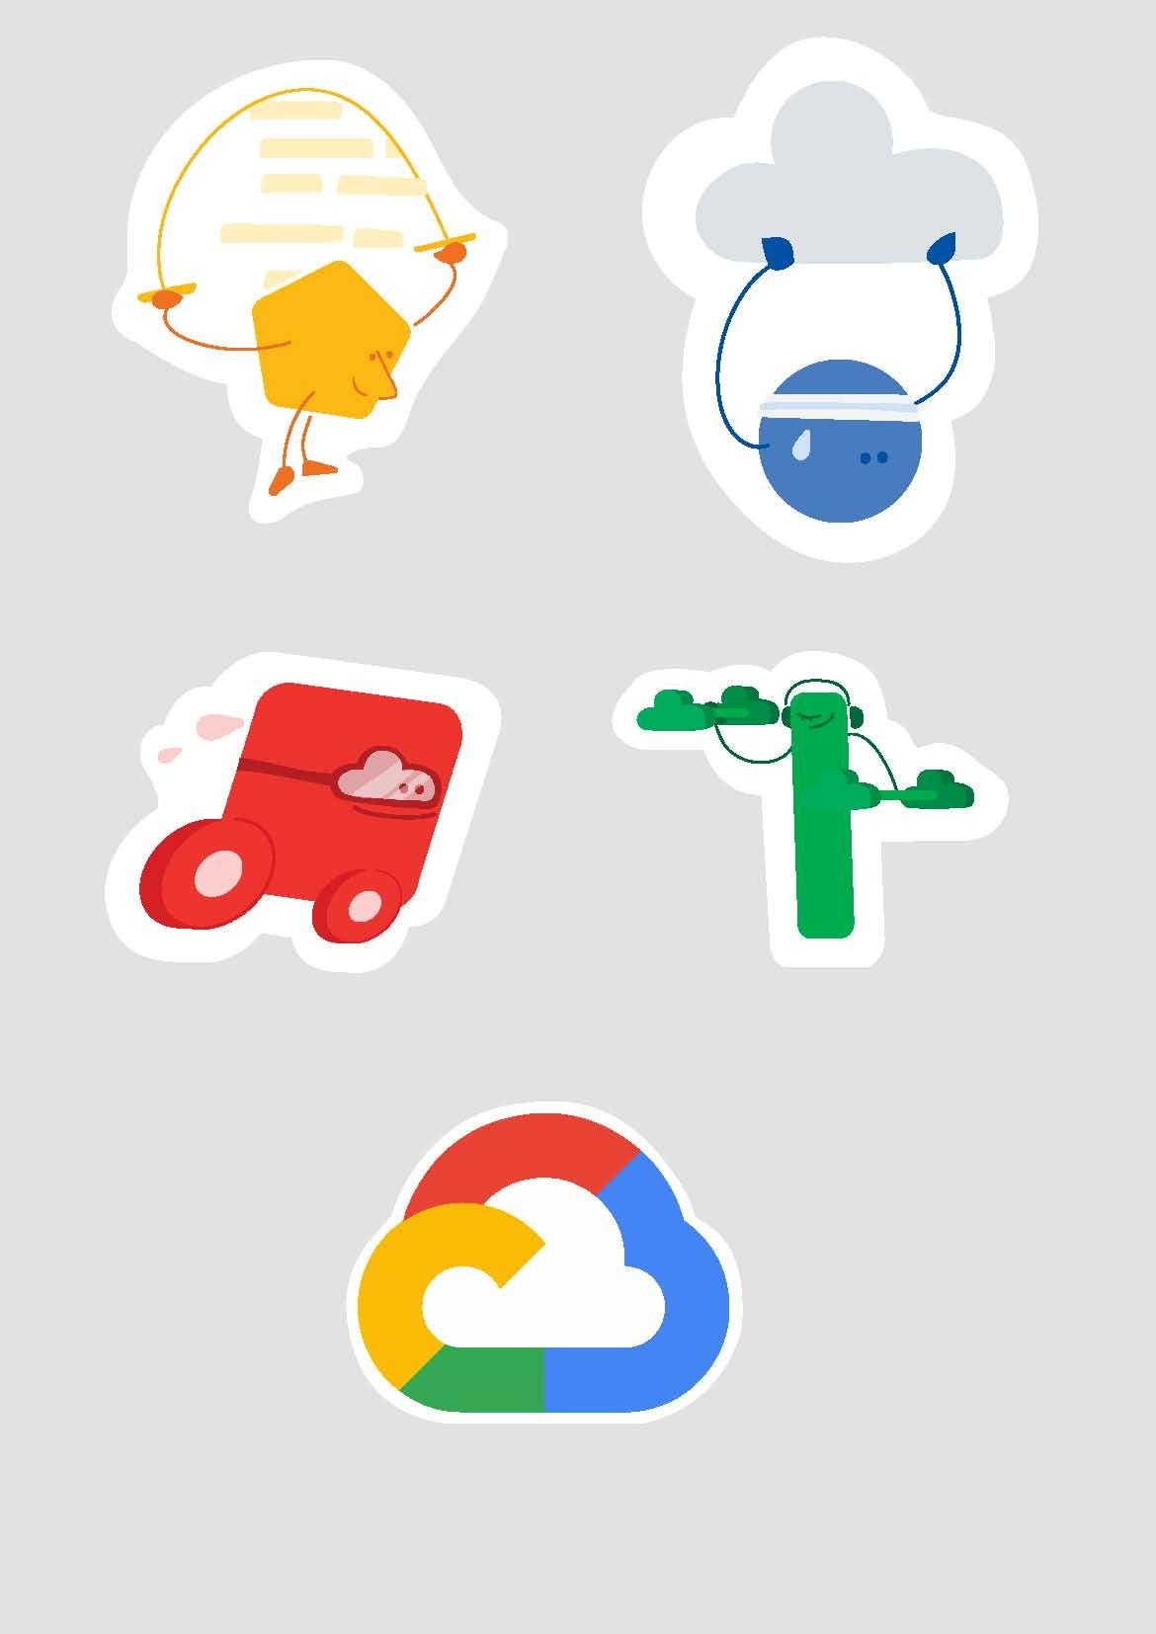
Option 1
Complete any one - Track 1 OR Track 2
Rewards for Participants
*You’ll only get rewards for the milestone that you achieve after enrolment date & not for the ones before that.

Slide 19
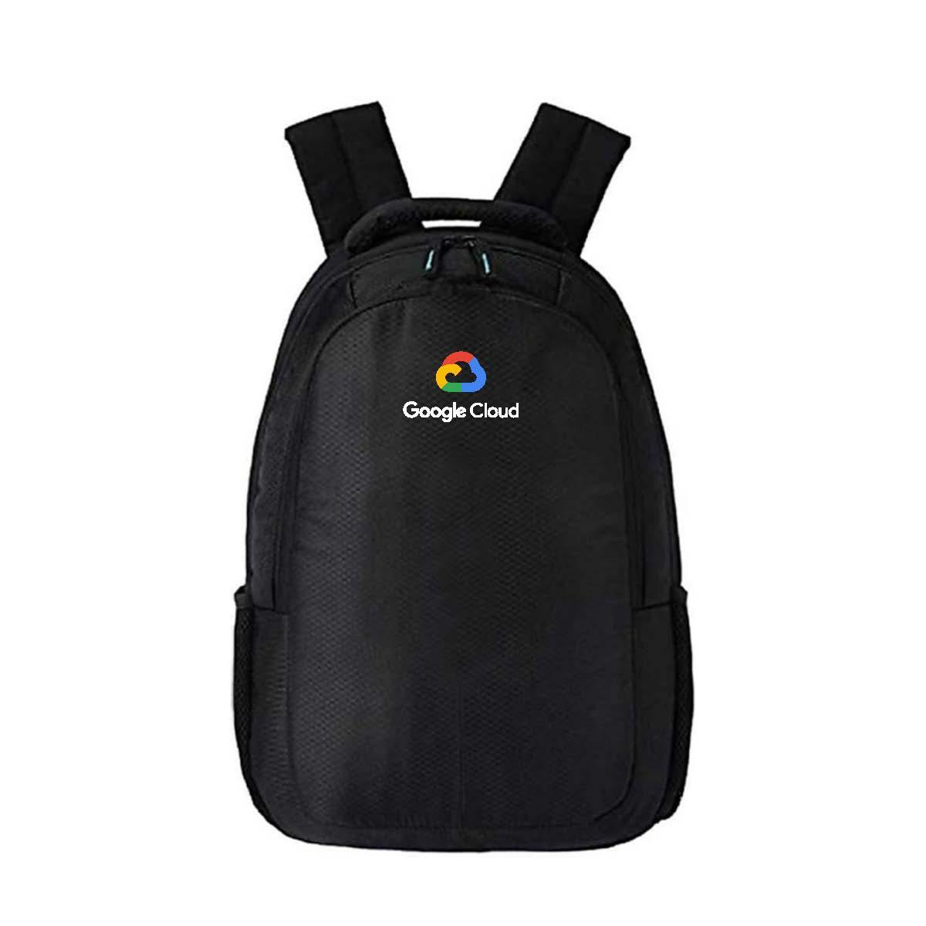
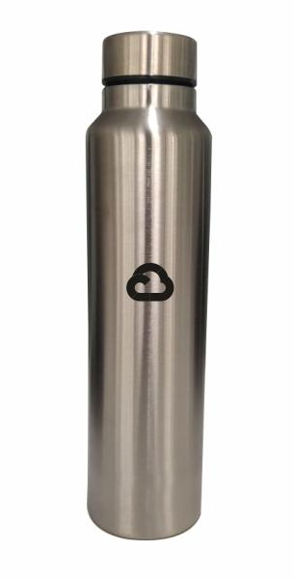
Option 2
Complete both the tracks - Track 1 AND Track 2
Rewards for Participants
*You’ll only get rewards for the milestone that you achieve after enrolment date & not for the ones before that.

Slide 20
Thank You!

